Slide 1
ROS
Robot Operating System

Slide 2
Table of contents
01
02
03
Concept
Concept
Workspace &
Package
Operation
04
05
06
ROS & Robot
ROS & AGV
ROS & Industrial

Slide 3

Concept (1)
ROS History
Author : Willow Garage
Stanford AI Laboratory Open Robotics.
Initial release : 2007,stable version 2014

Slide 4
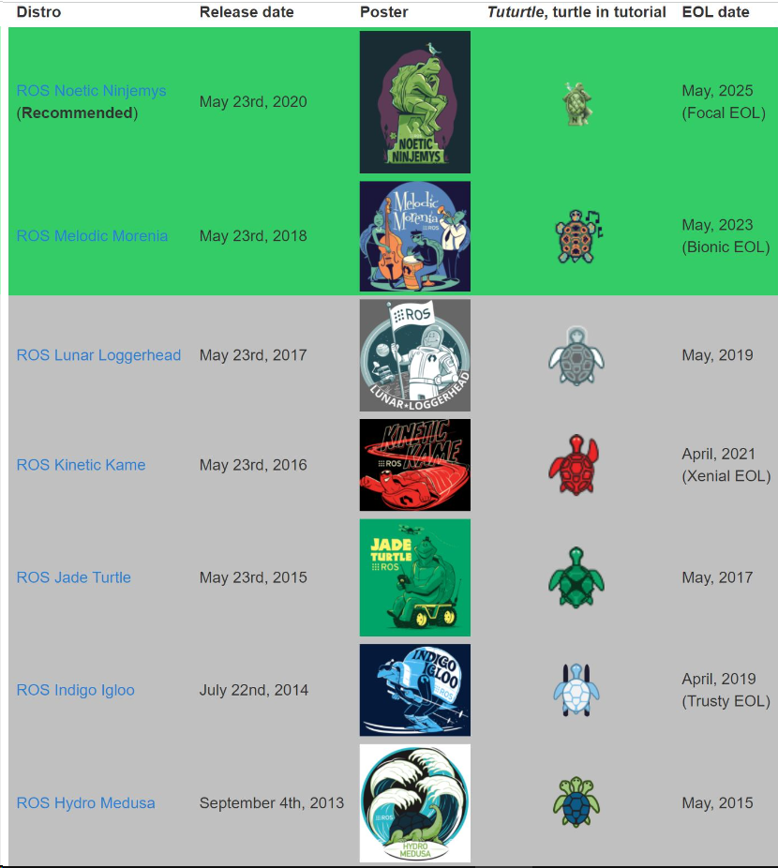
Concept (2)
ROS Distributions

Slide 5
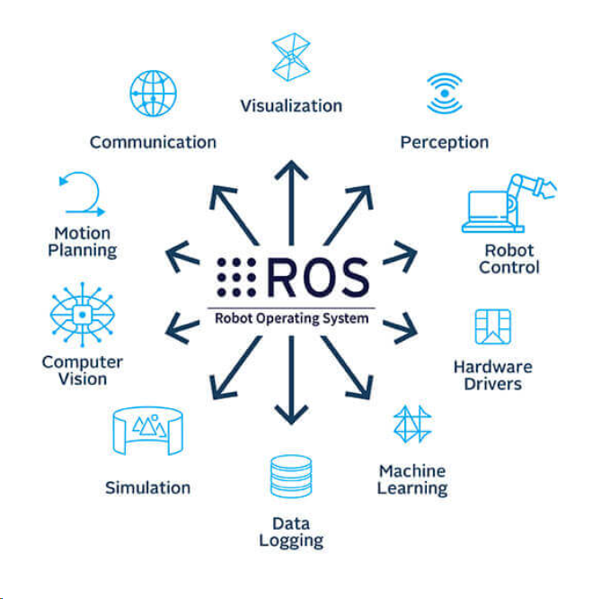
Concept (3)
Applications

Slide 6



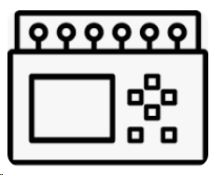
Concept (4)
Why need ROS in Industrial
PLC
PLC

Slide 7
Concept (5)
How to working
Advertising
Subscribing
ROS Master
Publishing
Service
Node
Topic
Node

Slide 8
Concept (6)
ROS features
OS Support
Language
Linux
Mac
Windows 10
Python 2.7 +
C++
Version
Applications
ROS (Noetic)
ROS2 (Foxy,Humble)
Manipulation
AGV

Slide 9
Workspace & Package (1)
Create ROS workspace
Open terminal
$ : mkdir -p ~/your_ws/src
$ : cd ~/your_ws/
$ : catkin_make
$ : source devel/setup.bash
Workspace
Package 2
Package 1
Package …n
http://wiki.ros.org/catkin/Tutorials/create_a_workspace

Slide 10
Workspace & Package (2)
Create ROS package
Open terminal
$ : cd ~/your_ws/src
$ : catkin_create_pkg beginner_tutorials std_msgs rospy roscpp
catkin_create_pkg <package_name> [depend 1] [depend 2] [depend n]
$ : cd ~/your_ws
$ : catkin_make
$ : echo source ~/your_ws/devel/setup.bash >>~/.bashrc
Check your package :
$ : rospack list
http://wiki.ros.org/ROS/Tutorials/CreatingPackage

Slide 11
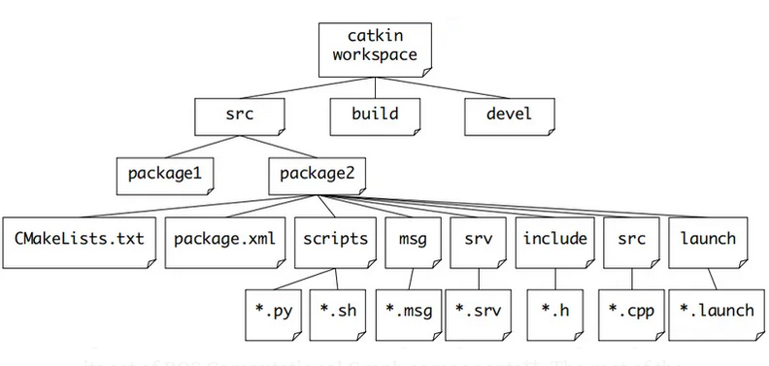
Workspace & Package (3)
ROS diagrams

Slide 12
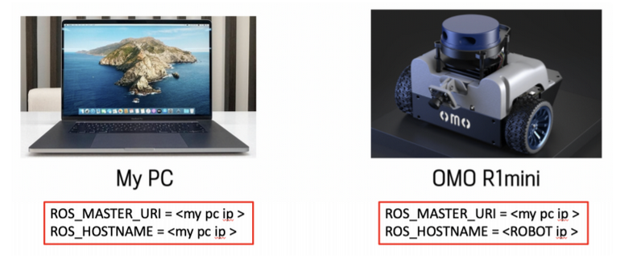
Workspace & Package (4)
ROS Master
Open terminal
$: sudo nano ~/.bashrc
$: echo export ROS_MASTER_URI=http://192.168.1.101:11311 >> ~/.bashrc
$: echo export ROS_HOSTNAME=192.168.1.xxx >> ~/.bashrc
Master IP
Robot IP
IP address check
$: ifconfig

Slide 13
Operation (1)
 | Function
Publisher | Publisher message.
Subscriber | Subscriber message.
Service | Create function server & client.
Bag | Storage data from topic.

Slide 14
Operation (2)
ROS Message Type
Standard message (std_msgs)
Int8, Int16, Int32, Int64
Int8MultiArray ,
Int16MultiArray,
Float32 ,Float64
Float32MultiArray, Float64MultiArray
Bool
Char, String
http://wiki.ros.org/std_msgs
Geometry message (geometry_msgs)
Twist
Linear x,y,z
Angular x,y,z
http://wiki.ros.org/geometry_msgs
Sensor message (sensor_msgs)
JointState
Name
Position
Velocity
effort
http://wiki.ros.org/sensor_msgs

Slide 15
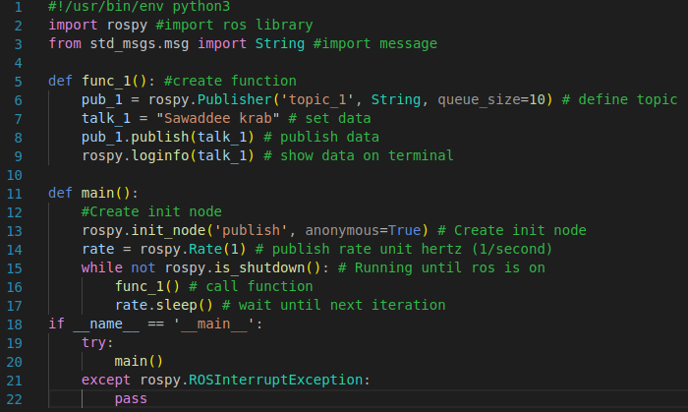
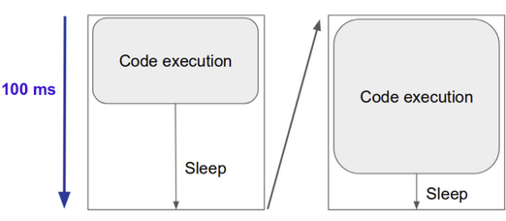
Operation (3)
Publisher
Open terminal
$: roscd your_package/src
$: mkdir scripts
$: sudo touch ros_publish.py
$: sudo chmod +x ros_publish.py
$: cd ~/your_ws
$: catkin_make
$: rosrun your_package ros_publish.py
ROS sleep()

Slide 16
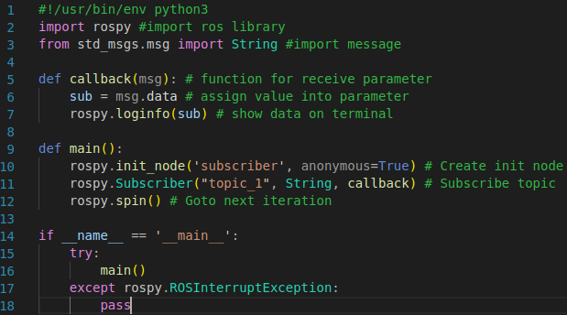
Operation (4)
Subscriber
Open terminal
$: roscd your_package/src
$: mkdir scripts
$: sudo touch ros_subscriber.py
$: sudo chmod +x ros_subscriber.py
$ : cd ~/your_ws
$ : catkin_make
$: rosrun your_package ros_subscriber.py

Slide 17
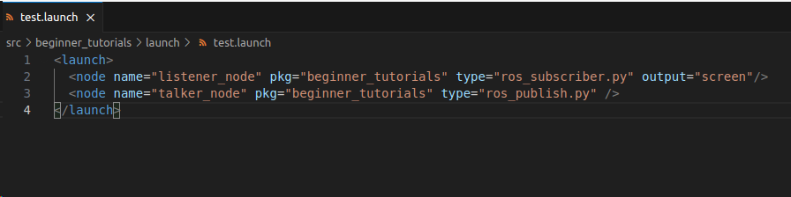
Operation (5)
Launch file
Open terminal
$: roscd your_package/
$: mkdir launch
$: cd launch
$: sudo touch test.launch
$: roscd your_package/ launch
$: sudo chmod +x test.launch
$:roslaunch test.launch

Slide 18
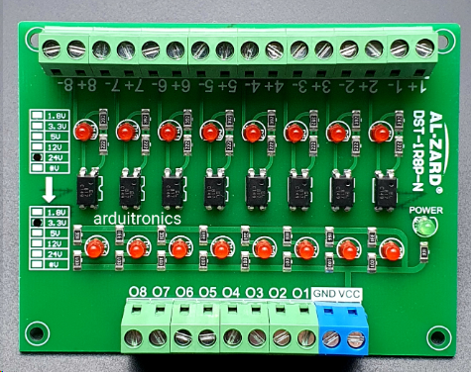
ROS & Industrial (1)
Connection protocol
serial
Serial
Serial
Requirement
ESP32
Isolation module
https://en.wikipedia.org/wiki/MQTT

Slide 19
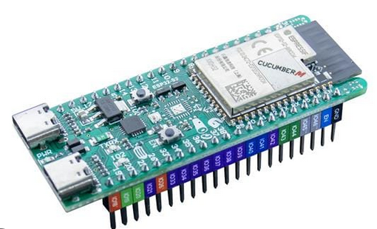
ROS & Industrial (2)
ROS Serial
What rosserial?
Communicate with uart (rx,tx) ,usb
Bi-direction communications.
Rosserial
IOT Device
ROS Master

Slide 20
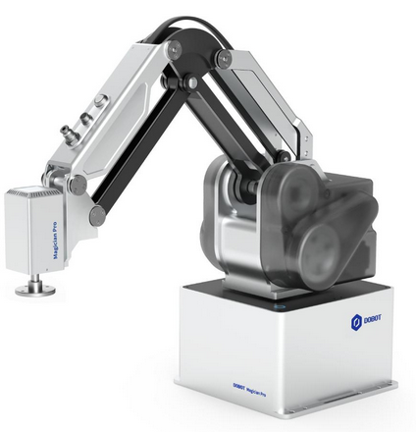
ROS & Robot (1)
Dobot MG400
Specification
Max payload 0.5 kg.
Working radius 440 mm.
4 joints movement
ROS
API
Dobot MG400
Dobot MG400

