Slide 1

Notes:
JB. A stock market for the businesses that will never be listed.

Slide 2
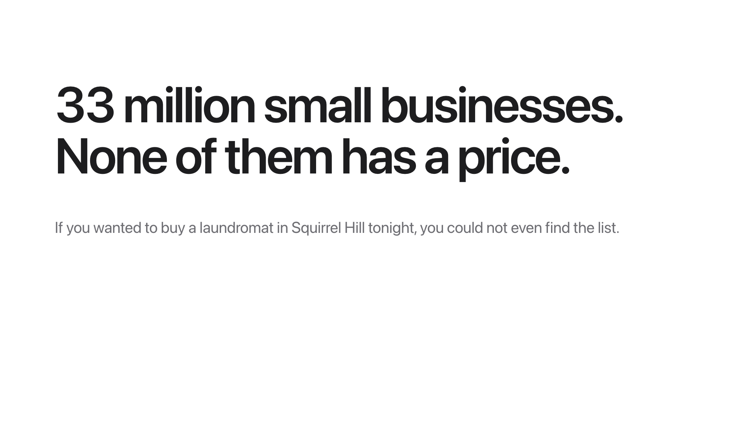
Notes:
There are 33 million small businesses in the US and none of them has a price. If you wanted to buy a laundromat in Squirrel Hill tonight you could not even find the list.

Slide 3
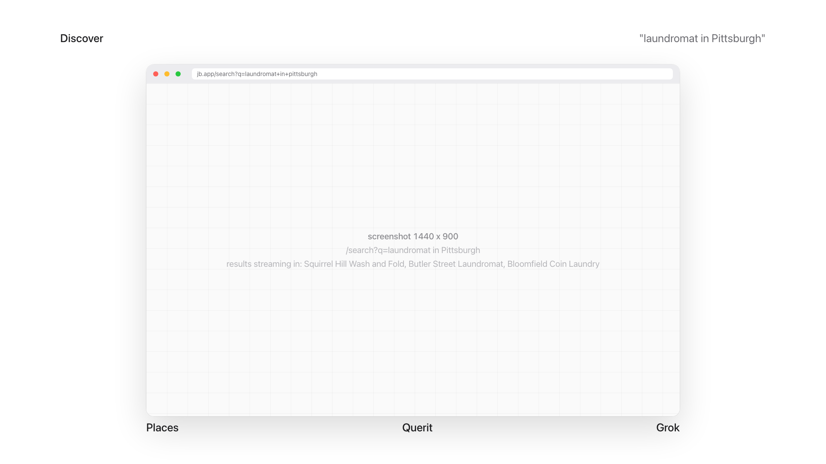
Notes:
Type "laundromat in Pittsburgh". Results stream in with bid, ask, confidence. Places finds them, Querit reads the web about each one, Grok extracts a cited profile.

Slide 4
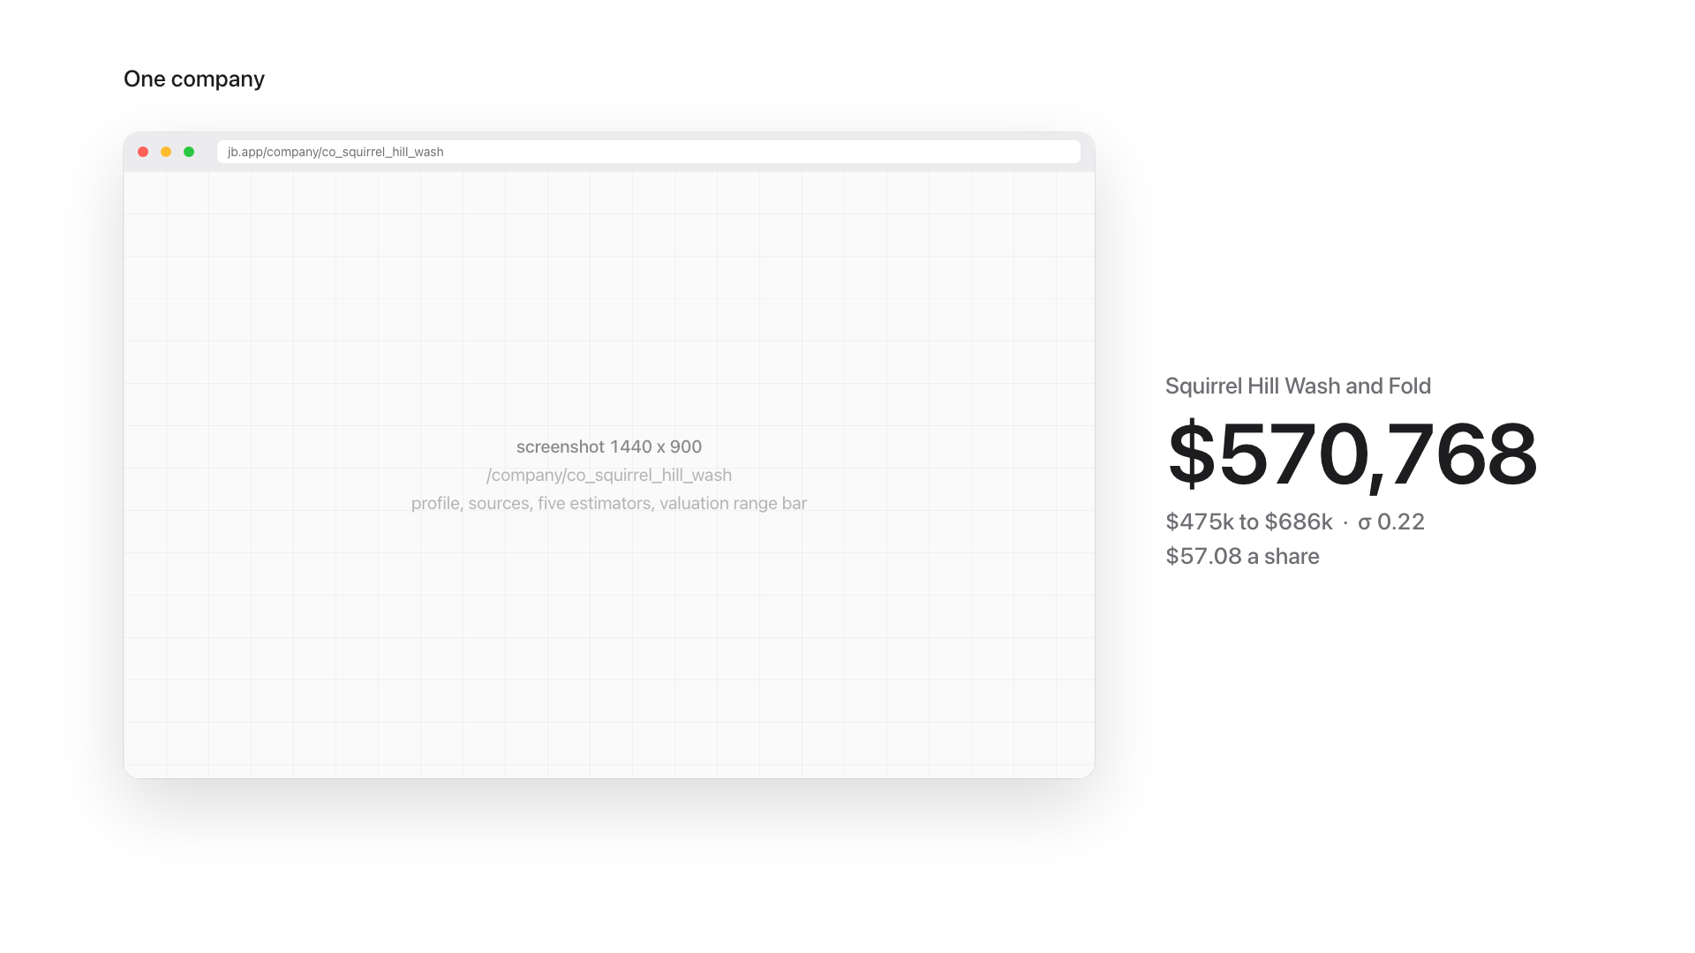
Notes:
Click one. Profile with sources, five independent estimators and their spread, a valuation range, the live book and the countdown.

Slide 5
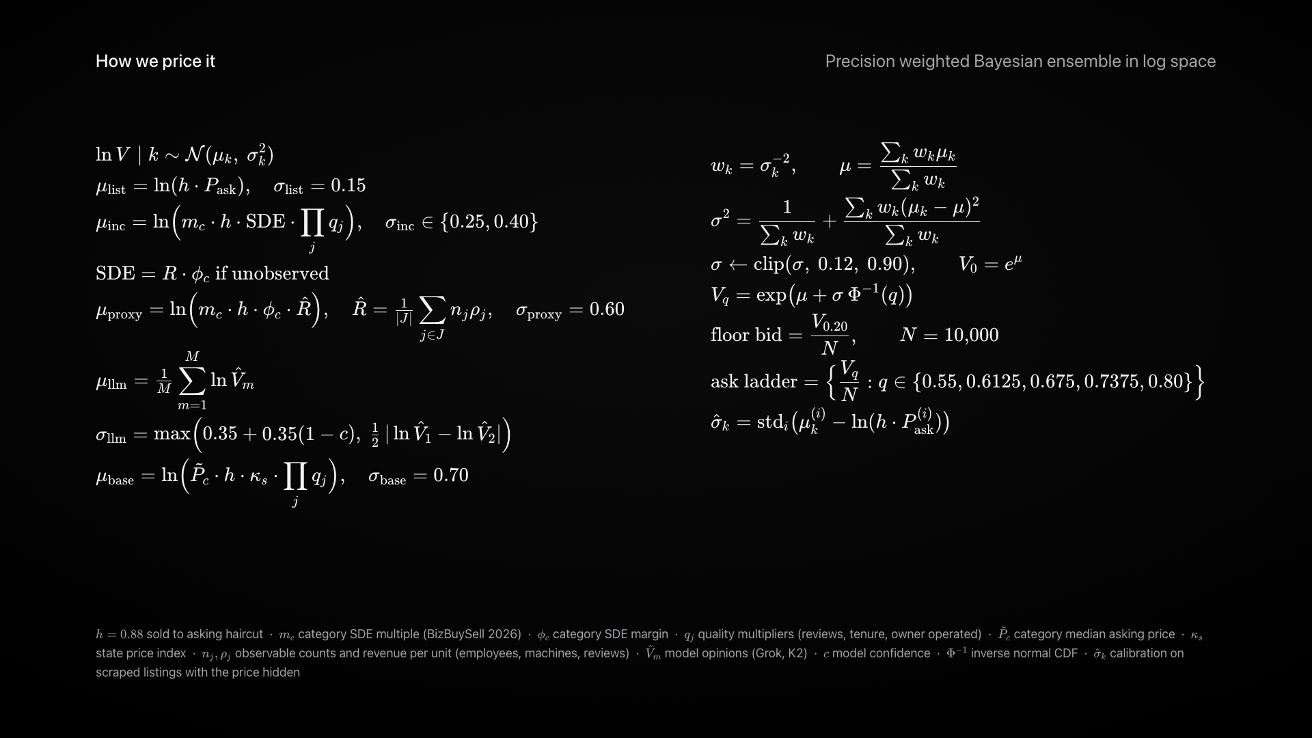
Notes:
Every estimator is a belief about log value with its own sigma. Precision weighted, inflated by disagreement, calibrated on real listings. The owner quotes come from the same posterior.

Slide 6
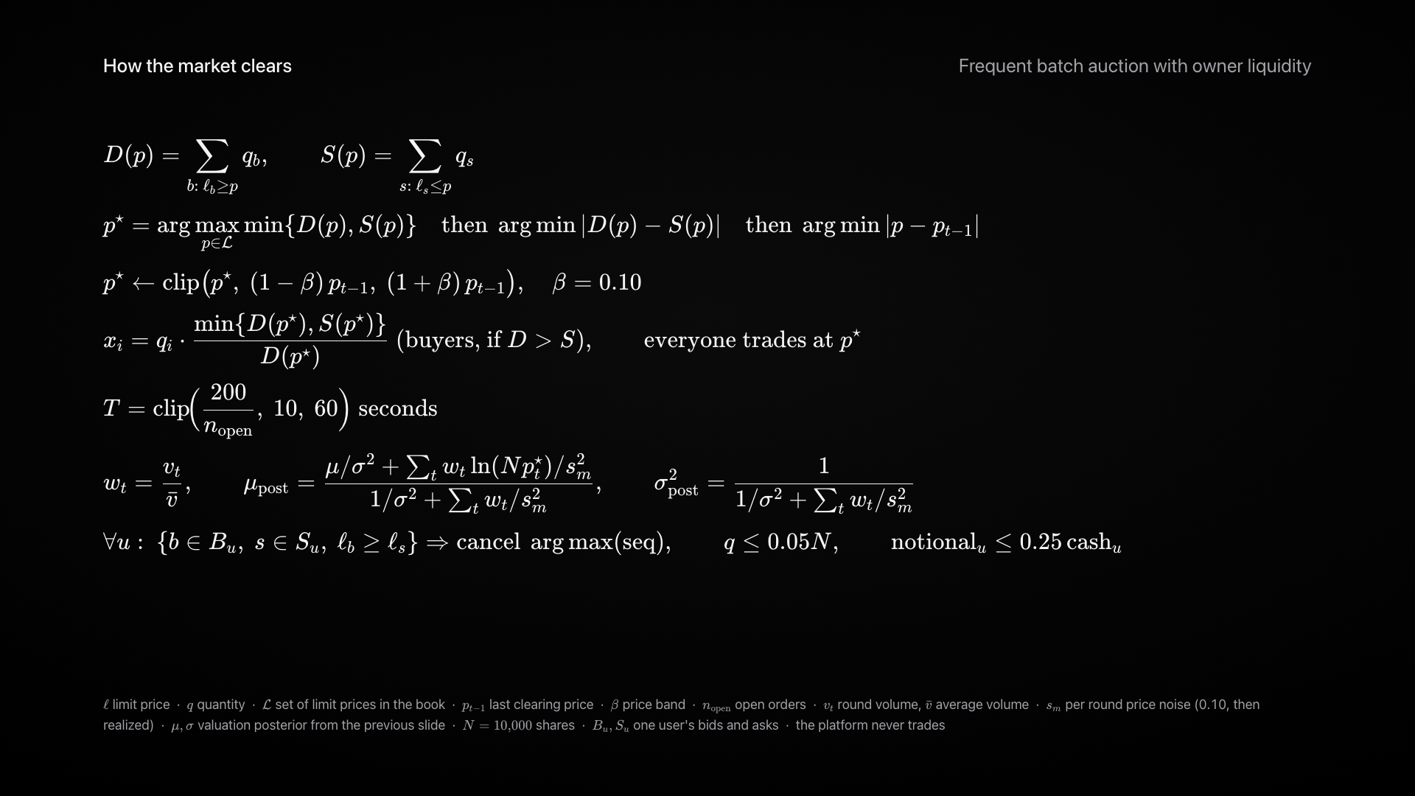
Notes:
Every ten seconds we run a uniform price auction and clear at the volume maximizing price. Price band, pro rata rationing, belief update after each round. The platform never trades.

Slide 7
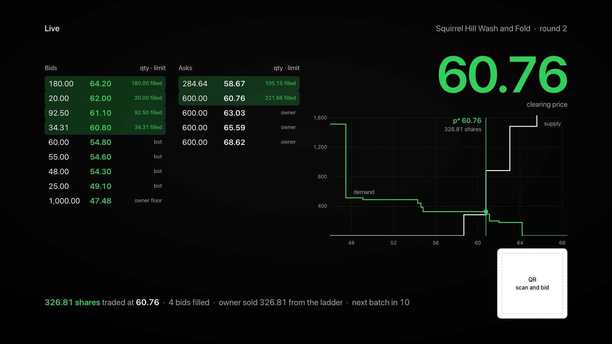
Notes:
Scan the QR and bid. Watch the batch clear: bids arrive, the countdown hits zero, demand meets supply, one price for everyone.

Slide 8
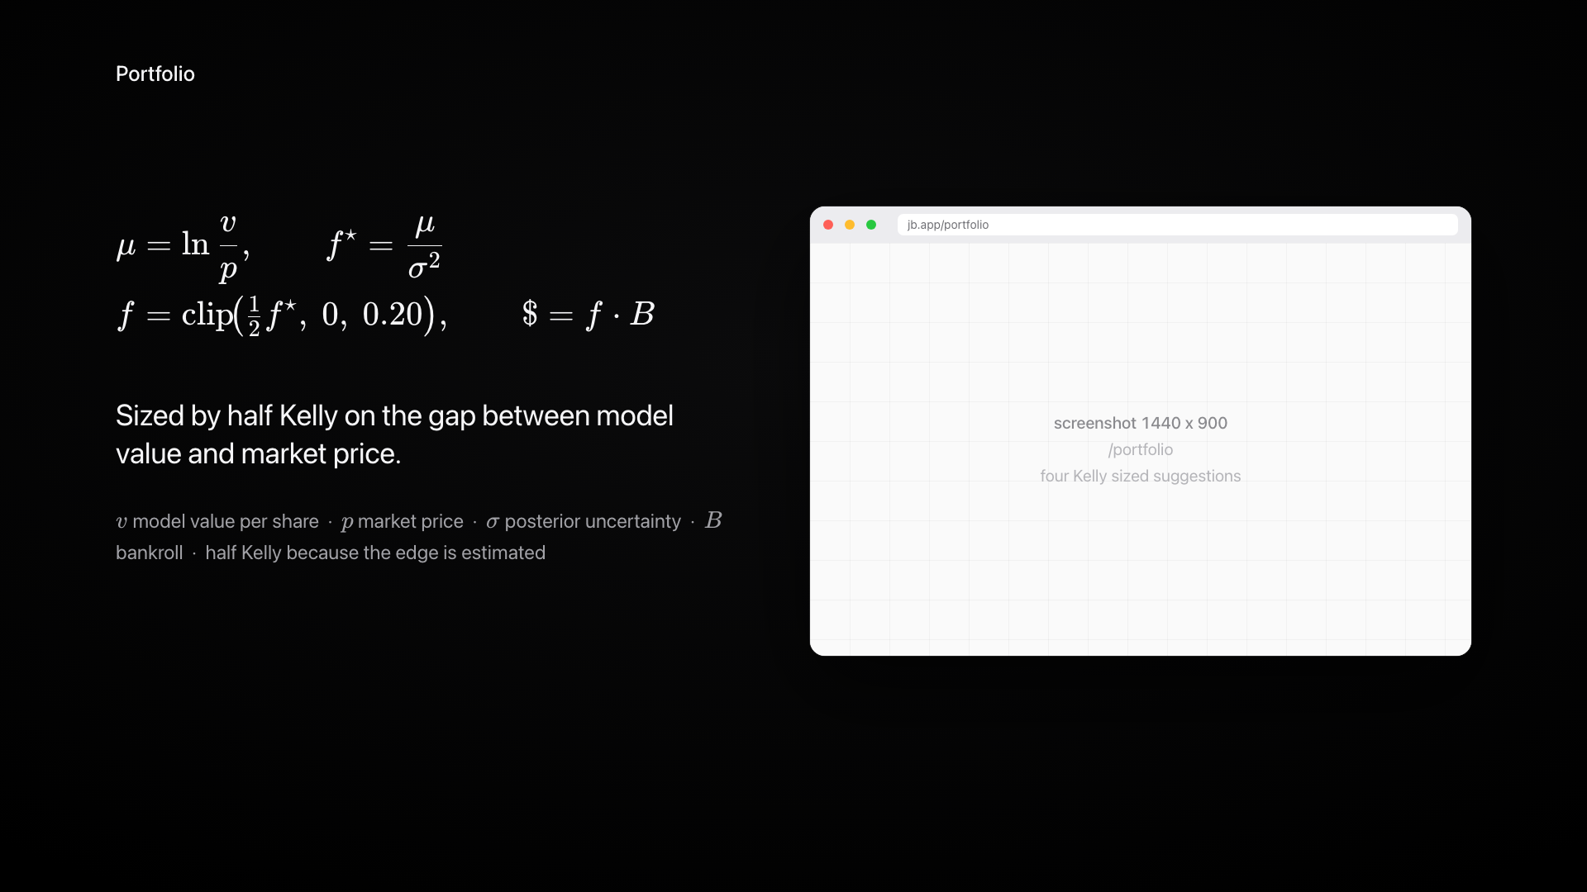
Notes:
Portfolio. Given your profile, here are four stakes sized by half Kelly on the gap between model value and market price.

Slide 9
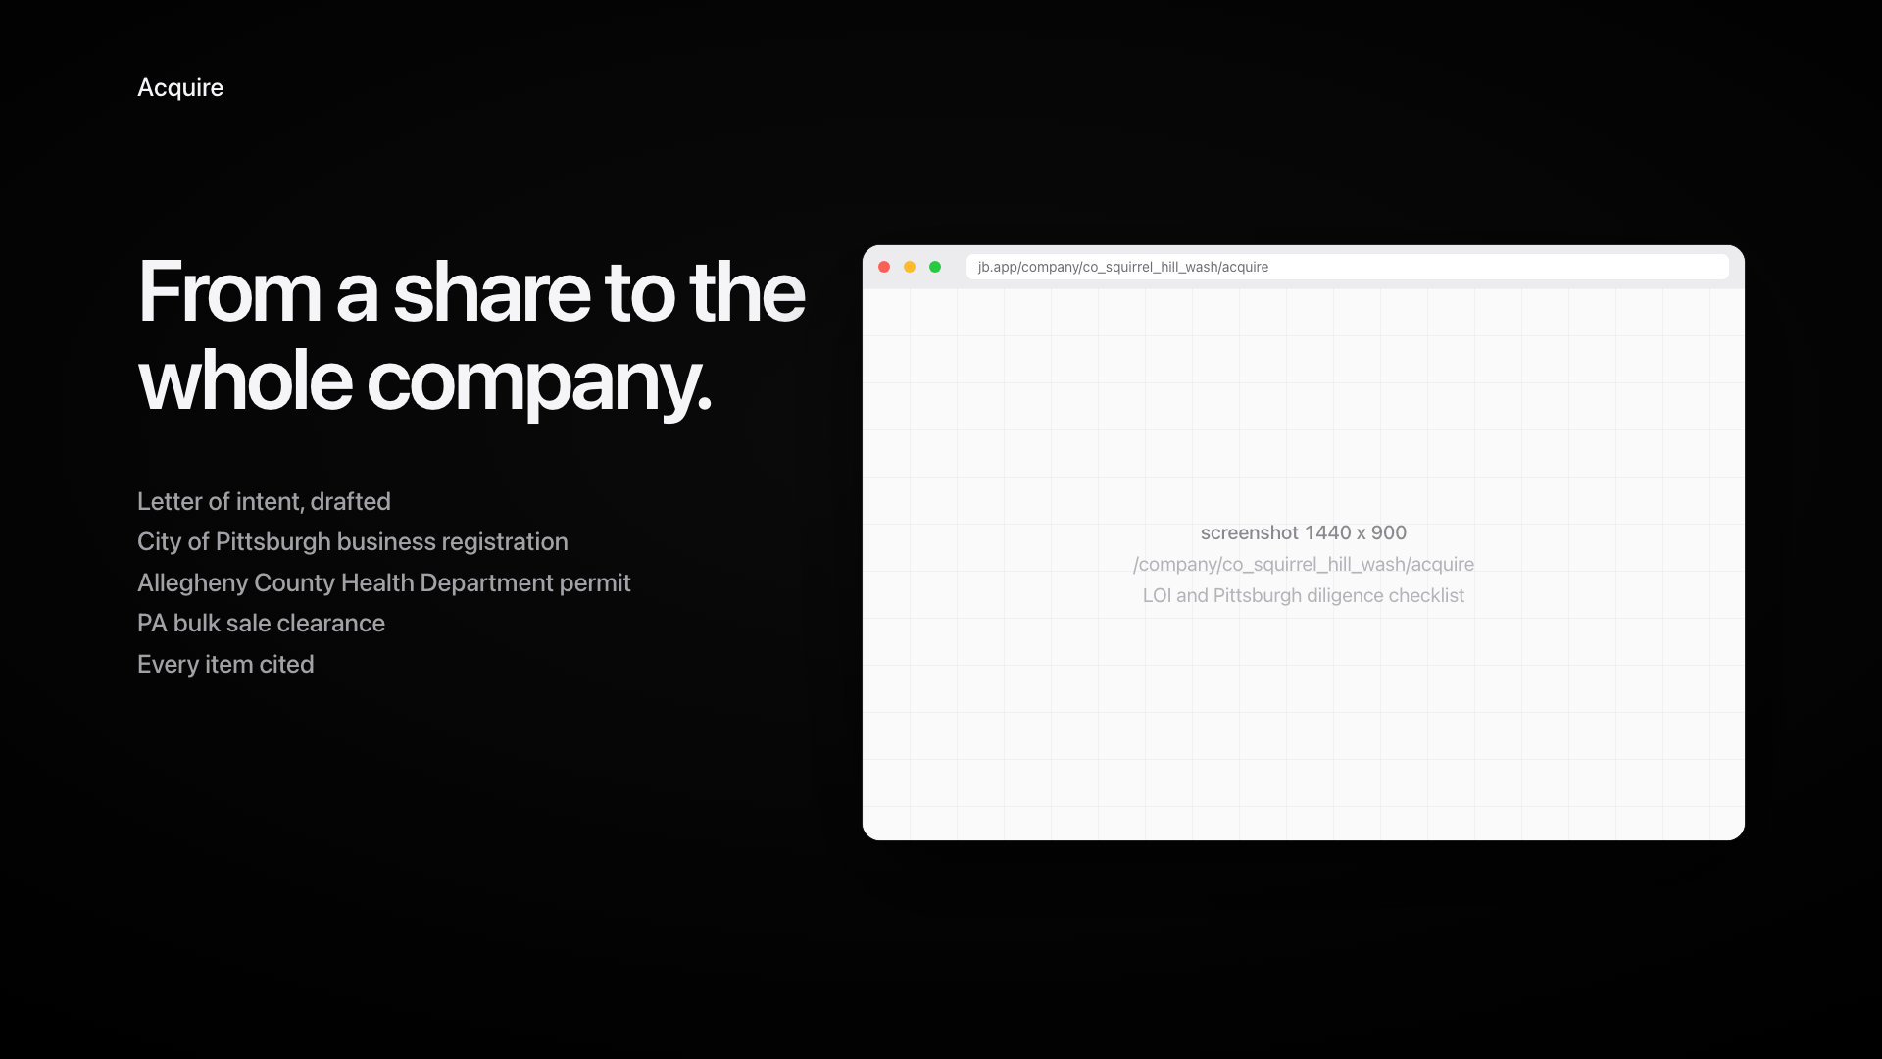
Notes:
Acquire. A drafted LOI and a Pittsburgh specific diligence checklist with citations. From a share to the whole company.

Slide 10
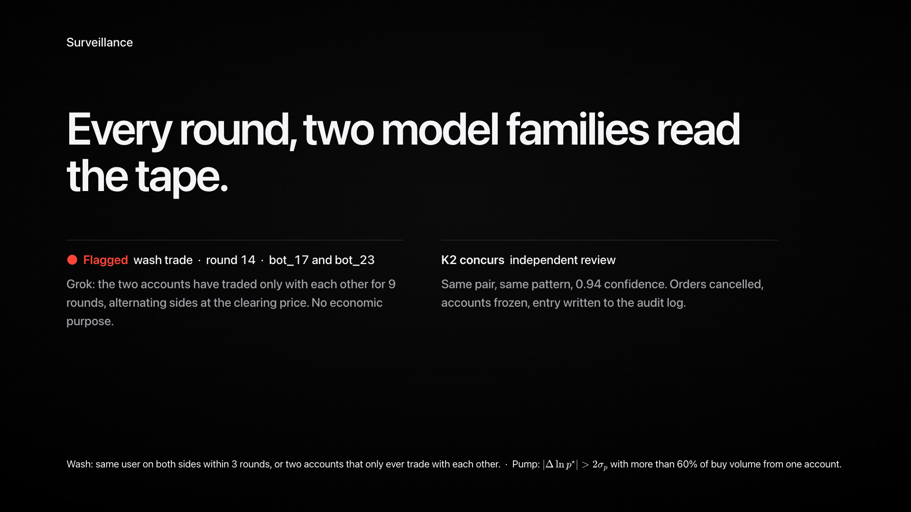
Notes:
Surveillance. Every round two model families read the tape. Grok flags a planted wash trade, K2 concurs. Independent review.

Slide 11
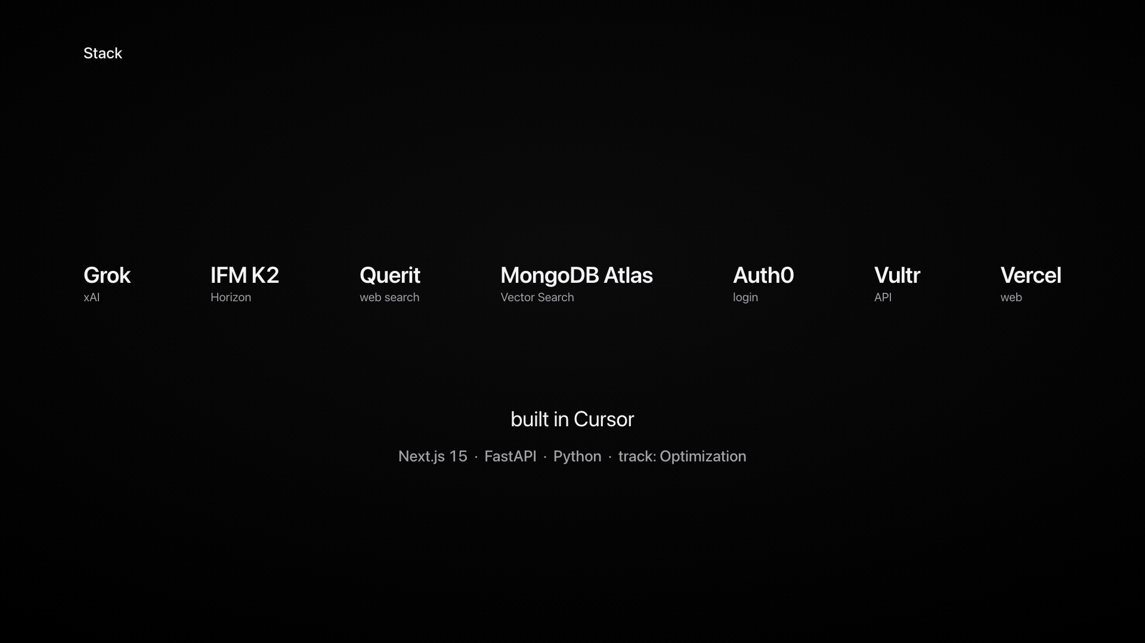
Notes:
Grok, IFM K2, Querit, MongoDB Atlas Vector Search, Auth0, Vultr, Vercel. Next.js and FastAPI, built in Cursor. Track: Optimization.

Slide 12
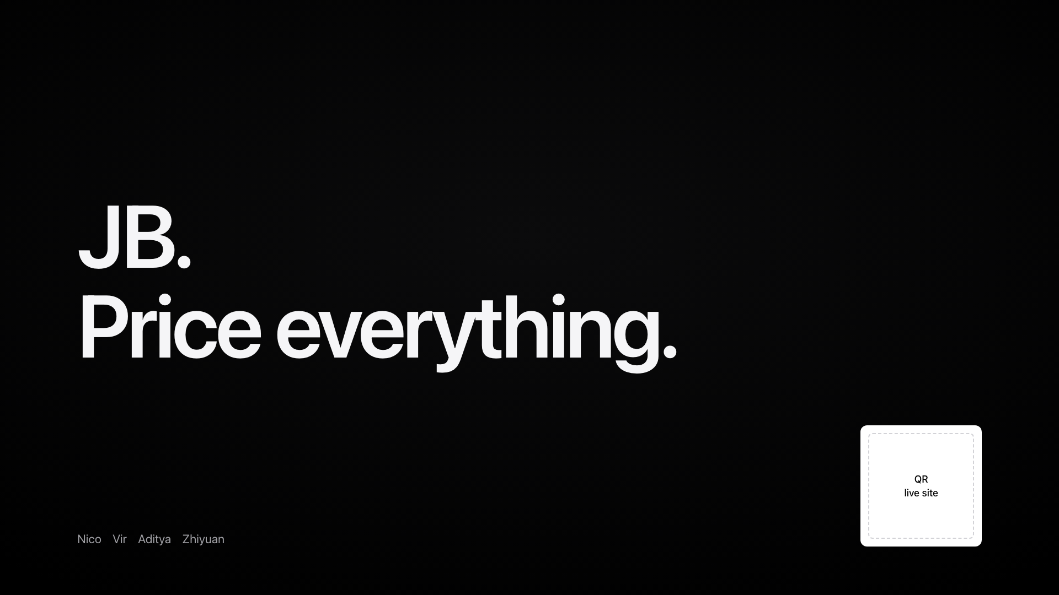
Notes:
JB. Price everything.

