Slide 1
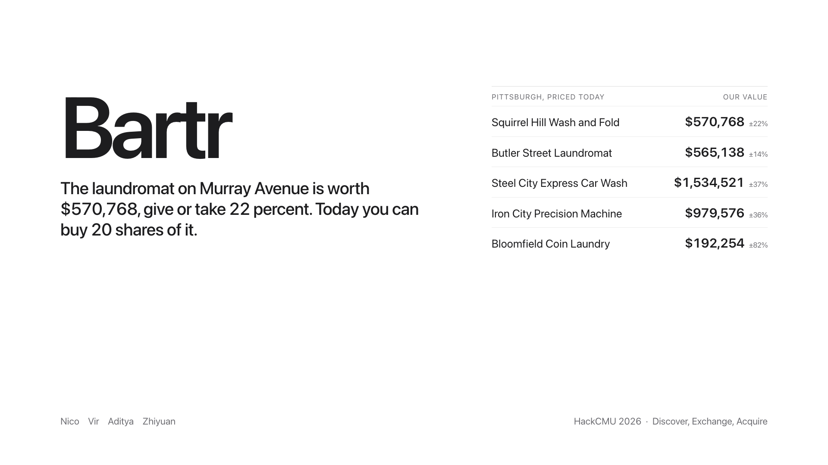
Notes:
The laundromat on Murray Avenue is worth 570,768 dollars, give or take 22 percent. Today you can buy 20 shares of it. That is Bartr.

Slide 2
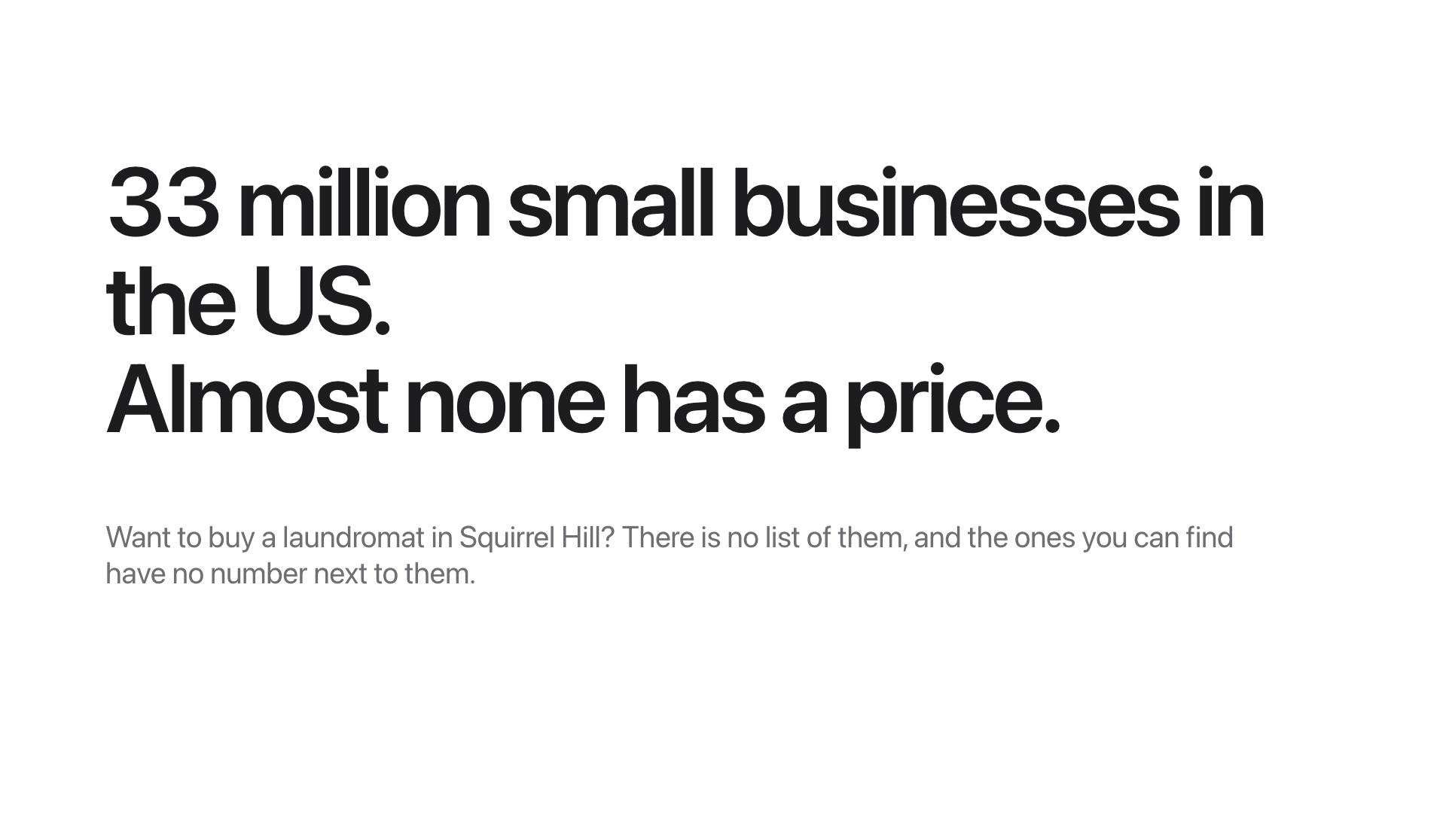
Notes:
33 million small businesses. Almost none has a price. Want a laundromat in Squirrel Hill? There is no list.

Slide 3
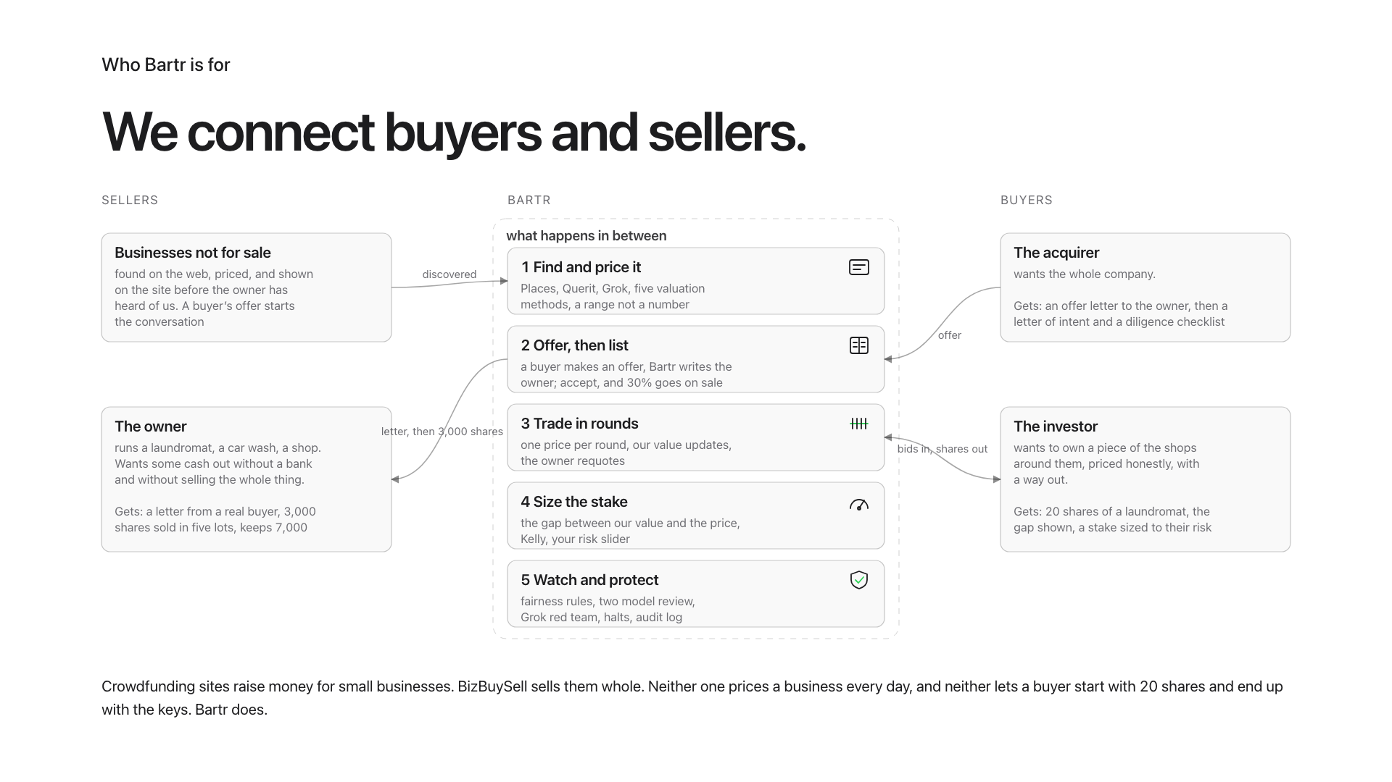
Notes:
We connect buyers and sellers. Owners get cash for 30 percent and keep the keys. Investors get 20 shares with a price and a way out. Acquirers get the owner s ear and a letter of intent.

Slide 4
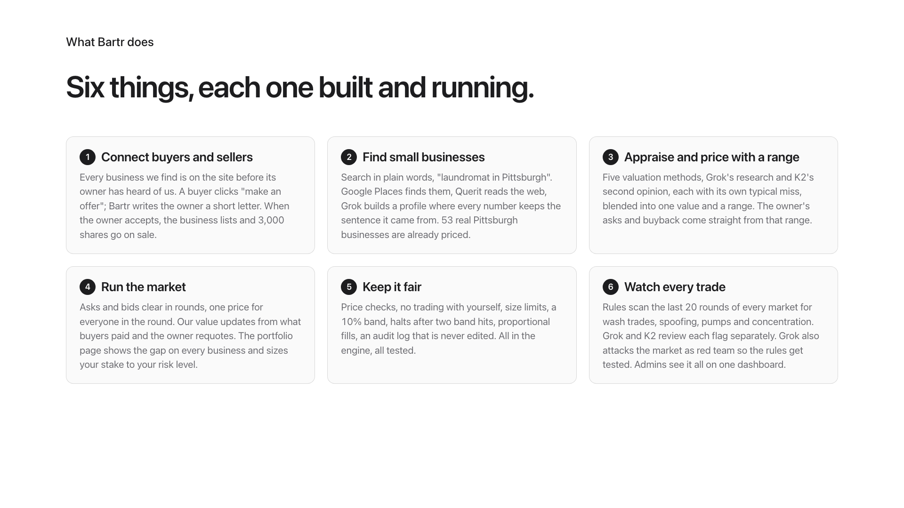
Notes:
Six things, all running: connect buyers and sellers, find businesses, appraise with a range, run the market, keep it fair, watch every trade.

Slide 5
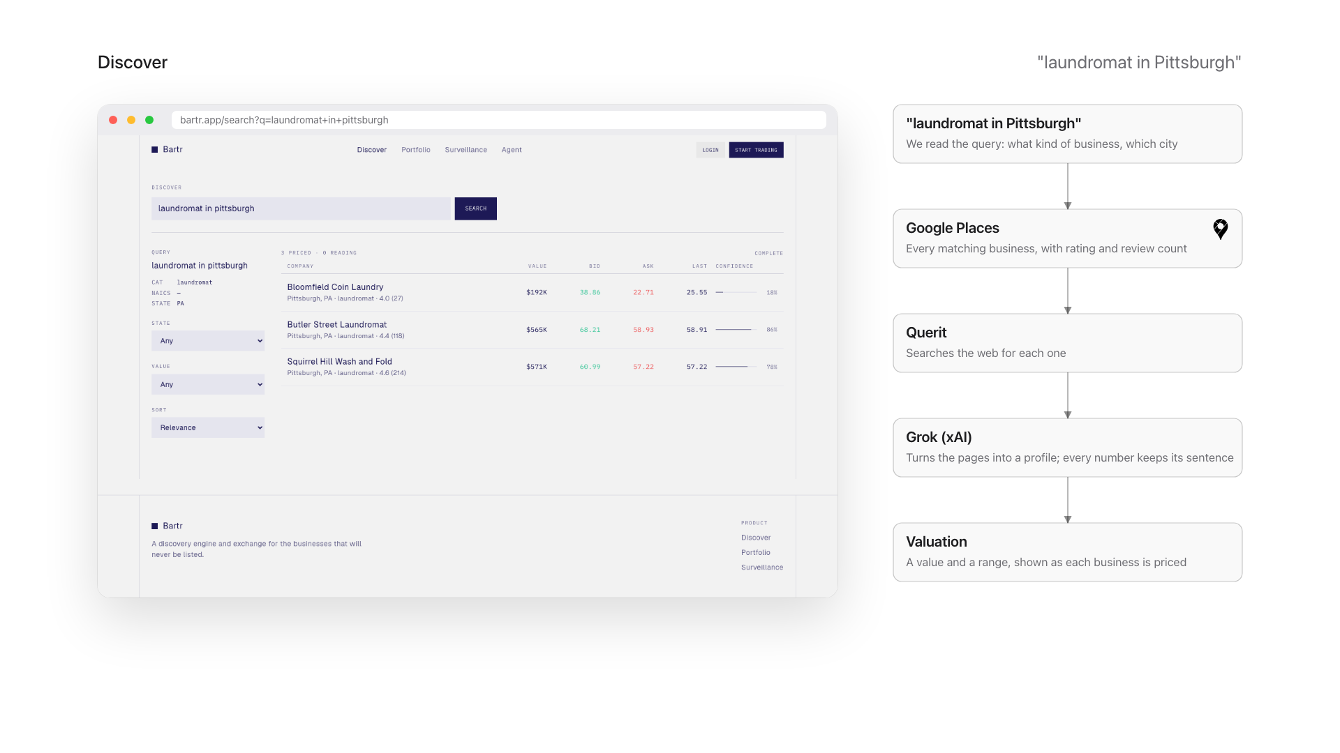
Notes:
Type laundromat in Pittsburgh. Places, Querit, Grok. Every number keeps the sentence it came from. 53 real businesses priced.

Slide 6
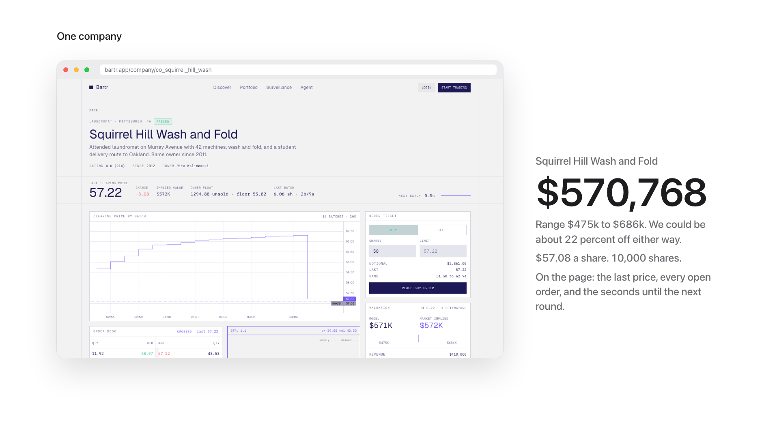
Notes:
Squirrel Hill Wash and Fold: 570,768 dollars, range 475 to 686 thousand.

Slide 7
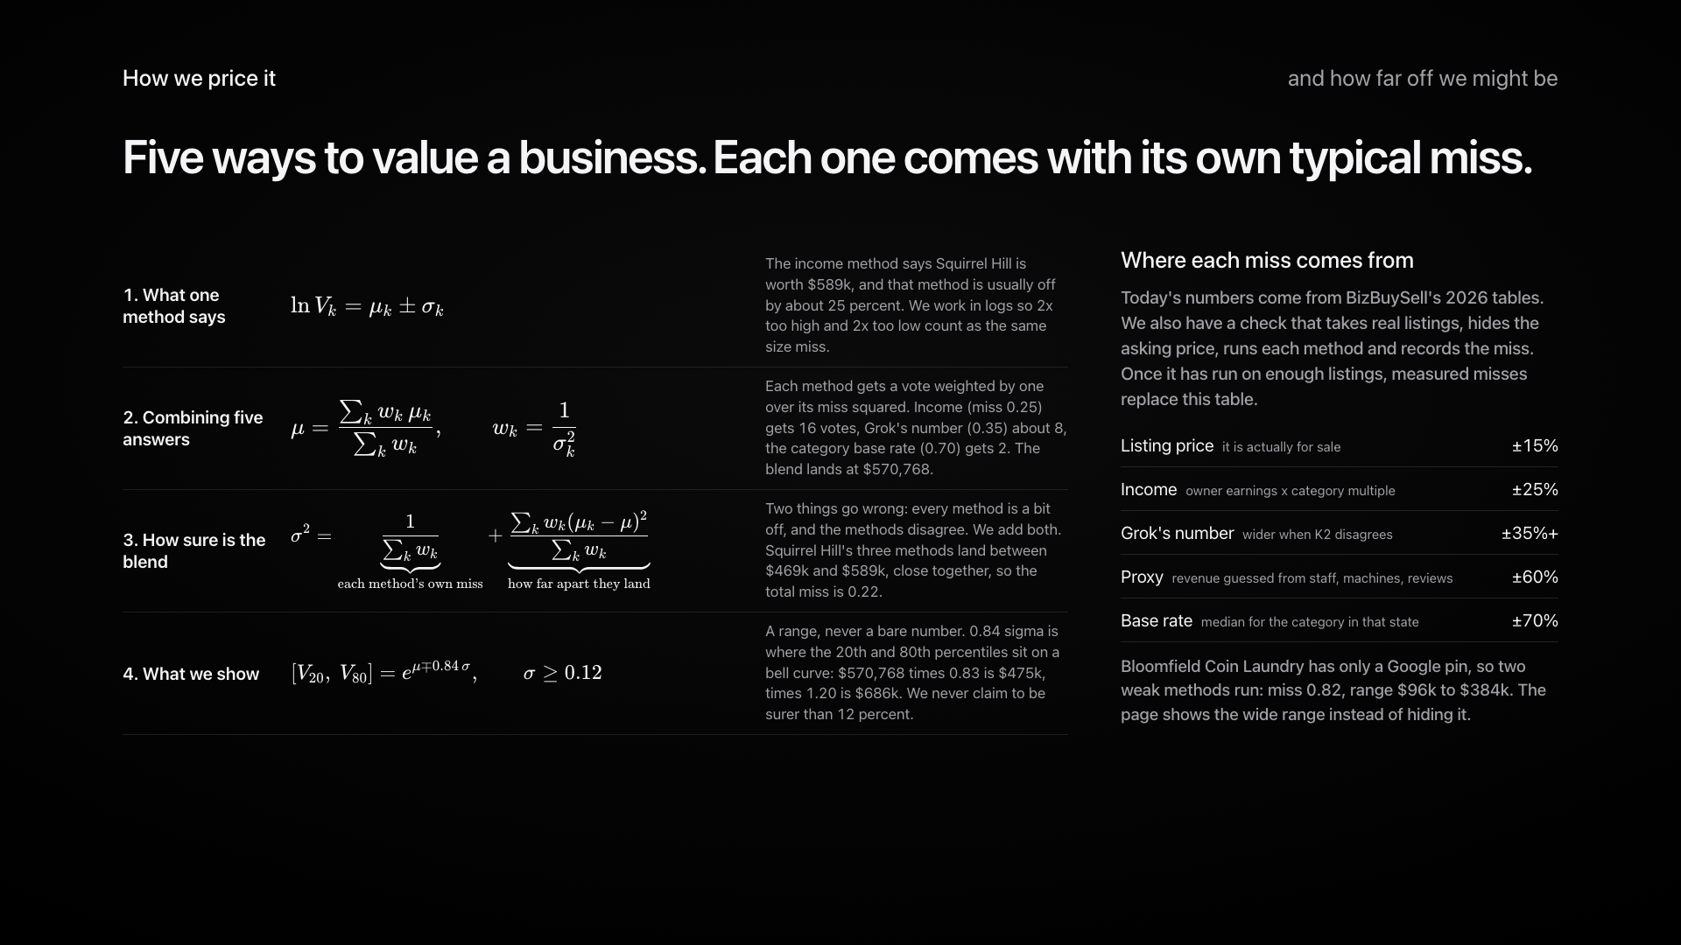
Notes:
Five ways to value it, each with its own typical miss. Weighted by one over the miss squared. Each method is a bit off and they disagree; we add both. A range, never a bare number.

Slide 8
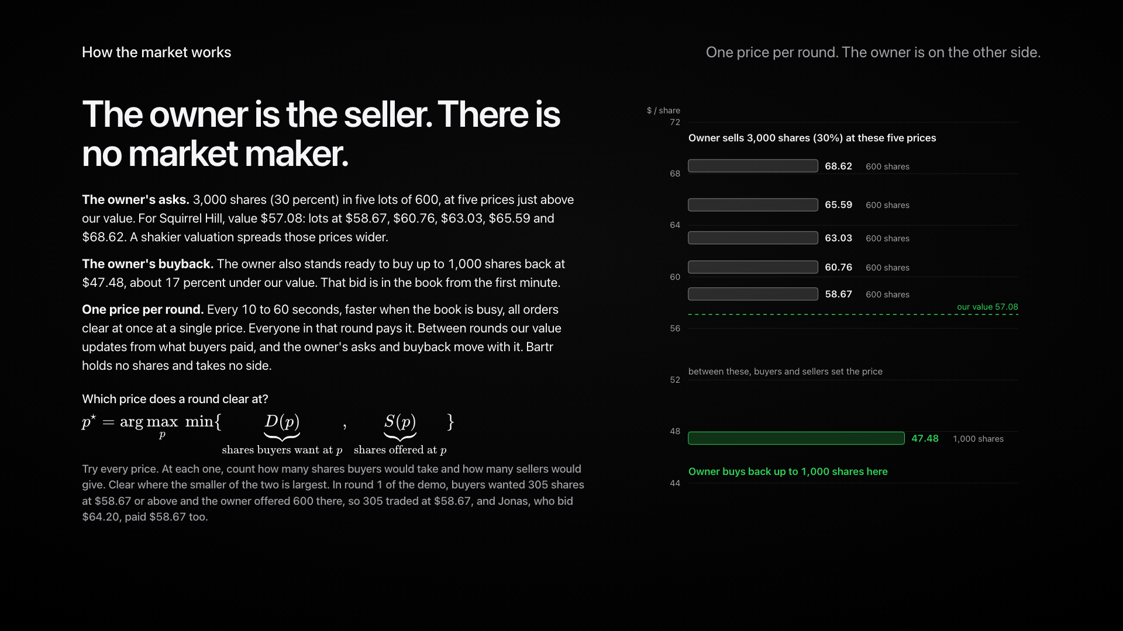
Notes:
The owner is the seller. Five lots above our value, a buyback below. Every round, one price for everyone, and the owner requotes from the updated value.

Slide 9
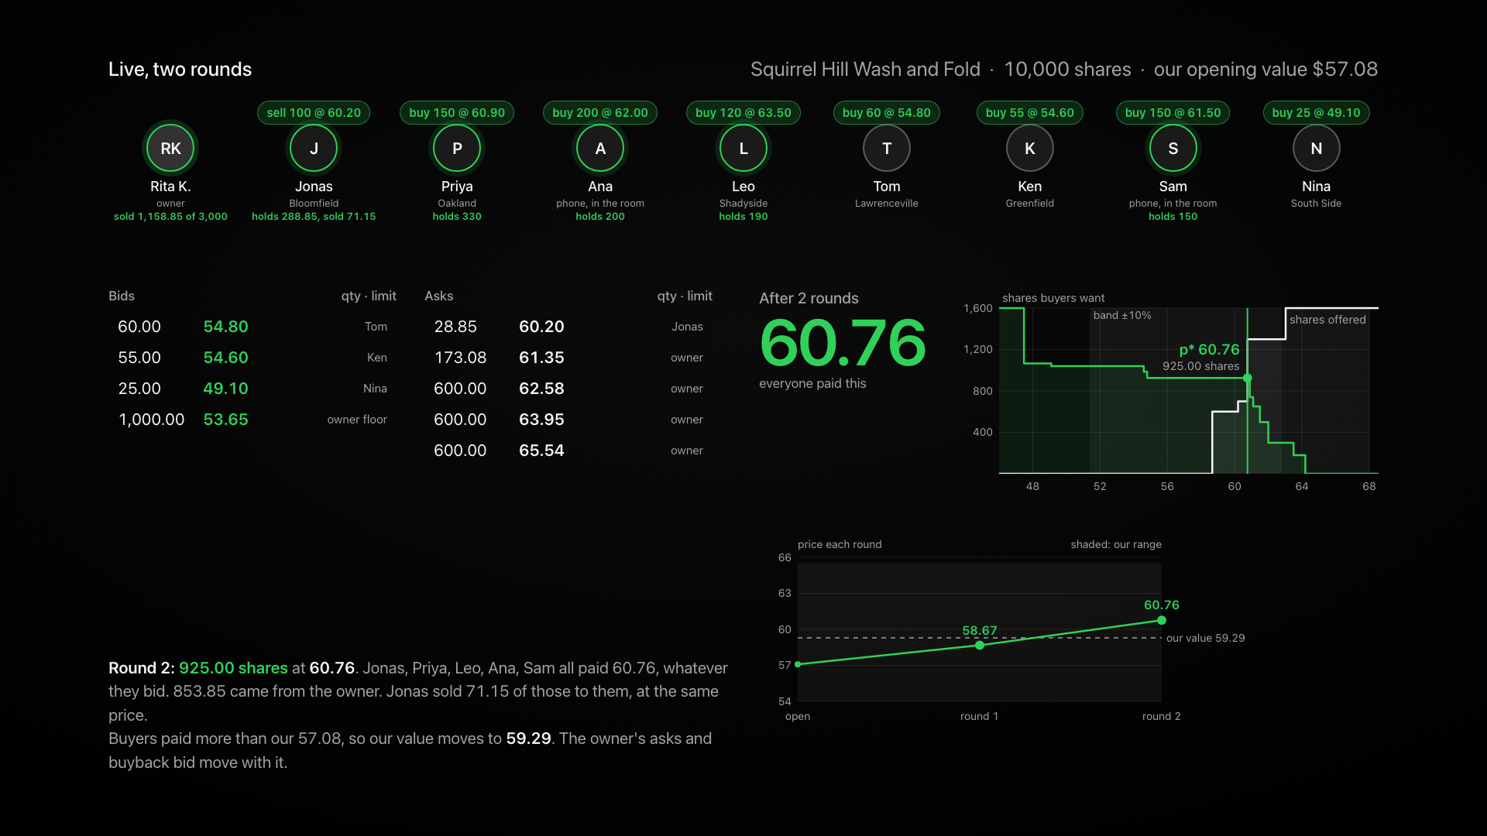
Notes:
Two rounds. Everyone paid 58.67, including Jonas who bid 64.20. Round two: the value moved, the owner requoted, Jonas sold part of his stake at the same price the new buyers paid.

Slide 10
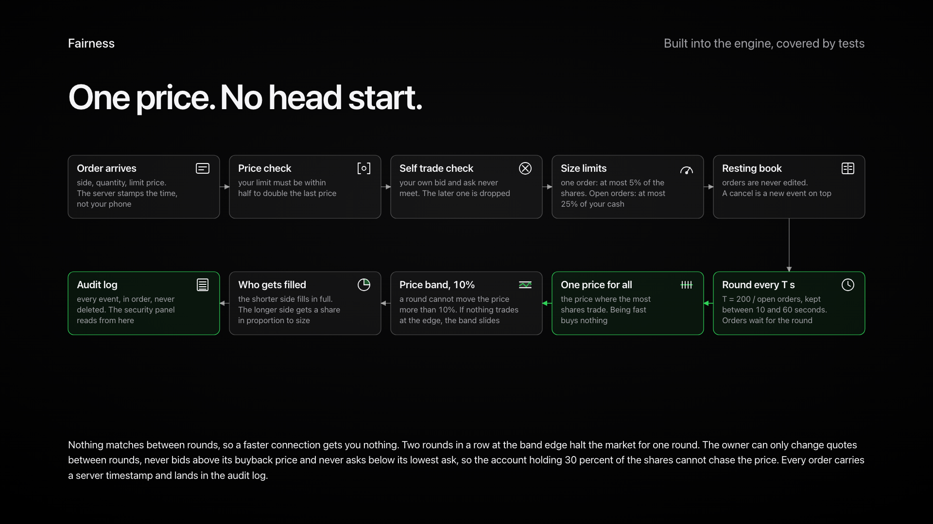
Notes:
One price, no head start. Price check, no self trades, size limits, a 10 percent band, proportional fills, an audit log.

Slide 11
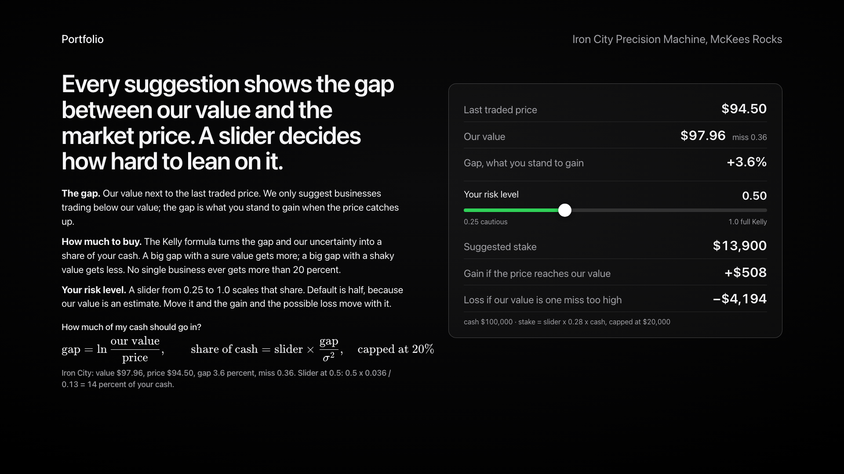
Notes:
Every suggestion shows the gap. Kelly sizes the stake. The slider is your risk: move it and the gain and the possible loss move with it.

Slide 12
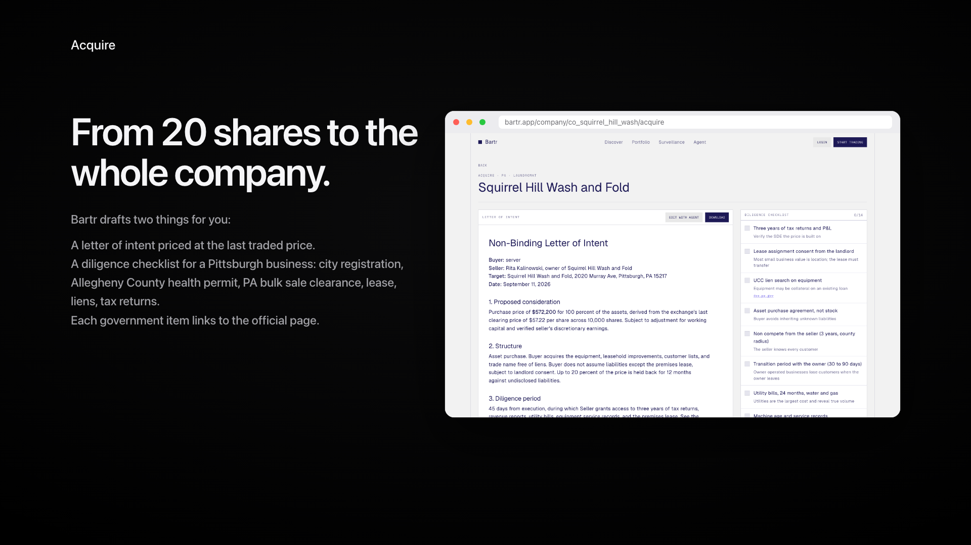
Notes:
From 20 shares to the whole company: an LOI at the last price and a Pittsburgh checklist with the official forms.

Slide 13
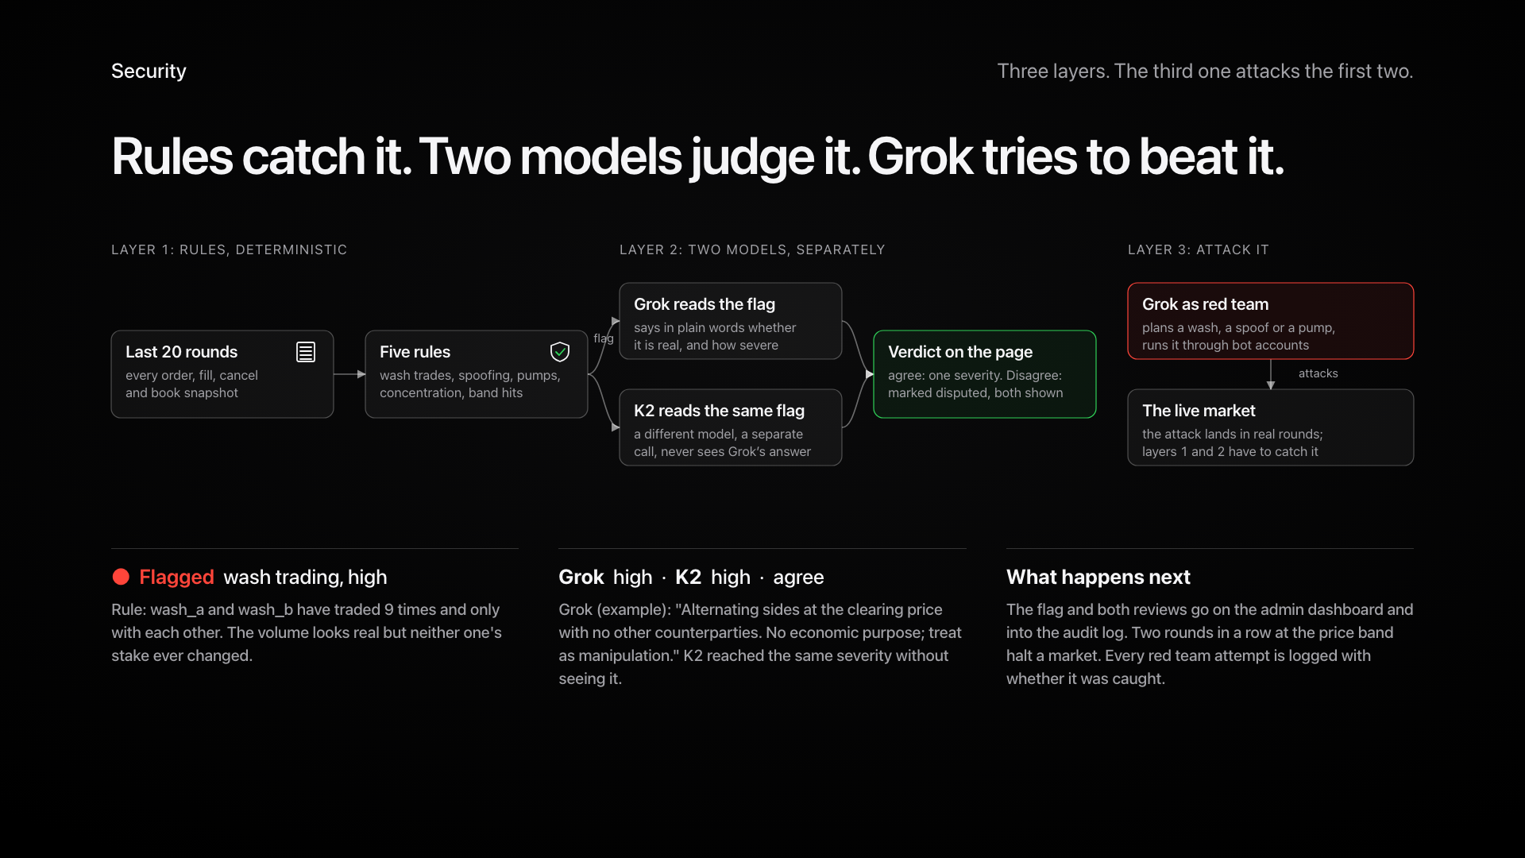
Notes:
Rules catch it, two models judge it separately, and Grok tries to beat it as red team.

Slide 14
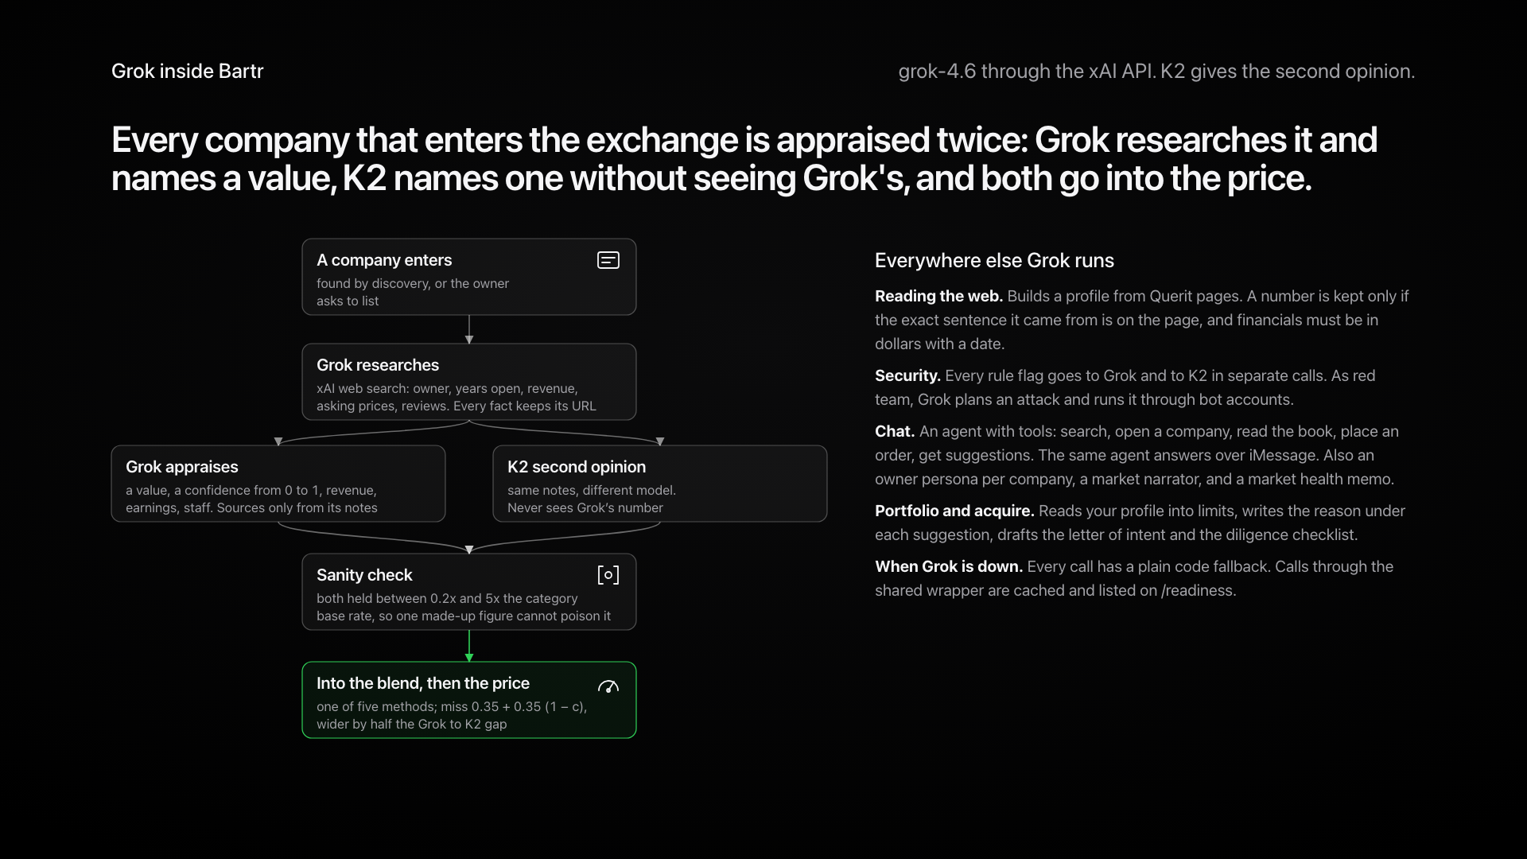
Notes:
Every company is appraised twice: Grok researches and names a value, K2 names one blind, both go into the price.

Slide 15
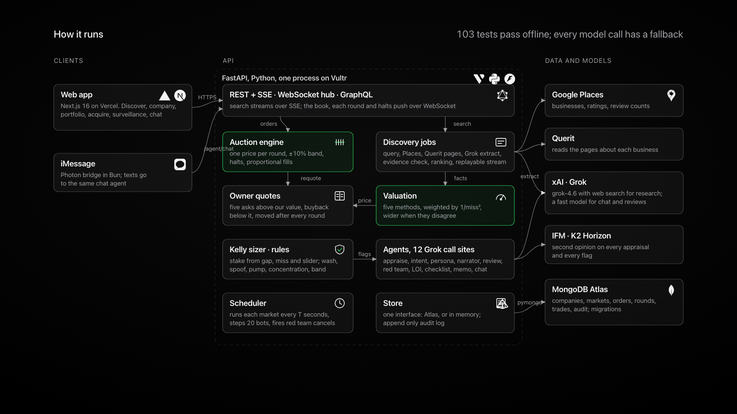
Notes:
Next.js, FastAPI, Atlas, Places, Querit, Grok, K2, iMessage. 103 tests.

Slide 16
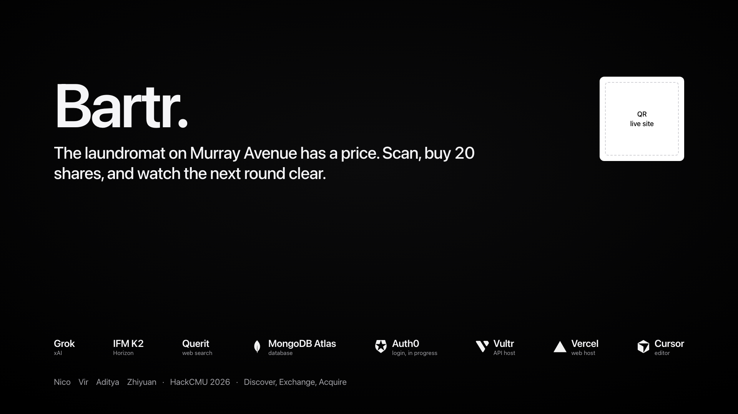
Notes:
The laundromat on Murray Avenue has a price. Scan, buy 20 shares, watch the next round.

