Slide 1
sg607 PAM Noise Analysis
9 mission phases analyzed | QC applied

Slide 2
Summary
124,836 science rows across 9 mission phases: shakedown, fast, shallow dives, slow, intermediate, drift, mini-slow, mini-intermediate, mini-fast
Overall energy-mean broadband SPL: 118.3 dB re: 1 μPa (min 78.4, max 136.9)
Variables binned: temperature, salinity, density, soundVelocity, depth, latitude, longitude
QC status: QC applied
depth_mask_flag: 3,518 of 126,907 rows flagged (2.8%) - dropped from this analysis
Strongest overall correlation with broadband SPL: latitude (r=0.13, n=123,389)
Strongest per-mode correlation: depth during "shallow dives" (r=0.26, n=5,529)

Slide 3
Full-mission overview

Slide 4
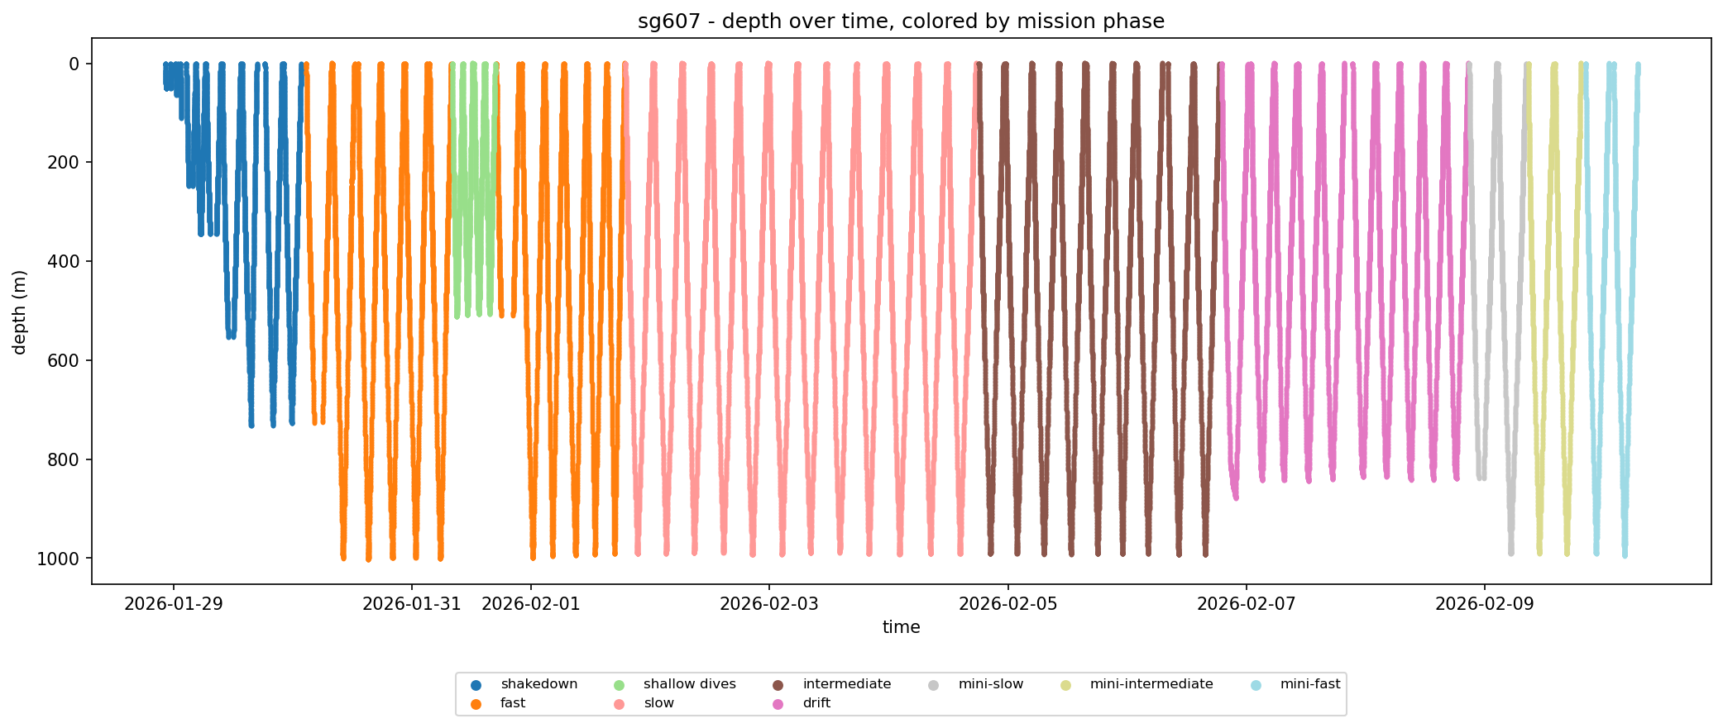
Depth over time by mission phase
Full-deployment dive profile, colored by mission phase.

Slide 5
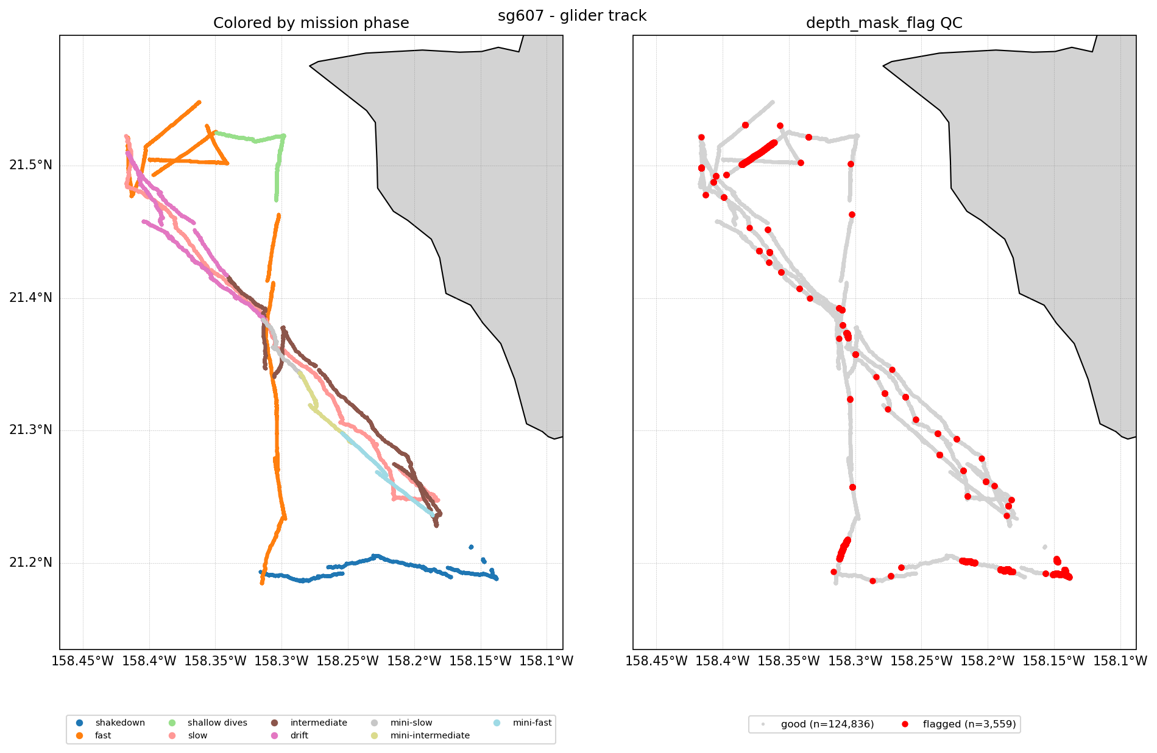
Glider track: phase & QC
Full-deployment glider track (longitude vs latitude): left colored by mission phase, right highlighting rows flagged by the depth_mask_flag QC check.

Slide 6
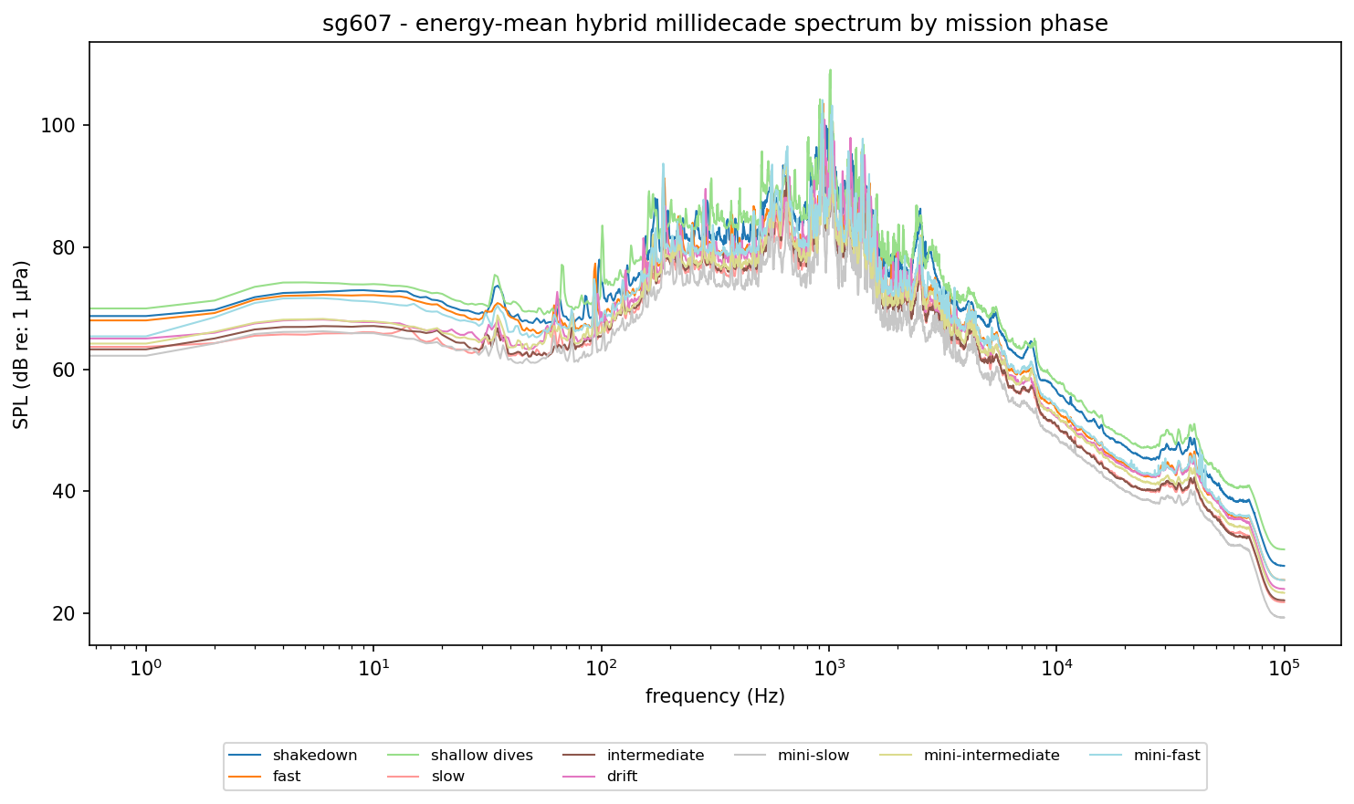
Energy-mean spectrum by mission phase
Energy-mean hybrid millidecade noise spectrum for each mission phase (levels averaged in linear power, then converted back to dB) - frequency (log) vs SPL, one line per mode.

Slide 7
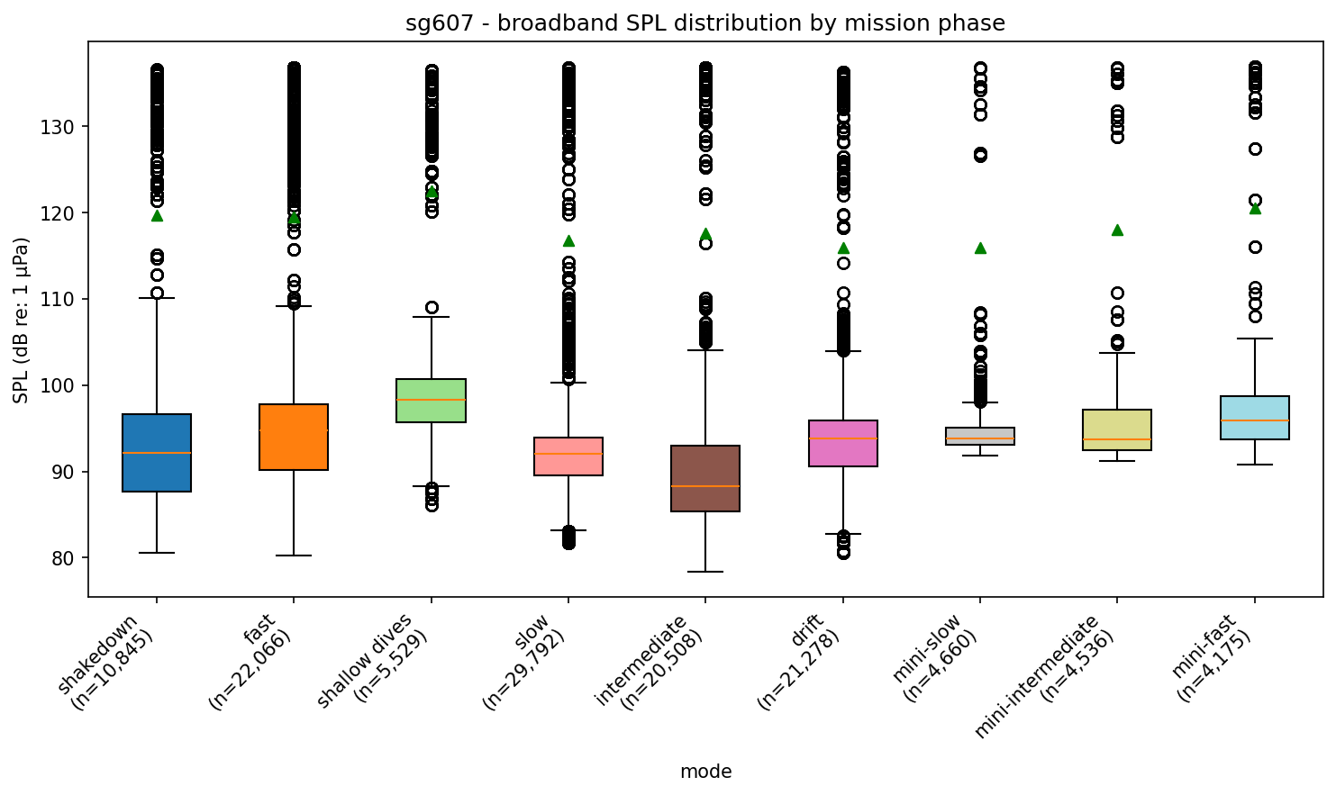
Broadband SPL by mission phase
Distribution of broadband SPL for each mission phase. Green triangles mark the energy mean.

Slide 8
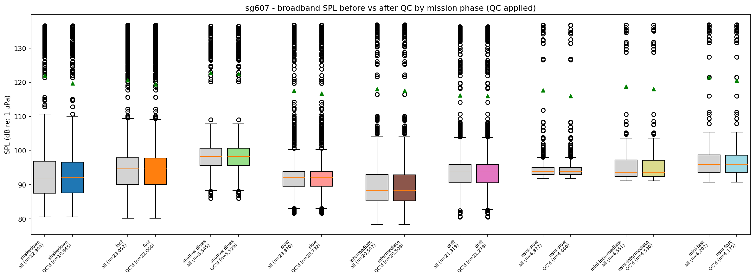
Broadband SPL before vs after QC
One pair of boxes per mission phase: all data vs depth_mask_flag-filtered ("QC'd"), green triangles = energy mean. If QC is off, each pair matches - nothing was dropped.

Slide 9
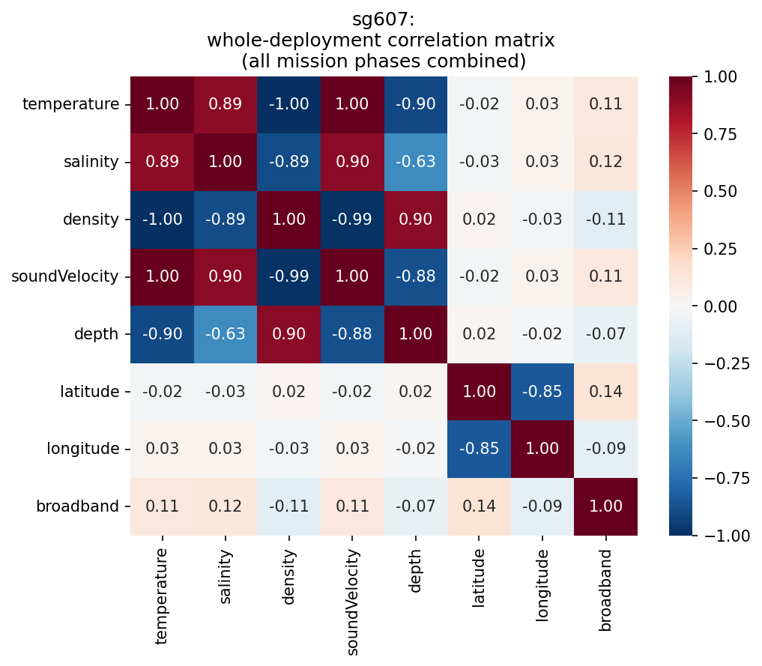
Whole-deployment correlation matrix
Pearson correlation between every CTD/science variable and broadband SPL, all mission phases combined.

Slide 10
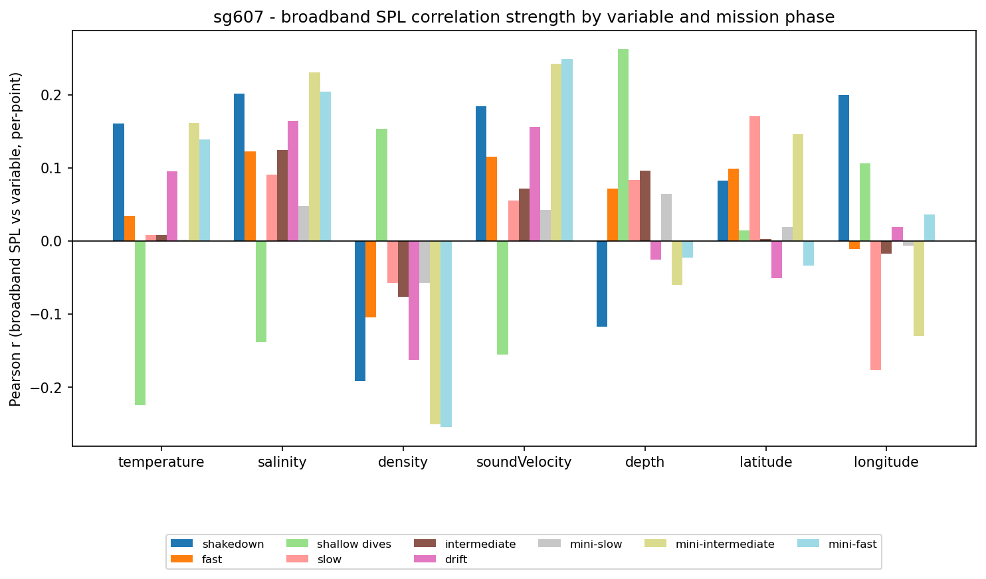
Broadband SPL correlation strength by variable and mode
Real per-point Pearson r between broadband SPL and each raw variable, grouped by mission phase.

Slide 11
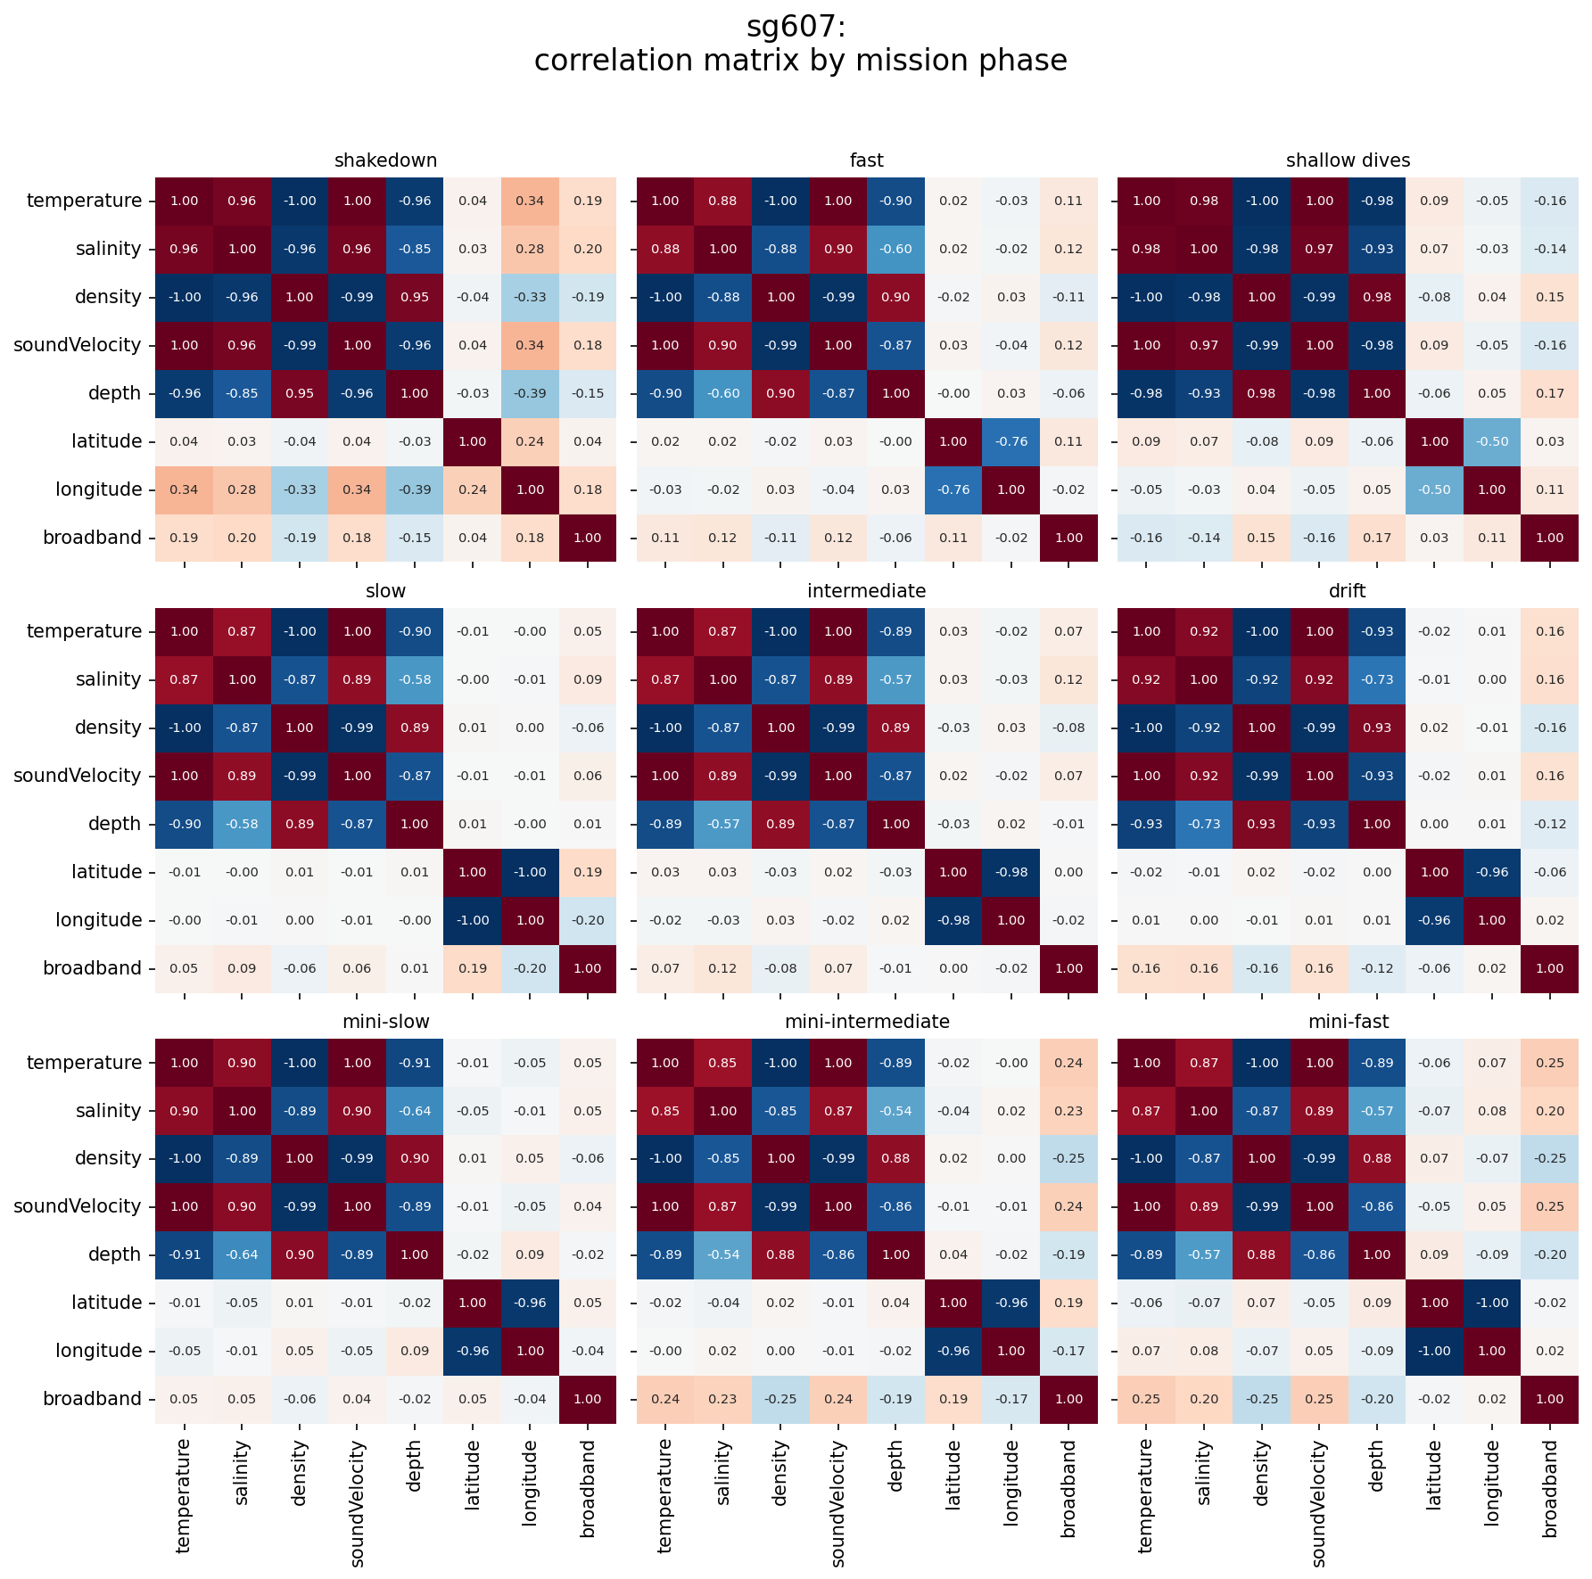
Correlation matrix by mission phase
Full CTD/science variable + broadband SPL correlation matrix, computed separately within each mission phase, for direct side-by-side comparison.

Slide 12
shakedown

Slide 13
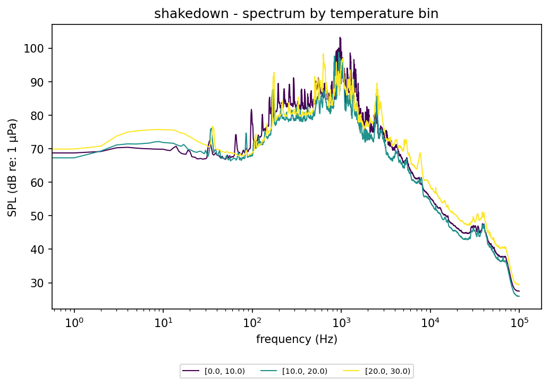
shakedown - spectrum by temperature bin
Energy-mean noise spectrum during "shakedown" (frequency, log scale, vs SPL), one line per temperature bin.

Slide 14
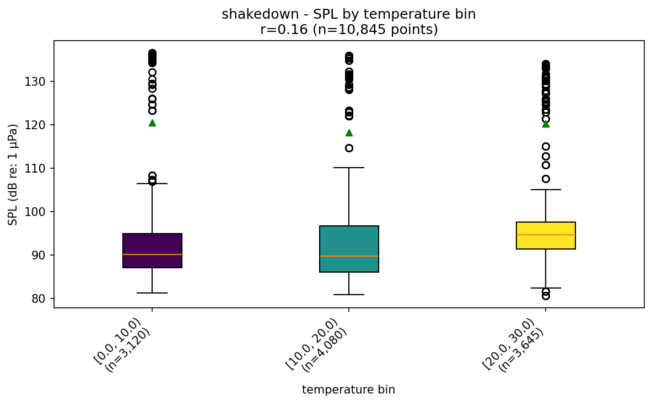
shakedown - SPL by temperature bin
Broadband SPL distribution during "shakedown", split by temperature bin (green triangles = energy mean). Title shows the real per-point Pearson r between raw temperature and raw SPL for this mode.

Slide 15
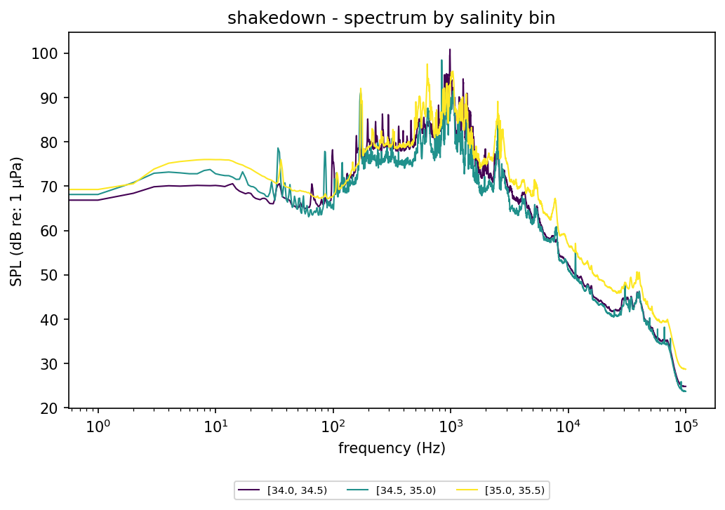
shakedown - spectrum by salinity bin
Energy-mean noise spectrum during "shakedown" (frequency, log scale, vs SPL), one line per salinity bin.

Slide 16
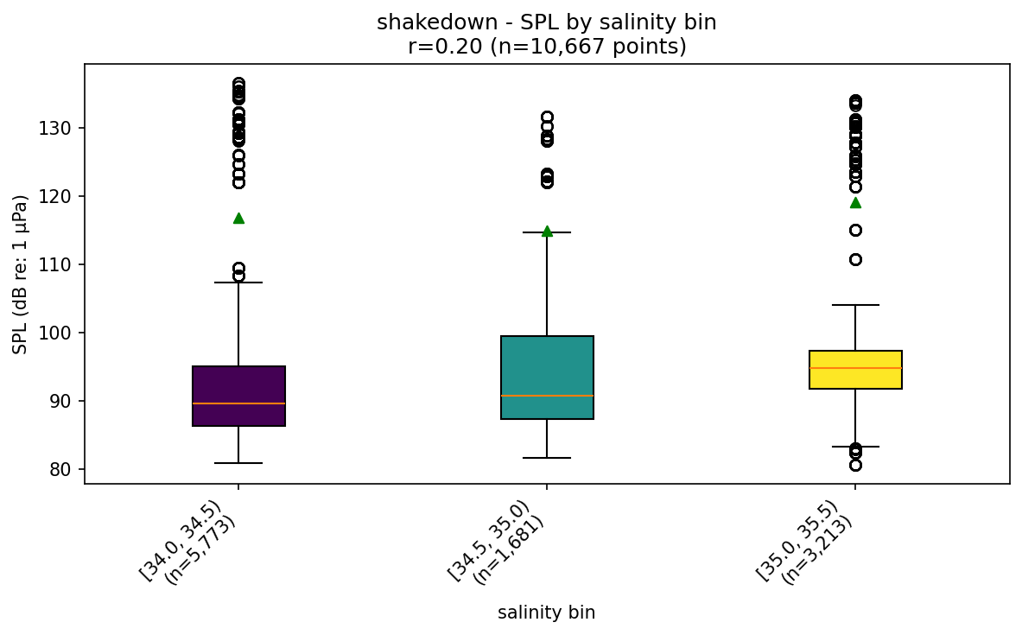
shakedown - SPL by salinity bin
Broadband SPL distribution during "shakedown", split by salinity bin (green triangles = energy mean). Title shows the real per-point Pearson r between raw salinity and raw SPL for this mode.

Slide 17
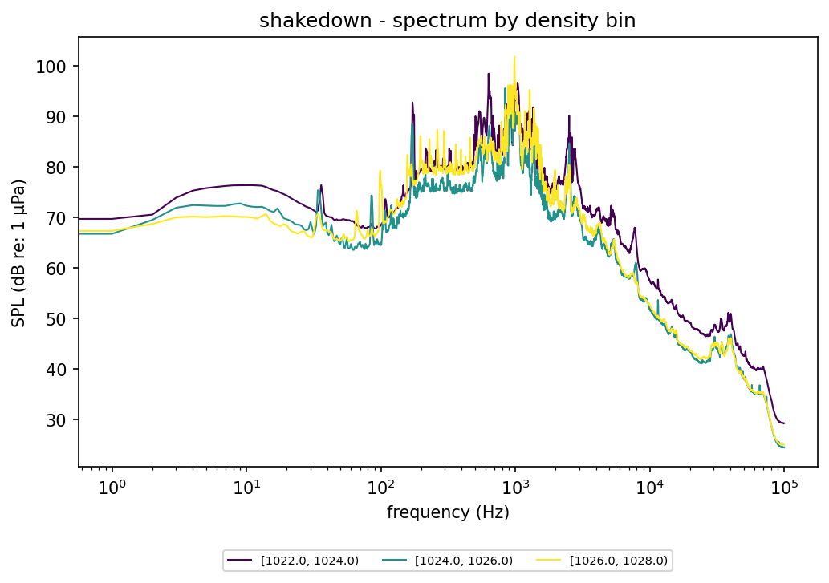
shakedown - spectrum by density bin
Energy-mean noise spectrum during "shakedown" (frequency, log scale, vs SPL), one line per density bin.

Slide 18
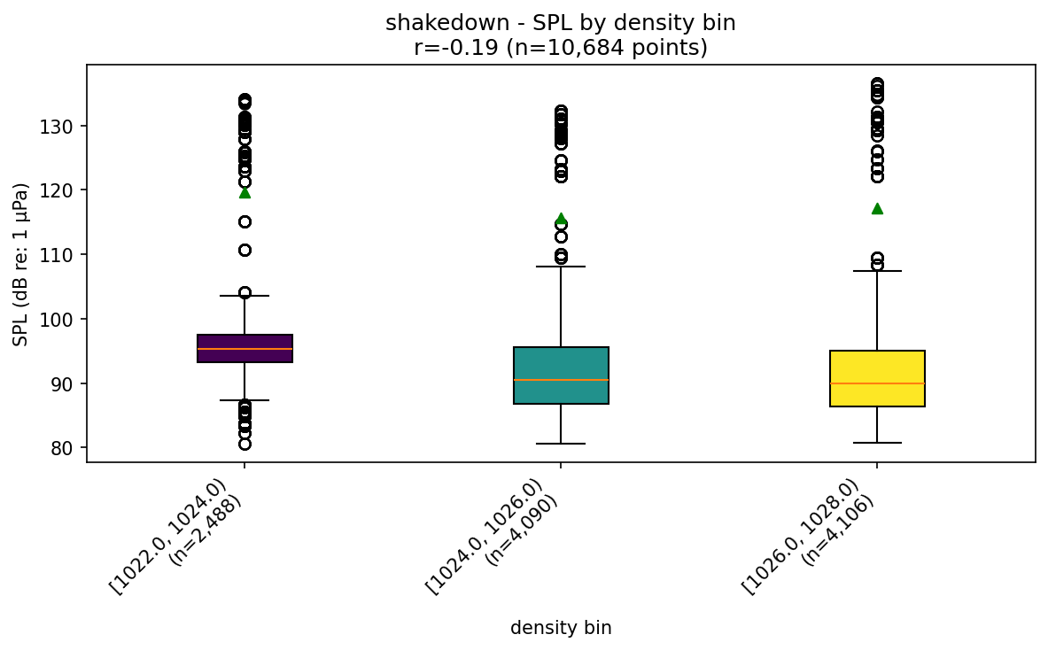
shakedown - SPL by density bin
Broadband SPL distribution during "shakedown", split by density bin (green triangles = energy mean). Title shows the real per-point Pearson r between raw density and raw SPL for this mode.

Slide 19
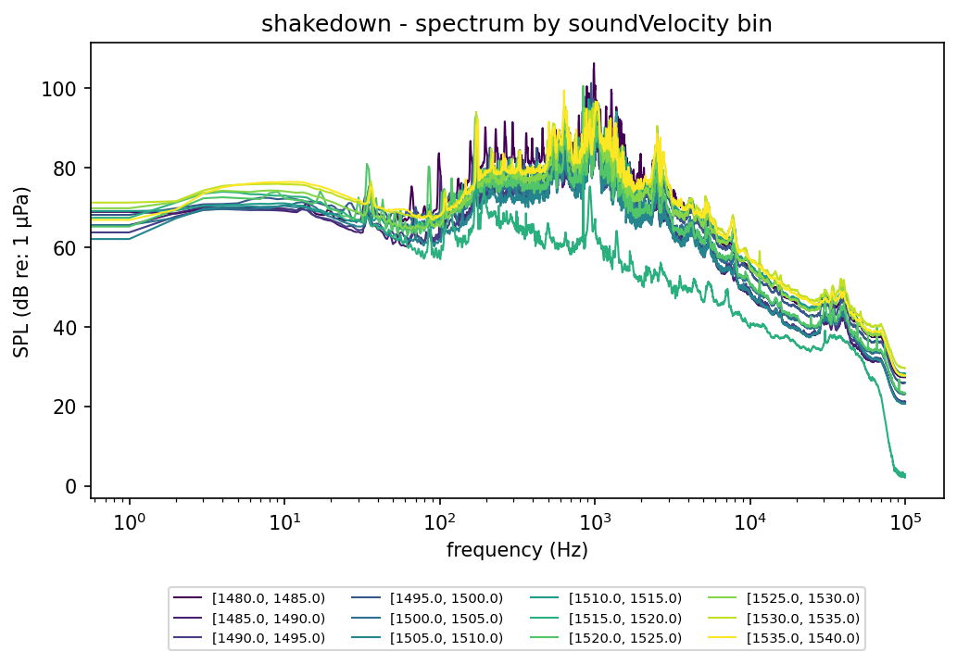
shakedown - spectrum by soundVelocity bin
Energy-mean noise spectrum during "shakedown" (frequency, log scale, vs SPL), one line per soundVelocity bin.

Slide 20
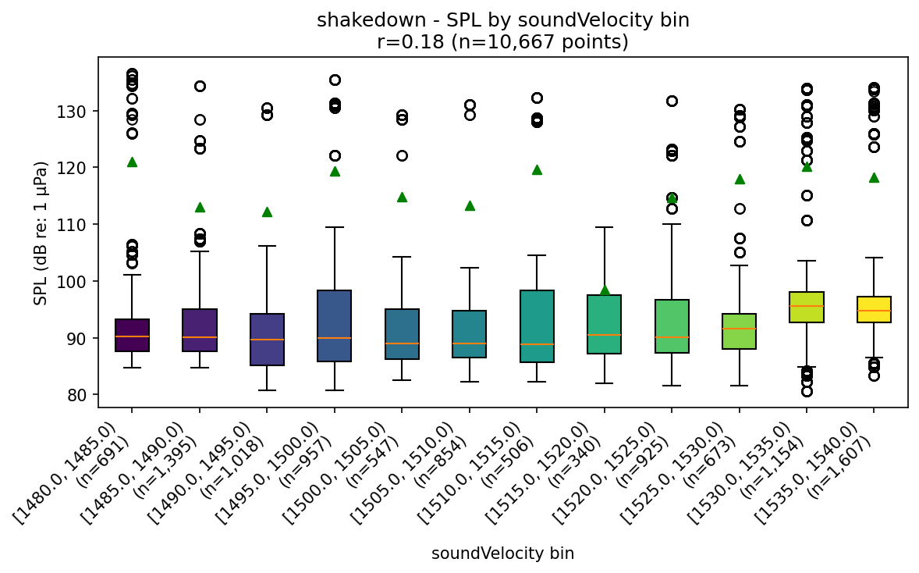
shakedown - SPL by soundVelocity bin
Broadband SPL distribution during "shakedown", split by soundVelocity bin (green triangles = energy mean). Title shows the real per-point Pearson r between raw soundVelocity and raw SPL for this mode.

Slide 21
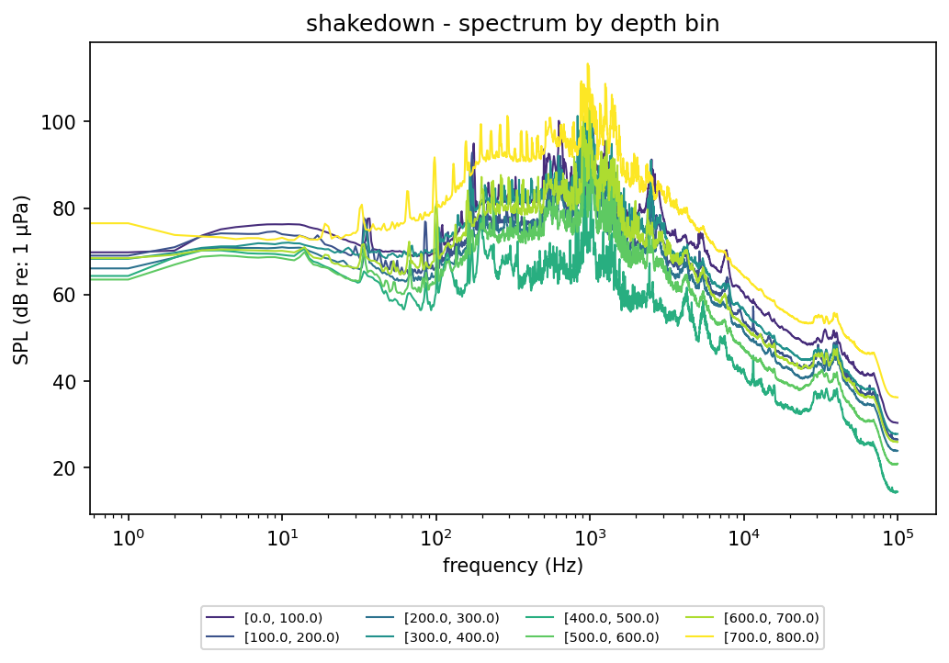
shakedown - spectrum by depth bin
Energy-mean noise spectrum during "shakedown" (frequency, log scale, vs SPL), one line per depth bin.

Slide 22
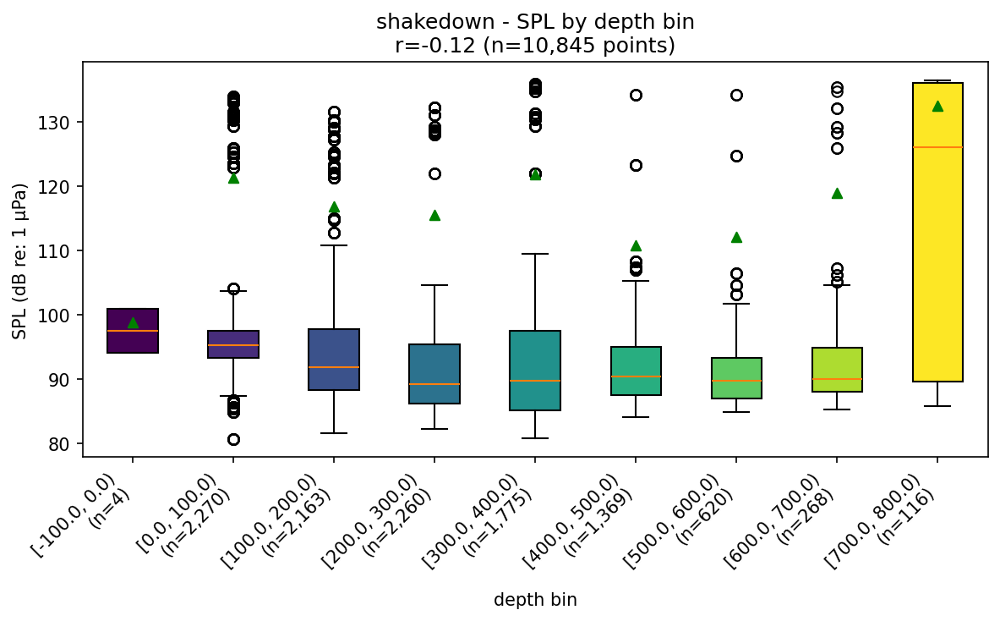
shakedown - SPL by depth bin
Broadband SPL distribution during "shakedown", split by depth bin (green triangles = energy mean). Title shows the real per-point Pearson r between raw depth and raw SPL for this mode.

Slide 23
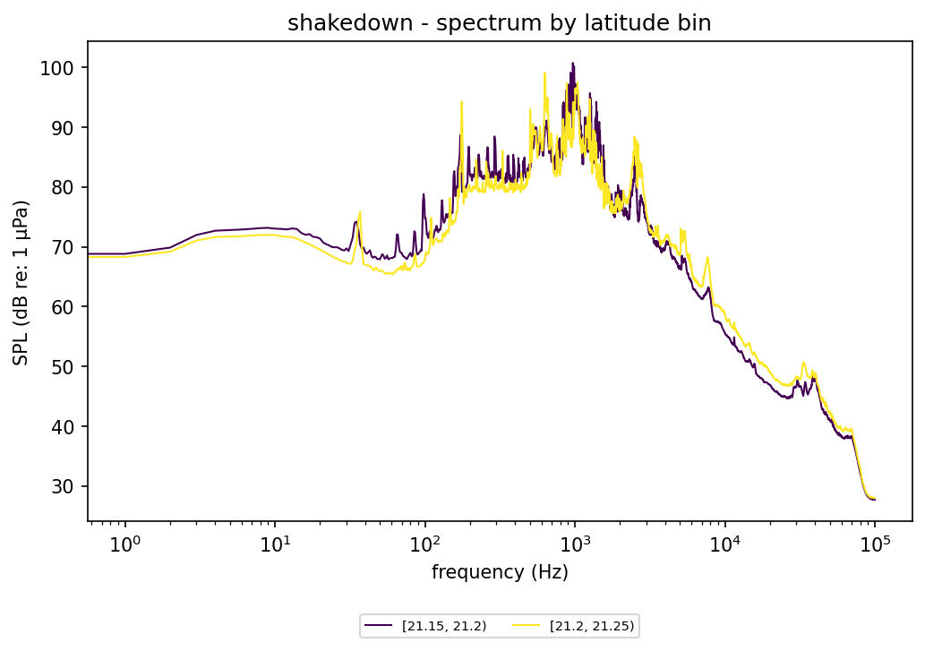
shakedown - spectrum by latitude bin
Energy-mean noise spectrum during "shakedown" (frequency, log scale, vs SPL), one line per latitude bin.

Slide 24
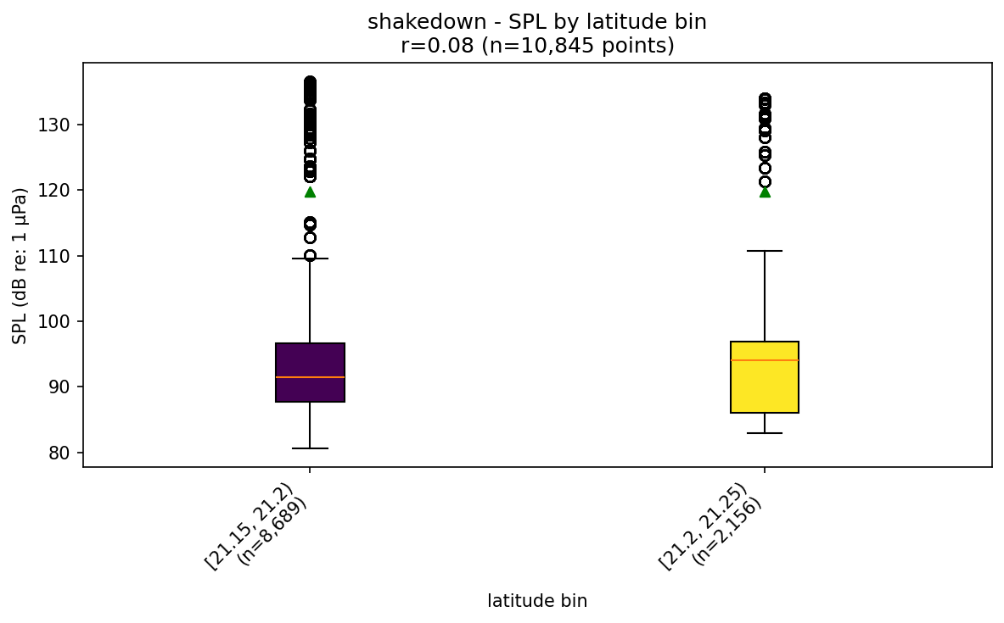
shakedown - SPL by latitude bin
Broadband SPL distribution during "shakedown", split by latitude bin (green triangles = energy mean). Title shows the real per-point Pearson r between raw latitude and raw SPL for this mode.

Slide 25
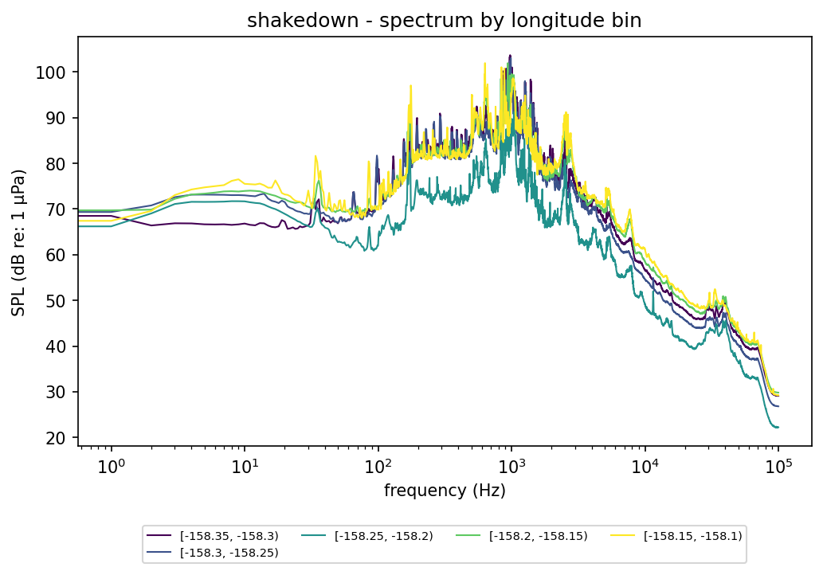
shakedown - spectrum by longitude bin
Energy-mean noise spectrum during "shakedown" (frequency, log scale, vs SPL), one line per longitude bin.

Slide 26
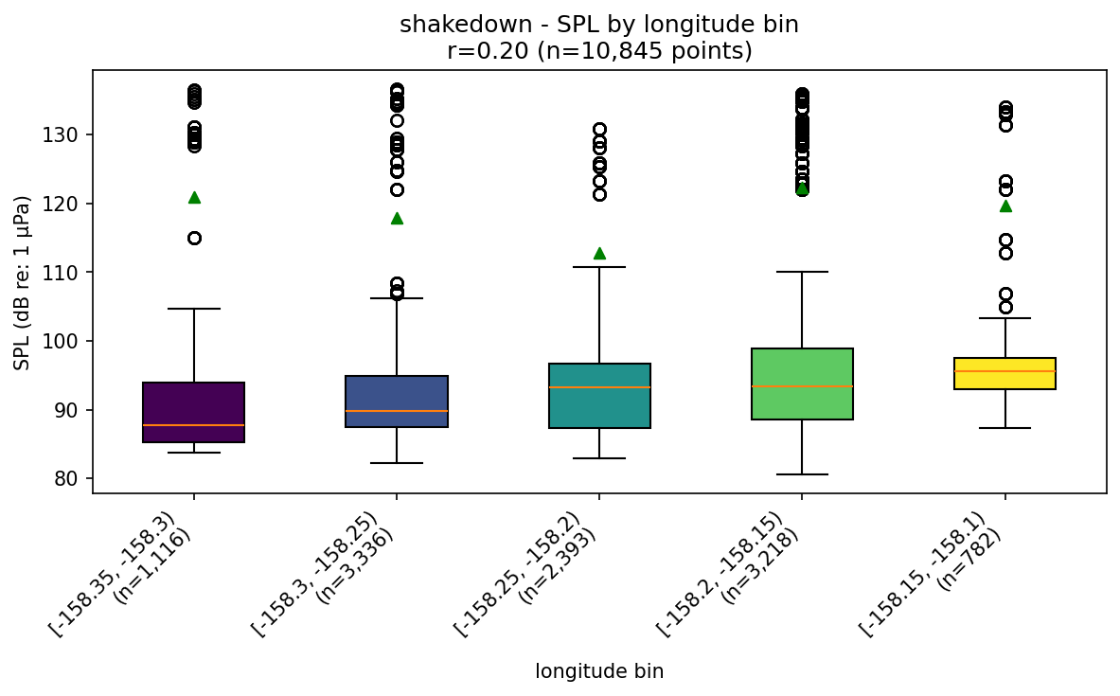
shakedown - SPL by longitude bin
Broadband SPL distribution during "shakedown", split by longitude bin (green triangles = energy mean). Title shows the real per-point Pearson r between raw longitude and raw SPL for this mode.

Slide 27
fast

Slide 28
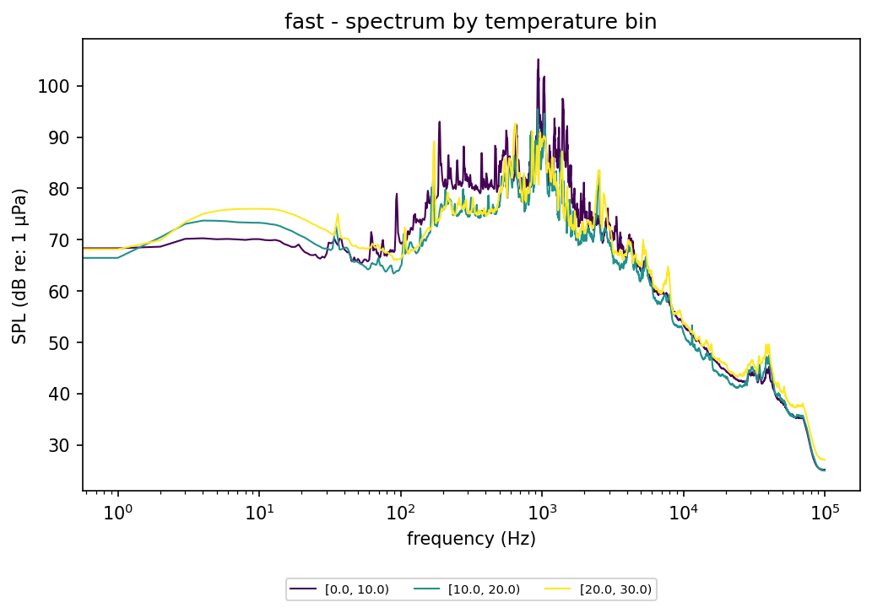
fast - spectrum by temperature bin
Energy-mean noise spectrum during "fast" (frequency, log scale, vs SPL), one line per temperature bin.

Slide 29
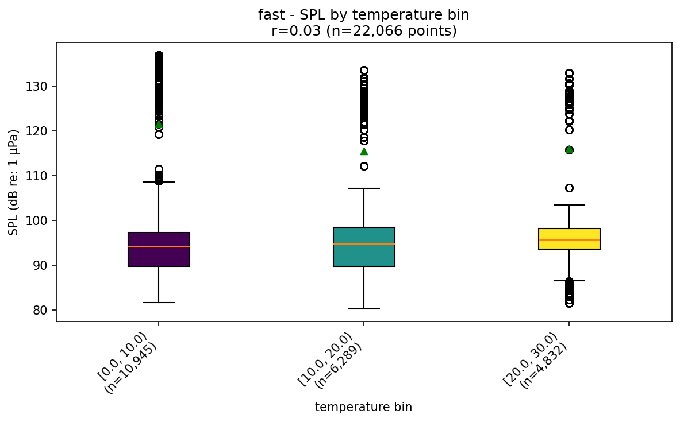
fast - SPL by temperature bin
Broadband SPL distribution during "fast", split by temperature bin (green triangles = energy mean). Title shows the real per-point Pearson r between raw temperature and raw SPL for this mode.

Slide 30
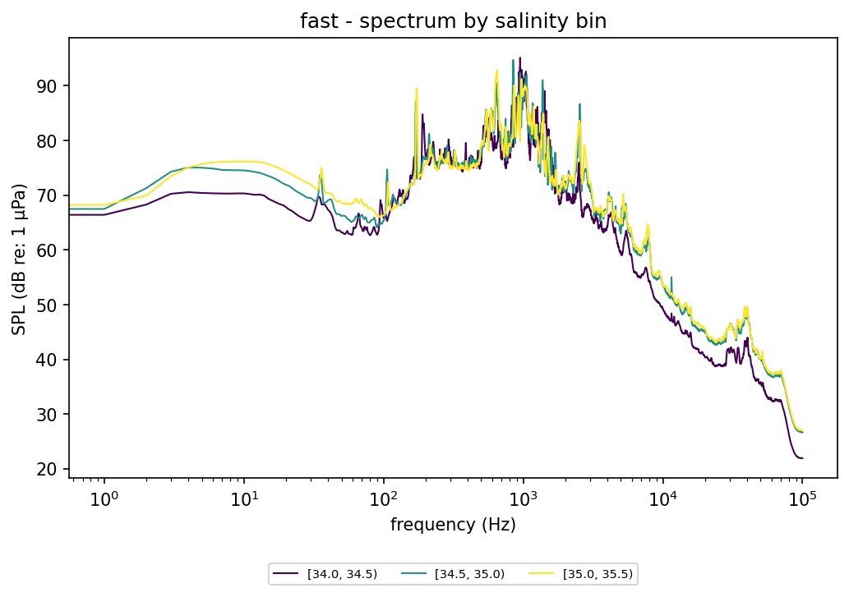
fast - spectrum by salinity bin
Energy-mean noise spectrum during "fast" (frequency, log scale, vs SPL), one line per salinity bin.

Slide 31
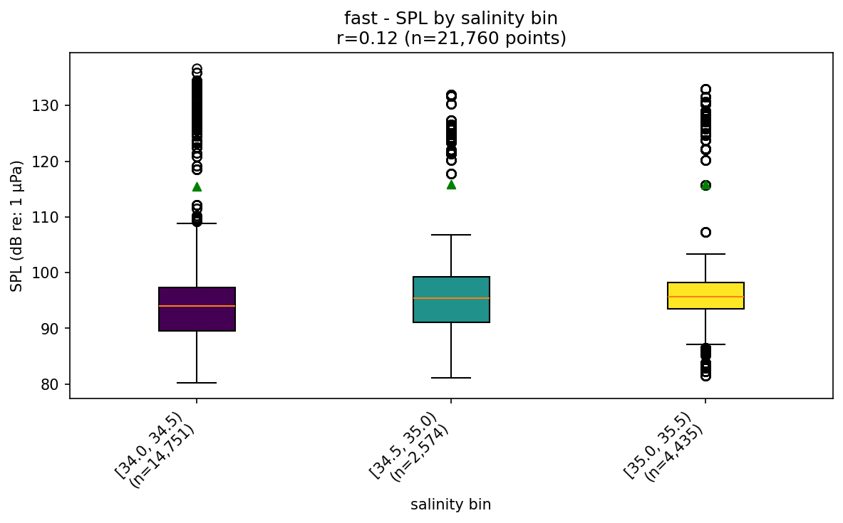
fast - SPL by salinity bin
Broadband SPL distribution during "fast", split by salinity bin (green triangles = energy mean). Title shows the real per-point Pearson r between raw salinity and raw SPL for this mode.

Slide 32
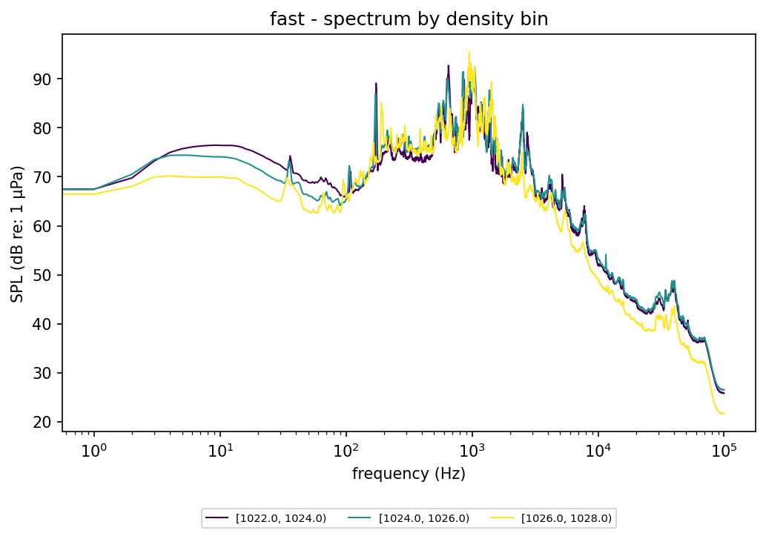
fast - spectrum by density bin
Energy-mean noise spectrum during "fast" (frequency, log scale, vs SPL), one line per density bin.

Slide 33
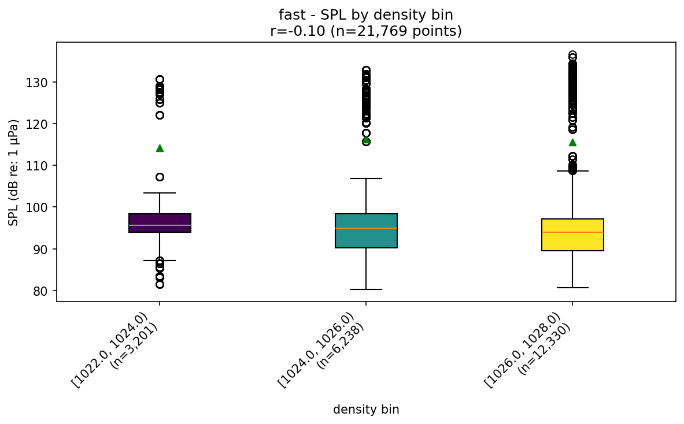
fast - SPL by density bin
Broadband SPL distribution during "fast", split by density bin (green triangles = energy mean). Title shows the real per-point Pearson r between raw density and raw SPL for this mode.

Slide 34
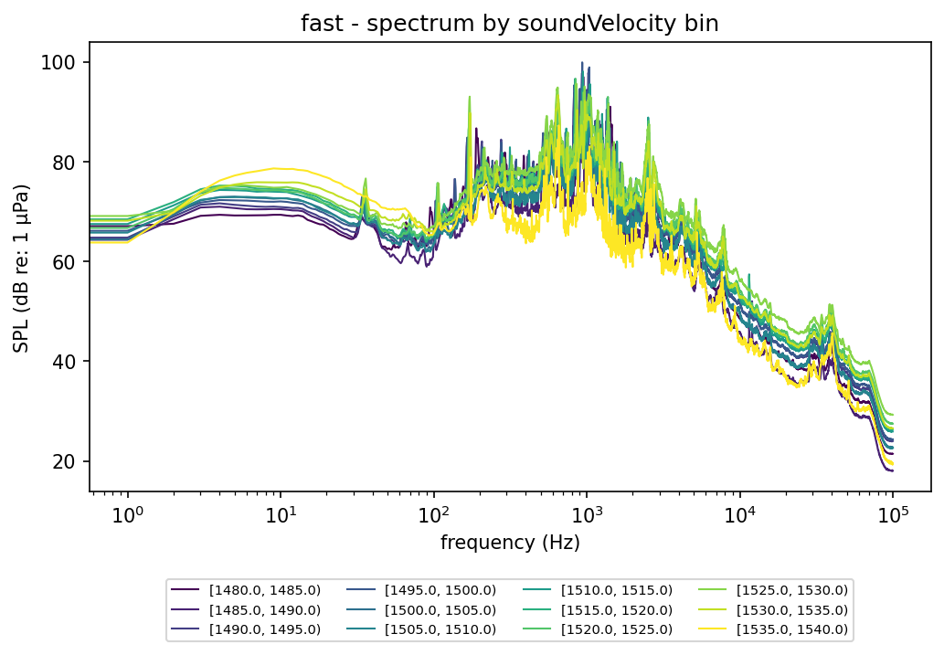
fast - spectrum by soundVelocity bin
Energy-mean noise spectrum during "fast" (frequency, log scale, vs SPL), one line per soundVelocity bin.

Slide 35
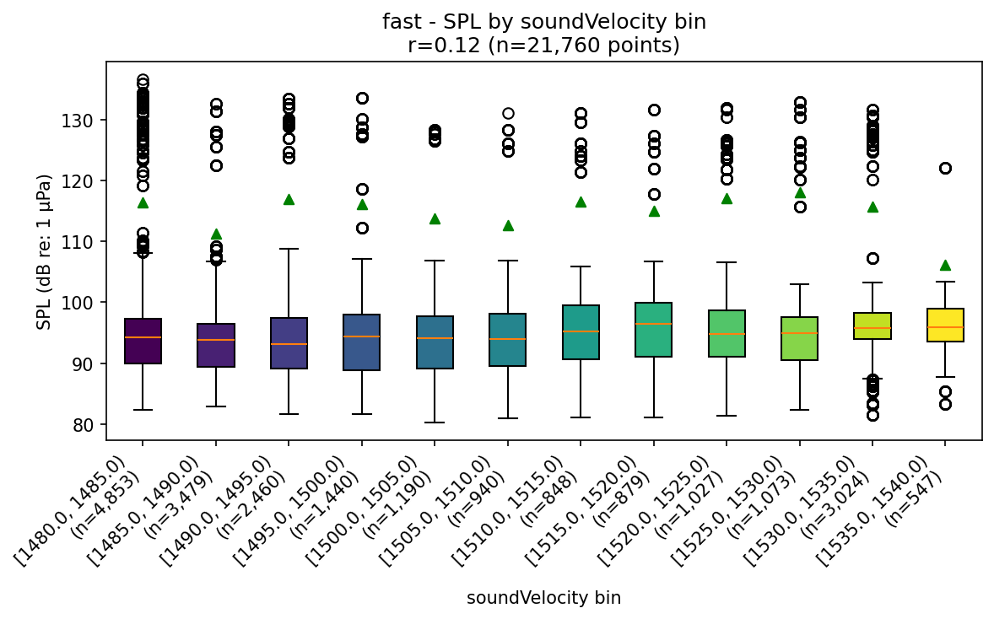
fast - SPL by soundVelocity bin
Broadband SPL distribution during "fast", split by soundVelocity bin (green triangles = energy mean). Title shows the real per-point Pearson r between raw soundVelocity and raw SPL for this mode.

Slide 36
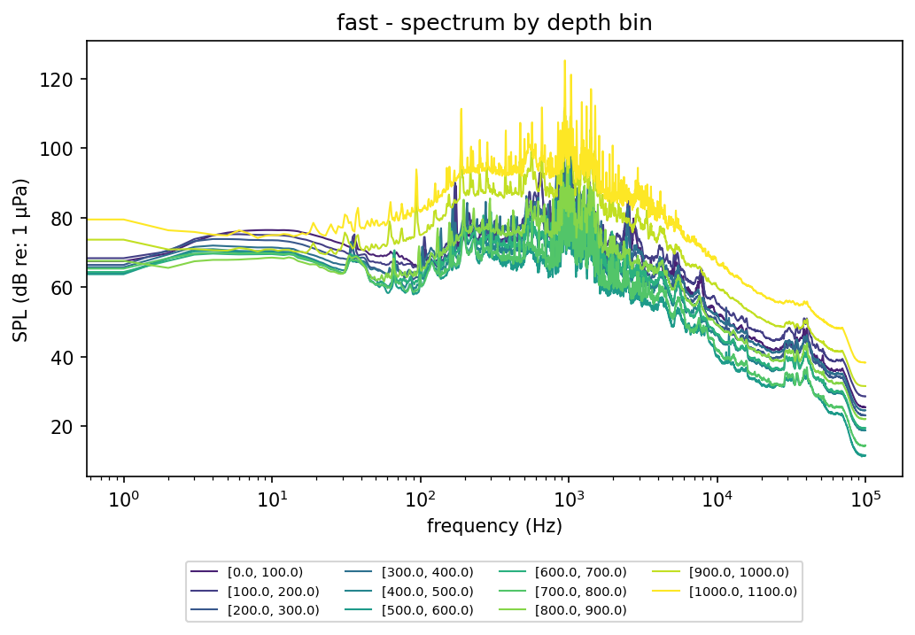
fast - spectrum by depth bin
Energy-mean noise spectrum during "fast" (frequency, log scale, vs SPL), one line per depth bin.

Slide 37
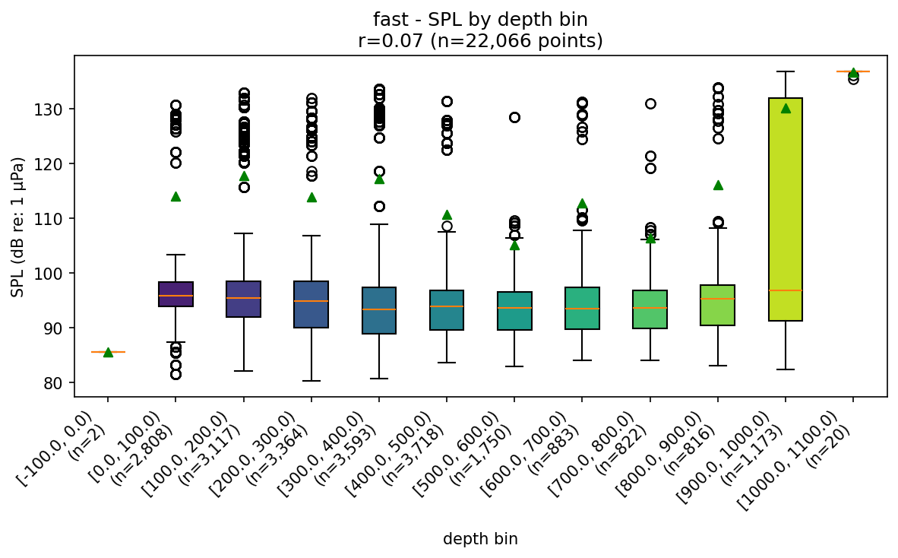
fast - SPL by depth bin
Broadband SPL distribution during "fast", split by depth bin (green triangles = energy mean). Title shows the real per-point Pearson r between raw depth and raw SPL for this mode.

Slide 38
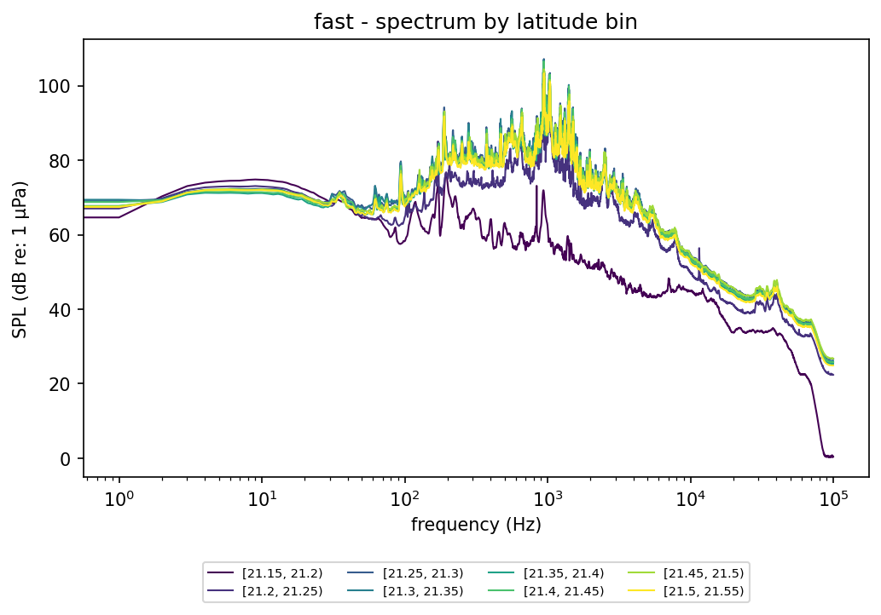
fast - spectrum by latitude bin
Energy-mean noise spectrum during "fast" (frequency, log scale, vs SPL), one line per latitude bin.

Slide 39
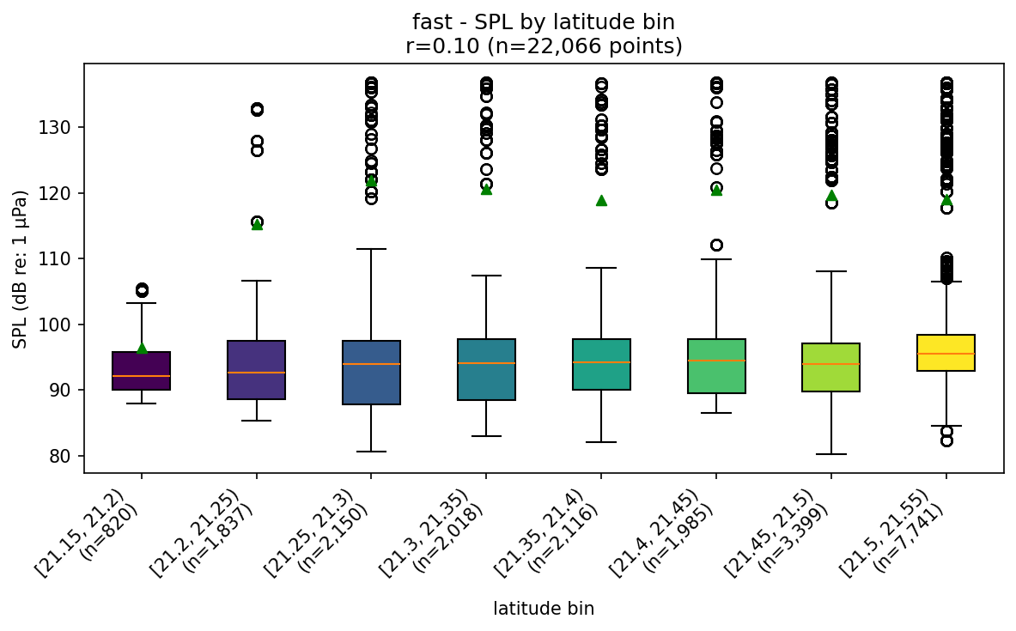
fast - SPL by latitude bin
Broadband SPL distribution during "fast", split by latitude bin (green triangles = energy mean). Title shows the real per-point Pearson r between raw latitude and raw SPL for this mode.

Slide 40
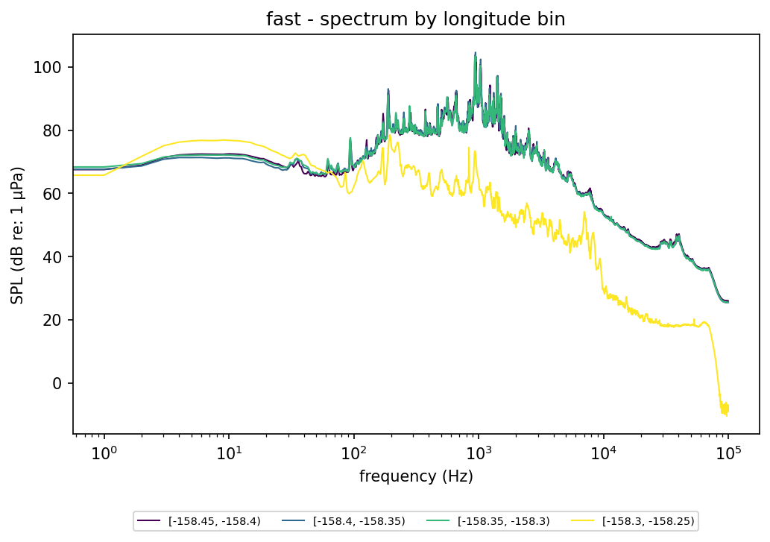
fast - spectrum by longitude bin
Energy-mean noise spectrum during "fast" (frequency, log scale, vs SPL), one line per longitude bin.

Slide 41
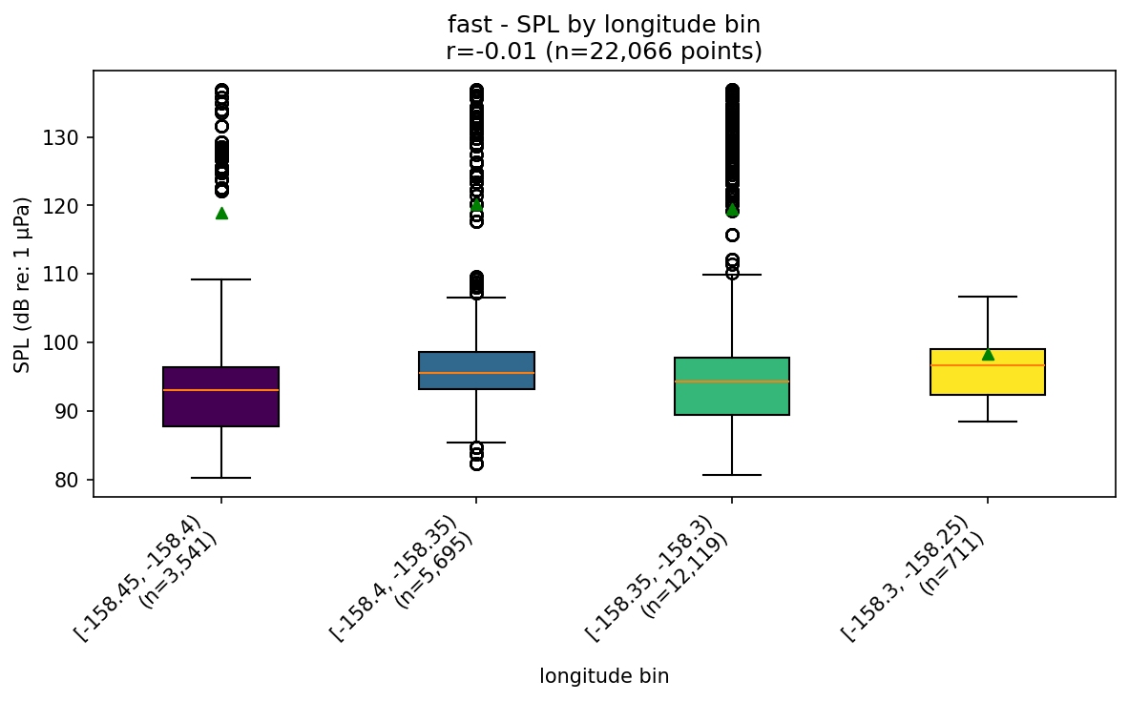
fast - SPL by longitude bin
Broadband SPL distribution during "fast", split by longitude bin (green triangles = energy mean). Title shows the real per-point Pearson r between raw longitude and raw SPL for this mode.

Slide 42
shallow dives

Slide 43
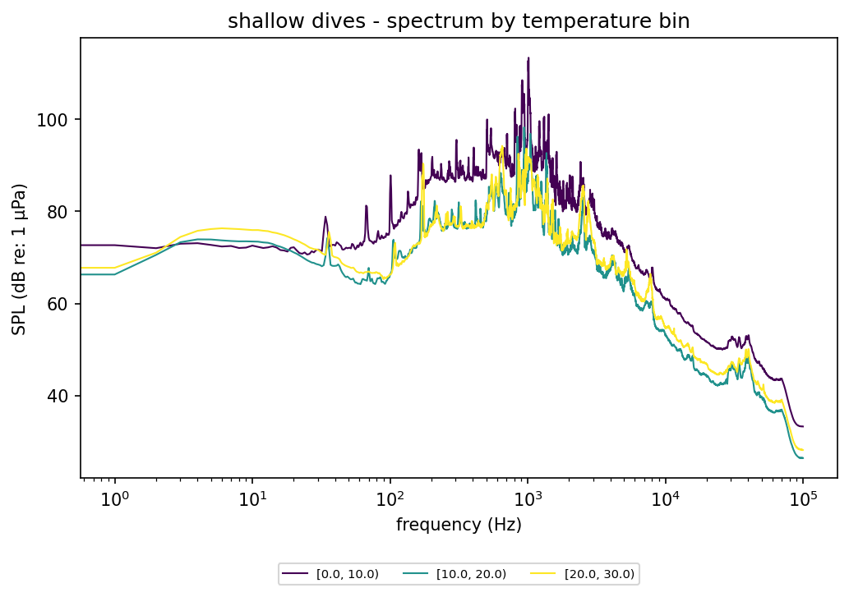
shallow dives - spectrum by temperature bin
Energy-mean noise spectrum during "shallow dives" (frequency, log scale, vs SPL), one line per temperature bin.

Slide 44
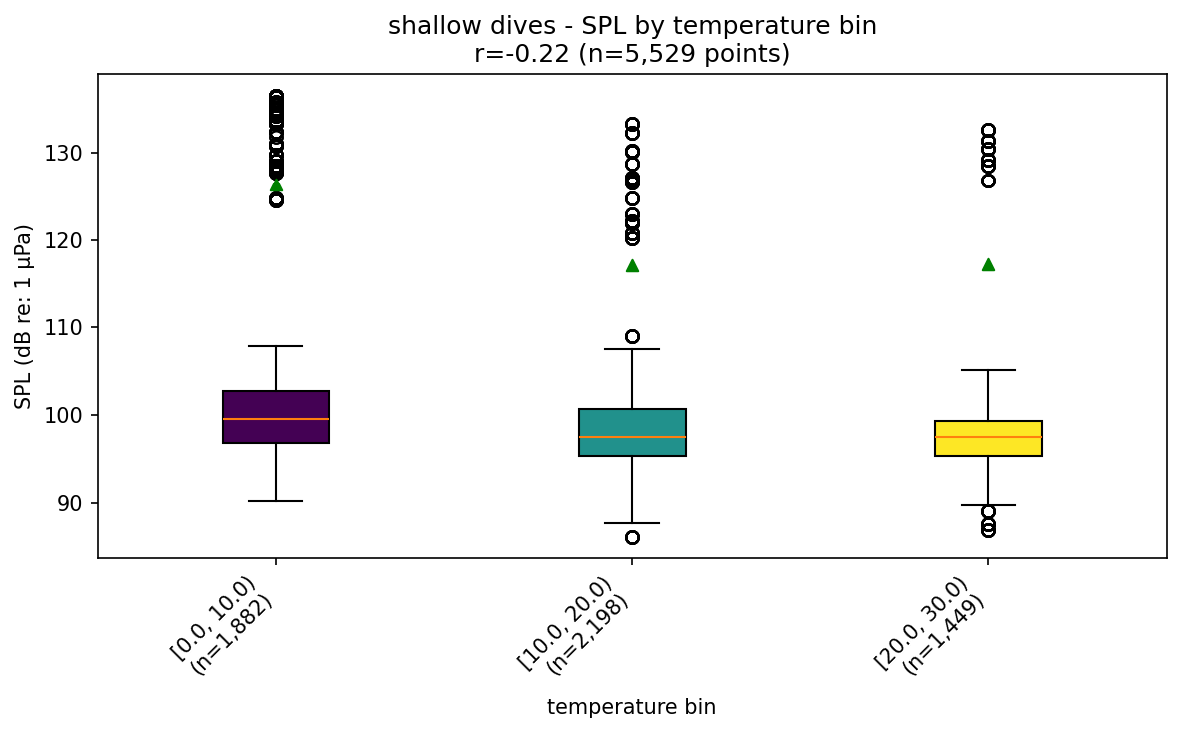
shallow dives - SPL by temperature bin
Broadband SPL distribution during "shallow dives", split by temperature bin (green triangles = energy mean). Title shows the real per-point Pearson r between raw temperature and raw SPL for this mode.

Slide 45
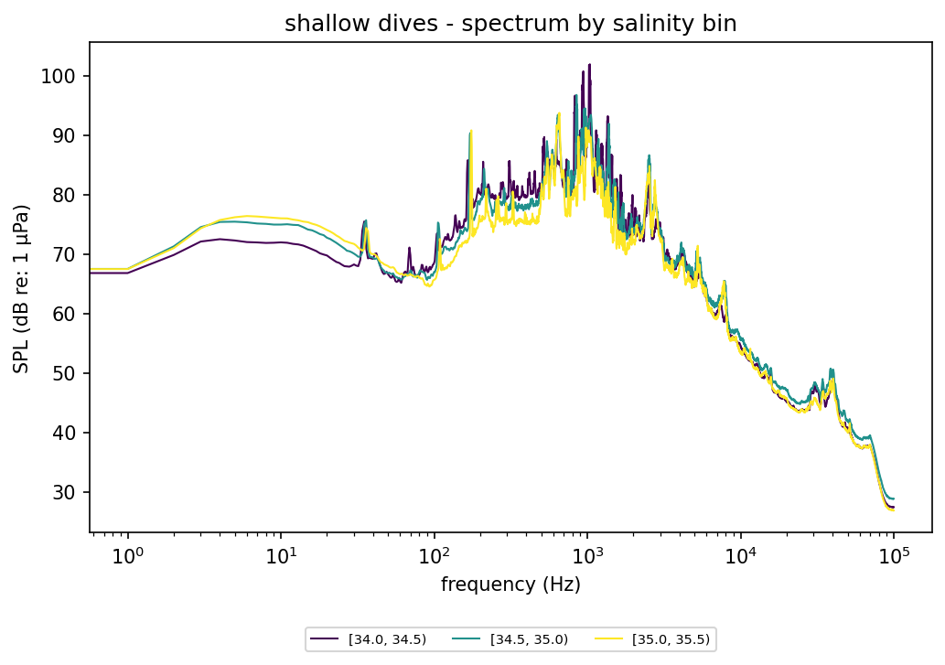
shallow dives - spectrum by salinity bin
Energy-mean noise spectrum during "shallow dives" (frequency, log scale, vs SPL), one line per salinity bin.

Slide 46
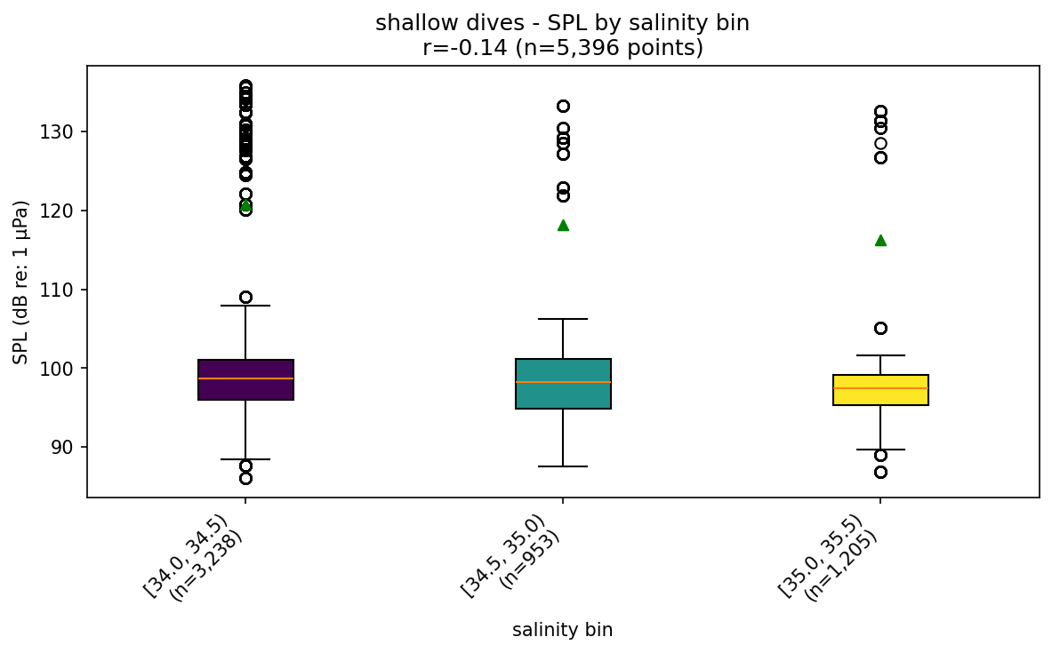
shallow dives - SPL by salinity bin
Broadband SPL distribution during "shallow dives", split by salinity bin (green triangles = energy mean). Title shows the real per-point Pearson r between raw salinity and raw SPL for this mode.

Slide 47
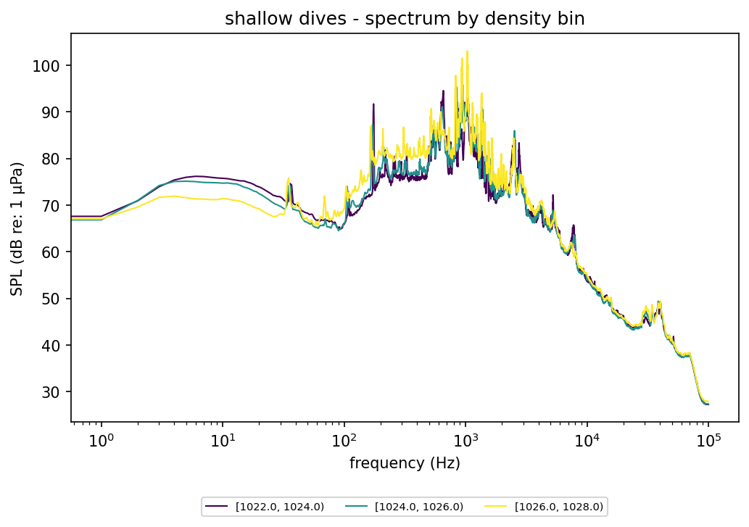
shallow dives - spectrum by density bin
Energy-mean noise spectrum during "shallow dives" (frequency, log scale, vs SPL), one line per density bin.

Slide 48
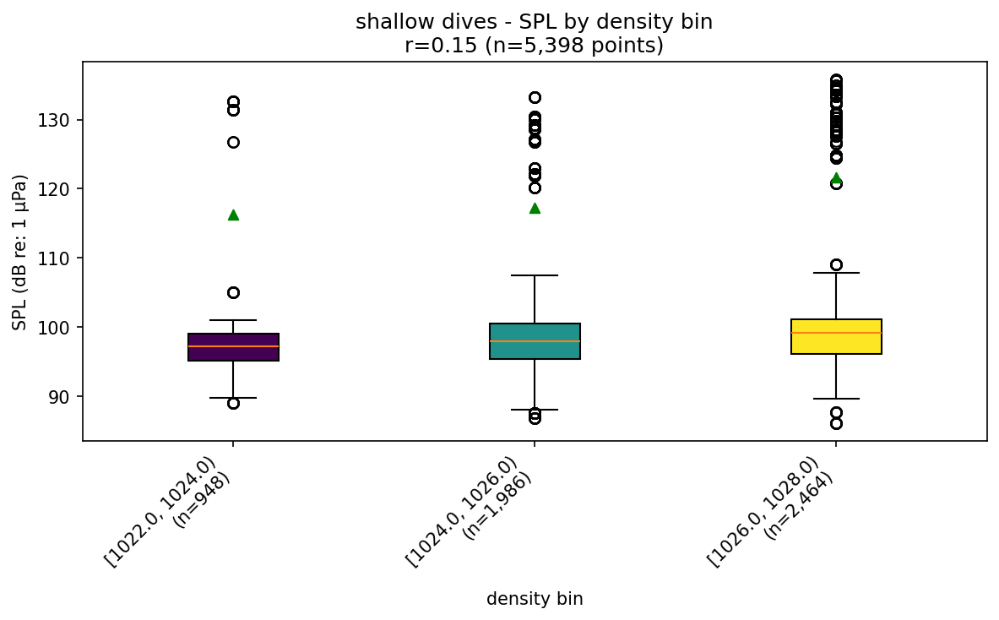
shallow dives - SPL by density bin
Broadband SPL distribution during "shallow dives", split by density bin (green triangles = energy mean). Title shows the real per-point Pearson r between raw density and raw SPL for this mode.

Slide 49
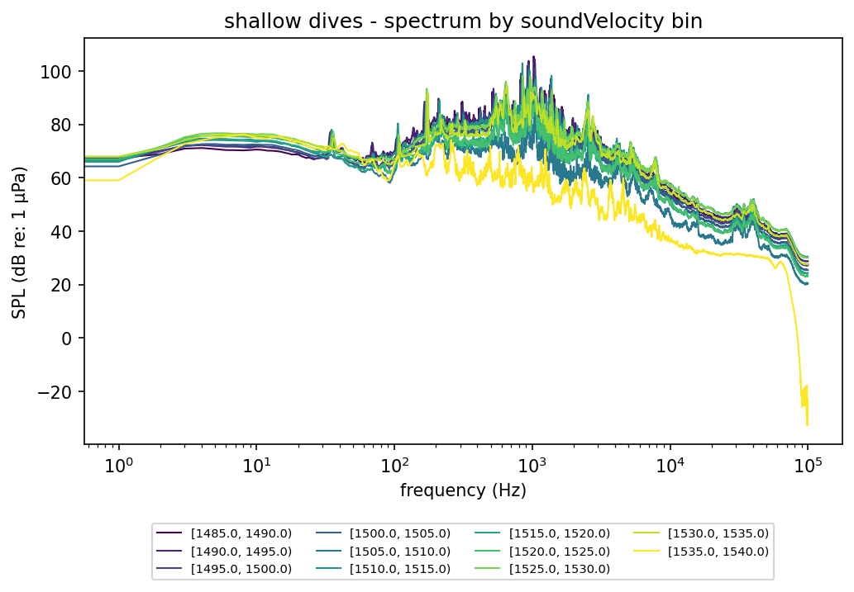
shallow dives - spectrum by soundVelocity bin
Energy-mean noise spectrum during "shallow dives" (frequency, log scale, vs SPL), one line per soundVelocity bin.

Slide 50
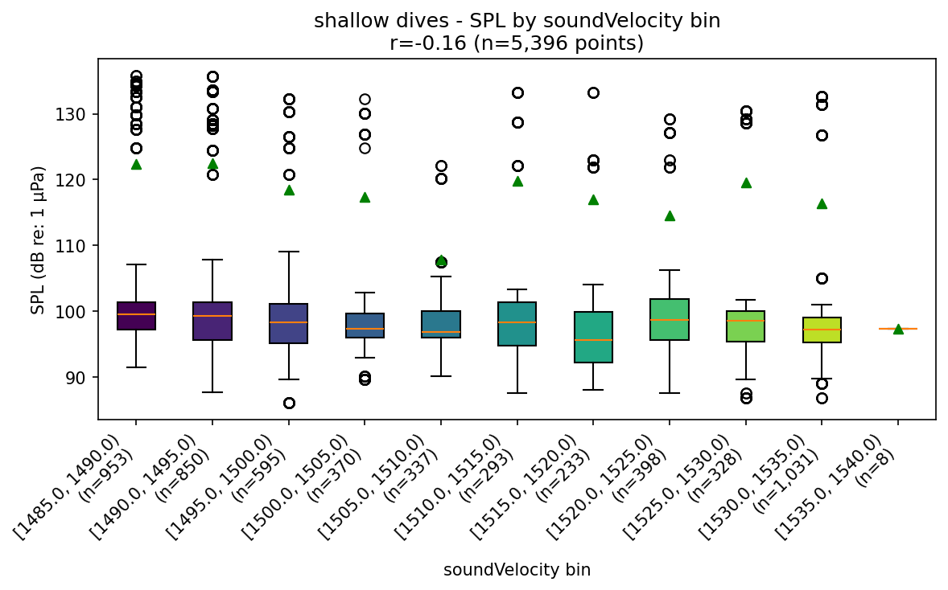
shallow dives - SPL by soundVelocity bin
Broadband SPL distribution during "shallow dives", split by soundVelocity bin (green triangles = energy mean). Title shows the real per-point Pearson r between raw soundVelocity and raw SPL for this mode.

Slide 51
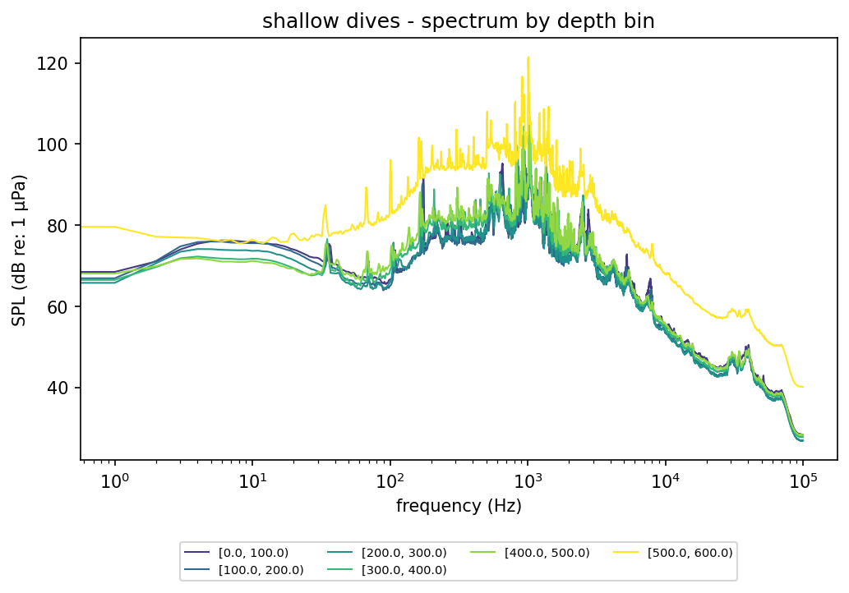
shallow dives - spectrum by depth bin
Energy-mean noise spectrum during "shallow dives" (frequency, log scale, vs SPL), one line per depth bin.

Slide 52
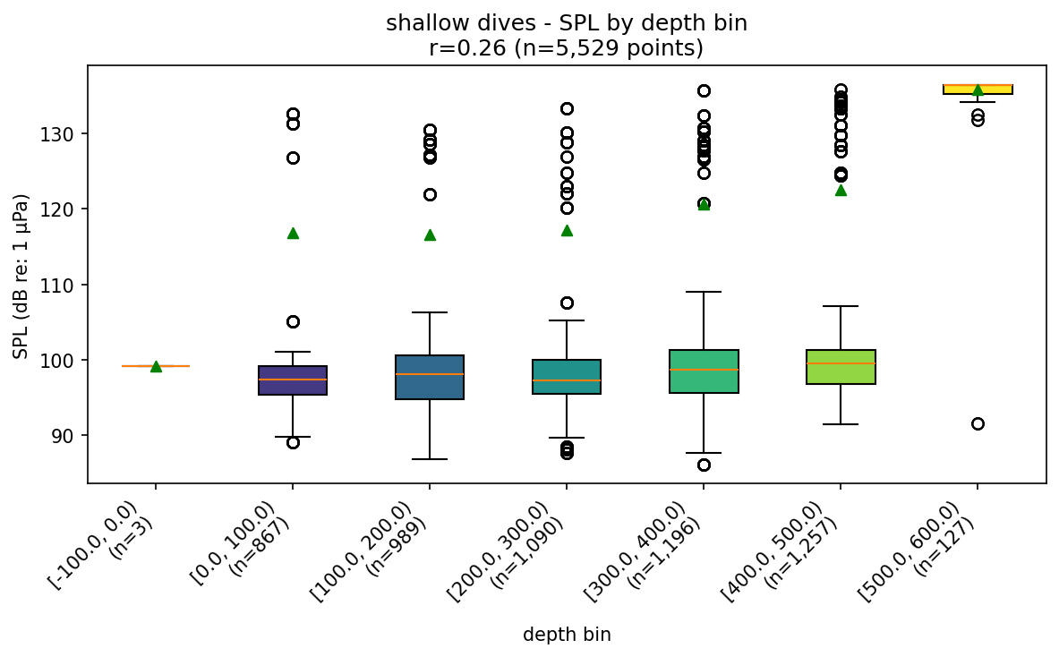
shallow dives - SPL by depth bin
Broadband SPL distribution during "shallow dives", split by depth bin (green triangles = energy mean). Title shows the real per-point Pearson r between raw depth and raw SPL for this mode.

Slide 53
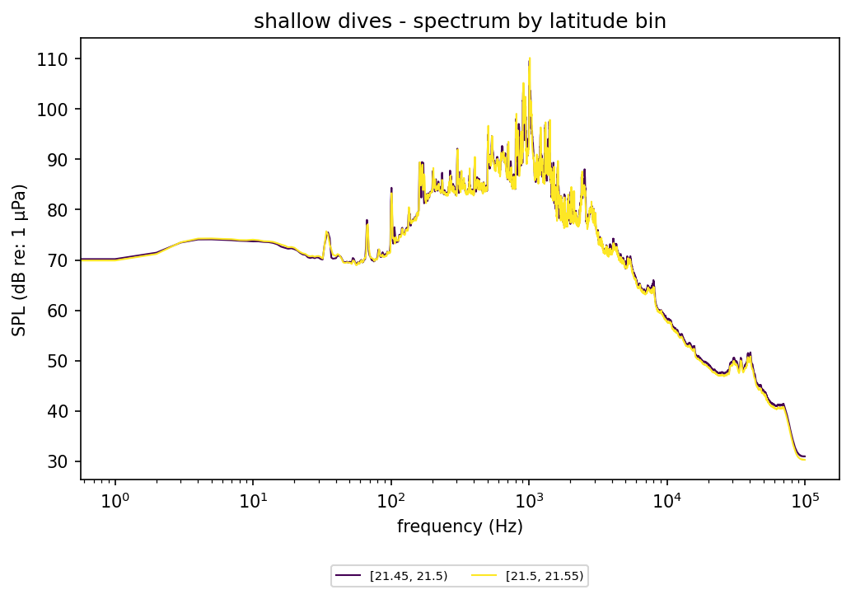
shallow dives - spectrum by latitude bin
Energy-mean noise spectrum during "shallow dives" (frequency, log scale, vs SPL), one line per latitude bin.

Slide 54
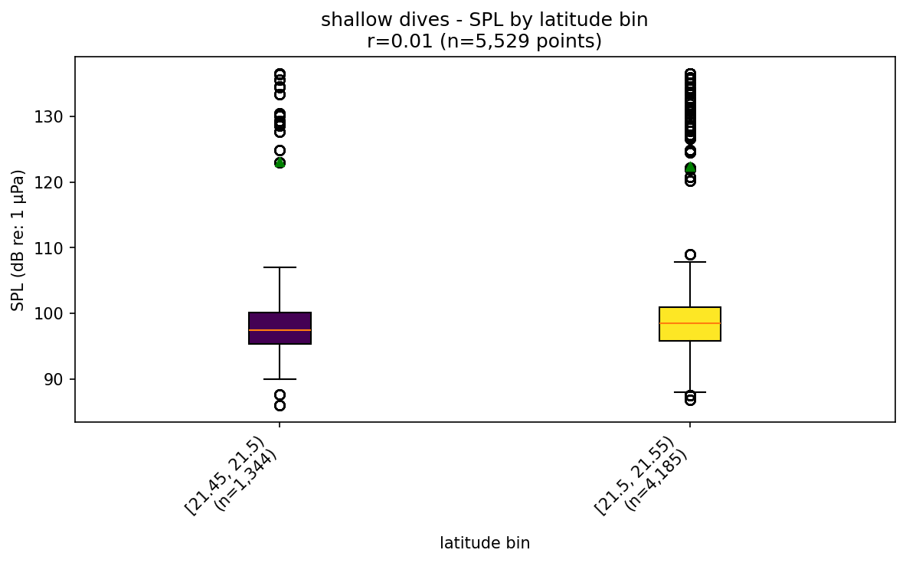
shallow dives - SPL by latitude bin
Broadband SPL distribution during "shallow dives", split by latitude bin (green triangles = energy mean). Title shows the real per-point Pearson r between raw latitude and raw SPL for this mode.

Slide 55
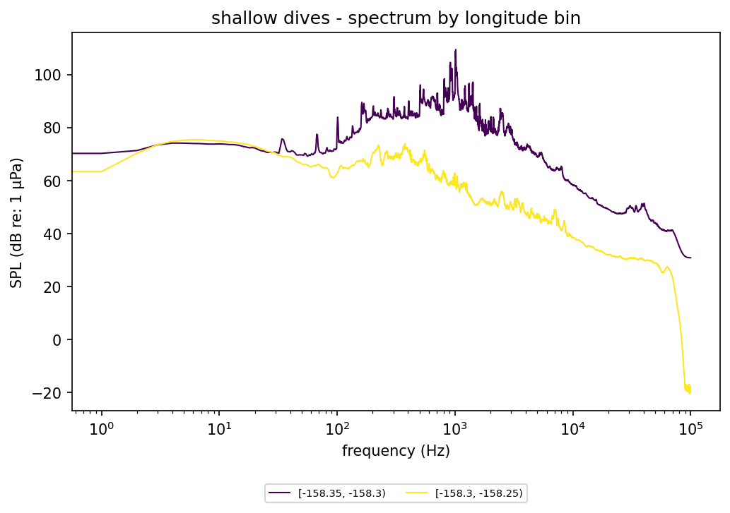
shallow dives - spectrum by longitude bin
Energy-mean noise spectrum during "shallow dives" (frequency, log scale, vs SPL), one line per longitude bin.

Slide 56
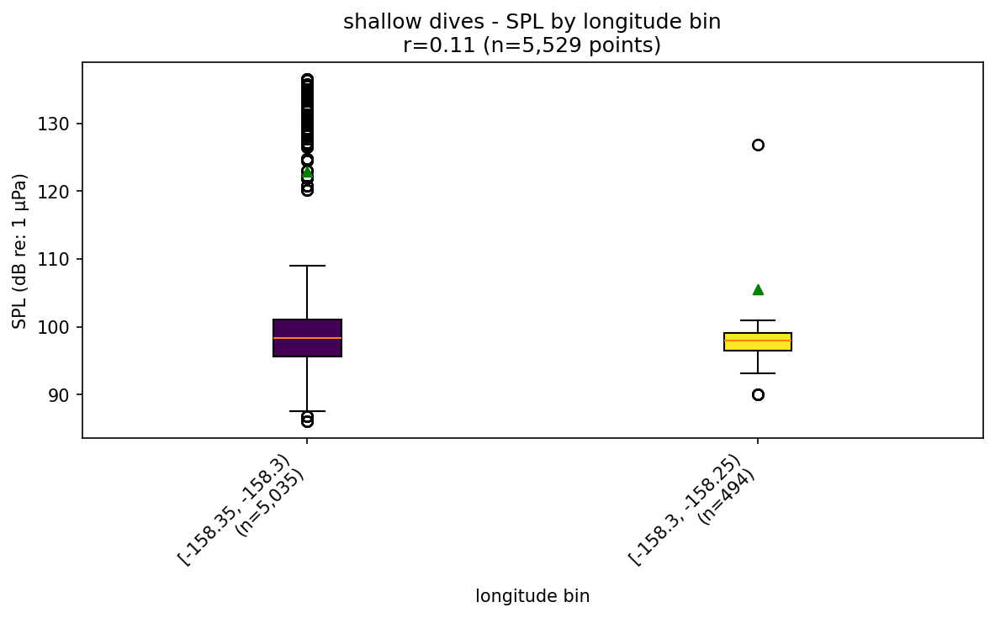
shallow dives - SPL by longitude bin
Broadband SPL distribution during "shallow dives", split by longitude bin (green triangles = energy mean). Title shows the real per-point Pearson r between raw longitude and raw SPL for this mode.

Slide 57
slow

Slide 58

slow - spectrum by temperature bin
Energy-mean noise spectrum during "slow" (frequency, log scale, vs SPL), one line per temperature bin.

Slide 59

slow - SPL by temperature bin
Broadband SPL distribution during "slow", split by temperature bin (green triangles = energy mean). Title shows the real per-point Pearson r between raw temperature and raw SPL for this mode.

Slide 60

slow - spectrum by salinity bin
Energy-mean noise spectrum during "slow" (frequency, log scale, vs SPL), one line per salinity bin.

Slide 61

slow - SPL by salinity bin
Broadband SPL distribution during "slow", split by salinity bin (green triangles = energy mean). Title shows the real per-point Pearson r between raw salinity and raw SPL for this mode.

Slide 62

slow - spectrum by density bin
Energy-mean noise spectrum during "slow" (frequency, log scale, vs SPL), one line per density bin.

Slide 63

slow - SPL by density bin
Broadband SPL distribution during "slow", split by density bin (green triangles = energy mean). Title shows the real per-point Pearson r between raw density and raw SPL for this mode.

Slide 64

slow - spectrum by soundVelocity bin
Energy-mean noise spectrum during "slow" (frequency, log scale, vs SPL), one line per soundVelocity bin.

Slide 65

slow - SPL by soundVelocity bin
Broadband SPL distribution during "slow", split by soundVelocity bin (green triangles = energy mean). Title shows the real per-point Pearson r between raw soundVelocity and raw SPL for this mode.

Slide 66

slow - spectrum by depth bin
Energy-mean noise spectrum during "slow" (frequency, log scale, vs SPL), one line per depth bin.

Slide 67

slow - SPL by depth bin
Broadband SPL distribution during "slow", split by depth bin (green triangles = energy mean). Title shows the real per-point Pearson r between raw depth and raw SPL for this mode.

Slide 68

slow - spectrum by latitude bin
Energy-mean noise spectrum during "slow" (frequency, log scale, vs SPL), one line per latitude bin.

Slide 69

slow - SPL by latitude bin
Broadband SPL distribution during "slow", split by latitude bin (green triangles = energy mean). Title shows the real per-point Pearson r between raw latitude and raw SPL for this mode.

Slide 70

slow - spectrum by longitude bin
Energy-mean noise spectrum during "slow" (frequency, log scale, vs SPL), one line per longitude bin.

Slide 71

slow - SPL by longitude bin
Broadband SPL distribution during "slow", split by longitude bin (green triangles = energy mean). Title shows the real per-point Pearson r between raw longitude and raw SPL for this mode.

Slide 72
intermediate

Slide 73

intermediate - spectrum by temperature bin
Energy-mean noise spectrum during "intermediate" (frequency, log scale, vs SPL), one line per temperature bin.

Slide 74

intermediate - SPL by temperature bin
Broadband SPL distribution during "intermediate", split by temperature bin (green triangles = energy mean). Title shows the real per-point Pearson r between raw temperature and raw SPL for this mode.

Slide 75

intermediate - spectrum by salinity bin
Energy-mean noise spectrum during "intermediate" (frequency, log scale, vs SPL), one line per salinity bin.

Slide 76

intermediate - SPL by salinity bin
Broadband SPL distribution during "intermediate", split by salinity bin (green triangles = energy mean). Title shows the real per-point Pearson r between raw salinity and raw SPL for this mode.

Slide 77

intermediate - spectrum by density bin
Energy-mean noise spectrum during "intermediate" (frequency, log scale, vs SPL), one line per density bin.

Slide 78

intermediate - SPL by density bin
Broadband SPL distribution during "intermediate", split by density bin (green triangles = energy mean). Title shows the real per-point Pearson r between raw density and raw SPL for this mode.

Slide 79

intermediate - spectrum by soundVelocity bin
Energy-mean noise spectrum during "intermediate" (frequency, log scale, vs SPL), one line per soundVelocity bin.

Slide 80

intermediate - SPL by soundVelocity bin
Broadband SPL distribution during "intermediate", split by soundVelocity bin (green triangles = energy mean). Title shows the real per-point Pearson r between raw soundVelocity and raw SPL for this mode.

Slide 81

intermediate - spectrum by depth bin
Energy-mean noise spectrum during "intermediate" (frequency, log scale, vs SPL), one line per depth bin.

Slide 82

intermediate - SPL by depth bin
Broadband SPL distribution during "intermediate", split by depth bin (green triangles = energy mean). Title shows the real per-point Pearson r between raw depth and raw SPL for this mode.

Slide 83

intermediate - spectrum by latitude bin
Energy-mean noise spectrum during "intermediate" (frequency, log scale, vs SPL), one line per latitude bin.

Slide 84

intermediate - SPL by latitude bin
Broadband SPL distribution during "intermediate", split by latitude bin (green triangles = energy mean). Title shows the real per-point Pearson r between raw latitude and raw SPL for this mode.

Slide 85

intermediate - spectrum by longitude bin
Energy-mean noise spectrum during "intermediate" (frequency, log scale, vs SPL), one line per longitude bin.

Slide 86

intermediate - SPL by longitude bin
Broadband SPL distribution during "intermediate", split by longitude bin (green triangles = energy mean). Title shows the real per-point Pearson r between raw longitude and raw SPL for this mode.

Slide 87
drift

Slide 88

drift - spectrum by temperature bin
Energy-mean noise spectrum during "drift" (frequency, log scale, vs SPL), one line per temperature bin.

Slide 89

drift - SPL by temperature bin
Broadband SPL distribution during "drift", split by temperature bin (green triangles = energy mean). Title shows the real per-point Pearson r between raw temperature and raw SPL for this mode.

Slide 90

drift - spectrum by salinity bin
Energy-mean noise spectrum during "drift" (frequency, log scale, vs SPL), one line per salinity bin.

Slide 91

drift - SPL by salinity bin
Broadband SPL distribution during "drift", split by salinity bin (green triangles = energy mean). Title shows the real per-point Pearson r between raw salinity and raw SPL for this mode.

Slide 92

drift - spectrum by density bin
Energy-mean noise spectrum during "drift" (frequency, log scale, vs SPL), one line per density bin.

Slide 93

drift - SPL by density bin
Broadband SPL distribution during "drift", split by density bin (green triangles = energy mean). Title shows the real per-point Pearson r between raw density and raw SPL for this mode.

Slide 94

drift - spectrum by soundVelocity bin
Energy-mean noise spectrum during "drift" (frequency, log scale, vs SPL), one line per soundVelocity bin.

Slide 95

drift - SPL by soundVelocity bin
Broadband SPL distribution during "drift", split by soundVelocity bin (green triangles = energy mean). Title shows the real per-point Pearson r between raw soundVelocity and raw SPL for this mode.

Slide 96

drift - spectrum by depth bin
Energy-mean noise spectrum during "drift" (frequency, log scale, vs SPL), one line per depth bin.

Slide 97

drift - SPL by depth bin
Broadband SPL distribution during "drift", split by depth bin (green triangles = energy mean). Title shows the real per-point Pearson r between raw depth and raw SPL for this mode.

Slide 98

drift - spectrum by latitude bin
Energy-mean noise spectrum during "drift" (frequency, log scale, vs SPL), one line per latitude bin.

Slide 99

drift - SPL by latitude bin
Broadband SPL distribution during "drift", split by latitude bin (green triangles = energy mean). Title shows the real per-point Pearson r between raw latitude and raw SPL for this mode.

Slide 100

drift - spectrum by longitude bin
Energy-mean noise spectrum during "drift" (frequency, log scale, vs SPL), one line per longitude bin.

Slide 101

drift - SPL by longitude bin
Broadband SPL distribution during "drift", split by longitude bin (green triangles = energy mean). Title shows the real per-point Pearson r between raw longitude and raw SPL for this mode.

Slide 102
mini-slow

Slide 103

mini-slow - spectrum by temperature bin
Energy-mean noise spectrum during "mini-slow" (frequency, log scale, vs SPL), one line per temperature bin.

Slide 104

mini-slow - SPL by temperature bin
Broadband SPL distribution during "mini-slow", split by temperature bin (green triangles = energy mean). Title shows the real per-point Pearson r between raw temperature and raw SPL for this mode.

Slide 105

mini-slow - spectrum by salinity bin
Energy-mean noise spectrum during "mini-slow" (frequency, log scale, vs SPL), one line per salinity bin.

Slide 106

mini-slow - SPL by salinity bin
Broadband SPL distribution during "mini-slow", split by salinity bin (green triangles = energy mean). Title shows the real per-point Pearson r between raw salinity and raw SPL for this mode.

Slide 107

mini-slow - spectrum by density bin
Energy-mean noise spectrum during "mini-slow" (frequency, log scale, vs SPL), one line per density bin.

Slide 108

mini-slow - SPL by density bin
Broadband SPL distribution during "mini-slow", split by density bin (green triangles = energy mean). Title shows the real per-point Pearson r between raw density and raw SPL for this mode.

Slide 109

mini-slow - spectrum by soundVelocity bin
Energy-mean noise spectrum during "mini-slow" (frequency, log scale, vs SPL), one line per soundVelocity bin.

Slide 110

mini-slow - SPL by soundVelocity bin
Broadband SPL distribution during "mini-slow", split by soundVelocity bin (green triangles = energy mean). Title shows the real per-point Pearson r between raw soundVelocity and raw SPL for this mode.

Slide 111

mini-slow - spectrum by depth bin
Energy-mean noise spectrum during "mini-slow" (frequency, log scale, vs SPL), one line per depth bin.

Slide 112

mini-slow - SPL by depth bin
Broadband SPL distribution during "mini-slow", split by depth bin (green triangles = energy mean). Title shows the real per-point Pearson r between raw depth and raw SPL for this mode.

Slide 113

mini-slow - spectrum by latitude bin
Energy-mean noise spectrum during "mini-slow" (frequency, log scale, vs SPL), one line per latitude bin.

Slide 114

mini-slow - SPL by latitude bin
Broadband SPL distribution during "mini-slow", split by latitude bin (green triangles = energy mean). Title shows the real per-point Pearson r between raw latitude and raw SPL for this mode.

Slide 115

mini-slow - spectrum by longitude bin
Energy-mean noise spectrum during "mini-slow" (frequency, log scale, vs SPL), one line per longitude bin.

Slide 116

mini-slow - SPL by longitude bin
Broadband SPL distribution during "mini-slow", split by longitude bin (green triangles = energy mean). Title shows the real per-point Pearson r between raw longitude and raw SPL for this mode.

Slide 117
mini-intermediate

Slide 118

mini-intermediate - spectrum by temperature bin
Energy-mean noise spectrum during "mini-intermediate" (frequency, log scale, vs SPL), one line per temperature bin.

Slide 119

mini-intermediate - SPL by temperature bin
Broadband SPL distribution during "mini-intermediate", split by temperature bin (green triangles = energy mean). Title shows the real per-point Pearson r between raw temperature and raw SPL for this mode.

Slide 120

mini-intermediate - spectrum by salinity bin
Energy-mean noise spectrum during "mini-intermediate" (frequency, log scale, vs SPL), one line per salinity bin.

Slide 121

mini-intermediate - SPL by salinity bin
Broadband SPL distribution during "mini-intermediate", split by salinity bin (green triangles = energy mean). Title shows the real per-point Pearson r between raw salinity and raw SPL for this mode.

Slide 122

mini-intermediate - spectrum by density bin
Energy-mean noise spectrum during "mini-intermediate" (frequency, log scale, vs SPL), one line per density bin.

Slide 123

mini-intermediate - SPL by density bin
Broadband SPL distribution during "mini-intermediate", split by density bin (green triangles = energy mean). Title shows the real per-point Pearson r between raw density and raw SPL for this mode.

Slide 124

mini-intermediate - spectrum by soundVelocity bin
Energy-mean noise spectrum during "mini-intermediate" (frequency, log scale, vs SPL), one line per soundVelocity bin.

Slide 125

mini-intermediate - SPL by soundVelocity bin
Broadband SPL distribution during "mini-intermediate", split by soundVelocity bin (green triangles = energy mean). Title shows the real per-point Pearson r between raw soundVelocity and raw SPL for this mode.

Slide 126

mini-intermediate - spectrum by depth bin
Energy-mean noise spectrum during "mini-intermediate" (frequency, log scale, vs SPL), one line per depth bin.

Slide 127

mini-intermediate - SPL by depth bin
Broadband SPL distribution during "mini-intermediate", split by depth bin (green triangles = energy mean). Title shows the real per-point Pearson r between raw depth and raw SPL for this mode.

Slide 128

mini-intermediate - spectrum by latitude bin
Energy-mean noise spectrum during "mini-intermediate" (frequency, log scale, vs SPL), one line per latitude bin.

Slide 129

mini-intermediate - SPL by latitude bin
Broadband SPL distribution during "mini-intermediate", split by latitude bin (green triangles = energy mean). Title shows the real per-point Pearson r between raw latitude and raw SPL for this mode.

Slide 130

mini-intermediate - spectrum by longitude bin
Energy-mean noise spectrum during "mini-intermediate" (frequency, log scale, vs SPL), one line per longitude bin.

Slide 131

mini-intermediate - SPL by longitude bin
Broadband SPL distribution during "mini-intermediate", split by longitude bin (green triangles = energy mean). Title shows the real per-point Pearson r between raw longitude and raw SPL for this mode.

Slide 132
mini-fast

Slide 133

mini-fast - spectrum by temperature bin
Energy-mean noise spectrum during "mini-fast" (frequency, log scale, vs SPL), one line per temperature bin.

Slide 134

mini-fast - SPL by temperature bin
Broadband SPL distribution during "mini-fast", split by temperature bin (green triangles = energy mean). Title shows the real per-point Pearson r between raw temperature and raw SPL for this mode.

Slide 135

mini-fast - spectrum by salinity bin
Energy-mean noise spectrum during "mini-fast" (frequency, log scale, vs SPL), one line per salinity bin.

Slide 136

mini-fast - SPL by salinity bin
Broadband SPL distribution during "mini-fast", split by salinity bin (green triangles = energy mean). Title shows the real per-point Pearson r between raw salinity and raw SPL for this mode.

Slide 137

mini-fast - spectrum by density bin
Energy-mean noise spectrum during "mini-fast" (frequency, log scale, vs SPL), one line per density bin.

Slide 138

mini-fast - SPL by density bin
Broadband SPL distribution during "mini-fast", split by density bin (green triangles = energy mean). Title shows the real per-point Pearson r between raw density and raw SPL for this mode.

Slide 139

mini-fast - spectrum by soundVelocity bin
Energy-mean noise spectrum during "mini-fast" (frequency, log scale, vs SPL), one line per soundVelocity bin.

Slide 140

mini-fast - SPL by soundVelocity bin
Broadband SPL distribution during "mini-fast", split by soundVelocity bin (green triangles = energy mean). Title shows the real per-point Pearson r between raw soundVelocity and raw SPL for this mode.

Slide 141

mini-fast - spectrum by depth bin
Energy-mean noise spectrum during "mini-fast" (frequency, log scale, vs SPL), one line per depth bin.

Slide 142

mini-fast - SPL by depth bin
Broadband SPL distribution during "mini-fast", split by depth bin (green triangles = energy mean). Title shows the real per-point Pearson r between raw depth and raw SPL for this mode.

Slide 143

mini-fast - spectrum by latitude bin
Energy-mean noise spectrum during "mini-fast" (frequency, log scale, vs SPL), one line per latitude bin.

Slide 144

mini-fast - SPL by latitude bin
Broadband SPL distribution during "mini-fast", split by latitude bin (green triangles = energy mean). Title shows the real per-point Pearson r between raw latitude and raw SPL for this mode.

Slide 145

mini-fast - spectrum by longitude bin
Energy-mean noise spectrum during "mini-fast" (frequency, log scale, vs SPL), one line per longitude bin.

Slide 146

mini-fast - SPL by longitude bin
Broadband SPL distribution during "mini-fast", split by longitude bin (green triangles = energy mean). Title shows the real per-point Pearson r between raw longitude and raw SPL for this mode.

