Slide 1
NMM mobile app

Slide 2
App is proposed into two parts
Dynamic approach: Using PHP services for dynamic event creation.
Non dynamic approach: Hardcode events in mobile database.

Slide 3
Dynamic approach architecture
The web
getEvents [Request]
getEvents [Request]
Database
NMM App
API Service
getEvents [Response]
getEvents [Response]

Slide 4
Non dynamic approach
getEvents [Request]
Database
Platform
getEvents [Response]

Slide 5
Difference between two
Dynamic approach
Non dynamic approach
Admin has control of creating and deleting events, this is on the fly.
You can change event images, contents on the fly.
No need to write extra code unless there is a new feature request in the admin portal
Need SSL for security for the services and data being transferred on the network.
The admin portal needs to be secured using tools available in PHP for security or token management and few tables needs to be created in mySQL for logging purpose.
Cost would be required to renew SSL’s every year.
In upcoming releases we can use this model for push notifications for any events, newsletters etc
Admin has to request developer and developer has to re-upload app for new event to reflect which will take 2 days.
Any changes whatsoever has to go through development and testing team and then management team for final blessings and then release to app/play store.
For small updates we need to write code and then upload it to play store for approval which may take day or two to reflect new changes.
No SSL required.
No admin portal required
No SSL required so no cost here
We would need SSL anyways to support push notifications.

Slide 6
Dynamic approach
We can use the foundation of the dynamic approach for our NMM website as well and let the admin handle everything than the development team.
We can launch the non-dynamic one for now and see how the crowd responds to it and then X months later take a decision on how we want to proceed with this approach.
OR

Slide 7
Development work pending to achieve dynamic approach
SSL certification purchase
Webservice deployment on server
Testing the services which are deployed on the server
Integrating a final development check
Testing and bug fixes
Releasing builds to management team
Production release to google play and apple app store.

Slide 8
Development work pending to achieve Non-dynamic approach
Creating the mobile database with pre-baked events and images
Integrating a final development check
Testing and bug fixes
Releasing builds to management team
Production release to google play and apple app store.

Slide 9
Need a date on when we can release the app
The basic feature of the app is ready we can go live with that.
We can also keep on adding features on the fly once we release the basic version.
The app is just waiting on a final decision on SSL.
The app can also be released without SSL it’s just how we want it as given by the benefits of both the approaches.
The app is compatible with tablets and phones.

Slide 10
Questions and critics are always welcome
Thank you for your time today, hope I was able to answer your questions on the mobile app and we can close this at the earliest and release it to our NMM family.

Slide 11
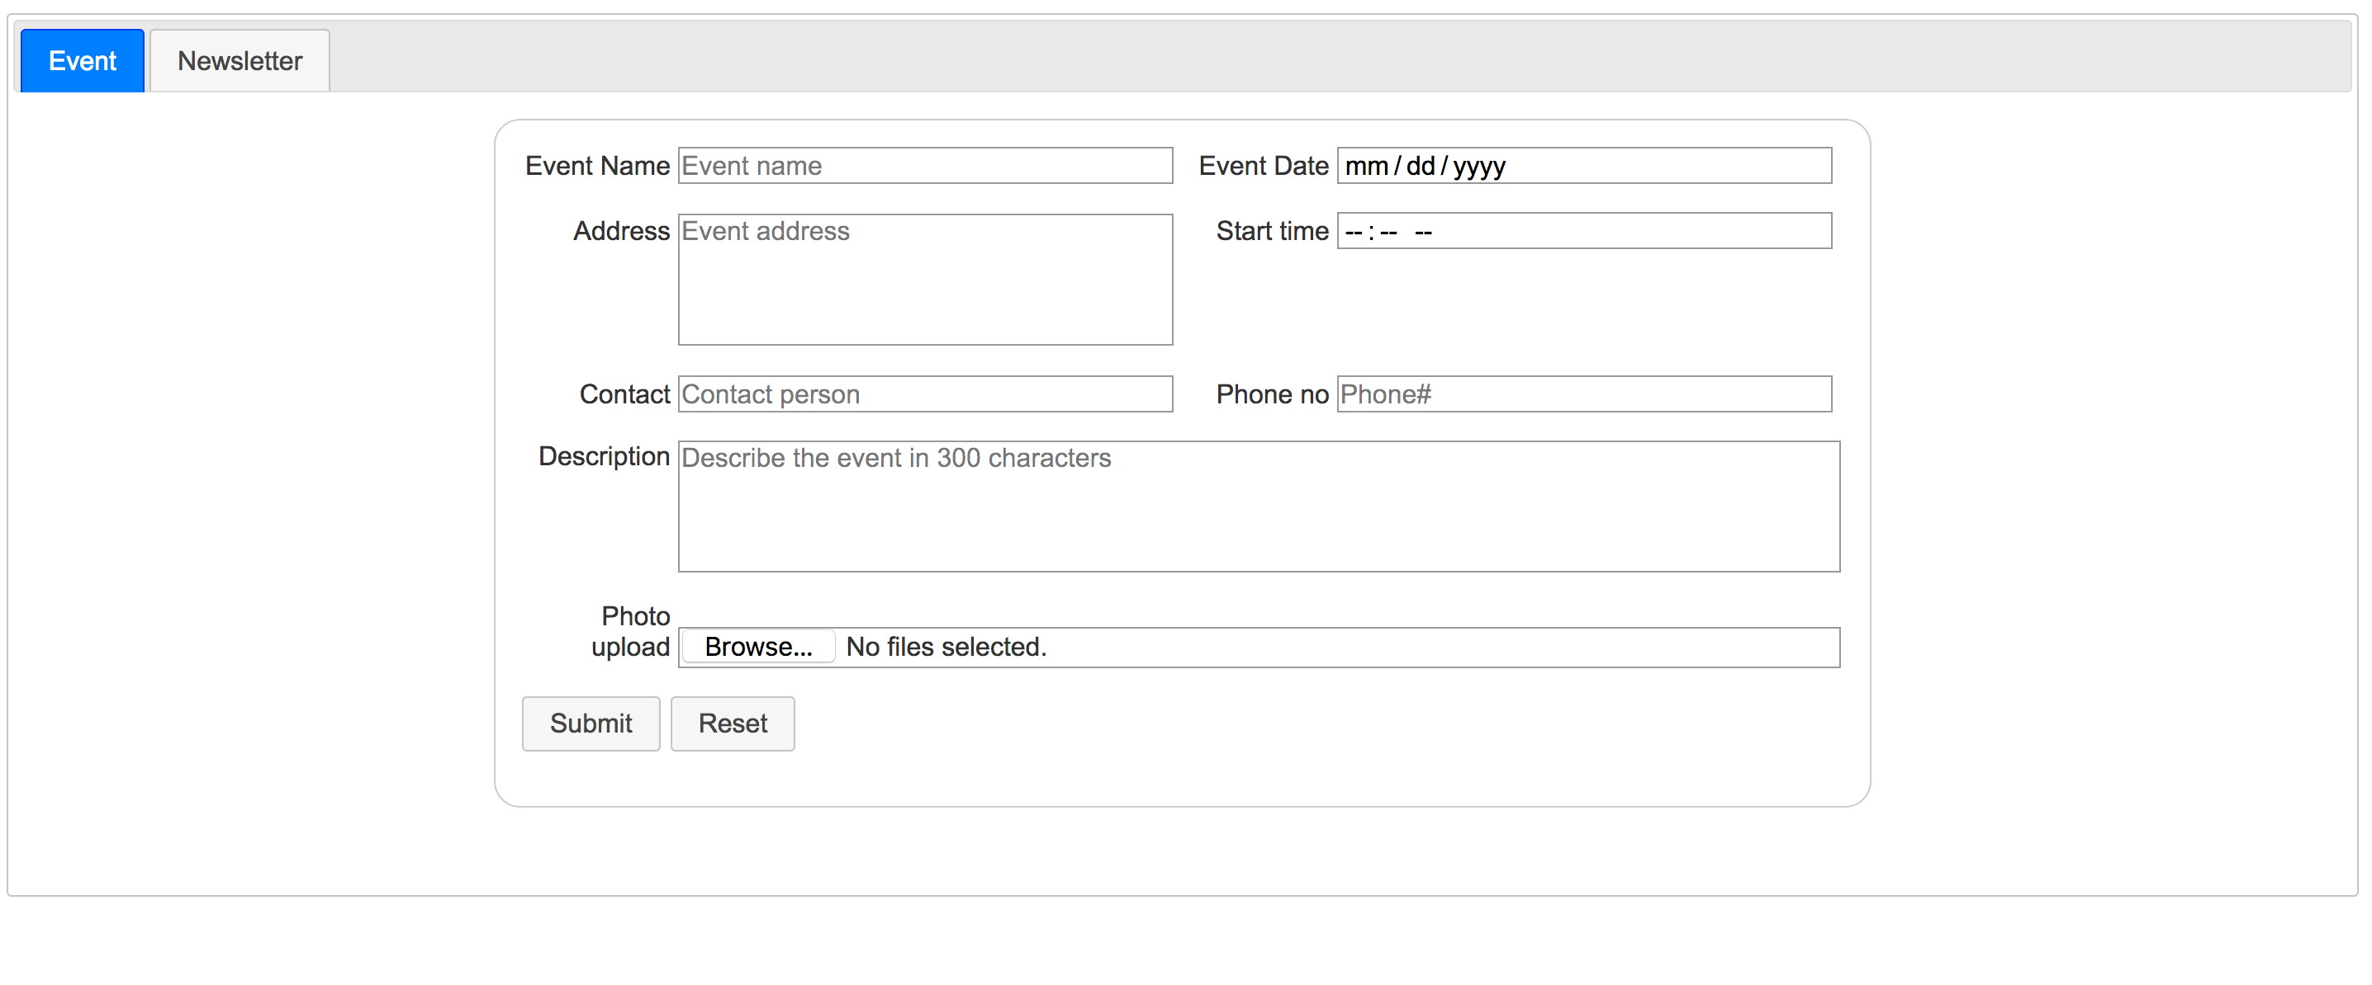
Admin portal view

Slide 12
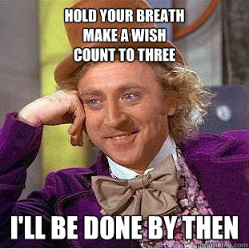
Demo of the NMM app

