Slide 1
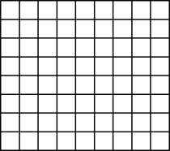
A. Course scale
B. Fine scale
Low quality
High
quality

