Slide 1
CS374 Project
Prof. Madhukant Sharma
201801224 Jigar Zanzarukiya
201801438 Hiren Chaudhary
201801439 Naman Dave
201801443 Deep Patel

Slide 2
Problem 1: Newton Raphson Method, Finding extreme points of a function, then methods to find maxima and minima explicitly, and then implementing Gradient Descent using Newton Raphson Method (Matlab): Newton Raphson Method is used to find roots of a function by iterative manner, we can use the same technique to find maxima or minima of a function. Furthermore, we can also modify this method to find only the minima as well as the maxima. And then onwards we implement the most widely used optimizer for DL newralnets, i.e. Gradient Descent which is also a slight change in Newton Raphson Method with a few assumptions and some additional parameters which are called as hyperparameters.
I) find extreme point, modification in newton method to find an extreme point (f’ = 0)
Here, the extreme point could be a local/global maxima/minima
II) find local maxima and minima by modifying newton’s method
III) Further modification of problem II to implement gradient descent

Slide 3
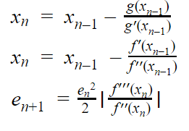
I) find extreme point, modification in newton method to find an extreme point (f’ = 0)
An extreme point is a point where f’ vanishes
We take g = f’ and find roots of g using newton’s method,
Implementing newton’s method, we get
Here, the extreme point could be a local/global maxima/minima

Slide 4
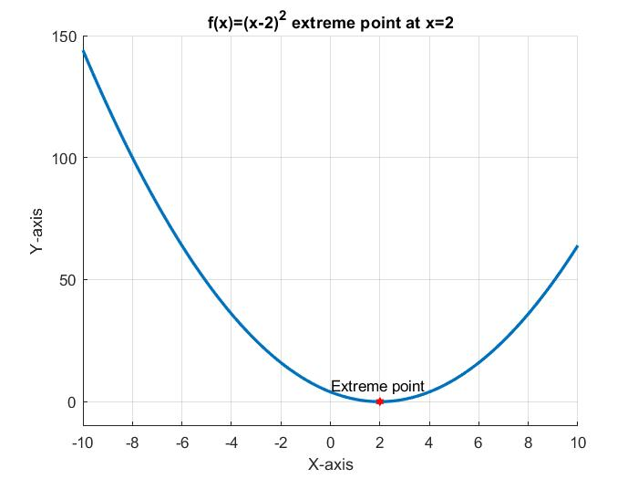

Extreme point example 1
Range of x is [-10 10].
Extreme point at x = 2.

Slide 5
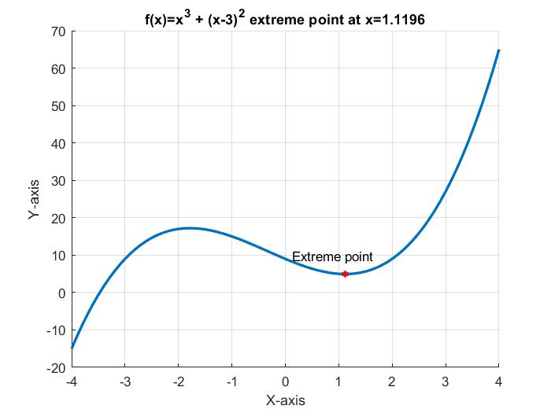

Extreme point
Example 2
Range of x is [-4 4].
Extreme point at x = 1.1196.

Slide 6


II) find local maxima and minima by modifying newton’s method
For local minima, we can use
For local maxima, we can use

Slide 7
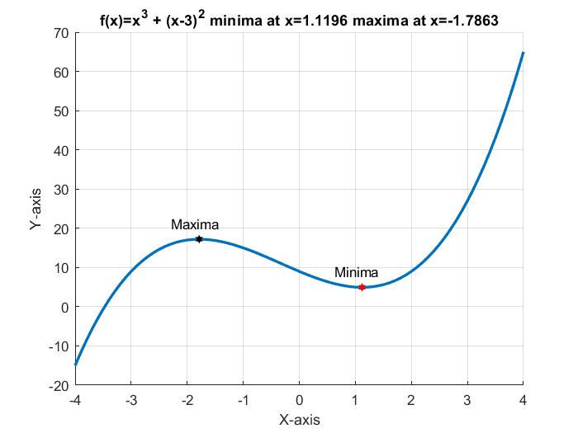

Maxima and Minima explicitly
Range of x is [-4 to 4].
Minima at x = 1.1196.
Maxima at x = -1.7863

Slide 8

III) Further modification of problem II to implement gradient descent
For Gradient descent algorithm,
Where LR is called Learning Rate which controls step size.

Slide 9
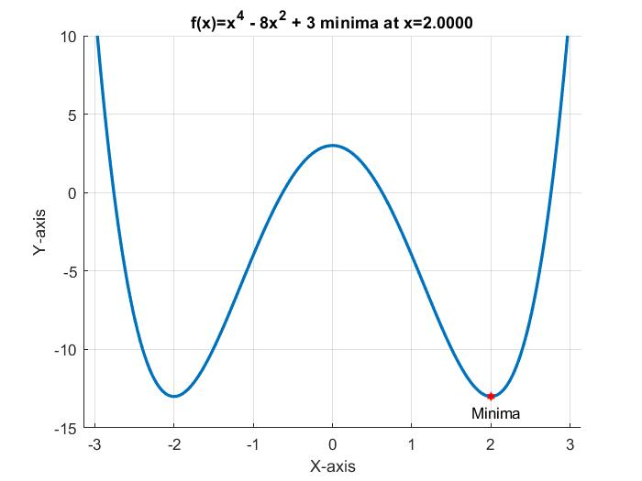

Gradient Descent example
vf
Range of x is [-3 3].
Initial value of x is 0.01.
Algorithm terminate at x = 2.0 which is local minima.

Slide 10
Problem 2: F1 race car tuning (Using Secant Method): Racing isn’t just speed, however it is the most important when the road is straight but in normal F1 races the roads are curvy. So the car’s efficiency also depends upon two other factors; 1) Acceleration, 2) Handling. Now an F1 race car is finely tuned when the max-speed efficiency equals the handling efficiency times 10 plus acceleration times 0.23. Our goal is to find the point where the tuning happens (if multiple tuning points then find the optimum one) (Matlab). As the efficiency curves’ function may not be differentiable at all the points, so we can not user methods involving derivatives, therefore we use Secant Method
Here, we have functions for max-speed, acceleration and handling, the tuning point is where the maximum speed equals 10 times handling and 0.23 times acceleration, for that we need to find zeros of
f = max-speed - 0.23 acceleration - 10 handling, the functions are mentioned in further slides. The optimal tuning point is the maximum of all the tuning points.

Slide 11
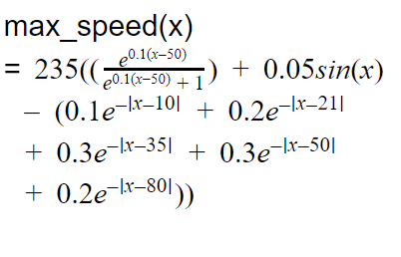
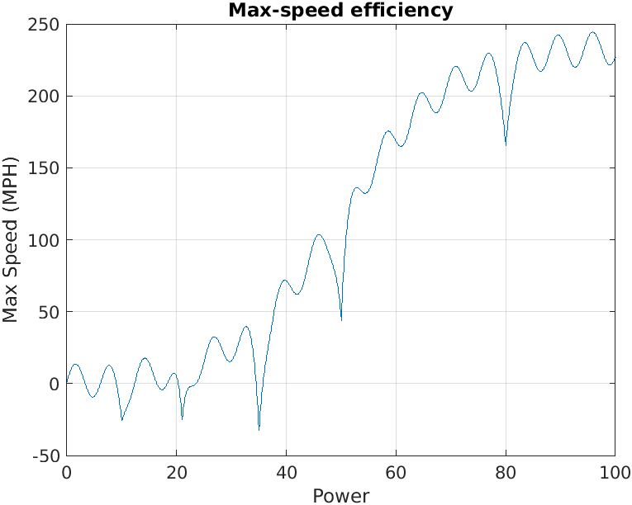
max-speed efficiency function

Slide 12
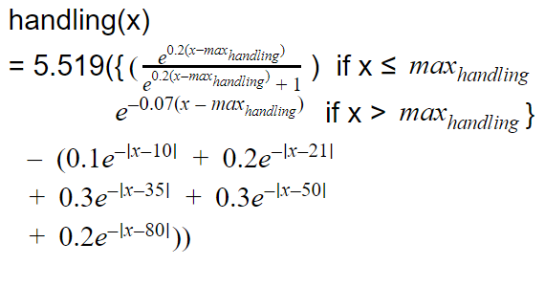
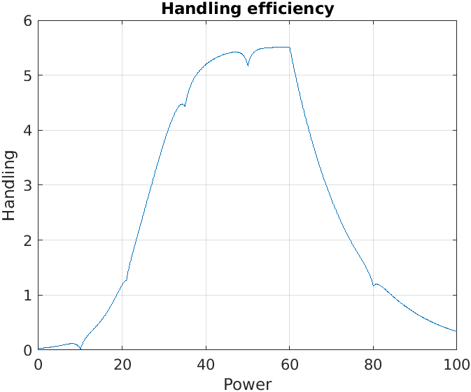
Handling efficiency function

Slide 13
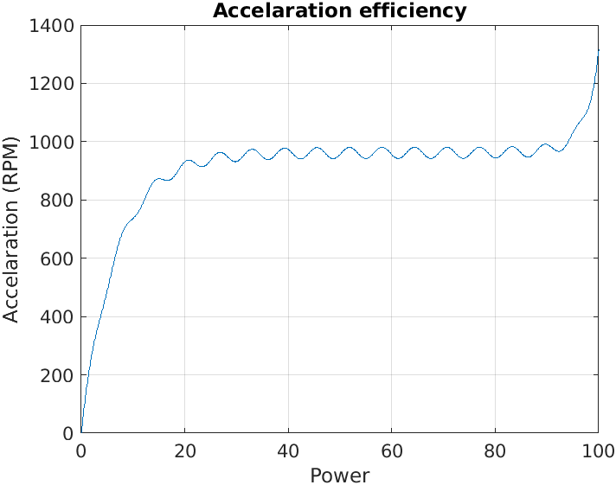
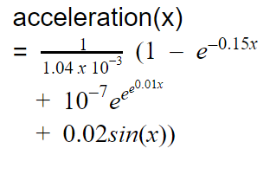

Slide 14
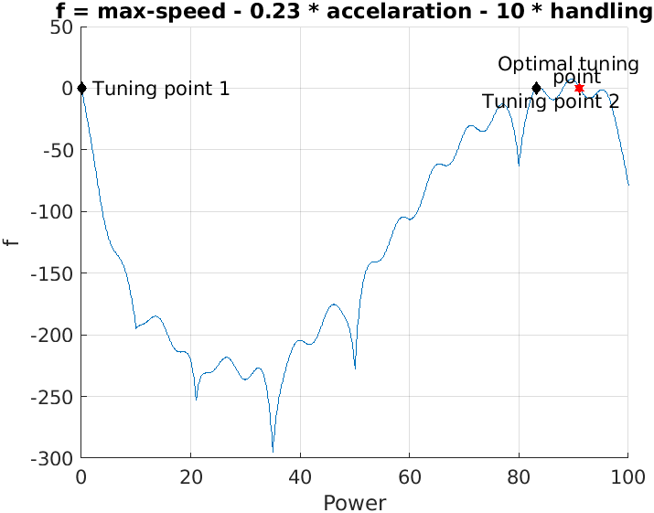
f(x) = max-speed(x) - 0.23 acceleration(x) - 10 handling(x)
Optimal Tuning Point : 91.1207
Tuning Point 1 : 0.0497
Tuning Point 2 : 83.2633

Slide 15
Problem 3: Comparison of Polynomial Interpolation (Lagrange and Newton’s interpolation) and Polynomial Regression by accuracy, sensitivity and other comparison matrices: Comparison of completely fitting curve vs. best fitting hyperplane (Python: ML). First we consider some data points and we fit our polynomial using these methods and then we predict the datapoint with a given set of attributes that will give us the accuracy. Also adding errors will give the approx idea about the sensitivity of methods.(Error Used: Summed Squared Error)

Slide 16
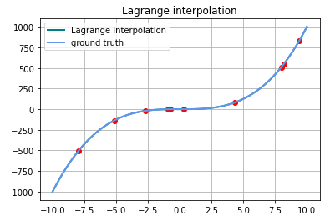
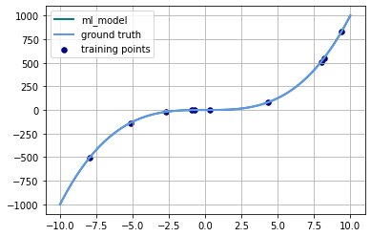
Randomized coefficients of polynomial:
Random_coffs: 0.64442979 0.46303623 -1.1214624
Lagrange interpolation error is: 3.4784069720843e-21
Polynomial regression is :1.5406403549548525e-24

Slide 17
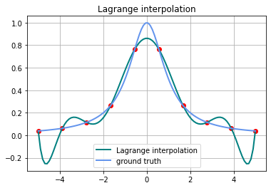
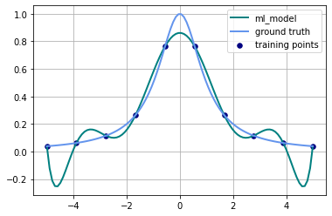
Func(x) = 1/(1 + x^2), has infinite degrees
Lagrange interpolation error is : 1.1888696081316732
polynomial regression is : 1.188869608122818
Lagrange error is 8.855138844410249e-12 more than Poly-regression

Slide 18
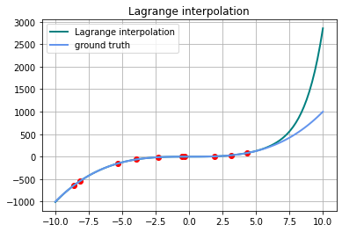

Error Sensitivity:
We add some error in y values. The interpolation gives more error than polynomial regression. Polynomial regression is more immune to error and interpolation is more prone to the slight error
Lagrange interpolation error is : 10922229.878232282
polynomial regression is : 0.0870671028771425

Slide 19
Conclusion: Interpolation techniques tend to completely fit the data points, when the polynomial regression without regularization tend to overfit the data points and polynomial regression with regularization fits to the data points optimally. As the new points are added for testing, the interpolation may or may not give accurate results as compared to the Polynomial Regression. The polynomial regression is more immune to the error as it removes the errors and fits the best towards the actual result/polynomial.

Slide 20
Problem 4: Cholesky Decomposition Compression of a symmetric matrix vs. splitting compression of symmetric matrix. Computational time comparison using GPU operations (Matlab/Python: GPU): Compression of a symmetric matrix can be done using two methods; 1) Cholesky Decomposition, 2) Consider only the lower triangle with diagonal (Splitting). Now retrieving original matrices, we have one method for the Cholesky Decomposition which is to perform matrix multiplication. While retrieving splitted matrix, we have three methods; 1) Two Loops, 2) Add matrix with its transpose and half the diagonal, 3) Decompose the compressed matrix with two matrices; a lower triangle matrix with zeros on diagonal and a diagonal matrix. Add the lower triangular matrix with its transpose and add the diagonal matrix. Now the main performance criteria we consider here is the time taken by these methods, because the time taken also depends upon the hardware selection, as the Cholesky decomposition takes GPU/TPU as a primary hardware which is optimized for matrix multiplications and the rest may or may not use GPU, our goal is to compare all the methods on retrieving time and give the final results.

Slide 21
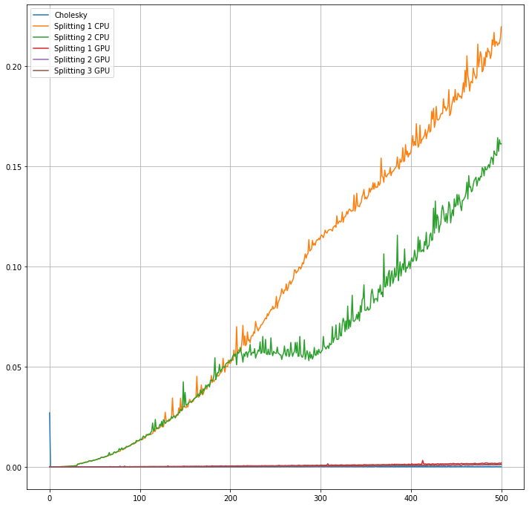
Cholesky reconstruction, CPU without time optimization, with Numpy GPU

Slide 22
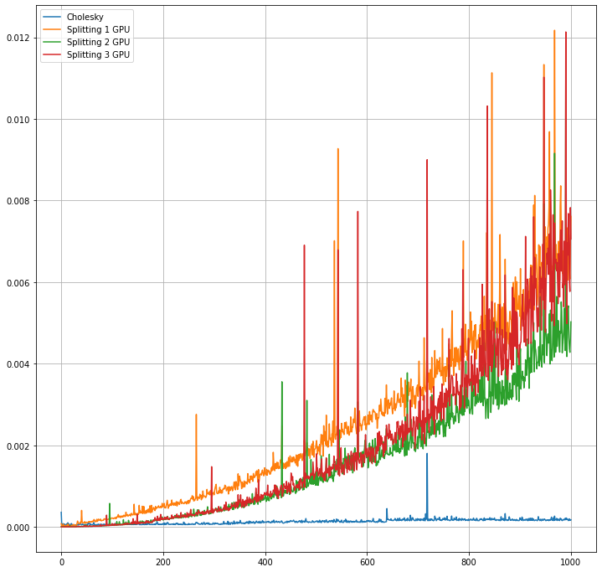
Cholesky and Numpy GPU optimization

Slide 23
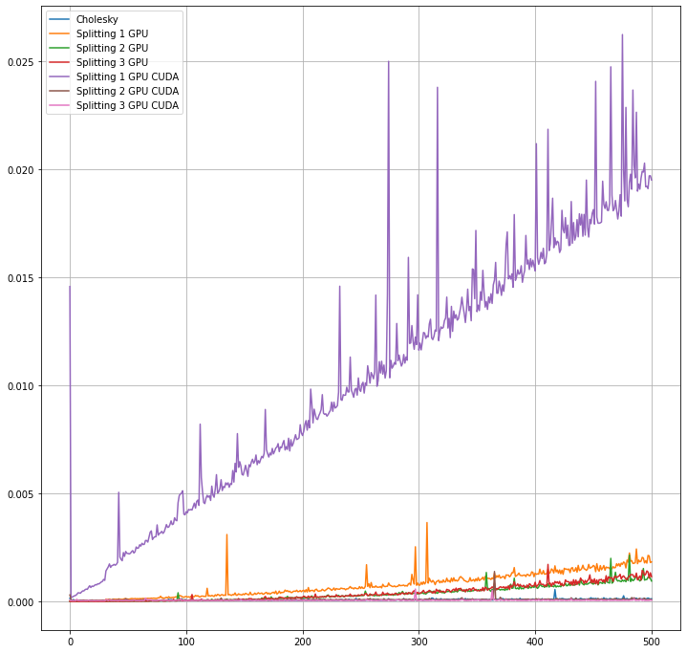
Cholesky, Partial CPU/GPU, Numpy GPU, and CUDA pytorch GPU
Splitting 1 GPU CUDA is partial CPU/GPU

Slide 24
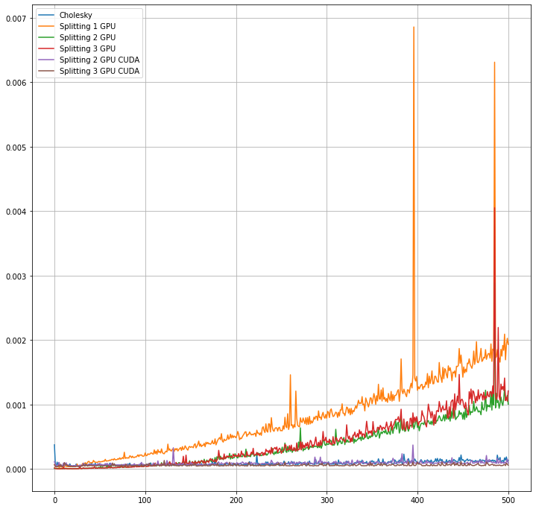
Cholesky and Numpy GPU and CUDA NVIDIA GPU time comparison

Slide 25
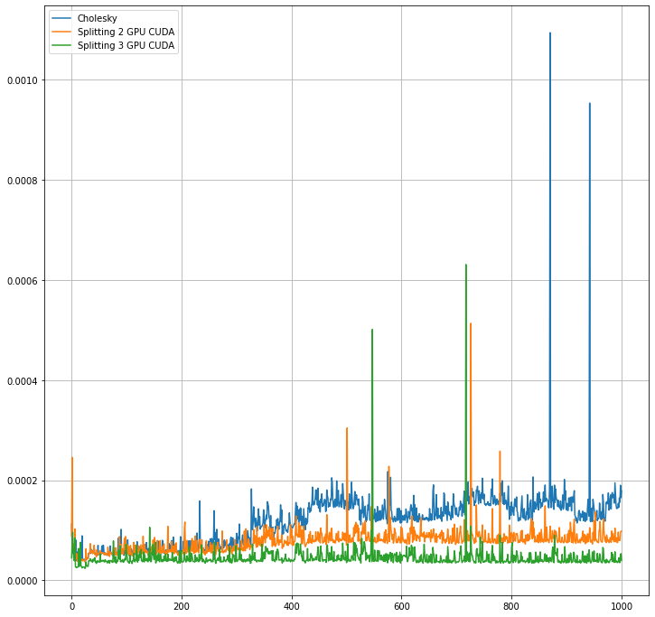
Cholesky and Splitting on GPU CUDA(NVIDIA)

Slide 26
Conclusion:
CPU operation takes more time than GPU. So it is efficient to use cholesky on CUDA GPU than Splitting matrices on CPU even with Numpy GPU.
Now the splitting matrices function can be converted to GPU operations and due to very high amount of cores in CUDA, it takes almost constant time to finish the task (200 microsecs for 1000 x 1000 SPD) with too much speed.

Slide 27
Problem 5 : Applications of various numerical integration methods(Random Interval Riemann sum / Riemann integration, Simpson's method, Trapezoidal method) and comparing their accuracies by using these methods on some crazy integrals.
Part 1 : Obtaining the value of omega constant Ω.
Part 2 : Using the value of π, get the value of e and compare these algorithms' error and efficiency.

Slide 28



Part 1 : Obtaining the value of omega constant Ω.
or
Value of Ω
Using Riemann sum/integration: 0.567143
Using Simpson's integration: 0.000000
Using Trapezoidal integration: 0.567143

Slide 29
Observation:
Simpsons integration could not provide the answers and the rest could.
The reason can be that the function includes complex numbers for the integrations and there we can not use Simpson's integration.

Slide 30
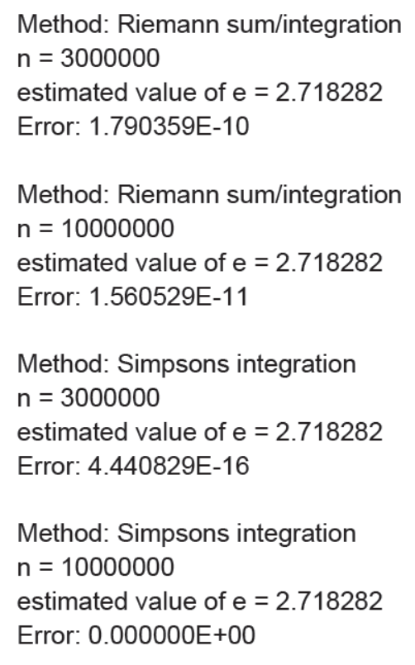

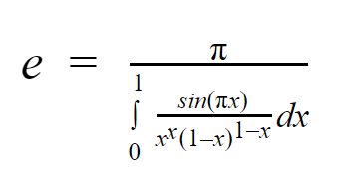
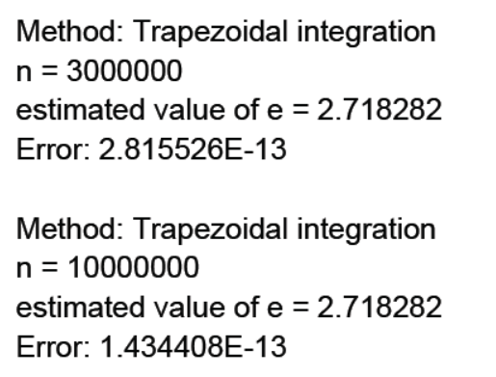
Part 2 Using the value of π, get the value of e and compare these algorithms' error and efficiency.

Slide 31
Observation :
Simpson's method is fast and accurate than any other method but it is much more sensitive as we have seen in the first problem, it could not converge to the actual answer because it involved complex numbers in integrations.
The most stable method for integration is the Random Interval Riemann Sum or Riemann Integration.
The Trapezoidal integration method is the intermediate of the Simpsons method and Riemann integration with random intervals in terms of stability, accuracy.

