Slide 1



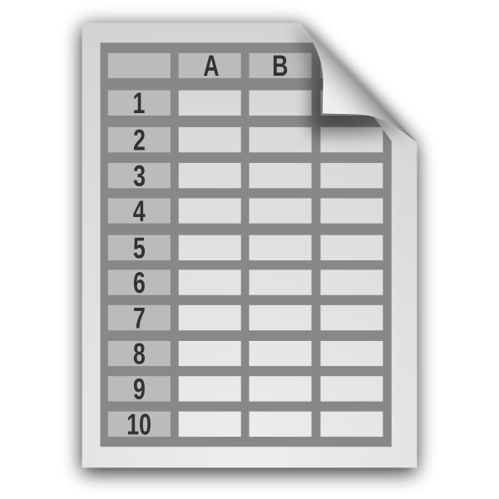

Workflow Overview
DNA sequence data (Illumina)
ASSEMBLE
ANNOTATE
EXPORT
QC sequence data
Assemble mitogenome
Circularize
Calculate coverage
BLAST
Identify gene regions
Automatic and manual curation
Flag problematic samples/annotations
Group samples
Final quality checks
Create sequence FASTA files + GFFs
Generate GenBank submission files
Submit to GenBank
OR
User-generated assemblies and (optionally) annotations
>Sample1
ATCCTTTACTGACTGACCCCCTTATCG
circular mitogenome
genes
> Sample1 NAD1
ATGACTTCTAATCTCCTTACTCACCTA
Sample metadata
fastp, GetOrganelle, MitoFinder, bowtie2
MITOS2, tRNAscan-SE, MitoFinder, ARWEN, ARAGORN, ORFfinder
>Feature Sample1
2729 3709 gene
gene nad1

