Slide 1
Title: Video Prediction Models as Image Encoders
Members: Jay Maier (MS Robotics, CMU)
Nishanth Mohankumar (MS Artificial Intelligence, CMU)
https://github.com/NMOHANK1999/VPT

Slide 2
200 Tb: Internet Video Data Generated Daily¹
32 Gb: MS COCO Dataset
¹https://explodingtopics.com/blog/data-generated-per-day

Slide 3

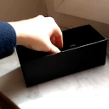
Video Prediction Models as General Visual Encoders
Key Idea: In order to generate accurate video from a single frame, a model must encode:
Instance segmentation (i.e. what might move)
Relative depth (i.e. what will be occluded)
Instance classification (i.e. how will this object change)
Our Goal: Use open-source video prediction model as encoder, train lightweight decoder to adapt latent representation to downstream tasks

Slide 4
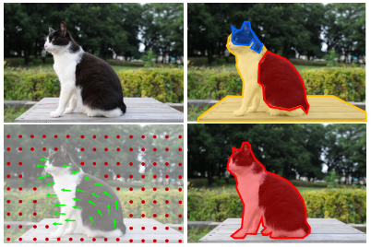
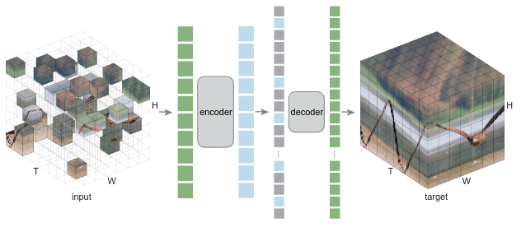
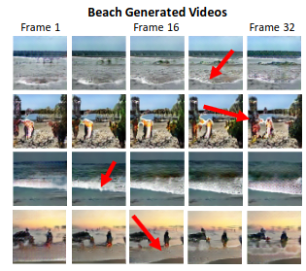
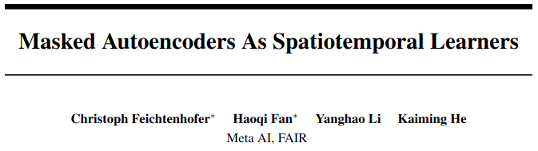
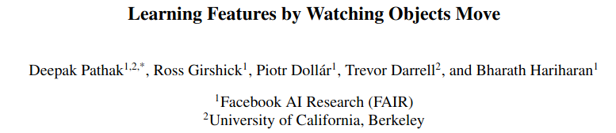
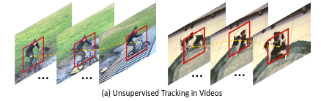
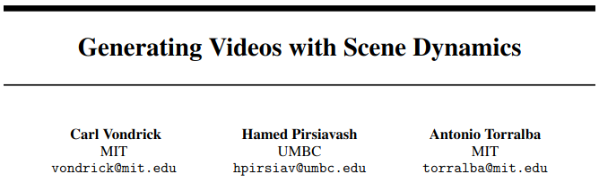
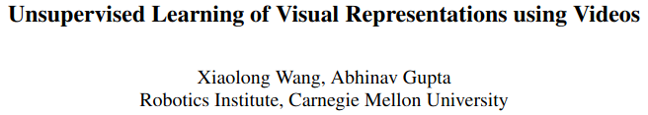
Related Work

Slide 5
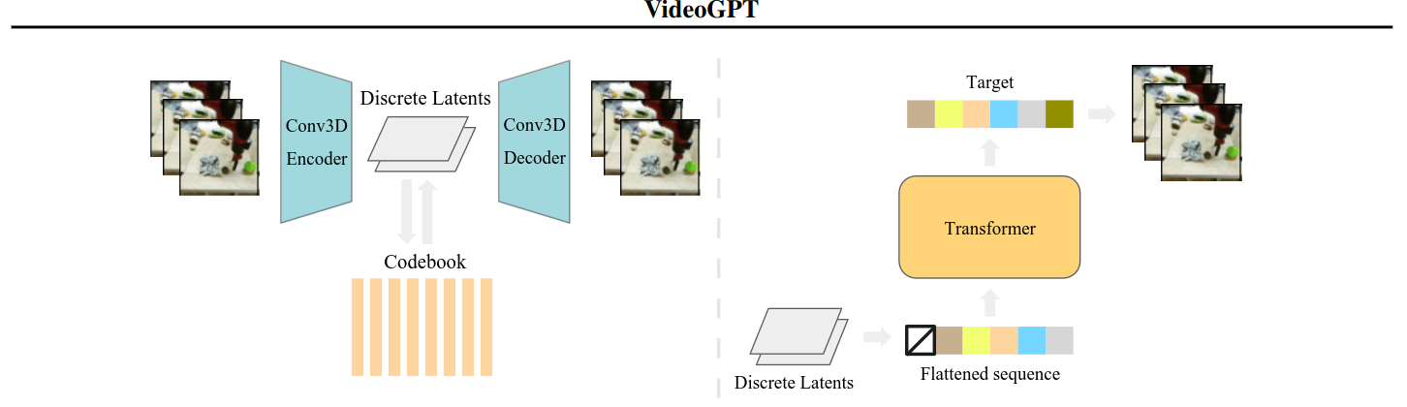
What we did - High Level

Slide 6
What we did - High Level
1)
Encode still image using encoder trained on videos

Slide 7
What we did - High Level
2)
2) Autoregressively generate latent space representation conditioned on still frame encoding

Slide 8
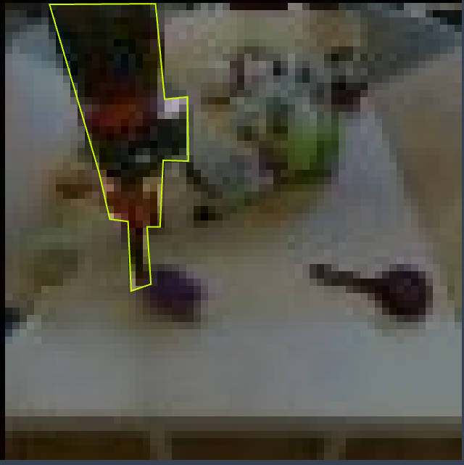
What we did - High Level
3)
Seg Head
3) Feed latent encoding into custom head which outputs segmentation masks

Slide 9
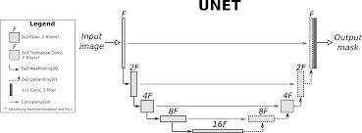
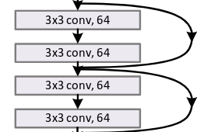
What we did - Details and Experiments
Video Encoding Models:
Video GPT (103 FVD)^{[1]}
MAGVIT (73 FVD)^{[1]}
Segmentation Heads
Head 1: FC + Conv
Head 2: FC+ Conv + res. con.
Head 3: UNET
Self Annotated Dataset
Model Tuning, Loss Functions and LR schedulers
Notes:
3d convnet
[1]https://paperswithcode.com/sota/video-generation-on-bair-robot-pushing

Slide 10
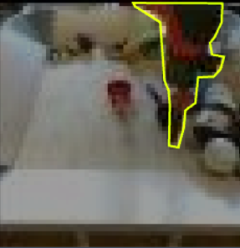
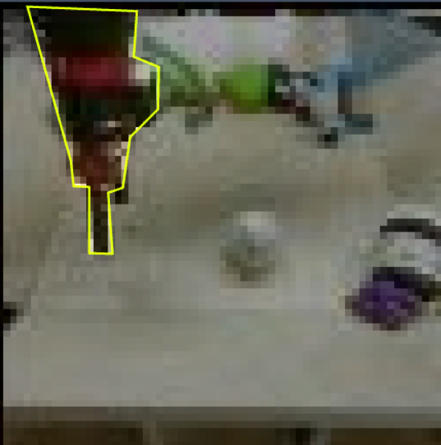


Results
Test | IOU Score
Noise(lat. space) + simple conv(decoder) | 0.00
VGPT(lat. space) + simple conv(decoder) | 0.225
* VGPT(lat. space) + UNET (decoder) | 0.35
Full UNET | 0.76
Our Model:
VGPT + UNET
Dice loss
UNET

Slide 11
Future Work
We believe that a source of error in our model is that the latent space captures the latent space of a generated video rather than the still image.
Hence, we aim to explore other video encoding spaces that differ in training mechanisms.
Continued…

