Slide 1
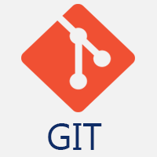
GIT
Yerram Sneha

Slide 2
Git is a modern and widely used distributed version control system in the world. It is developed to manage projects with high speed and efficiency. The version control system allows us to monitor and work together with our team members at the same workspace.
Version Control System
Version Control System (VCS) is a software that helps software developers to work together and maintain a complete history of their work.
Listed below are the functions of a VCS −
Allows developers to work simultaneously.
Does not allow overwriting each other’s changes.
Maintains a history of every version.
Following are the types of VCS −
Centralized version control system (CVCS).
Distributed/Decentralized version control system (DVCS).
Git is a version control system.
Git helps you keep track of code changes.
Git is used to collaborate on code.

Slide 3
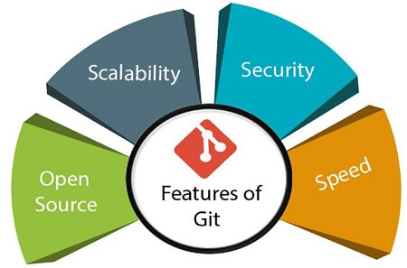

Slide 4
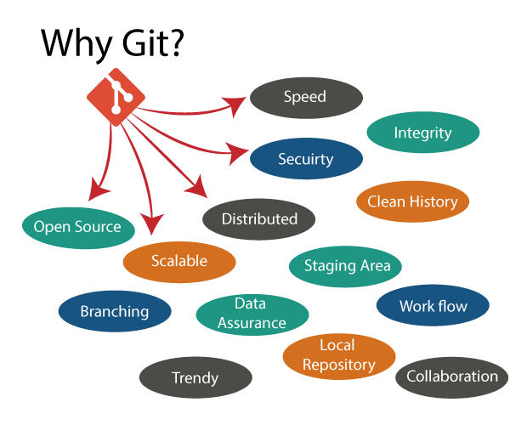
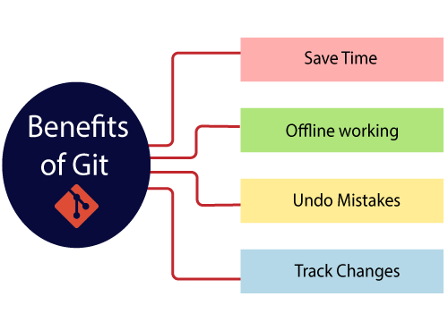

Slide 5
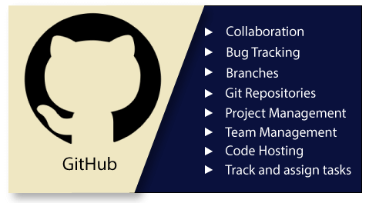
What is GitHub?
GitHub is a Git repository hosting service. GitHub also facilitates with many of its features, such as access control and collaboration. It provides a Web-based graphical interface.
GitHub is an American company. It hosts source code of your project in the form of different programming languages and keeps track of the various changes made by programmers.
It offers both distributed version control and source code management (SCM) functionality of Git. It also facilitates with some collaboration features such as bug tracking, feature requests, task management for every project.

Slide 6
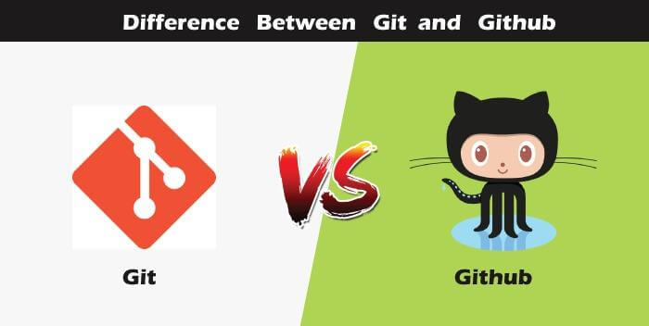

Slide 7
