Slide 1

CardioGood Fitness Project Study BY Naeem Sufi

Slide 2
Objectives
Define Customer profile (characteristics of a customer) of the different products.
Perform Uni-variate and Multi-Variate Analysis to understand the data
Generate insights and recommendations that will help the Cardio Fitness in targeting new customers
What we will see
Problem Statement
Process Flow
Data Overview
Exploratory Analysis
Key Insights
Conclusion

Slide 3
Problem Statement
Identify profile of the typical customer for each treadmill product offered by Cardio Good Fitness.
Investigate whether there are differences across the product lines with respect to customer characteristics.

Slide 4
Process Flow
Step 1
Step 2
Load the Dataset
Examine Characteristics of the dataset
Step 3
Step 4
Graphical representation of the Dataset
Gain insights & provide suggestions

Slide 5
Summary of Data
Measures | TM195 | TM498 | TM798
Sold | 80 | 60 | 40
Female Customers | 40 | 29 | 7
Male Customers | 40 | 31 | 33
MaritalStatus-Partnered | 48 | 36 | 23
MaritalStatus-Single | 32 | 24 | 17
Average Usage | 3.09 | 3.07 | 4.78 | 2 to 7 Times in a Week
Average Fitness Rating | 2.96 | 2.9 | 4.63
Average Miles | 82.79 | 87.93 | 166.90 | 21 to 60 Miles planning to run every week
Average Income | $46,418.03 | $48,973.65 | $75,441.58 | 29,562 to 104,581
Median Income | $46,617.00 | $49,459.50 | $76,568.50
Miles Walk/Run | 25-147 | 47-128 | 50-300
Mean Miles | 82.79 | 87.93 | 166.90
Mean Age | 28.55 | 28.90 | 29.10 | 18-50 (in years)
Mean Fitness Level | 2.96 | 2.90 | 4.62 | 1 to 5 Self Rate Fitness on Scale of 1 to 5
Education |  |  |  | 12 to 21 (in Years)
Note: No Missing data found

Slide 6
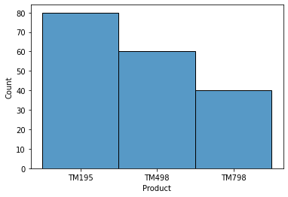
Cardio Good Fitness Customer Characteristics
TM195
It has the highest number of overall customers
TM498
It has the 2nd highest number of overall customers
TM798
TM195 is the highest selling product.
It has the Least number of customers

Slide 7
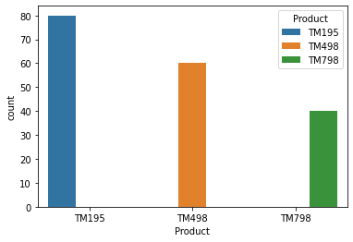
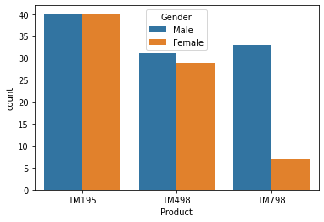
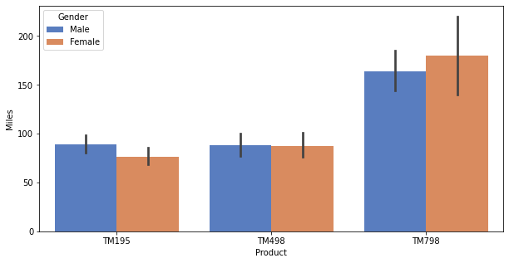
Cardio Good Fitness Customer Characteristics By Product
TM195 is the most sold model
Number of customers preferring TM195 is amost twice as the ones preferring TM798
TM798 is bought more by males than females
Number of miles planned by male and female does not vary much within the same product

Slide 8
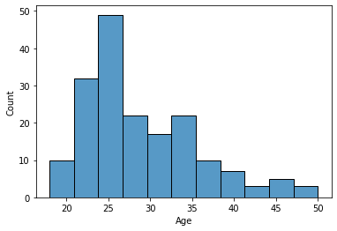
Cardio Good Fitness Customer Characteristics Age
Most of the customer lie in 20 to 35 years of age
Number of Customers above 35 Years is low
Age is not a factor in sales of these products

Slide 9
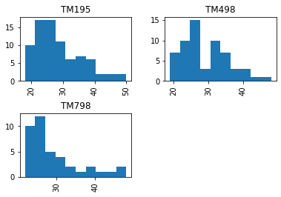
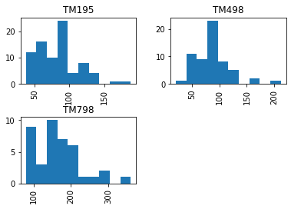
Cardio Good Fitness Customer Characteristics AGE & MILES
AGE
MILES
Most of the buyers are in the age group 20 to 35 for all three products
Age is not a great predictor in identifying the preference of the customer
TM798 is bought by customers who are planning to run higher number of miles (above 100 miles) compared to other two models
No visible relation between age and Miles

Slide 10
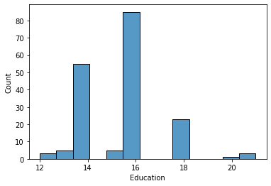
Cardio Good Fitness Customer Characteristics Education
Most of the customers have 16 years of education
There are very few customers with highest and lowest possible years of eudcation

Slide 11
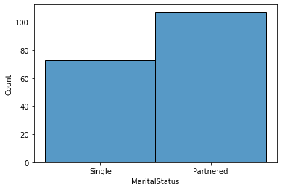
Cardio Good Fitness Customer Characteristics Relationship Status
Relationship status of most of the customers is partnered
Marital Status is not predictor of sales of these products

Slide 12
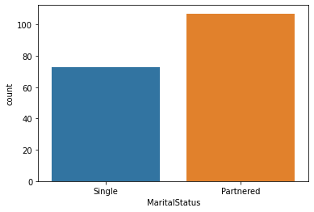
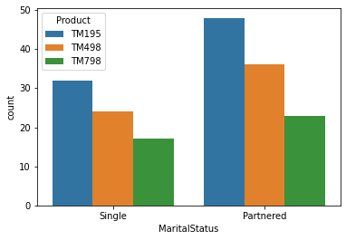
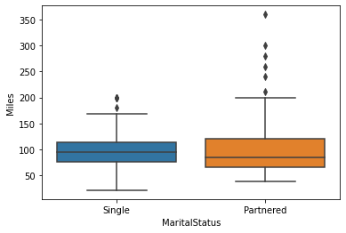
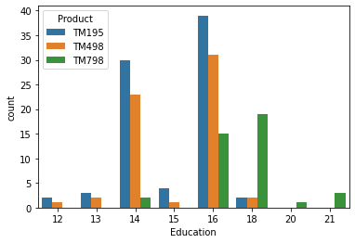
Cardio Good Fitness Customer Characteristics Marital Status and Education
Almost two-third of customers are partnered
Marital status is not a strong predictor in determining the preference of the customer
Partnered people are planning to run more miles
Most of the customers have 16 years of education
TM798 users are in the higher education level compared to other product users

Slide 13
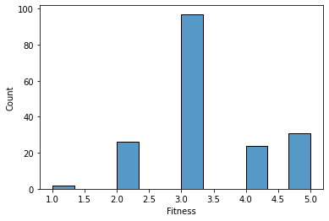
Cardio Good Customer Characteristics Fitness Level
Most of the customers have an average fitness level of 3
There are very few customers with least fitness level
People with high fitness level tend to be buyers of Treadmills
There are customers with Fitness Level of 5

Slide 14
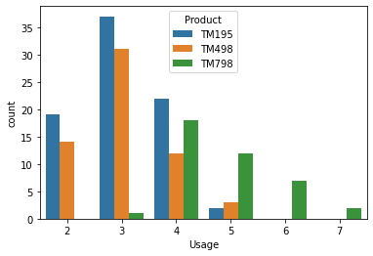
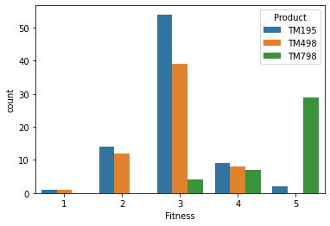
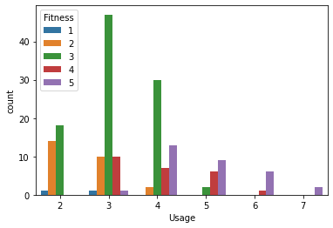
Cardio Good Customer Characteristics Usage & Fitness
TM195 and TM498 are preferred by customers who are planning to use moderately
TM798 are preferred by customers who are planning for a heavy usage
TM195 and TM498 are bought by customers of varied fitness level;TM798 are who rate themselves with high fitness.
Customers who rate themselves with fitness level 5 are planning to use more than 4 times a week

Slide 15
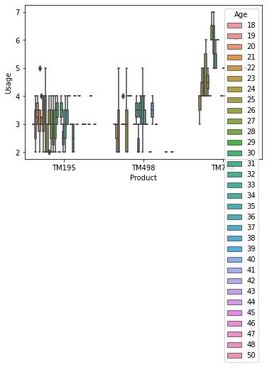
Cardio Good Fitness Customer Characteristics Usage
TM195 usage has most diversre range of customers in terms of age
TM798 usage has the least diverse range of customer in terms of age

Slide 16
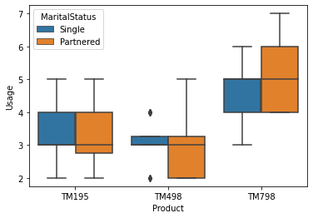
Cardio Good Fitness Customer Characteristics Marital Status & Usage
Partnered persons use all three machines
Partnered person are more likely to use TM798

Slide 17
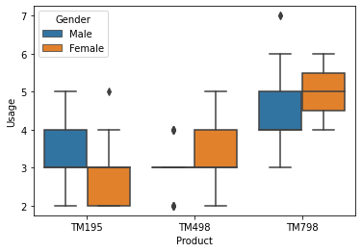
Cardio Good Fitness Customer Characteristics Gender & Usage
Males are more likely to use TM195 or TM798
Females are are more likely to use TM498 and TM798
There are not many Males Customers for TM498.
TM195 and TM798 is popular among both Males and Females.

Slide 18
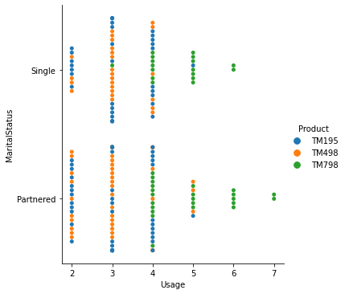
Cardio Good Fitness Customer Characteristics Product – Marital Status and Usage
TM798 is mostly used by both single and partnered if its usage is more than or equals to 4 times a week
TM195, TM498 are mostly used by single and partnered if usage is less than 4 times a week
Suggestion: Customers with more frequent use should be targeted for sale of TM798. The Relationship factor doesn’t affect much here so it should not be taken into consideration

Slide 19
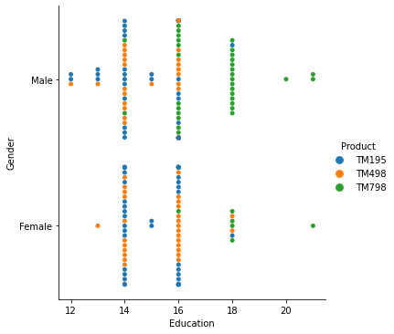
Cardio Good Fitness customer characteristics Product – Gender & Education
TM798 is moslty used by both male and female who are highly educated
TM195, TM498 are mostly used by males and females with 16 year or less education
Suggestion: Both male and female with higher education should be targeted for TM798 for male and female with education 16 years or less should be targeted for other products

Slide 20
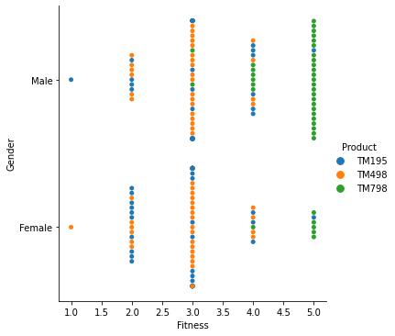
Cardio Good Fitness Customer Characteristics Product – Gender & Fitness
TM798 is mostly used by both male and female with higher level of fitness
TM195, TM498 are mostly used by males and females with average or below average fitness
Suggestion: Males and Females with higher level of fitness should be targeted for TM798 and for people with fitness level 4 or less should be targeted for other two products

Slide 21
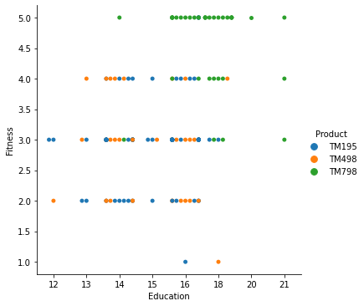
Cardio Good Fitness Customer Characteristics Product – Fitness & Education
TM798 is mostly used by Customers with high Education and Fitness level
TM195, TM498 are used by Customers with average and below average Fitness and Education Levels
Suggestion: Customers with higher level of education and fitness should be targeted for TM798 and for customers with average and below average education and fitness TM195 and TM498 should be considered as better option

Slide 22
Conclusion
TM195 most economical and beginner's choice; TM798 - Expert level fitness choice
TM195 and TM498 customer characters does not vary much
TM195
Most Popular
preferred among people with lower income range , fitness level equal to or less than 3 Usage less than 4 times a week
TM498
less popular than TM195
with low-income group , moderate fitness level
TM798
Least Sold
High End Model
preferred among people with higher income range , fitness level greater than 3 , Usage more than 4 times a week
Use the capital from sales of TM195 and invest in increasing sales of TM798

