Slide 1
An alternative proposal for determining DY yields
Stephen Pate, Chatura Kuruppu
NMSU
19 August 2025

Slide 2
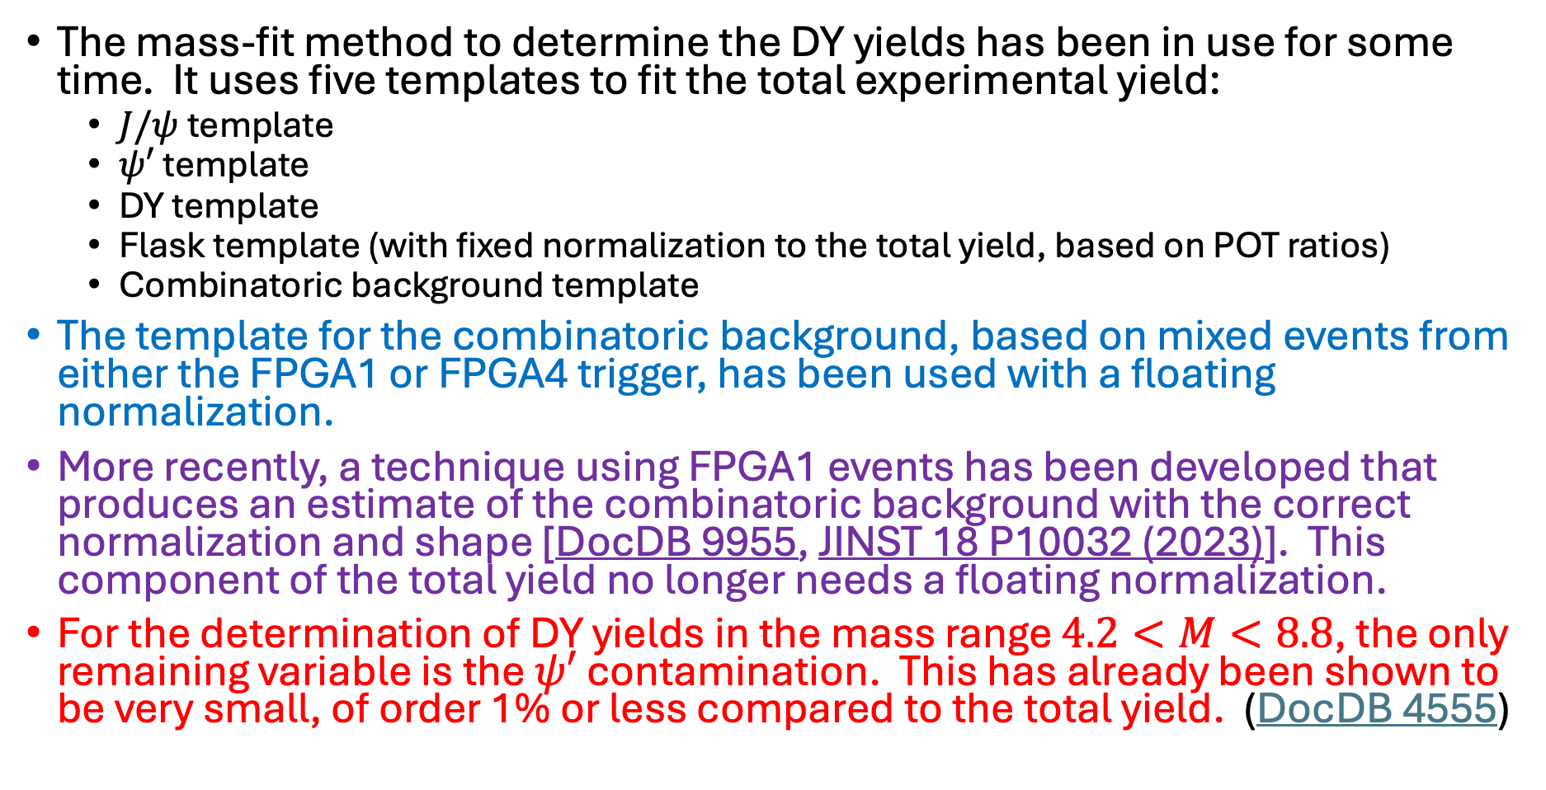
Motivation
The mass-fit method to determine the DY yields has been in use for some time. It uses five templates to fit the total experimental yield:
$J/ψ$ template
$ψ′$ template
DY template
Flask template (with fixed normalization to the total yield, based on POT ratios)
Combinatoric background template
The template for the combinatoric background, based on mixed events from either the FPGA1 or FPGA4 trigger, has been used with a floating normalization.
More recently, a technique using FPGA1 events has been developed that produces an estimate of the combinatoric background with the correct normalization and shape [DocDB 9955, JINST 18 P10032 (2023)]. This component of the total yield no longer needs a floating normalization.
For the determination of DY yields in the mass range $4.2<M<8.8$, the only remaining variable is the $ψ′$ contamination. This has already been shown to be very small, of order 1% or less compared to the total yield. (DocDB 4555)

Slide 3
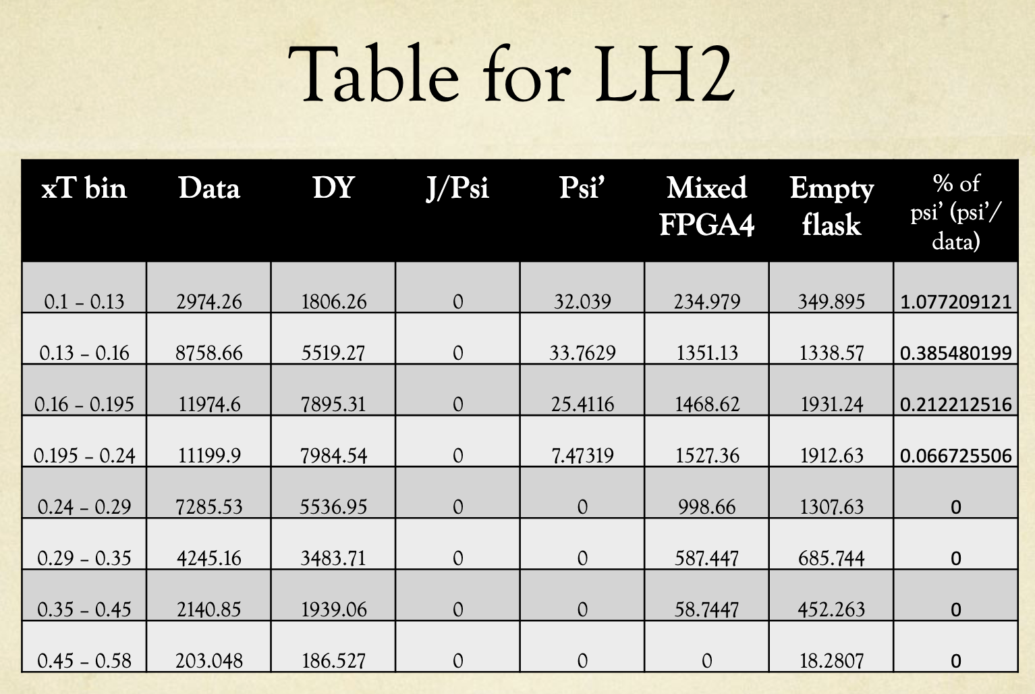
DocDB 4555
RS 67 R008

Slide 4
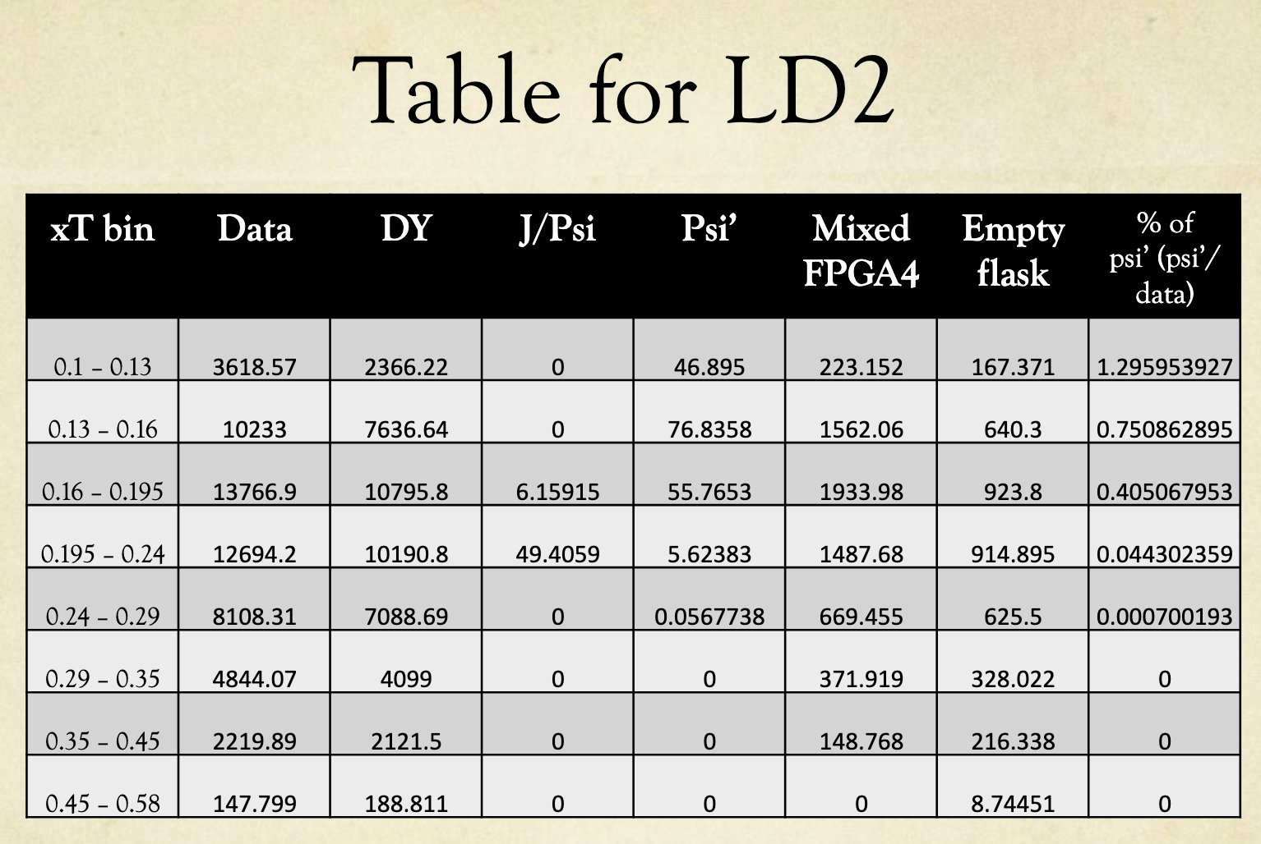
DocDB 4555
RS 67 R008

Slide 5
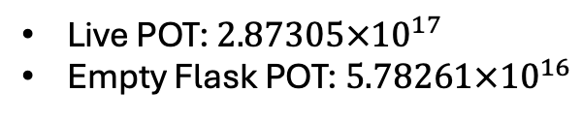

Additional Studies of $ψ′$ Contamination
Files used:
Data:
Real data: chleung/rootfiles/67/FPGA1/R008_roadset67_0_2111v42_tmp_noPhys_noOcc.root
Mixed data (RS67): /seaquest/users/apun/e906_projects/rs67_merged_files/merged_RS67_3089LH2.root
Empty Flask Mix (RS67): /seaquest/users/apun/e906_projects/rs67_merged_files/merged_RS67_3089flask.root
GMC for LH2 (made for RS67):
D-Y: chleung/pT_ReWeight/mc_drellyan_LH2_M027_S002_messy_occ_pTxFweight_v2.root
J/ψ: chleung/pT_ReWeight/mc_jpsi_LH2_M027_S002_messy_occ_pTxFweight_v2.root
ψ′: chleung/pT_ReWeight/mc_psiprime_LH2_M027_S002_messy_occ_pTxFweight_v2.root
Theory Curves (NLO):
CT18:
chleung/theory/new/v2/E906/NNPDF40_xFnew_p.root
NNPDF40:
chleung/theory/new/v2/E906/CT18_xFnew_p.root
Weights used:
M027_S002: J/Psi:`ReWeight` DY: `ReWeight` PsiP: `ReWeight`
Live POT: $2.87305×{10}^{17}$
Empty Flask POT: $5.78261×{10}^{16}$

Slide 6

Additional Studies of $ψ′$ Contamination
Main cuts used:
TCut dataCut = physicsCuts_noMassCut_2111v42_tmp && occCut && intensityCuts_2111v42 && "mass<8.8";
TCut MCCut = chuckCutsPositive_2111v42_tmp && chuckCutsNegative_2111v42_tmp && chuckCutsDimuon_2111v42 && physicsCuts_noMassCut_2111v42_tmp && occCut && "0.99*mass<8.8";
TCut mixCut = chuckCutsPositive_2111v42_tmp && chuckCutsNegative_2111v42_tmp && chuckCutsDimuon_2111v42 && physicsCuts_noMassCut_2111v42_tmp && occCut && "mass<8.8";
Histograms filled:
dataTree->Draw("mass>>h_data",dataCut&&TString::Format("targetPos==%i",target), "goff"); here: target==1 (LH2)
dataTree->Draw("mass>>h_flask",dataCut&&TString::Format("targetPos==%i",flaskPos),"goff"); here: flaskPos==2
mixTree->Draw("mass>>h_mix",mixCut, "goff");
mcTree->Draw("0.99*mass>>"hName, "ReWeight"*MCCut, "goff");

Slide 7
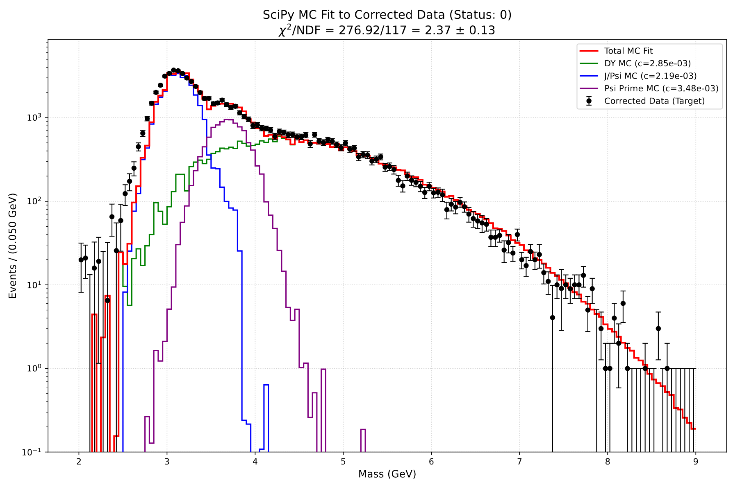
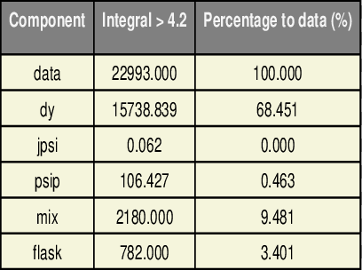
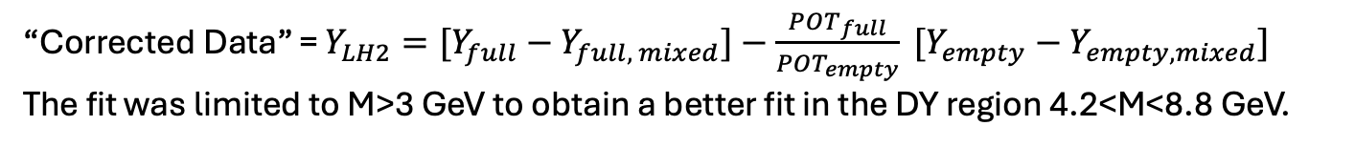




Previous MassFit Presented in Docdb 11224
“Corrected Data” = $Y_{LH2}=[Y_{full}−Y_{full, mixed}]−\frac{POT_{full}}{POT_{empty}} [Y_{empty}−Y_{empty, mixed}]$
The fit was limited to M>3 GeV to obtain a better fit in the DY region 4.2<M<8.8 GeV.
$$Corrected Data=\left(\text{71324.214 }±\text{469.67}1\right)$$
$$DY MC=\left(24963.798±233.379\right)$$
$$PsiP MC=\left(10360.488±96.483\right)$$
$$J/Psi MC=\left(34966.595±762.457\right)$$
DY region 4.2<M<8.8 GeV

Slide 8
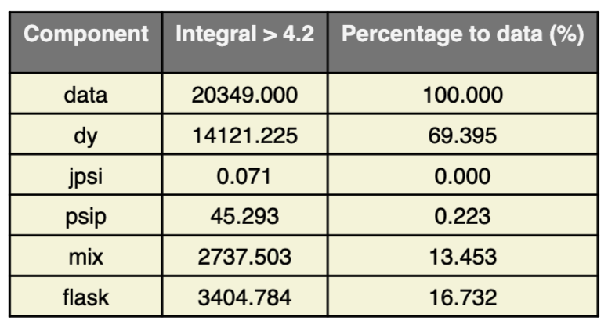
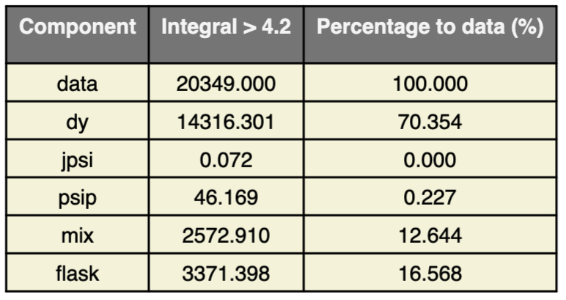
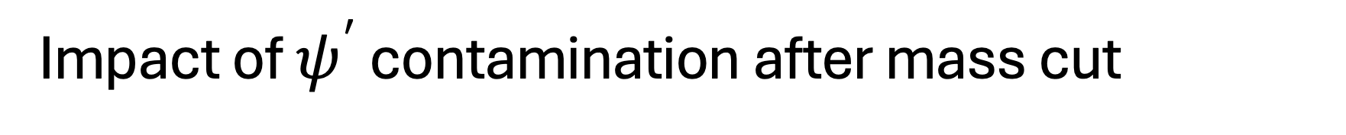
Impact of $ψ^{′}$ contamination after mass cut
Hugo’s mass fit using TFractionFitter.
Reproducing Hugo’s massfit using SciPY technique.
Results are very similar; SciPY routine does not adjust the templates as TFF does.
Notes:
Then I wrote my own version of massFitter and as you can see the scaling factors I reproduced are in a good agreement with Hugo's fit. Now there is a decent data total fit agreement at lower mass region.
During yesterday's meeting I already had a meeting with Steve and he further explained that:
If I use identical inputs to Hugo, I should get the very similar chi^2/ndf. Perhaps we are not in the same minimum
Also, the mix spectra look different at the high mass region.

Slide 9
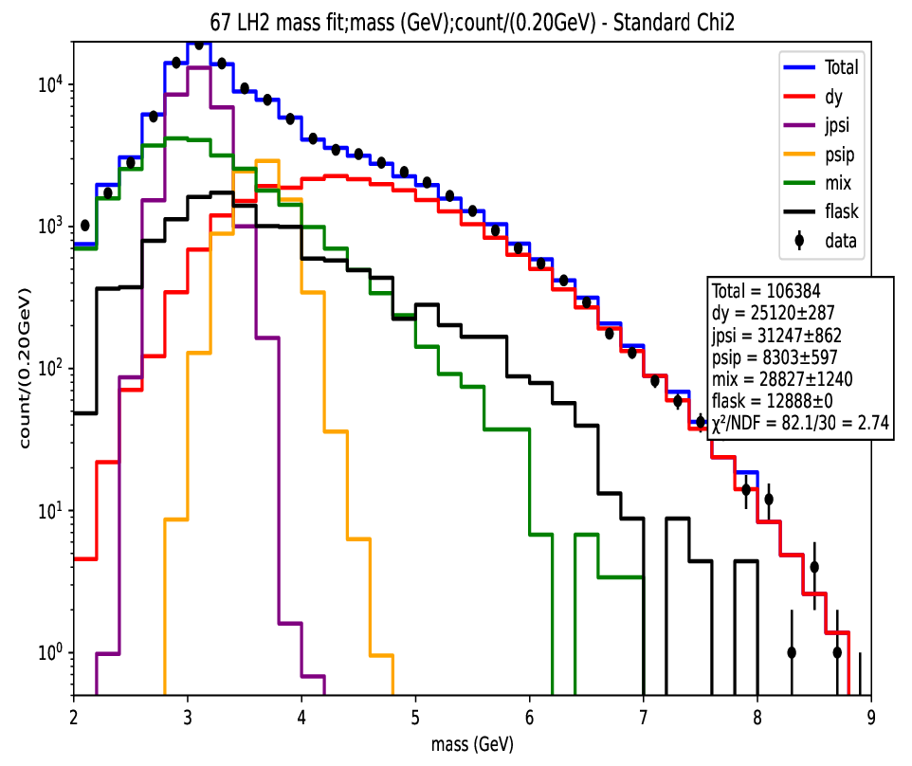
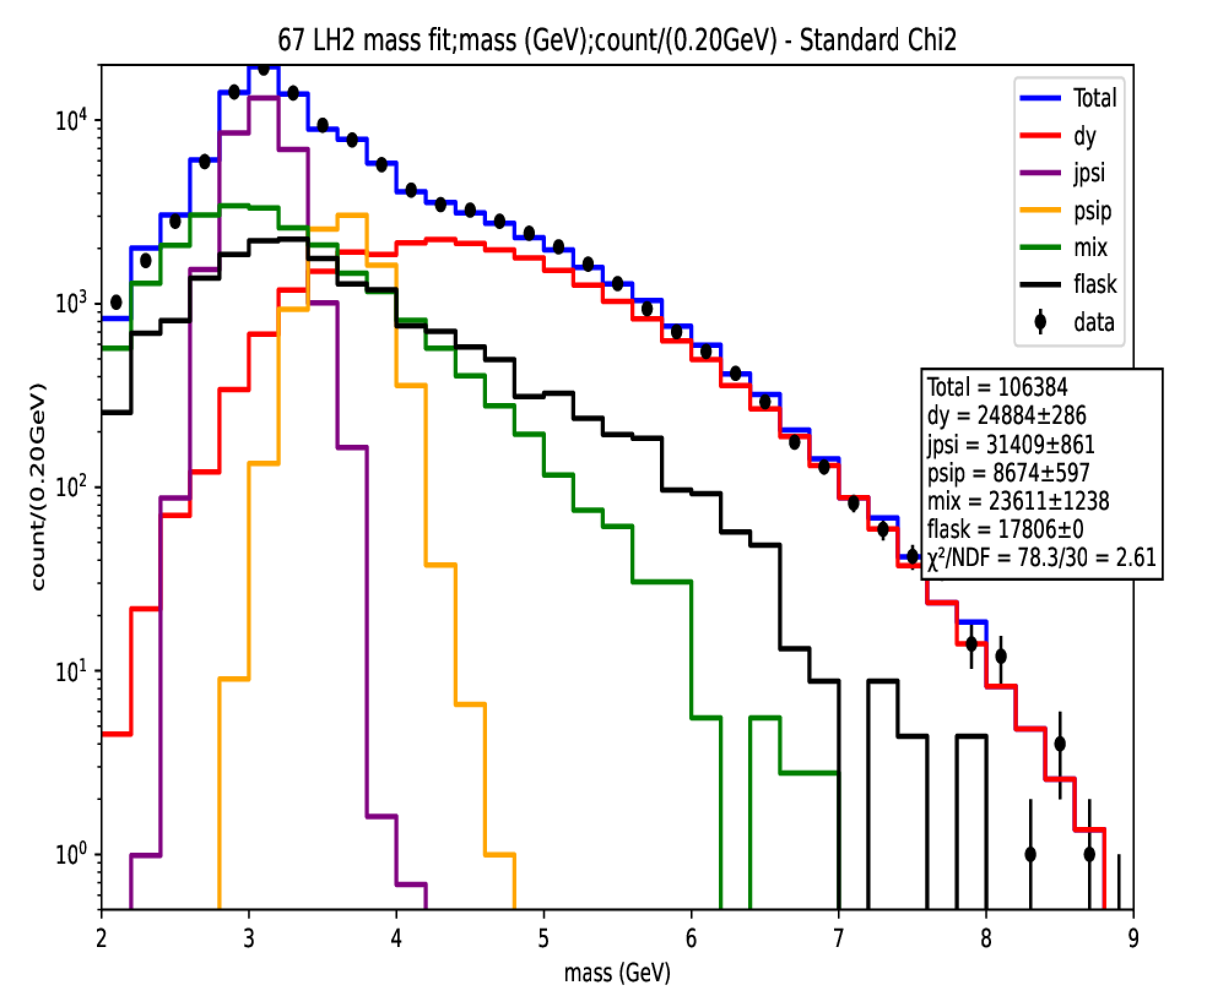
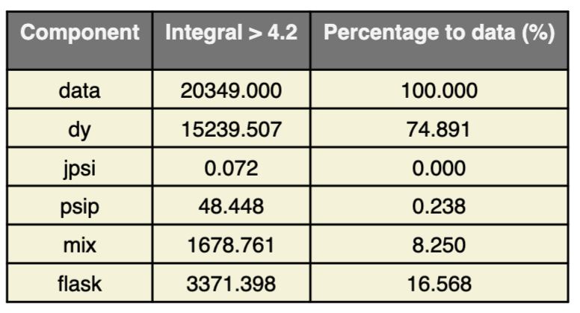
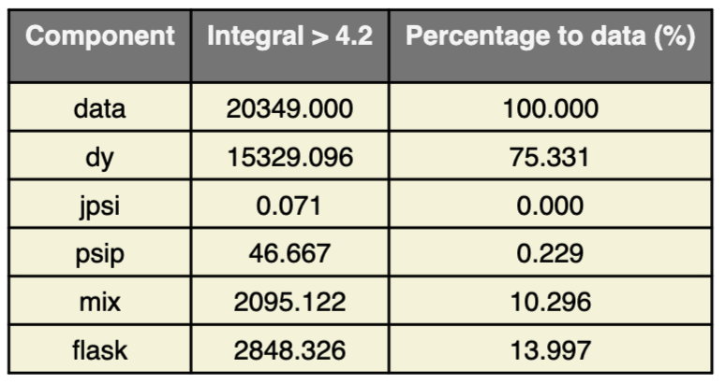
RS-67 LH2 NMSU Mix
Flask - flaskMix
Flask
SciPY mass-fit using NMSU mixed events without subtracting combinatorics in empty flask.
SciPY mass-fit using NMSU mixed events including subtracting combinatorics in empty flask.
The result for J/psi, psi’ and DY is identical because the LH2 mixed and flask mixed distributions have the same shape (next page).
Notes:
So, when it comes to the upcoming DNP meeting I am planning to present the absolute cross-section measurements for both LH2 and LD2 targets with different x_F bins.
Speaking of the timeline, we have 88 days and based on the disscussion with Kenichi I was advised to prepare a technote that clearly discribes the analysis procedure used to calculate the cross-section and that requires to circulate prior to 28 days and I will release the presentation including all the plots prior to 14 days of the conference.
After that I will address the comments received from the collaboration.

Slide 10
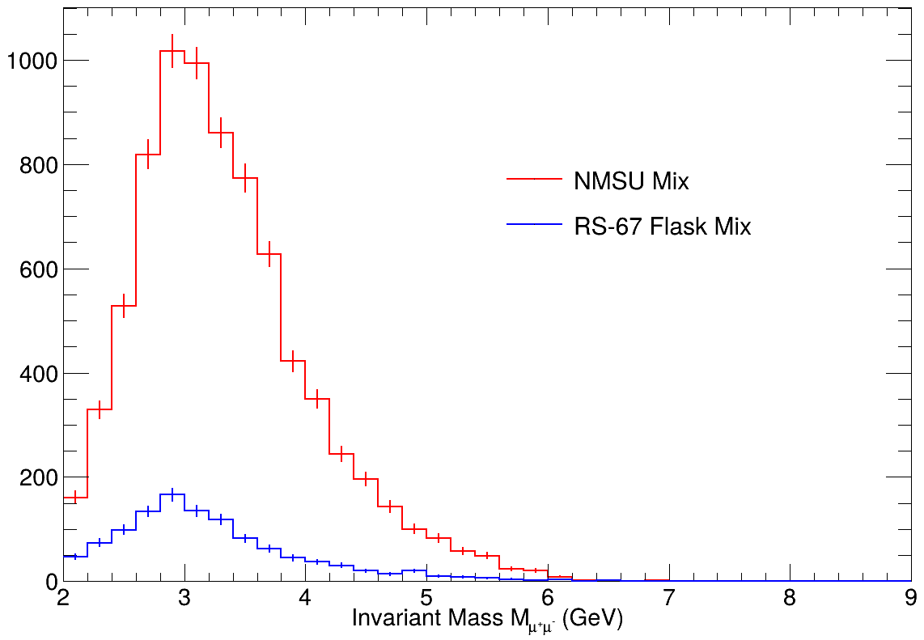
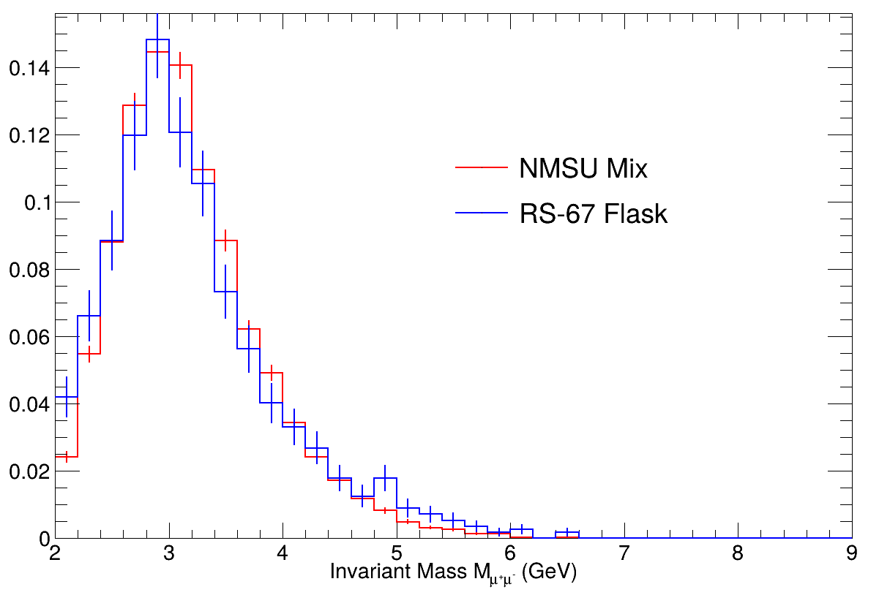
RS-67: NMSU LH2 Mix vs Flask Mix
LH2 Mix
Flask Mix
LH2 Mix
Flask Mix
Comparison between LH2 mix vs Flask mix spectra (after event selection)
Comparison between LH2 mix vs Flask mix spectra (after event selection) –- area normalized
The LH2 mixed-event and Flask mixed-event distributions have the same shape. If you don’t explicitly use the flask mixed spectra, then the mass-fit will boost the LH2 mixed component to make up for it. (See previous page.)
Notes:
So, when it comes to the upcoming DNP meeting I am planning to present the absolute cross-section measurements for both LH2 and LD2 targets with different x_F bins.
Speaking of the timeline, we have 88 days and based on the disscussion with Kenichi I was advised to prepare a technote that clearly discribes the analysis procedure used to calculate the cross-section and that requires to circulate prior to 28 days and I will release the presentation including all the plots prior to 14 days of the conference.
After that I will address the comments received from the collaboration.

Slide 11

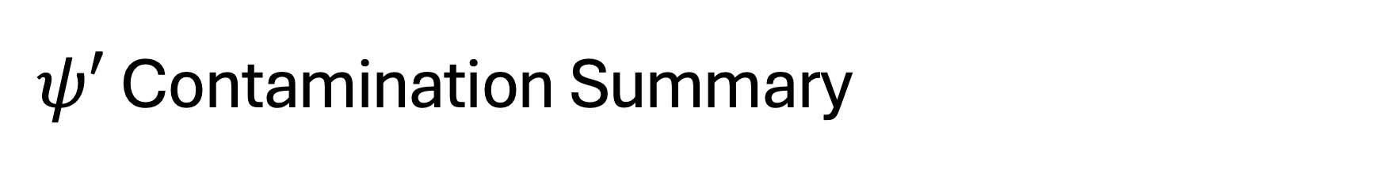
$ψ′$ Contamination Summary
Depending on assumptions made about the combinatoric background shape and normalization, the $ψ′$ contamination (as a fraction of the total yield) overall is about 0.5% or less.
If you examine individual kinematic bins, the contamination can range from 0% to not more than 2%.

Slide 12
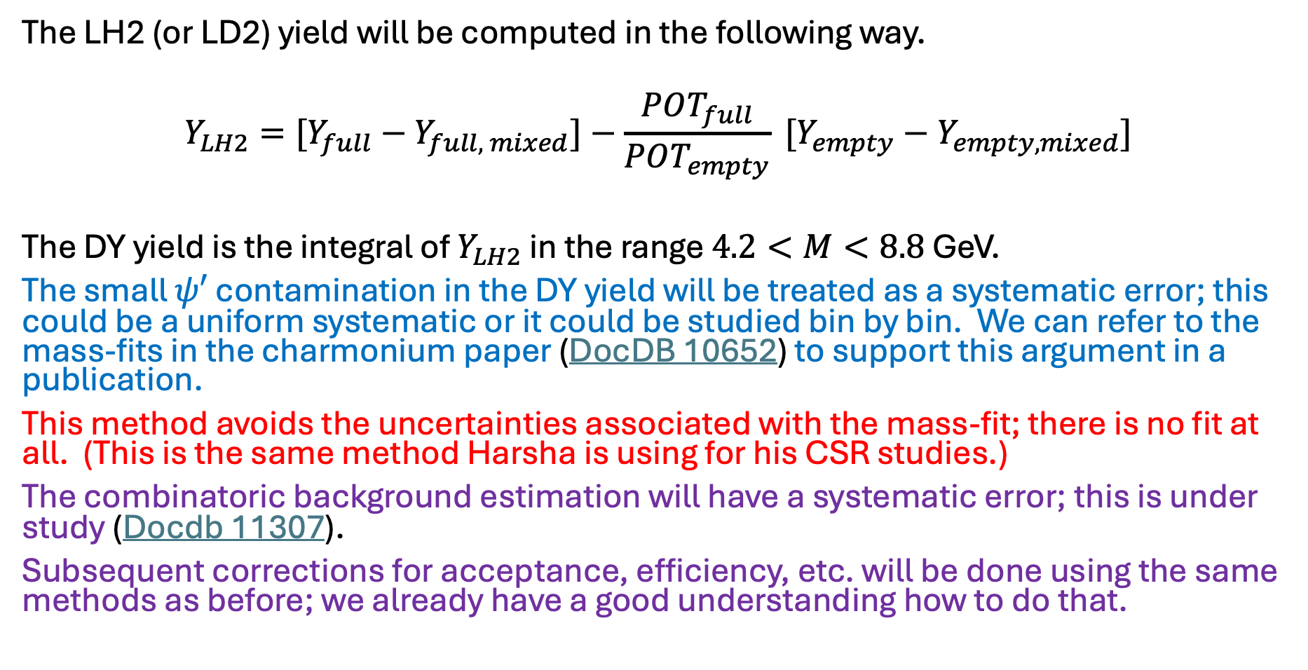
Proposal for determination of DY Yield
The LH2 (or LD2) yield will be computed in the following way.
$$Y_{LH2}=[Y_{full}−Y_{full, mixed}]−\frac{POT_{full}}{POT_{empty}} [Y_{empty}−Y_{empty, mixed}]$$
The DY yield is the integral of $Y_{LH2}$ in the range $4.2<M<8.8$ GeV.
The small $ψ′$ contamination in the DY yield will be treated as a systematic error; this could be a uniform systematic or it could be studied bin by bin. We can refer to the mass-fits in the charmonium paper (DocDB 10652) to support this argument in a publication.
This method avoids the uncertainties associated with the mass-fit; there is no fit at all. (This is the same method Harsha is using for his CSR studies.)
The combinatoric background estimation will have a systematic error; this is under study (Docdb 11307).
Subsequent corrections for acceptance, efficiency, etc. will be done using the same methods as before; we already have a good understanding how to do that.

