Slide 1
Alchemic Forest
Michael Daviet
Michael Garcia
Lei Qian
Elizabeth Van Dyke

Slide 2
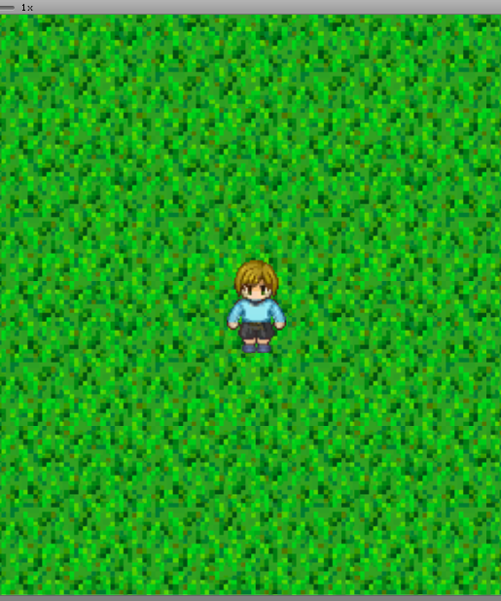
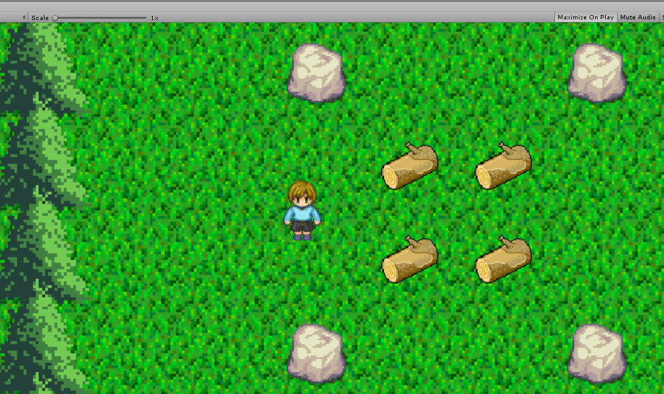
Project Overview
2D top down game
Heavy focus on puzzle solving
Implements an item collection and crafting process
Simple controls and gameplay

Slide 3
Key Architectural Drivers
A robust architecture that can fully encompass the system
The architecture will be reusable for all parts of system design
An adjustable architecture that can adapt to system changes

Slide 4
Architecture Candidates
Layered
Component Based
Provides ability to divide project by functionality
Focuses on abstract implementation
Hard to scale if the project grows
Architectural division can lead to disjointed elements
Can be harder to read due to numerous components
Allows for easier additions of functionality if project grows
Breaks project into tasks
Makes component reuse easy and traceable

Slide 5
Chosen Style
Component Based
The ability to easily add more components is ideal for our changing game
Examples of components that will be used:
Obstacles Interactions Levels
Pickups Player

Slide 6
Conclusion Component Based Architecture
Advantages
Disadvantages
The Architecture can grow with project specifications
Components can be tracked within the design
Components can be reused as needed
Dependencies can become clumped
Debugging interactions can be complex
Small changes to components can have large effects on the system

