Slide 1
Team 1 Git Clucked
Team Members:
Joshua Rosencrans
Jay Glover
Luke Anderwald

Slide 2
Project Overview
Java based game
Fighting Zombies and Zombie chickens
Side Scroller
Scaled enemy population
Scaled difficulty
Store and experience attributes
Save States

Slide 3
Key Architecture Drivers
Components relay on one another
Data needs to be shared
Components need to share and request data

Slide 4
Architecture Styles
Publish/subscribe
Key logging
Peer to Peer (Chosen one)
Components accessing each other
Components relying on one another to run

Slide 5
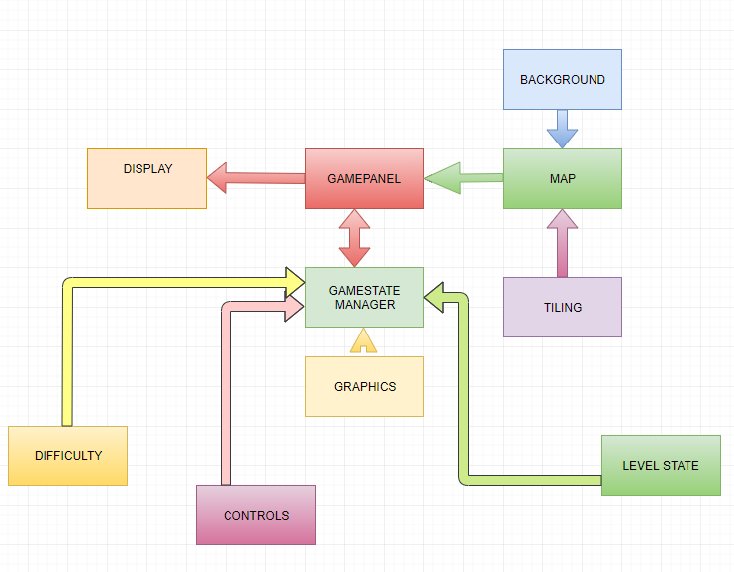
Architecture Diagram

Slide 6
Conclusion
Peer to Peer Architecture style
Risks
Scope accessibility
Cascading Failures
Permission accessibility

