Slide 1
Team 1 Git Clucked
Team Members:
Joshua Rosencrans
Jay Glover
Luke Anderwald

Slide 2
Project Overview
Java based game
Fighting Zombies and Zombie chickens
Side Scroller
Scaled enemy population
Scaled difficulty
Store and experience attributes
Save States

Slide 3
Key Architecture Drivers
Components relay on one another
Data needs to be shared
Components need to share and request data

Slide 4
Architecture Styles
Publish/subscribe
Key logging
Layering (Chosen one)
Components accessing each other
Components relying on one another to run
Each manager relies on the other managers to run such as the gamestate manager map manager

Slide 5
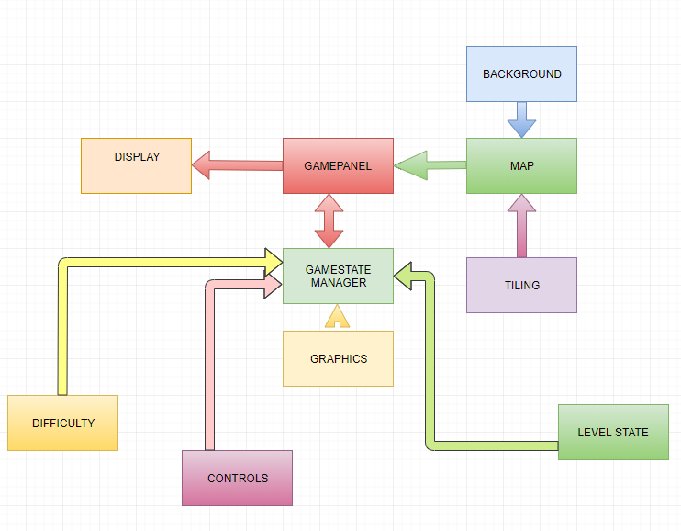
Architecture Diagram

Slide 6
Conclusion
Layering Architecture style
Risks
Scope accessibility
Cascading Failures
Permission accessibility

