Slide 1
Python Programming: An Introduction to Computer Science
Chapter 4
Objects and Graphics

Slide 2
Objectives
To understand the concept of objects and how they can be used to simplify programs.
To be familiar with the various objects available in the graphics library.
To be able to create objects in programs and call appropriate methods to perform graphical computations.
To understand the fundamental concepts of computer graphics, especially the role of coordinate systems and coordinate transformations.

Slide 3
Objectives
To understand how to work with both mouse and text-based input in a graphical programming context.
To be able to write simple interactive graphics programs using the graphics library.

Slide 4
4.1 Overview
Each data type can represent a certain set of values, and each had a set of associated operations.
The traditional programming view is that data is passive – it’s manipulated and combined with active operations.

Slide 5
4.1 Overview
Modern computer programs are built using an object-oriented approach.
Graphical programming is a lot of fun and provides a great vehicle for learning about objects.
Most applications you’re familiar with have Graphical User Interfaces (GUI) that provide windows, icons, buttons and menus.
There’s a graphics library (graphics.py) written specifically to go with this course.

Slide 6
4.2 The Object of Objects
Basic idea – view a complex system as the interaction of simpler objects. An object is a sort of active data type that combines data and operations.
Objects know stuff (contain data) and they can do stuff (have operations).
Objects interact by sending each other messages.

Slide 7
4.2 The Object of Objects
Example: Develop a data processing system for a college or university.
Keep records on students who attend the school.
Each student will be represented as an object.

Slide 8
4.2 The Object of Objects
Example: Develop a data processing system for a college or university.
The student object would contain data like:
Name
ID number
Courses taken
Campus Address
Home Address
GPA
Etc.

Slide 9
4.2 The Object of Objects
Example: Develop a data processing system for a college or university.
The student object should also respond to requests.
May need to send out a campus-wide mailing, so we need a campus address for each student.
We could send the printCampusAddress to each student object. When the student object receives the message, it prints its own address.

Slide 10
4.2 The Object of Objects
Example: Develop a data processing system for a college or university.
Objects may refer to other objects.
Each course might be represented by an object:
Instructor
Student roster
Prerequisite courses
When and where the class meets

Slide 11
4.2 The Object of Objects
Example: Develop a data processing system for a college or university.
Sample Operation
addStudent
delStudent
changeRoom
Etc.

Slide 12
4.2 The Object of Objects
As a beginning programmer, we are not yet ready to tackle a college information system.
In the following, we'll study objects in the context of some simple graphics programming.

Slide 13
4.3 Simple Graphics Programming
This chapter uses the graphics.py library supplied with the supplemental materials.
The package graphics.py is a simple object oriented graphics library designed to make it very easy for novice programmers to experiment with computer graphics in an object oriented fashion.

Slide 14
4.3 Simple Graphics Programming
Using the graphics library is as easy as placing a copy of the graphics.py file in the same folder as your graphics program(s).
Alternatively, you can place it in a system directory where other Python libraries are stored so that it can be used from any folder on the system.

Slide 15
4.3 Simple Graphics Programming
There are two kinds of objects in the library. The GraphWin class implements a window where drawing can be done and various GraphicsObjects are provided that can be drawn into a GraphWin.
GraphWin objects support coordinate transformation through the setCoords method and input via mouse or keyboard.

Slide 16
4.3 Simple Graphics Programming
The library provides the following graphical objects: Point, Line, Circle, Oval, Rectangle, Polygon, Text, Entry (for text-based input), and Image.
Various attributes of graphical objects can be set such as outline-color, ll-color, and line-width. Graphical objects also support moving and undrawing for animation effects.

Slide 17
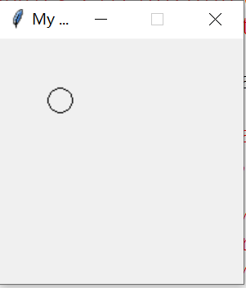
4.3 Simple Graphics Programming
Example: How to draw a circle of radius 10 centered in a 100x100 window.
import graphics
def main():
win = graphics.GraphWin("My Circle", 100, 100)
c = graphics.Circle(graphics.Point(50,50), 10)
c.draw(win)
win.getMouse() # pause for click in window
win.close()

Slide 18
4.3 Simple Graphics Programming
Graphics is a library, we need to import the graphics commands
>>>import graphics
If this import fails, it means that Python couldn't find the graphics module. Make sure the file is in the correct folder and try again.
To create a graphics window on the screen where the graphics will appear.
>>> win = graphics . GraphWin ( )
This command creates a new window titled “Graphics Window.”

Slide 19
4.3 Simple Graphics Programming
GraphWin is an object assigned to the variable win. We can manipulate the window object through this variable, similar to manipulating files through file variables.
Windows can be closed/destroyed by issuing the command >>> win.close()

Slide 20
4.3 Simple Graphics Programming
It is tedious to use the graphics. notation to access the graphics library routines.
from graphics import *
instead of
import graphics
The “from” statement allows you to load specific functions from a library module. “*” will load all the functions, or you can list specific ones.

Slide 21
4.3 Simple Graphics Programming
Example: Doing the import this way eliminates the need to preface graphics commands with graphics.
>>> from graphics import * >>> win = GraphWin()

Slide 22
4.3 Simple Graphics Programming
A graphics window is a collection of points called pixels (picture elements).
The default GraphWin is 200 pixels tall by 200 pixels wide (40,000 pixels total).
One way to get pictures into the window is one pixel at a time, which would be tedious. The graphics routine has a number of predefined routines to draw geometric shapes.

Slide 23
4.3 Simple Graphics Programming
The simplest object is the Point. Like points in geometry, point locations are represented with a coordinate system (x, y), where x is the horizontal location of the point and y is the vertical location.
The origin (0,0) in a graphics window is the upper left corner.
y values increase from left to right, y values from top to bottom. Lower right corner is (199, 199).
Drawing a Point sets the color of the corresponding pixel in the GraphWin. The default color for drawing is black.

Slide 24
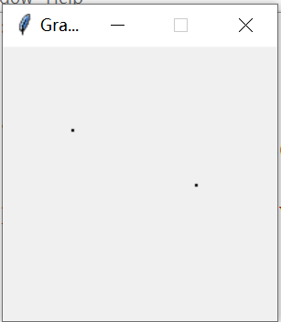
4.3 Simple Graphics Programming
Example: Illustrating the function Points.
>>> from graphics import*
>>> p=Point(50,60)
>>> p.getX() # 50
>>> p.getY() #60
>>> win=GraphWin()
>>> p.draw(win)
>>> p2=Point(140,100)
>>> p2.draw(win)

Slide 25
4.3 Simple Graphics Programming
Example: Illustrating the function Points.
>>> from graphics import*
>>> p=Point(50,60)
>>> p.getX() # 50
>>> p.getY() #60
>>> win=GraphWin()
>>> p.draw(win)
>>> p2=Point(140,100)
>>> p2.draw(win)
The first line creates a Point located at (50,60).
After the Point has been created, its coordinate values can be accessed by the operations getX and getY.
A Point is drawn into a window using the draw operation.
In this example, two different Point objects (p and p2) are created and drawn into the GraphWin called win.

Slide 26
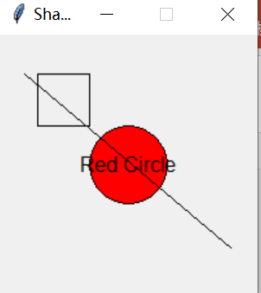
4.3 Simple Graphics Programming
Example: Use graphics commands to draw lines, circles, rectangles, ovals, polygons and text.
>>>win= GraphWin('Shapes')
>>> center = Point(100,100)
>>> circ = Circle(center, 30)
>>> circ.setFill("red")
>>> circ.draw(win)
>>> label=Text(center,"Red Circle")
>>> label.draw(win)
>>> rect=Rectangle(Point(30,30),Point(70,70))
>>> rect.draw(win)
>>>line=Line(Point(20,30),Point(180,165))
>>> line.draw(win)

Slide 27
4.3 Simple Graphics Programming
Example: Use graphics commands to draw lines, circles, rectangles, ovals, polygons and text.
>>>win= GraphWin('Shapes')
>>> center = Point(100,100)
>>> circ = Circle(center, 30)
>>> circ.setFill("red")
>>> circ.draw(win)
#### Open a graphics window and draw a red circle centered at point (100,100) with radius 30

Slide 28
4.3 Simple Graphics Programming
Example: Use graphics commands to draw lines, circles, rectangles, ovals, polygons and text.
>>> label=Text(center,"Red Circle")
>>> label.draw(win)
#### Put a textual label in the center of the circle
>>> rect=Rectangle(Point(30,30),Point(70,70))
>>> rect.draw(win)
>>>line=Line(Point(20,30),Point(180,165))
>>> line.draw(win)
#### Draw a square using a Rectangle object and draw a line segment using a Line object

Slide 29
4.3 Simple Graphics Programming
All graphics objects support the following generic set of methods:
setFill(color) Sets the interior of the object to the given color.
setOutline(color) Sets the outline of the object to the given color.
setWidth(pixels) Sets the width of the outline of the object to the desired number of pixels.
draw(aGraphWin) Draws the object into the given GraphWin and returns the drawn object.
undraw() Undraws the object from a graphics window.
move(dx,dy) Moves the object dx units in the x direction and dy units in the y direction.

Slide 30
4.3 Simple Graphics Programming
Point(x,y) Constructs a point having the given coordinates.
Line(point1, point2) Constructs a line segment from point1 to point2.
Circle(centerPoint, radius) Constructs a circle with the given center point and radius.
Rectangle(point1, point2) Constructs a rectangle having opposite corners at point1 and point2.
Oval(point1, point2) Constructs an oval in the bounding box determined by point1 and point2.
Polygon(point1, point2, point3, ...) Constructs a polygon with the given points as vertices.
Text(anchorPoint, textString) Constructs a text object that displays textString centered at anchorPoint.

Slide 31
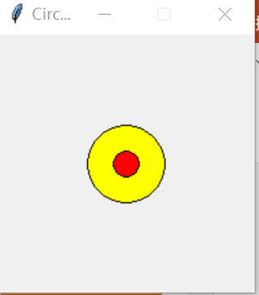
Class problem
Draw two circles with the same center, the smaller one with a red and the bigger one with a green color.
Hint: Objects drawn later will appear on top of objects drawn earlier. Fill in the color of the big one.
from graphics import*
def main():
center=Point(100,100)
circ1=Circle(center,10)
circ2=Circle(center,30)
win= GraphWin('Circles')
circ2.draw(win)
circ2.setFill("yellow")
circ1.draw(win)
circ1.setFill("red")

Slide 32
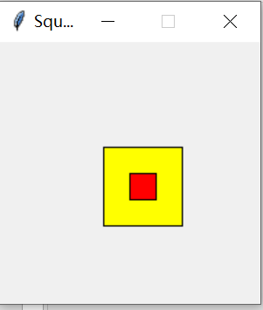
Practice problem
Using the function Rectangle to construct two Squares, the smaller one with a red color is inside the bigger one with a yellow color.
from graphics import*
def main():
A=Point(100,100)
B=Point(120,120)
C=Point(80,80)
D=Point(140,140)
squr1=Rectangle(A,B)
squr2=Rectangle(C,D)
win= GraphWin('Squares')
squr2.draw(win)
squr2.setFill("yellow")
squr1.draw(win)
squr1.setFill("red")

Slide 33
Homework
An archery target consists of a central circle of yellow surrounded by concentric rings of red, blue, black and white. Each ring has the same width, which is the same as the radius of the yellow circle. Write a program that draws such a target.
Hint: Objects drawn later will appear on top of objects drawn earlier.

Slide 34
4.4 Using Graphical Objects
To really understand the graphics module, we need to take an object –oriented point of view.
Objects combine data with operations.
Computation is preformed by asking an object to carry out one of its operations.
In the previous examples we manipulated GraphWin, Point, Circle, Oval, Line, Text and Rectangle. These are examples of classes.

Slide 35
4.4 Using Graphical Objects
Each object is an instance of some class, and the class describes the properties of the instance.
Take an example:
If we say that Augie is a dog, it means Augie is a specific individual in the larger class of all dogs. Augie is an instance of the dog class. Furthermore, Augie has four legs, a tail, a cold, wet nose.
If Rex is a dog, we expect that he will have similar properties like Augie, even though Rex and Augie may differ in specific details such as size or color.

Slide 36
4.4 Using Graphical Objects
The same ideas hold for our computational objects. We can create two separate instances of Point, say p1 and p2.
Each of these points has an x and y value, and they both support the same set of operations like getX and draw.
These properties hold because the objects are Points.

Slide 37
4.4 Using Graphical Objects
To create a new instance of a class, we use a special operation called a constructor. <class-name>(<param1>, <param2>, …)
<class-name> is the name of the class we want to create a new instance of, e.g. Circle or Point.
The parameters are required to initialize the object. For example, Point requires two numeric values.

Slide 38

4.4 Using Graphical Objects
p = Point(50, 60)
The constructor for the Point class requires to parameters, the x and y coordinates for the point.
These values are stored as instance variables inside of the object.
The resulting point is then assigned to the variable p.

Slide 39
4.4 Using Graphical Objects
To perform an operation on an object, we send the object a message. The set of messages an object responds to are called the methods of the object.
Methods are like functions that live inside the object.
Methods are invoked using dot-notation: <object>.<method-name>(<param1>, <param2>, …)

Slide 40
4.4 Using Graphical Objects
p.getX() and p.getY() returns the x and y values of the point. Routines like these are referred to as accessors because they allow us to access information from the instance variables of the object.
Other methods change the state of the object by changing the values of the object’s instance variables.
move(dx, dy) moves the object dx units in the x direction and dy in the y direction.
Move erases the old image and draws it in its new position. Methods that change the state of an object are called mutators.

Slide 41
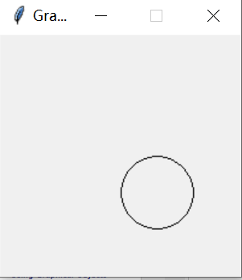
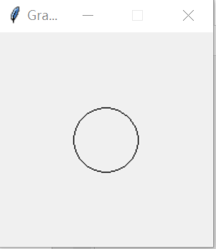
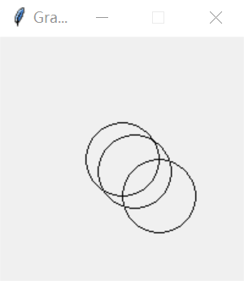
4.4 Using Graphical Objects
Class example
win=GraphWin()
circ = Circle(Point(100, 100), 30)
circ.draw(win)
circ.move(10,10)
circ.move(20,20)

Slide 42
4.4 Using Graphical Objects
Class example: Write a program to create two circles that are 20 units apart.
In the same graph window
To differ them with different color

Slide 43
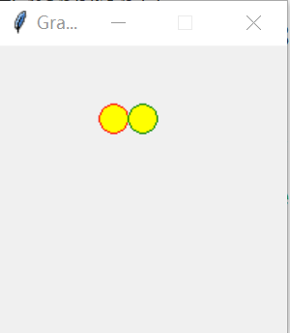
4.4 Using Graphical Objects
Class example: Write a program to create two circles that are 20 units apart.
from graphics import*
def main():
win=GraphWin()
circ1 = Circle(Point(80, 50), 10)
circ1.setFill('yellow')
circ1.setOutline('red')
circ2 = Circle(Point(100, 50), 10)
circ2.setFill('yellow')
circ2.setOutline('green')
circ1.draw(win)
circ2.draw(win)

Slide 44
4.4 Using Graphical Objects
Class example: Write a program to create two circles that are 20 units apart.
The graphics library has a better solution. Graphical objects have a clone method that will make a copy of the object!
from graphics import*
def main():
win=GraphWin()
circ1 = Circle(Point(80, 50), 10)
circ1.setFill('yellow')
circ1.setOutline('red’)
circ2=circ1.clone()
circ2.move(20,0)
circ1.draw(win)
circ2.draw(win)

Slide 45
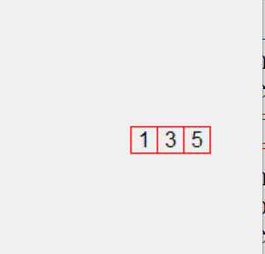
Practice problem
Write a program that draws 3 dice on the screen with the face value 1, 3, 5.
from graphics import*
def main():
win=GraphWin()
face1=Rectangle(Point(100,100),Point(120,120))
center=Point(110,110)
label1=Text(center,"1")
face1.setOutline('red')
face2=face1.clone()
face2.move(20,0)
center2=center.clone()
center2.move(20,0)
label2=Text(center2,"3")
face3=face2.clone()
face3.move(20,0)
center3=center2.clone()
center3.move(20,0)
label3=Text(center3,"5")
face3.draw(win)
label3.draw(win)
face1.draw(win)
label1.draw(win)
face2.draw(win)
label2.draw(win)

Slide 46
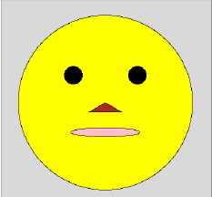
Homework
Write a program that draws some sort of face.

Slide 47
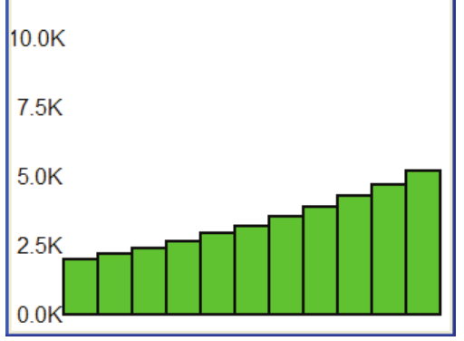
4.5 Graphing Future Value
One of the most important uses of graphics is providing a visual representation of data.
Recall the class example: Computed the future value of a ten-year investment?
In this section we will create a graphical summary.

Slide 48
4.5 Graphing Future Value
The original program futval.py had two inputs: the amount of money to be invested and the annualized rate of interest
The program calculated the change in principal year by year for ten years using the formula
principal = principal * (1 + apr).
In the graphical version, the output will be a ten-year bar graph where the height of successive bars represents the value of the principal in successive years.

Slide 49
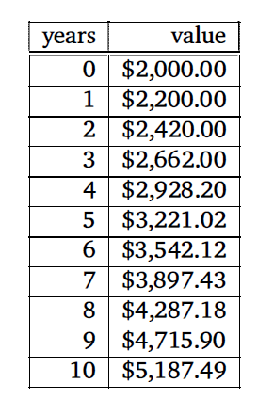
4.5 Graphing Future Value
Suppose we invest $2000 at 10% interest.
With the program we obtain the growth of the investment over a ten-year period.
Our program will display this information in a bar graph.
The graph contains eleven bars. The first bar shows the original value of the principal.

Slide 50
4.5 Graphing Future Value
How to draw a bar for year five with height corresponding to $3221.02?
How should the labels be drawn?
How wide should the bar be?
Use pencil and paper handy to draw some diagrams and scratch out calculations as
we go along.

Slide 51
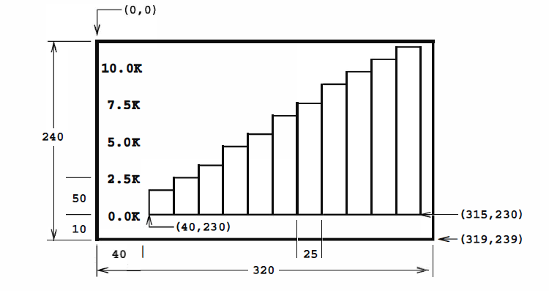
4.5 Graphing Future Value

Slide 52
4.5 Graphing Future Value
# Create a graphics window with labels on left edge
win = GraphWin("Investment Growth Chart",320 ,240)
win.setBackground("white" )
Text(Point( 20,230), "0.0K").draw(win)
Text(Point( 20,180), "2.5K").draw(win)
Text(Point( 20,130),"5.0K").draw(win)
Text(Point( 20,80), "7.5K").draw(win)
Text(Point( 20,30), "10.0K").draw(win)

Slide 53
4.5 Graphing Future Value
# Draw bar for initial principal
height=principal * 0.02
bar=Rectangle (Point(40,230) , Point(65,230-height))
bar.setFill ("green")
bar.setWidth(2)
bar.draw(win)

Slide 54
4.5 Graphing Future Value
# Draw bars for successive years
for year in range (1 ,11):
# calculate value f or the next year
principal = principal*(1+ apr)
# draw bar for this value
xll=year*25+40
height=principal* 0.02
bar= Rectangle (Point(xll,230), Point(xll+25,230-height))
bar.setFill("green")
bar.setWidth(2)
bar.draw(win)

Slide 55
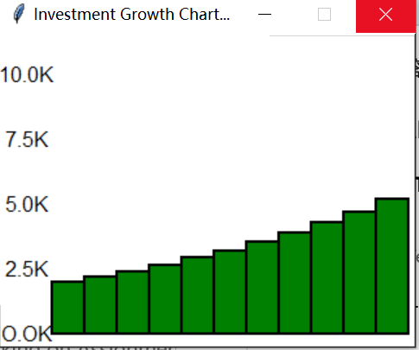
4.5 Graphing Future Value

Slide 56
4.6 Choosing Coordinates
Most graphics programming problems require some sort of a coordinate transformation to change values from a real-world problem into the window coordinates that get mapped onto the computer screen.
Coordinate transformation is an integral and well-studied component of computer graphics.

Slide 57
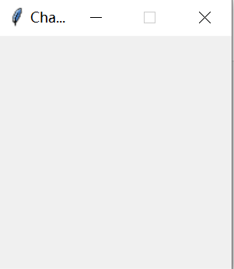
4.6 Choosing Coordinates
Example: Set coordinates to go from (0 , 0) in the lower left to (3 , 3) in the upper right .
Win() gives us a default 200 x 200 window
>>> win=GraphWin("Change coordinate")
>>> win.setCoords(0,0,3,3)

Slide 58
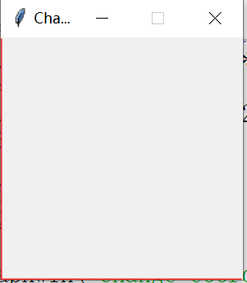
4.6 Choosing Coordinates
Example: Set coordinates to go from (0 , 0) in the lower left to (3 , 3) in the upper right .
Add the x axis and y axis in this window.
X axis is line through (0,0) and (0,3)
Y axis is a line go through (0,0) and (3,0)
>>> xl=Line(Point(0,0), Point(0,3))
>>> xl.draw(win)
>>> xl.setFill("red")
>>> yl=Line(Point(0,0),Point(3,0))
>>> yl.draw(win)
>>> yl.setFill("red")

Slide 59
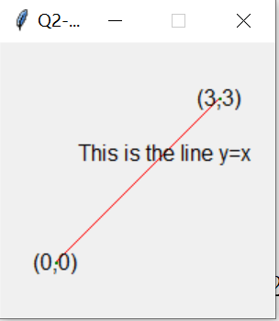
Homework
Set coordinates to go from (-1 , -1) in the lower left to (4, 4) in the upper right . Draw the line go through the points (0,1) and (2,3).
Label the equation of this line, like y=ax+b, you need to find the correct values of a and b. ( a is the slope, b is the intercept)
Label the two points in the window.
The line with the red color and two points with the green color.

Slide 60
4.7 Interactive Graphics
In a GUI environment, users typically interact with their applications by clicking on buttons, choosing items from menus, and typing information into on-screen text boxes.
These applications use a technique called event-driven programming.
Event-driven programming draws interface elements (widgets) on the screen and then waits for the user to do something.

Slide 61
4.7 Interactive Graphics
An event is generated whenever a user moves the mouse, clicks the mouse, or types a key on the keyboard.
An event is an object that encapsulates information about what just happened!
The event object is sent to the appropriate part of the program to be processed, for example, a button event.

Slide 62
4.7 Interactive Graphics
Getting Mouse Clicks
We can get graphical information from the user via the getMouse method of the GraphWin class.
When getMouse is invoked on a GraphWin, the program pauses and waits for the user to click the mouse somewhere in the window.
The spot where the user clicked is returned as a Point.

Slide 63
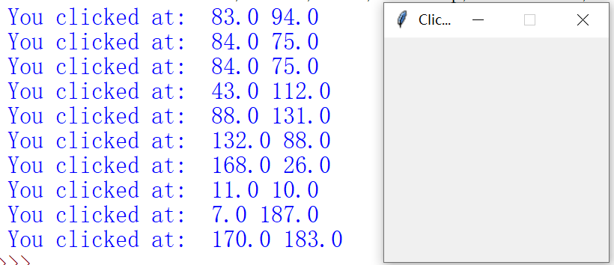
4.7 Interactive Graphics
The following code reports the coordinates of a mouse click
from graphics import*
def main( ):
win = GraphWin ( " Click Me ! " )
for i in range (10):
p = win.getMouse( )
print(" You clicked at: ",p.getX(), p.getY())
main ( )

Slide 64
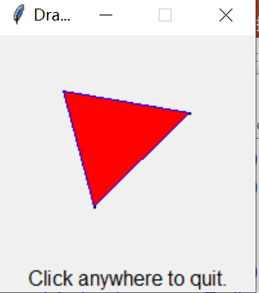
Class Example
Write a program to draw a triangle by clicking on three points in a graphics window.
win=GraphWin("Draw a Triangle ")
win.setCoords(0,0,10,10)
message=Text(Point(5,0.5),"Click on three points")
message.draw(win)
#get the three points
p1=win.getMouse( )
p1.draw(win)
p2=win.getMouse( )
p2.draw(win)
p3=win.getMouse( )
p3.draw(win)
#draw the triangle
triangle=Polygon(p1,p2,p3)
triangle.setFill("red")
triangle.setOutline("blue")
triangle.draw(win)
#use another click to quit
message.setText( "Click anywhere to quit.")
win.getMouse( )
win.close()

Slide 65
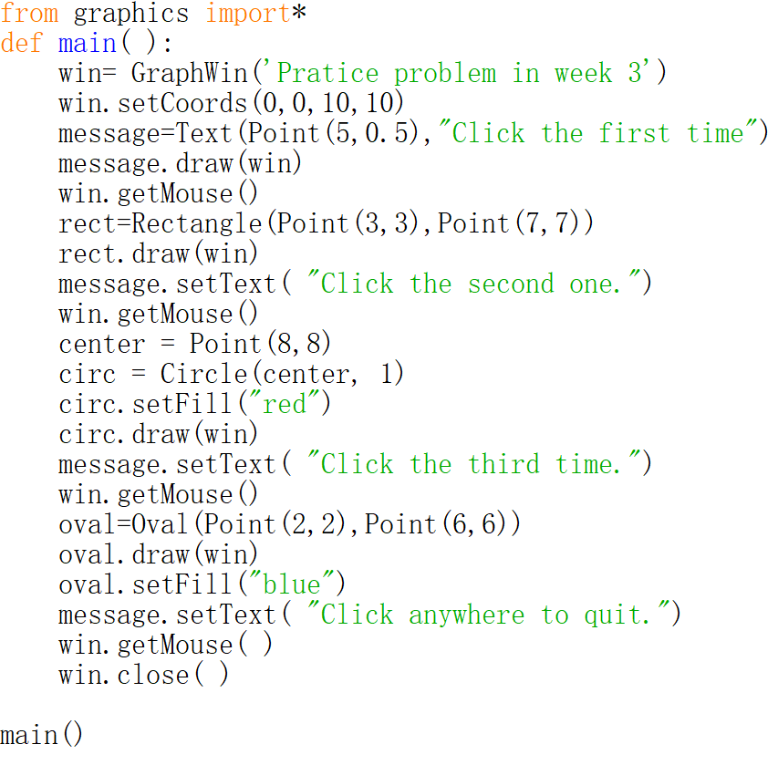
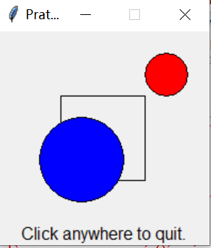
Practice problem
After click three times in a window, you will get a rectangle, circle and oval. Write a program to do it.

Slide 66
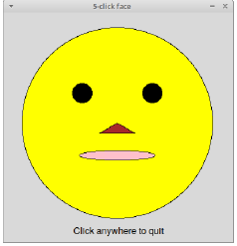
Homework
Write a program that click five times to draw some sort of face.
There are 5 "control points" for the face that come from 5 mouse clicks by the user. In order they are:
p1: The center of the face
p2: Somewhere on the edge of the face
p3: The lower-left corner of the nose
p4: The center of the left eye
p5: The lower-left corner of the mouth

Slide 67
Homework
Write a program that click five times to draw some sort of face.
The size and locations of the various features are determined by these control points as follows:
Head: This is a circle centered at p1 and having radius equal to the distance from p1 to p2.
Nose: The nose is an isosceles triangle formed by p1, p3, and a point that is vertically aligned with p3 and the same distance to the right of p1 as p3 is to the left of p1. Thus the nose will always be symmetric and horizontally centered in the face.
Eyes: The eyes are circles with a radius equal to one-tenth the radius of the head. The left eye is centered at p4 and the right eye should be placed symmetrically to match the left.
Mouth: The mouth is an oval with the lower-left corner of its bounding-box at p5. The mouth is centered horizontally and the height of the bounding-box is the same as the radius of the eyes

Slide 68
4.7 Interactive Graphics
Handling Textual Input
In the triangle example, all of the input was provided through mouse clicks.
Often we will want to allow the user to interact with a graphics window via the keyboard.
The Graph Win object provides a getKey () method that works very much like the getMouse method.

Slide 69
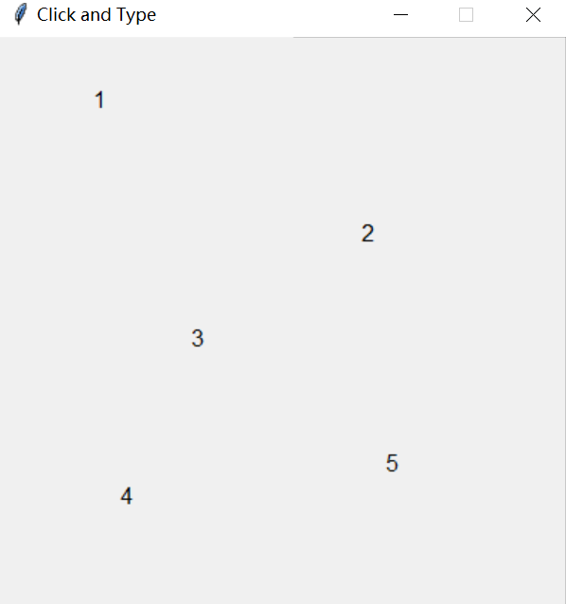
4.7 Interactive Graphics
Handling Textual Input
Example: Write a program that allows the user to label positions in a window by typing a single keypress after each mouse click.
from graphics import *
def main ( ):
win=GraphWin ("Click and Type " ,400 ,400)
for i in range (5):
pt=win.getMouse( )
key=win.getKey( )
label=Text(pt,key)
label.draw(win)

Slide 70
4.7 Interactive Graphics
Handling Textual Input
Example: Write a program that allows the user to label positions in a window by typing a single keypress after each mouse click.
from graphics import *
def main ( ):
win=GraphWin ("Click and Type " ,400 ,400)
for i in range (5):
pt=win.getMouse( )
key=win.getKey( )
label=Text(pt,key)
label.draw(win)
First it waits for a mouse click, and the resulting Point is saved as the variable p. Then the program waits for the user to type a key on the keyboard. The key that is pressed is returned as a string and saved as the variable key.
For example, if the user presses g on the keyboard, then key will be the string 'g'. The Point and string are then used to create a text object (called label) that is drawn into the window.

Slide 71
4.7 Interactive Graphics
Handling Textual Input
While the getKey method is useful, how about to get a name instead of single keypress?
The graphics library provides an Entry object that allows the user to actually type input right into a GraphWin.

Slide 72
4.7 Interactive Graphics
Handling Textual Input
The Entry object draws a box on the screen that can contain text. It understands setText and getText, with one difference that the input can be edited.

Slide 73
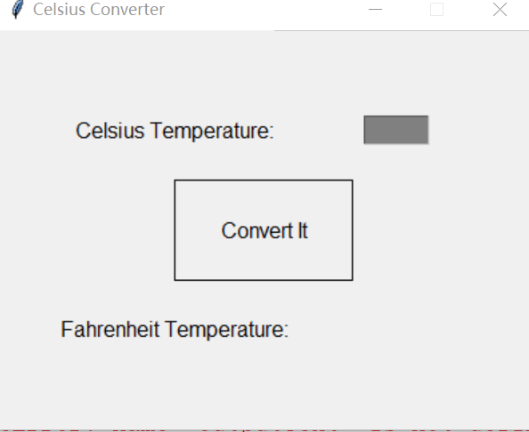
4.7 Interactive Graphics
Example: Recall the temperature conversion program in Chapter 2. Redo it with a graphical user interface.
win = GraphWin ("Celsius Converter", 400 , 300)
win.setCoords (0,0,3,4)
# Draw the interface
Text(Point(1,3), "Celsius Temperature:").draw(win)
Text(Point(1,1),"Fahrenheit Temperature:").draw(win)
inputText=Entry(Point(2.25,3),5)
inputText.setText("")
inputText.draw (win)
outputText=Text(Point(2.25,1)," ")
outputText.draw(win)
button=Text(Point(1.5,2),"Convert It")
button.draw(win) Rectangle(Point(1,1.5),Point(2,2.5)).draw(win)

Slide 74
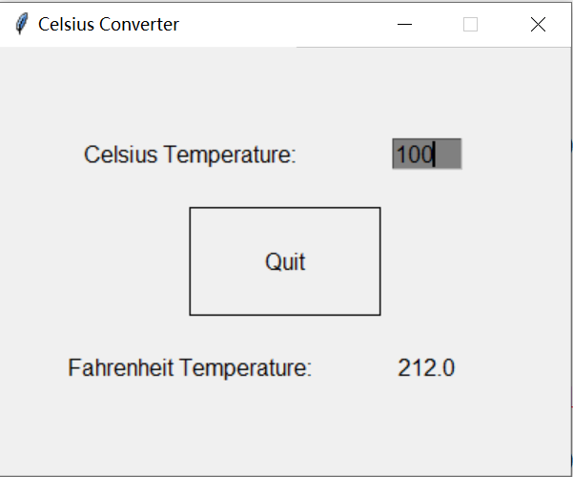
4.7 Interactive Graphics
Example: Recall the temperature conversion program in Chapter 2. Redo it with a graphical user interface.
# wait for a mouse click
win.getMouse( )
# convert input
celsius=float(inputText.getText( ))
fahrenheit=9/5 * celsius + 32
# display output and change button
outputText.setText(round(fahrenheit,2))
button.setText("Quit")
# wait for click and then quit
win.getMouse( )
win.close( )

Slide 75
4.7 Interactive Graphics
Example: Recall the temperature conversion program in Chapter 2. Redo it with a graphical user interface.
When run, this program produces a window with an entry box for typing in the Celsius temperature and a button to “do” the conversion.
The button is for show only! We are just waiting for a mouse click anywhere in the window.
The program pauses until the user clicks the mouse.

Slide 76
4.7 Interactive Graphics
Example: Recall the temperature conversion program in Chapter 2. Redo it with a graphical user interface.
The input is processed in three steps:
The value entered is converted into a number with eval. This number is converted to degrees Fahrenheit.
This number is then converted to a string and formatted for display in the output text area.

Slide 77

Homework
Write a program that computes the intersection of a circle with a horizontal line and displays the information textually and graphically. Do it with a graphical user interface.
You can complete this question with the following steps
1. Draw a circle centered at (0, 0) with the given radius, r, in a window with coordinates running from -10,-10 to 10, 10.
2. Draw a horizontal line across the window with the given y-intercept.
3. Draw the two points of intersection in red.
4. Print out the x values of the points of intersection.
Hint: the formula to calculate the intersections

Slide 78
4.8 GraphWin Objects
GraphWin (title , width , height ) Constructs a new graphics window for drawing on the screen. The parameters are optional; the default title is "Graphics Window," and the default size is 200 x 200 pixels.
plot (x , y , color) Draws the pixel at ( x, y) in the window. Color is optional; black is the default.
plotPixel (x , y , color) Draws the pixel at the "raw'' position (x, y), ignoring any coordinate transformations set up by setCoords .

Slide 79
4.8 GraphWin Objects
setBackground ( color) Sets the window background to the given color. The default background color depends on your system.
close () Closes the on-screen window.
getCenter ( ) Returns a clone of the midpoint of the line segment, center of a circle, center of a rectangle, etc.

Slide 80
Class example:
from graphics import *
def main( ) :
win=GraphWin( )
shape=Circle(Point (50,50),20)
shape.setOutline("red")
shape.setFill("red")
shape.draw(win)
for i in range (5):
p=win.getMouse( )
c=shape.getCenter( )
dx=p.getX( )-c.getX( )
dy=p.getY( )- c.getY ( )
shape.move(dx,dy)
win.close( )
Describe what happens when the interactive graphics program runs:

Slide 81
Homework
Modify the program of class example (circle moves), do the following tasks
(a) Make it draw squares instead of circles.
(b) Have each successive click draw an additional square on the screen(rather than moving the existing one).
(c) Print a message on the window "Click again to quit" after the loop, and wait for a final click before closing the window.

Slide 82
Review of Exam 1
1. Class examples
2. Practice problems
3. Assignments.

Slide 83
Review of Exam 1
Chapter 1
Understand some basic build in functions, like eval, input, print, etc.
Chapter 2
Know how to write the simple program to solve some real problems.
Chapter 3
Understand the concept of for loop
Know how to write the program to calculate some values, which the formulas are provided.
Know how to use the for loop to complete some simple tasks.

Slide 84
Review of Exam 1
Chapter 4
Understand how to use the package graphics.py to draw the specific graphs.
Know how to use the object Point, Line, Rectangle, Oval, Polygons, Text to draw some graphs.
Understand the importance of the mouse click, and know how to write codes for its purpose.
Know how to write the program to complete a task with the graphical user interface.

