Slide 1
Up-lifting revenue with controllable marketing variables in telecommunication sector.
Team : DS_2020_3
Perera G.Y.V. - 209363M
Weerasooriya P. A. A. - 209392B
Maldini P.A.N. - 209355P

Slide 2
The problem
Data
Research Question
Outcomes
The dataset contains the details of 400 prepaid users of a leading global telecommunication company. It has 38 attributes such as; data usage, talk time, recharge amount for a month. The data were collected in 2018.
Identifying a set of attributes of the data set, alterations of which in turn can increase the mean revenue for a given month.
Identifying how the said attributes could be mapped to promotional campaigns.
Analysis on identifying the target group is out of the scope.
A descriptive analysis to give an overall idea about the sample.
A diagnostics analysis investigating the causality.
A Predictive analysis on predicting the revenue or the usage of a new user.
Prescriptive analysis, in order to explore the aforementioned research question.

Slide 3
The Data Set
Categorical attributes
Overview
District: ['GAM' 'KAL' 'MTR' 'COL' 'AMP' 'KAN' 'RAT' 'KEG' 'GAL' 'ANU' 'BAD' 'BAT' 'KUR' 'PUT' 'HAM' 'POL' 'MAT' 'NUW' 'TRI' 'MON' 'VAV' 'JAF']
Language: ['SIN' 'TAM' 'ENG']
Smart_ph_flag: [0 1]
Dual_sim_flag: [1 0]

Slide 4
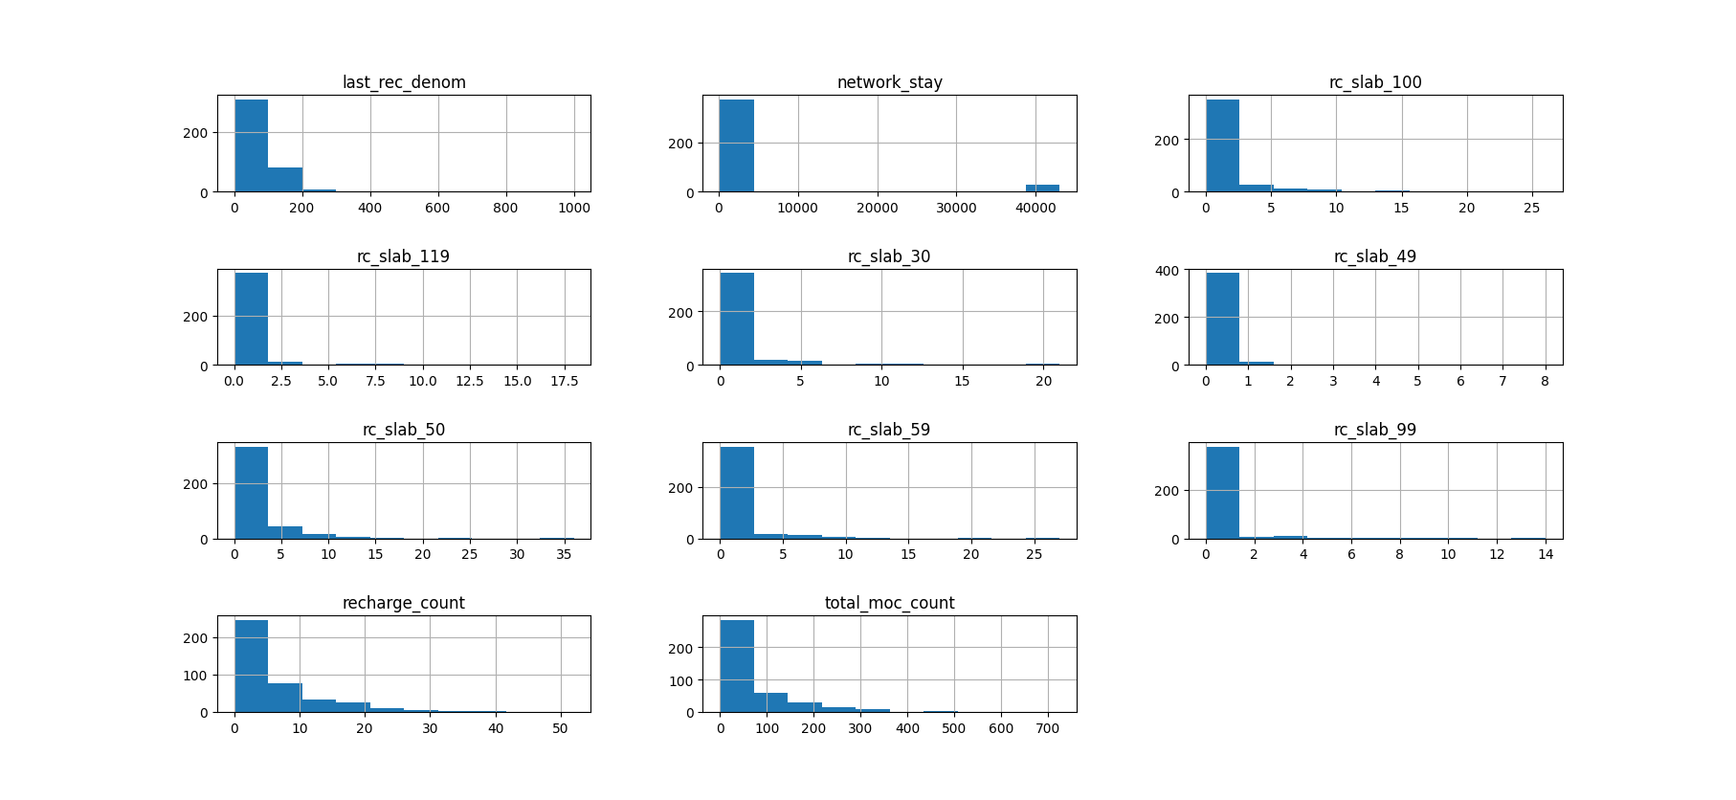
The Data Set
Metric Discrete attributes
Overview
Overview

Slide 5
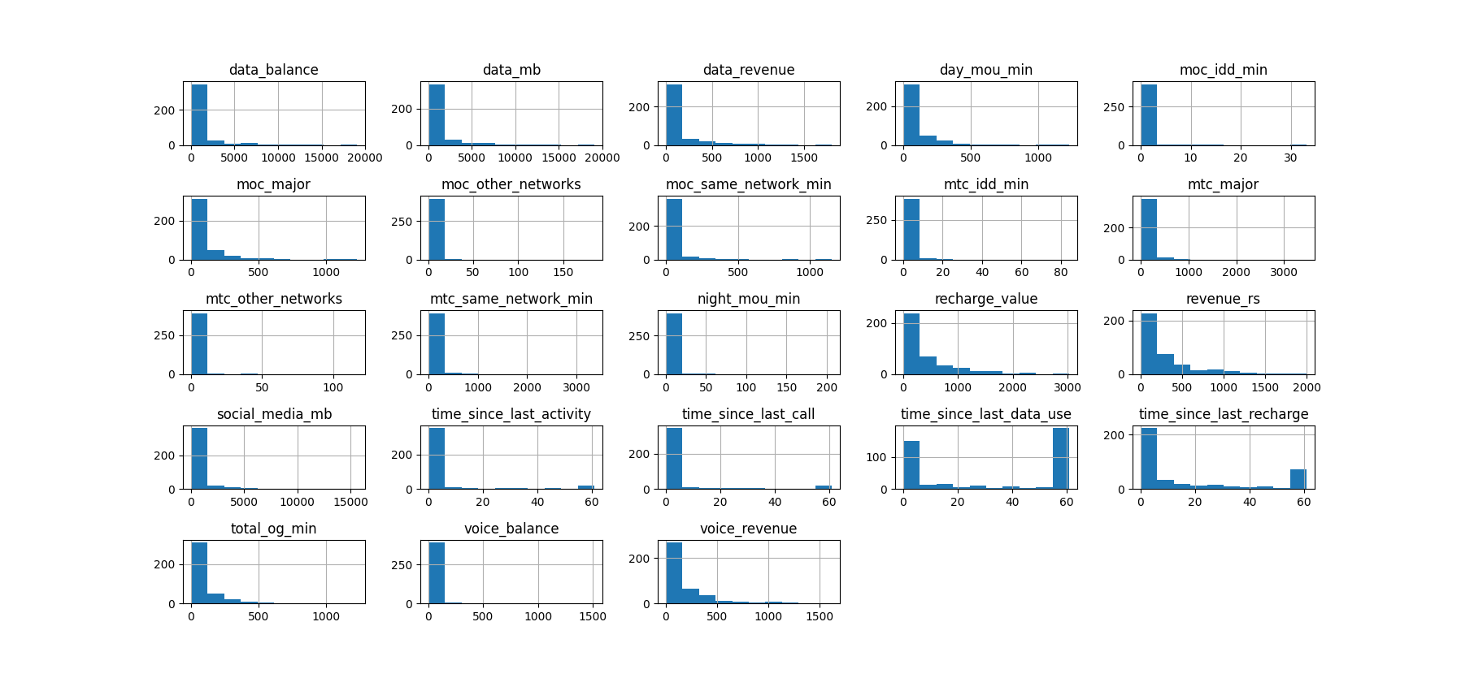
The Data Set
Metric Continuous attributes
Overview

Slide 6
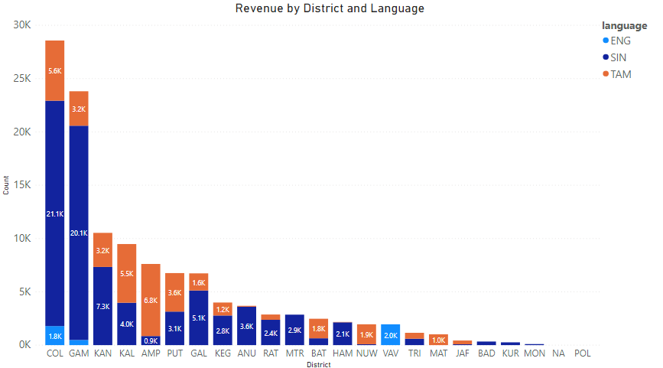
Descriptive and Diagnostic Analysis
Revenue by district and language

Slide 7
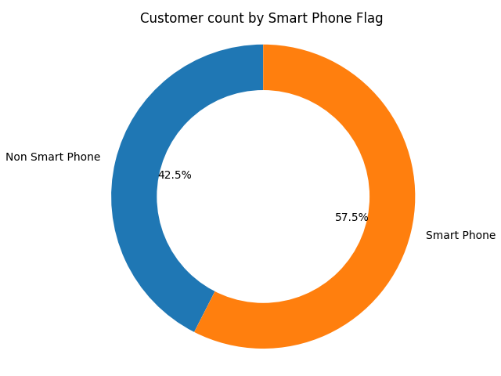
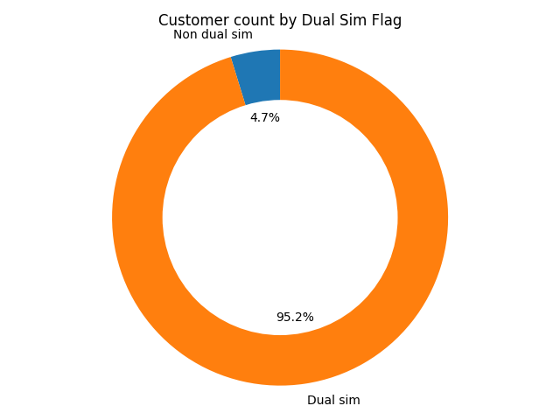
Descriptive and Diagnostic Analysis
Smart Phones and Customer Count / Dual Sim and Customer Count

Slide 8
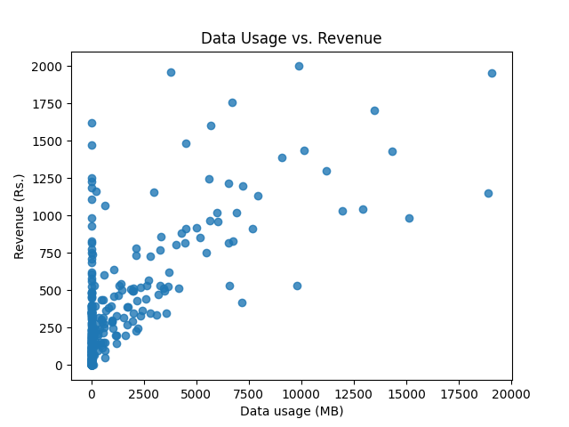
Descriptive and Diagnostic Analysis
Data Usage and Revenue

Slide 9
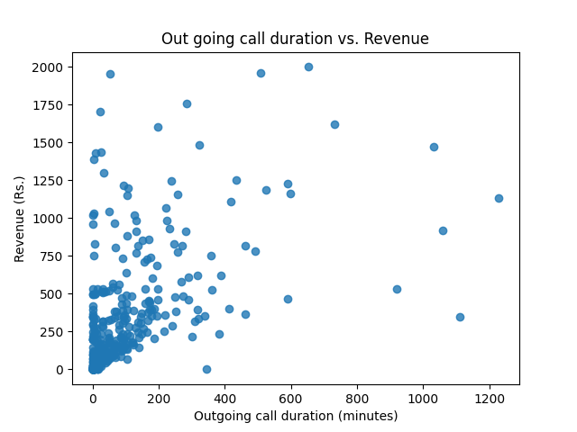
Descriptive and Diagnostic Analysis
Outgoing call duration and Revenue

Slide 10
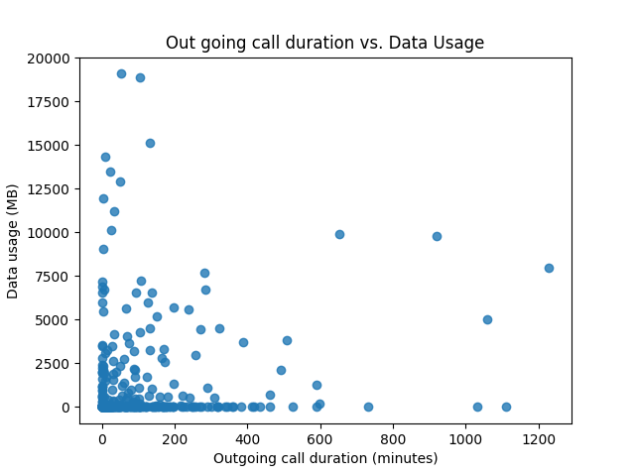
Descriptive and Diagnostic Analysis
Outgoing call duration and Data Usage

Slide 11
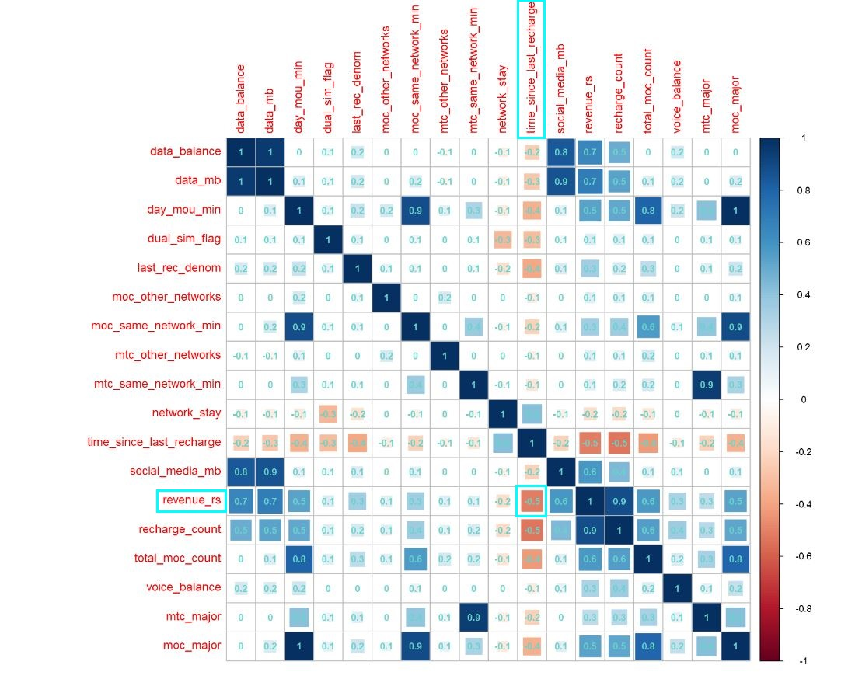
Descriptive and Diagnostic Analysis
Correlation Plot
Highly correlated variables for revenue_rs : data_mb, data_balance, recharge_value
Time_since_last_recharge and revenu_rs variables show moderate negative correlation.

Slide 12
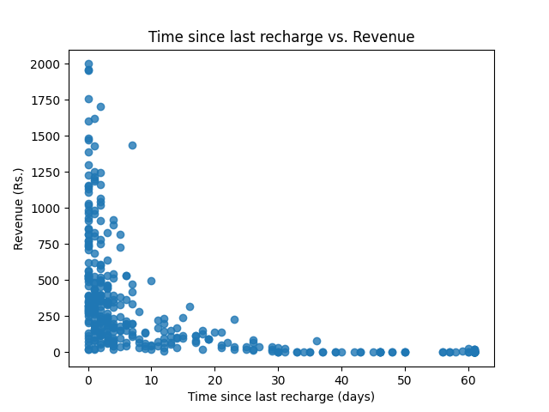
Descriptive and Diagnostic Analysis
Scatter Plot - Time since last recharge vs revenue
mean 4.630000
std 13.722933
min 0.000000
25% 0.000000
50% 0.000000
75% 1.000000
max 61.000000
An average customer stays 5 days without any activity in the network.
75% of the customers have a very less number of days since their last activity in the network.

Slide 13
Predictive Analysis
Overview
A regression analysis was done in order to predict the monthly revenue of each customer. Both random forest model and linear regression model were built and the linear regression model was selected based on the accuracy measures.
Highly correlated variables :
The highly correlated variables were identified as follows. Pearson correlation was used to calculate the correlation coefficients and the variable sets with coefficient >$ 0.80 were considered as 'high'.

Slide 14
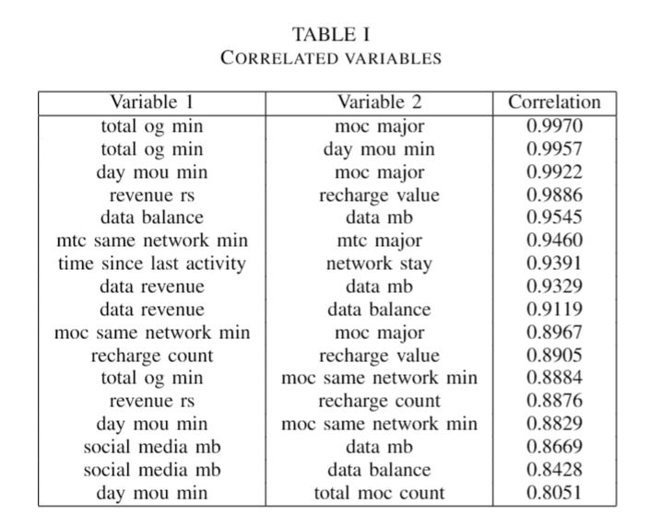
Predictive Analysis
Correlated Variables
Highly correlated variables :
The highly correlated variables were identified as follows. Pearson correlation was used to calculate the correlation coefficients and the variable sets with coefficient $>$ 0.80 were considered as 'high'.

Slide 15
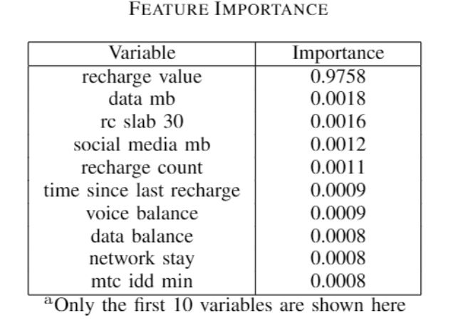
Predictive Analysis
Feature Importance
A base random forest model was built with 10000 trees.Feature importance measures were obtained as follows.
Selected variables
recharge value
data mb
rc slab 30
time since last recharge
voice balance
data balance
network stay
mtc idd min moc same network min
mtc same network min
moc idd min
total moc count
mtc other networks

Slide 16
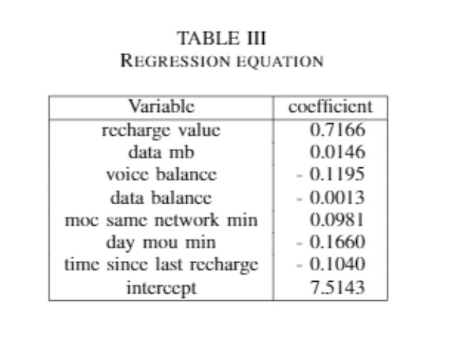
Predictive Analysis
Model Building
A linear regression model was built to predict the monthly revenue of the customers. 80% of the data was used as the training data set. The mean squared error, which is the average squared difference between the estimated values and the actual value was used on testing data set (the 20% left) to evaluate the model results.
The best model results:
Mean Absolute Error:17.30
Mean Squared Error :801.08
Root Mean Squared Error :28.30
The monthly revenue was predicted for the group of customers in the testing data set.
Actual total revenue = Rs.19690.77
Predicted total revenue = Rs.19756.54

Slide 17
Prescriptive Analysis
Overview
Actionable insights were given by analysing the results of the descriptive, diagnostics and predictive analyses.
In telecommunication sector, the usual approach for up sell-cross sell is sending out the same promotion for the entire customer base. As the usage and network stay is different from customer to customer, this approach has limitations in maximizing the profit.

Slide 18
Prescriptive Analysis
Promotion Related Details
Voice promotion
Internal cost : Rs.25
Mapped controllable predictor : moc same network min
Details : Recharge Rs.50 and talk for Rs.100 inthe same network (≈65 minutes)
Data promotion
Internal cost : Rs.15
Mapped controllable predictor : data mb
Details : Recharge Rs.49 (800 mb) and use 1GB

Slide 19
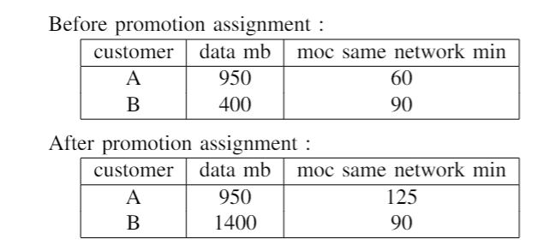
Prescriptive Analysis
Revenue Prediction With The Controllable Variables
e.g: Offer the ‘voice promotion’ to customer ‘A’ and the ‘data promotion’ to customer ‘B’
The controllable predictor ‘moc same network min’ value of the customer ‘A’ is increased by the promotion amount(65 minutes) when the voice promotion is offered to the customer ‘A’.
The controllable predictor ‘data mb’ value of the customer ‘B’ is increased by the promotion amount (1000MB) when the data promotion is offered to the customer ‘B’ (Assuming that the customer ‘A’ and ‘B’ accept the promotion if and only if he/she has non zero historical values for the corresponding variable)
The revenue prediction after the promotion campaign is done by feeding the updated predictor values in to the linear regression model which was explained in the predictive analysis.

Slide 20
Prescriptive Analysis
Experimental setup
The predictors ‘moc same network min’ and ‘data mb’ were increased and the monthly revenue prediction was done by feeding the updated predictor values in to the linear regression model.
In the experimental set-up :
Predicted total revenue = Rs.23573.22
The revenue uplift = Rs.21791.50 - Rs.19756.54 = Rs.2034.97
Profit = The revenue uplift - Total internal cost
Profit = Rs.2034.97 - Rs.315.00 = Rs.1719.97
The experimental set-up was done by identifying the needy customers to accept the respective promotion. The variables ‘moc same network min’ and ‘data mb’ were scaled using MinMaxScaler. The respective promotion is assigned to the customers whose scaled value is greater than a threshold (⍶= 0.02)
The cost is calculated as below
No of customers with the data promotion = 18
No of customers with the voice promotion = 27
Cost for both promotions = Rs.10 x 18 + Rs.5 x 27
Total internal cost = Rs.315

Slide 21
CONCLUSION
This analysis suggests a method of assigning the promotions while tuning the predicted figure of the revenue uplift. The promotion assignment can be done using the same model by varying the threshold ⍶ .

Slide 22
Q & A

