Slide 1


Computational modelling of underwater noise generation by turbulent fluid-structure interactions
Nicholas McCaw
n.mccaw@soton.ac.uk
FEE

Slide 2

Motivation
Environmental impact of ship noise
New regulations
Real Reason

Slide 3
Background
Hydrofoils
Stresses on hydrofoils
Effect of shape
Notes:
Hydrofoils work by creating a pressure difference between the two surfaces to produce a force
Hydrofoils aren’t infinitely stiff therefore bend due to the pressure difference
The shape of the hydrofoil causes the force, therefore the changing the shape changes the force etc etc

Slide 4
Background
Flow regimes
  Laminar
  Turbulent
Effects of turbulence
Notes:
Laminar, flow regime with relatively simple flow physics. Easily solved via Navier-Stokes equations
Turbulent more difficult. ‘Random’ fluctuations in pressure and velocity. Caused by viscosity.
Turbulence can reduce drag in some cases, however due to fluctuations in pressure there is deformation of foil. Called turbulent buffering

Slide 5
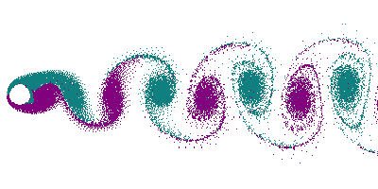
Aims Of Project
Vibration causes noise
Trailing edge vibration
Reduce the noise by reducing vibration
Notes:
Noise is caused by the vibration of the structure
Von karman vortices are produced at the trailing edge which cause oscillation pressure differences which cause vibration
To reduce the noise

Slide 6
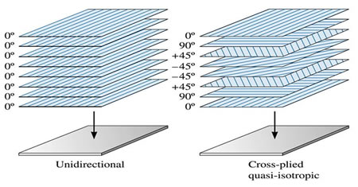
How?
Various methods to reduce vibration
  Trailing edge treatments
  Composite tailoring
  Etc …

Slide 7
Conclusion
Propeller vibration causes Noise
Want to reduce noise
Do this by trailing edge treatments or other methods

Slide 8
Computational modelling of underwater noise generation by turbulent fluid-structure interactions
There will be no questions
Nicholas McCaw
n.mccaw@soton.ac.uk
FEE

