Slide 1
DESIGNING A NETWORK
GOMEZ| LEE | MACASAET | SAN JUAN

Slide 2
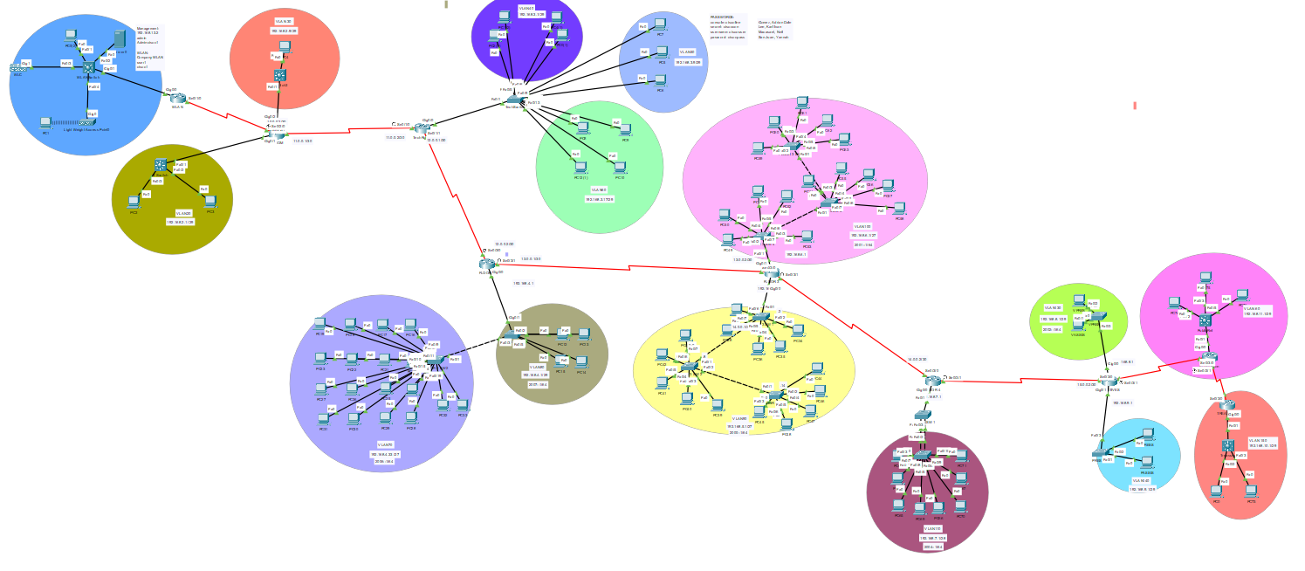
TOPOLOGY

Slide 3
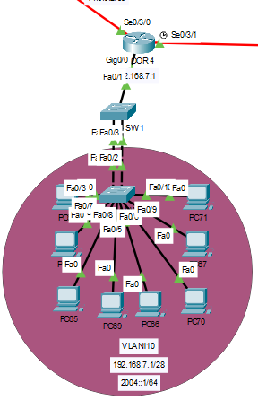
BACKGROUND/SCENARIO
Etherchannel
FLOOR 4
- Modes: Auto and Desirable
IPv6
- Stateless DHCPv6
- Auto config

Slide 4
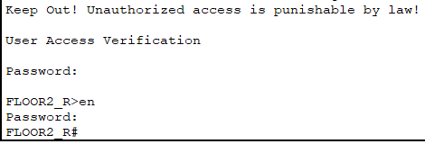

BACKGROUND/SCENARIO
Basic Enhanced Security
User Exec Password
Privileged Mode Password
MD5 Security
SSH

Slide 5
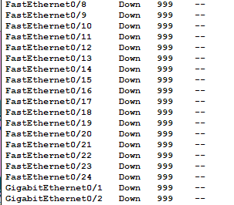
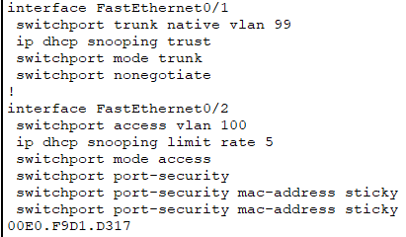
BACKGROUND/SCENARIO
Network Security
Port Security
Trunk Security
Unused Switchport Security
DHCP Snooping

Slide 6
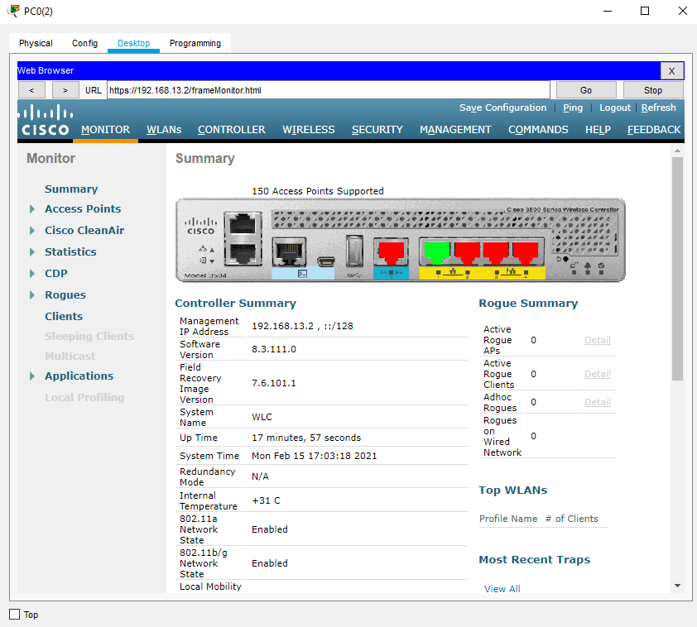
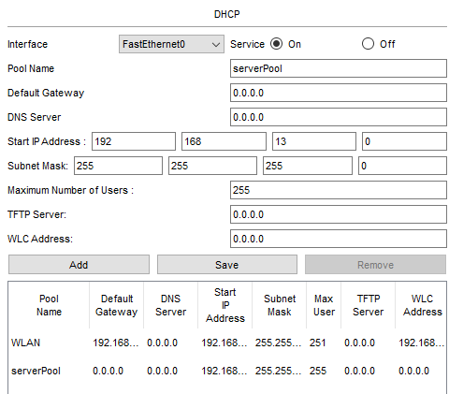
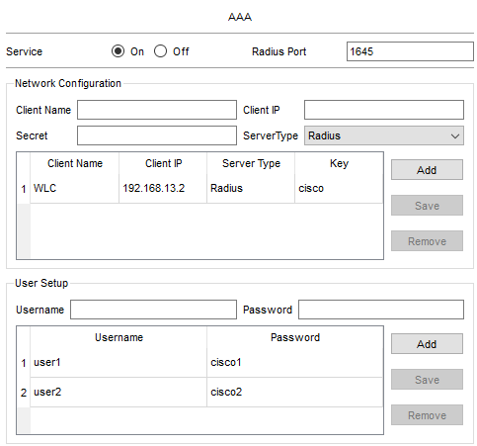
BACKGROUND/SCENARIO
WLAN
WLC Configuration
AAA/RADIUS Security
Automatic DHCP Addressing
Access Points

Slide 7
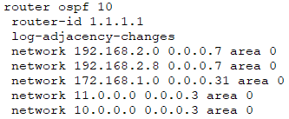
BACKGROUND/SCENARIO
OSPF
Router ID
IP Address Configuration

Slide 8
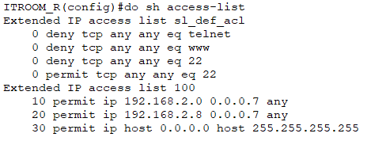
BACKGROUND/SCENARIO
ACL
Extended ACL
IT Room can ping all routers; other routers can only ping IT Room

Slide 9
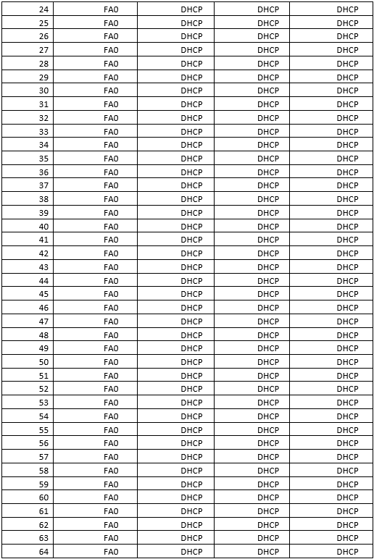
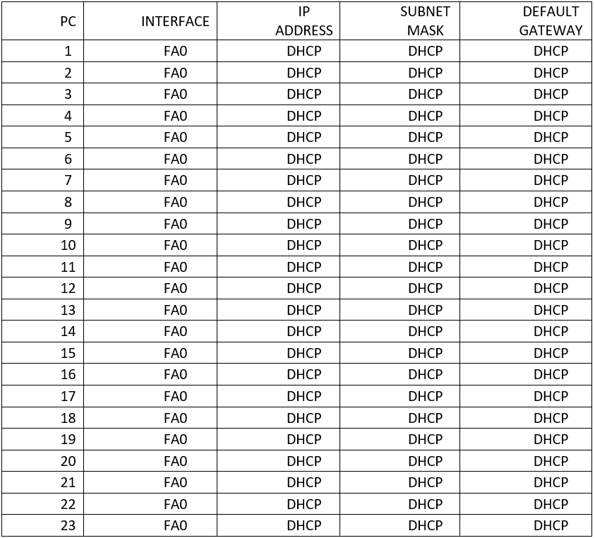
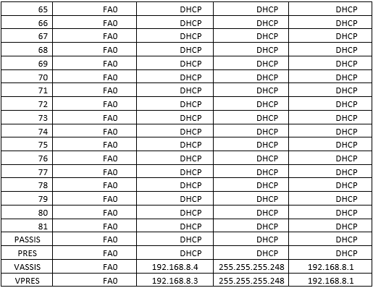
ADDRESSING TABLE
FOR PC: 85 PCs

Slide 10
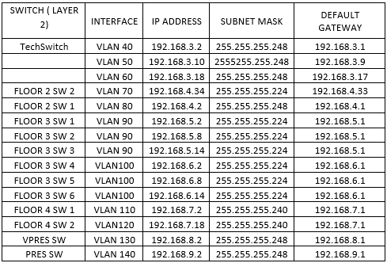
ADDRESSING TABLE
FOR LAYER 2 SWITCHES:
PASSWORDS:
console: ciscoline
secret: ciscocon
username: ciscouser
pasword: ciscopass

Slide 11
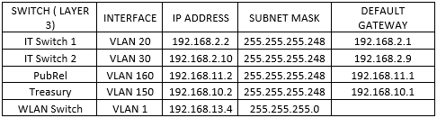
ADDRESSING TABLE
FOR LAYER 3 SWITCHES:

