Slide 1

SHEIN Data
Cleaning Assignment
Nicky Melville
Data Quality Pipeline | May 11th 2026

Slide 2
The Dataset
Source
Original size
SHEIN product scrape
(us.shein.com)
~111,189 rows
8 raw columns
Format
Variables
CSV / XLSX
Scraped Feb 2023
url, name, sku (stock keeping unit), price,
size, brand, description, images

Slide 3

What I Set Out to Do
Build a reproducible data-quality pipeline in R that reads, validates, cleans, and prepares the SHEIN product dataset for missing-value imputation.
Scoped Variables
sku
Product identifier (primary key)
price
Sale price — parsed to numeric
brand
Brand name — mojibake cleaned
color
Extracted from description field
size
Classified into 13+ size systems
images
Left as is, image URLs counted

Slide 4

Pipeline Architecture
RAW
DIAGNOSE
CLEAN
IMPUTE
EXPORT
REPORT
00_config.R
01_ingest.R
02_diagnosis.R
03_clean.R
04_impute.R
05_export.R
06_report.Rmd
Outputs: shein_cleaned.csv → .sav / .dta / .xlsx / .rds + Word report + diagnostics workbook

Slide 5

Top Data Quality Issues
Duplicate rows from repeated scraping
~7.18% of raw rows are exact duplicates by SKU, (7,987/111,189)
Mojibake in brand field
Corrupted characters + category breadcrumbs appended after brand name
Description is a serialised Python dict
Structured as [{'Color':'Black'}, {'Material':'Fabric'}] — not directly usable
Size column encodes 13+ different systems
Standard, EU, shoe, bedding, kids, bra, petite, plus, jeans, etc. in one field

Slide 6

How I Cleaned It
Variable | Cleaning Action | Result
sku | Strip 'SKU:' prefix, deduplicate | Primary key; 7.18% rows removed
price | Strip '$', coerce to numeric, flag issues | price_flag: ok | missing | invalid | outlier
brand | latin-ascii transliteration, extract before '?' | Clean brand name; empty → NA
color | Regex extract 'Color' from description | Standalone column; description dropped
size | Classify system → extract labels, US sizes, dims | 5 new columns; NA for non-applicable systems

Slide 7
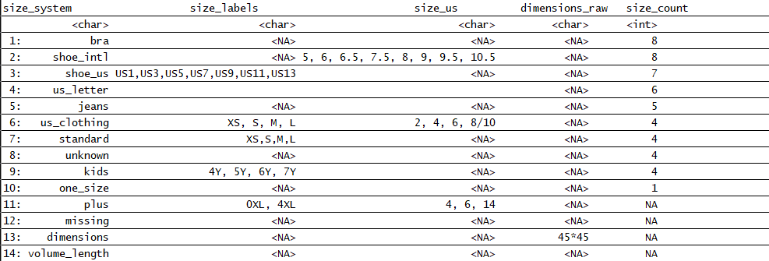

Slide 8

Imputation Strategy
Variable | Method | Justification
price | Grouped median by size_system | Robust to outliers; respects product category
brand | Left as NA (not imputable) | Brand is scraped metadata — cannot be inferred
color | Mode by product category | Categorical; most common within category is safe
size_labels | Left as NA where non-applicable | NA by design for bedding/unknown systems
Design principle: all size system columns present in every row. NA is preferred over omitting non-applicable columns — this preserves structure for downstream grouped imputation.

Slide 9

Size System Distribution

Slide 10

Outputs
shein_cleaned.csv
Primary cleaned dataset — all columns, one row per product
shein_cleaned.sav
SPSS format for statistical software users
shein_cleaned.dta
Stata format for econometric workflows
shein_cleaned.xlsx
Excel workbook for non-technical stakeholders
shein_cleaned.rds
Native R format preserving data types and factors
shein_data_quality_report.docx
Rendered Word report documenting all decisions
shein_exploratory_diagnostics.xlsx
20-sheet diagnostics workbook (evidence base)

Slide 11

What Went Well
Modular pipeline design
Scripts 00–03 each have a clear single responsibility. New stages slot in without rewriting earlier code.
Size system classification
13+ distinct size systems correctly identified and parsed into structured columns — a genuinely complex regex task.
Drop log accountability
Every column dropped or replaced is recorded with an explicit reason. Decisions are auditable.
Diagnostics-first approach
20-sheet diagnostics workbook built before cleaning began — issues were quantified, not guessed.

Slide 12

What Was Hard
Git LFS setup for large CSV
The raw file exceeded GitHub's limit. Configuring LFS was the first-day bottleneck.
Next time: Would set up LFS before starting data work next time.
data.table reference semantics
Shallow copy warnings, .SDcols placement, and := scoping caused repeated debugging cycles.
Next time: Now use setDT() immediately after as.data.table() and copy() before mutations.
Size field complexity
One column encoding 13+ size systems required iterative regex design and repeated misclassification fixes.
Next time: Would prototype on a stratified sample first, then scale to full data.
The pipeline, report, git pushes and cleaning sizes
All these tasks were challenges, as I had to ask for guidance on several occasions for push in the right direction.
Next time: I know how to clean larger datasets, create cleaner pipelines, README and cleaning csv scraped data.

Slide 13

Time Breakdown
Total: ~46 hours

Slide 14

With More Time
Automated test suite
Unit tests for each cleaning function — validate regex outputs against known edge cases.
Image URL validation
HTTP HEAD requests to verify image links are still live; flag broken URLs.
Price modelling by category
Use size_system + color + brand to build a simple predictive model for missing prices.
Interactive diagnostics dashboard
Shiny app showing missingness heatmaps, size system breakdowns, and price distributions.

Slide 15
Thank You
Questions & Discussion
https://github.com/NMelville2000/Shein_Data_Cleaning_Assignment.git

