Slide 1
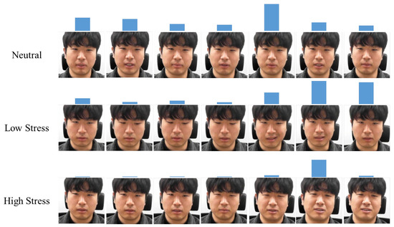
CMPE 258 — Deep Learning · SJSU · Spring 2026
Facial Stress &
Fatigue Detection
Multi-Task DINOv2 + LLM Wellness Layer
Nikita Memane · Sankalp Wahane
Live Demo
Model
GitHub

Slide 2
1
Problem & Motivation
The Challenge
Target Use Cases
Stress and fatigue significantly impact health, safety, and productivity across diverse domains including workplace environments, educational settings, and transportation systems.
Study-break reminders
Detect cognitive fatigue during long study sessions
Driver-monitoring assists
Self-report instruments (PSS, KSS) are noisy and intrusive
Real-time fatigue detection for road safety
Wearables work but require hardware most users won't carry
Workplace wellness dashboards
Ambient stress monitoring in office environments
The Solution
A camera-based estimator is the missing third modality: passive , ambient , sensorless .
Not clinical diagnosis. A soft, ambient signal for gentle interventions without requiring users to wear or fill out anything.

Slide 3
2
Why This Is Hard
1
Proxy Labels
3
No Temporal Cues
FER-2013 has emotion labels, not stress labels — we map them to three stress levels with a documented heuristic.
Single-frame fatigue is much harder than single-clip fatigue. Blink rate, micro-expressions need video.
This introduces systematic bias: emotion-stress mapping is approximate, not ground truth.
Static images miss dynamic behavioral markers critical for fatigue assessment.
2
Tiny Fatigue Dataset
4
Demographic Skew
Only ~400 fatigue images total; test split is n=33. We are explicit about this limitation throughout.
FER-2013 is not balanced across age, ethnicity, and gender; we flag this as important future work.
Statistical power is severely limited; results are encouraging but not robust.
Model may not generalize equitably across populations without fairness auditing.
Intellectual honesty shapes interpretation. Calling out limitations up front ensures readers interpret every later number with appropriate skepticism.

Slide 4
3
Data & Preprocessing
Datasets
Stress Proxy Mapping
Dataset | Task | Size | Notes
FER-2013 | Stress (3) | 35,887 | Emotion → stress proxy
Yawn-Eye | Fatigue (2) | 433 | Subject-grouped split
LOW
happy / surprise / neutral
MODERATE
sad
HIGH
angry / fear / disgust
Splits: 70/15/15 — train 25,300 / val 5,653 / test 5,367
Augmentation Strategy
RandAugment
Horizontal Flip
Mild Jitter
N=2, M=9
p=0.5
Color augmentation

Slide 5
4
Architecture
Model Architecture
Model Specifications
Input
Image (224×224×3)
22.2M
Total Parameters
DINOv2-small (ViT) layers 0-8 frozen, 9+ fine-tuned
Trainable
5.49M
Backbone
Trainable %
24.7%
CLS Token
384-d
Training Time
~25 min
Shared Trunk
Linear(384→256) → LN → GELU → Dropout(0.3)
Single Tesla T4 GPU
Stress Head
Fatigue Head
Key insight: Partial-freeze + multi-task. Most of the backbone is frozen; the shared trunk and top transformer layers do the task-specific work.
Linear → 3 classes
Linear → 2 classes

Slide 6
5
Design Rationale: DINOv2 + Multi-Task
DINOv2 over ResNet-50
Multi-Task over Independent
Self-supervised pretraining
Regularization effect
Trained on 142M images without labels — learns robust visual representations
Stress task (n=25k) regularizes the tiny fatigue task (n=400)
Feature reuse
Stronger transfer learning
Shared low-level cues (eyes, brows, mouth) learned once, not twice
Better performance on small downstream datasets [Oquab et al. 2023]
Inference efficiency
Aligned pretrain objective
Half the inference cost — single forward pass for both tasks
Augmentation-invariance objective is well-aligned with affect cues in facial expressions
Both choices are about data efficiency. With 400 fatigue samples, an independent model would memorize the training set. The shared backbone forces general feature learning.

Slide 7
6
Training Setup & Results
Training Hyperparameters
Test Results
Setting | Value
Optimizer | AdamW (wd 0.01)
Learning Rate | Backbone 3e-5 · Head 3e-4
Schedule | 500-step warmup → cosine to 1e-6
Loss | Masked CE + focal (γ=2.0)
Batch | 32, fp16 mixed precision
Early Stop | Patience 3 on mean bal. acc
Seed | 42 (fully reproducible)
Metric | Stress (n=5,334) | Fatigue (n=33)
Balanced Accuracy | 0.7145 | 0.9615
Macro F1 | 0.7003 | 0.9678
ROC-AUC | 0.8921 | 0.9885
ECE (Calibration) | 0.0537 | 0.0303
Mean: Balanced Acc 0.8380 · Macro-F1 0.8340
Honest caveat:
Fatigue n=33 — encouraging but not statistically robust. Stress n=5,334 is the reliable number we stand behind.
Training Curve
Validation balanced accuracy by epoch:
Epoch 0-4:
0.5824 → 0.6288
Epoch 5-6:
0.6104 → 0.6168
Epoch 7 (BEST):
0.6311 ★
Epoch 8-10:
0.6176 → 0.5923
Early stopping correctly halted at epoch 10

Slide 8
7
Confusion Matrices & Calibration
Stress Confusion Matrix
Calibration Analysis
 | Pred Low | Pred Mod | Pred High
True Low | High | Med | Low
True Mod | Med | High | Med
True High | Low | Med | High
Expected Calibration Error
0.0537
Well-calibrated without temperature scaling
Reliability diagram tracks diagonal closely
Mild over-confidence at very-high confidence bins
Values normalized — diagonal = correct predictions
Why Calibration Matters
Key insight: Off-diagonal mass concentrated at adjacent classes (low↔moderate, moderate↔high). Almost no low↔high confusion — this is the benign failure mode for an ordinal 3-class problem.
For a wellness tool, "we're 90% sure" should correspond to being right 90% of the time. ECE measures that directly. The live demo surfaces confidence values directly to users — calibration ensures these are meaningful.

Slide 9
8
MLOps Pipeline
Deployment Pipeline
Kaggle GPU
Best CKPT
HF Hub
Pull
GitHub
Push main
GitHub Actions
Rebuild
HF Space
Training Notebook
Model Registry
Source of Truth
Auto Deploy
Live Gradio App
TensorBoard Logs → Centralized Tracking
MLOps Maturity: Level 2–3
Centralized tracking — TensorBoard logs
Reproducibility: Every result is reproducible by a third party with two API tokens.
Model registry — HF Hub versioned models
Automated deployment — GitHub Actions CI/CD
The training notebook runs on free Kaggle GPUs; deployment is one git push. No proprietary infrastructure required.
Fully reproducible — seed 42, versioned deps

Slide 10
9
Live Demo
Deployed Application
Key Features
huggingface.co/spaces/NMemane1/facial-stress-fatigue
Upload or Webcam
Gradio Interface
Flexible image capture options
3-class Stress + 2-class Fatigue
Prediction Results
With confidence values for each
Stress
Moderate 66%
LLM-Generated Wellness
Fatigue
Alert 89%
Claude with deterministic fallback
~150 ms Inference
Wellness Suggestion
On CPU basic hardware
"Consider taking a 5-minute walk and practicing deep breathing to reduce tension."
Reliability
Screenshot from real user-uploaded face. Stress prediction "moderate" matches visible tension cues; LLM-generated wellness sentence is task-appropriate without medical claims.
Deterministic fallback ensures the demo never breaks. If LLM fails, pre-written wellness suggestions are served automatically.

Slide 11
10
Limitations & Future Work
Acknowledged Limitations
Future Work (Priority Order)
1
Small fatigue test set
1
Better fatigue data
n=33 — not statistically robust; results are encouraging but preliminary
Purpose-built dataset with thousands of held-out samples
2
Proxy labels
2
Temporal modeling
Stress labels are emotion-to-stress mapping, not ground truth physiological stress
Short video clips for blink-rate and micro-expression cues
3
Single-frame input
3
Fairness audit
No temporal cues — blink rate, micro-expressions require video
Across age, skin tone, gender, lighting conditions
4
Demographic skew
4
On-device inference
FER-2013 not balanced across age, ethnicity, gender
ONNX export, mobile deployment for edge computing
5
Physiological stress labels
Ground-truth labels from cortisol, HRV, not proxy

Slide 12
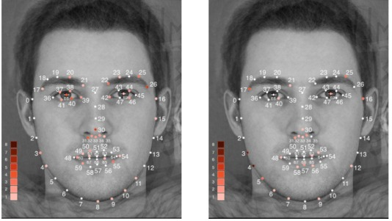
Thank You
Questions & Discussion
Key Results
0.71
0.05
5,334
25 min
Balanced Accuracy
ECE Calibration
Stress Test Samples
Training Time
Repository
Live Demo
Model
GitHub
HF Space
HF Hub

