Slide 1
CMPE 258 · DEEP LEARNING · SHORT STORY
One Model to Forecast Them All
The Rise of Time-Series Foundation Models
A review of “Empowering Time Series Analysis with Foundation Models: A Comprehensive Survey”
Ye, Yu, Zhang, Wang, Li & Tsung — arXiv:2405.02358v3 (2025)
Nikita Memane · San José State University
Plus a hands-on reproduction of the survey's core claim — and why 2025's benchmarks can't be fully trusted.
Notes:
Welcome. This short story reviews a 2025 survey on time-series foundation models. I'll explain what these models are, how they're built, then reproduce the central claim myself, and end with an honest look at the benchmarking crisis. Roughly an 18-slide, 15-20 minute talk.

Slide 2
MOTIVATION
Time series was the last modality to get a foundation model
Text
Images
Audio
Time series
GPT, Llama
CLIP, SAM
Whisper
??? until 2024
Why time series resisted the “pre-train once, reuse everywhere” recipe:
1
Data is scarce & siloed — No internet-scale firehose of signals. Useful series hide in private hospital, factory and bank silos.
2
Every dataset has a different shape — Different sampling rates, channel counts, and meanings — the survey calls it “semantic variability.”
3
Classical methods were already strong — ARIMA and exponential smoothing are fast and hard to beat on a single clean series.
Time-Series Foundation Models · CMPE 258 Short Story
2
Notes:
Text, images and audio all got their foundation-model moment years ago. Time series did not — for three concrete reasons: the data is scarce and fragmented, every dataset has a different shape, and classical methods were already very good. The 2024–25 breakthrough was realising these are engineering problems, not fundamental barriers.

Slide 3
THE CORE IDEA
A foundation model: pre-train once, reuse everywhere
What is a foundation model?
THE QUESTION THIS TALK ANSWERS
A large network pre-trained on a huge, broad dataset, then reused — often with no further training — across many tasks.
For time series the tasks are: forecasting, imputation (gap-filling), classification, and anomaly detection.
Can a model pre-trained once forecast a series it has never seen — with zero training on it — and still beat models tuned to that series?
THE SURVEY
Ye et al. (2025) map 88 papers — the only survey covering all three build pathways under one “modality-aware, challenge-oriented” lens.
This is the “zero-shot” promise. Slides 11–14 put it to the test on real data.
Time-Series Foundation Models · CMPE 258 Short Story
3
Notes:
A foundation model is pre-trained once on broad data and reused across tasks. The survey maps 88 papers. The question driving this whole talk: can such a model forecast a series it never saw, zero-shot, and still beat models tuned to that series? I test exactly that later.

Slide 4
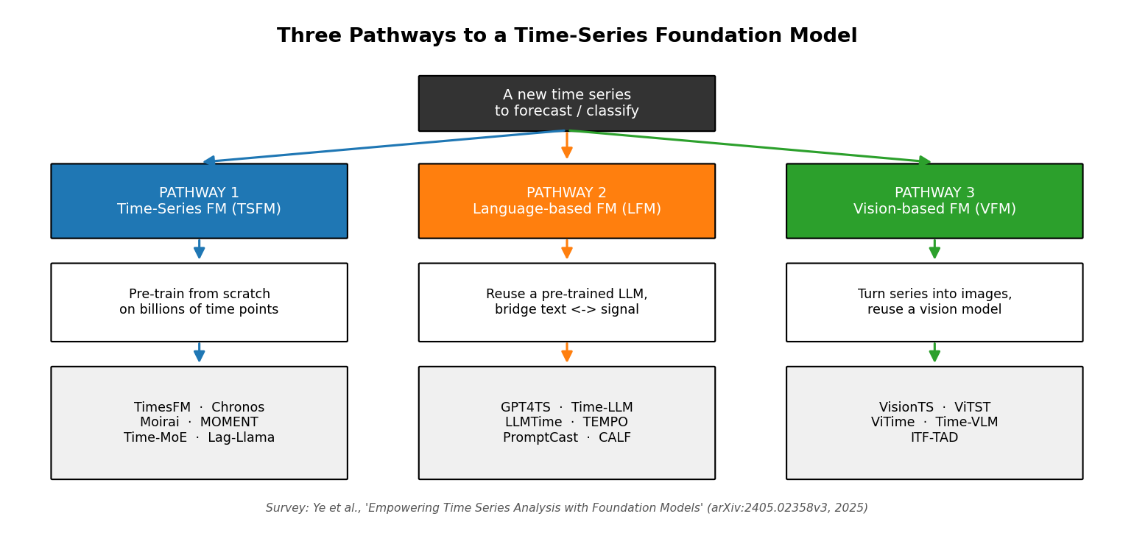
TAXONOMY
Three pathways to a time-series foundation model
1 · TSFM
Pre-train from scratch on billions of real time points.
2 · LFM
Reuse a pre-trained LLM; bridge text and signal.
3 · VFM
Render the series as an image; reuse a vision model.
Time-Series Foundation Models · CMPE 258 Short Story
4
Notes:
The survey's central insight: you can reach a time-series foundation model from three starting points. Pathway 1 — pre-train from scratch on raw signals. Pathway 2 — reuse an existing LLM and teach it to read numbers. Pathway 3 — render the series as an image and feed a vision model. Most headline progress is Pathway 1, which the next slides focus on.

Slide 5
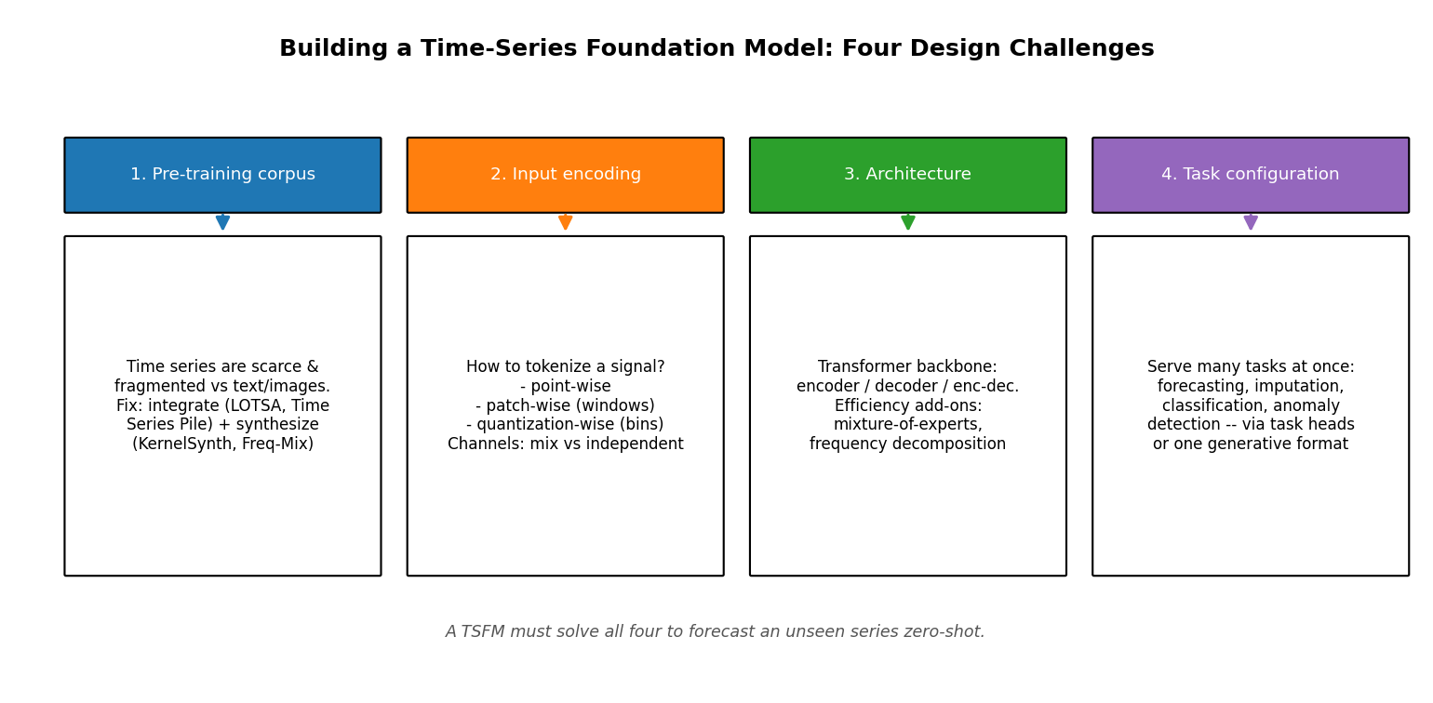
PATHWAY 1 · TSFM
Building a TSFM means solving four design challenges
Corpus
Encoding
Architecture
Tasks
Integrate + synthesize data
Turn a signal into tokens
Pick a Transformer backbone
Serve many tasks at once
Time-Series Foundation Models · CMPE 258 Short Story
5
Notes:
Pre-training from scratch decomposes into four challenges. One: build a corpus, since no time-series firehose exists — teams integrate every public dataset (LOTSA, Time Series Pile, Time-300B, even a trillion-point corpus) and synthesize more. Two: encoding. Three: architecture. Four: serve forecasting, imputation, classification and anomaly detection together. Almost every TSFM you've heard of is just one set of answers to these four.

Slide 6
CHALLENGE 2 · ENCODING
How do you turn a continuous signal into tokens?
Point-wise
Patch-wise
Quantization-wise
Each timestamp is one token.
Slice into short fixed windows; each window is a token. Most popular choice.
Scale values and bin them into a fixed vocabulary — like words.
USED BY Time-MoE
USED BY TimesFM · Moirai · MOMENT
USED BY Chronos
A second hidden choice: channel independence vs channel mixing — Moirai's “any-variate attention” handles any number of channels.
Time-Series Foundation Models · CMPE 258 Short Story
6
Notes:
A Transformer eats tokens; a signal is floats. Three recurring answers: point-wise (one token per timestamp), patch-wise (short windows as tokens — the most popular), and quantization-wise, where Chronos bins scaled values into a vocabulary and literally treats forecasting as language modeling. A second choice: treat channels independently or let them mix.

Slide 7
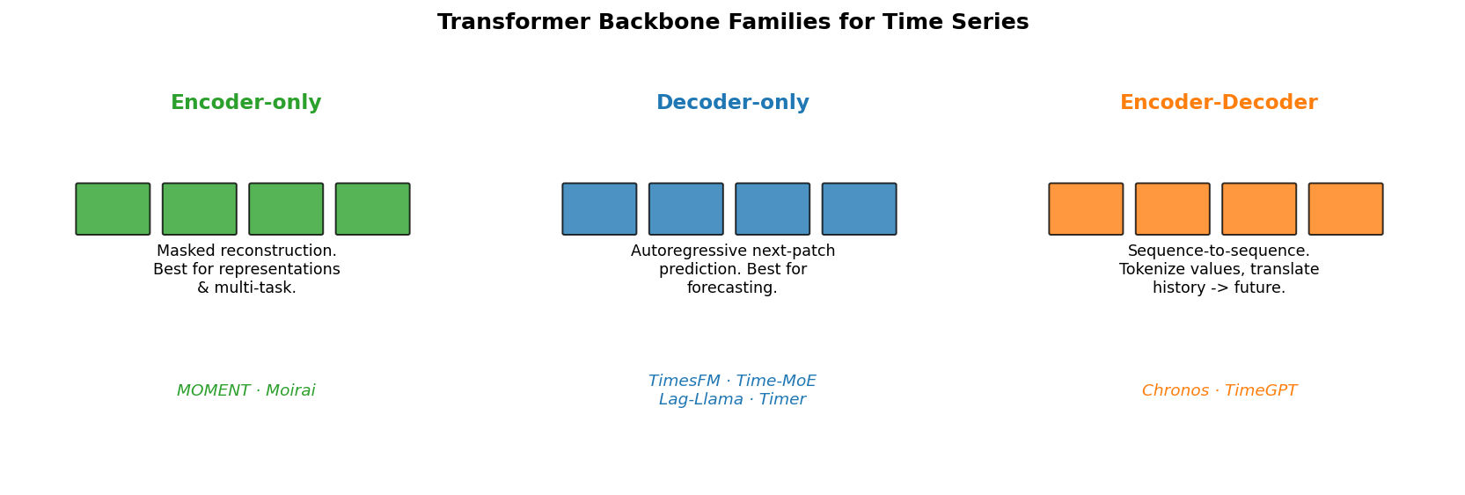
CHALLENGE 3 · ARCHITECTURE
Three Transformer backbone families
The pattern across all three surveys: decoder-only for forecasting, encoder-only for representation & multi-task work.
It is no accident that the largest TSFMs — Time-MoE, TimesFM — are decoder-only. Chronos is encoder-decoder because it reuses Google's T5 text model almost unchanged.
Time-Series Foundation Models · CMPE 258 Short Story
7
Notes:
Strip the branding and every TSFM is one of three Transformer shapes. Encoder-only (MOMENT, Moirai) — masked reconstruction, the BERT recipe, great for representations and multi-task. Decoder-only (TimesFM, Time-MoE, Lag-Llama, Timer) — autoregressive next-patch, the GPT recipe, dominates forecasting. Encoder-decoder (Chronos, TimeGPT) — sequence-to-sequence; Chronos reuses T5. Remember: decoder-only for forecasting, encoder-only for multi-task.

Slide 8
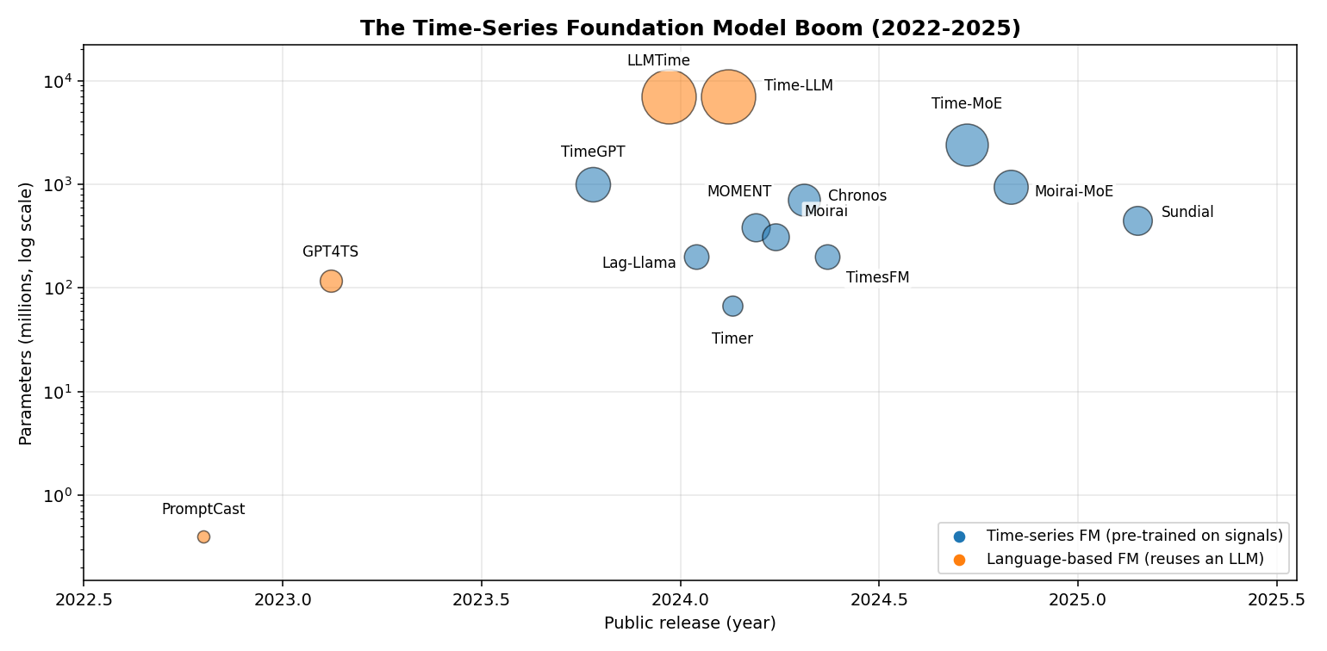
LANDSCAPE
The model boom: ~100 models in two years
What stands out
Scale jump
67M → 2.4B parameters in under a year.
Vendor land-grab
Google, Amazon, Salesforce, Nixtla, IBM, Tsinghua.
Bigger ≠ better
IBM's Tiny Time Mixers (~1M params) competes — lightweight design is a real research track.
Time-Series Foundation Models · CMPE 258 Short Story
8
Notes:
The pace of 2024–25 is hard to overstate. Parameter counts jumped from 67 million to 2.4 billion in under a year. Every major vendor shipped a model. But the survey's quiet counter-point: bigger is not automatically better — IBM's Tiny Time Mixers, around a million parameters, competes, and lightweight design is a first-class research direction.

Slide 9
REFERENCE
The headline TSFMs at a glance
Model | Builder | Architecture | Tokenization | Scale | Pre-training corpus
TimesFM | Google | Decoder-only | Patch-wise | 200M | ~100B points
Chronos | Amazon | Encoder-decoder (T5) | Quantization-wise | 710M | ~84B points
Moirai | Salesforce | Encoder-only | Patch-wise | 311M | LOTSA, 27B points
MOMENT | CMU Auton Lab | Encoder-only | Patch-wise | 385M | Time Series Pile, 1.2B
Time-MoE | Time-MoE team | Decoder-only + MoE | Point-wise | 2.4B | Time-300B, 300B points
Lag-Llama | ServiceNow et al. | Decoder-only | Point-wise + lags | 200M | ~352M points
Timer | Tsinghua THUML | Decoder-only | Patch-wise | 67M | UTSD, ~1B points
Decoder-only models dominate pure forecasting; encoder-only models dominate representation and multi-task use. Corpus sizes span six orders of magnitude.
Time-Series Foundation Models · CMPE 258 Short Story
9
Notes:
A compact reference. Note the spread: Google's TimesFM at 200 million parameters, Amazon's Chronos at 710 million reusing T5, Salesforce's Moirai trained on the 27-billion-point LOTSA corpus, and Time-MoE at 2.4 billion parameters on a 300-billion-point corpus. Decoder-only for forecasting, encoder-only for multi-task — the table makes the pattern visible.

Slide 10
PATHWAYS 2 & 3
Borrowing brains from language and vision
Language-based models (LFMs)
Vision-based models (VFMs)
Can a model trained only on text forecast numbers? Surprisingly often, yes. Organized by how they bridge signal and language:
The survey's most surprising chapter: forecasting becomes image completion.
LLMTime — write numbers as digit strings, let GPT continue them.
Time-LLM — keep the LLM frozen, “reprogram” the series via cross-attention to word embeddings.
GPT4TS — freeze most of GPT-2, tune only embeddings & norms; still handles 4 tasks.
Render the series as a line plot, heatmap or scalogram.
VisionTS feeds it to a masked autoencoder pre-trained only on natural images.
The model “inpaints” the missing future — and it works.
Recurring theme: parameter-efficient tuning.
My take: underrated — it quietly reuses the largest pre-trained models on Earth.
Time-Series Foundation Models · CMPE 258 Short Story
10
Notes:
Pathway 2: language models. The crude LLMTime just writes numbers as digit strings. Time-LLM keeps the LLM frozen and reprograms the series through cross-attention. GPT4TS freezes most of GPT-2. The theme is parameter-efficient tuning. Pathway 3: vision. Render the series as a picture and let a vision model inpaint the future — VisionTS does exactly this with a masked autoencoder trained only on natural images. I think the vision route is underrated.

Slide 11
MY REPRODUCTION
Putting the zero-shot claim to the test
THE EXPERIMENT
The fair fight
Model: Chronos (chronos-bolt-small, ~48M params). Never call .fit() — pure zero-shot.
Classical baselines get an unfair advantage — they are trained on the very series they predict. The foundation model gets nothing.
Data: 4 classic public datasets the model never saw — airline passengers, car sales, sunspots, daily temperatures.
Baselines: fit per series
Chronos: zero training, zero tuning
Baselines: Naive, Seasonal Naive, Exponential Smoothing — each fit individually to its own series.
Runs on a laptop CPU in about one minute. Code + executed notebook in the repo's reproduction/ folder.
Metric: MASE — below 1.0 beats a seasonal-naive forecast; comparable across datasets.
Time-Series Foundation Models · CMPE 258 Short Story
11
Notes:
Now my own experiment. I used Chronos — the bolt-small model, 48 million parameters — never calling fit, pure zero-shot. I forecast the held-out tail of four classic public datasets the model never saw, against three classical baselines each fit individually to its target series. The baselines get an unfair advantage; the foundation model gets nothing. Headline metric is MASE — below 1 beats seasonal naive.

Slide 12
MY REPRODUCTION · RESULT
Zero-shot beat models tuned to each series
~1.66
~1.04
~0.92
Seasonal Naive
mean MASE
Exp. Smoothing
mean MASE (fit per series)
Chronos zero-shot
mean MASE
0 / 4 wins
1 / 4 wins
2 / 4 wins
The hypothesis holds.
A 48M-parameter model that did zero training on these series achieved a lower average error than Exponential Smoothing models each tuned to their own data — in about a second of CPU inference, with no training loop at all. It also produced calibrated uncertainty bands for free.
Time-Series Foundation Models · CMPE 258 Short Story
12
Notes:
The result. Seasonal Naive averaged a MASE of 1.66. Exponential Smoothing, fit per series, averaged 1.04. Chronos, zero-shot, averaged 0.92 — and won outright on two of four datasets. A 48-million-parameter model that did zero training on these series beat models tuned to each one, in a second of CPU inference. The hypothesis holds.

Slide 13
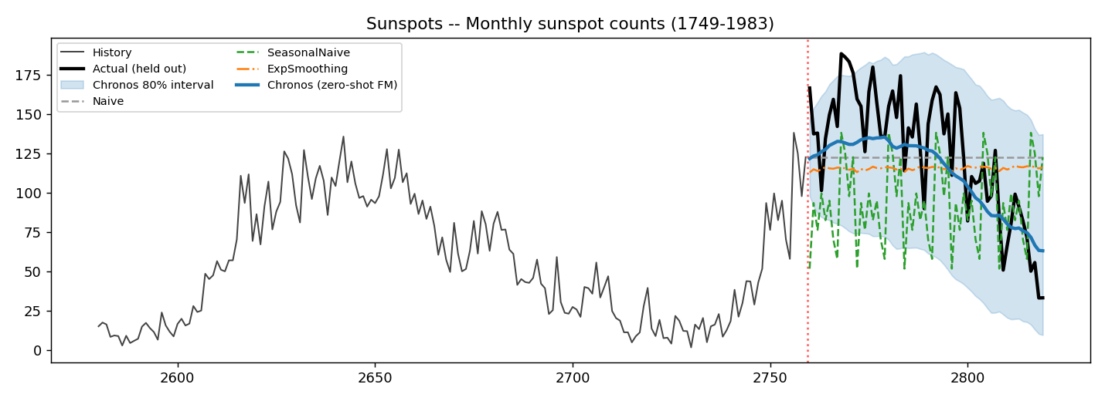
MY REPRODUCTION · EVIDENCE
The clearest win: a long-horizon forecast
Sunspots
60-step horizon
Chronos (blue) anticipates the falling solar cycle.
Classical baselines collapse to a flat line.
The shaded band is its 80% prediction interval — uncertainty for free.
MASE 1.01 — the single best score in the whole experiment.
Time-Series Foundation Models · CMPE 258 Short Story
13
Notes:
The clearest win. On monthly sunspots over a long 60-step horizon, the classical models simply reverted to a flat mean. Chronos — drawing on broad temporal patterns absorbed during pre-training — anticipated the shape of the declining solar cycle. And the shaded band is its 80% prediction interval: it tells you how confident it is, for free.

Slide 14
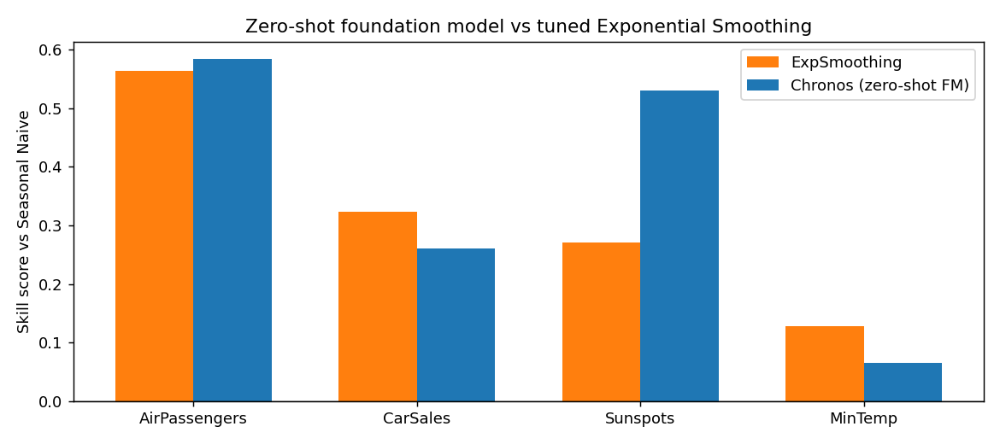
MY REPRODUCTION · HONEST READ
Strong — but not magic
Where it wins
Long horizons and rich structure — sunspots, airline passengers. Broad pre-training pays off exactly where classical methods struggle.
Where it doesn't
On the near-stationary daily-temperature series, the plain Naive forecast won. The survey's “no free lunch” caveat in miniature — an honest review must say so.
Time-Series Foundation Models · CMPE 258 Short Story
14
Notes:
An honest read. The skill score shows the zero-shot model winning on three of four datasets. But it is not magic: on the daily-temperature series — short horizon, near-stationary — the dumb Naive forecast won. Foundation models shine on long horizons and rich structure, and add little where a one-line heuristic already nails it. A good review says that out loud.

Slide 15
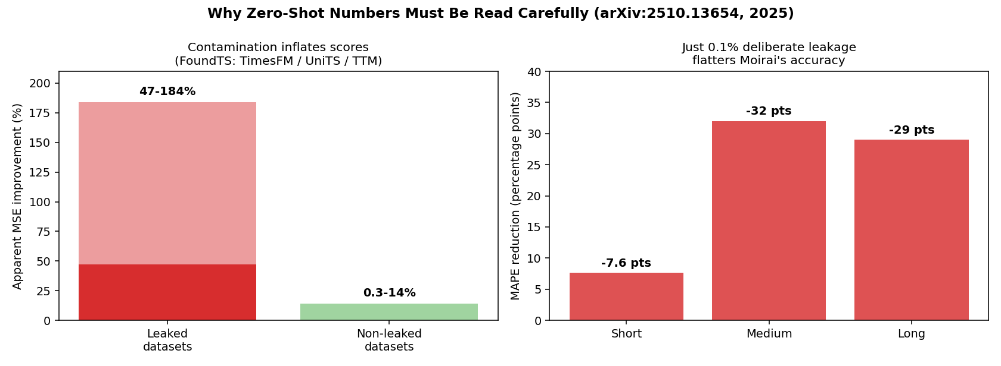
THE CATCH
Can we even trust the benchmarks?
Test-set contamination
If a model pre-trains on “every public dataset,” the benchmark may already be in its training data.
Only 7% of datasets were never used for pre-training or fine-tuning by some model.
0.1% deliberate leakage flattered Moirai by up to 32 MAPE points — and bigger models memorized more.
THE FIX
A continuously advancing temporal split — the test set is always genuine, unseen future.
Time-Series Foundation Models · CMPE 258 Short Story
15
Notes:
Now the catch. If a model is pre-trained on every public dataset, how do you know the benchmark wasn't in the training data? That's test-set contamination — the same crisis that haunts LLM evaluation. The Meyer 2025 survey found only 7% of datasets were never used for training by some model. A controlled study showed just 0.1% deliberate leakage flattered Moirai by up to 32 MAPE points — and larger models memorized more, not less. Leaked datasets showed 47 to 184% better scores versus under 14% on clean data.

Slide 16
MY TWO CENTS
What I actually think after reading three surveys
1
The zero-shot result is real
2
Headline numbers are softer than they look
I went in skeptical — “fit per series” should win. It didn't. A TSFM is now a strong default baseline you call in one line of code.
After the contamination data, I don't fully trust any leaderboard MASE I haven't checked myself. Accuracy is solved enough; evaluation is not.
3
The vision pathway is underrated
4
The frontier is trust, not scale
“Render as an image, inpaint the future” sounds like a hack — but it reuses the biggest pre-trained models on Earth.
The next milestone isn't a 10B-parameter model. It's one you can audit: clean benchmarks, calibrated uncertainty, interpretability.
Time-Series Foundation Models · CMPE 258 Short Story
16
Notes:
My two cents. One: the zero-shot result is real — I was skeptical and was wrong; a TSFM is now a strong one-line default baseline. Two: the field's headline numbers are softer than they look — accuracy is solved enough, evaluation is not. Three: the vision pathway is underrated. Four: the real frontier is trust, not scale — a model you can audit, not a bigger one.

Slide 17
CONCLUSION
Pre-train once, predict anything —
finally, for time series too.
The map — Three pathways, four design challenges, three architecture families — ~100 models in two years.
The proof — My reproduction confirmed the core claim: a zero-shot foundation model matched models tuned per series.
The open problem — Trustworthy evaluation. Until benchmarks are contamination-proof, every impressive number deserves a second look.
The work that remains is making sure we can believe the predictions.
Notes:
To conclude. The survey gives us the map: three pathways, four challenges, three architectures, a hundred models. My reproduction gives the proof: zero-shot really works. And the 2025 benchmarking survey gives the cold shower: the open problem is trustworthy evaluation. Pre-train once, predict anything has finally reached time series — the work that remains is making sure we can believe the predictions.

Slide 18
References & Links
1. Ye, Yu, Zhang, Wang, Li, Tsung. “Empowering Time Series Analysis with Foundation Models: A Comprehensive Survey.” arXiv:2405.02358v3, 2025. (primary paper reviewed)
2. Kottapalli et al. “Foundation Models for Time Series: A Survey.” arXiv:2504.04011, 2025.
3. Meyer, Kaltenpoth, Zalipski, Müller. “Rethinking Evaluation in the Era of Time Series Foundation Models: (Un)Known Information Leakage Challenges.” arXiv:2510.13654, 2025.
4. Ansari et al. “Chronos: Learning the Language of Time Series.” TMLR, 2024.
5. Das, Kong, Sen, Zhou. “A Decoder-Only Foundation Model for Time-Series Forecasting” (TimesFM). ICML, 2024.
GitHub repository — code, executed notebook, article, slides & video
github.com/NMemane1/CMPE258-Short-Story-TS-FM-DeepLearning
Medium article + reproduction figures linked in the repository README.
Thank you — Nikita Memane · CMPE 258, San José State University
Notes:
References and links. The primary paper reviewed is the Ye et al. 2025 survey, supported by two further 2025 surveys. All code, the executed notebook, the article, these slides and the video are in the GitHub repository shown. Thank you.

