Slide 1
Інтуіція при оптимізації, або оптимізація інтуіції
Олександр Каленюк <Oleksandr.Kaleniuk@materialise.kiev.ua>

Slide 2
Задача майже зі співбесіди
8 | 1 | 6
3 | 5 | 7
4 | 9 | 2
#include <iostream>
#include <chrono>
using namespace std;
bool check_if_magic(const std::string& square)
{
// add your code here
// ...
return false;
}
= “816357492”
// this generates all possible combinations
// of 1-9 digits that may or may not
// form a magic square
static string buffer = "000000000";
void generate_or_check(int index_or_check = 8)
{
if(index_or_check == -1){
if(check_if_magic(buffer))
cout << buffer << " ";
return;
}
for(auto i = 1u; i < 10; ++i){
buffer[index_or_check] = '0' + i;
generate_or_check(index_or_check-1);
}
}
// this runs the generator and measures time
int main()
{
auto start = std::chrono::system_clock::now();
generate_or_check();
auto end = std::chrono::system_clock::now();
chrono::duration<double>
difference = end - start;
cout << difference.count() << "\n\n";
}

Slide 3

Тільки генерація
bool check_if_magic(const std::string& square) { return false; } static string buffer = " "; void generate_or_check(int index_or_check = 8) { if (index_or_check == -1) { if (check_if_magic(buffer)) cout << buffer << " "; return; } for (auto i = 1u; i < 10; ++i) { buffer[index_or_check] = '0' + i; generate_or_check(index_or_check - 1); } } int main() { auto start = std::chrono::system_clock::now(); generate_or_check(); auto end = std::chrono::system_clock::now(); std::chrono::duration<double> difference = end - start; std::cout << difference.count() << "\n\n"; }
Приклад пробігає в середньому за 0.8 сек.

Slide 4

Стоп! Що я забув?
Підказка: це дуже важливо!

Slide 5
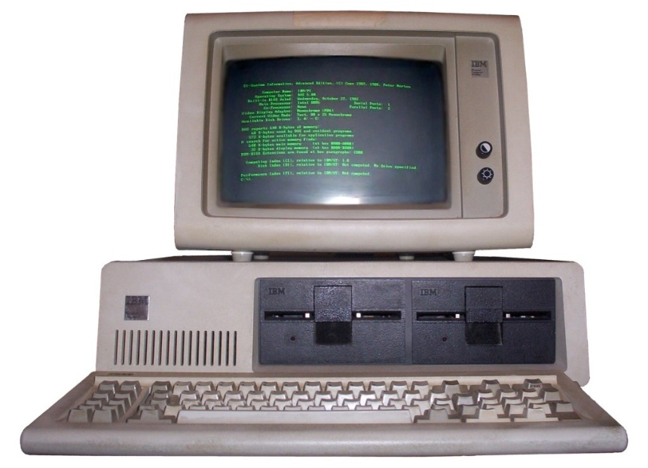
Процесор, компілятор, оптимізації
Intel(R) Core(TM) i7-7700HQ CPU @ 2.80GHz
g++ 5.4.0
-O2

Slide 6
Який приклад швидший?
bool check_if_magic(const std::string& square) { if ((square[0] + square[1] + square[2] != '5'*3) || (square[3] + square[4] + square[5] != '5'*3) || (square[6] + square[7] + square[8] != '5'*3) || (square[0] + square[3] + square[6] != '5'*3) || (square[1] + square[4] + square[7] != '5'*3) || (square[2] + square[5] + square[8] != '5'*3) || (square[0] + square[4] + square[8] != '5'*3) || (square[2] + square[4] + square[6] != '5'*3)) return false; std::array<int, 9> numbers_count{}; for(auto i = 0u; i < 9; ++i) ++numbers_count[square[i]-'1']; for(auto i = 0u; i < 9; ++i) if(numbers_count[i] != 1) return false; return true; } | bool check_if_magic(const std::string& square) { std::array<int, 9> numbers_count{}; for(auto i = 0u; i < 9; ++i) ++numbers_count[square[i]-'1']; for(auto i = 0u; i < 9; ++i) if(numbers_count[i] != 1) return false; if ((square[0] + square[1] + square[2] != '5'*3) || (square[3] + square[4] + square[5] != '5'*3) || (square[6] + square[7] + square[8] != '5'*3) || (square[0] + square[3] + square[6] != '5'*3) || (square[1] + square[4] + square[7] != '5'*3) || (square[2] + square[5] + square[8] != '5'*3) || (square[0] + square[4] + square[8] != '5'*3) || (square[2] + square[4] + square[6] != '5'*3)) return false; return true; }

Slide 7
Лівий у 5 разів
bool check_if_magic(const std::string& square) { if ((square[0] + square[1] + square[2] != '5'*3) || (square[3] + square[4] + square[5] != '5'*3) || (square[6] + square[7] + square[8] != '5'*3) || (square[0] + square[3] + square[6] != '5'*3) || (square[1] + square[4] + square[7] != '5'*3) || (square[2] + square[5] + square[8] != '5'*3) || (square[0] + square[4] + square[8] != '5'*3) || (square[2] + square[4] + square[6] != '5'*3)) return false; std::array<int, 9> numbers_count{}; for(auto i = 0u; i < 9; ++i) ++numbers_count[square[i]-'1']; for(auto i = 0u; i < 9; ++i) if(numbers_count[i] != 1) return false; return true; } | bool check_if_magic(const std::string& square) { std::array<int, 9> numbers_count{}; for(auto i = 0u; i < 9; ++i) ++numbers_count[square[i]-'1']; for(auto i = 0u; i < 9; ++i) if(numbers_count[i] != 1) return false; if ((square[0] + square[1] + square[2] != '5'*3) || (square[3] + square[4] + square[5] != '5'*3) || (square[6] + square[7] + square[8] != '5'*3) || (square[0] + square[3] + square[6] != '5'*3) || (square[1] + square[4] + square[7] != '5'*3) || (square[2] + square[5] + square[8] != '5'*3) || (square[0] + square[4] + square[8] != '5'*3) || (square[2] + square[4] + square[6] != '5'*3)) return false; return true; }
0.77 сек.
3.87 сек.

Slide 8

Чому?
bool check_if_magic(const std::string& square) { if ((square[0] + square[1] + square[2] != '5'*3) || (square[3] + square[4] + square[5] != '5'*3) || (square[6] + square[7] + square[8] != '5'*3) || (square[0] + square[3] + square[6] != '5'*3) || (square[1] + square[4] + square[7] != '5'*3) || (square[2] + square[5] + square[8] != '5'*3) || (square[0] + square[4] + square[8] != '5'*3) || (square[2] + square[4] + square[6] != '5'*3)) return false; std::array<int, 9> numbers_count{}; for(auto i = 0u; i < 9; ++i) ++numbers_count[square[i]-'1']; for(auto i = 0u; i < 9; ++i) if(numbers_count[i] != 1) return false; return true; }
Short-circuit evaluation. Кожна зелена строчка – самодостатня умова виходу.
3 цифри від 1 до 9 складають 15
у 8.36% випадків. У 92.74% випадків, перевірка закінчується на першій строчці.
Всі червоні строчки мають виконуватись разом.

Slide 9
Не всі строчки однаково корисні
bool check_if_magic(const std::string& square) { if ((square[0] + square[1] + square[2] != '5'*3) || (square[3] + square[4] + square[5] != '5'*3) || (square[6] + square[7] + square[8] != '5'*3) || (square[0] + square[3] + square[6] != '5'*3) || (square[1] + square[4] + square[7] != '5'*3) || (square[2] + square[5] + square[8] != '5'*3) || (square[0] + square[4] + square[8] != '5'*3) || (square[2] + square[4] + square[6] != '5'*3)) return false; std::array<int, 9> numbers_count{}; for(auto i = 0u; i < 9; ++i) ++numbers_count[square[i]-'1']; for(auto i = 0u; i < 9; ++i) if(numbers_count[i] != 1) return false; return true; }
387420489 hits, 8.4% passed
32417901 hits, 8.4% passed
2712609 hits, 8.4% passed
226981 hits, 9.3% passed
21195 hits, 10.4% passed
2191 hits, 100.0% passed
2191 hits, 8.6% passed
189 hits, 21.7% passed
41 hits

Slide 10
Який приклад швидший?
bool check_if_magic(const std::string& square) { if ((square[0] + square[1] + square[2] != '5'*3) || (square[3] + square[4] + square[5] != '5'*3) || (square[6] + square[7] + square[8] != '5'*3) || (square[0] + square[3] + square[6] != '5'*3) || (square[1] + square[4] + square[7] != '5'*3) || (square[2] + square[5] + square[8] != '5'*3) || (square[0] + square[4] + square[8] != '5'*3) || (square[2] + square[4] + square[6] != '5'*3)) return false; std::array<int, 9> numbers_count{}; for(auto i = 0u; i < 9; ++i) ++numbers_count[square[i]-'1']; for(auto i = 0u; i < 9; ++i) if(numbers_count[i] != 1) return false; return true; } | bool check_if_magic(const std::string& square) { if ((square[0] + square[1] + square[2] != '5'*3) || (square[3] + square[4] + square[5] != '5'*3) // || (square[6] + square[7] + square[8] != '5'*3) || (square[0] + square[3] + square[6] != '5'*3) || (square[1] + square[4] + square[7] != '5'*3) // || (square[2] + square[5] + square[8] != '5'*3) || (square[0] + square[4] + square[8] != '5'*3) || (square[2] + square[4] + square[6] != '5'*3)) return false; std::array<int, 9> numbers_count{}; for(auto i = 0u; i < 9; ++i) ++numbers_count[square[i]-'1']; for(auto i = 0u; i < 9; ++i) if(numbers_count[i] != 1) return false; return true; }

Slide 11
Лівий на 25% швидше
bool check_if_magic(const std::string& square) { if ((square[0] + square[1] + square[2] != '5'*3) || (square[3] + square[4] + square[5] != '5'*3) || (square[6] + square[7] + square[8] != '5'*3) || (square[0] + square[3] + square[6] != '5'*3) || (square[1] + square[4] + square[7] != '5'*3) || (square[2] + square[5] + square[8] != '5'*3) || (square[0] + square[4] + square[8] != '5'*3) || (square[2] + square[4] + square[6] != '5'*3)) return false; std::array<int, 9> numbers_count{}; for(auto i = 0u; i < 9; ++i) ++numbers_count[square[i]-'1']; for(auto i = 0u; i < 9; ++i) if(numbers_count[i] != 1) return false; return true; } | bool check_if_magic(const std::string& square) { if ((square[0] + square[1] + square[2] != '5'*3) || (square[3] + square[4] + square[5] != '5'*3) // || (square[6] + square[7] + square[8] != '5'*3) || (square[0] + square[3] + square[6] != '5'*3) || (square[1] + square[4] + square[7] != '5'*3) // || (square[2] + square[5] + square[8] != '5'*3) || (square[0] + square[4] + square[8] != '5'*3) || (square[2] + square[4] + square[6] != '5'*3)) return false; std::array<int, 9> numbers_count{}; for(auto i = 0u; i < 9; ++i) ++numbers_count[square[i]-'1']; for(auto i = 0u; i < 9; ++i) if(numbers_count[i] != 1) return false; return true; }
0.77 сек.
0.96 сек.

Slide 12
Чому?
bool check_if_magic(const std::string& square) { if ((square[0] + square[1] + square[2] != '5'*3) || (square[3] + square[4] + square[5] != '5'*3) || (square[6] + square[7] + square[8] != '5'*3) || (square[0] + square[3] + square[6] != '5'*3) || (square[1] + square[4] + square[7] != '5'*3) // || (square[2] + square[5] + square[8] != '5'*3) || (square[0] + square[4] + square[8] != '5'*3) || (square[2] + square[4] + square[6] != '5'*3)) return false; std::array<int, 9> numbers_count{}; for(auto i = 0u; i < 9; ++i) ++numbers_count[square[i]-'1']; for(auto i = 0u; i < 9; ++i) if(numbers_count[i] != 1) return false; return true; }
З тієї ж причини. Вигідніше вийти раніше аніж перевіряти всі цифри на унікальність.
Тільки одна строчка зайва. Інша працює як евристика скорочуючи кількість заходів у перевірку унікальності.
Якщо приберемо одну строчку, отримаємо малопомітний але приріст

Slide 13
Який приклад швидший?
bool check_if_magic(const std::string& square) { if ((square[0] + square[1] + square[2] != '5'*3) || (square[3] + square[4] + square[5] != '5'*3) || (square[6] + square[7] + square[8] != '5'*3) || (square[0] + square[3] + square[6] != '5'*3) || (square[1] + square[4] + square[7] != '5'*3) || (square[2] + square[5] + square[8] != '5'*3) || (square[0] + square[4] + square[8] != '5'*3) || (square[2] + square[4] + square[6] != '5'*3)) return false; std::array<int, 9> numbers_count{}; for(auto i = 0u; i < 9; ++i) ++numbers_count[square[i]-'1']; for(auto i = 0u; i < 9; ++i) if(numbers_count[i] != 1) return false; return true; } | const auto magic_number = '5' * 3; const uint_fast64_t ideal_char_map = static_cast<uint_fast64_t>(0x1FF) << 49; const uint_fast64_t char_map_one = 1u; bool check_if_magic(const std::string& square) { if ((square[0] + square[1] + square[2] != magic_number) || (square[3] + square[4] + square[5] != magic_number) || (square[6] + square[7] + square[8] != magic_number) || (square[0] + square[3] + square[6] != magic_number) || (square[1] + square[4] + square[7] != magic_number) || (square[2] + square[5] + square[8] != magic_number) || (square[0] + square[4] + square[8] != magic_number) || (square[2] + square[4] + square[6] != magic_number)) return false; auto char_map = ideal_char_map; for(auto i = 0u; i < 9; ++i) char_map ^= char_map_one << square[i]; if (char_map != 0) return false; return true; }

Slide 14
Знов лівий на 20%
bool check_if_magic(const std::string& square) { if ((square[0] + square[1] + square[2] != '5'*3) || (square[3] + square[4] + square[5] != '5'*3) || (square[6] + square[7] + square[8] != '5'*3) || (square[0] + square[3] + square[6] != '5'*3) || (square[1] + square[4] + square[7] != '5'*3) || (square[2] + square[5] + square[8] != '5'*3) || (square[0] + square[4] + square[8] != '5'*3) || (square[2] + square[4] + square[6] != '5'*3)) return false; std::array<int, 9> numbers_count{}; for(auto i = 0u; i < 9; ++i) ++numbers_count[square[i]-'1']; for(auto i = 0u; i < 9; ++i) if(numbers_count[i] != 1) return false; return true; } | const auto magic_number = '5' * 3; const uint_fast64_t ideal_char_map = static_cast<uint_fast64_t>(0x1FF) << 49; uint_fast64_t char_map_one = 1u; bool check_if_magic(const std::string& square) { if ((square[0] + square[1] + square[2] != magic_number) || (square[3] + square[4] + square[5] != magic_number) || (square[6] + square[7] + square[8] != magic_number) || (square[0] + square[3] + square[6] != magic_number) || (square[1] + square[4] + square[7] != magic_number) || (square[2] + square[5] + square[8] != magic_number) || (square[0] + square[4] + square[8] != magic_number) || (square[2] + square[4] + square[6] != magic_number)) return false; auto char_map = ideal_char_map; for(auto i = 0u; i < 9; ++i) char_map ^= char_map_one << square[i]; if (char_map != 0) return false; return true; }
0.77 сек.
0.94 сек.

Slide 15
Чому?
const auto magic_number = '5' * 3; const uint_fast64_t ideal_char_map = static_cast<uint_fast64_t>(0x1FF) << 49; uint_fast64_t char_map_one = 1u; bool check_if_magic(const std::string& square) { if ((square[0] + square[1] + square[2] != magic_number) || (square[3] + square[4] + square[5] != magic_number) || (square[6] + square[7] + square[8] != magic_number) || (square[0] + square[3] + square[6] != magic_number) || (square[1] + square[4] + square[7] != magic_number) || (square[2] + square[5] + square[8] != magic_number) || (square[0] + square[4] + square[8] != magic_number) || (square[2] + square[4] + square[6] != magic_number)) return false; auto char_map = ideal_char_map; for(auto i = 0u; i < 9; ++i) char_map ^= char_map_one << square[i]; if (char_map != 0) return false; return true; }
Бо у загальному випадку це не так.
Мікрооптимізації працюють у контексті компілятора, процесора і оптимізацій.
ARMv7 (v71), clang 3.5.0, -O2: 24.8 vs 24.4
Intel i7-7700HQ, g++, -O3: 0.89 vs 0.75
Intel i7-4700, MSVC 15.9.11, -O2: 4.0 vs 3.7
Втім, в загальному випадку не варто на них покладатися.

Slide 16
Наскільки правий приклад швидший?
auto c15 = '5' * 3; uint_fast64_t ideal_char_map = static_cast<uint_fast64_t>(0x1FF) << 49; uint_fast64_t char_map_one = 1u; bool check_if_magic(const std::string& sq) { if ((sq[0] + sq[1] + sq[2] != c15) || (sq[3] + sq[4] + sq[5] != c15) || (sq[6] + sq[7] + sq[8] != c15) || (sq[0] + sq[3] + sq[6] != c15) || (sq[1] + sq[4] + sq[7] != c15) || (sq[2] + sq[5] + sq[8] != c15) || (sq[0] + sq[4] + sq[8] != c15) || (sq[2] + sq[4] + sq[6] != c15)) return false; auto char_map = ideal_char_map; for(auto i = 0u; i < 9; ++i) char_map ^= char_map_one << sq[i]; if (char_map != 0) return false; return true; } | auto c15 = '5' * 3; uint_fast64_t ideal_char_map = static_cast<uint_fast64_t>(0x1FF) << 49; uint_fast64_t char_map_one = 1u; bool check_if_magic(const std::string& sq) { if ( (sq[0] & 1) != 0 || (sq[1] & 1) == 0 || (sq[2] & 1) != 0 || (sq[3] & 1) == 0 || (sq[4] & 1) == 0 || (sq[5] & 1) == 0 || (sq[6] & 1) != 0 || (sq[7] & 1) == 0 || (sq[8] & 1) != 0) return false; if ((sq[0] + sq[1] + sq[2] != c15) || (sq[3] + sq[4] + sq[5] != c15) || (sq[6] + sq[7] + sq[8] != c15) || (sq[0] + sq[3] + sq[6] != c15) || (sq[1] + sq[4] + sq[7] != c15) || (sq[2] + sq[5] + sq[8] != c15) || (sq[0] + sq[4] + sq[8] != c15) || (sq[2] + sq[4] + sq[6] != c15)) return false; auto char_map = ideal_char_map; for(auto i = 0u; i < 9; ++i) char_map ^= char_map_one << sq[i]; if (char_map != 0) return false; return true; }

Slide 17
Тільки на 15%
auto c15 = '5' * 3; uint_fast64_t ideal_char_map = static_cast<uint_fast64_t>(0x1FF) << 49; uint_fast64_t char_map_one = 1u; bool check_if_magic(const std::string& sq) { if ((sq[0] + sq[1] + sq[2] != c15) || (sq[3] + sq[4] + sq[5] != c15) || (sq[6] + sq[7] + sq[8] != c15) || (sq[0] + sq[3] + sq[6] != c15) || (sq[1] + sq[4] + sq[7] != c15) || (sq[2] + sq[5] + sq[8] != c15) || (sq[0] + sq[4] + sq[8] != c15) || (sq[2] + sq[4] + sq[6] != c15)) return false; auto char_map = ideal_char_map; for(auto i = 0u; i < 9; ++i) char_map ^= char_map_one << sq[i]; if (char_map != 0) return false; return true; } | auto c15 = '5' * 3; uint_fast64_t ideal_char_map = static_cast<uint_fast64_t>(0x1FF) << 49; uint_fast64_t char_map_one = 1u; bool check_if_magic(const std::string& sq) { if ( (sq[0] & 1) != 0 || (sq[1] & 1) == 0 || (sq[2] & 1) != 0 || (sq[3] & 1) == 0 || (sq[4] & 1) == 0 || (sq[5] & 1) == 0 || (sq[6] & 1) != 0 || (sq[7] & 1) == 0 || (sq[8] & 1) != 0) return false; if ((sq[0] + sq[1] + sq[2] != c15) || (sq[3] + sq[4] + sq[5] != c15) || (sq[6] + sq[7] + sq[8] != c15) || (sq[0] + sq[3] + sq[6] != c15) || (sq[1] + sq[4] + sq[7] != c15) || (sq[2] + sq[5] + sq[8] != c15) || (sq[0] + sq[4] + sq[8] != c15) || (sq[2] + sq[4] + sq[6] != c15)) return false; auto char_map = ideal_char_map; for(auto i = 0u; i < 9; ++i) char_map ^= char_map_one << sq[i]; if (char_map != 0) return false; return true; }
0.94 сек.
0.8 сек.

Slide 18
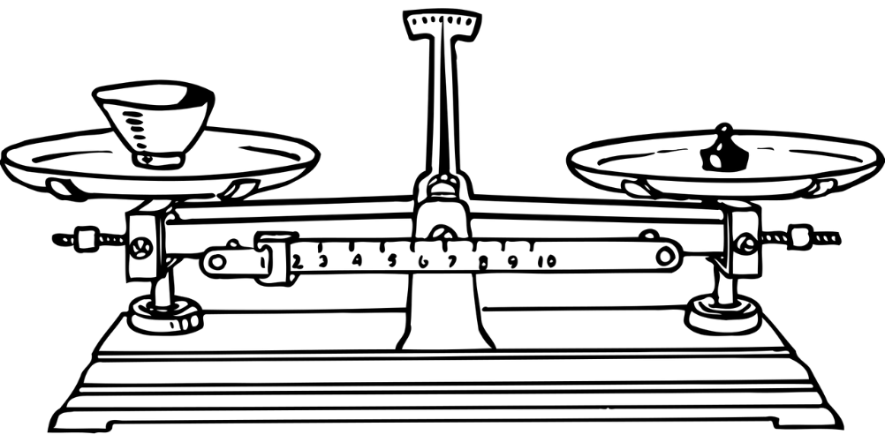
Чому?
auto c15 = '5' * 3; uint_fast64_t ideal_char_map = static_cast<uint_fast64_t>(0x1FF) << 49; uint_fast64_t char_map_one = 1u; bool check_if_magic(const std::string& sq) { if ( (sq[0] & 1) != 0 || (sq[1] & 1) == 0 || (sq[2] & 1) != 0 || (sq[3] & 1) == 0 || (sq[4] & 1) == 0 || (sq[5] & 1) == 0 || (sq[6] & 1) != 0 || (sq[7] & 1) == 0 || (sq[8] & 1) != 0) return false; if ((sq[0] + sq[1] + sq[2] != c15) || (sq[3] + sq[4] + sq[5] != c15) || (sq[6] + sq[7] + sq[8] != c15) || (sq[0] + sq[3] + sq[6] != c15) || (sq[1] + sq[4] + sq[7] != c15) || (sq[2] + sq[5] + sq[8] != c15) || (sq[0] + sq[4] + sq[8] != c15) || (sq[2] + sq[4] + sq[6] != c15)) return false; auto char_map = ideal_char_map; for(auto i = 0u; i < 9; ++i) char_map ^= char_map_one << sq[i]; if (char_map != 0) return false; return true; }
Евристика сильна, кожна умова обмежує прохід далі або на 4/9 або на 5/9.
Всього звужчує на 5*4*5*4*5*4*5*4*5 / (9*9*9*9*9*9*9*9*9), або до 0.2%.
Але! Власний оверхед. Перевірки не набагато дешевші за перевірки на 15.
Відносно дорога хоча і ефективна евристика.

Slide 19
Наскільки правий варіант швидший?
auto c15 = '5' * 3; uint_fast64_t ideal_char_map = static_cast<uint_fast64_t>(0x1FF) << 49; uint_fast64_t char_map_one = 1u; bool check_if_magic(const std::string& sq) { if ((sq[0] + sq[1] + sq[2] != c15) || (sq[3] + sq[4] + sq[5] != c15) || (sq[6] + sq[7] + sq[8] != c15) || (sq[0] + sq[3] + sq[6] != c15) || (sq[1] + sq[4] + sq[7] != c15) || (sq[2] + sq[5] + sq[8] != c15) || (sq[0] + sq[4] + sq[8] != c15) || (sq[2] + sq[4] + sq[6] != c15)) return false; auto char_map = ideal_char_map; for(auto i = 0u; i < 9; ++i) char_map ^= char_map_one << sq[i]; if (char_map != 0) return false; return true; } | auto magic_number = '5' * 3; auto not_so_magic_number = '5' * 2; uint_fast64_t ideal_char_map = static_cast<uint_fast64_t>(0x1FF) << 49; uint_fast64_t char_map_one = 1u; bool check_if_magic(const std::string& sq) { if(sq[4] != '5') return false; if ((sq[0] + sq[1] + sq[2] != magic_number) || (sq[3] + sq[5] != not_so_magic_number) || (sq[6] + sq[7] + sq[8] != magic_number) || (sq[0] + sq[3] + sq[6] != magic_number) || (sq[1] + sq[7] != not_so_magic_number) || (sq[2] + sq[5] + sq[8] != magic_number) || (sq[0] + sq[8] != not_so_magic_number) || (sq[2] + sq[6] != not_so_magic_number)) return false; auto char_map = ideal_char_map; for(auto i = 0u; i < 9; ++i) char_map ^= char_map_one << sq[i]; if (char_map != 0) return false; return true; }

Slide 20
На 80%
auto c15 = '5' * 3; uint_fast64_t ideal_char_map = static_cast<uint_fast64_t>(0x1FF) << 49; uint_fast64_t char_map_one = 1u; bool check_if_magic(const std::string& sq) { if ((sq[0] + sq[1] + sq[2] != c15) || (sq[3] + sq[4] + sq[5] != c15) || (sq[6] + sq[7] + sq[8] != c15) || (sq[0] + sq[3] + sq[6] != c15) || (sq[1] + sq[4] + sq[7] != c15) || (sq[2] + sq[5] + sq[8] != c15) || (sq[0] + sq[4] + sq[8] != c15) || (sq[2] + sq[4] + sq[6] != c15)) return false; auto char_map = ideal_char_map; for(auto i = 0u; i < 9; ++i) char_map ^= char_map_one << sq[i]; if (char_map != 0) return false; return true; } | auto magic_number = '5' * 3; auto not_so_magic_number = '5' * 2; uint_fast64_t ideal_char_map = static_cast<uint_fast64_t>(0x1FF) << 49; uint_fast64_t char_map_one = 1u; bool check_if_magic(const std::string& sq) { if(sq[4] != '5') return false; if ((sq[0] + sq[1] + sq[2] != magic_number) || (sq[3] + sq[5] != not_so_magic_number) || (sq[6] + sq[7] + sq[8] != magic_number) || (sq[0] + sq[3] + sq[6] != magic_number) || (sq[1] + sq[7] != not_so_magic_number) || (sq[2] + sq[5] + sq[8] != magic_number) || (sq[0] + sq[8] != not_so_magic_number) || (sq[2] + sq[6] != not_so_magic_number)) return false; auto char_map = ideal_char_map; for(auto i = 0u; i < 9; ++i) char_map ^= char_map_one << sq[i]; if (char_map != 0) return false; return true; }
0.94 сек.
0.52 сек.

Slide 21

Чому?
bool check_if_magic(const std::string& square) { // це можна міряти return false; } void check(const std::vector<std::string> &test_strings) { for(const std::string& test_string : test_strings) { if (check_if_magic(test_string)) { std::cout << test_string << " "; } } } int main() { std::mt19937 rng(0); std::uniform_int_distribution<char> digit_dist('1', '9'); std::vector<std::string> test_strings(100'000'000, "123456789"); for(auto& test_string : test_strings) { for (auto& digit : test_string) { digit = digit_dist(rng); } } auto start = std::chrono::system_clock::now(); check(test_strings); auto end = std::chrono::system_clock::now(); std::chrono::duration<double> difference = end - start; std::cout << difference.count() << "\n\n"; }
Неефективна евристика, скорочує «лише» в 9 разів. Але працює помітно швидше.
Бо насправді ми міряємо не функцію check_if_magic, а те, як вона працює в контексті генератора.
Branch prediction майже завжди працює правильно у контексті перебору варіантів підряд.
Із стохастичним бенчмарком, маємо
0.33 vs 0.35, тобто «оптимізація» провалює швидкодію на 6%.

Slide 22
Який приклад швидший?
auto c15 = '5' * 3; uint_fast64_t ideal_char_map = static_cast<uint_fast64_t>(0x1FF) << 49; uint_fast64_t char_map_one = 1u; bool check_if_magic(const std::string& sq) { if ((sq[0] + sq[1] + sq[2] != c15) || (sq[3] + sq[4] + sq[5] != c15) || (sq[6] + sq[7] + sq[8] != c15) || (sq[0] + sq[3] + sq[6] != c15) || (sq[1] + sq[4] + sq[7] != c15) || (sq[2] + sq[5] + sq[8] != c15) || (sq[0] + sq[4] + sq[8] != c15) || (sq[2] + sq[4] + sq[6] != c15)) return false; auto char_map = ideal_char_map; for(auto i = 0u; i < 9; ++i) char_map ^= char_map_one << sq[i]; if (char_map != 0) return false; return true; } | auto magic_number = '5' * 3; const std::array<uint16_t, 58> bit_shifts { 0, 0, 0, 0, 0, 0, 0, 0, 0, 0, 0, 0, 0, 0, 0, 0, 0, 0, 0, 0, 0, 0, 0, 0, 0, 0, 0, 0, 0, 0, 0, 0, 0, 0, 0, 0, 0, 0, 0, 0, 0, 0, 0, 0, 0, 0, 0, 0, 0, 1, 2, 4, 8, 16, 32, 64, 128, 256 }; bool check_if_magic(const std::string& sq) { if ((sq[0] + sq[1] + sq[2] != c15) || (sq[3] + sq[4] + sq[5] != c15) || (sq[6] + sq[7] + sq[8] != c15) || (sq[0] + sq[3] + sq[6] != c15) || (sq[1] + sq[4] + sq[7] != c15) || (sq[2] + sq[5] + sq[8] != c15) || (sq[0] + sq[4] + sq[8] != c15) || (sq[2] + sq[4] + sq[6] != c15)) return false; auto char_map = 0u; for(auto i = 0u; i < 9; ++i) char_map ^= bit_shifts[sq[i]]; if (char_map != 511) return false; return true; }

Slide 23
Справа швидше на 40%
auto c15 = '5' * 3; uint_fast64_t ideal_char_map = static_cast<uint_fast64_t>(0x1FF) << 49; uint_fast64_t char_map_one = 1u; bool check_if_magic(const std::string& sq) { if ((sq[0] + sq[1] + sq[2] != c15) || (sq[3] + sq[4] + sq[5] != c15) || (sq[6] + sq[7] + sq[8] != c15) || (sq[0] + sq[3] + sq[6] != c15) || (sq[1] + sq[4] + sq[7] != c15) || (sq[2] + sq[5] + sq[8] != c15) || (sq[0] + sq[4] + sq[8] != c15) || (sq[2] + sq[4] + sq[6] != c15)) return false; auto char_map = ideal_char_map; for(auto i = 0u; i < 9; ++i) char_map ^= char_map_one << sq[i]; if (char_map != 0) return false; return true; } | auto magic_number = '5' * 3; const std::array<uint16_t, 58> bit_shifts { 0, 0, 0, 0, 0, 0, 0, 0, 0, 0, 0, 0, 0, 0, 0, 0, 0, 0, 0, 0, 0, 0, 0, 0, 0, 0, 0, 0, 0, 0, 0, 0, 0, 0, 0, 0, 0, 0, 0, 0, 0, 0, 0, 0, 0, 0, 0, 0, 0, 1, 2, 4, 8, 16, 32, 64, 128, 256 }; bool check_if_magic(const std::string& sq) { if ((sq[0] + sq[1] + sq[2] != c15) || (sq[3] + sq[4] + sq[5] != c15) || (sq[6] + sq[7] + sq[8] != c15) || (sq[0] + sq[3] + sq[6] != c15) || (sq[1] + sq[4] + sq[7] != c15) || (sq[2] + sq[5] + sq[8] != c15) || (sq[0] + sq[4] + sq[8] != c15) || (sq[2] + sq[4] + sq[6] != c15)) return false; auto char_map = 0u; for(auto i = 0u; i < 9; ++i) char_map ^= bit_shifts[sq[i]]; if (char_map != 511) return false; return true; }
0.94 сек.
0.67 сек.

Slide 24
Valgrind (cachegrind)
I refs: 13,099,624,571 I1 misses: 1,846 LLi misses: 1,705 I1 miss rate: 0.00% LLi miss rate: 0.00% D refs: 7,435,891,049 (4,739,364,171 rd + 2,696,526,878 wr) D1 misses: 15,886 ( 13,670 rd + 2,216 wr) LLd misses: 9,155 ( 7,758 rd + 1,397 wr) D1 miss rate: 0.0% ( 0.0% + 0.0% ) LLd miss rate: 0.0% ( 0.0% + 0.0% ) LL refs: 17,732 ( 15,516 rd + 2,216 wr) LL misses: 10,860 ( 9,463 rd + 1,397 wr) LL miss rate: 0.0% ( 0.0% + 0.0% ) | I refs: 13,041,321,061 I1 misses: 1,843 LLi misses: 1,705 I1 miss rate: 0.00% LLi miss rate: 0.00% D refs: 7,438,562,794 (4,742,035,917 rd + 2,696,526,877 wr) D1 misses: 15,894 ( 13,676 rd + 2,218 wr) LLd misses: 9,156 ( 7,761 rd + 1,395 wr) D1 miss rate: 0.0% ( 0.0% + 0.0% ) LLd miss rate: 0.0% ( 0.0% + 0.0% ) LL refs: 17,737 ( 15,519 rd + 2,218 wr) LL misses: 10,861 ( 9,466 rd + 1,395 wr) LL miss rate: 0.0% ( 0.0% + 0.0% )

Slide 25
Який приклад швидший?
auto c15 = '5' * 3; uint_fast64_t ideal_char_map = static_cast<uint_fast64_t>(0x1FF) << 49; uint_fast64_t char_map_one = 1u; bool check_if_magic(const std::string& sq) { if ((sq[0] + sq[1] + sq[2] != c15) || (sq[3] + sq[4] + sq[5] != c15) || (sq[6] + sq[7] + sq[8] != c15) || (sq[0] + sq[3] + sq[6] != c15) || (sq[1] + sq[4] + sq[7] != c15) || (sq[2] + sq[5] + sq[8] != c15) || (sq[0] + sq[4] + sq[8] != c15) || (sq[2] + sq[4] + sq[6] != c15)) return false; auto char_map = ideal_char_map; for(auto i = 0u; i < 9; ++i) char_map ^= char_map_one << sq[i]; if (char_map != 0) return false; return true; } | const std::array<std::string, 8> all_magic_squares = { "816357492", "492357816", "618753294", "294753618", "834159672", "672159834", "438951276", "276951438" }; bool check_if_magic(const std::string& sq) { for(auto i = 0u; i < 8; ++i) if(sq == all_magic_squares[i]) return true; return false; }

Slide 26
Лівий в 10 разів швидший!
auto c15 = '5' * 3; uint_fast64_t ideal_char_map = static_cast<uint_fast64_t>(0x1FF) << 49; uint_fast64_t char_map_one = 1u; bool check_if_magic(const std::string& sq) { if ((sq[0] + sq[1] + sq[2] != c15) || (sq[3] + sq[4] + sq[5] != c15) || (sq[6] + sq[7] + sq[8] != c15) || (sq[0] + sq[3] + sq[6] != c15) || (sq[1] + sq[4] + sq[7] != c15) || (sq[2] + sq[5] + sq[8] != c15) || (sq[0] + sq[4] + sq[8] != c15) || (sq[2] + sq[4] + sq[6] != c15)) return false; auto char_map = ideal_char_map; for(auto i = 0u; i < 9; ++i) char_map ^= char_map_one << sq[i]; if (char_map != 0) return false; return true; } | const std::array<std::string, 8> all_magic_squares = { "816357492", "492357816", "618753294", "294753618", "834159672", "672159834", "438951276", "276951438" }; bool check_if_magic(const std::string& sq) { for(auto i = 0u; i < 8; ++i) if(sq == all_magic_squares[i]) return true; return false; }

Slide 27
Який приклад швидший?
const std::array<std::string, 8> all_magic_squares = { "816357492", "492357816", "618753294", "294753618", "834159672", "672159834", "438951276", "276951438" }; bool check_if_magic(const std::string& sq) { for(auto i = 0u; i < 8; ++i) if(sq == all_magic_squares[i]) return true; return false; } | const std::set<std::string> all_magic_squares = { "816357492", "492357816", "618753294", "294753618", "834159672", "672159834", "438951276", "276951438" }; bool check_if_magic(const std::string& sq) { return all_magic_squares.find(sq) != all_magic_squares.end()); }

Slide 28
Правий в 2 рази швидший
const std::array<std::string, 8> all_magic_squares = { "816357492", "492357816", "618753294", "294753618", "834159672", "672159834", "438951276", "276951438" }; bool check_if_magic(const std::string& sq) { for(auto i = 0u; i < 8; ++i) if(sq == all_magic_squares[i]) return true; return false; } | const std::set<std::string> all_magic_squares = { "816357492", "492357816", "618753294", "294753618", "834159672", "672159834", "438951276", "276951438" }; bool check_if_magic(const std::string& sq) { return all_magic_squares.find(sq) != all_magic_squares.end()); }

Slide 29
Який приклад швидший?
const std::set<std::string> all_magic_squares = { "816357492", "492357816", "618753294", "294753618", "834159672", "672159834", "438951276", "276951438" }; bool check_if_magic(const std::string& sq) { return all_magic_squares.find(sq) != all_magic_squares.end()); } | const std::unordered_set<std::string> all_magic_squares = { "816357492", "492357816", "618753294", "294753618", "834159672", "672159834", "438951276", "276951438" }; bool check_if_magic(const std::string& sq) { return all_magic_squares.find(sq) != all_magic_squares.end()); }

Slide 30
Лівий на 25% швидший
const std::set<std::string> all_magic_squares = { "816357492", "492357816", "618753294", "294753618", "834159672", "672159834", "438951276", "276951438" }; bool check_if_magic(const std::string& sq) { return all_magic_squares.find(sq) != all_magic_squares.end()); } | const std::unordered_set<std::string> all_magic_squares = { "816357492", "492357816", "618753294", "294753618", "834159672", "672159834", "438951276", "276951438" }; bool check_if_magic(const std::string& sq) { return all_magic_squares.find(sq) != all_magic_squares.end()); }

Slide 31
Наскільки правий приклад швидший?
const std::array<std::string, 8> all_magic_squares = { "816357492", "492357816", "618753294", "294753618", "834159672", "672159834", "438951276", "276951438" }; bool check_if_magic(const std::string& sq) { for(auto i = 0u; i < 8; ++i) if(sq == all_magic_squares[i]) return true; return false; } | const std::array<std::string, 8> all_magic_squares = { "816357492", "492357816", "618753294", "294753618", "834159672", "672159834", "438951276", "276951438" }; bool check_if_magic(const std::string& sq) { if ( (sq[0] & 1) != 0 || (sq[1] & 1) == 0 || (sq[2] & 1) != 0 || (sq[3] & 1) == 0 || (sq[4] & 1) == 0 || (sq[5] & 1) == 0 || (sq[6] & 1) != 0 || (sq[7] & 1) == 0 || (sq[8] & 1) != 0) return false; for(auto i = 0u; i < 8; ++i) if(sq == all_magic_squares[i]) return true; return false; }

Slide 32
Правий більш ніж у 20 разів!
const std::array<std::string, 8> all_magic_squares = { "816357492", "492357816", "618753294", "294753618", "834159672", "672159834", "438951276", "276951438" }; bool check_if_magic(const std::string& sq) { for(auto i = 0u; i < 8; ++i) if(sq == all_magic_squares[i]) return true; return false; } | const std::array<std::string, 8> all_magic_squares = { "816357492", "492357816", "618753294", "294753618", "834159672", "672159834", "438951276", "276951438" }; bool check_if_magic(const std::string& sq) { if ( (sq[0] & 1) != 0 || (sq[1] & 1) == 0 || (sq[2] & 1) != 0 || (sq[3] & 1) == 0 || (sq[4] & 1) == 0 || (sq[5] & 1) == 0 || (sq[6] & 1) != 0 || (sq[7] & 1) == 0 || (sq[8] & 1) != 0) return false; for(auto i = 0u; i < 8; ++i) if(sq == all_magic_squares[i]) return true; return false; }

Slide 33
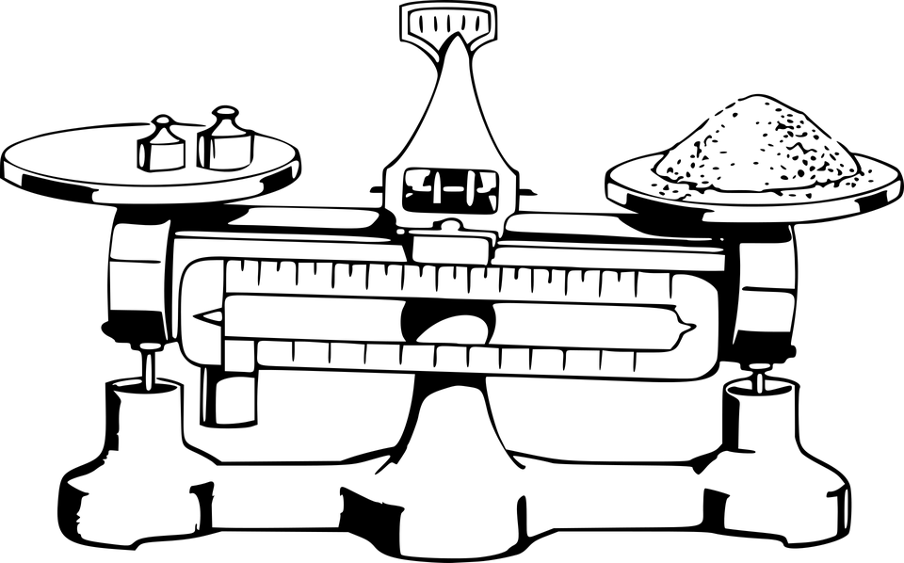
Чому?
const std::array<std::string, 8> all_magic_squares = { "816357492", "492357816", "618753294", "294753618", "834159672", "672159834", "438951276", "276951438" }; bool check_if_magic(const std::string& sq) { if ( (sq[0] & 1) != 0 || (sq[1] & 1) == 0 || (sq[2] & 1) != 0 || (sq[3] & 1) == 0 || (sq[4] & 1) == 0 || (sq[5] & 1) == 0 || (sq[6] & 1) != 0 || (sq[7] & 1) == 0 || (sq[8] & 1) != 0) return false; for(auto i = 0u; i < 8; ++i) if(sq == all_magic_squares[i]) return true; return false; }
Бо чим більше пропорція між оверхедом евристики і її ефективністю, тим більше це видно.

Slide 34
Ідея як позбутися строк
Правильні контейнери зменшують алгоритмічну складність, але скалдність операцій на строках все ще завелика.
Для нашої задачі, ми можемо ефективно перетворити строки на цілі числа.
8 | 1 | 6
3 | 5 | 7
4 | 9 | 2
64 бітне число
‘8’ | ‘1’ | ‘6’ | ‘3’ | ‘7’ | ‘4’ | ‘9’ | ‘2’
0x
38 | 31 | 36 | 33 | 37 | 34 | 39 | 32

Slide 35
Який приклад швидший?
auto c15 = '5' * 3; uint_fast64_t ideal_char_map = static_cast<uint_fast64_t>(0x1FF) << 49; uint_fast64_t char_map_one = 1u; bool check_if_magic(const std::string& sq) { if ((sq[0] + sq[1] + sq[2] != c15) || (sq[3] + sq[4] + sq[5] != c15) || (sq[6] + sq[7] + sq[8] != c15) || (sq[0] + sq[3] + sq[6] != c15) || (sq[1] + sq[4] + sq[7] != c15) || (sq[2] + sq[5] + sq[8] != c15) || (sq[0] + sq[4] + sq[8] != c15) || (sq[2] + sq[4] + sq[6] != c15)) return false; auto char_map = ideal_char_map; for(auto i = 0u; i < 9; ++i) char_map ^= char_map_one << sq[i]; if (char_map != 0) return false; return true; } | const std::array<uint64_t, 8> magic_numbers { 3545515123101087289, 3690191062107239479, 3544956562637535289, 3978984379655991859, 3689073941180135479, 4123101758198592049, 3977867258728887859, 4122543197735040049 }; bool check_if_magic(const std::string& sq) { if(sq[4] != '5') return false; uint64_t magic_number = *(reinterpret_cast<const uint32_t*> (sq.data())); magic_number <<= 32; magic_number += *(reinterpret_cast<const uint32_t*> (sq.data()+5)); for(auto i = 0u; i < 8; ++i) if(magic_number == magic_numbers[i]) return true; return false; }

Slide 36
Правий на 50%
auto c15 = '5' * 3; uint_fast64_t ideal_char_map = static_cast<uint_fast64_t>(0x1FF) << 49; uint_fast64_t char_map_one = 1u; bool check_if_magic(const std::string& sq) { if ((sq[0] + sq[1] + sq[2] != c15) || (sq[3] + sq[4] + sq[5] != c15) || (sq[6] + sq[7] + sq[8] != c15) || (sq[0] + sq[3] + sq[6] != c15) || (sq[1] + sq[4] + sq[7] != c15) || (sq[2] + sq[5] + sq[8] != c15) || (sq[0] + sq[4] + sq[8] != c15) || (sq[2] + sq[4] + sq[6] != c15)) return false; auto char_map = ideal_char_map; for(auto i = 0u; i < 9; ++i) char_map ^= char_map_one << sq[i]; if (char_map != 0) return false; return true; } | const std::array<uint64_t, 8> magic_numbers { 3545515123101087289, 3690191062107239479, 3544956562637535289, 3978984379655991859, 3689073941180135479, 4123101758198592049, 3977867258728887859, 4122543197735040049 }; bool check_if_magic(const std::string& sq) { if(sq[4] != '5') return false; uint64_t magic_number = *(reinterpret_cast<const uint32_t*> (sq.data())); magic_number <<= 32; magic_number += *(reinterpret_cast<const uint32_t*> (sq.data()+5)); for(auto i = 0u; i < 8; ++i) if(magic_number == magic_numbers[i]) return true; return false; }

Slide 37
Який приклад швидший?
const std::array<uint64_t, 8> magic_numbers { 3545515123101087289, 3690191062107239479, 3544956562637535289, 3978984379655991859, 3689073941180135479, 4123101758198592049, 3977867258728887859, 4122543197735040049 }; bool check_if_magic(const std::string& sq) { if(sq[4] != '5') return false; uint64_t magic_number = *(reinterpret_cast<const uint32_t*> (sq.data())); magic_number <<= 32; magic_number += *(reinterpret_cast<const uint32_t*> (sq.data()+5)); for(auto i = 0u; i < 8; ++i) if(magic_number == magic_numbers[i]) return true; return false; } | const std::set<uint64_t> magic_numbers { 3545515123101087289, 3690191062107239479, 3544956562637535289, 3978984379655991859, 3689073941180135479, 4123101758198592049, 3977867258728887859, 4122543197735040049 }; bool check_if_magic(const std::string& sq) { if(sq[4] != '5') return false; uint64_t magic_number = *(reinterpret_cast<const uint32_t*> (sq.data())); magic_number <<= 32; magic_number += *(reinterpret_cast<const uint32_t*> (sq.data()+5)); return magic_numbers.find(magic_number) != magic_numbers.end(); }

Slide 38
Лівий на 25% швидший
const std::array<uint64_t, 8> magic_numbers { 3545515123101087289, 3690191062107239479, 3544956562637535289, 3978984379655991859, 3689073941180135479, 4123101758198592049, 3977867258728887859, 4122543197735040049 }; bool check_if_magic(const std::string& sq) { if(sq[4] != '5') return false; uint64_t magic_number = *(reinterpret_cast<const uint32_t*> (sq.data())); magic_number <<= 32; magic_number += *(reinterpret_cast<const uint32_t*> (sq.data()+5)); for(auto i = 0u; i < 8; ++i) if(magic_number == magic_numbers[i]) return true; return false; } | const std::set<uint64_t> magic_numbers { 3545515123101087289, 3690191062107239479, 3544956562637535289, 3978984379655991859, 3689073941180135479, 4123101758198592049, 3977867258728887859, 4122543197735040049 }; bool check_if_magic(const std::string& sq) { if(sq[4] != '5') return false; uint64_t magic_number = *(reinterpret_cast<const uint32_t*> (sq.data())); magic_number <<= 32; magic_number += *(reinterpret_cast<const uint32_t*> (sq.data()+5)); return magic_numbers.find(magic_number) != magic_numbers.end(); }

Slide 39
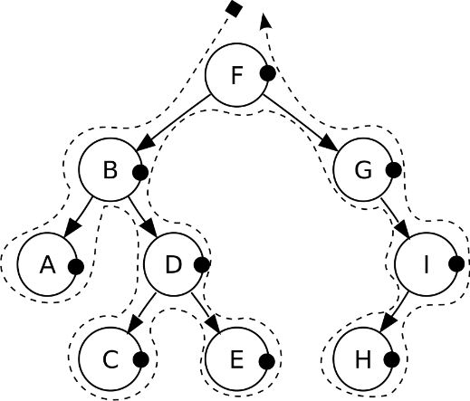
Чому?
const std::array<uint64_t, 8> magic_numbers { 3545515123101087289, 3690191062107239479, 3544956562637535289, 3978984379655991859, 3689073941180135479, 4123101758198592049, 3977867258728887859, 4122543197735040049 }; const std::set<uint64_t> magic_numbers { 3545515123101087289, 3690191062107239479, 3544956562637535289, 3978984379655991859, 3689073941180135479, 4123101758198592049, 3977867258728887859, 4122543197735040049 };
На достатньо коротких масивах, лінійний прохід ефективніший за обхід дерева.
Але!
На ARMv7 це 55 vs 14 тобто дерево ефективніше.
8 64-бітних чисел – це 64 байти.
64 байти – розмір кеш-лінії на Intel i7.
Совпадєніє?

Slide 40
Який приклад швидший?
const std::array<uint64_t, 8> magic_numbers { 3545515123101087289, 3690191062107239479, 3544956562637535289, 3978984379655991859, 3689073941180135479, 4123101758198592049, 3977867258728887859, 4122543197735040049 }; bool check_if_magic(const std::string& sq) { if(sq[4] != '5') return false; uint64_t magic_number = *(reinterpret_cast<const uint32_t*> (sq.data())); magic_number <<= 32; magic_number += *(reinterpret_cast<const uint32_t*> (sq.data()+5)); for(auto i = 0u; i < 8; ++i) if(magic_number == magic_numbers[i]) return true; return false; } | const std::unordered_set<uint64_t> magic_numbers { 3545515123101087289, 3690191062107239479, 3544956562637535289, 3978984379655991859, 3689073941180135479, 4123101758198592049, 3977867258728887859, 4122543197735040049 }; bool check_if_magic(const std::string& sq) { if(sq[4] != '5') return false; uint64_t magic_number = *(reinterpret_cast<const uint32_t*> (sq.data())); magic_number <<= 32; magic_number += *(reinterpret_cast<const uint32_t*> (sq.data()+5)); return magic_numbers.find(magic_number) != magic_numbers.end(); }

Slide 41
Лівий в 2 рази швидший
const std::array<uint64_t, 8> magic_numbers { 3545515123101087289, 3690191062107239479, 3544956562637535289, 3978984379655991859, 3689073941180135479, 4123101758198592049, 3977867258728887859, 4122543197735040049 }; bool check_if_magic(const std::string& sq) { if(sq[4] != '5') return false; uint64_t magic_number = *(reinterpret_cast<const uint32_t*> (sq.data())); magic_number <<= 32; magic_number += *(reinterpret_cast<const uint32_t*> (sq.data()+5)); for(auto i = 0u; i < 8; ++i) if(magic_number == magic_numbers[i]) return true; return false; } | const std::unordered_set<uint64_t> magic_numbers { 3545515123101087289, 3690191062107239479, 3544956562637535289, 3978984379655991859, 3689073941180135479, 4123101758198592049, 3977867258728887859, 4122543197735040049 }; bool check_if_magic(const std::string& sq) { if(sq[4] != '5') return false; uint64_t magic_number = *(reinterpret_cast<const uint32_t*> (sq.data())); magic_number <<= 32; magic_number += *(reinterpret_cast<const uint32_t*> (sq.data()+5)); return magic_numbers.find(magic_number) != magic_numbers.end(); }

Slide 42


Чому?
const unordered_set<uint64_t, 8> magic_numbers { 3545515123101087289, 3690191062107239479, 3544956562637535289, 3978984379655991859, 3689073941180135479, 4123101758198592049, 3977867258728887859, 4122543197735040049 };
На достатньо коротких масивах, обчислення хеш-функції дорожче за прохід.
Алгоритмічна складність не дорівнює практичній ефективності.
Вибір стандартних контейнерів і алгоритмів має залежати від конетксту задачі.

Slide 43
Підсумки
Круто коли бенчмарк міряє швидкодію коду (який працює в контексті генератора).
Мікрооптимізації працюють тільки в контексті процесора і компілятора.
Алгоритмічні оптимізації працюють тільки в контексті задачі.
Інтуіція не працює*
* - Теоретично можна натренуватися оптимізувати код
без замірів, але компілятори і процесори зміняться
швидше ніж закінчиться тренування.
Deep learning FTW?

Slide 44

P. S. Приклад-чемпіон

Slide 45
Наскільки правий швидший?
const std::array<uint64_t, 8> magic_numbers { 3545515123101087289, 3690191062107239479, 3544956562637535289, 3978984379655991859, 3689073941180135479, 4123101758198592049, 3977867258728887859, 4122543197735040049 }; bool check_if_magic(const std::string& sq) { if(sq[4] != '5') return false; uint64_t magic_number = *(reinterpret_cast<const uint32_t*> (sq.data())); magic_number <<= 32; magic_number += *(reinterpret_cast<const uint32_t*> (sq.data()+5)); for(auto i = 0u; i < 8; ++i) if(magic_number == magic_numbers[i]) return true; return false; } | static uint64_t magic_numbers[8] = { 0x3336313832393437, 0x3134333832373639, 0x3734393238313633, 0x3936373238333431, 0x3332393436313837, 0x3938333436373231, 0x3738313634393233, 0x3132373634333839, }; static uint64_t magic_number(const char sq[9]) { uint32_t a, b; memcpy(&a, sq, sizeof(uint32_t)); memcpy(&b, sq + 5, sizeof(uint32_t)); return ((uint64_t)a << 32) + b; } bool check_if_magic(const std::string& square) { const auto* sq = square.data(); if (sq[4] != '5') return false; int index = sq[0] & 7 | (sq[1] >> 1) & 1; return magic_numbers[index] == magic_number(sq); } // Proposed by kocsis1david from Reddit.

Slide 46
В три рази!
const std::array<uint64_t, 8> magic_numbers { 3545515123101087289, 3690191062107239479, 3544956562637535289, 3978984379655991859, 3689073941180135479, 4123101758198592049, 3977867258728887859, 4122543197735040049 }; bool check_if_magic(const std::string& sq) { if(sq[4] != '5') return false; uint64_t magic_number = *(reinterpret_cast<const uint32_t*> (sq.data())); magic_number <<= 32; magic_number += *(reinterpret_cast<const uint32_t*> (sq.data()+5)); for(auto i = 0u; i < 8; ++i) if(magic_number == magic_numbers[i]) return true; return false; } | static uint64_t magic_numbers[8] = { 0x3336313832393437, 0x3134333832373639, 0x3734393238313633, 0x3936373238333431, 0x3332393436313837, 0x3938333436373231, 0x3738313634393233, 0x3132373634333839, }; static uint64_t magic_number(const char sq[9]) { uint32_t a, b; memcpy(&a, sq, sizeof(uint32_t)); memcpy(&b, sq + 5, sizeof(uint32_t)); return ((uint64_t)a << 32) + b; } bool check_if_magic(const std::string& square) { const auto* sq = square.data(); if (sq[4] != '5') return false; int index = sq[0] & 7 | (sq[1] >> 1) & 1; return magic_numbers[index] == magic_number(sq); } // Proposed by kocsis1david from Reddit.

Slide 47
Чому?
static uint64_t magic_numbers[8] = { 0x3336313832393437, 0x3134333832373639, 0x3734393238313633, 0x3936373238333431, 0x3332393436313837, 0x3938333436373231, 0x3738313634393233, 0x3132373634333839, }; static uint64_t magic_number(const char sq[9]) { uint32_t a, b; memcpy(&a, sq, sizeof(uint32_t)); memcpy(&b, sq + 5, sizeof(uint32_t)); return ((uint64_t)a << 32) + b; } bool check_if_magic(const std::string& square) { const auto* sq = square.data(); if (sq[4] != '5') return false; int index = sq[0] & 7 | (sq[1] >> 1) & 1; return magic_numbers[index] == magic_number(sq); } // Proposed by kocsis1david from Reddit.
Я сам не розумію як воно працює
¯\_(ツ)_/¯

Slide 48
Посилання
Challenge your performance intuition with C++ operators
C++ magic squares demystified with Valgrind and disassembly
Learning the value of good benchmarking technique with C++ magic squares

