Slide 1
Can we trust a cell label on a Visium HD map?
LAB MEETING · NOVEMBER 2026
A project update: what we built, what it found on a tumour section where the right answer is known, and what it means for the ovary atlas
Nick Minster · Pediatric and Adolescent Gynecology Lab, NICHD

Slide 2
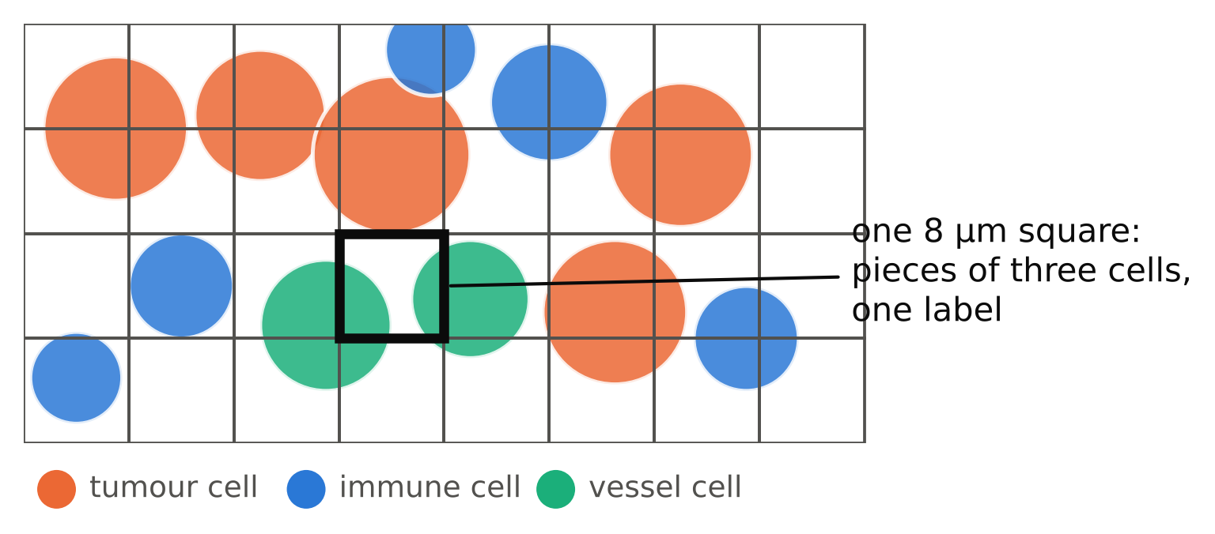
The problem: Visium HD does not see cells
It reads RNA in 8-micron squares. Each square holds pieces of about three cells.
The software then guesses one cell type for every square, and never says how sure it is.
Every map, every gene list and every cell-to-cell signal we read from the atlas inherits those guesses.
Visium-QC · lab meeting, November 2026 · 2

Slide 3
How we checked: a tumour section measured twice
210,000
370,000
2
cells on the section whose identity is known, from Xenium, a second assay that names every cell one by one
8-micron squares on the same section; 290,000 of them (78%) sit on or next to a known cell and are scored, the rest are left out of every number here
sections of the same tumour, run with two different kits; every result below held on both
Public 10x lung tumour data. We also tried smaller squares, larger squares and software-drawn cells; the picture was the same, so everything that follows is about 8-micron squares on one section.
Visium-QC · lab meeting, November 2026 · 3

Slide 4
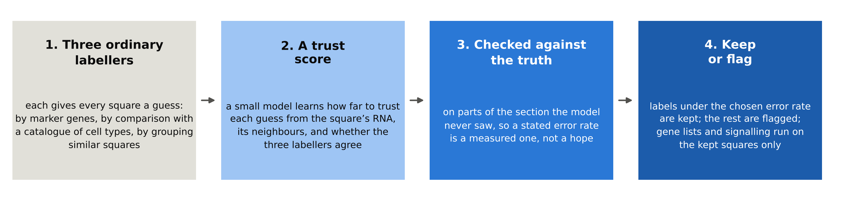
How the method works
The three labellers are the standard approaches in use today, none of them ours: scoring each square’s marker genes; matching each square to a catalogue of cell types built from published single-cell data (the Human Lung Cell Atlas, plus a lung cancer atlas for the tumour cells); and grouping similar squares, then labelling each group.
What is new is steps 3 and 4: the trust score is checked against known answers, and the map is allowed to say “not sure”. Nothing is tuned on the squares it is scored on: the section is cut into blocks, and each block is scored by a model that never saw it, so the error rates are honest.
Visium-QC · lab meeting, November 2026 · 4

Slide 5
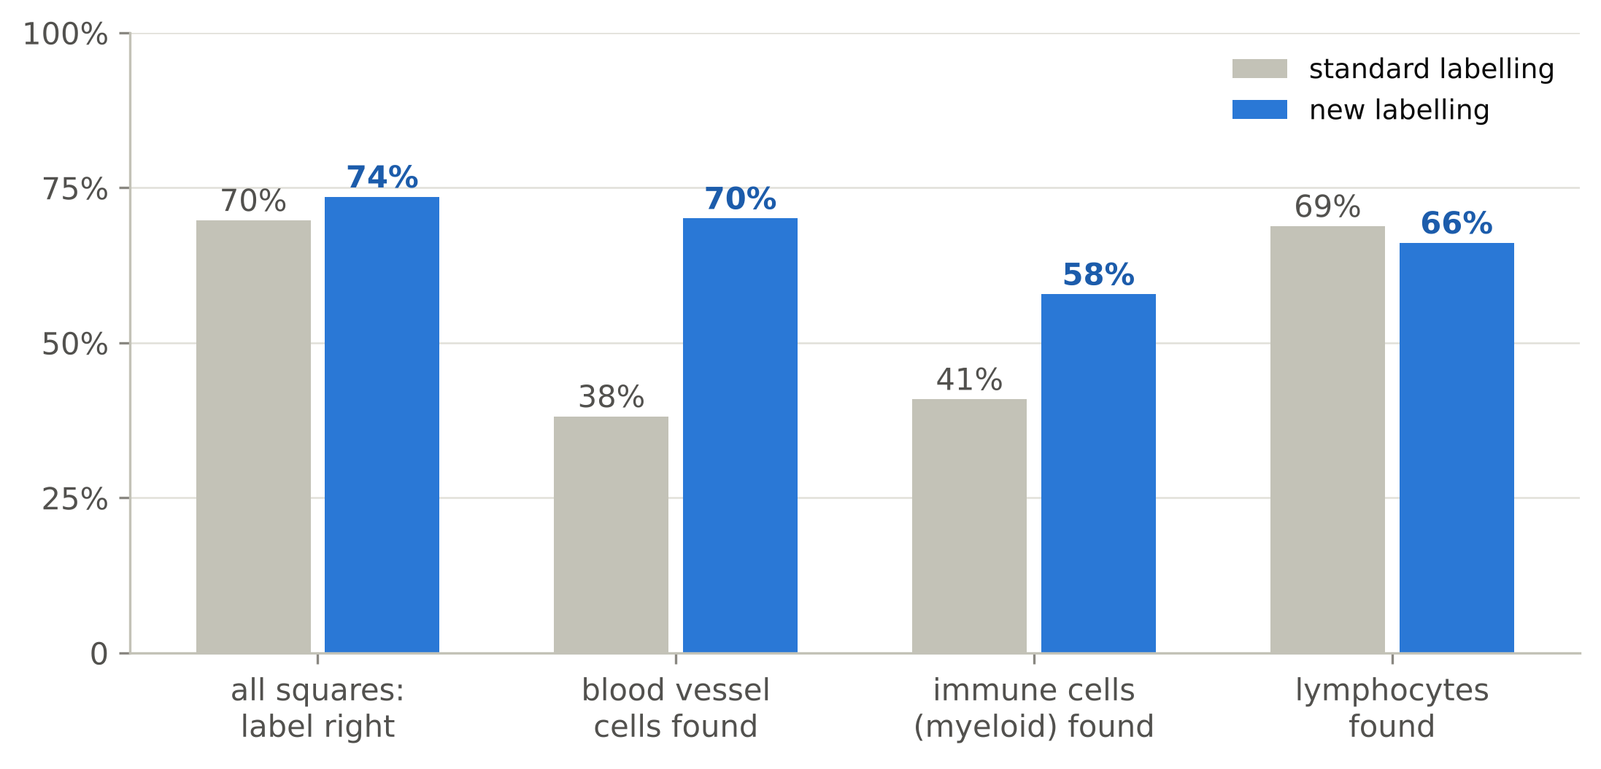
Result 1: more labels right, and the rare cells found
Standard labelling gets 7 in 10 squares right; ours gets 74%. The bigger change is in the rare cells: blood vessel cells are found twice as often.
Why it matters: vessels and immune cells are the cells our ovary questions turn on, and the ones a square rarely holds enough of.
Lymphocytes do not improve. They are small, carry little RNA and sit between other cells, so a square seldom holds enough of one to tell.
Finer labels (fourteen cell types instead of five): standard labelling gets 21% of squares right, ours 62%, and tumour cells are found 85% of the time.
Visium-QC · lab meeting, November 2026 · 5

Slide 6
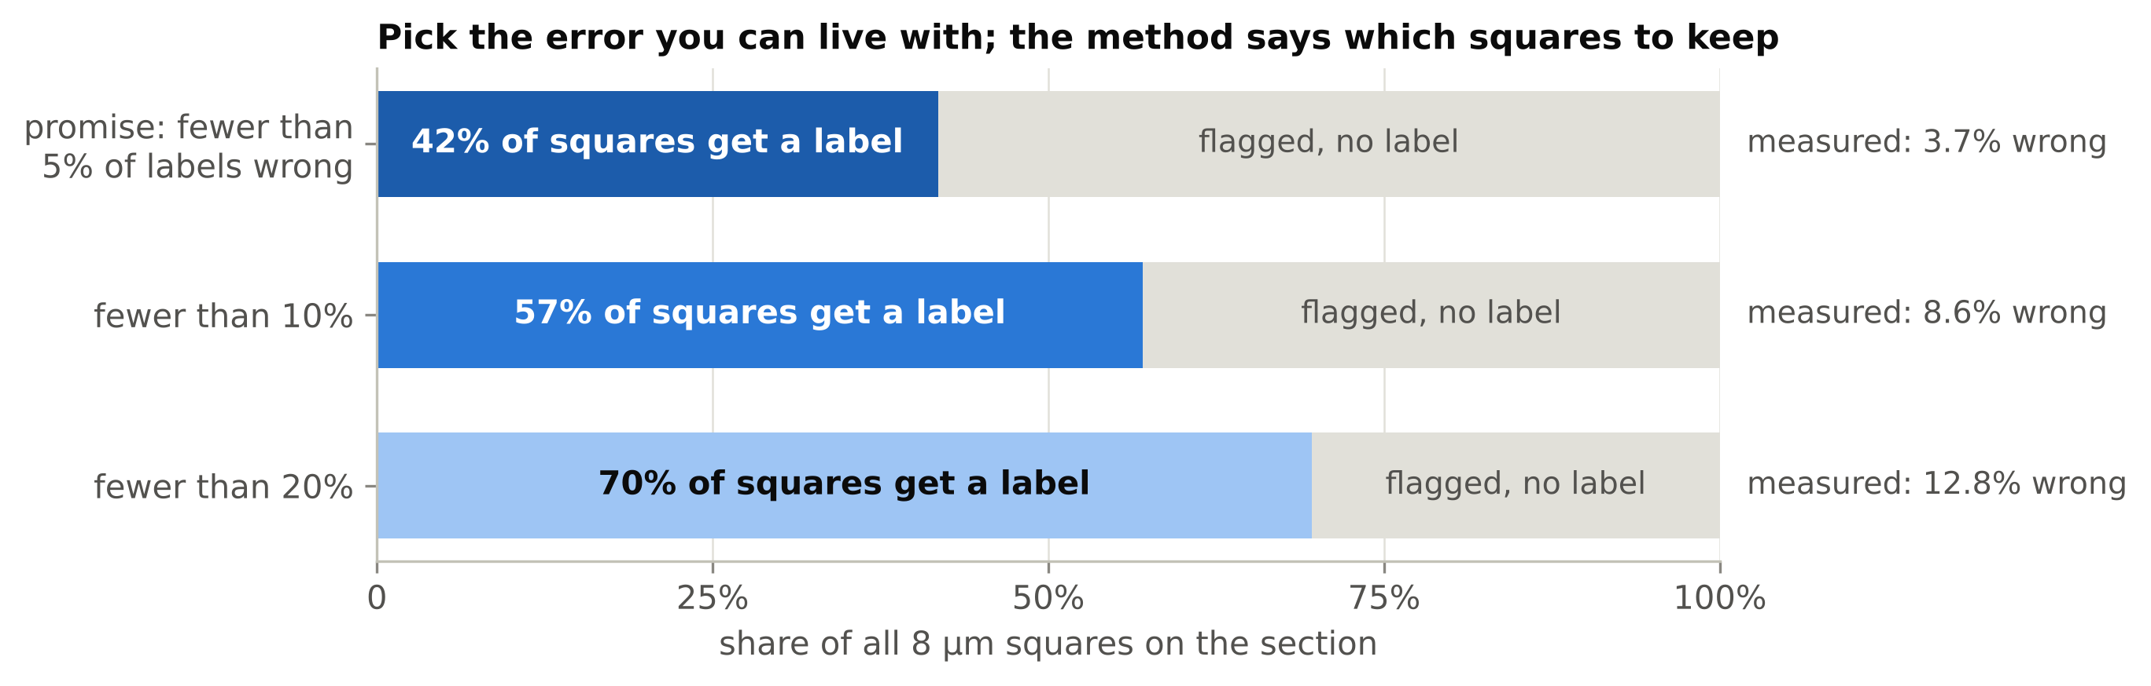
Result 2: we can say which labels to trust
Pick an error rate you can live with. The method keeps a label only on the squares that meet it and flags the rest as uncertain.
At 5%, 42% of squares keep a label, and the error we then measured was 3.7%. At 10%, 57% keep one.
What happens to the wrong squares: standard labelling leaves them coloured in, with nothing to tell them apart. Here, 43% of the flagged squares would have been wrong, against 3.7% of the kept ones. The flag catches most of the errors and shows where they are; no current tool does this.
Visium-QC · lab meeting, November 2026 · 6

Slide 7
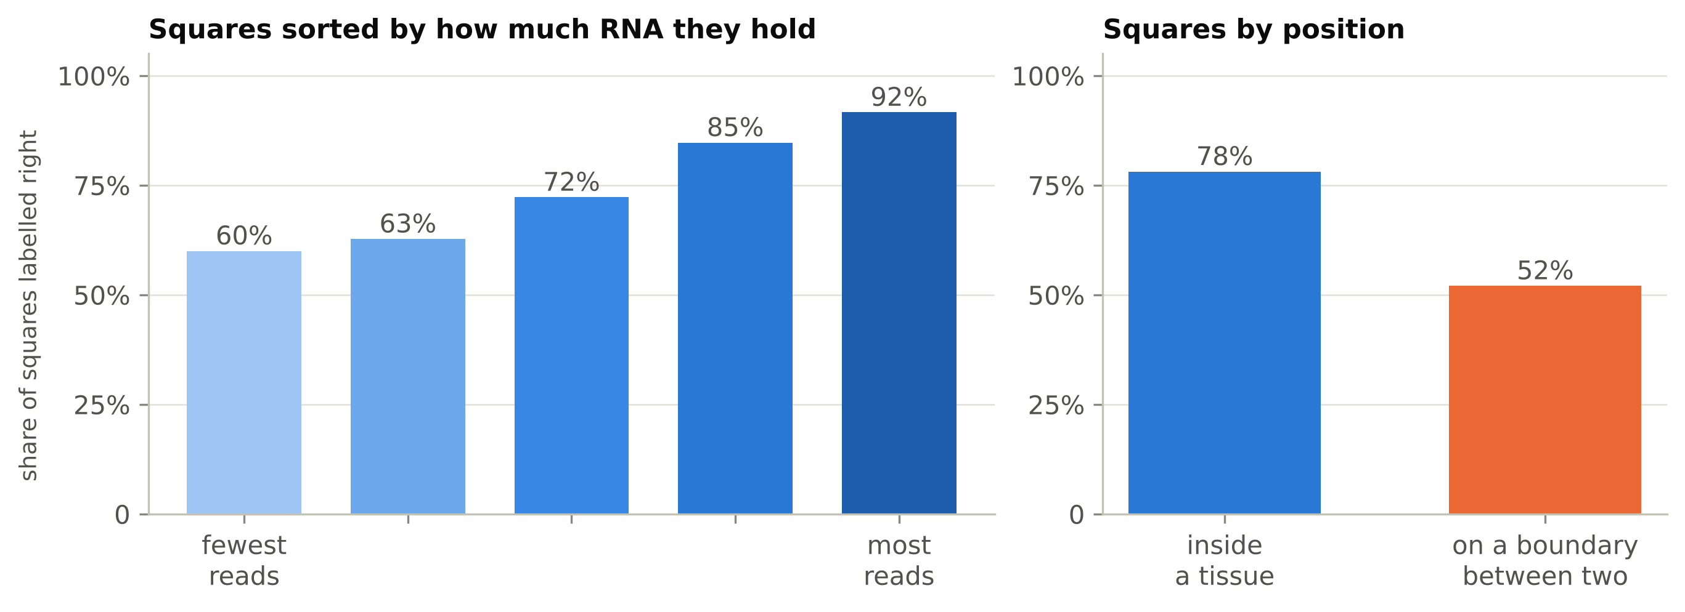
Result 3: where labels fail, and why
Squares with little RNA: 60% right among the emptiest fifth, 92% among the fullest. How much RNA a square captured is the first limit.
Squares on a boundary between two tissues: 52% right, because the square holds two kinds of cell and gets one label. These are the squares to flag, not to colour in.
Not the problem: the alignment between the two assays. Shifting it by half a square changed nothing.
Visium-QC · lab meeting, November 2026 · 7

Slide 8
Result 4: better labels give the right genes
75%
67%
50%
of the genes that mark each cell type, called from our labels, are the right ones: 3 in 4
with standard labelling: 2 in 3. One wrong gene in three is what a mislabelled map hands to the next experiment
if every square is kept and the uncertain ones are down-weighted instead of flagged: worse than either. Leaving them out is the better choice
How we scored it: the marker genes of each cell type were called from the Visium labels and compared with the same genes called from the known cell identities on the same squares.
Visium-QC · lab meeting, November 2026 · 8

Slide 9
Where this sits, and what the next results could look like
WHAT EXISTS TODAY
WHAT COULD COME NEXT
Tools that draw and label cells on Visium HD (Space Ranger 4, Bin2cell, CellART, 2025 to 2026) give one label per cell, with no error rate and no flag for uncertain cells.
The ovary atlas: maps that show where they are sure and flag where they are not, with follicle and oocyte labels checked against the H&E.
The benchmarks of those tools (MCseg, SpatialBench, 2026) compare the outlines of cells, not whether the labels are right.
A second tissue: a public colon cancer section where pathologists labelled the cells by hand.
Labels with a measured error rate exist for dissociated single cells (scConform, 2025); nobody has done it for a spatial map.
Cell-to-cell signalling: how many of the signals called on a map disappear when only trusted labels are used.
The field’s own 2026 review names errors spreading from cell labels into signalling analysis as its top unsolved problem.
A preprint in December, and software others can run on their own sections.
The claim: the first spatial method whose labels carry a measured error rate, tested against a cell-by-cell truth.
Visium-QC · lab meeting, November 2026 · 9

Slide 10
What this means for the ovary atlas, and what I am asking for
NOW
THE CATCH
ASKS
The five ovary captures go through the same pipeline. Each map will show where its labels are sure and flag where they are not, and the gene lists will come from the sure squares.
No ovary section has been measured twice, so on the ovary the error rates are borrowed from lung, not measured. A Xenium run on one ovary section would fix that; it is a cost decision.
Two to three hours of expert marking of regions on the ovary H&E, so the flagged and the sure squares can be checked against anatomy. A read of the draft paper in December.
Timeline: final lung runs this week; paper draft in December; ovary maps for review in January.
Visium-QC · lab meeting, November 2026 · 10

Slide 11
Next: a model that knows the ovary's cells
0.4%
0.08%
237
of the public cell atlas that today's models learn from is human ovary, and half of that is tumour
is mouse ovary: two studies, no nuclei, no estrous cycle, no ovary older than 9 months
mouse oocytes in the whole atlas. The follicle, the part that defines the organ, is almost absent
What a foundation model is. A model trained on millions of single cells from public atlases. It learns what each cell type and state looks like, so it can label new data and, in the best case, predict how cells change under a treatment. The Arc Institute now runs a yearly contest for exactly that prediction.
Why the ovary needs its own. Those models have seen almost no ovary, and none of the biology we ask about: the cycle, ovulation, ageing, the response to surgery. The data exist in GEO, more than a million mouse cells, but nobody has gathered them into something a model can learn from.
Visium-QC · lab meeting, November 2026 · 11
Notes:
Framing for a non-computational audience: a foundation model is a model pre-trained on millions of cells that can be reused for many tasks. The numbers come from the CELLxGENE Census release of November 2025, queried directly. The Arc Institute's Virtual Cell Challenge (2026 edition) is the motivation and the yardstick; we are not entering it.

Slide 12
What we will build: three things, each useful alone
1 · THE COLLECTION
2 · THE TEST
3 · THE MODEL
Every public mouse ovary dataset we can find, re-processed from raw counts into one collection with one shared vocabulary of cell types: the estrous cycle, ovulation time courses after hCG, ageing and menopause models, and our own oophorectomy nuclei. About one to two million cells. Most of it sits in GEO and never reached the atlases the big models learn from.
A held-out test. The model is given only a compartment's baseline cells, say granulosa before hCG, or young stroma, and asked to predict the treated state: 4 hours after hCG, or aged. Its answer is scored against the real cells on a 0-to-1 scale, where 0 is no change at all and 1 is what a second animal achieves.
A modest mouse model, started from a public one and trained further on the ovary collection, judged against simple methods on the same test. If it does not beat them by a margin we have written down in advance, the collection and the test are still the papers, and we say so.
The yardstick is the Arc Institute's 2026 Virtual Cell Challenge: the same task shape and the same way of scoring, copied onto ovarian compartments and conditions. We use its rules; we are not entering it.
Visium-QC · lab meeting, November 2026 · 12
Notes:
Datasets already in hand: Isola 2024 (ageing, Stout lab), Huang 2025 (ovulation, PLOS Biology), Wang and Suh 2026 (estropause, PNAS), the Schuh lab ovulation series (Nature Cell Biology 2024), Gaylord 2025 (Science), Morris 2022 (the cycling ovary, Pépin lab, pending a download), plus our 30-day oophorectomy nuclei. The base model is scPRINT-2 (Apache-2.0 weights); the primary comparison is scVI/scANVI.

Slide 13
How the test works, in one picture
BASELINE CELLS
one compartment, before the treatment (granulosa at 0 h; young stroma)
THE MODEL
sees only those cells and the name of the treatment
PREDICTED CELLS
what it thinks 4 h after hCG, or aged, looks like
REAL CELLS
the measured treated cells, held back from the model
vs
The score, per compartment and treatment
0
the bar
1
the baseline copied: no change predicted
what you get by borrowing the response from another dataset, no learning at all
what a second animal reproduces; the ceiling we can measure
Whole datasets are held out, never one condition of a dataset. The genes that name the treatment (the immediate-early genes after hCG) are removed from the scoring, as the Challenge removes the knocked-down gene. A compartment that does not respond is listed but not scored.
The rule, written down before any model is trained: a model counts only if it clears the bar in at least two held-out contexts. Otherwise we publish the collection, the test and the ceilings, and report the model as the negative result it is.
Visium-QC · lab meeting, November 2026 · 13
Notes:
The scoring copies the Challenge's 2026 contract: six measures of how well the predicted cells match the real ones (which genes change, in which direction, by how much; how separable the responses are), each rescaled so that the control copy is 0 and a split-half replicate across animals is 1. The bar is retrieval and transfer, the approach that placed in both Challenges. Preregistration lives in the repo.

Slide 14
Our oophorectomy data, status, and the asks
OUR DATA
NOW
ASKS
The 30-day ooph vs sham nuclei become a test the model never trains on: no public single-cell dataset of compensatory ovulation exists, so ours is the only one. The 120-day cohort is designed to be scorable: at least 400 nuclei per compartment per arm, three mice per arm if the budget allows, estrous stage recorded at collection.
The pipeline is built and tested. Four public datasets are through QC and labelling, and the first ceilings table ran: 45 compartment-by-condition tests. It taught us two things: one deposit is raw droplets and now gets cell calling; and with thousands of cells per group every gene looks significant, so groups are now capped, as the Challenge does.
One hour on the cell-type crosswalk: our names against the Cell Ontology's new granulosa, theca and luteal terms, with the markers beside each. A decision on the 120-day design. And a conversation about the one thing no lab has: a perturbation experiment in the ovary itself, which is what moved the score in every Challenge so far.
Timeline: the last two atlases and the corrected tables this month; the collection and the first results, November to January; the model and its ablations, spring; the write-up, next autumn. Everything is on Biowulf and in the Virtual_Cell repository.
Visium-QC · lab meeting, November 2026 · 14
Notes:
Status on 2026-11-05: Huang 2025 (25,080 cells, 16 named clusters), Wang and Suh 2026 (78,538 cells, 18 ovaries), Gaylord 2025 (51,841 cells, 6 mice) and the Schuh 2024 follicle series are through QC; Isola 2024 (Census) and Morris 2022 (OSF) are pending. The first ceilings run (45 bundles, two hours) showed the Schuh deposit holds every droplet (49 million barcodes) and that uncapped groups make every gene significant; both are fixed in the pipeline and the table is being rerun. The crosswalk review is the one task that needs the lab's biology rather than compute. The in vivo perturbation point is an option, not a dependency: the plan stands without it, but every 2026 result says in-context perturbation data is what makes a learned model beat transfer.

