Slide 1
TradeTracker AI
Empowering African Small Traders with AI-Powered Financial Intelligence
"Speak your sales, snap your receipts, see your profits instantly"
Team: Nelson Masbayi Muyodi
Event: Vibe Coding Hackathon 2025 Challenge: Retail & Ecommerce - Lightweight Storefront Builder
Date: May 2025
NM
by Nelson Muyodi

Slide 2
Small Traders Are Losing Money Every Day
70%
15-25%
0
Don't Track Expenses
Average Profit Loss
Simple Solutions
Small traders in Africa operating without financial visibility
Due to poor financial tracking and visibility
Current apps are complex, require literacy, and cost too much
The Reality:
- 📊 70% of small traders in Africa don't track their expenses
- 💰 Average profit loss: 15-25% due to poor financial visibility
- 📱 Barriers: Complex apps, literacy requirements, high costs
- ⏰ Time constraint: Too busy serving customers to do bookkeeping
Real Impact: "I thought I was making money, but at the end of the month, I had nothing to show for it." — Mary, Nairobi Market Trader
The Core Problem: Small traders can't grow their businesses without knowing their actual profits.

Slide 3




TradeTracker AI - Financial Intelligence Made Simple
Speak Your Sales
"I sold 5 bags of rice for 2000 shillings"
Natural language processing in local context
Snap Your Receipts
Point camera at any receipt
AI extracts all transaction details instantly
See Your Profits
Real-time profit/loss calculations
Smart business insights and recommendations
Three Magic Words: Speak. Snap. See.
The Vision: Make expense tracking as simple as having a conversation.

Slide 4
Voice-to-Transaction Magic
Click "Voice Input" button
Start the voice recording process with a single tap
Say: "I sold 10 chickens for 5000 shillings today"
Speak naturally in your preferred language
Watch AI process and categorize automatically
The system identifies products, quantities, and amounts
Review confidence score and parsing results
Verify the AI understood your transaction correctly
Confirm transaction with one click
Add the verified transaction to your records instantly
Key Features Shown:
- ✅ Natural language understanding
- ✅ Automatic categorization
- ✅ Swahili/English support
- ✅ Confidence scoring
- ✅ Beautiful voice recording UI
Wow Factor: From voice to verified transaction in under 10 seconds!

Slide 5
AI-Powered Receipt Processing
Click "Scan Receipt"
Launch the camera interface with a single tap
Upload sample receipt photo
Take a photo or select from your gallery
Show OCR text extraction
Watch as the AI reads all text from the image
Display AI-parsed transaction data
See structured data extracted from the receipt
Highlight vendor, amount, items detected
Verify the extracted information is correct
Technical Magic:
🔍 Google Vision API - Professional OCR
🤖 OpenAI GPT-3.5 - Intelligent parsing
🎯 Smart Categorization - Context-aware classification
💾 Instant Integration - One-click to add transaction
Impact: Eliminate manual data entry completely!

Slide 6
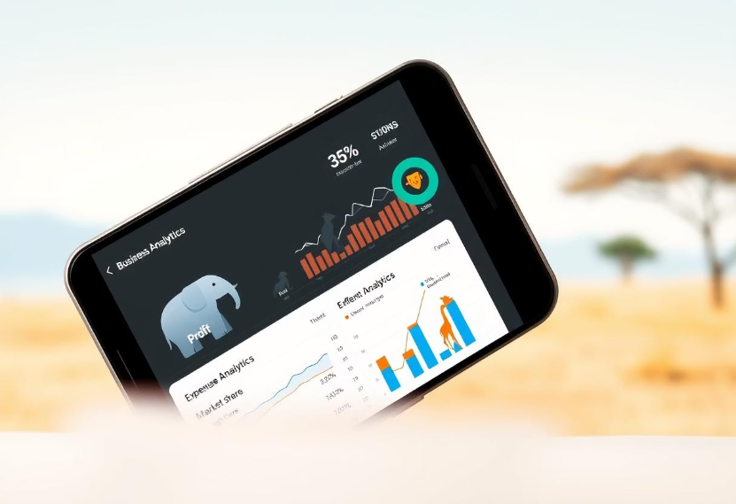
Business Intelligence That Actually Helps
Demo Navigation:
Navigate to Analytics page
Show period filtering (Last 30 days)
Highlight key metrics cards
Display trend charts and category breakdown
Read business insight recommendations
Intelligence Features:
📈 Trend Analysis - Revenue, expenses, profit over time
🎯 Smart Insights - "Your transport costs increased 25% this week"
📋 Category Breakdown - Visual expense analysis
📤 Export Ready - CSV reports for accountants
Business Value: Turn data into actionable business decisions.

Slide 7




AI-First Architecture for Real Impact
Voice Input
Receipt Photo
Pattern Matching (Free) + OpenAI (Premium)
Google Vision OCR + GPT-3.5 Parsing
Mobile-First
Transaction Data
Perfect for market traders
Real-time Analytics + Business Insights
Smart Design Decisions:
🆓 Free Tier Available - Pattern matching works offline
💎 Premium Enhancement - AI for complex scenarios
⚡ Real-time Updates - Supabase for instant sync
📱 Mobile-First - Perfect for market traders
Tech Stack:
- Frontend: React + Tailwind CSS
- Backend: Supabase (PostgreSQL + Auth)
- AI Services: OpenAI + Google Vision
- Deployment: Vercel

Slide 8



Massive Impact Potential
Revenue Potential
$50M ARR at 1% market penetration
Business Model
Freemium with premium AI features ($2-5/month)
Target Market
200M+ small traders across Africa
Target Market:
- 🏪 200M+ small traders across Africa
- 💰 $180B informal economy needing financial tools
- 📱 85% smartphone penetration - ready for mobile solutions
- 🚀 0.1% current digital adoption - huge opportunity
Business Model:
- 🆓 Freemium - Basic tracking free forever
- 💎 Premium ($2-5/month) - AI features, advanced analytics
- 🏢 Enterprise - Multi-location, team management
- 🤝 Partnerships - Mobile money, microfinance integration

Slide 9



Built to Scale Across Africa
Phase 1: Kenya (Current)
Nairobi market traders, English + Swahili, KES currency
Phase 2: East Africa (6 months)
Uganda, Tanzania, Rwanda, local languages, regional mobile money
Phase 3: Continental (12 months)
20+ African countries, multi-currency, microfinance partnerships
Technical Scalability:
- ☁️ Cloud-native - Auto-scaling infrastructure
- 🔄 Multi-tenant - Millions of users per instance
- 🌐 API-first - Easy integrations and partnerships

