Slide 1
Audio Denoising with UNET
Ruchi M Dhamnaskar

Slide 2
Workflow
Audio to spectrum using mfcc
MFCC and inverse MFCC
Unet: understand architecture
Sample Dataset
UNET training
Run inference on test audio samples
Download and Generate dataset
Evaluate
Clean dataset
Train
Evaluate
Metrics

Slide 3
Kinds of noise & Datasets
Background Noise:
Sounds like: persistent, low-level sounds present in an environment
Caused by: air conditioning, fans, or traffic.
Impulse Noise:
Sounds like: sudden, brief disturbances or spikes in an audio signal such as clicks, pops, or crackling sounds.
Caused by: electrical interference, microphone handling noise, or external factors like sudden movements or impacts.
Electrical Noise:
Sounds like: hums, buzzes, or static-like disturbances in the audio.
Caused by: power lines, grounding issues, electronic devices, or poor audio equipment connections.
Reverberation:
sound reflections in an enclosed space. It occurs when sound waves bounce off surfaces, causing a prolonged decay of sound.
Reverberation can make audio sound distant, muffled, or unclear
rooms with poor acoustics or excessive echo.
Modelled sensor noise:
Combination of gaussian and poisson distribution

Slide 4
Audio processing
Amplitude Scaling/Quantization
Sampling Frequency
Quantization method
Time and Frequency Analysis
Fourier transform, STFT
Spectrogram
MFCC Spectrogram
DNN on frequency domain image
Evidence supporting use:
https://github.com/rdadlaney/Audio-Denoiser-CNN/tree/main
Use STFT as input – using mfcc may solve some issues - studied in next section
Comparison of input: https://arxiv.org/pdf/1706.07156.pdf%5D
Evidence against use
https://arxiv.org/pdf/1806.03185.pdf
Magnitude is passed to CNN, what about phase??
Spectrogram are calculated of of a limited time slice, long temporal information is not utilized (Refer to “sound is serial” in next section)
Known issues of using MFCC/ spectrogram for CNN
Sound is serial: information gathered over time, a picture gives more information than a slice of sound at a moment
Sound is non local: neighbouring pixels belong to similar object, neighbouring frequencies may not
Axes of spectrogram vs Axes of image: spectrogram is not spatially invariant: a face anywhere in the image is atill a face, an utterance from a man when shifted along frequency axis may become that of a woman!
https://towardsdatascience.com/whats-wrong-with-spectrograms-and-cnns-for-audio-processing-311377d7ccd
Signal to-Distortion ratio evaluation metric

Slide 5
STFT snd MFCC

Slide 6
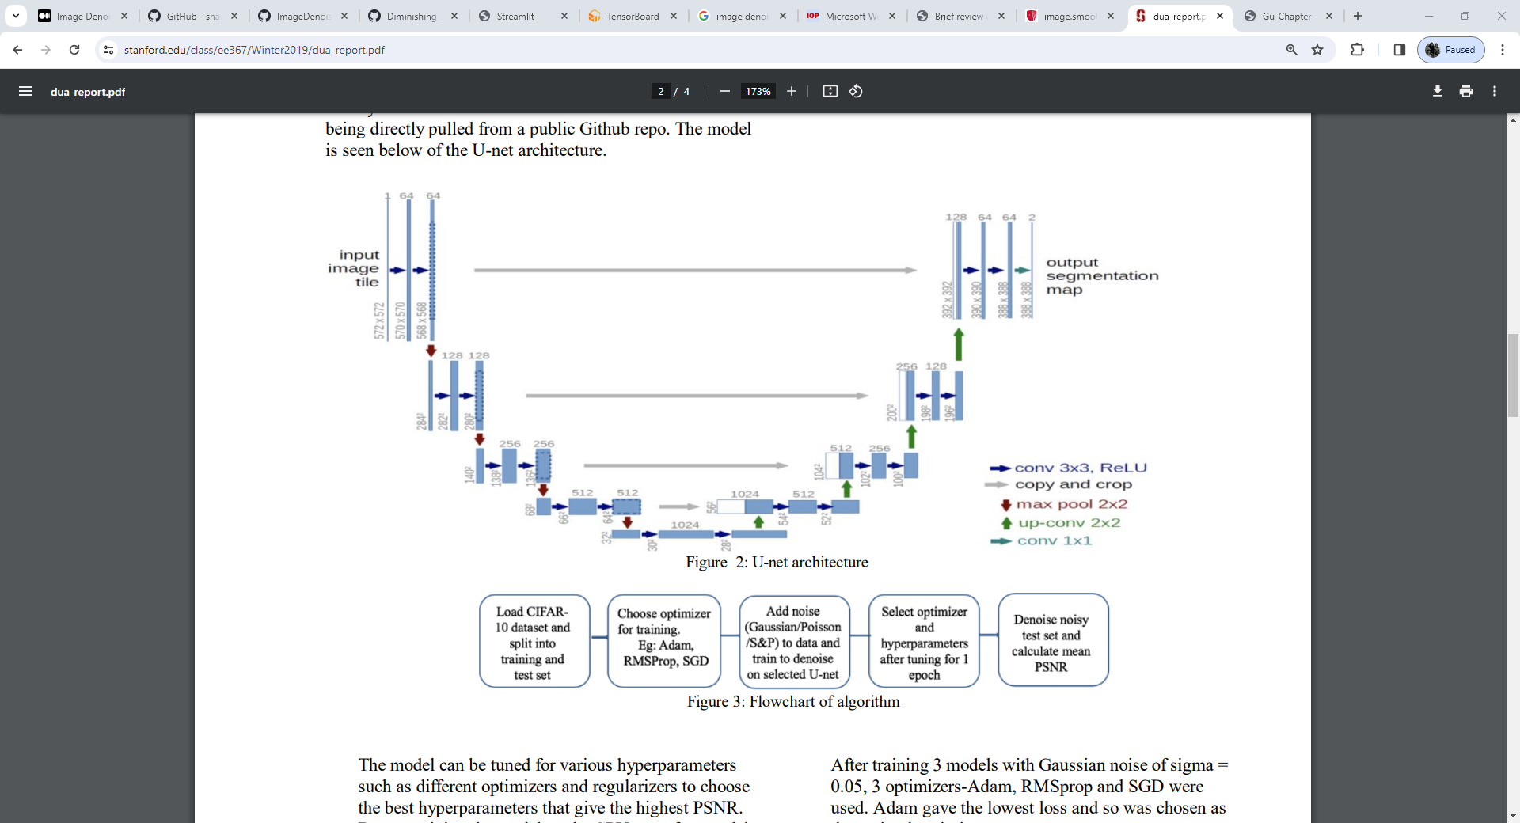
UNET Architecture
Contracting path:
Downsamples the images and gets the features
Conv and max pool layers
Expanding path:
Upsamples the images and combines the features
Conv and relu + Repeat pixel values in window to upsample
Skip connections:
Passes on the features from the contracting path to the expanding path
UNET
few training images and yields more precise segmentations
Add expanding branch where pooling operators are replaced by upsampling operators. Hence, these layers increase the resolution of the output.
high resolution features from the contracting path are combined with the upsampled
upsampling part has a large number of feature channels, which allow the network to propagate context information to higher resolution layers
The network does not have any fully connected layers and only uses the valid part of each convolution, i.e., the segmentation map only contains the pixels, for which the full context is available in the input image. This strategy allows the seamless segmentation of arbitrarily large images by an overlap-tile strategy
https://stanford.edu/class/ee367/Winter2019/dua_report.pdf
https://arxiv.org/pdf/1505.04597.pdf

Slide 7
Information loss checks
Amplitude Scaling/Quantization
Sampling Frequency
Quantization method
Time and Frequency Analysis
MFCC
Spectrogram
Sound vs image
Spatial invariance
Signal to-Distortion ratio evaluation metric

Slide 8
Dataset study

Slide 9
Evaluation

