Slide 1
Compilers 101
Backends - Part 1

Slide 2
Previously…
Preprocessing
Lexical analysis
Frontend
Syntax analysis
Semantic analysis
IR Generation
IR Optimization
Middle-end
Optimization
Backend
Code generation

Slide 3
Today
Compiler backends
Backend stages and algorithms behind

Slide 4
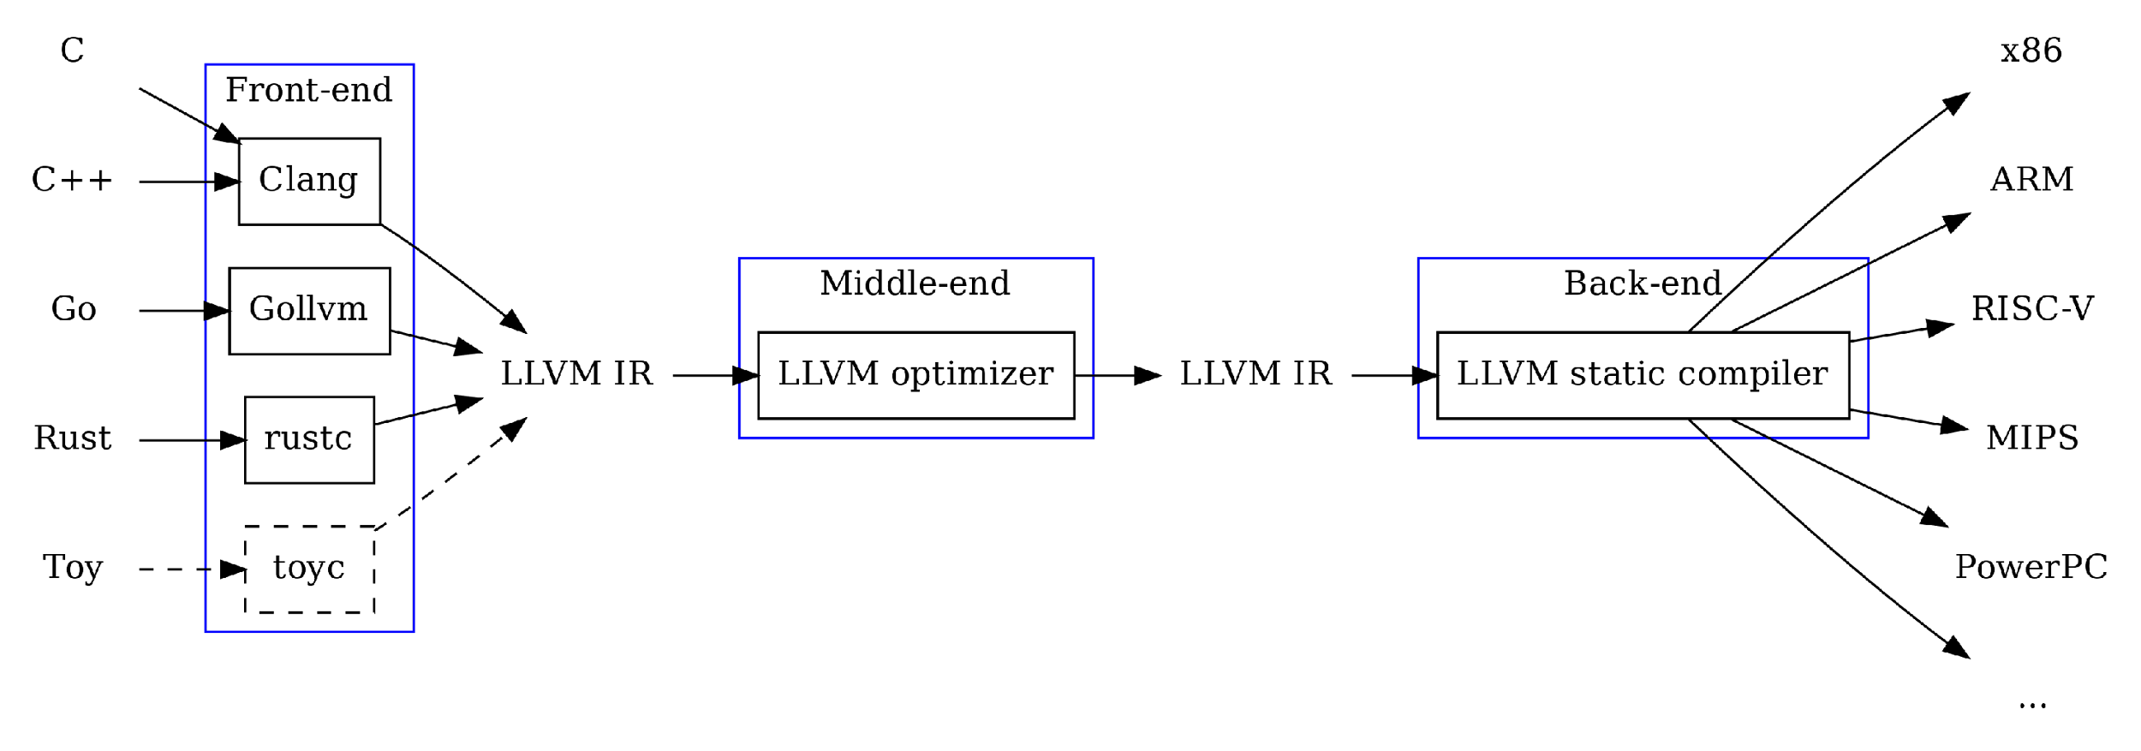
Backend in LLVM
https://wr.informatik.uni-hamburg.de/_media/teaching/wintersemester_2020_2021/ep-2021_hosseini_llvm.pdf

Slide 5
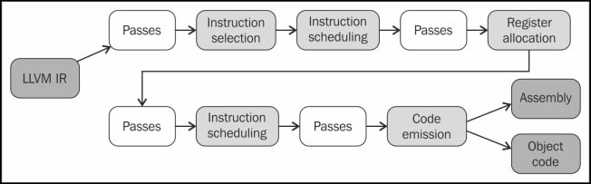
LLVM backend pipeline (overview)
https://getting-started-with-llvm-core-libraries-zh-cn.readthedocs.io/zh-cn/latest/ch06.html

Slide 6
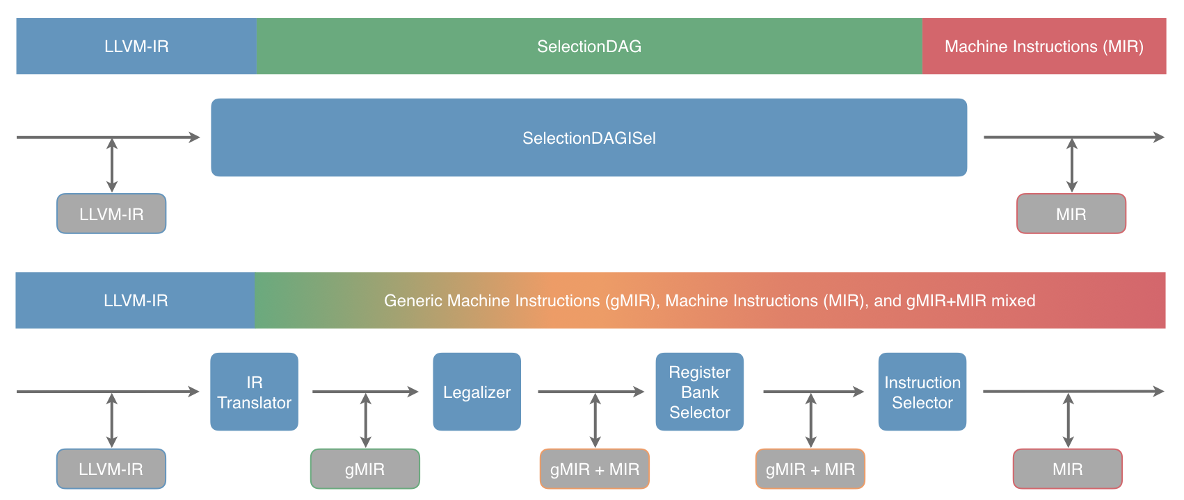
Modern LLVM backend: detailed view
https://llvm.org/docs/GlobalISel/Pipeline.html
Details about LLVM backend are going to be covered next time…

Slide 7
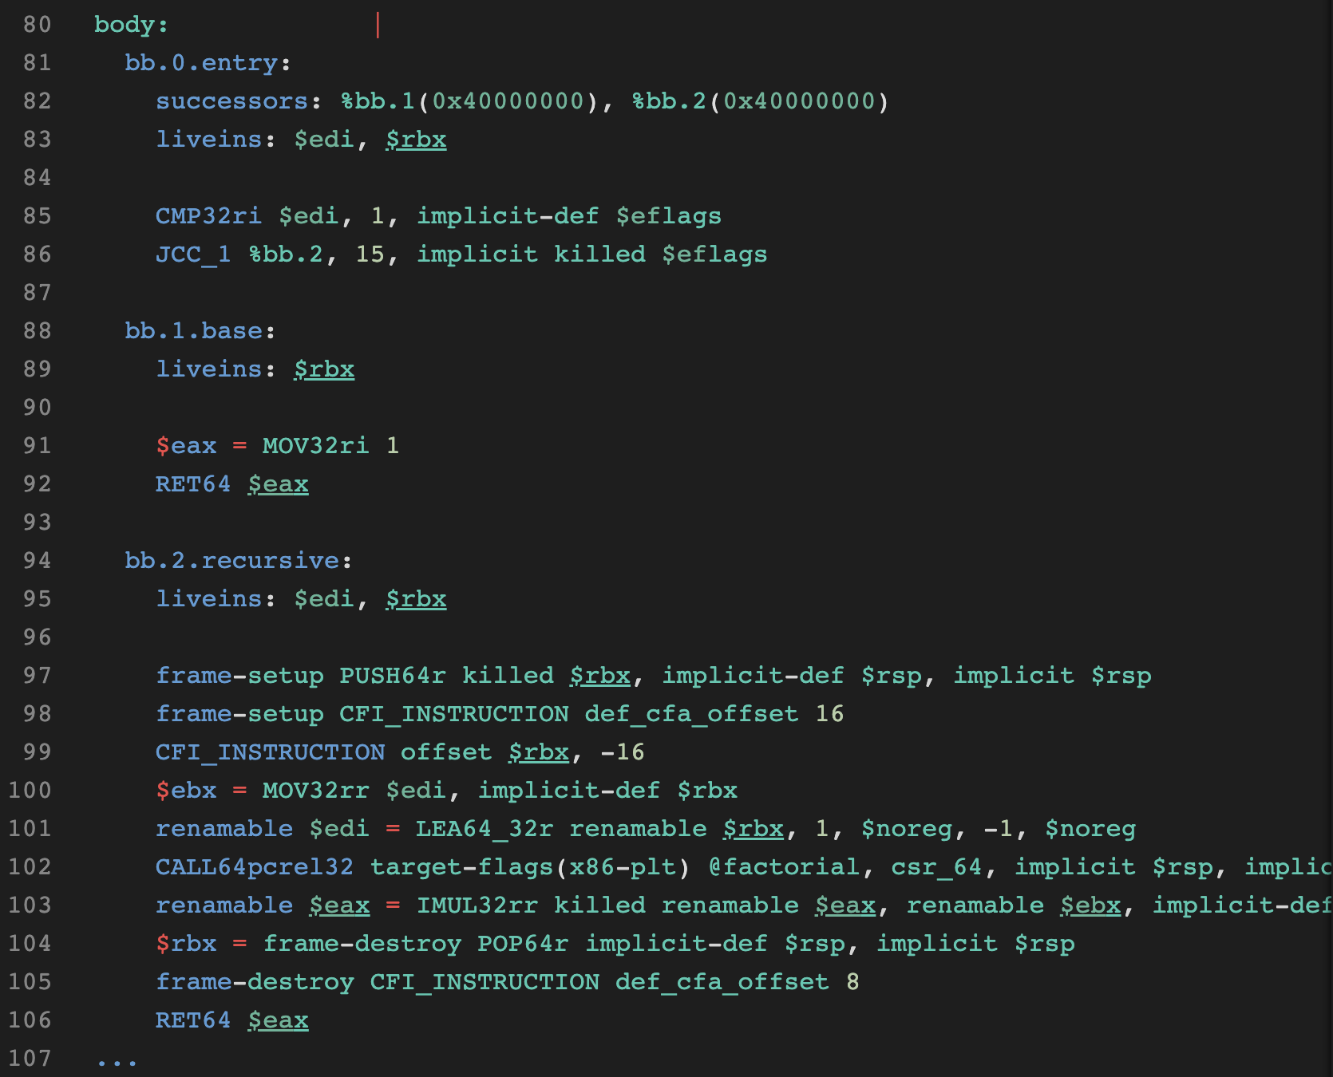
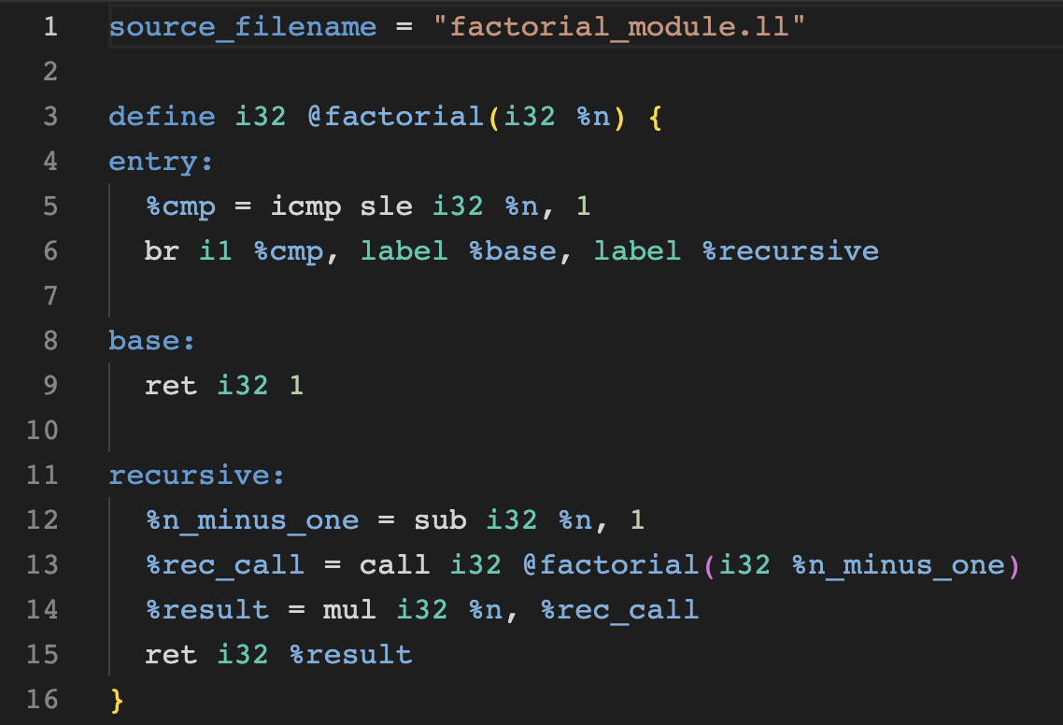

Instruction selection
We now have an optimized IR code, but it’s not consumable by HW
Instruction selection is a stage of compiler, that transforms IR into low-level IR
In case of LLVM compiler: LLVM IR → MIR (Machine IR)
MIR
LLVM IR
https://godbolt.org/z/d33c1P99M

Slide 8
Instruction selection methods
Abstract/HW agnostic instructions
HW specific instructions
Macro expansion
Replace all IR instructions by matching templates
Graph covering
Transform IR into graph
Cover graph with patterns – templates that match a portion of a graph
Lowest common denominator strategy
Attempt to select instructions that would allow execution on the widest range of hardware

Slide 9
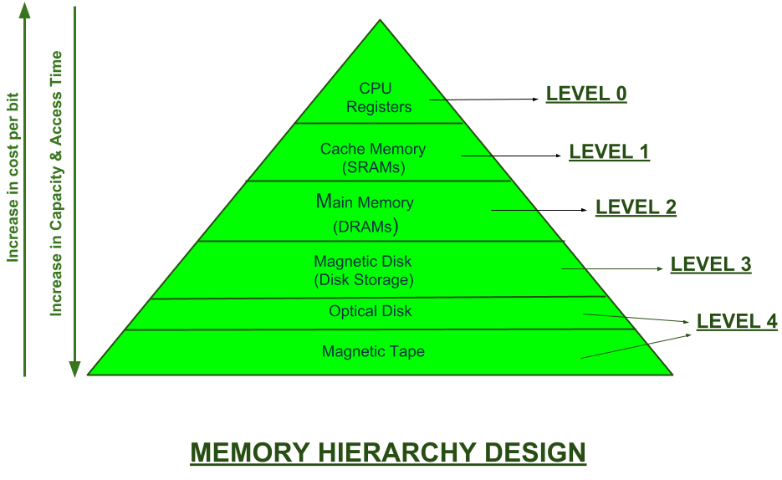
Memory hierarchy
https://www.geeksforgeeks.org/memory-hierarchy-design-and-its-characteristics/

Slide 10
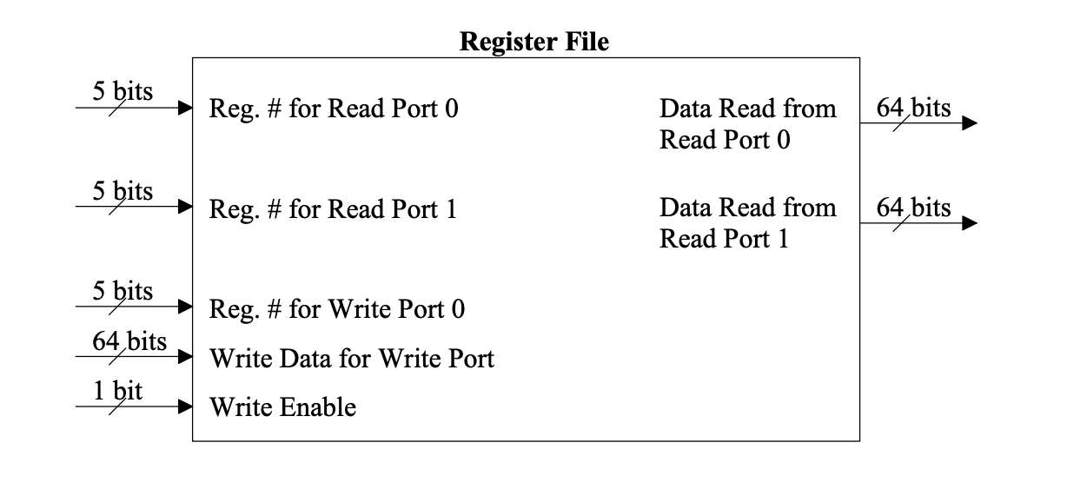
Registers
https://www.cs.uni.edu/~fienup/cs041s08/lectures/lec13_reg_file.pdf

Slide 11
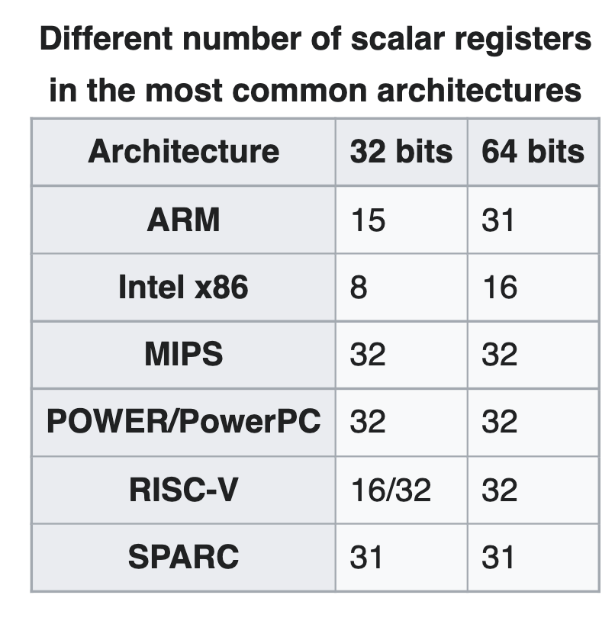
Registers in modern CPUs
https://en.wikipedia.org/wiki/Register_allocation

Slide 12
SSA recap
Registers are only assigned once
Infinite amount of registers

Slide 13
Challenges
Registers are scarce
In most of the cases, we deal with dozens of registers
Registers are complicated
Registers can be made of smaller registers
Some registers may be reserved
Some instructions must store results to certain registers
Some registers are part of ABI

Slide 14
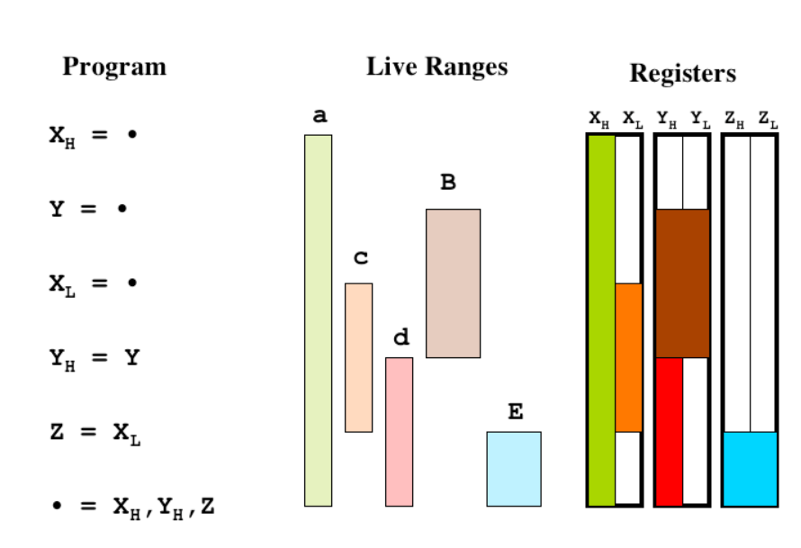
Challenges
https://llvm.org/pubs/2008-06-PLDI-PuzzleSolving.pdf

Slide 15
Graph theory to the rescue!
Each register is a node in a graph
Edges are interfering ranges (i.e., registers that live together)

Slide 16
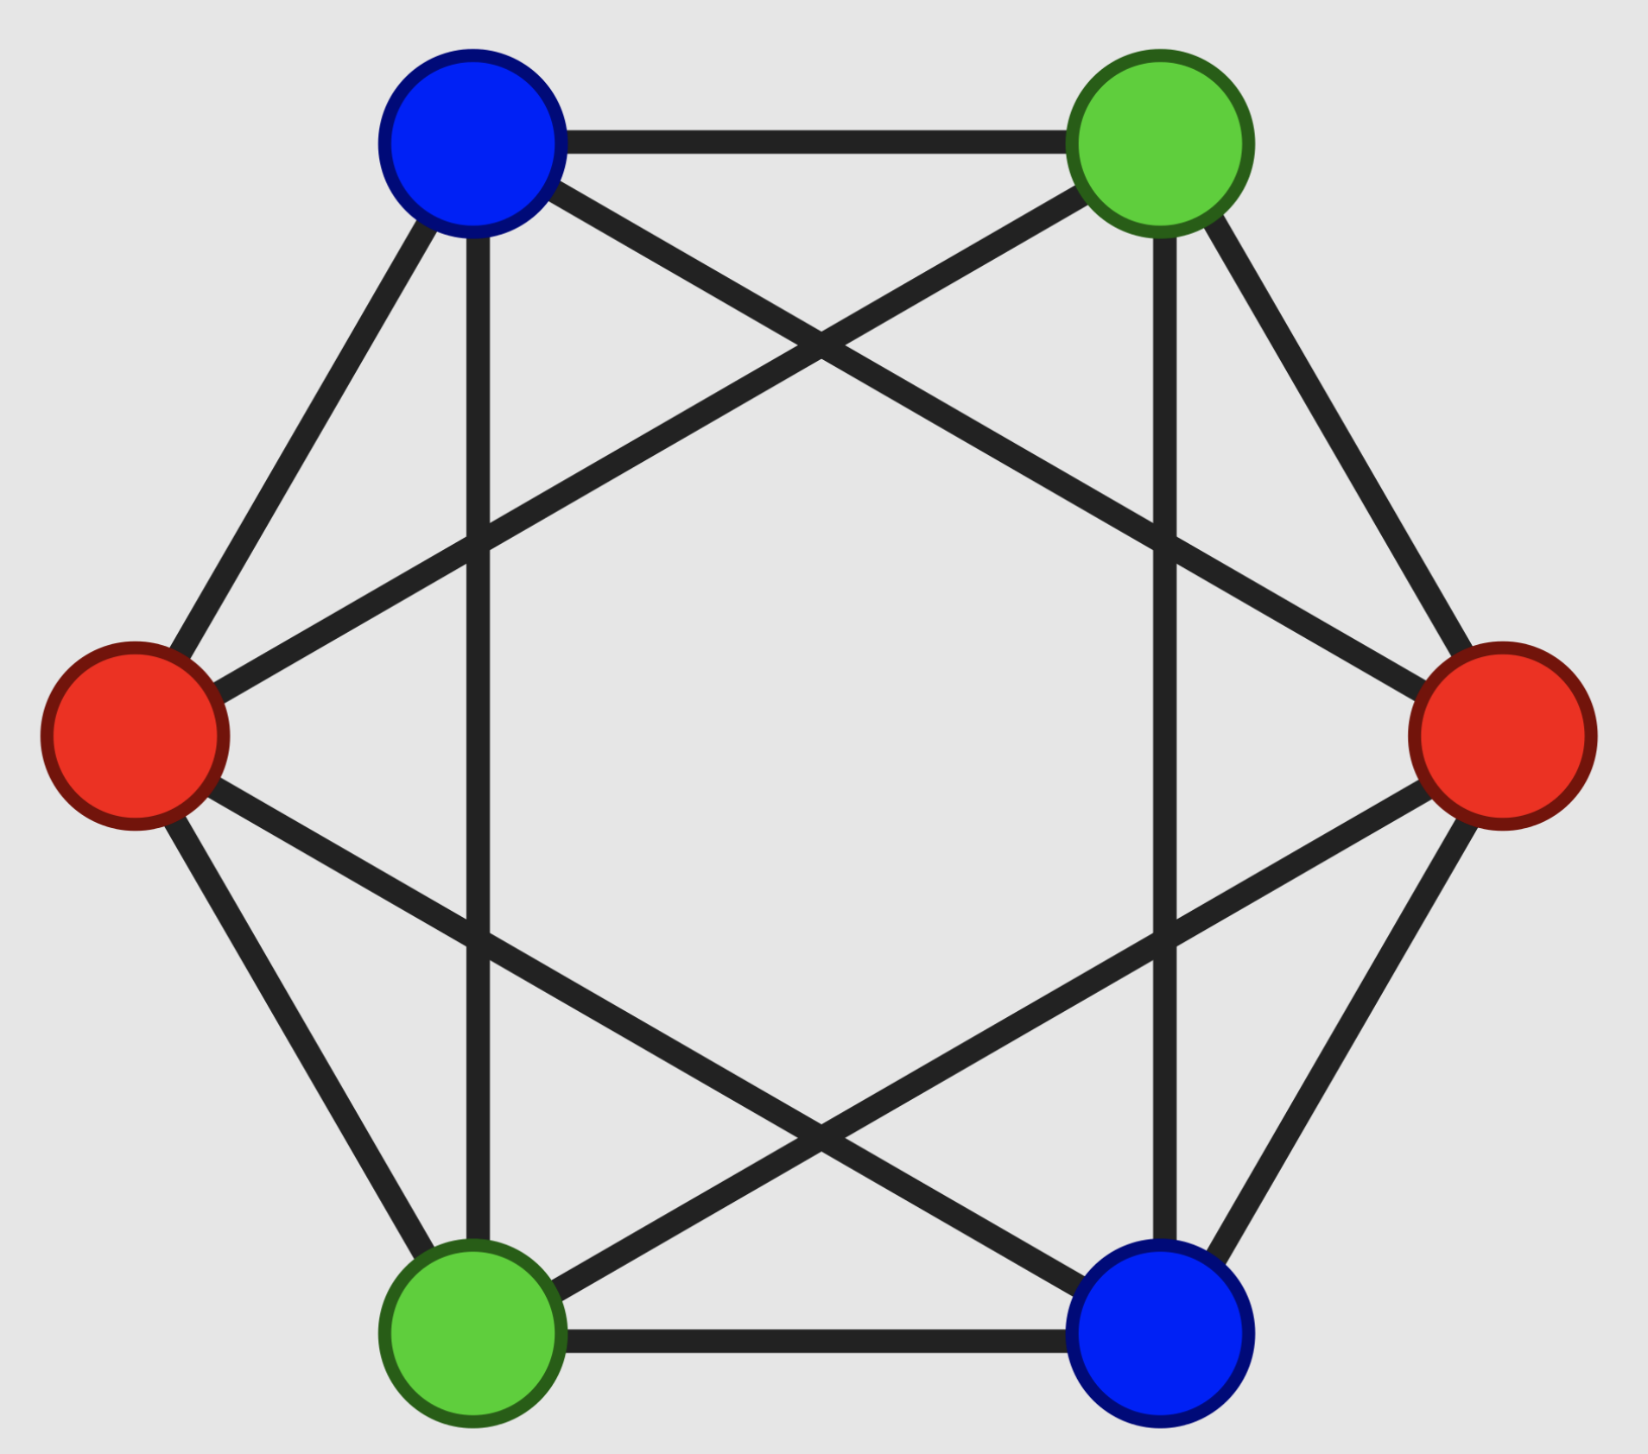
Graph coloring
Process vertices in the given order
Assign colors to each vertex
Use the smallest color number that is not already in use

Slide 17
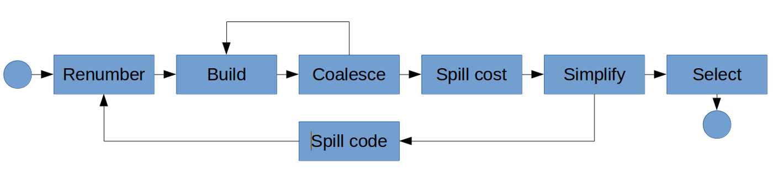
Register allocation mechanism

Slide 18
Register allocation mechanism stages
Renumber
assign/verify unique virtual register IDs
Build
build a graph: liveness analysis
Coalesce
merge nodes that represent copy-related variables (reduce need of COPY)
Spill Cost
calculate a spill cost for each variable
Simplify
simplify a graph (e.g., drop low-degree nodes and push them to the stack)
Select
compiler pops nodes from the stack and tries to assign them to registers (color them)
if a node cannot be assigned a register (e.g., it conflicts with all available registers), the compiler designates it as “spilled”
Insert spill code
compiler inserts extra load/store instructions (the spill code) to move that variable between memory and registers (if needed)

Slide 19
Pros and cons
Good known algorithm
NP-hard problem
Evicted variables are spilled everywhere
Variable, that is not spilled, is kept in the register throughout its whole lifetime

Slide 20
Linear scan to the rescue!
Instead of building a graph, all the variables are linearly scanned to determine their live range
All ranges are sorted and traversed chronologically.
Registers are allocated in a greedy way

Slide 21
Pros and cons
Fast algorithm
Lifetime holes
Spilled variable will stay spilled for its entire lifetime

Slide 22
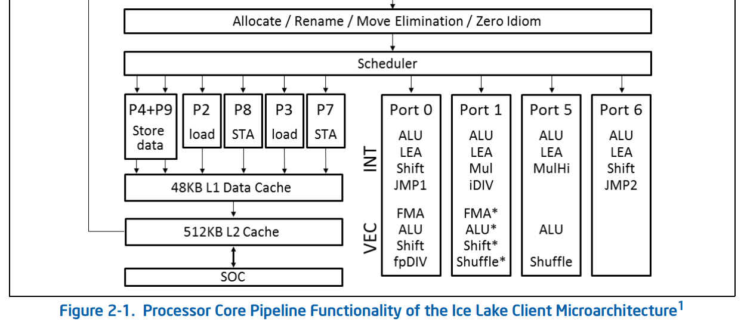
CPU scheduler and pipeline
https://www.intel.com/content/www/us/en/developer/articles/technical/intel-sdm.html

Slide 23
Instruction scheduling
Instruction scheduling is a compiler optimization used to improve ILP
Goals:
Avoid pipeline stalls
Avoid illegal or semantically ambiguous operations

Slide 24
Instruction scheduling types
Static instruction scheduling:
during compile time
reordering instructions
compiler has less execution context
more time for instruction rearrangement at compile time
complicates compiler
Dynamic instruction scheduling:
during execution time on a HW
Selectively issuing instructions to execution units
HW (e.g. CPU) has more execution context
less time for instruction rearrangement at execution time
complicates HW

Slide 25
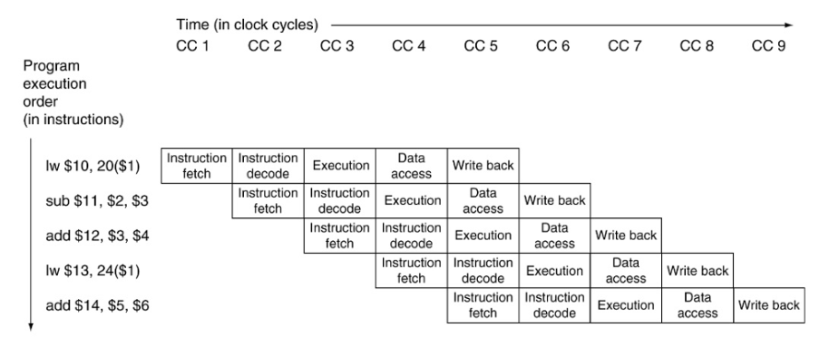
Pipeline execution

Slide 26
Data hazards
Read after Write
Instruction 1 writes a value used later by instruction 2. I1 must come first.
Write after Read
Instruction 1 reads a location that is later overwritten by Instruction 2. Instruction 1 must come first, or it will read the new value instead of the old
Write after Write
Two instructions both write the same location. They must occur in their original order

Slide 27
Scheduling algorithm inputs
Hardware details like:
Micro-ops
Latencies
Resource cycles

Slide 28
Scheduling algorithm
Build dependency graph
Apply topology sort
Use target-specific heuristics to schedule instructions

Slide 29
List scheduling algorithm
Input: list of jobs that should be executed on a set of m machines
Take first job in the list
Find a machine that is available for executing job
If a machine is found, schedule the job
Otherwise, select the next job

Slide 30
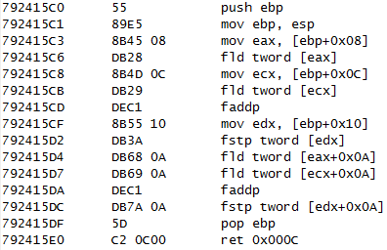
Code emission
IR
asm emission
object file generation
obj
asm

Slide 31
Target specific passes
Instruction selection
Register allocation
Peephole optimizations
Loop optimizations
Vectorizer
Machine Code optimizations
Fine-tunes machine code, including adjusting alignment, optimizing branch instructions, and applying target-specific tweaks to increase efficiency.
Link-Time optimizations (LTO)
Performs optimizations across multiple compilation units or modules at the link stage, enabling more global optimizations that are not possible when compiling files separately
Profile-Guided Optimization (PGO)
Uses runtime profiling information to guide optimization decisions, such as which branches to prioritize for speed or which loops to optimize for unrolling

Slide 32
Next time…
LLVM backend overview

Slide 33

Test
https://forms.gle/Y5EggA67Reh7hfSR9
Submission time: 10 minutes
Backup: me@gooddoog.ru

Slide 34

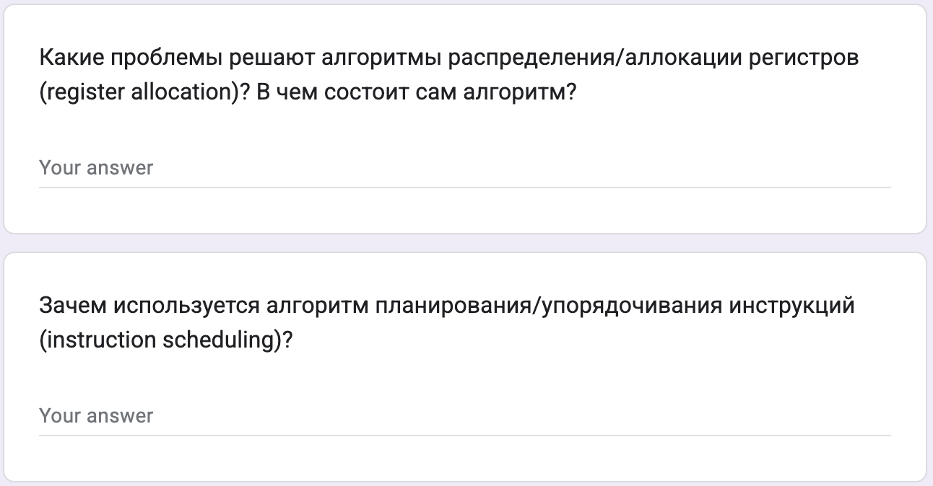
Test
https://forms.gle/LZZZYDejbnUV19zY7
Submission time: 10 minutes
Backup: me@gooddoog.ru

Slide 35
Extra materials
LLVM Developers’ Meeting: J. Bogner & A. Nandakumar & D. Sanders “Tutorial: GlobalISel ” - https://www.youtube.com/watch?v=Zh4R40ZyJ2k
Tutorial: Creating an LLVM Backend for the Cpu0 Architecture - https://jonathan2251.github.io/lbd/
https://llvm.org/devmtg/2014-04/PDFs/Talks/Building%20an%20LLVM%20backend.pdf
Writing an LLVM backend: https://llvm.org/docs/WritingAnLLVMBackend.html
Welcome to the Back End: The LLVM Machine Representation: https://llvm.org/devmtg/2017-10/slides/Braun-Welcome%20to%20the%20Back%20End.pdf

