Slide 1
Compilers 101
Compiler frontend.
AST and static analysis

Slide 2
Previously…
Preprocessing
Lexical analysis
Frontend
Syntax analysis
Semantic analysis
IR Generation
Middle-end
IR Optimization
Optimization
Backend
Code generation

Slide 3
Today
Static analysis and its use cases
Control-flow graphs
Practical usage of Clang framework

Slide 4
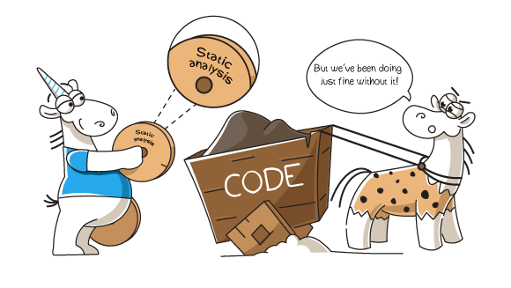
What is static analysis?
Static analysis is the analysis of software without executing any program code
Pic: https://pvs-studio.com/en/blog/posts/cpp/0873/

Slide 5
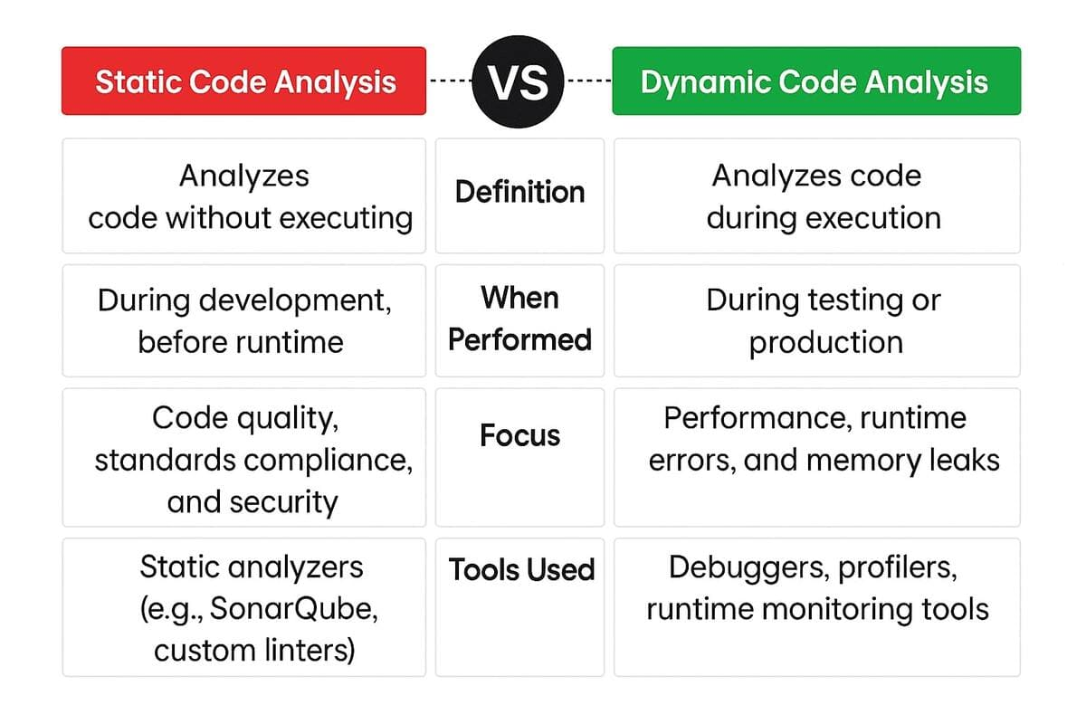
Static vs dynamic code analysis
https://www.accelq.com/blog/static-code-analysis/

Slide 6
Why static analysis?
Reduce number of bugs
Some bugs are hard to find, e.g., = vs ==
Legal obligations
Safety critical code must pass certifications
Code quality improvement, efficiency and automation
Education
Basically, any rule enforcement

Slide 7
Warnings
The most basic kind of static analysis
Missing return statement, missing case in switch, use of deprecated functions and many others
Built into all compilers
available sets of warnings in different compilers may differ though
intended to check for the most obvious and easy-to-check mistakes
BKM (best known method): always enable -Wall (-Wextra) -Werror flags (or analogs) for your projects

Slide 8
Linters
Checks that your code follows some rules
Google Code Style rules
C++ core guidelines
Those checks are not necessarily related to program functionality
Often highly opinionated

Slide 9
clang-format styles
Can be found in the docs: https://clang.llvm.org/docs/ClangFormatStyleOptions.html
Possible values:
LLVM A style complying with the LLVM coding standards
Google A style complying with Google’s C++ style guide
Chromium A style complying with Chromium’s style guide
Mozilla A style complying with Mozilla’s style guide
WebKit A style complying with WebKit’s style guide
Microsoft A style complying with Microsoft’s style guide
GNU A style complying with the GNU coding standards
Built-in rule templates can be modified by using various parameters

Slide 10
Static analyzers
The most advanced static analyzers can perform data flow analysis and provide correctness checks
Examples:
clang static analyzer
cppcheck
PVS Studio

Slide 11
Static analyzers for different programming languages
C/C++: clang-tidy, clang static analyzer (scan-build), cppcheck, PVS-Studio, Coverity, SonarQube
Java: SpotBugs, PMD
Python: Ruff, Pylint, Flake8, mypy, pyright, bandit
JavaScript: ESLint
Kotlin: detekt, ktlint
Rust: clippy
Go: govet
Swift: SwiftLint
Ruby: RuboCop
…

Slide 12
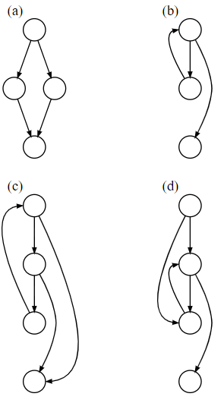
Control-flow graphs
A control-flow graph is a representation of all paths that might be traversed through a program during execution
Source: https://en.wikipedia.org/wiki/Control-flow_graph

Slide 13
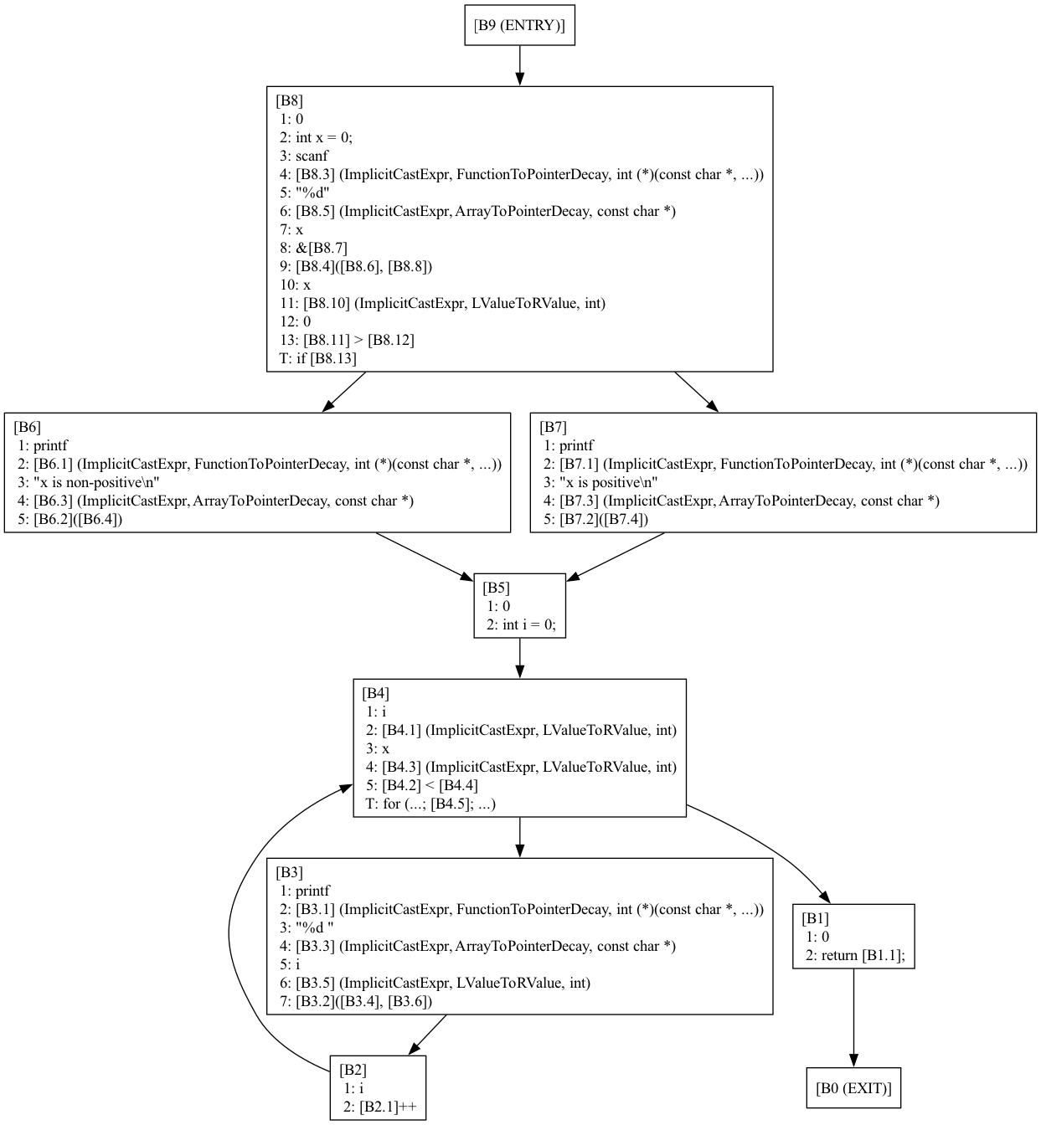
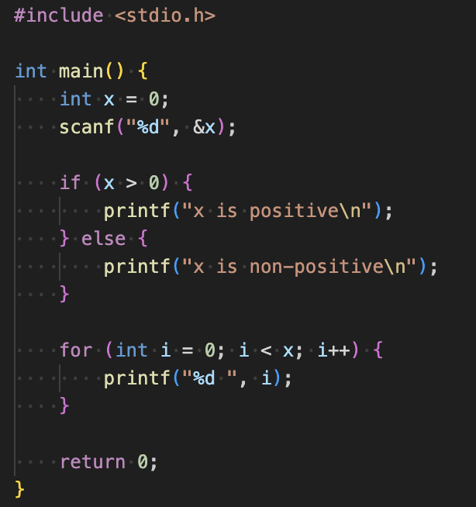
CFG demo
clang -Xclang -analyze -Xclang -analyzer-checker=debug.ViewCFG -Xclang -analyzer-output=text cfg.cpp

Slide 14
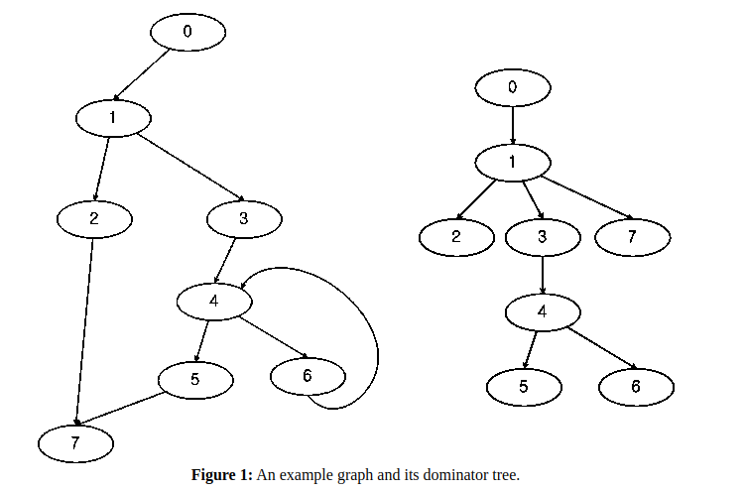
Dominators
A block M dominates block N if every path from the entry that reaches block N must pass through block M
Block M postdomintates block N if every path from N to exit must pass through M
idom (immediate-dominator tree)
Source: https://www.boost.org/doc/libs/1_85_0/libs/graph/doc/lengauer_tarjan_dominator.htm

Slide 15
Dominator trees
Data structure depicting the dominator relationships
Lengauer-Tarjan algorithm: O(nlogn)
See more: https://www.llvm.org/devmtg/2017-10/slides/Kuderski-Dominator_Trees.pdf

Slide 16
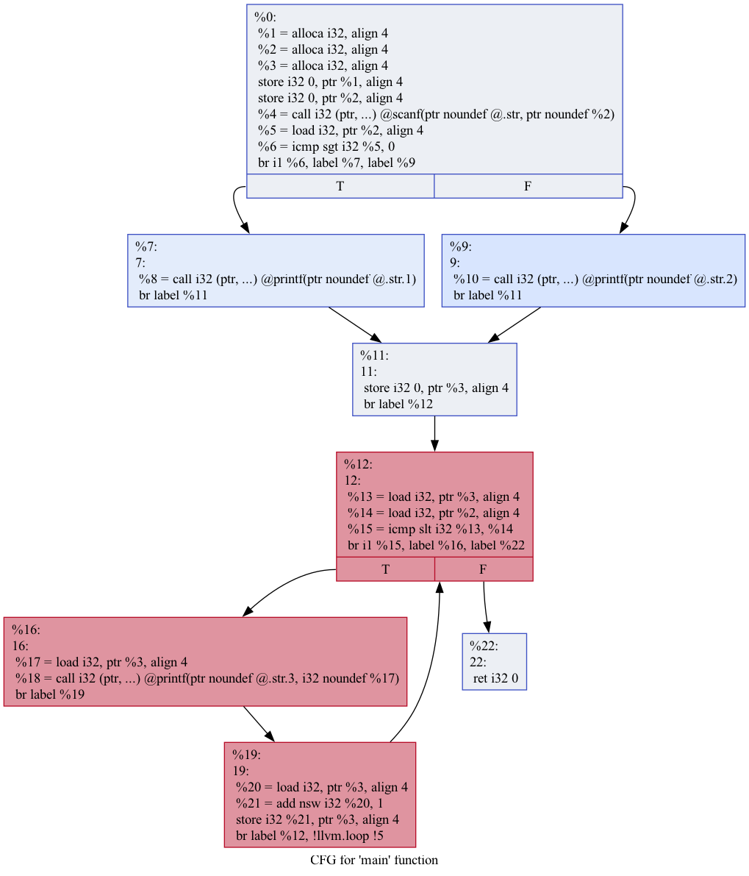
Dominator trees (demo)
How to build:
clang -S -emit-llvm dominator.cpp -o dominator.ll
opt -passes='dot-cfg' dominator.ll
dot -Tpng .main.dot -o main.png
What are domination relationships in this CFG?
%0 dominates all
%7 dominates only %7
%9 dominates only %9
%11 dominates %11, %12, %16, %19, %22
%12 dominates %12, %16, %19, %22
%16 dominates %16, %19
%19 dominates only %19
%22 dominates only %22

Slide 17
Hacking on Clang
LibTooling – interface to write standalone tools based on clang
LibFormat – library for automatic source code formatting
LibClang – stable C interface for Clang
Clang Plugins – do extra actions during compilation
More on that: https://clang.llvm.org/docs/index.html#using-clang-as-a-library

Slide 18
Working with AST
AST is a graph, and you can use any graph theory algorithms
Examining AST: -Xclang -ast-dump -fsyntax-only
Clang framework provides a few helpers to work with AST
ASTConsumer
RecursiveASTVisitor
ASTAction
More on that: https://www.youtube.com/watch?v=VqCkCDFLSsc

Slide 19
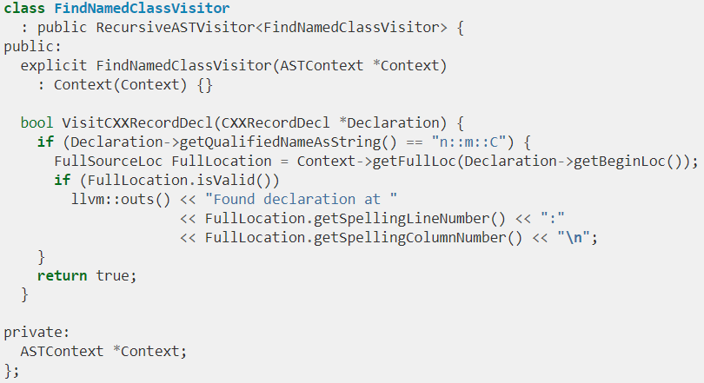
RecursiveASTVisitor
CRTP class
Provides methods to act on certain AST node classes
Basically, an implementation of DFS

Slide 20
LLVM IR generation
Typical use case for AST node visitors. Also can be referred as CodeGen, but do not confuse with LLVM CodeGen
Uses AST visitors, IRBuilder, and TargetInfo classes
CodeGenModule class keeps global state, e.g. LLVM type cache. Emits global and some shared entities.
CodeGenFunction class keeps per function state. Emits LLVM IR for function body statements.
The output can be inspected using the -emit-llvm (to force -S for textual representation) option to clang. You can also use -emit-llvm-bc to write an LLVM bitcode file which can be processed by the suite of LLVM tools like llvm-dis, llvm-nm, etc.

Slide 21
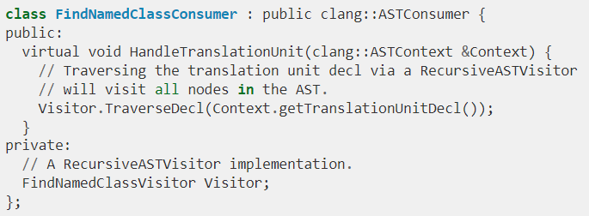
ASTConsumer
An interface used to write generic actions on AST
Provides many different entry points

Slide 22
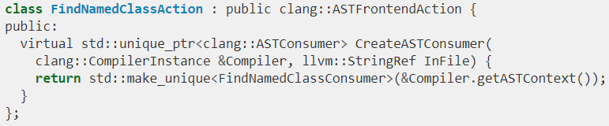
FrontendAction
FrontendActions are entry points for Clang-based tools (including Clang compiler)

Slide 23
Source manager
Source location
file:line:col
AST does not contain information on source locations
It may be required for code re-writing
SourceManager is owned by ASTContext:
More info: https://clang.llvm.org/docs/RAVFrontendAction.html

Slide 24
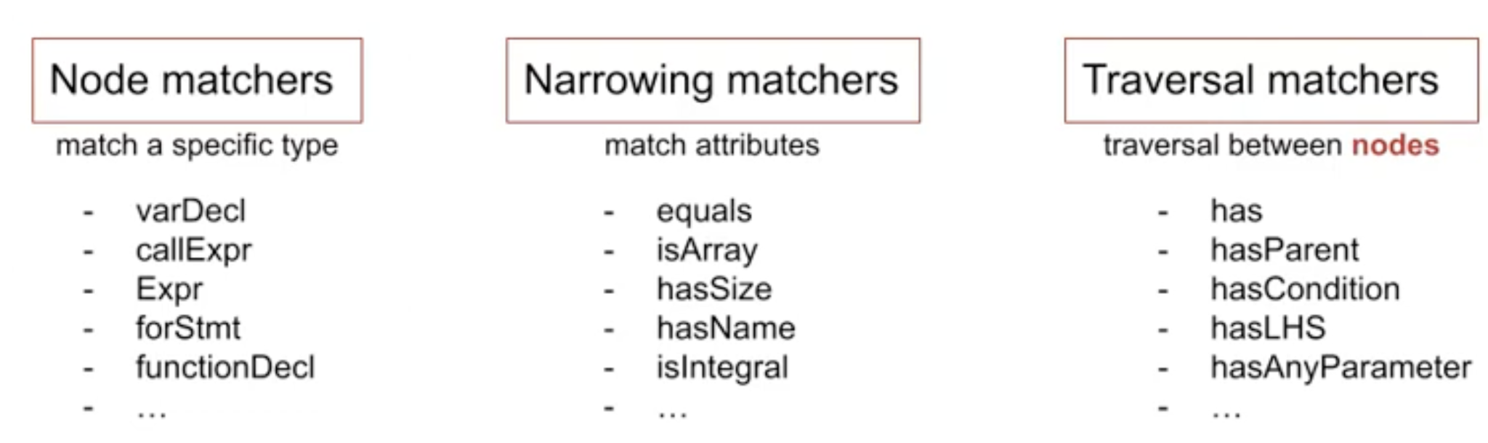
Matching AST
Sometimes there’s a need to find certain patterns in AST
Clang provides matchers interface:
Node matchers – find specific node type
Narrowing matchers – match attributes on AST nodes
Traversal matchers – traversal between AST nodes
More info on syntax: https://clang.llvm.org/docs/LibASTMatchersReference.html#decl-matchers

Slide 25
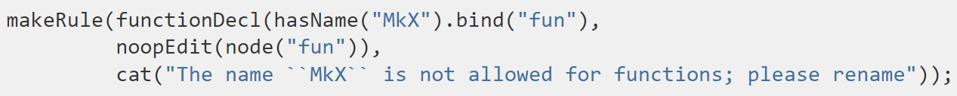
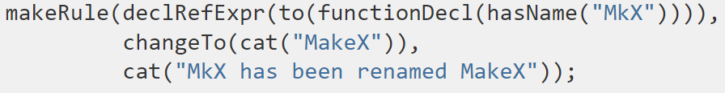
Clang Transformer
Framework for writing C++ diagnostics and source transformations
Built on Matchers interface and LibTooling
Rule examples:

Slide 26
clang-tidy
Clang-based linter tool
Provides rules for many standards, including:
C++ core guidelines
Abseil
Google
CERT
Linux Kernel
LLVM
Supports FIX-IT hints
Docs: https://clang.llvm.org/extra/clang-tidy/index.html
Full list of checks: https://clang.llvm.org/extra/clang-tidy/checks/list.html

Slide 27
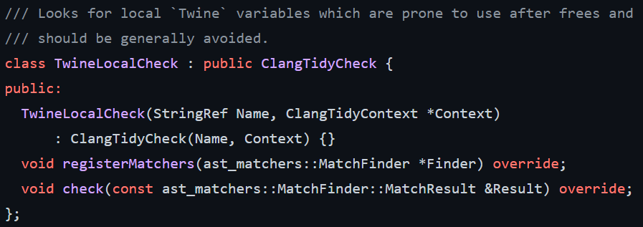
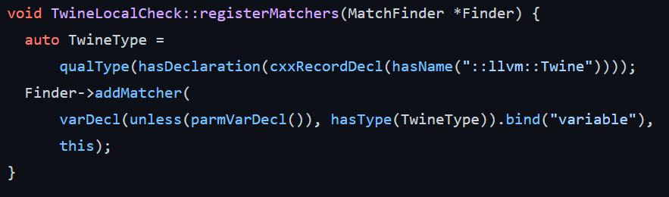
Extending clang-tidy
Most useful source of knowledge: look at existing code
Example: https://github.com/llvm/llvm-project/blob/main/clang-tools-extra/clang-tidy/llvm/

Slide 28
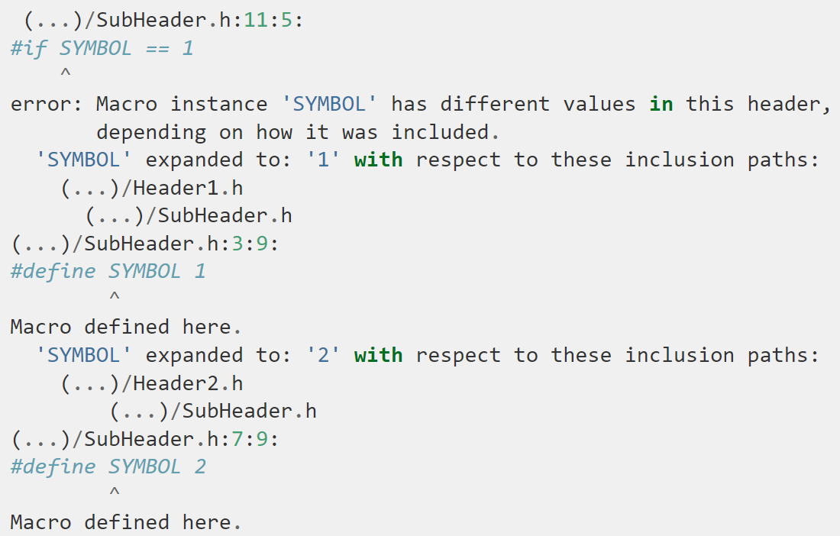
Case study: modularize
modularize is a standalone tool that checks whether a set of headers provides the consistent definitions required to use modules

Slide 29
Case study: C++ core guidelines
C++ Core Guidelines provide helper types for memory management
gsl::owner<…>
gsl::not_null<…>
clang-tidy will warn if you’re not using any of these and to suspicious things
https://clang.llvm.org/extra/clang-tidy/checks/cppcoreguidelines/owning-memory.html

Slide 30
Lab assignment #1
Implement clang AST plugin
Task list in Google Docs
Deadline: March, 17
Where to seek help
https://clang.llvm.org/docs/ClangPlugins.html
https://github.com/llvm/llvm-project/tree/main/clang/examples/PrintFunctionNames
Contact teachers

Slide 31
Lab assignment acceptance criterias
The code base with implementation passes clang-format checks on CI
The code base with implementation passes build and test stage on CI
LIT tests are added and passed on CI

Slide 32
FileCheck tool
Tool from LLVM toolchain
It is widely used for testing in LLVM framework
How to run FileCheck tool:
FileCheck %s - compare stdin with file %s
string to be verified:
CHECK: content
Manual: https://llvm.org/docs/CommandGuide/FileCheck.html
Run LIT test:
llvm-lit path/to/test

Slide 33
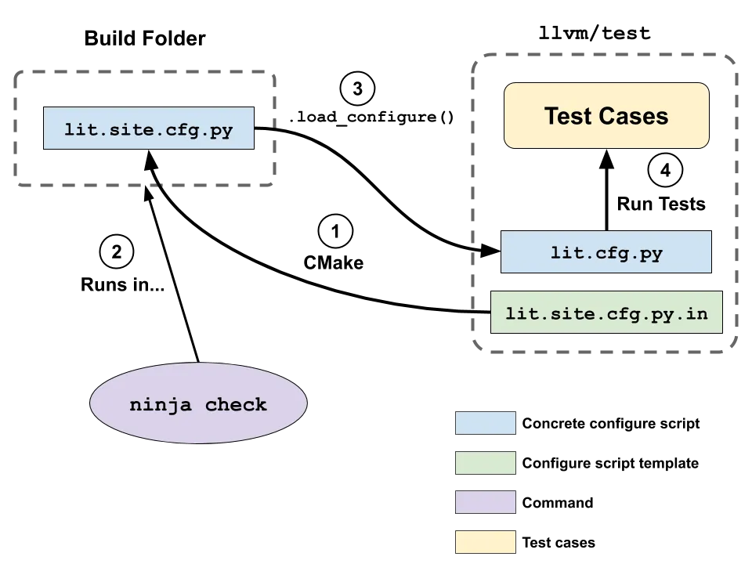
llvm-lit
lit is a portable tool for executing LLVM and Clang style test suites, summarizing their results, and providing indication of failures. lit is designed to be a lightweight testing tool with as simple a user interface as possible.
Manual: https://llvm.org/docs/CommandGuide/lit.html
Pic: https://medium.com/@mshockwave/using-llvm-lit-out-of-tree-5cddada85a78

Slide 34
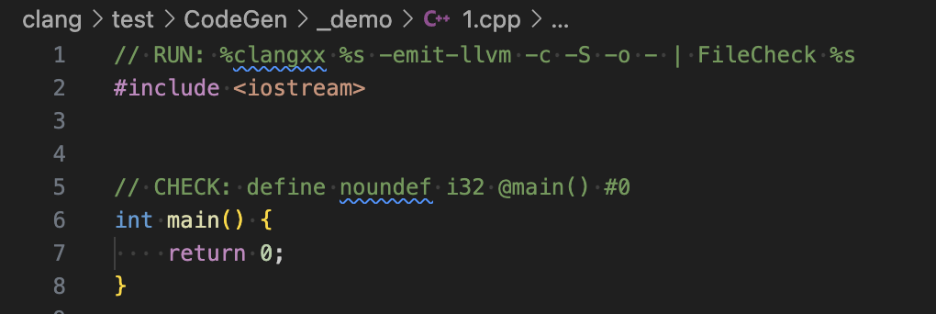
llvm-lit simple test demo
$PATH_TO_LLVM_BIN/llvm-lit -a clang/test/_demo/1.cpp

Slide 35
Next time…
Intermediate representations
LLVM IR
IR generation

Slide 36
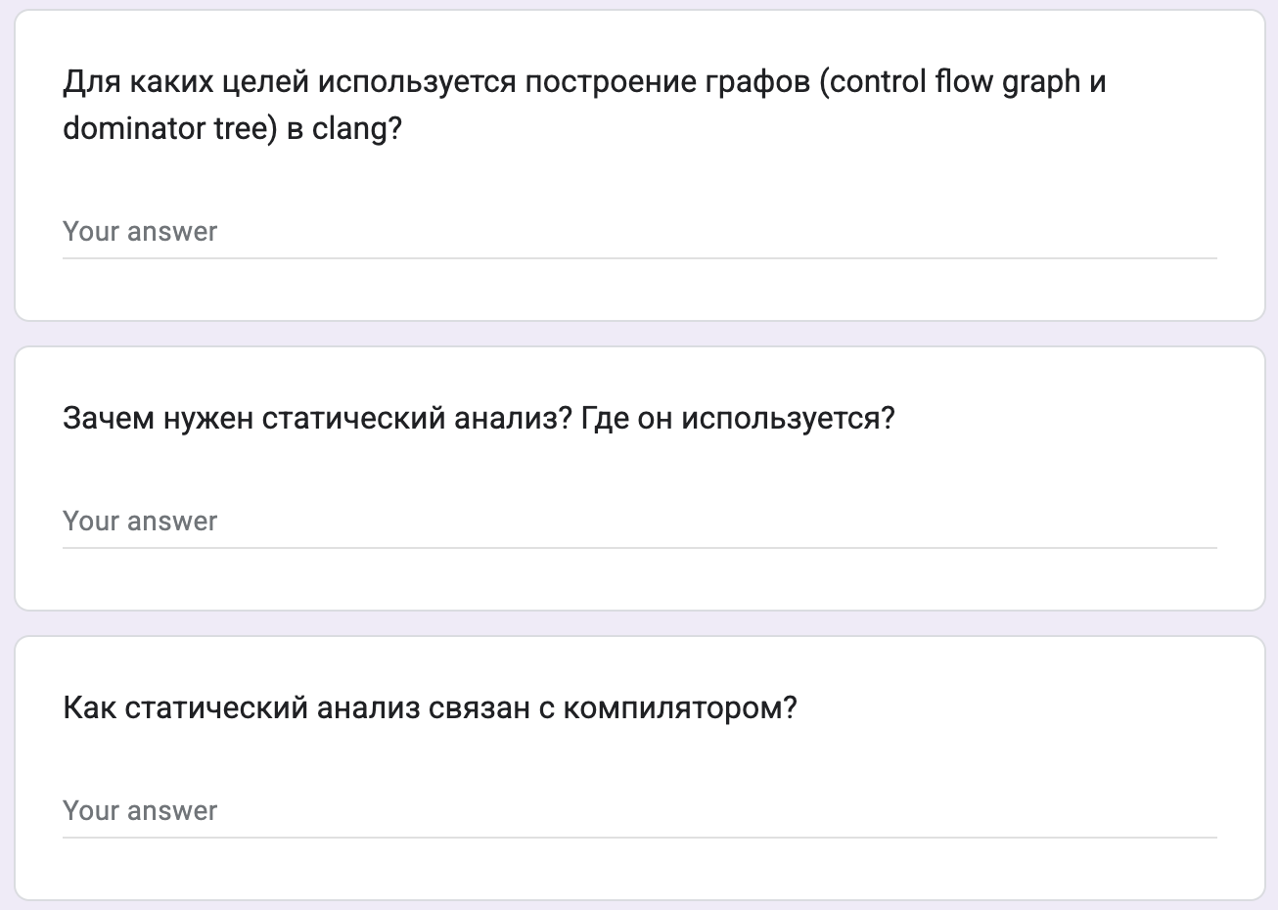

Test
https://forms.gle/KedxuyGUAkYiMmYf6
Backup: me@gooddoog.ru

Slide 37


Test
https://forms.gle/B3ZrMNTH7wraYEtm6
Backup: me@gooddoog.ru

Slide 38
Extra materials
Data flow analysis - https://www.youtube.com/watch?v=OROXJ9-wUQE
AST Matchers:
https://github.com/lac-dcc/llvm-course/tree/master/ast-matcher
https://www.youtube.com/watch?v=mizS4KnfTtQ
A. Homescu “Mutating the clang AST from Plugins”: https://www.youtube.com/watch?v=_rUwW8Awc5s
Software Quality Metrics course: https://yegor256.github.io/sqm/

