Slide 1
Compilers 101
Backends - Part 1

Slide 2
Previously…
Preprocessing
Lexical analysis
Frontend
Syntax analysis
Semantic analysis
IR Generation
IR Optimization
Middle-end
Optimization
Backend
Code generation

Slide 3
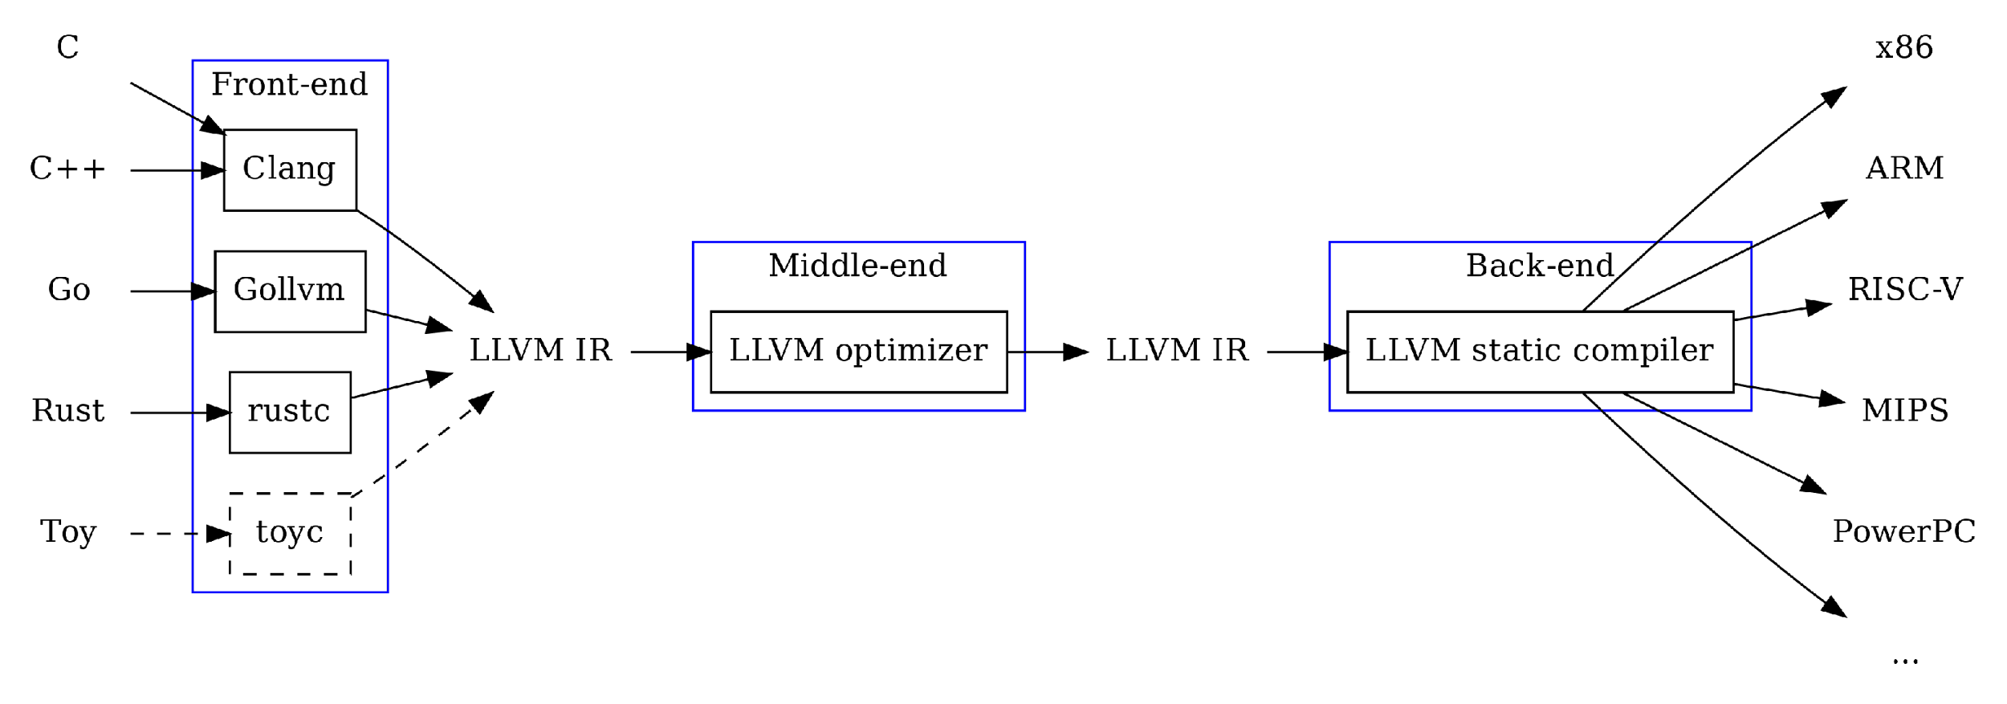
Backend in LLVM

Slide 4
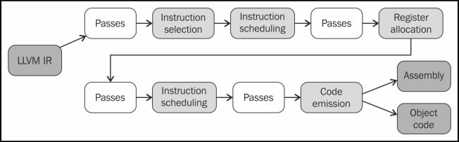
LLVM backend pipeline (overview)

Slide 5
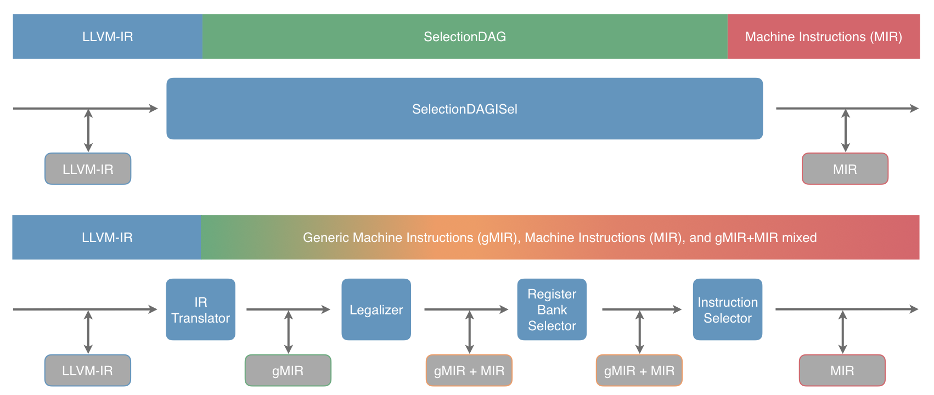
Modern LLVM backend: detailed view
Details about LLVM backend are going to be covered next time…

Slide 6
Instruction selection
We now have an optimized IR code, but it’s not consumable by HW
Instruction selection is a stage of compiler, that transforms IR into low-level IR

Slide 7
Methods
Macro expansion
Replace all IR instructions by matching templates
Graph covering
Transform IR into graph
Cover graph with patterns – templates that match a portion of a graph
Lowest common denominator strategy
Attempt to select instructions that would allow execution on the widest range of hardware

Slide 8
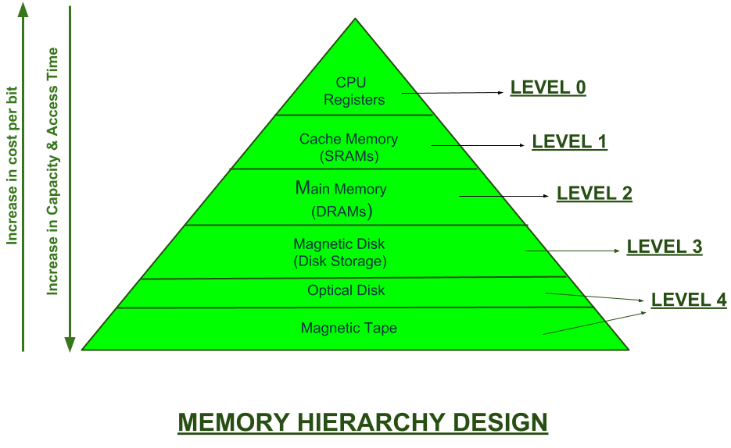
Memory hierarchy
https://www.geeksforgeeks.org/memory-hierarchy-design-and-its-characteristics/

Slide 9
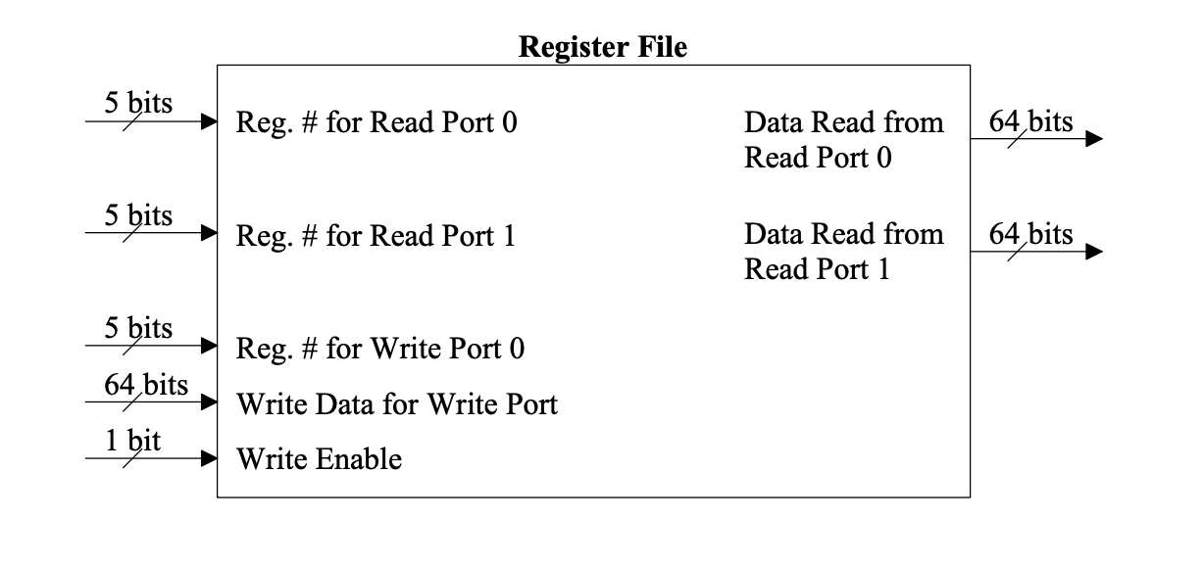
Registers
https://www.cs.uni.edu/~fienup/cs041s08/lectures/lec13_reg_file.pdf

Slide 10
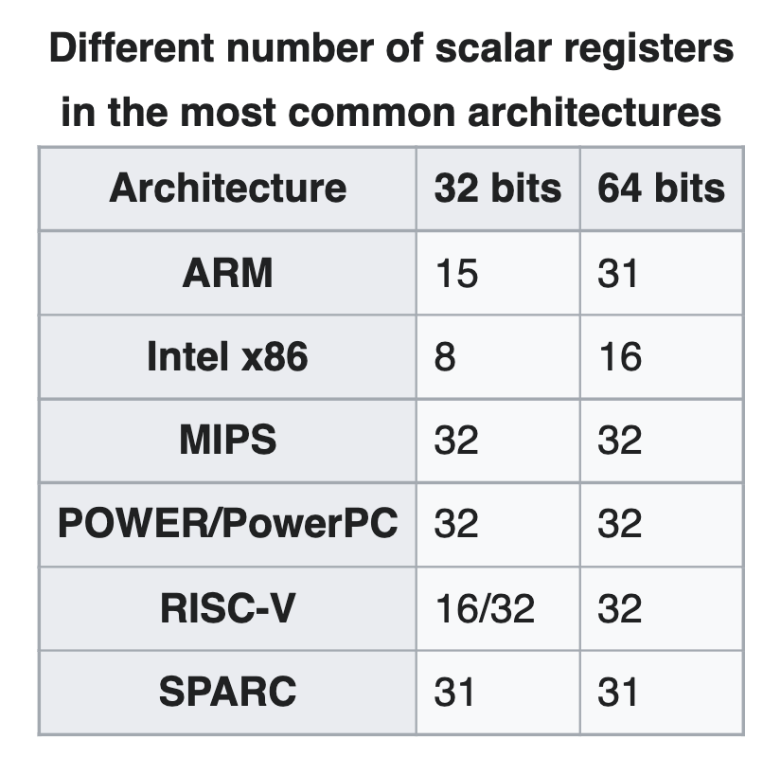
Registers in modern CPUs
https://en.wikipedia.org/wiki/Register_allocation

Slide 11
SSA recap
Registers are only assigned once
Infinite amount of registers

Slide 12
Challenges
Registers are scarce
In most of the cases, we deal with dozens of registers
Registers are complicated
Registers can be made of smaller registers
Some registers may be reserved
Some instructions must store results to certain registers
Some registers are part of ABI

Slide 13
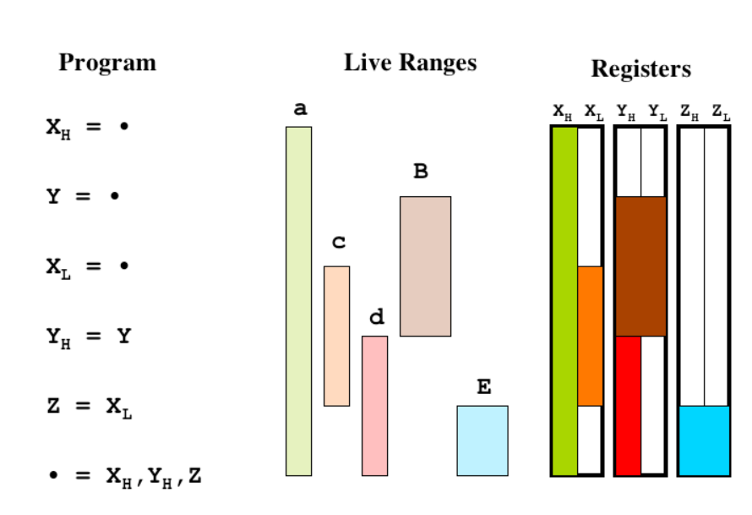
Challenges
https://llvm.org/pubs/2008-06-PLDI-PuzzleSolving.pdf

Slide 14
Graph theory to the rescue!
Each register is a node in a graph
Edges are interfering ranges (i.e., registers that live together)

Slide 15
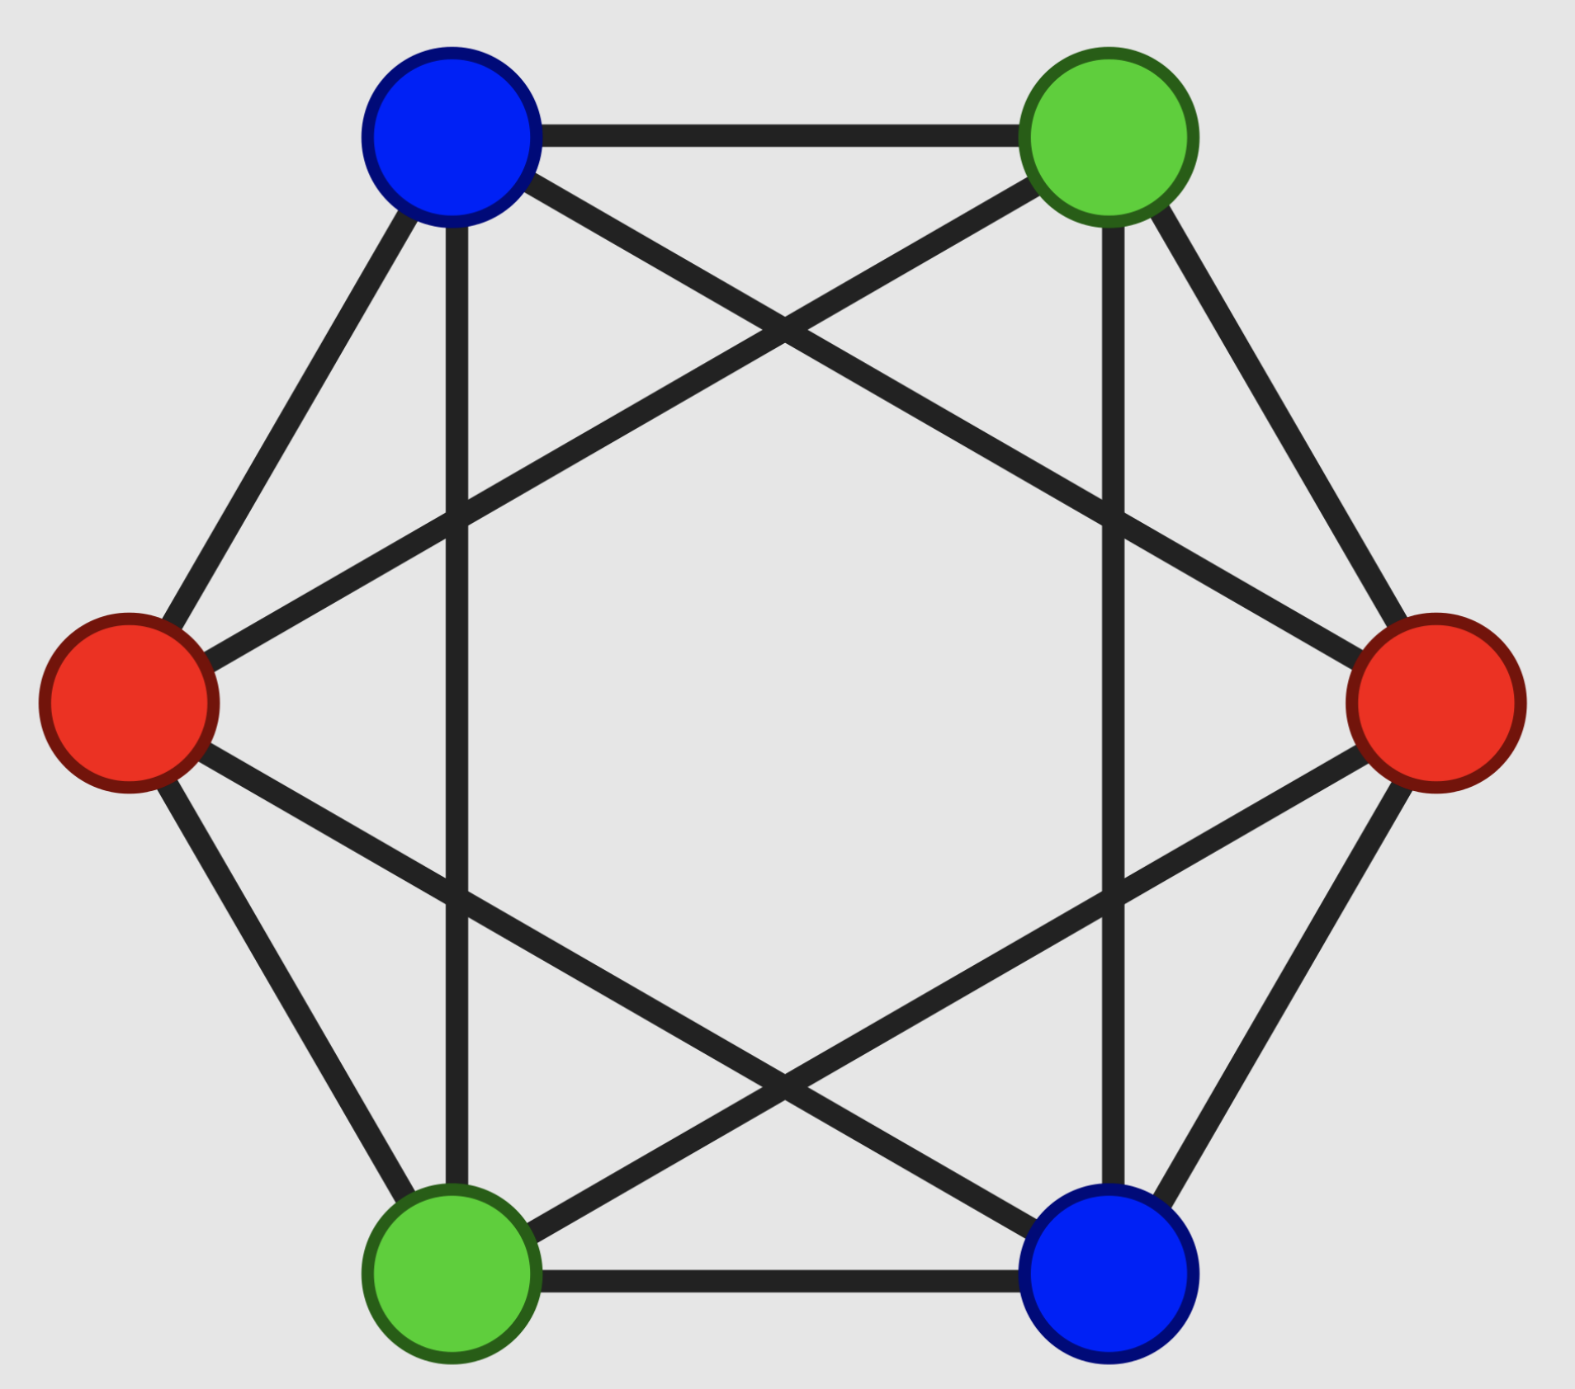
Graph coloring
Process vertices in the given order
Assign colors to each vertex
Use the smallest color number that is not already in use

Slide 16
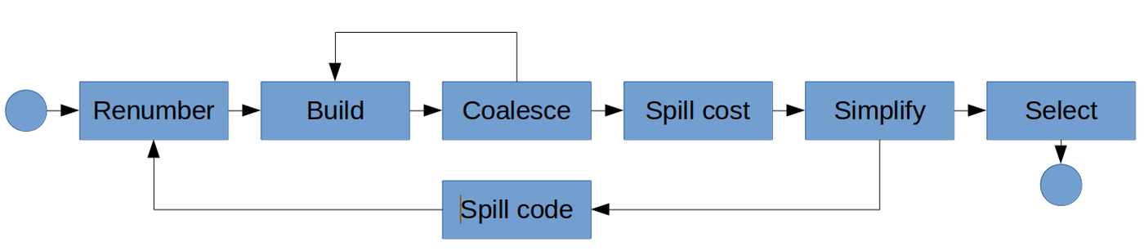
Register allocation mechanism

Slide 17
Pros and cons
Good known algorithm
NP-hard problem
Evicted variables are spilled everywhere
Variable, that is not spilled, is kept in the register throughout its whole lifetime

Slide 18
Linear scan to the rescue!
Instead of building a graph, all the variables are linearly scanned to determine their live range
All ranges are sorted and traversed chronologically.
Registers are allocated in a greedy way

Slide 19
Pros and cons
Fast algorithm
Lifetime holes
Spilled variable will stay spilled for its entire lifetime

Slide 20
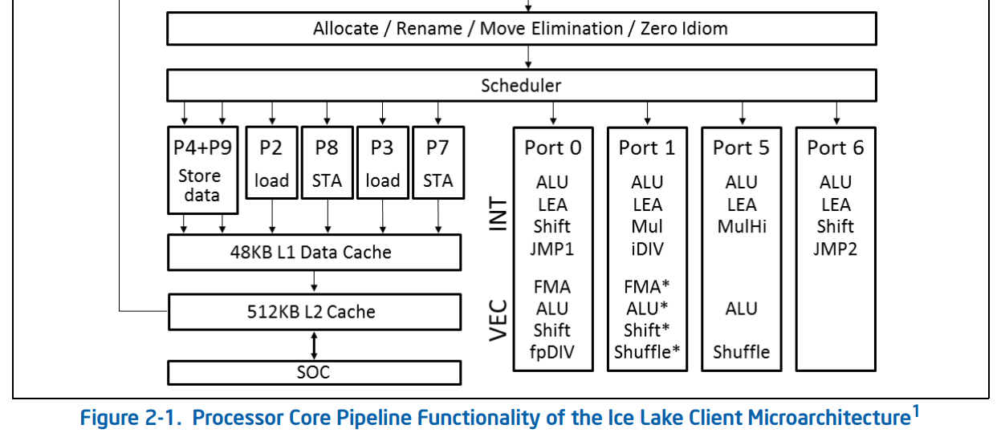
CPU scheduler and pipeline
https://www.intel.com/content/www/us/en/developer/articles/technical/intel-sdm.html

Slide 21
Instruction scheduling
Instruction scheduling is a compiler optimization used to improve ILP
Goals:
Avoid pipeline stalls
Avoid illegal or semantically ambiguous operations

Slide 22
Instruction scheduling types
Static instruction scheduling:
during compile time
reordering instructions
compiler has less execution context
more time for instruction rearrangement at compile time
complicates compiler
Dynamic instruction scheduling:
during execution time on a HW
Selectively issuing instructions to execution units
HW (e.g. CPU) has more execution context
less time for instruction rearrangement at execution time
complicates HW

Slide 23
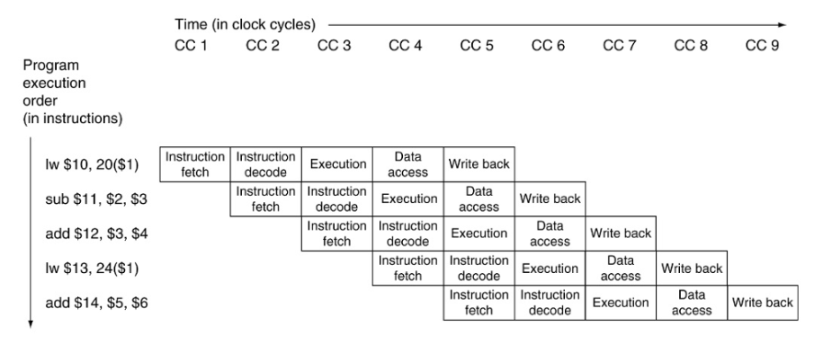
Pipeline execution

Slide 24
Data hazards
Read after Write
Instruction 1 writes a value used later by instruction 2. I1 must come first.
Write after Read
Instruction 1 reads a location that is later overwritten by Instruction 2. Instruction 1 must come first, or it will read the new value instead of the old
Write after Write
Two instructions both write the same location. They must occur in their original order

Slide 25
Scheduling algorithm inputs
Hardware details like:
Micro-ops
Latencies
Resource cycles

Slide 26
Scheduling algorithm
Build dependency graph
Apply topology sort
Use target-specific heuristics to schedule instructions

Slide 27
List scheduling algorithm
Input: list of jobs that should be executed on a set of m machines
Take first job in the list
Find a machine that is available for executing job
If a machine is found, schedule the job
Otherwise, select the next job

Slide 28
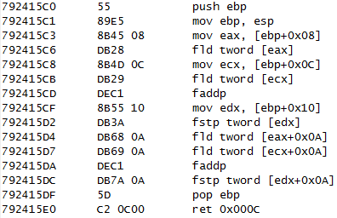
Code emission
IR
asm emission
object file generation
obj
asm

Slide 29
Target specific passes
Instruction selection
Register allocation
Peephole optimizations
Loop optimizations
Vectorizer
Machine Code optimizations
Fine-tunes machine code, including adjusting alignment, optimizing branch instructions, and applying target-specific tweaks to increase efficiency.
Link-Time optimizations (LTO)
Performs optimizations across multiple compilation units or modules at the link stage, enabling more global optimizations that are not possible when compiling files separately
Profile-Guided Optimization (PGO)
Uses runtime profiling information to guide optimization decisions, such as which branches to prioritize for speed or which loops to optimize for unrolling

Slide 30
Next time…
LLVM backend overview

Slide 31

Test
https://forms.gle/Y5EggA67Reh7hfSR9
Submission time: 10 minutes
Backup: me@gooddoog.ru

Slide 32
Extra materials
LLVM Developers’ Meeting: J. Bogner & A. Nandakumar & D. Sanders “Tutorial: GlobalISel ” - https://www.youtube.com/watch?v=Zh4R40ZyJ2k
Tutorial: Creating an LLVM Backend for the Cpu0 Architecture - https://jonathan2251.github.io/lbd/
https://llvm.org/devmtg/2014-04/PDFs/Talks/Building%20an%20LLVM%20backend.pdf
Writing an LLVM backend: https://llvm.org/docs/WritingAnLLVMBackend.html

