Slide 1
Compilers 101
Compiler frontend.
Working with AST and static analysis

Slide 2
Previously…
Preprocessing
Lexical analysis
Frontend
Syntax analysis
Semantic analysis
IR Generation
IR Optimization
Middle-end
Optimization
Backend
Code generation

Slide 3
Today
Static analysis and its use cases
Control-flow graphs
Practical usage of Clang framework

Slide 4
What is static analysis?
Static analysis is the analysis of software without executing any program code

Slide 5
Why static analysis?
Reduce number of bugs
Some bugs are hard to find, e.g., = vs ==
Legal obligations
Safety critical code must pass certifications
Code Quality Improvement, efficiency and automation
Education
Basically, any rule enforcement

Slide 6
Warnings
The most basic kind of static analysis
Missing return statement, missing case in switch, use of deprecated functions
Built into compiler
BKM: always enable -Wall (-Wextra) -Werror flags (or analogs) for your project

Slide 7
Linters
Checks that your code follows some rules
Google Code Style rules
C++ core guidelines
Those checks are not necessarily related to program functionality
Often highly opinionated

Slide 8
Static analyzers
The most advanced static analyzers can perform data flow analysis and provide correctness checks
Examples:
clang static analyzer
cppcheck
PVS Studio

Slide 9
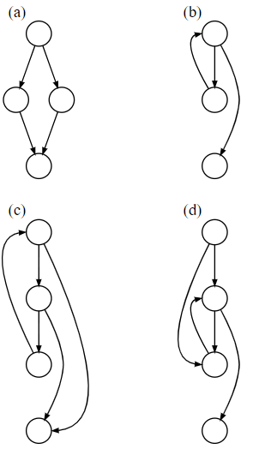
Control-flow graphs
A control-flow graph is a representation of all paths that might be traversed through a program during execution
Source: https://en.wikipedia.org/wiki/Control-flow_graph

Slide 10
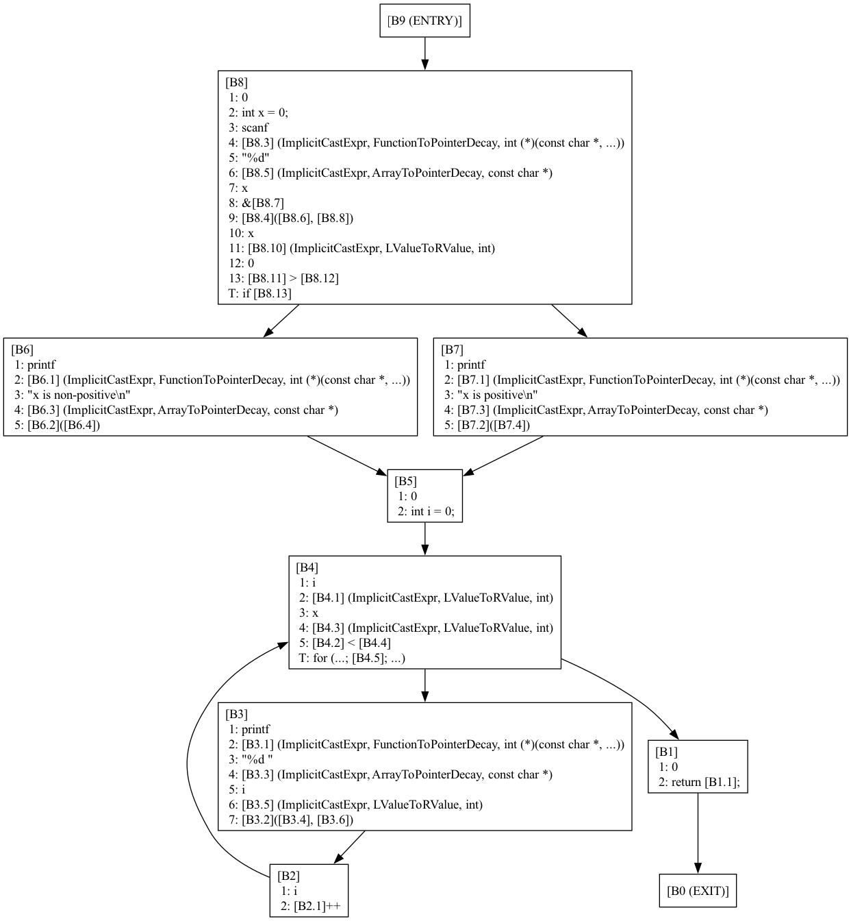
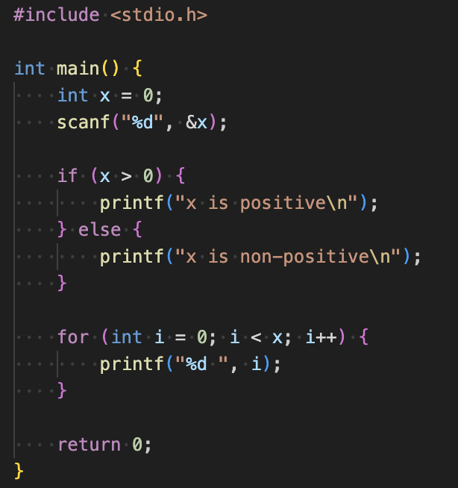
CFG demo
clang -Xclang -analyze -Xclang -analyzer-checker=debug.ViewCFG -Xclang -analyzer-output=text cfg.cpp

Slide 11
Dominators
A block M dominates block N if every path from the entry that reaches block N must pass through block M
Block M postdomintates block N if every path from N to exit must pass through M

Slide 12
Dominator trees
Data structure depicting the dominator relationships
Lengauer-Tarjan algorithm (O(nlogn))
See more: https://www.llvm.org/devmtg/2017-10/slides/Kuderski-Dominator_Trees.pdf

Slide 13
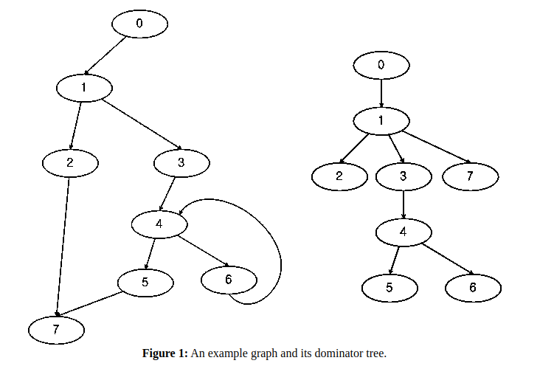
Dominator tree (example)
Source: https://www.boost.org/doc/libs/1_85_0/libs/graph/doc/lengauer_tarjan_dominator.htm

Slide 14
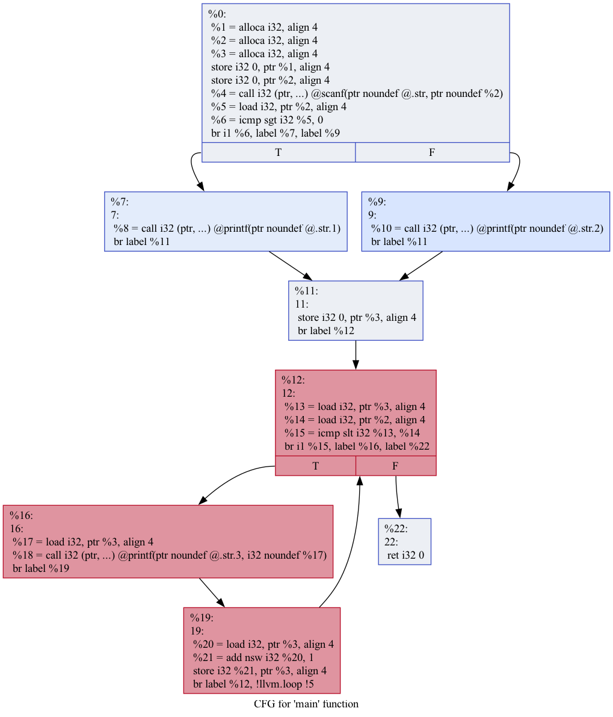
Dominator trees (demo)
How to build:
clang -S -emit-llvm dominator.cpp -o dominator.ll
opt -passes='dot-cfg' dominator.ll
dot -Tpng .main.dot -o main.png

Slide 15
Hacking on Clang
LibTooling – interface to write standalone tools based on clang
LibFormat – library for automatic source code formatting
LibClang – stable C interface for Clang
Clang Plugins – do extra actions during compilation
More on that: https://clang.llvm.org/docs/index.html#using-clang-as-a-library

Slide 16
Working with AST
AST is a graph, and you can use any graph theory algorithms
Examining AST: -Xclang -ast-dump -fsyntax-only
Clang framework provides a few helpers to work with AST
ASTConsumer
RecursiveASTVisitor
ASTAction
More on that: https://www.youtube.com/watch?v=VqCkCDFLSsc

Slide 17
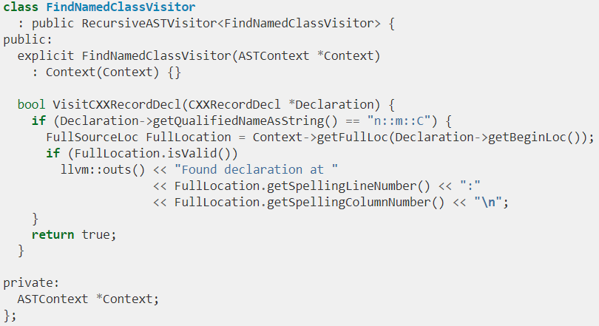
RecursiveASTVisitor
CRTP class
Provides methods to act on certain AST node classes
Basically, an implementation of DFS

Slide 18
LLVM IR generation
Typical use case for AST node visitors. Also can be referred as CodeGen, but do not confuse with LLVM CodeGen
Uses AST visitors, IRBuilder, and TargetInfo classes
CodeGenModule class keeps global state, e.g. LLVM type cache. Emits global and some shared entities.
CodeGenFunction class keeps per function state. Emits LLVM IR for function body statements.
The output can be inspected using the -emit-llvm (to force -S for textual representation) option to clang. You can also use -emit-llvm-bc to write an LLVM bitcode file which can be processed by the suite of LLVM tools like llvm-dis, llvm-nm, etc.

Slide 19
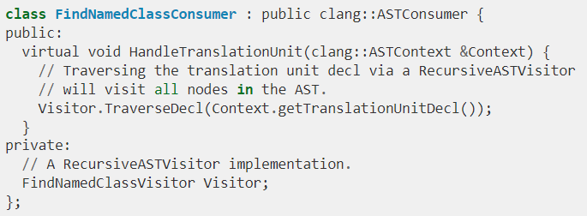
ASTConsumer
An interface used to write generic actions on AST
Provides many different entry points

Slide 20
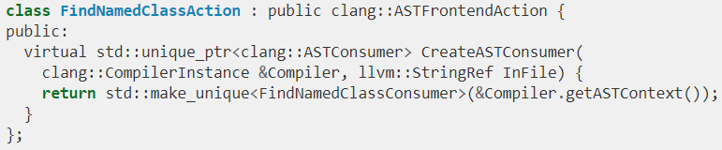
FrontendAction
FrontendActions are entry points for Clang-based tools (including Clang compiler)

Slide 21
Source manager
Source location
file:line:col
AST does not contain information on source locations
It may be required for code re-writing
SourceManager is owned by ASTContext:
More info: https://clang.llvm.org/docs/RAVFrontendAction.html

Slide 22
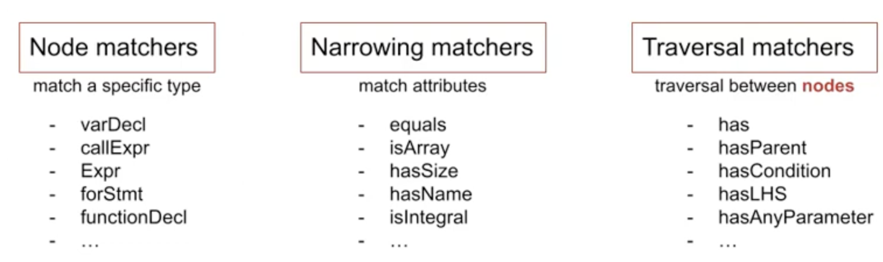
Matching AST
Sometimes there’s a need to find certain patterns in AST
Clang provides matchers interface:
Node matchers – find specific node type
Narrowing matchers – match attributes on AST nodes
Traversal matchers – traversal between AST nodes
More info on syntax: https://clang.llvm.org/docs/LibASTMatchersReference.html#decl-matchers

Slide 23
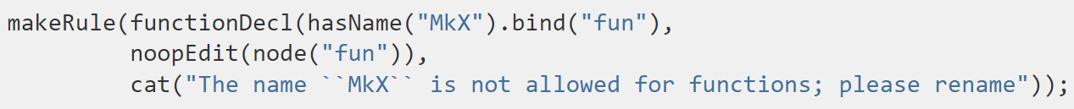
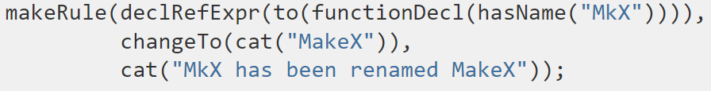
Clang Transformer
Framework for writing C++ diagnostics and source transformations
Built on Matchers interface and LibTooling
Rule examples:

Slide 24
clang-tidy
Clang-based linter tool
Provides rules for many standards, including:
C++ core guidelines
Abseil
Google
CERT
Linux Kernel
LLVM

Slide 25
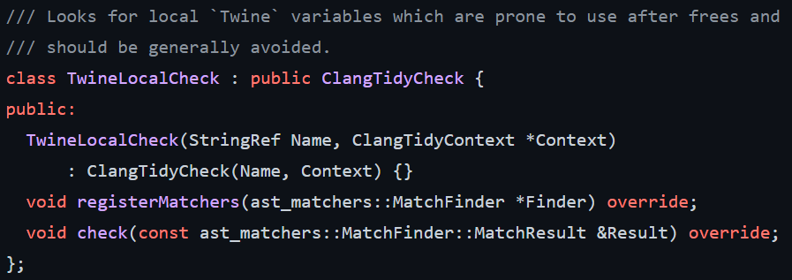
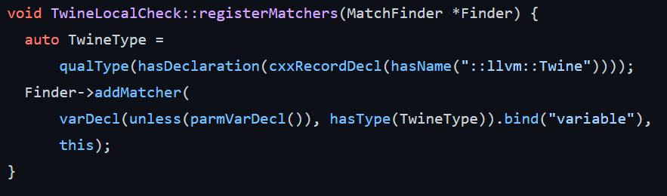
Extending clang-tidy
Most useful source of knowledge: look at existing code
Example (https://github.com/llvm/llvm-project/blob/main/clang-tools-extra/clang-tidy/llvm/):

Slide 26
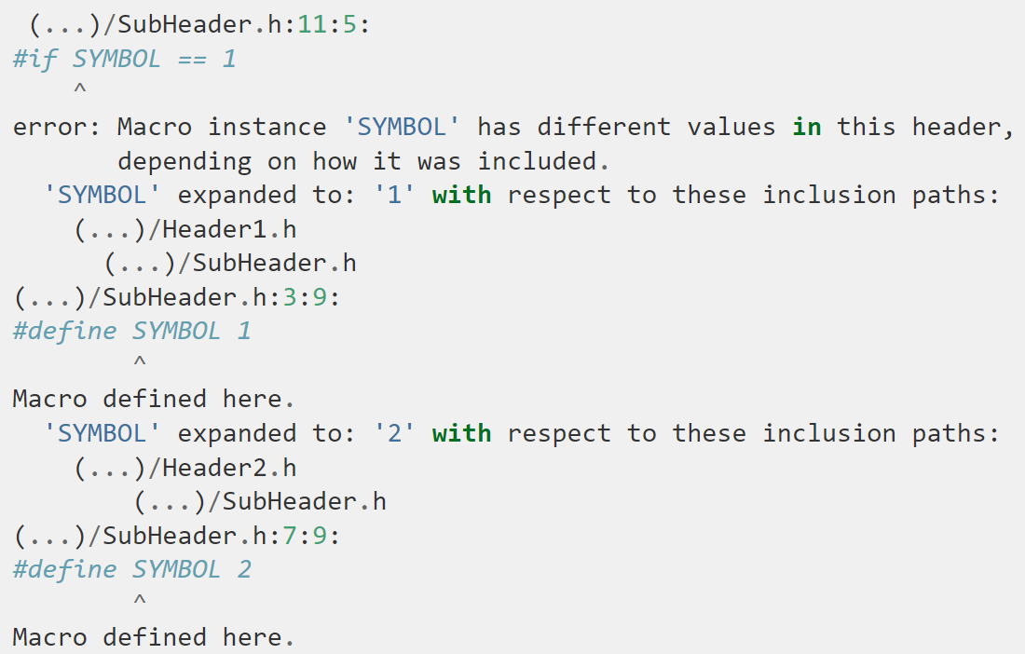
Case study: modularize
modularize is a standalone tool that checks whether a set of headers provides the consistent definitions required to use modules

Slide 27
Case study: C++ core guidelines
C++ Core Guidelines provide helper types for memory management
gsl::owner<…>
gsl::not_null<…>
clang-tidy will warn if you’re not using any of these and to suspicious things
https://clang.llvm.org/extra/clang-tidy/checks/cppcoreguidelines/owning-memory.html

Slide 28
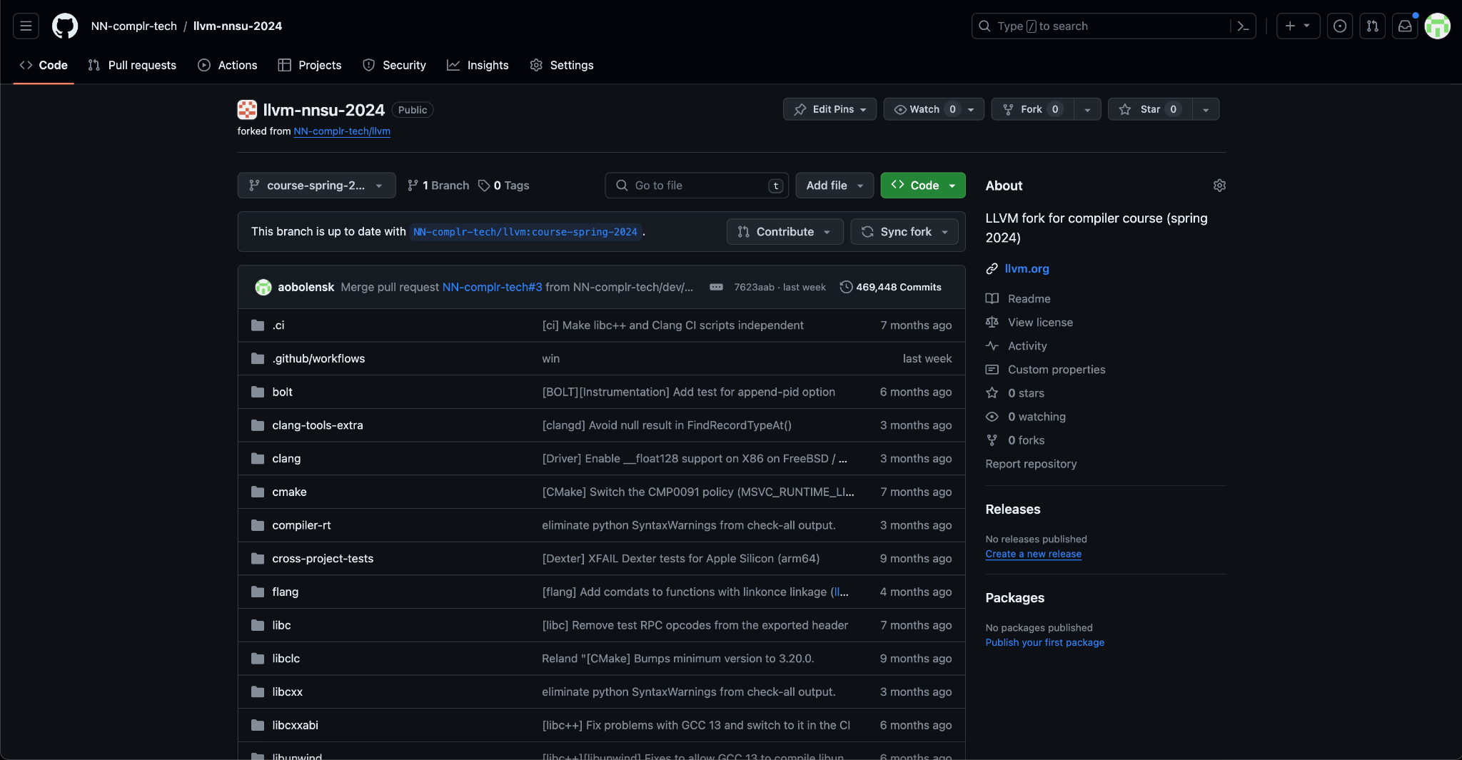
Hands-on
https://github.com/NN-complr-tech/compiler-course-2025

Slide 29
Lab assignment #1
Write a simple Clang AST plugin
Task list in Google Docs
Deadline: March, 19
Where to seek help
https://clang.llvm.org/docs/ClangPlugins.html
https://github.com/llvm/llvm-project/tree/main/clang/examples/PrintFunctionNames
Contact teachers

Slide 30
Acceptance criterias
The code base with implementation passes clang-format/clang-tidy checks on CI
The code base with implementation passes build and test stage on CI
LIT tests are added and passed on CI

Slide 31
FileCheck
Tool from clang toolchain
It is widely used for testing in LLVM framework
How to run FileCheck tool:
FileCheck %s - compare stdin with file %s
string to be verified:
CHECK: content
Manual: https://llvm.org/docs/CommandGuide/FileCheck.html
Run LIT test:
llvm-lit path/to/test

Slide 32
llvm-lit
lit is a portable tool for executing LLVM and Clang style test suites, summarizing their results, and providing indication of failures. lit is designed to be a lightweight testing tool with as simple a user interface as possible.
Manual: https://llvm.org/docs/CommandGuide/lit.html

Slide 33
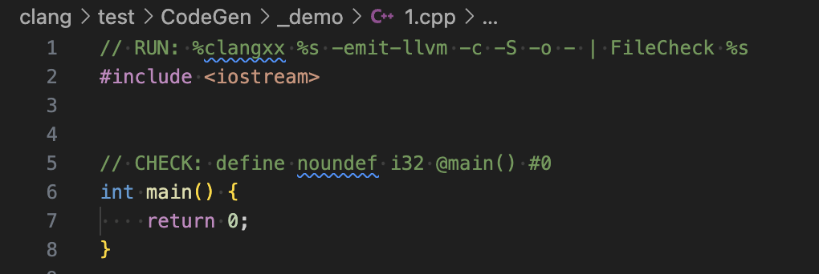
llvm-lit simple test demo
$PATH_TO_LLVM_BIN/llvm-lit -a clang/test/_demo/1.cpp

Slide 34
Next time…
Intermediate representations
LLVM IR
IR generation

Slide 35
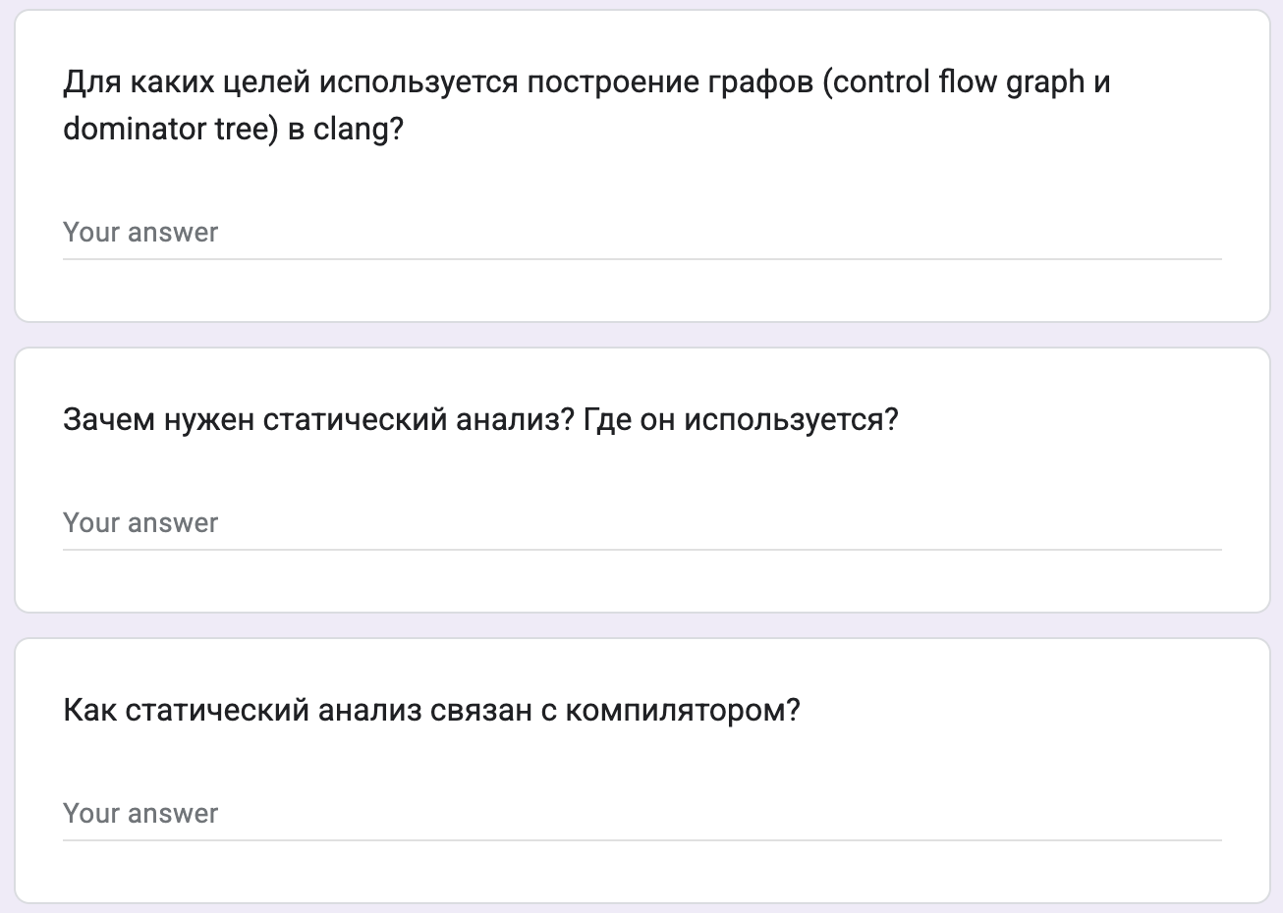

Test
https://forms.gle/KedxuyGUAkYiMmYf6
Backup: me@gooddoog.ru

Slide 36
Extra materials
Data flow analysis - https://www.youtube.com/watch?v=OROXJ9-wUQE
AST Matchers:
https://github.com/lac-dcc/llvm-course/tree/master/ast-matcher
https://www.youtube.com/watch?v=mizS4KnfTtQ
A. Homescu “Mutating the clang AST from Plugins”: https://www.youtube.com/watch?v=_rUwW8Awc5s

