Slide 1
Compilers 101
Compiler frontend

Slide 2
Previously…
Preprocessing
Lexical analysis
Frontend
Syntax analysis
Semantic analysis
IR Generation
Middle-end
IR Optimization
Optimization
Backend
Code generation

Slide 3
Preprocessor
Preprocessing
Lexical analysis
Frontend
Syntax analysis
Semantic analysis
IR Generation
Middle-end
IR Optimization
Optimization
Backend
Code generation

Slide 4
Preprocessor
The preprocessor is a tool that processes your source code before compilation. It handles directives for preprocessing, such as #include, #define, and conditional compilation.
Key Features:
File Inclusion (#include): Incorporates the contents of a file into the source code, typically used for header files.
Macro Definition (#define): Defines macros, which are snippets of code that are given a name. Whenever the name is used, it is replaced by the content of the macro.
Conditional Compilation: Allows compiling code selectively based on conditions evaluated by the preprocessor (#ifdef, #ifndef, #if, #elif, #else, #endif).
Error Directive (#error): Generates an error from a specified location in your code, useful for flagging incorrect conditions during preprocessing.
Pragma directives (#pragma): Issues special commands to the compiler, such as optimization levels or code layout suggestions.

Slide 5
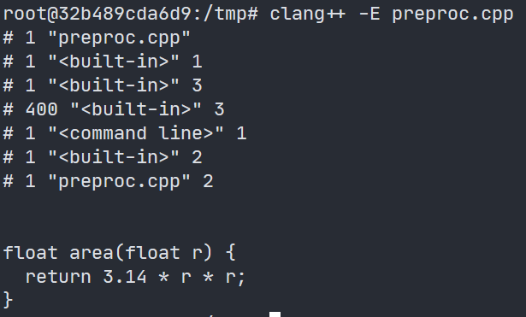
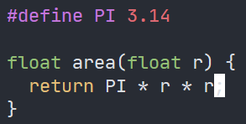

Preprocessor example
Input: C/C++ source code
Output: Preprocessed C/C++ source code
https://godbolt.org/z/zaacW8oGb

Slide 6
Why preprocessor is needed?
Importance:
Simplifies code by allowing file inclusion and macro expansions.
Enables platform-specific compilation through conditional directives.
Facilitates code maintenance and readability with organized, reusable code blocks; enables static polymorphism and other aspects of meta-programming
Use cases:
Defining compile-time constants.
Conditional compilation for cross-platform support.
Simplifying complex expressions or code snippets for readability and reusability.

Slide 7
Lexical analysis
Preprocessing
Lexical analysis
Frontend
Syntax analysis
Semantic analysis
IR Generation
Middle-end
IR Optimization
Optimization
Backend
Code generation

Slide 8
Goals of lexical analysis
Convert physical representation to machine-readable sequence of tokens
Tokens are the smallest units in the source code, such as keywords, identifiers, literals, operators, and punctuation symbols (like commas and semicolons).
Associate each token with a lexeme
E.g., 42 is an integer literal (token) with the value of 42 (lexeme)
In essence, a lexeme is the textual string in the source code, while a token is a structured object that represents a categorized lexeme along with its classification
Tokens may have extra attributes
The result will be then used to build AST

Slide 9
Basics
for
L_par
type(int)
ident(i)
eq
int lit(0)
semicol
ident(i)
less
int lit(42)
semicol
ident(i)
inc
R_par
for (int i = 0; i < 42; i++)

Slide 10
Choosing the right tokens
Depends on your language
Typically
Keywords
Literals
Punctuation

Slide 11
Formal languages
A formal language consists of words whose letters are taken from an alphabet and are well-formed according to a specific set of rules.
Examples
Alphabet Σ = {a, b}, Language = Σ* - the set of all words over alphabet
Alphabet Σ = {a}, Language = {a}* = {a^{n}} - where n ranges over the natural numbers and "a^{n}" means "a" repeated n times (this is the set of words consisting only of the symbol "a");

Slide 12
Regular expressions
Regular expressions are a family of descriptions that can be used to capture regular languages
There’s a set of operations on regular expressions (concatenation, alternation, Kleene star: concatenation of zero or more strings from the set)
There are multiple standards to describe the syntax of regular expressions

Slide 13
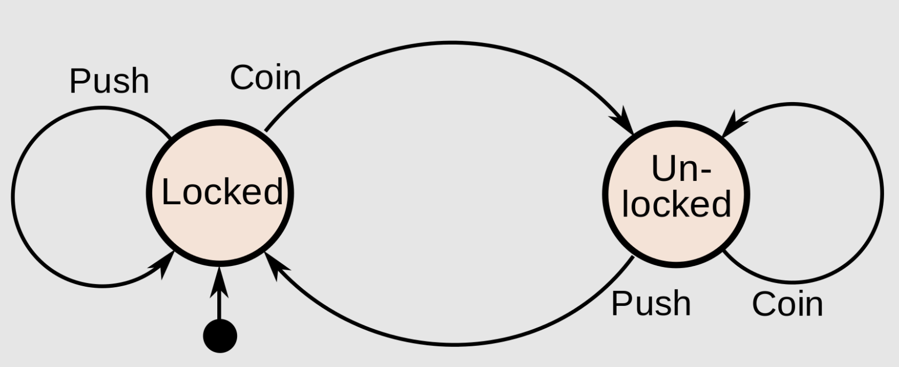
Matching regular expressions
Regular expressions can be implemented as finite-state machines
A finite-state machine is an abstract machine that can be in exactly one of a finite number of states
https://en.wikipedia.org/wiki/Finite-state_machine

Slide 14
Ambiguity resolution
Consider we have words do and double. How to assign tokens?
Rules
Left-to-right scanning
Maximal munch – always match the longest occurrence

Slide 15
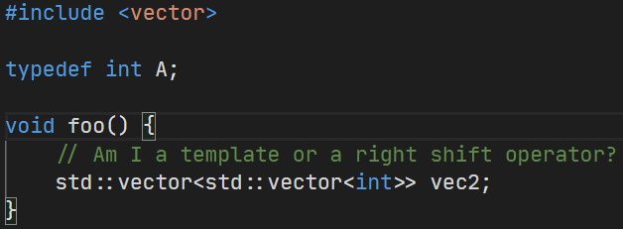
Lexical challenges
As seen by C++ compiler developers

Slide 16
Syntax analysis
Preprocessing
Lexical analysis
Frontend
Syntax analysis
Semantic analysis
IR Generation
IR Optimization
Middle-end
Optimization
Backend
Code generation

Slide 17
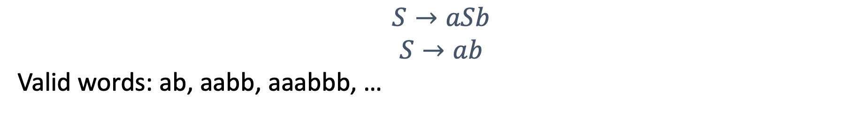
Grammars
A formal grammar is a set of rules that describe how to form strings from a language’s alphabet that are valid according to the language syntax
Example:

Slide 18
The Chomsky hierarchy
- Expressiveness
- Recognition complexity
Recursively enumerable (RE, Type 0)
Recursively enumerable subset in the set of all possible words over the alphabet of the language
Context-sensitive grammars (CSG, Type 1)
Left-hand side (LHS) and right-hand side (RHS) may be surrounded by a context of terminal and nonterminal symbols
Context-free grammars (CFG, Type 2)
LHS of each production rule consists only of a single nonterminal symbol
Regular grammars (Type 3)
All production rules have at most 1 nonterminal symbol
The symbol is always either at the start or at the end of rule’s RHS
- Restrictions on Production Rules
- Ease of Parsing
- Determinism

Slide 19
The Chomsky hierarchy (examples)
- Expressiveness
- Recognition complexity
Recursively enumerable (RE, Type 0)
These grammars can describe any language that can be recognized by a Turing machine, including highly complex or undecidable problems. There are not many practical examples in programming due to their complexity and generality
Context-sensitive grammars (CSG, Type 1)
Ones that can be represented by linear bound automata (some set of limitations applied on Turing machine)
Context-free grammars (CFG, Type 2)
Programming languages
Regular grammars (Type 3)
Regular expressions and finite automata can describe these languages
- Restrictions on Production Rules
- Ease of Parsing
- Determinism
Our focus is set on highlighted types

Slide 20
Backus–Naur form
BNF is a metasyntax notation for CFG, often used to describe programming languages
All rules are written in the following format
<symbol> ::= __expression__
Examples:
Python grammar is a mixture of EBNF and PEG (parsing expression grammar) https://docs.python.org/3/reference/grammar.html
YAML also has BNF description fractions in their spec: https://yaml.org/spec/1.2.2/
JSON has unofficial pure BNF description: https://github.com/JetBrains/Grammar-Kit/blob/master/testData/livePreview/Json.bnf, official spec also has only fractions of BNF https://www.json.org/json-en.html

Slide 21
BNF example: grammar for basic arithmetic expressions
Arithmetic expressions conforming given BNF grammar:
42
3+5
3+5*2
(3+5)*2
(1+2)*(3-4)/5
<expression> ::= <term>
| <expression> "+" <term>
| <expression> "-" <term>
<term> ::= <factor>
| <term> "*" <factor>
| <term> "/" <factor>
<factor> ::= <number>
| "(" <expression> ")"
<number> ::= <digit>
| <digit> <number>
<digit> ::= "0" | "1" | "2" | "3" | "4"
| "5" | "6" | "7" | "8" | "9"

Slide 22
From concrete to abstract trees
As a result of parsing, you will get a parse tree, which is also a concrete syntax tree
It contains all the small details about textual representation
Abstract syntax tree omits those irrelevant details
Parenthesis, semicolons, commas…
To get an abstract tree, you recursively traverse the parsing tree

Slide 23
Different types of parsing
Top-down parsing
Beginning with the start symbol, try to guess the productions to apply to end up at the user’s program
Bottom-up parsing
Beginning with user’s program, try to apply productions in reverse to convert the program back into the start symbol

Slide 24
LL(k) parsers
Left-to-right, leftmost derivation
Top-down parser for context-free languages
k tokens of lookahead
Most popular – LL(1) parsers
Will not be covered in details by this course

Slide 25
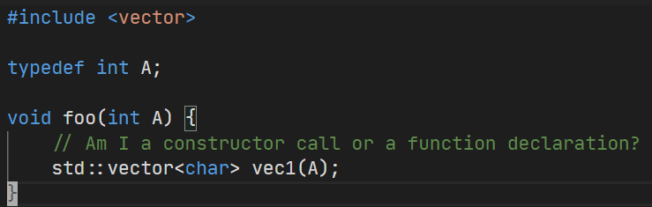
Syntax challenges
As seen by C++ compiler developers

Slide 26
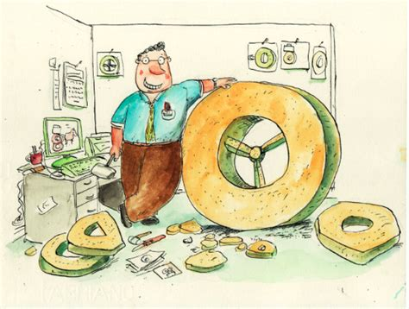
A word of advice
Do not re-invent the wheel!
This problem has been solved before
Try to use existing grammar description formats and use parser generators
Pic: https://www.ictworks.org/2015/07/10/stop-reinventing-the-flat-tire-with-custom-software-development/

Slide 27
Semantic analysis
Preprocessing
Lexical analysis
Frontend
Syntax analysis
Semantic analysis
IR Generation
Middle-end
IR Optimization
Code generation
Backend
Optimization

Slide 28
Goals of semantic analysis
Ensure that the program has a well-defined meaning
Variables and symbols are defined before they are used
Expressions have the right types
…
Gather useful information for later stages

Slide 29

Validity vs correctness
Valid syntax does not mean your program is correct
The following sample is only correct if x is 2

Slide 30
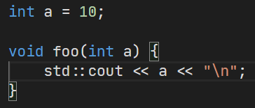
Symbol tables
Basically, a hash map where key is symbol name and value is its graph node
Except that it is scoped
Example implementation: https://llvm.org/doxygen/classllvm_1_1ScopedHashTable.html

Slide 31
OOP challenges
Classes may have parents
In that case we must look up symbol in base class symbol tables as well
Actual implementations may be different for particular languages

Slide 32
Multiple inheritance
Some languages allow multiple base classes
In that case we must look up the symbol in each base class
Again, rules depend on language design

Slide 33
IR Generation
Preprocessing
Lexical analysis
Frontend
Syntax analysis
Semantic analysis
IR Generation
Middle-end
IR Optimization
Optimization
Backend
Code generation

Slide 34
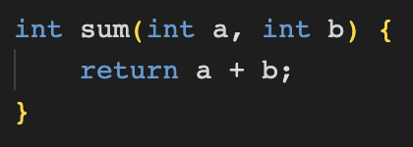
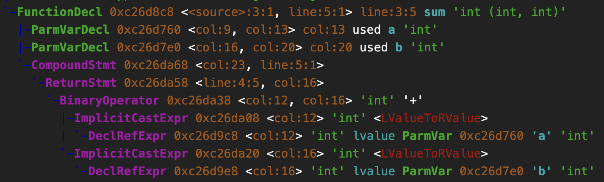
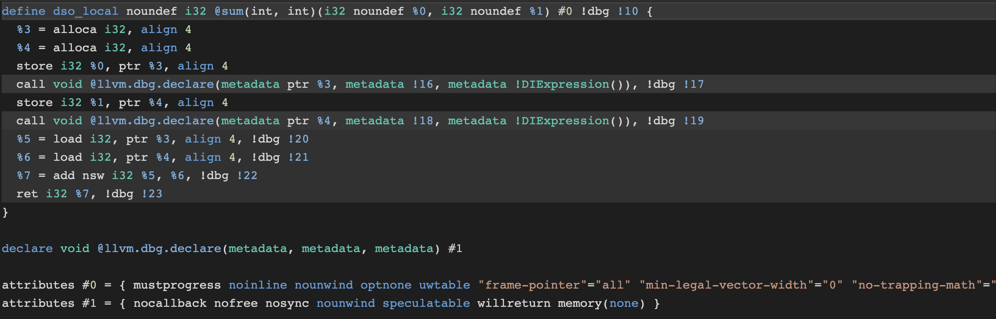
IR generation
Consumes AST
Produces LLVM IR
more on that on lecture 04

Slide 35
Overview of Clang

Slide 36
Simplified compiler flow
Preprocessor & lexer
Tokens
AST
IR
SRC
Driver
Parser
Sema
CodeGen
Compiler
Linker

Slide 37
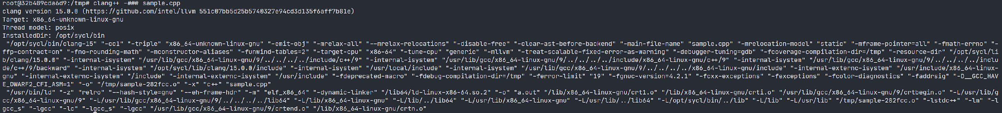
Clang driver
Clang supports multiple compatibility modes: with GCC and MSVC
The part that parses options and issues compile commands is called driver
Output can be seen with -### flag
https://godbolt.org/z/rWhqnzhT7

Slide 38
Preprocessor
GCC:
gcc -E in.cpp
GNU C compiler preprocessor as a standalone binary. You can use it directly to preprocess C files.
cpp in.cpp in.i
Clang:
clang -E in.cpp
https://godbolt.org/z/5nzzbE15T

Slide 39
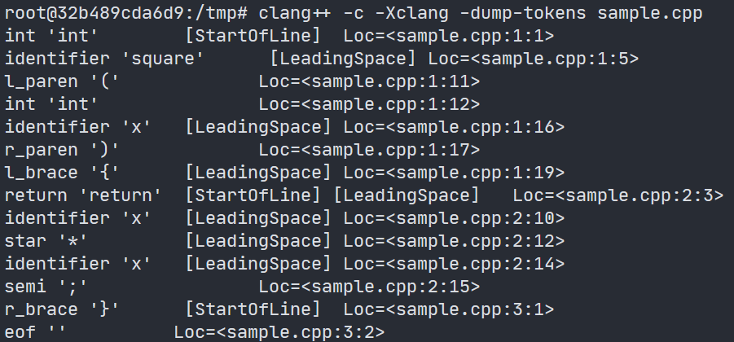

Lexer
Starts right after preprocessor
Flags
-c – compile only
-Xclang -dump-tokens – bypass driver and pass -dump-tokens to FE
https://godbolt.org/z/7bPxao3Pz

Slide 40
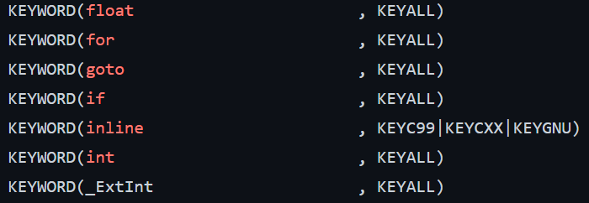
Lexer internals
Token kinds defined in clang/include/clang/Basic/TokenKinds.def
Consumed by clang/include/clang/Parse/Parser.h

Slide 41
Parser
Handwritten recursive-descent parser
Tentative parsing by looking at the tokens ahead
the parser can “peek” ahead and choose the best path without committing prematurely
Try to recover from errors as much as possible
Prevents cascading errors by synchronizing at known recovery points
Suggest FIX-IT hints
Analyzes error contexts to suggest potential fixes (e.g., missing semicolons, unmatched parentheses)
Aims to improve developer productivity by providing actionable guidance

Slide 42
Sema
Tightly coupled with parser
Verifies AST before it is sent out to other clients
Biggest client of diagnostics subsystem
Most warnings and errors come out of here
Sema verifies that the syntax that passes the parsing stage also makes sense according to the rules of the language
This involves checking for type errors, ensuring that variables are declared before use, enforcing scope rules, and more.

Slide 43
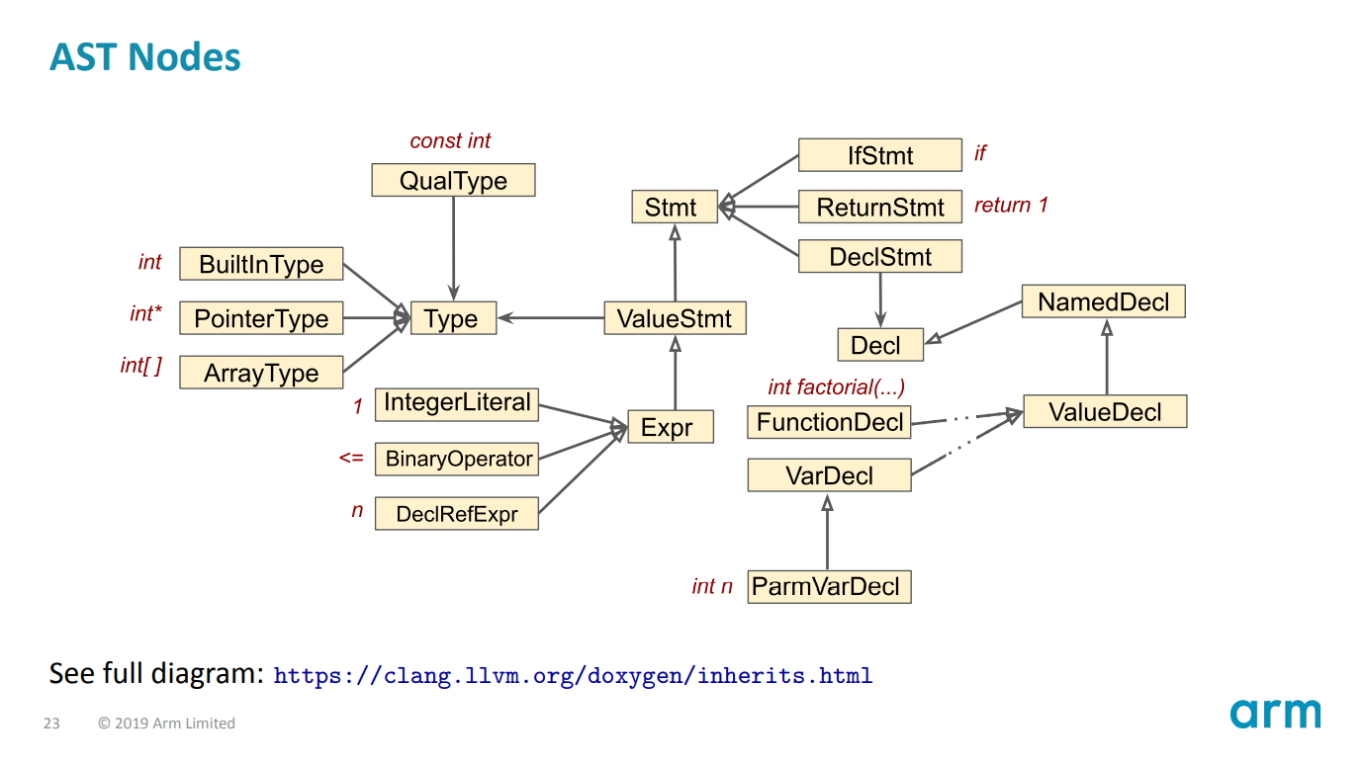
AST
https://llvm.org/devmtg/2019-10/slides/ClangTutorial-Stulova-vanHaastregt.pdf
https://godbolt.org/z/6Wq38MbPj

Slide 44
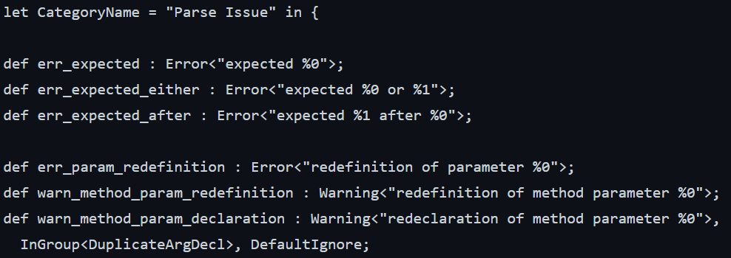
Diagnostics
Defined in Diagnostic*Kind.td
Diagnostic engine tries to render output in human-readable format
Not always successful, especially in heavily templated code

Slide 45
TableGen language
The LLVM TableGen language is a domain-specific language used within the LLVM project framework.
Key points:
Data Description Tool
Code Generation
Extensible with writing additional code generators
Language is widely used in LLVM frontend and backend, MLIR and other components
Language reference: https://llvm.org/docs/TableGen/ProgRef.html

Slide 46
TableGen example
Here is the example:
code snippet that could be used to add new attribute for clang
// In File: clang/include/clang/Basic/Attr.td
include "clang/Basic/AttrDocs.td"
def MyAttr : InheritableAttr {
let Documentation = [Undocumented];
// This specifies the attribute is for functions.
let Subjects = SubjectList<[Function], ErrorDiag>;
// The spelling of the attribute in the source code.
let Spellings = [CXX11<"clang", "my_attr">];
// The attribute does not take any arguments.
let Args = [];
}
[[clang::my_attr]]
void foo() {
}
__attribute__((my_attr))
void foo() {
}

Slide 47
Lab assignment #0
Try to build LLVM and Clang from source code and run tests
Source code: https://github.com/NN-complr-tech/compiler-course-2025
Follow build instructions: https://llvm.org/docs/CMake.html
Make sure to run check-clang and check-llvm targets, e.g.
cmake --build . --target check-clang
Better done on Linux or macOS. Windows is also OK.
Goal: learn how to work with basic LLVM infrastructure
Build may take several hours
Build usually requires 2GB of RAM per 1 thread. One can reduce number of threads with -j n flag, where n is a number of threads

Slide 48
Next time…
Look closer at practical usages of clang AST
Working with AST
Clang plugins
Clang-tidy and static analysis

Slide 49

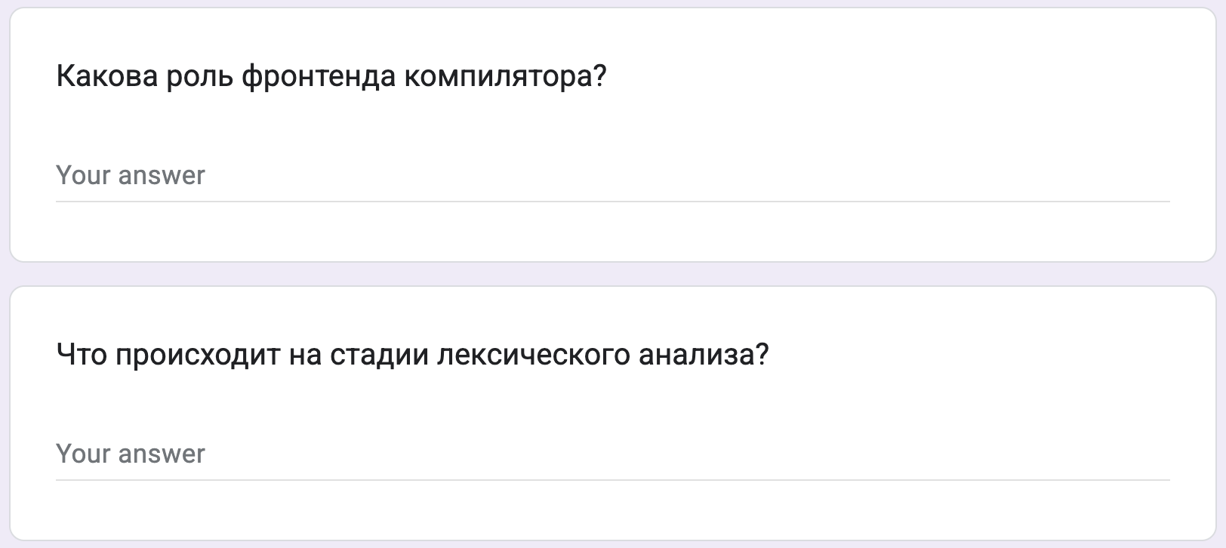
Test
https://forms.gle/sA5VYne7p9UyHdbH9
Backup: me@gooddoog.ru

Slide 50
Extra materials
An overview of Clang, LLVM Dev 2019 - https://www.youtube.com/watch?v=5kkMpJpIGYU
What is C++, Chandler Carruth, Titus Winters - https://www.youtube.com/watch?v=LJh5QCV4wDg
Гладкий А. В. Формальные грамматики и языки (RU)
Хопкрофт Дж., Мотвани Р., Ульман Дж. Введение в теорию автоматов, языков и вычислений (RU)
Hacking on clang - https://clang.llvm.org/hacking.html
Lessons in TableGen - https://www.youtube.com/watch?v=45gmF77JFBY
The Clang AST - a tutorial - https://www.youtube.com/watch?v=VqCkCDFLSsc

