Slide 1
Compilers 101
Optimizations – Part 2

Slide 2
Previously…
Preprocessing
Lexical analysis
Frontend
Syntax analysis
Semantic analysis
IR Generation
IR Optimization
Middle-end
Optimization
Backend
Code generation

Slide 3
Previously… (2)
LLVM IR
LLVM IR passes
LLVM IR optimizations

Slide 4
Today
opt tool showcase
Loop optimizations

Slide 5
Running optimizations
Generate LLVM IR
Use opt tool
Guide: https://llvm.org/docs/CommandGuide/opt.html

Slide 6
opt tool
LLVM optimizer
Input: LLVM IR
Output: LLVM IR
Passes list: https://llvm.org/docs/Passes.html
Options: https://llvm.org/docs/CommandGuide/opt.html
Command line examples:
opt -print-passes
opt -O2 input.ll -o optimized.bc
opt -passes=’dce’ input.bc
opt -dce input.bc
opt -load MyPass.so -my-custom-pass input.ll -o output.ll

Slide 7

Compiler Explorer
Is an interactive compiler exploration website. Edit code in C, C++, C#, F#, Rust, Go, D, Haskell, Swift, Pascal, ispc, Python, Java, or any of the other 30+ supported languages components, and see how that code looks after being compiled in real time.
Official website: https://godbolt.org/
GitHub repository: https://github.com/compiler-explorer/compiler-explorer

Slide 8
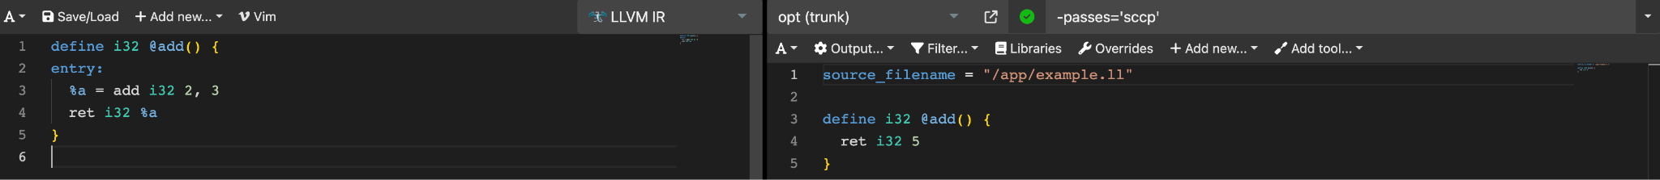

Running LLVM IR optimizations
Learn by example (1):
SCCP:
https://godbolt.org/z/vYzMohM3e

Slide 9
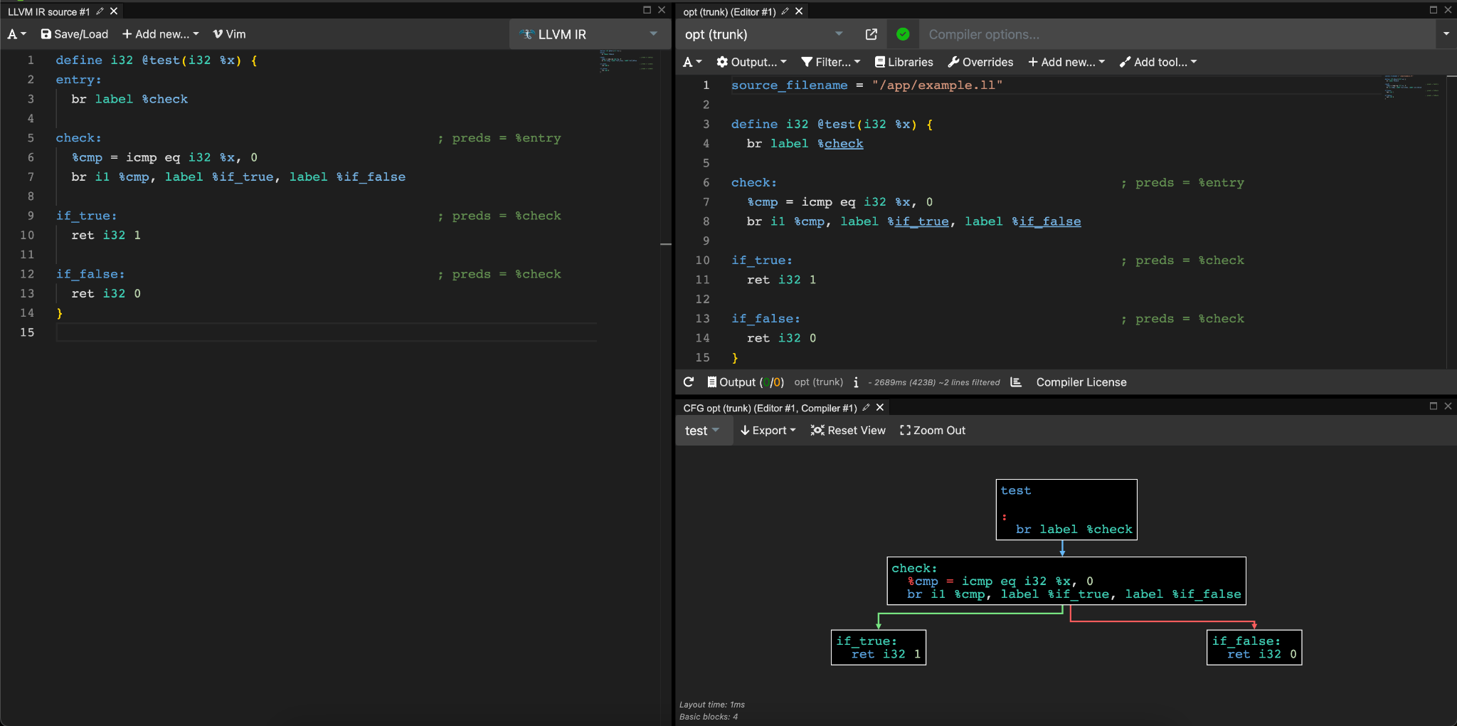
CFG visualization
opt -dot-cfg cfg_example.ll
dot -Tpng cfg_example.dot
https://godbolt.org/z/T6bWarjjK

Slide 10
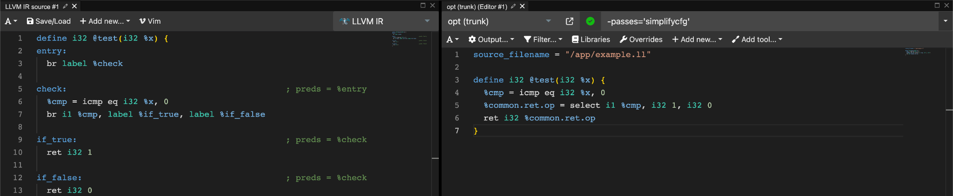
Running LLVM IR optimizations
Learn by example (2):
CFG simplification:
https://godbolt.org/z/hK4ndPbcq

Slide 11
Loop optimizations
Why are they important?
Pareto principle
20 percent of effort gives 80 percent of result
Most computationally intensive algorithms involve loops

Slide 12
Terminology
Trip count is a minimum number of times a loop executes
Induction variable is a variable that gets increased or decreased on each loop iteration
Loop invariant is the part of a computation inside a loop that remains unchanged (invariant) in each iteration

Slide 13
Detecting induction variables
i is a basic induction variable in a loop L if the only definitions of i within L are of the form i := i +/- c where c is loop invariant
k is a derived induction variable in loop L if
There’s only 1 definition of k within L in the form of k := j */+ c where j is an induction variable
If j is an induction variable in the family of i then
The only definition of j that reaches k is the one in the loop
There’s no definition of i on any path between the definition of j and the definition of k

Slide 14
Structured control flow
Structured control flow is a programming paradigm characterized by the clear, hierarchical organization of control paths through a program.
It relies exclusively on structured control constructs such as conditionals (if, else), loops (for, while), and function calls, which lead to well-defined entry and exit points.
The key attribute of structured CF is that it avoids the use of arbitrary jumps or goto statements, making the control flow predictable and easier to follow.

Slide 15
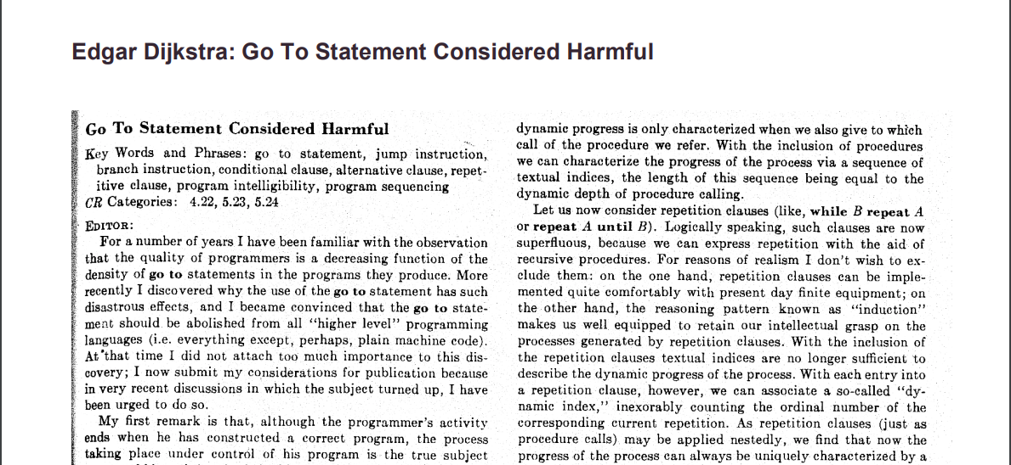
Structured control flow
https://dl.acm.org/doi/pdf/10.1145/362929.362947

Slide 16
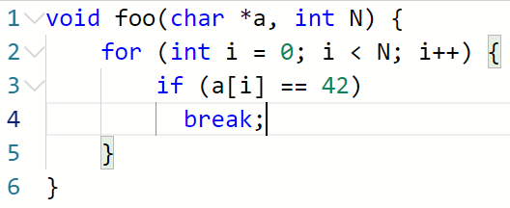
Structured control flow
Is this program structured?

Slide 17
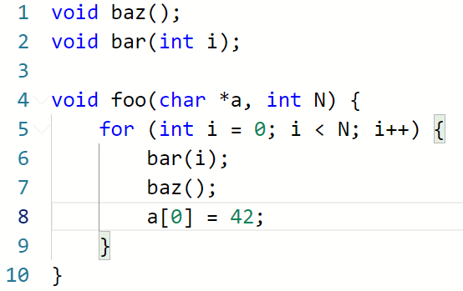
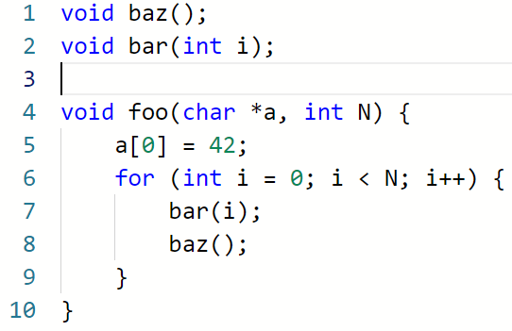
Loop-invariant code motion

Slide 18
Conditions for safe hoisting
hoisting - moving to outer scope
sinking - moving to inner scope
An invariant assignment d: x := y op z is safe to hoist if
d dominates all loop exits at which x is live and
there is only one definition of x in the loop, and
x is not live at the entry point for the loop

Slide 19
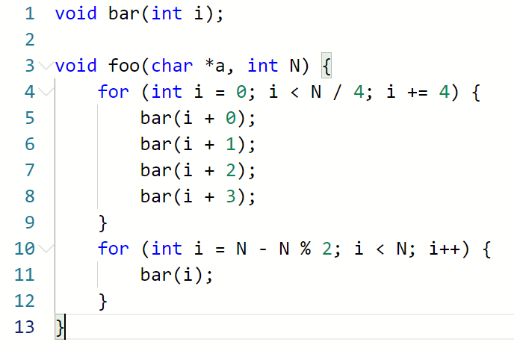
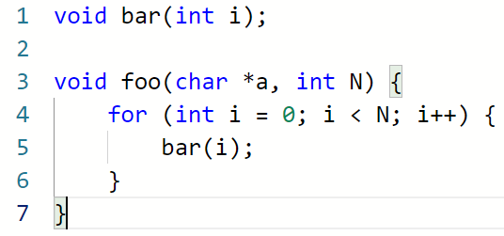
Loop unroll

Slide 20
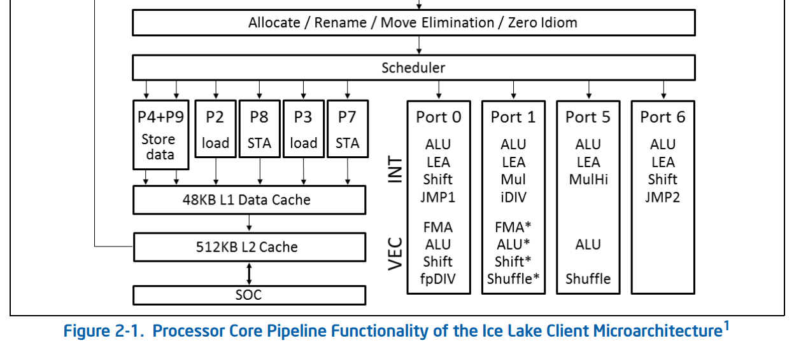
When it works and when it fails?
https://www.intel.com/content/www/us/en/developer/articles/technical/intel-sdm.html

Slide 21
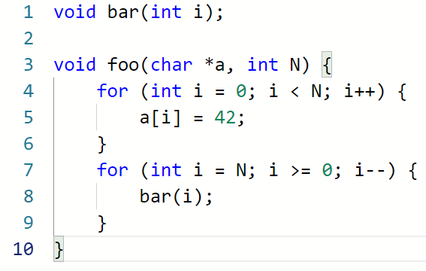
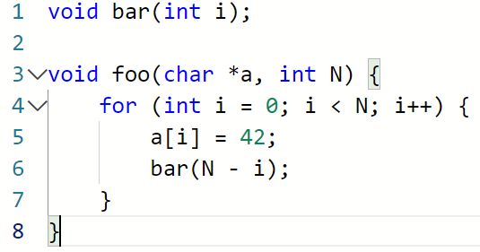
Loop fusion

Slide 22
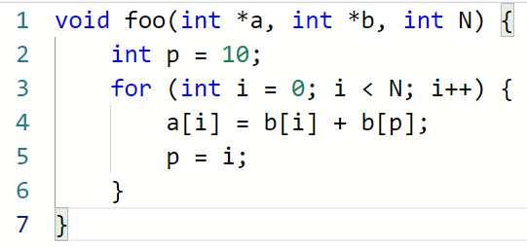
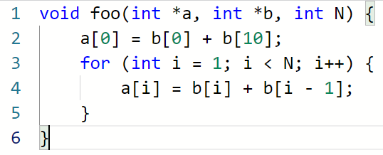
Loop peeling

Slide 23
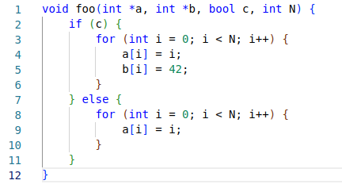
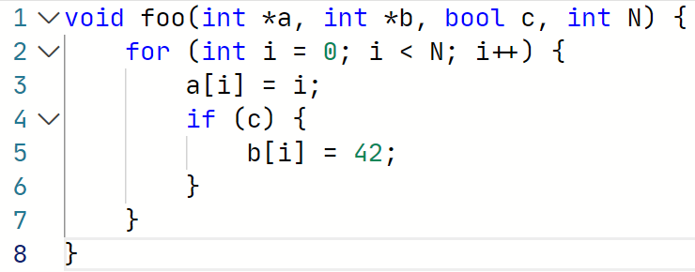
Loop unswitch

Slide 24
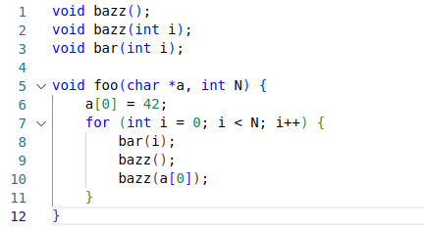
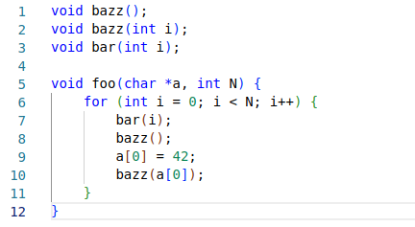
Control flow sink

Slide 25
Loop reroll

Slide 26
Loop fission

Slide 27
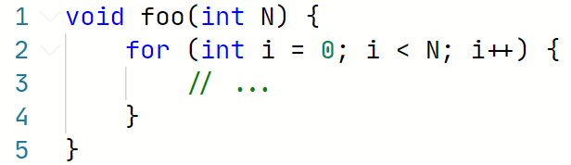
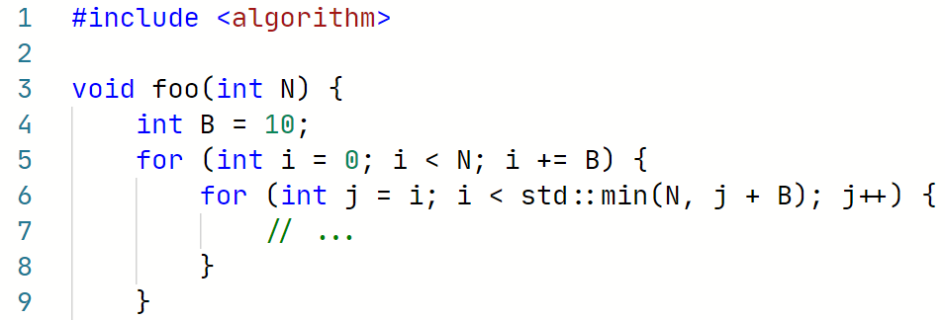
Loop tiling

Slide 28
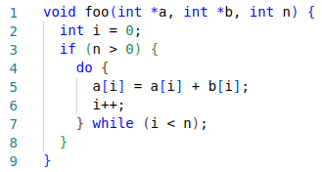

Loop rotation

Slide 29
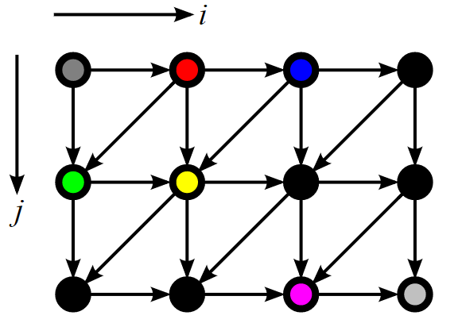
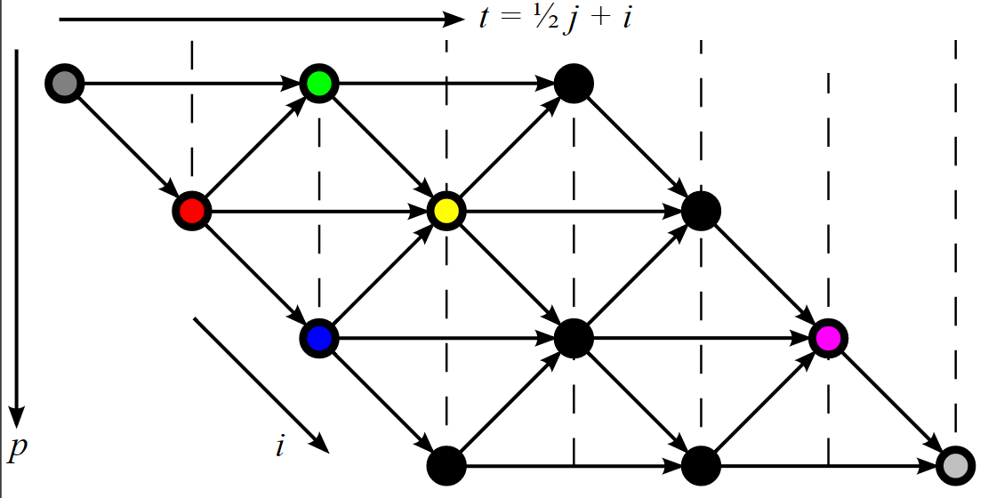
Polytope model
https://en.wikipedia.org/wiki/Polytope_model

Slide 30
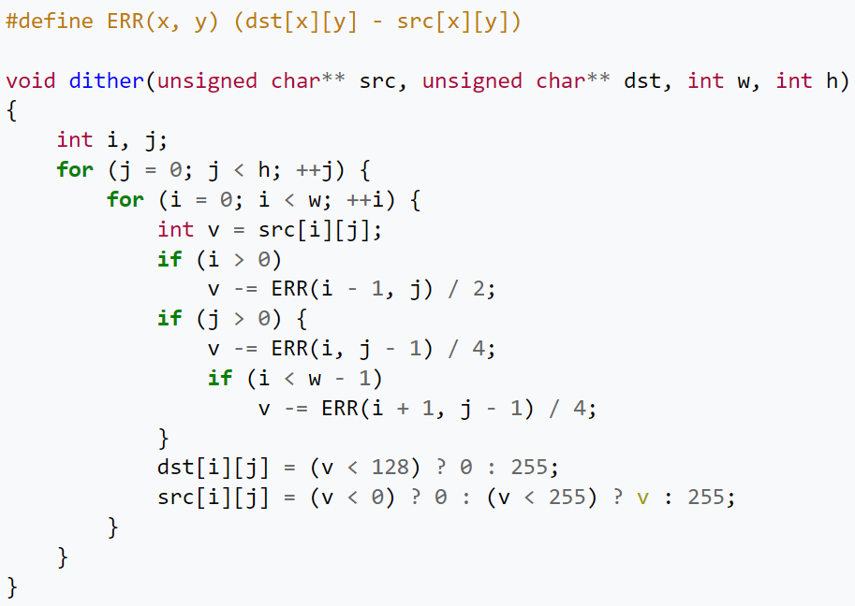
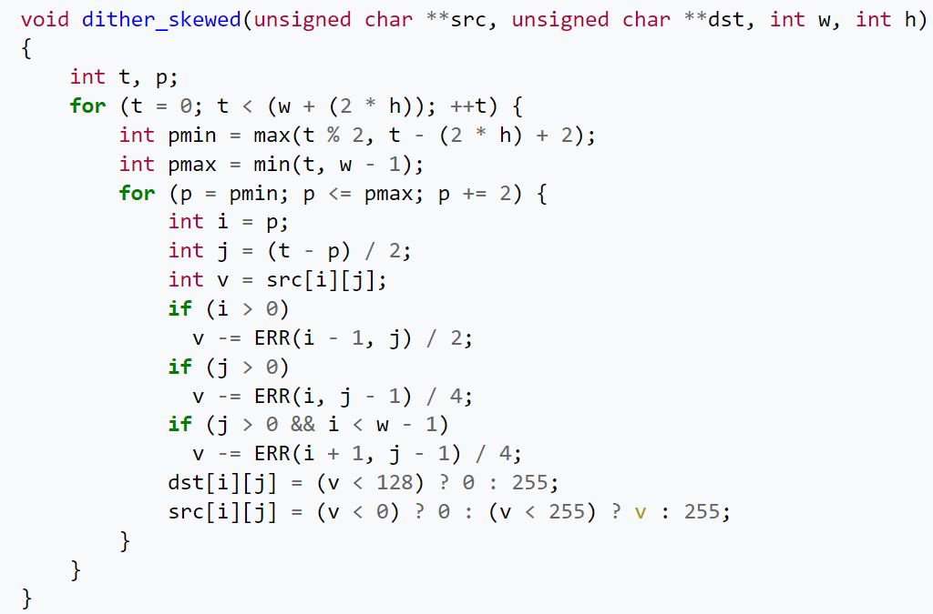
Affine transformations

Slide 31
Polyhedral transformations in LLVM
Polly is a high-performance loop and data-locality optimizer embedded framework within the LLVM. It utilizes mathematical models to analyze and optimize memory access patterns, significantly enhancing code efficiency, particularly in loops and matrix multiplications
Docs & info: https://polly.llvm.org/

Slide 32
Next time…
Vectorization

Slide 33
Lab assignment #2
Write a plugin with simple LLVM pass
Task list in Google Docs
Deadline: April, 9
Where to seek help
https://www.llvm.org/docs/WritingAnLLVMNewPMPass.html
https://github.com/llvm/llvm-project/tree/main/llvm/examples/IRTransforms
contact teachers

Slide 34


Test
https://forms.gle/A3XfkLu2PnZbRodT7
Submission time: 10 minutes
Backup: me@gooddoog.ru

Slide 35

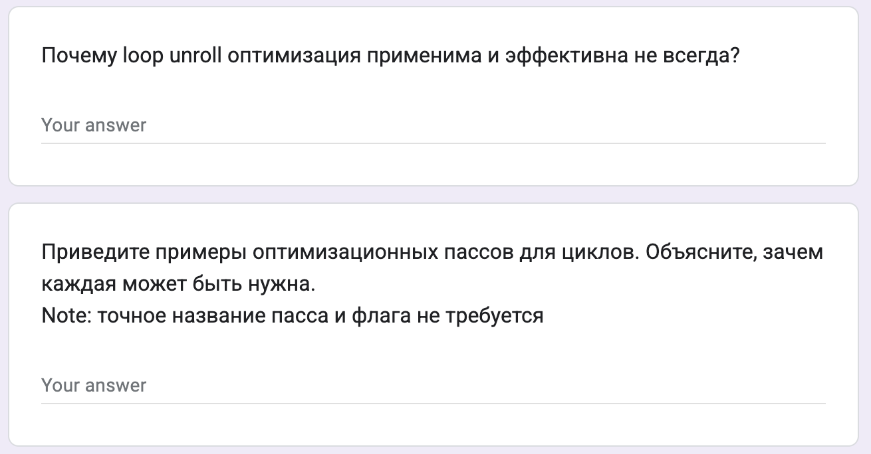
Test
https://forms.gle/ywfMNSijV2XqDiVF8
Submission time: 10 minutes
Backup: me@gooddoog.ru

Slide 36
Extra materials
Loop Optimizations in LLVM: The Good, The Bad, and The Ugly - https://llvm.org/devmtg/2018-10/slides/Kruse-LoopTransforms.pdf
EuroLLVM Developers' Meeting: J. Doerfert & T. Grosser "Analyzing and Optimizing ... Polly“ - https://www.youtube.com/watch?v=mXve_W4XU2g
LLVM Developers’ Meeting: T. Grosser “Polly - Polyhedral optimizations in LLVM” - https://www.youtube.com/watch?v=WwfZkQEuwEE

