Slide 1
Compilers 101
LLVM IR

Slide 2
Previously…
Preprocessing
Lexical analysis
Frontend
Syntax analysis
Semantic analysis
IR Generation
IR Optimization
Middle-end
Optimization
Backend
Code generation

Slide 3
Today
Three address code
Intermediate representations
LLVM IR

Slide 4
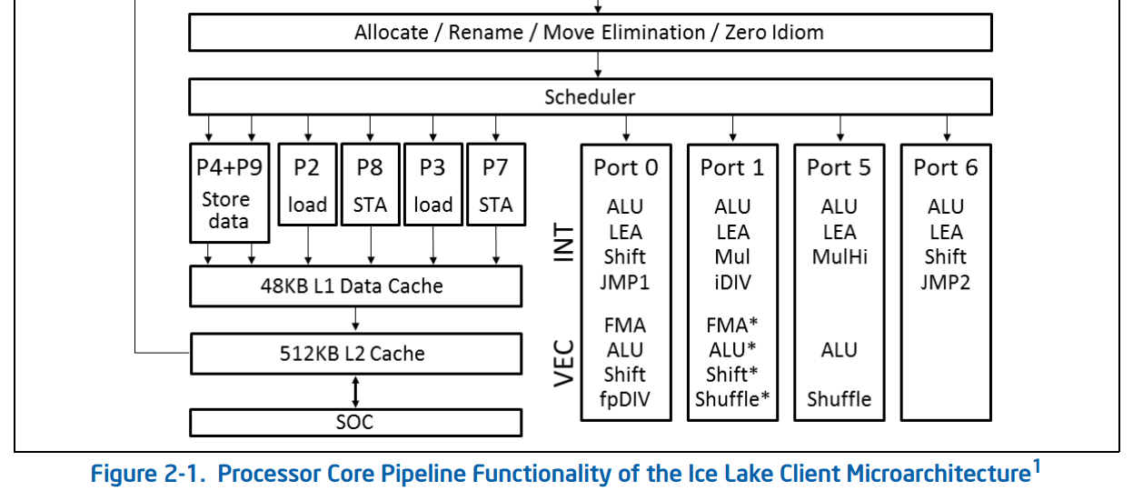
How to represent computation?
https://www.intel.com/content/www/us/en/developer/articles/technical/intel-sdm.html

Slide 5
Three-address code
Three-address code is a representation of the computation in the form of a sequence of expressions A := B op C
Example:
A = B + C + D
t1 = B + C
t2 = t1 + D
A = t2

Slide 6
TAC instructions
The following forms are allowed
A := constant
A := B
A := B op C
A := constant op B
A := B op constant
A := constant op constant

Slide 7
TAC control flow
int x, y;
while (x < y) {
x = x * 2;
}
y = x;
L0:
t0 := x >= y;
if t0 goto L1;
x := x * 2;
goto L0;
L1:
y := x;

Slide 8
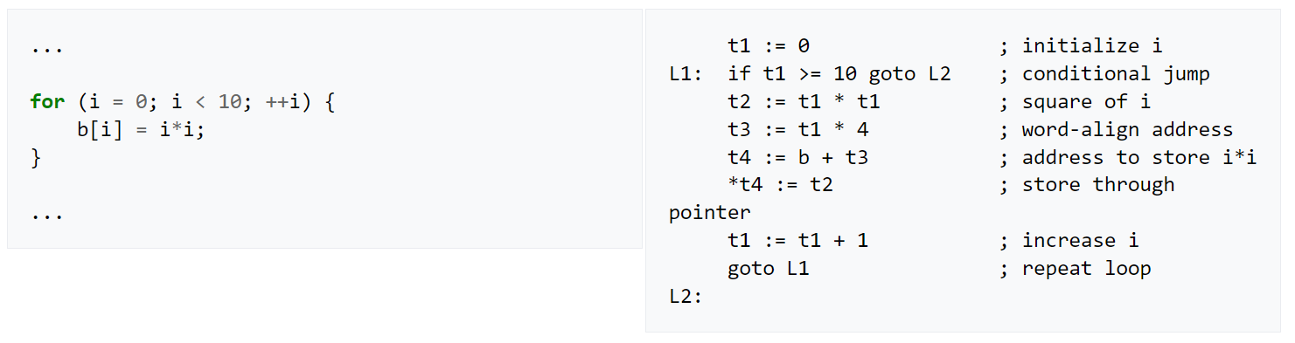
Three-address code example
https://en.wikipedia.org/wiki/Three-address_code

Slide 9
Function calls
bar:
B = pop;
A = pop;
…
foo:
push 10;
push 42;
goto bar;
…
void bar(int A, int B) {
…
}
void foo() {
bar(10, 42);
}

Slide 10
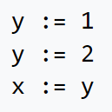
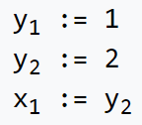
Single static assignment
SSA is a property of intermediate representation, which requires that each variable to be assigned exactly once
Benefits
https://en.wikipedia.org/wiki/Static_single_assignment_form

Slide 11
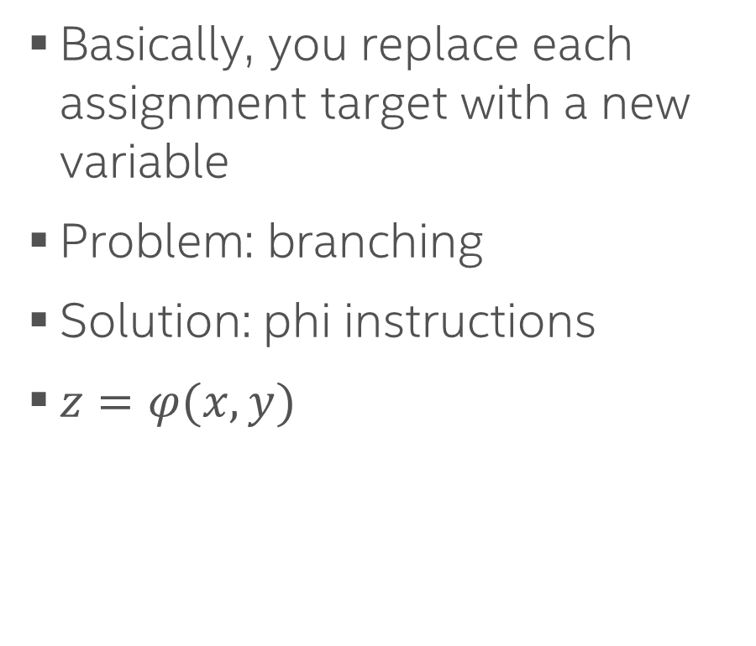
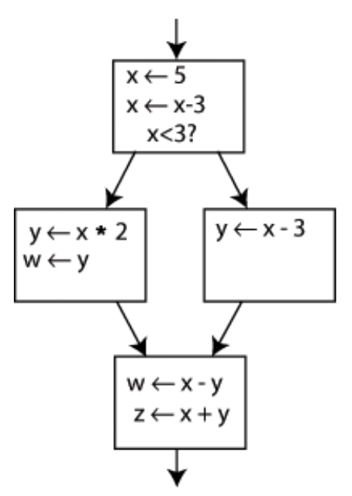
Converting to SSA

Slide 12
Computing minimal SSA
Dominance frontier: a node B is in the dominance frontier of a node A if A does not strictly dominate B, but does dominate some immediate predecessor of B, or if node A is an immediate predecessor of B.
If the node A defines a certain variable, then that definition will reach every node A dominates. When we leave those nodes and enter a dominance frontier, we must account for other flows.

Slide 13
Def-use analysis
Def-use analysis is a technique used in compilers to determine the points in the program where variables are defined (def) and used (use).
Definition (Def): A point in the program where a variable is assigned a value.
Use (Use): A point in the program where the value of a variable is read.
This analysis helps in:
Identifying dead code (code that is defined but never used).
Optimizing away redundant computations.
Facilitating more complex analyses like reaching definitions, live variable analysis, and more.

Slide 14
Intermediate representations (IRs)
LLVM
MLIR
LLVM IR
(g)MIR
GCC
GENERIC
GIMPLE
RTL

Slide 15
Intermediate representations of LLVM infrastructure
MLIR
LLVM IR
(g)MIR
Other IRs will be covered later as a part of this course as well

Slide 16
LLVM IR
SSA, infinite registers
Functions
Metadata
Textual and binary representation
Full reference: https://llvm.org/docs/LangRef.html

Slide 17
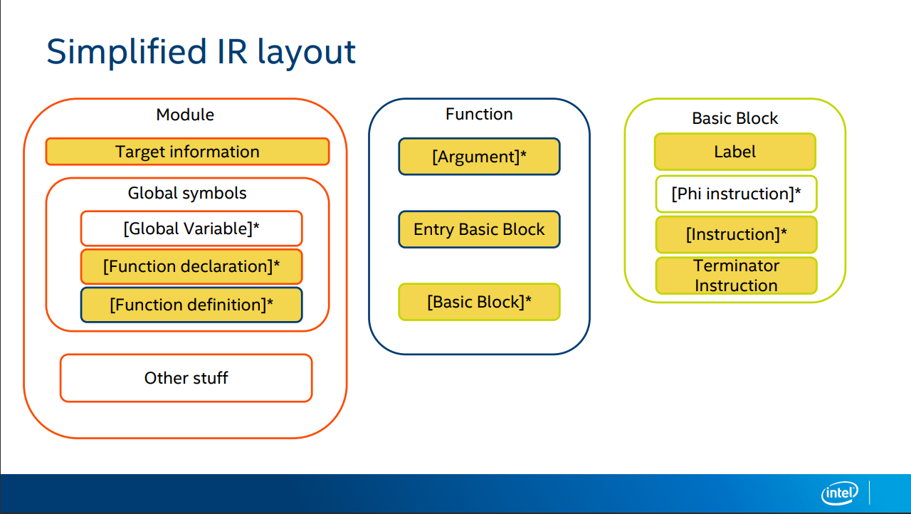
https://llvm.org/devmtg/2019-04/slides/Tutorial-Bridgers-LLVM_IR_tutorial.pdf

Slide 18
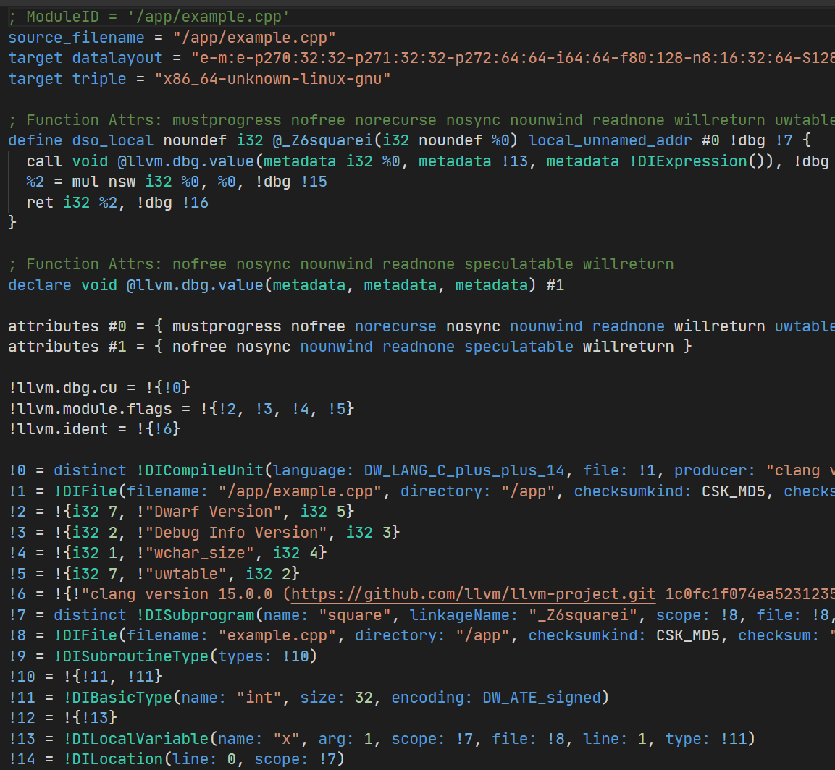
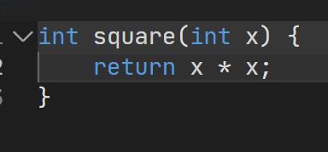

LLVM IR Example
https://godbolt.org/z/sqo4aG7Gd

Slide 19

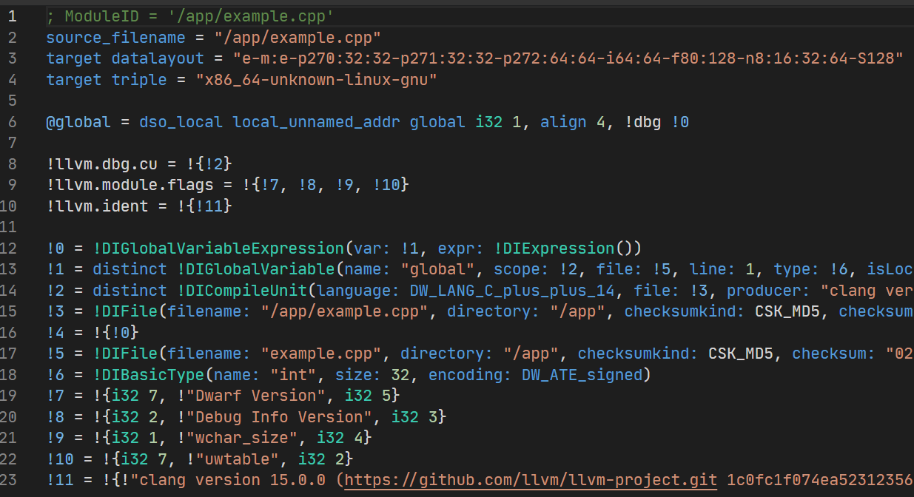
Global variables
https://godbolt.org/z/4hebzfe6s

Slide 20
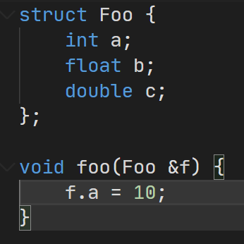
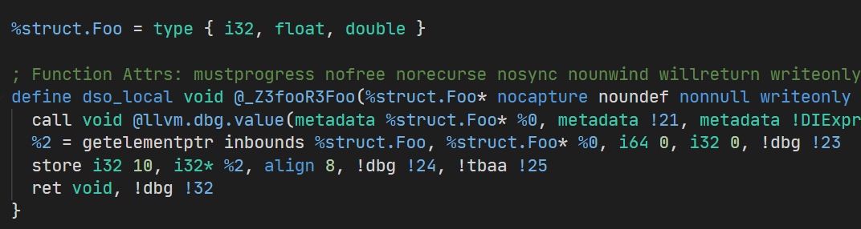
Structures
https://godbolt.org/z/898E47xGf

Slide 21
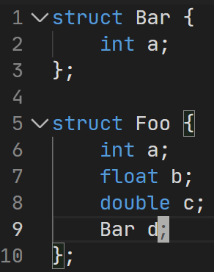
Nested structures
https://godbolt.org/z/jxcvxM57f

Slide 22
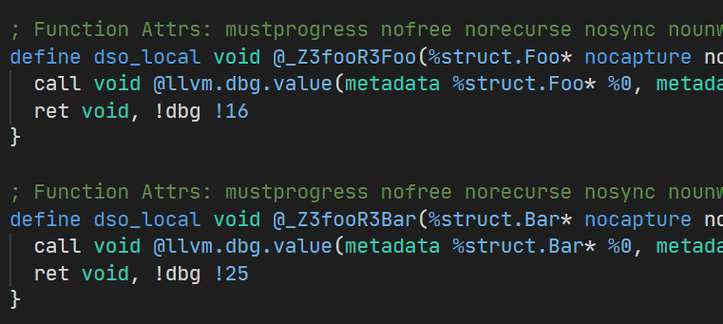
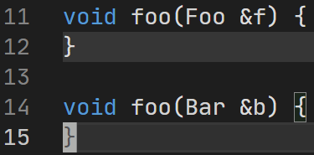
Functions
https://godbolt.org/z/jxcvxM57f

Slide 23
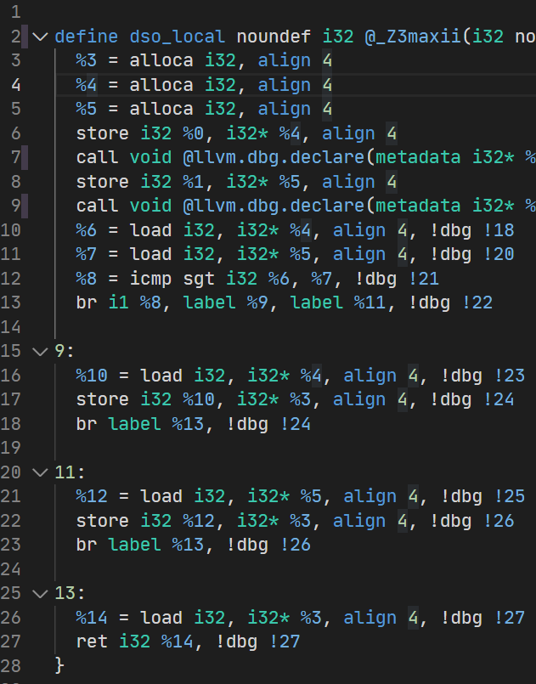
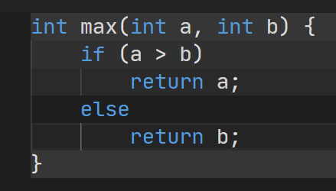
Branches
https://godbolt.org/z/GbqhabvM8

Slide 24
Basic blocks
A basic block is a sequence of consecutive statements in a program.
Execution in a basic block flows linearly (no jumps, branches, or labels except at the start and the end).
Basic block has a single entry and a single exit.

Slide 25
Basic blocks
Basic blocks
Terminators

Slide 26
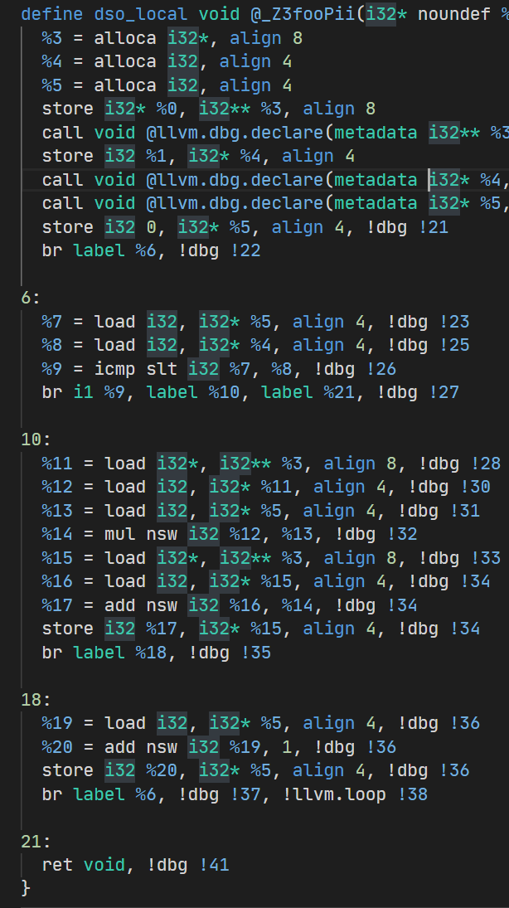
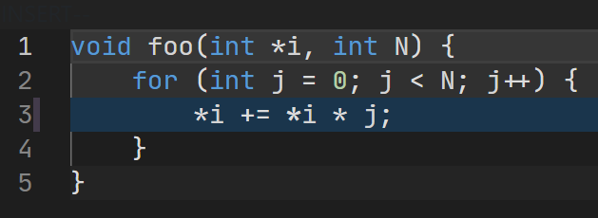
Loops

Slide 27
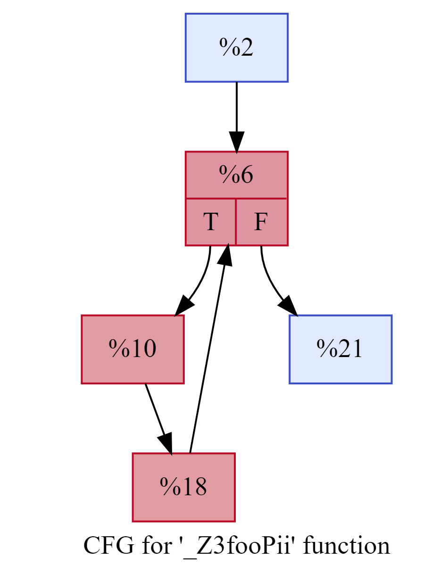
Loops. Control flow graph

Slide 28
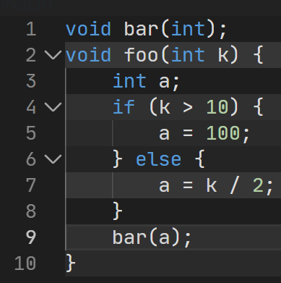
Single assignment
https://godbolt.org/z/x6bf1fxxv

Slide 29
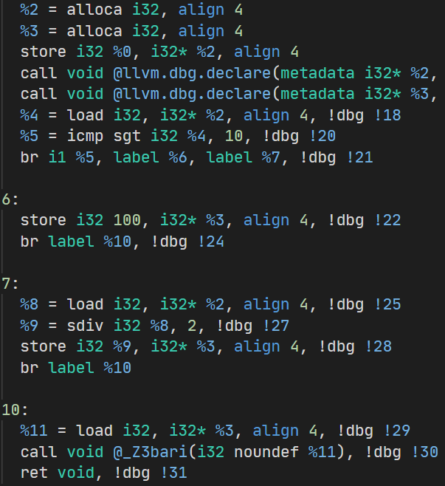
Memory SSA
https://godbolt.org/z/x6bf1fxxv

Slide 30
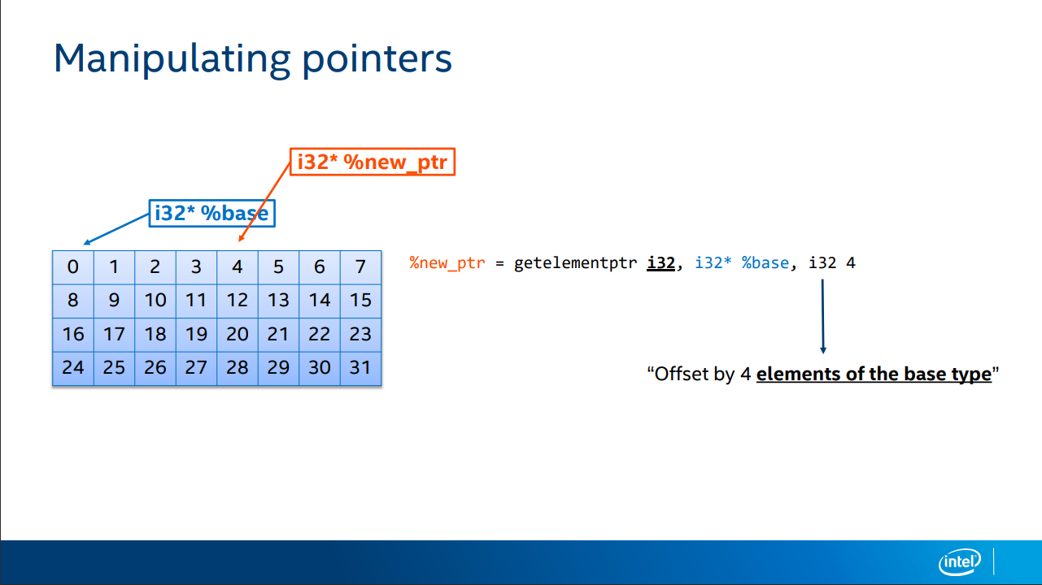
aka GEP

Slide 31
LLVM IR bitcode
Binary Representation of LLVM IR
Use Cases:
distribution (for usage or inspection by other LLVM based tools).
intermediate step in a build process that involves further optimization or cross-compilation.
Just-In-Time (JIT) compilation scenarios.

Slide 32
LLVM IR bitcode: tooling
Emit bitcode:
clang -emit-llvm -c source.c -o source.bc
Converting LLVM IR Bitcode to Human-Readable Format
llvm-dis source.bc -o source.ll
Converting Human-Readable LLVM IR to Bitcode
llvm-as source.ll -o source.bc
Linking Multiple LLVM Bitcode Files
llvm-link file1.bc file2.bc -o combined.bc
Execute LLVM IR bitcode
lli source.bc

Slide 33
Inspecting LLVM IR
Inspecting LLVM IR bitcode from clang
clang++ -emit-llvm -o file.bc file.cpp
Inspecting LLVM IR from clang
clang++ -emit-llvm -o file.ll file.cpp -S
Displaying CFG
opt -analyze -dot-cfg-only

Slide 34
Processing LLVM IR
Run optimizations
opt -O2 source.bc -o optimized.bc
opt -passes=’<pass-pipeline>’ source.bc -o optimized.bc
Compile down to assembler
llc -filetype=obj source.bc -o source.s -S
Compile down to binary (object file)
llc -filetype=obj source.bc -o source.o
Note: both .bc (binary) and .ll (text) are accepted here

Slide 35
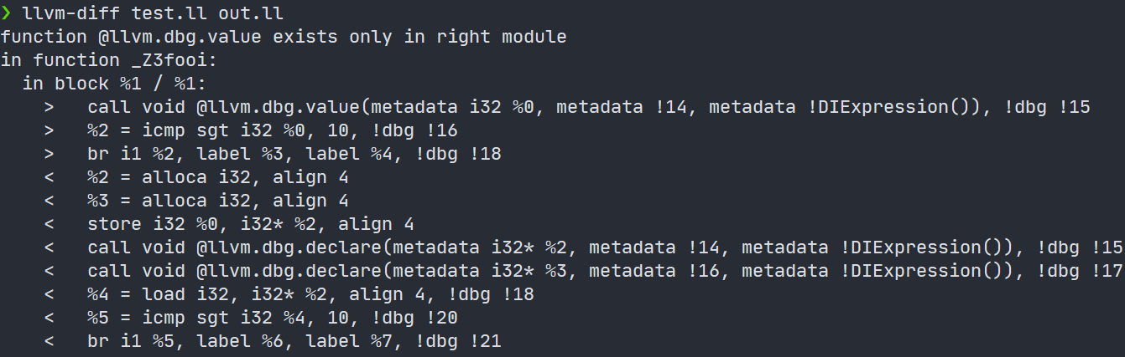
Comparing LLVM modules

Slide 36
Debugging LLVM IR
bugpoint
https://www.llvm.org/docs/CommandGuide/bugpoint.html
llvm-reduce
https://llvm.org/docs/CommandGuide/llvm-reduce.html
https://www.youtube.com/watch?v=n1jDj7J9N8c

Slide 37
Next time…
LLVM Passes
IR Optimizations

Slide 38


Test
https://forms.gle/JbjBRMFNXym6tBQG6
Backup: me@gooddoog.ru

Slide 39

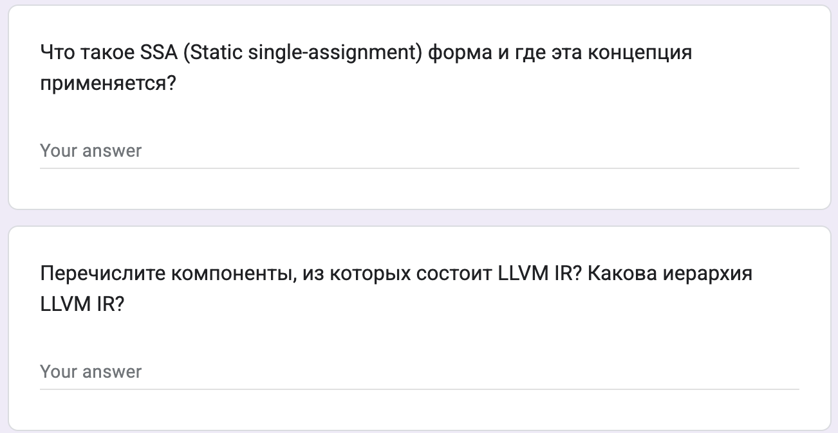
Test
https://forms.gle/KNKvREkPhq3QNHj18
Backup: me@gooddoog.ru

Slide 40
Extra materials
Mapping high-level constructs to LLVM IR - https://github.com/f0rki/mapping-high-level-constructs-to-llvm-ir
The often misunderstood GEP (GetElementPtr) instruction - https://www.llvm.org/docs/GetElementPtr.html
LLVM IR Tutorial - Phis, GEPs and other things, oh my! - Vince Bridgers (Intel Corporation), Felipe de Azevedo Piovezan (Intel Corporation) - https://www.youtube.com/watch?v=m8G_S5LwlTo

