Slide 1
Compilers 101
Optimizations – Part 2

Slide 2
Previously…
Preprocessing
Lexical analysis
Frontend
Syntax analysis
Semantic analysis
IR Generation
IR Optimization
Middle-end
Optimization
Backend
Code generation

Slide 3
Previously… (2)
LLVM IR
LLVM IR passes
LLVM IR optimizations

Slide 4
Today
opt tool showcase
Loop optimizations

Slide 5
Running optimizations
Generate LLVM IR
Use opt tool
Guide: https://llvm.org/docs/CommandGuide/opt.html

Slide 6
opt tool
LLVM optimizer
Input: LLVM IR
Output: LLVM IR
Passes list: https://llvm.org/docs/Passes.html
Options: https://llvm.org/docs/CommandGuide/opt.html
Command line examples:
opt -print-passes
opt -O2 input.ll -o optimized.bc
opt -passes=’dce’ input.bc
opt -dce input.bc
opt -load MyPass.so -my-custom-pass input.ll -o output.ll

Slide 7

Compiler Explorer
Is an interactive compiler exploration website. Edit code in C, C++, C#, F#, Rust, Go, D, Haskell, Swift, Pascal, ispc, Python, Java, or any of the other 30+ supported languages components, and see how that code looks after being compiled in real time.
Official website: https://godbolt.org/
GitHub repository: https://github.com/compiler-explorer/compiler-explorer

Slide 8
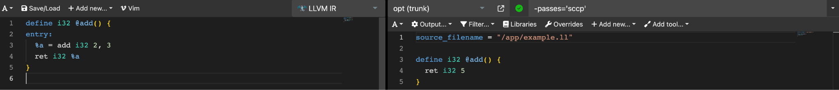

Running LLVM IR optimizations
Learn by example (1):
SCCP:
https://godbolt.org/z/vYzMohM3e

Slide 9
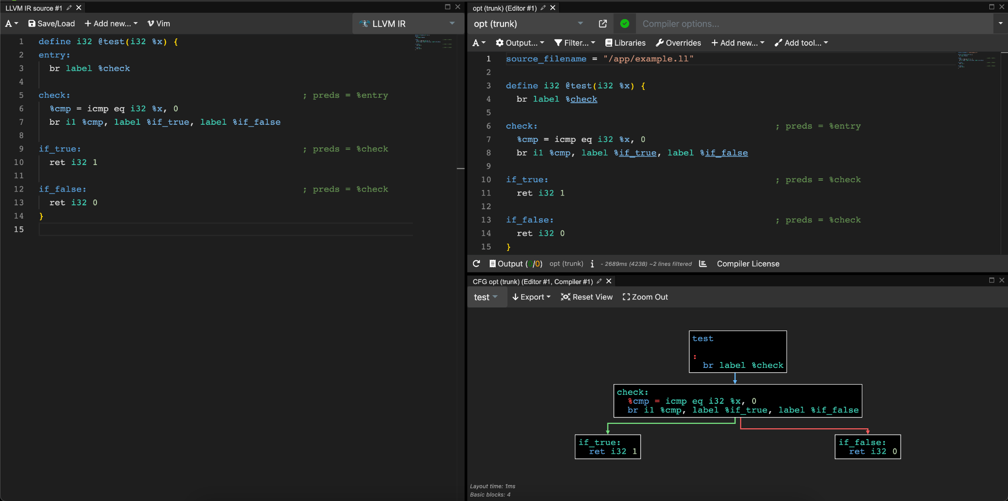
CFG visualization
opt -dot-cfg cfg_example.ll
dot -Tpng cfg_example.dot
https://godbolt.org/z/T6bWarjjK

Slide 10
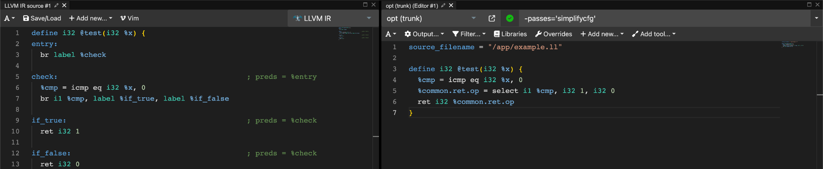
Running LLVM IR optimizations
Learn by example (2):
CFG simplification:
https://godbolt.org/z/hK4ndPbcq

Slide 11
Loop optimizations
Why are they important?
Pareto principle
20 percent of effort gives 80 percent of result
Most computationally intensive algorithms involve loops

Slide 12
Structured control flow
Structured control flow is a programming paradigm characterized by the clear, hierarchical organization of control paths through a program.
It relies exclusively on structured control constructs such as conditionals (if, else), loops (for, while), and function calls, which lead to well-defined entry and exit points.
The key attribute of structured CF is that it avoids the use of arbitrary jumps or goto statements, making the control flow predictable and easier to follow.

Slide 13
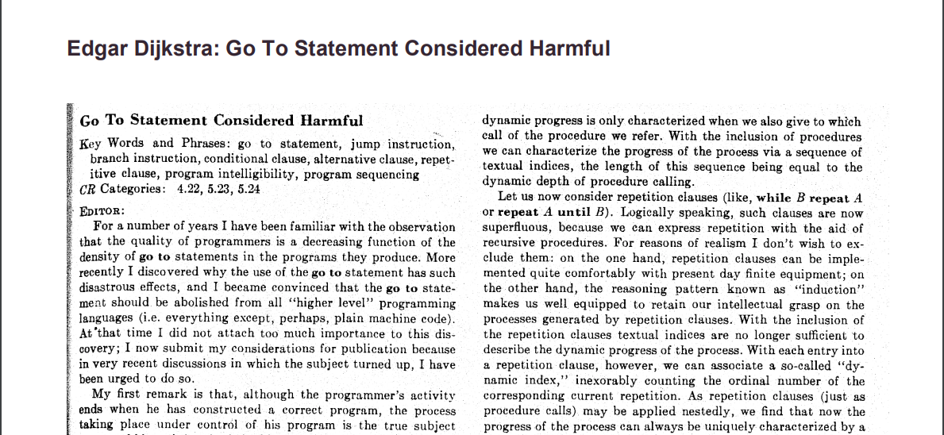
Structured control flow
https://dl.acm.org/doi/pdf/10.1145/362929.362947

Slide 14
Loop terminology
Trip count is a minimum number of times a loop executes
Induction variable is a variable that gets increased or decreased on each loop iteration
Loop invariant is the part of a computation inside a loop that remains unchanged (invariant) in each iteration

Slide 15
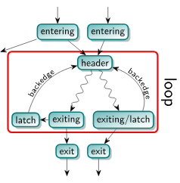
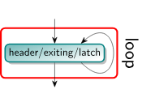
Loop terminology
An entering block (or loop predecessor) is a non-loop node that has an edge into the loop (necessarily the header). If there is only one entering block, and its only edge is to the header, it is also called the loop’s preheader. The preheader dominates the loop without itself being part of the loop.
A latch is a loop node that has an edge to the header.
A backedge is an edge from a latch to the header.
An exiting edge is an edge from inside the loop to a node outside of the loop. The source of such an edge is called an exiting block, its target is an exit block.
https://llvm.org/docs/LoopTerminology.html

Slide 16
Loop example
define dso_local void @foo(int*, int)(ptr noundef %a, i32 noundef %N) #0 {
entry:
%a.addr = alloca ptr, align 8
%N.addr = alloca i32, align 4
%i = alloca i32, align 4
store ptr %a, ptr %a.addr, align 8
store i32 %N, ptr %N.addr, align 4
store i32 0, ptr %i, align 4
br label %for.cond
for.cond:
%0 = load i32, ptr %i, align 4
%1 = load i32, ptr %N.addr, align 4
%cmp = icmp slt i32 %0, %1
br i1 %cmp, label %for.body, label %for.end
for.body:
%2 = load ptr, ptr %a.addr, align 8
%3 = load i32, ptr %i, align 4
%idxprom = sext i32 %3 to i64
%arrayidx = getelementptr inbounds i32, ptr %2, i64 %idxprom
%4 = load i32, ptr %arrayidx, align 4
%add = add nsw i32 %4, 1
store i32 %add, ptr %arrayidx, align 4
br label %for.inc
for.inc:
%5 = load i32, ptr %i, align 4
%inc = add nsw i32 %5, 1
store i32 %inc, ptr %i, align 4
br label %for.cond
for.end:
ret void
}
entering
or
preheader
clang++ -emit-llvm -fno-discard-value-names -g0
header
and
exiting
void foo(int *a, int N) {
for (int i = 0; i < N; ++i) {
a[i] += 1;
}
}
body
latch
exit
https://godbolt.org/z/KE4GKsfKT

Slide 17
Loop analysis
LoopInfo (LI) is the core analysis for obtaining information about loops. There are few key implications of the definitions given above which are important for working successfully with this interface.
Iterate through loop forest:
Note: LoopInfo provides an interface for enumerating all top level loops (e.g. those not contained in any other loop). From there, you may walk the tree of sub-loops rooted in that top level loop.
for (Loop *L : LI) {
// top-level loops only
}
Get info which loop is the current BB in:
if (Loop *L = LI.getLoopFor(BB)) {
// BB is inside loop L
}

Slide 18
Loop analysis example
define dso_local void @foo(int*, int)(ptr noundef %a, i32 noundef %N) #0 {
entry:
%a.addr = alloca ptr, align 8
%N.addr = alloca i32, align 4
%i = alloca i32, align 4
store ptr %a, ptr %a.addr, align 8
store i32 %N, ptr %N.addr, align 4
store i32 0, ptr %i, align 4
br label %for.cond
for.cond:
%0 = load i32, ptr %i, align 4
%1 = load i32, ptr %N.addr, align 4
%cmp = icmp slt i32 %0, %1
br i1 %cmp, label %for.body, label %for.end
for.body:
%2 = load ptr, ptr %a.addr, align 8
%3 = load i32, ptr %i, align 4
%idxprom = sext i32 %3 to i64
%arrayidx = getelementptr inbounds i32, ptr %2, i64 %idxprom
%4 = load i32, ptr %arrayidx, align 4
%add = add nsw i32 %4, 1
store i32 %add, ptr %arrayidx, align 4
br label %for.inc
for.inc:
%5 = load i32, ptr %i, align 4
%inc = add nsw i32 %5, 1
store i32 %inc, ptr %i, align 4
br label %for.cond
for.end:
ret void
}
opt -passes='print<loops>'
Loop info for function 'foo':
Loop at depth 1 containing: %for.cond<header><exiting>,%for.body,%for.inc<latch>
https://godbolt.org/z/ofGWxx4c4

Slide 19
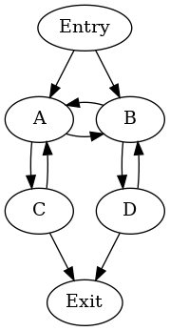
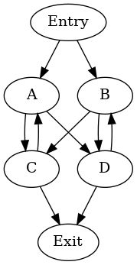
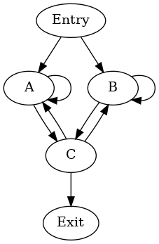
Cycles are not loops
In computer science literature, this is often called a natural loop. In LLVM, a more generalized definition is called a cycle.
Cycle is more generalized term:
Loop (natural loop)
https://llvm.org/docs/CycleTerminology.html

Slide 20
Loops simplification
This pass performs several transformations to transform natural loops into a simpler form, which makes subsequent analyses and transformations simpler and more effective.
When it is successful, the loop has:
A preheader
A single backedge (which implies that there is a single latch)
Dedicated exits. That is, no exit block for the loop has a predecessor that is outside the loop. This implies that all exit blocks are dominated by the loop header

Slide 21
Detecting induction variables
i is a basic induction variable in a loop L if the only definitions of i within L are of the form i := i +/- c where c is loop invariant
k is a derived induction variable in loop L if
There’s only 1 definition of k within L in the form of k := j */+ c where j is an induction variable
If j is an induction variable in the family of i then
The only definition of j that reaches k is the one in the loop
There’s no definition of i on any path between the definition of j and the definition of k

Slide 22
Structured control flow
Is this program structured?
void foo(char *a, int N) {
for (int i = 0; i < N; i++) {
if (a[i] == 42)
break;
}
}

Slide 23
Loop-invariant code motion
void baz();
void bar(int i);
void foo(char *a, int N) {
for (int i = 0; i < N; i++) {
bar(i);
baz();
a[0] = 42;
}
}
void baz();
void bar(int i);
void foo(char *a, int N) {
a[0] = 42;
for (int i = 0; i < N; i++) {
bar(i);
baz();
}
}

Slide 24
Conditions for safe hoisting
hoisting - moving to outer scope
sinking - moving to inner scope
An invariant assignment d: x := y op z is safe to hoist if
d dominates all loop exits at which x is live and
there is only one definition of x in the loop, and
x is not live at the entry point for the loop

Slide 25
Loop unroll
void bar(int i);
void foo(char *a, int N) {
for (int i = 0; i < N / 4; i += 4) {
bar(i + 0);
bar(i + 1);
bar(i + 2);
bar(i + 3);
}
for (int i = N - N % 2; i < N; i++) {
bar(i);
}
}
void bar(int i);
void foo(char *a, int N) {
for (int i = 0; i < N; i++) {
bar(i);
}
}

Slide 26
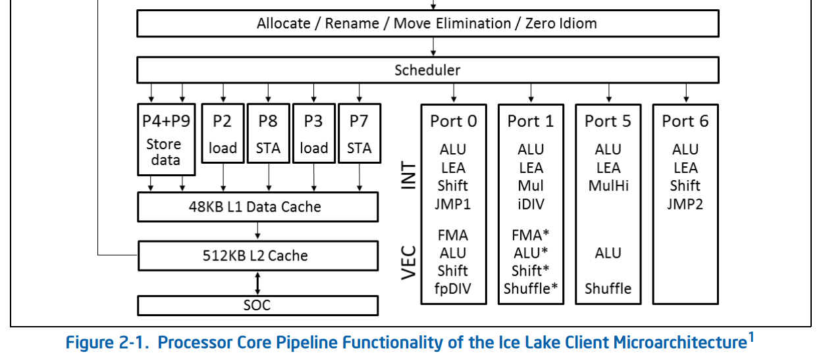
When it works and when it fails?
https://www.intel.com/content/www/us/en/developer/articles/technical/intel-sdm.html

Slide 27
Loop fusion
void bar(int i);
void foo(char *a, int N) {
for (int i = 0; i < N; i++) {
a[i] = 42;
}
for (int i = N; i > 0; i--) {
bar(i);
}
}
void bar(int i);
void foo(char *a, int N) {
for (int i = 0; i < N; i++) {
a[i] = 42;
bar(N - i);
}
}

Slide 28
Loop peeling
void foo(int *a, int *b, int N) {
int p = 10;
for (int i = 0; i < N; i++) {
a[i] = b[i] + b[p];
p = i;
}
}
void foo(int *a, int *b, int N) {
a[0] = b[0] + b[10];
for (int i = 1; i < N; i++) {
a[i] = b[i] + b[i - 1];
}
}

Slide 29
Loop unswitch
void foo(int *a, int *b, bool c, int N) {
if (c) {
for (int i = 0; i < N; i++) {
a[i] = i;
b[i] = 42;
}
} else {
for (int i = 0; i < N; i++) {
a[i] = i;
}
}
}
void foo(int *a, int *b, bool c, int N) {
for (int i = 0; i < N; i++) {
a[i] = i;
if (c) {
b[i] = 42;
}
}
}

Slide 30
Control flow sink
void bazz();
void bazz(int i);
void bar(int i);
void foo(char *a, int N) {
a[0] = 42;
for (int i = 0; i < N; i++) {
bar(i);
bazz();
bazz(a[0]);
}
}
void bazz();
void bazz(int i);
void bar(int i);
void foo(char *a, int N) {
for (int i = 0; i < N; i++) {
bar(i);
bazz();
a[0] = 42;
bazz(a[0]);
}
}

Slide 31
Loop reroll
void bar(int i);
void foo(char *a, int N) {
for (int i = 0; i < N / 4; i += 4) {
bar(i + 0);
bar(i + 1);
bar(i + 2);
bar(i + 3);
}
for (int i = N - N % 2; i < N; i++) {
bar(i);
}
}
void bar(int i);
void foo(char *a, int N) {
for (int i = 0; i < N; i++) {
bar(i);
}
}

Slide 32
Loop fission
void bar(int i);
void foo(char *a, int N) {
for (int i = 0; i < N; i++) {
a[i] = 42;
}
for (int i = N; i > 0; i--) {
bar(i);
}
}
void bar(int i);
void foo(char *a, int N) {
for (int i = 0; i < N; i++) {
a[i] = 42;
bar(N - i);
}
}

Slide 33
Loop tiling
void foo(int N) {
for (int i = 0; i < N; i++) {
// ...
}
}
#include <algorithm>
void foo(int N) {
int B = 10;
for (int i = 0; i < N; i += B) {
for (int j = i; i < std::min(N, j + B); j++) {
// ...
}
}
}

Slide 34
Loop rotation
void foo(int *a, int *b, int n) {
int i = 0;
if (n > 0) {
do {
a[i] = a[i] + b[i];
i++;
} while (i < n);
}
}
void foo(int *a, int *b, int n) {
for (int i = 0; i < n; i++)
a[i] = a[i] + b[i];
}

Slide 35
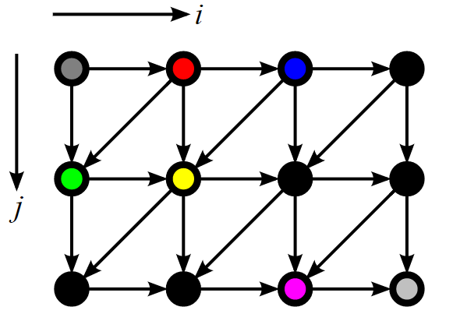
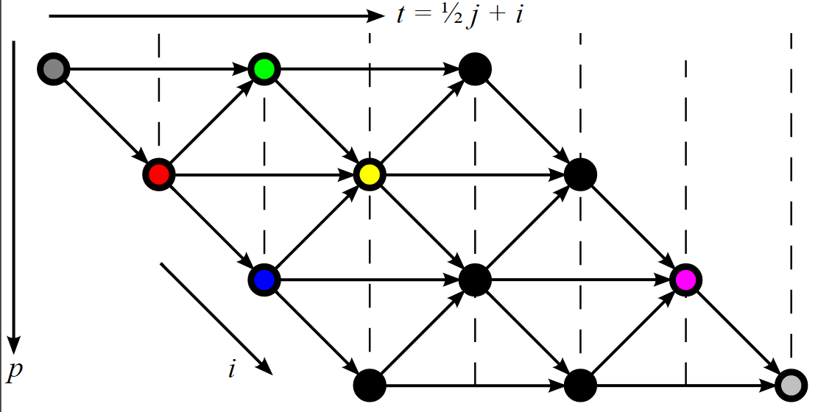
Polytope model
https://en.wikipedia.org/wiki/Polytope_model

Slide 36
Affine transformations
#define ERR(x, y) (dst[x][y] - src[x][y])
void dither_skewed(unsigned char **src, unsigned char **dst, int w, int h) {
int t, p;
for (t = 0; t < (w + (2 * h)); ++t) {
int pmin = max(t % 2, t - (2 * h) + 2);
int pmax = min(t, w - 1);
for (p = pmin; p <= pmax; p += 2) {
int i = p;
int j = (t - p) / 2;
int v = src[i][j];
if (i > 0)
v -= ERR(i - 1, j) / 2;
if (j > 0)
v -= ERR(i, j - 1) / 4;
if (j > 0 && i < w - 1)
v -= ERR(i + 1, j - 1) / 4;
dst[i][j] = (v < 128) ? 0 : 255;
src[i][j] = (v < 0) ? 0 : (v < 255) ? v : 255;
}
}
}
#define ERR(x, y) (dst[x][y] - src[x][y])
void dither(unsigned char** src, unsigned char** dst, int w, int h) {
int i, j;
for (j = 0; j < h; ++j) {
for (i = 0; i < w; ++i) {
int v = src[i][j];
if (i > 0)
v -= ERR(i - 1, j) / 2;
if (j > 0) {
v -= ERR(i, j - 1) / 4;
if (i < w - 1)
v -= ERR(i + 1, j - 1) / 4;
}
dst[i][j] = (v < 128) ? 0 : 255;
src[i][j] = (v < 0) ? 0 : (v < 255) ? v : 255;
}
}
}

Slide 37
Polyhedral transformations in LLVM
Polly is a high-performance loop and data-locality optimizer embedded framework within the LLVM. It utilizes mathematical models to analyze and optimize memory access patterns, significantly enhancing code efficiency, particularly in loops and matrix multiplications
Docs & info: https://polly.llvm.org/

Slide 38
Next time…
Vectorization

Slide 39
Lab assignment #2
Write a plugin with simple LLVM pass
Task list in Google Docs
Deadline: April, 7
Where to seek help
https://www.llvm.org/docs/WritingAnLLVMNewPMPass.html
https://github.com/llvm/llvm-project/tree/main/llvm/examples/IRTransforms
contact teachers

Slide 40

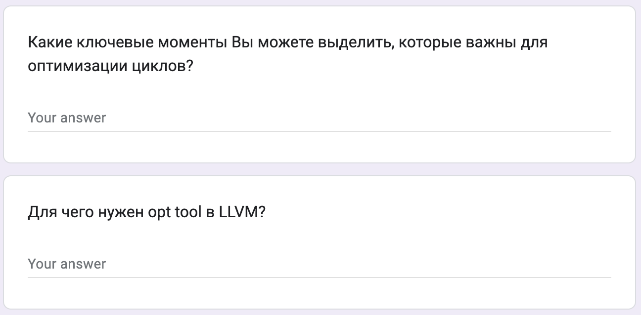
Test
https://forms.gle/A3XfkLu2PnZbRodT7
Submission time: 10 minutes
Backup: me@gooddoog.ru

Slide 41

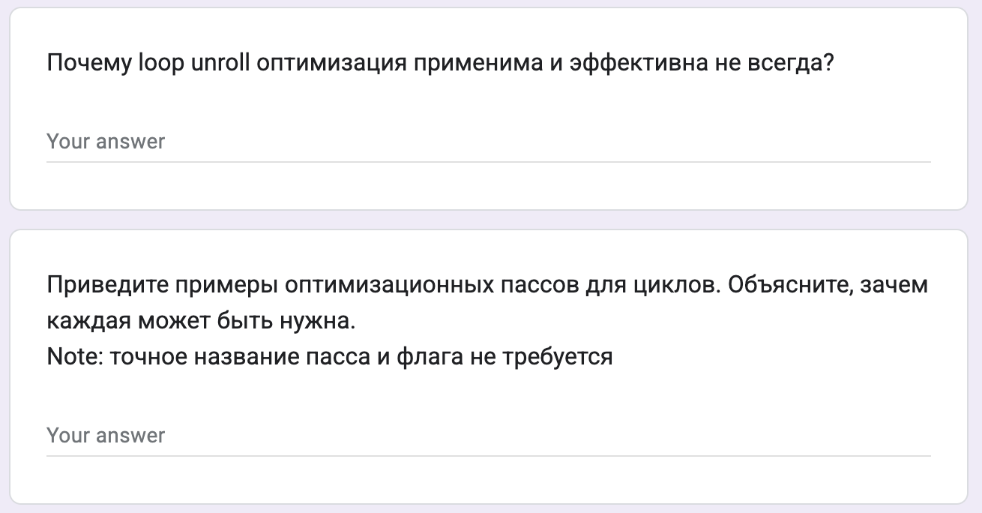
Test
https://forms.gle/ywfMNSijV2XqDiVF8
Submission time: 10 minutes
Backup: me@gooddoog.ru

Slide 42
Extra materials
Loop Optimizations in LLVM: The Good, The Bad, and The Ugly - https://llvm.org/devmtg/2018-10/slides/Kruse-LoopTransforms.pdf
EuroLLVM Developers' Meeting: J. Doerfert & T. Grosser "Analyzing and Optimizing ... Polly“ - https://www.youtube.com/watch?v=mXve_W4XU2g
LLVM Developers’ Meeting: T. Grosser “Polly - Polyhedral optimizations in LLVM” - https://www.youtube.com/watch?v=WwfZkQEuwEE

