Slide 1
Compilers 101
Outro

Slide 2
Content
LLVM vs GCC
AOT vs JIT
Compilers integration into ML workflows
Python compilation process

Slide 3


LLVM is not the only compiler infrastructure
Throughout this course, we were talking about LLVM compiler infrastructure
But this is not the one and only compiler infrastructure (if we focus on C/C++ only):
https://github.com/llvm/llvm-project
https://github.com/gcc-mirror/gcc
Some smaller alternatives (not ready for the production usage):
https://bellard.org/tcc/
https://github.com/dstogov/rcc
https://github.com/rui314/chibicc

Slide 4
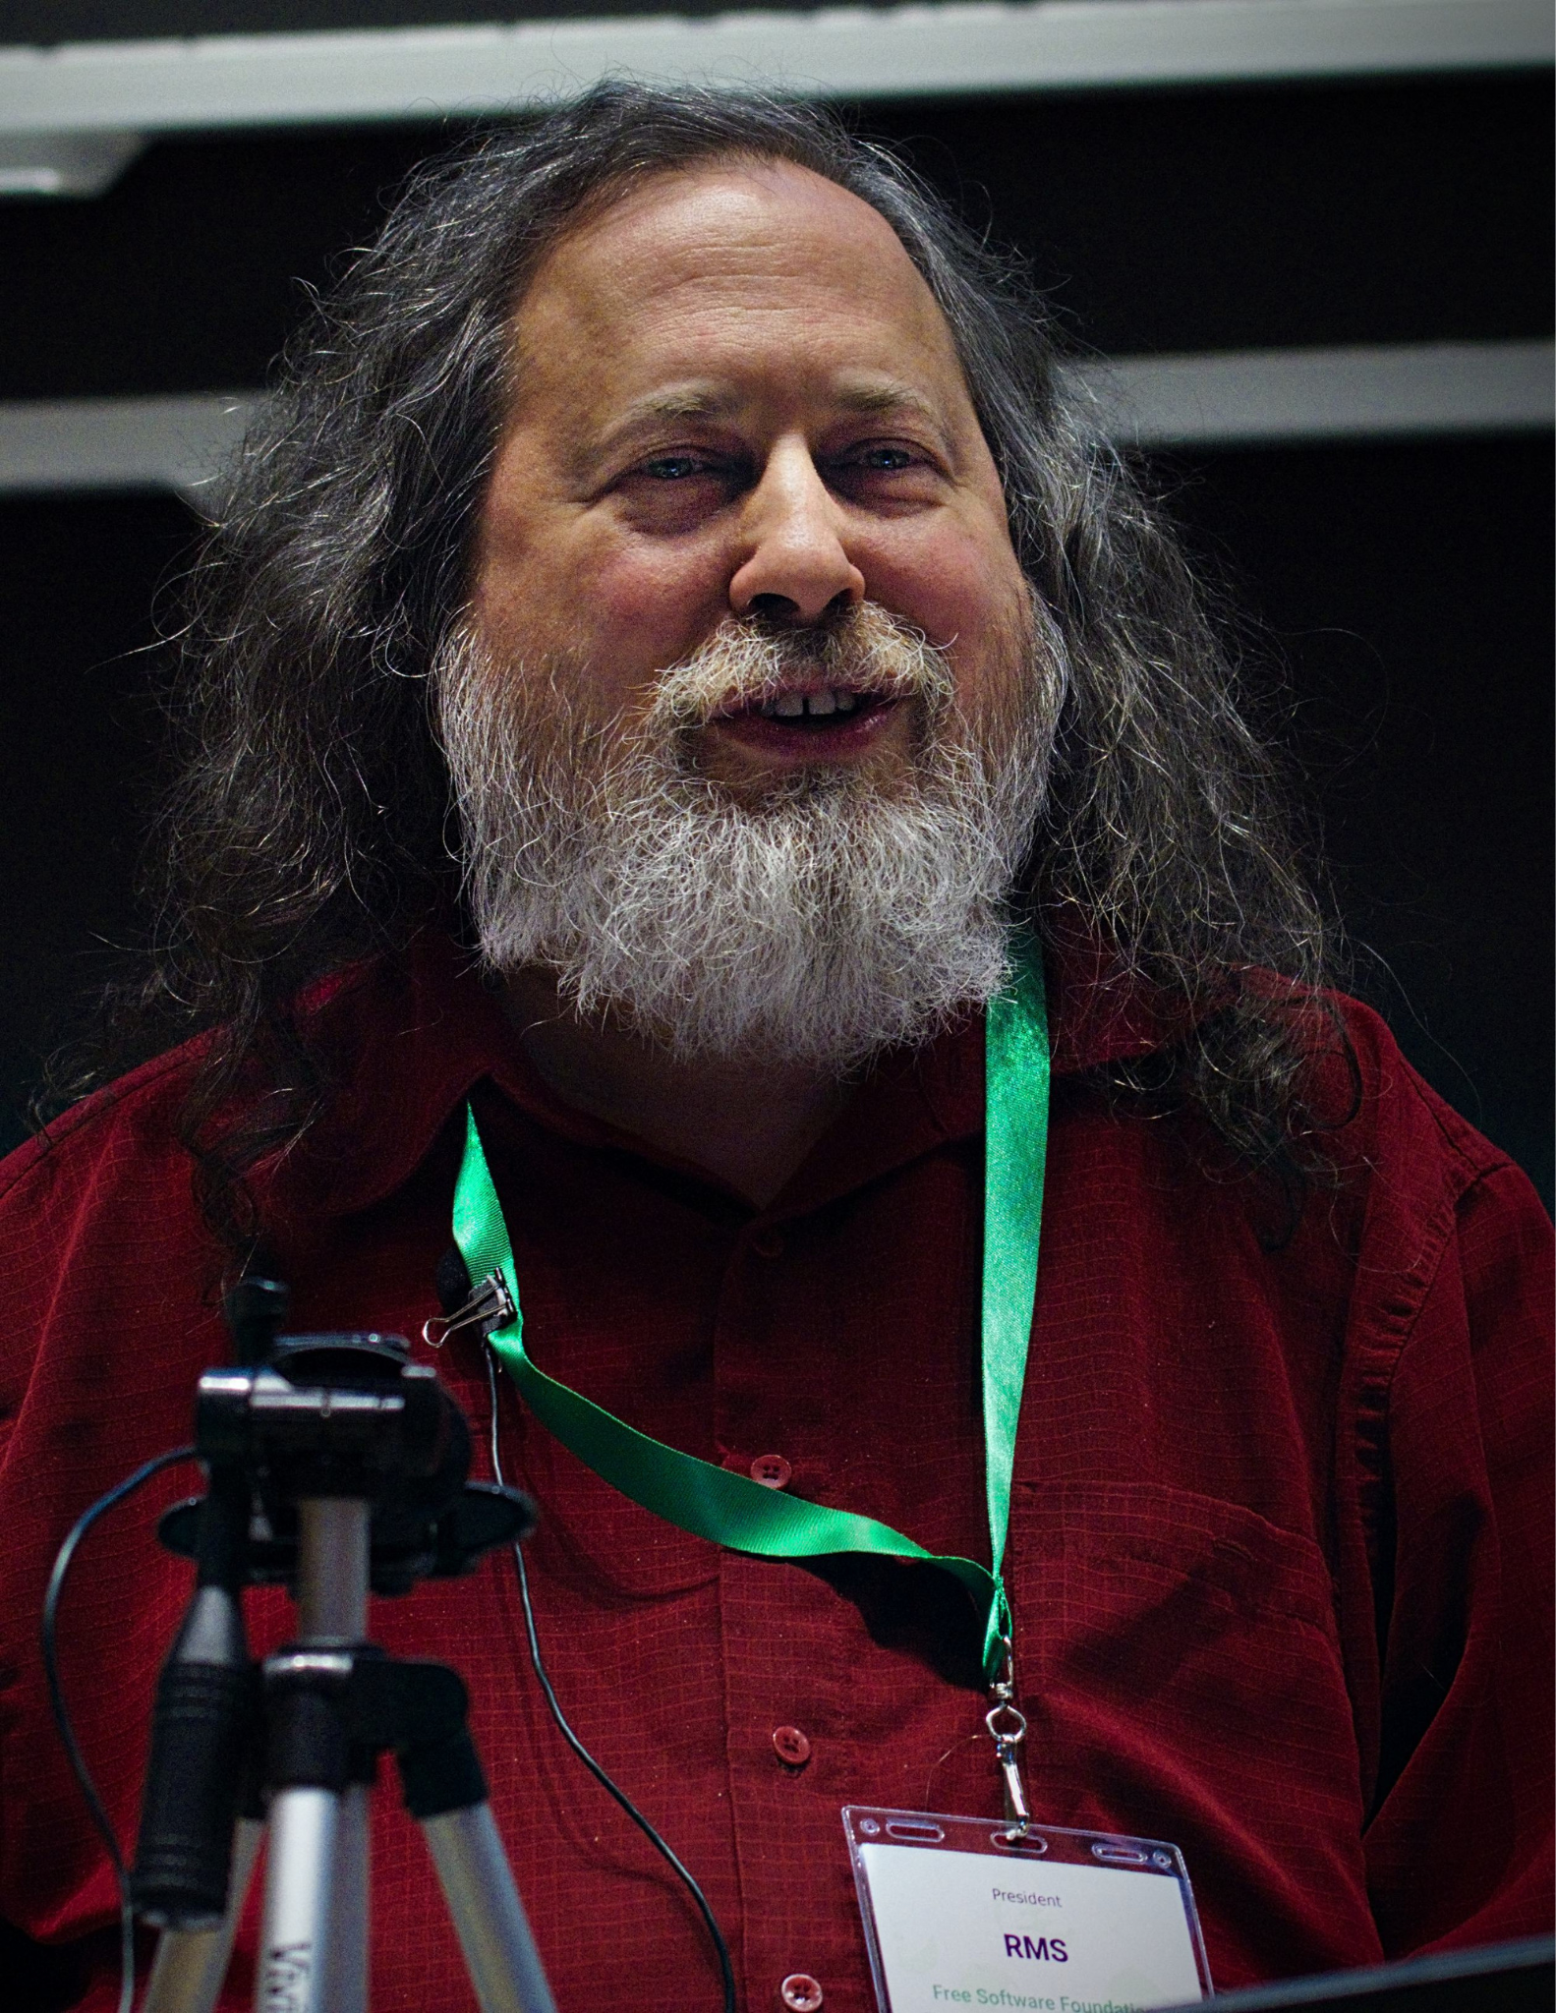
GNU Compiler Collection
GCC (GNU C Compiler) was started by Richard Stallman in 1985, with its first public beta released on March 22, 1987
In early 1990s GCC expanded beyond C, adding support for languages such as C++ and Fortran
Today GCC means GNU Compiler Collection and it provides shared optimization and code-generation infrastructure for many languages and processor architectures
Richard Matthew Stallman
GNU is an extensive collection of free software
GNU - GNU is not Unix
https://www.stallman.org/

Slide 5
LLVM vs GCC
 | LLVM | GCC
License | Apache 2.0 with LLVM Exceptions | GPLv3 with GCC Runtime Library Exception
Positioning | Modular, reusable compiler infrastructure | Traditional compiler
Languages
built-in (in-tree): | Clang: C, C++, Objective-C/++, OpenCL, C++ for OpenCL, CUDA and HIP, HLSL Flang: Fortran | C, C++, Fortran, Ada, Go, D
3rdparty (out-of-tree): | Many separate compilers use LLVM as a backend, including Rust, Julia, Swift, Haskell, Kotlin Native, Zig, D, … | Pascal (GPC), VHDL, …

Slide 6
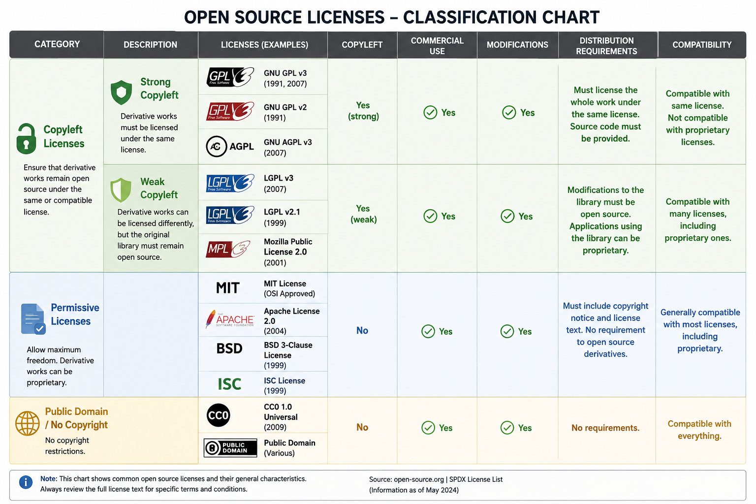
https://opensource.org/licenses

Slide 7

GNU GPL License
Strong copyleft open-source license
Allows commercial use, modification and redistribution
Distributed modified versions must remain under the GPL
Corresponding source code must be made available when binaries are distributed
Includes copyright notices and warranty disclaimers
Commonly used versions: GPLv2 and GPLv3
Copyleft is a licensing principle that allows software to be used, modified, and redistributed, but requires derivative works to remain under the same or a compatible open-source license

Slide 8
Content
LLVM vs GCC
AOT vs JIT
Compilers integration into ML workflows
Python compilation process

Slide 9
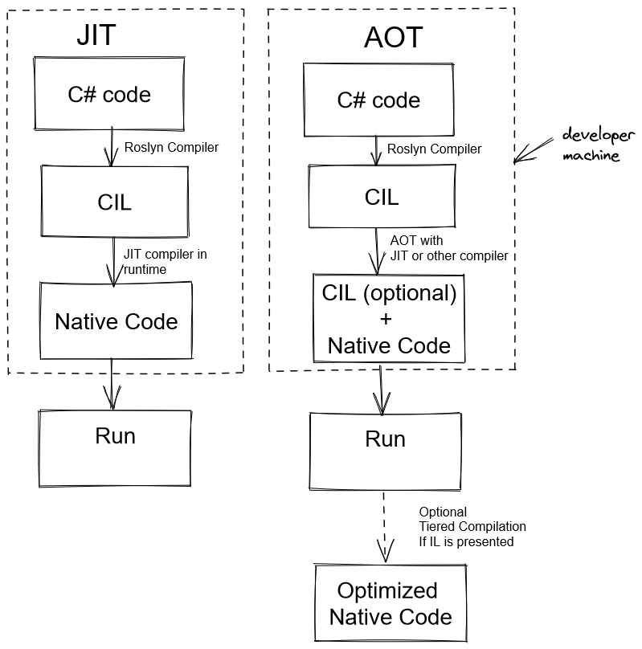
Compilation types: AOT vs JIT
A compiler translates a program from one representation to another.
But when the transformation happens?
Before execution (ahead-of-time, AOT)
  The program is compiled into machine code in advance
During execution (just-in-time, JIT)
  The program is compiled while it is running
https://flerka.github.io/personal-blog/2022-06-21-ahead-of-time-compilation/

Slide 10
AOT (ahead-of-time) compilation
Idea: compile the program before it is executed
Examples: statically compiled native languages (C/C++, Rust, Go, …)
Fast startup: code is already compiled
Easier deployment as a native binary
Predictable performance
Many optimizations can be done before execution
No compiler has to run during program execution
Less information about actual runtime behavior
Binary is usually platform-specific
Harder to optimize for real input data and real execution paths
Compilation may take a long time
Typical use cases:
Operating systems
Embedded systems
Performance-critical native applications

Slide 11
JIT (just-in-time) compilation
Idea: compile code while the program is running
Examples: dynamically compiled languages and their runtimes (Java JVM, .NET CLR, JavaScript engines such as V8, PyPy)
Can use runtime information for optimization
Can optimize hot paths: the parts of code executed most often
Can specialize code for actual types, values, CPU features, and branches
Portable bytecode can run on many platforms
Slower startup due to interpretation and compilation overhead
More complex runtime system
Uses extra memory for profiling data and generated machine code
Performance can change during execution due to recompilation and lack of optimizations
Typical use cases:
Web browsers
Virtual machines
Managed languages
Dynamic languages

Slide 12
AOT vs JIT
Feature | AOT | JIT
Compilation time | Before execution | During execution
Startup time | Usually faster | Usually slower
Runtime optimization | Limited | Strong
Runtime profiling | Usually unavailable | Available
Portability | Binary is platform-specific | Bytecode/IR can be portable
Runtime system complexity | Lower | Higher
Peak performance | High | Can be very high
Memory overhead | Lower | Higher

Slide 13
Content
LLVM vs GCC
AOT vs JIT
Compilers integration into ML workflows
Python compilation process

Slide 14
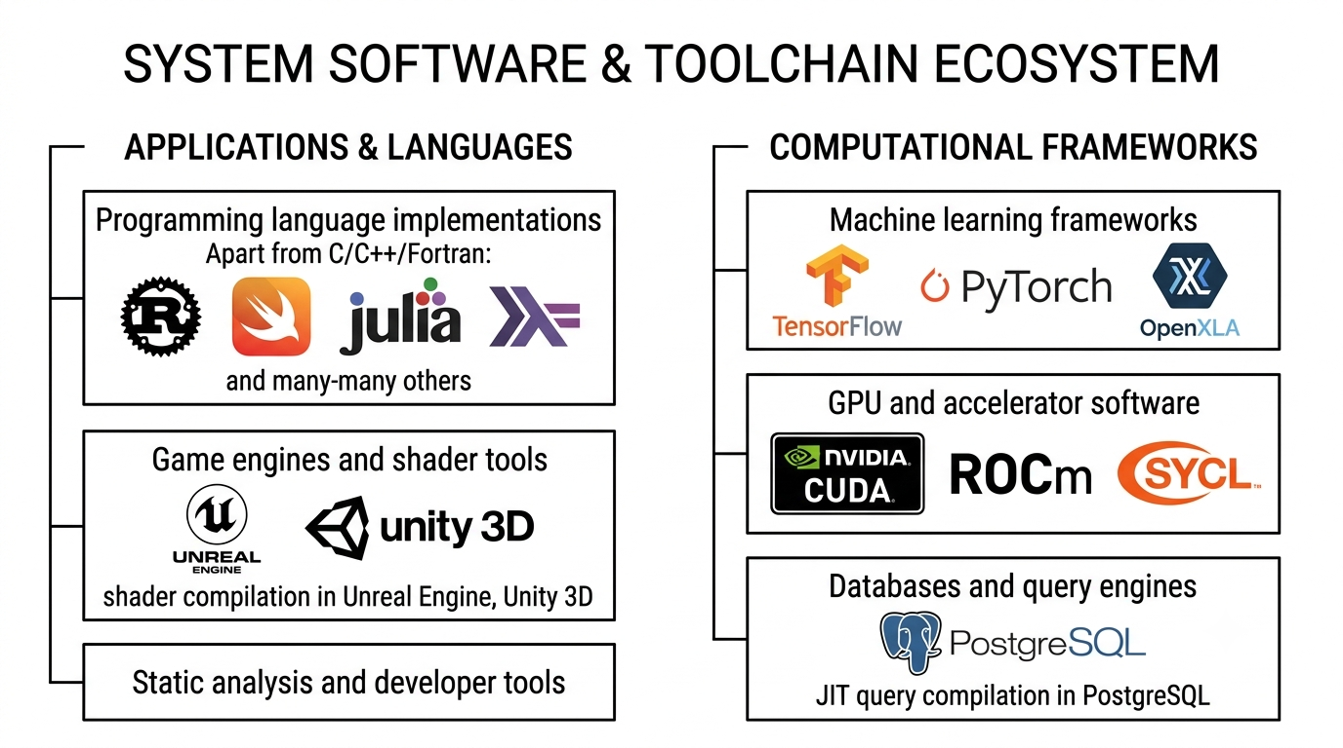
Integrating compilers to the workflow

Slide 15
Compiler infrastructure inside products
Frontend reuse:
  IDEs, linters, static analyzers, refactoring tools
Middle-end reuse:
  Custom IR transformations, custom optimization pipelines, domain-specific lowering
Backend reuse:
  CPU/GPU code generation, JIT, cross-compilation
SRC
Frontend
Middle-end
Backend
Program

Slide 16
LLVM: in-tree and out-of-tree
In-tree projects:
Projects living in LLVM monorepo (https://github.com/llvm/llvm-project)
Examples: clang, clang-tools-extra (clang-tidy, …), flang, mlir, lld, lldb, …
Out-of-tree projects:
Projects developed outside the LLVM monorepo but built against, extending, or reusing LLVM/Clang/MLIR libraries, APIs

Slide 17






LLVM-based compilers for other languages
rustc compiler: https://github.com/rust-lang/rust
Swift compiler: https://github.com/swiftlang/swift
Julia compiler: https://github.com/JuliaLang/julia
Emscripten (C++ to Wasm): https://github.com/emscripten-core/emscripten
Zig: https://codeberg.org/ziglang/zig
Haskell: https://github.com/ghc/ghc

Slide 18
3rdparty projects using LLVM
PostgreSQL JIT: https://github.com/postgres/postgres/blob/master/src/backend/jit
ClickHouse database: https://github.com/ClickHouse/ClickHouse
Mesa llvmpipe - Software OpenGL rasterizer: https://docs.mesa3d.org/drivers/llvmpipe.html
The Interactive C++ Interpreter: https://github.com/root-project/cling

Slide 19

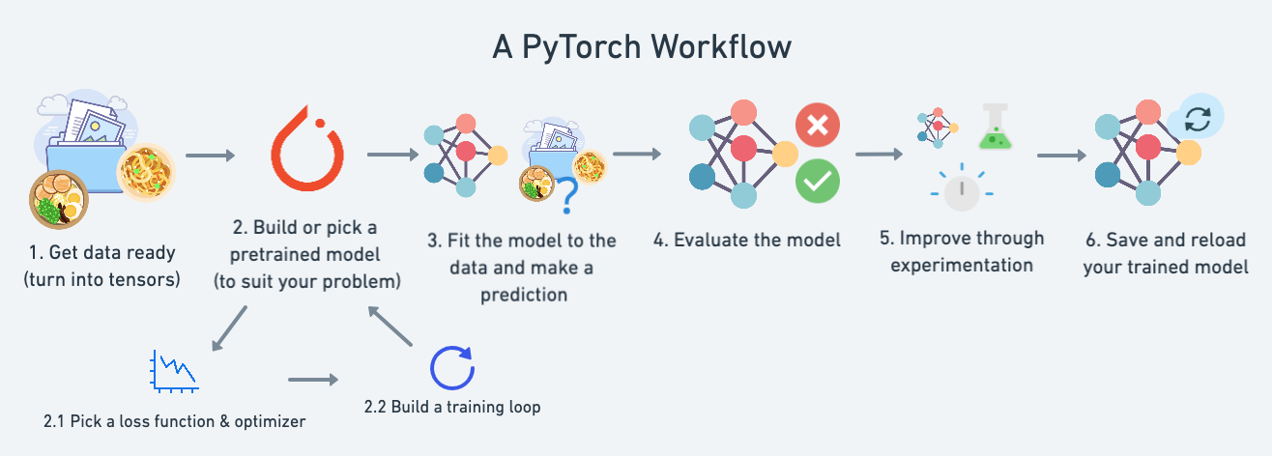
PyTorch
https://github.com/pytorch/pytorch
PyTorch is an open-source, Python-based machine learning library
https://www.learnpytorch.io/01_pytorch_workflow/

Slide 20
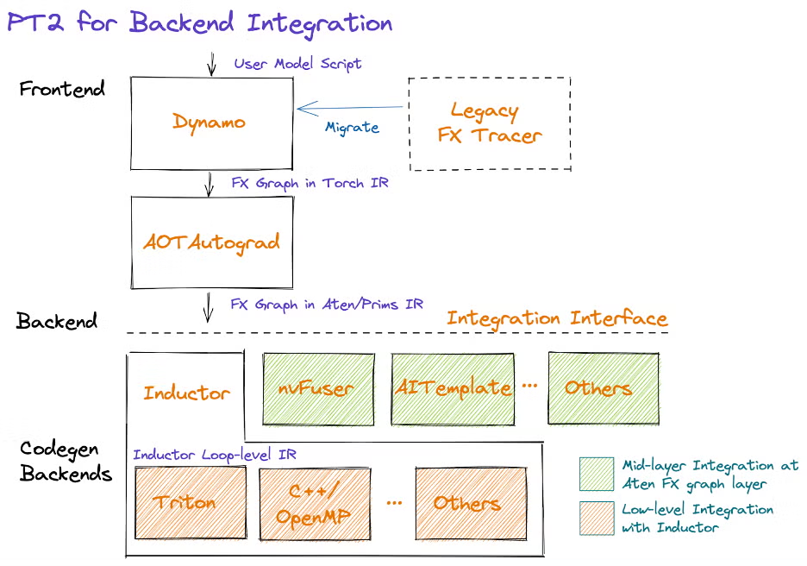
PyTorch compilation flow
Torch provides a set of compilers by itself:
https://docs.pytorch.org/tutorials/compilers_index.html
With PyTorch 2.0, we want to simplify the backend (compiler) integration experience. To do this, we have focused on reducing the number of operators and simplifying the semantics of the operator set necessary to bring up a PyTorch backend.
https://pytorch.org/get-started/pytorch-2-x/

Slide 21
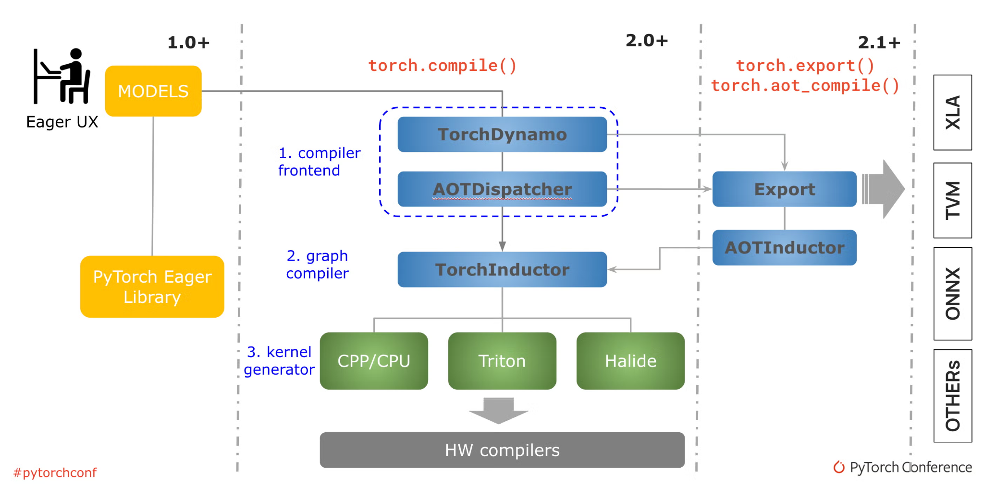
PyTorch compilation modes
inductor: the default production backend in torch.compile
eager: not an optimizing compiler. It runs Dynamo graph capture but executes with regular PyTorch eager mode. Useful for debugging whether graph itself works or not
https://pytorch.org/blog/accelerated-pytorch-inference/

Slide 22
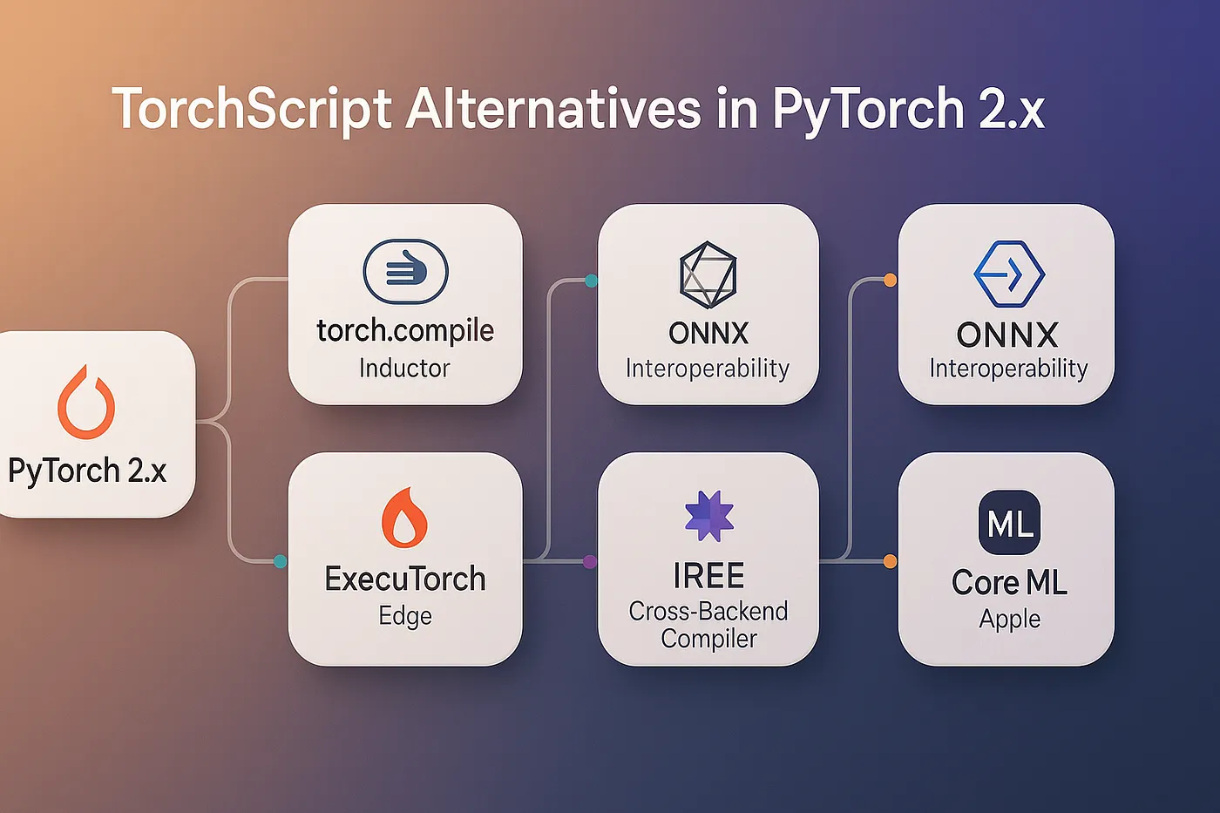
PyTorch vendor (3rdparty) backends
PyTorch provides an extendable interface that allows to bind different compilers for the actual model compilation
https://medium.com/@Modexa/eight-torchscript-alternatives-for-the-pytorch-2-x-era-34dcb68f2940

Slide 23
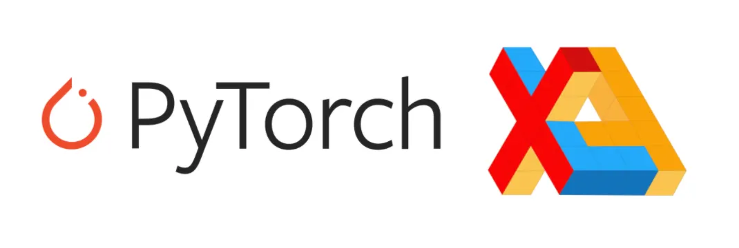




PyTorch backends
https://pytorch.org/docs/stable/torch.compiler.html
  Targets CPUs, GPUs
https://github.com/Lightning-AI/lightning-thunder
  Performs transformations on Pythonic IR (for NVIDIA GPUs)
https://github.com/iree-org/iree-turbine
  MLIR-based compiler/runtime path for PyTorch models, using Torch-MLIR-style lowering
https://github.com/pytorch/TensorRT
  compiler for NVIDIA GPUs
https://docs.openvino.ai/torchcompile
  for Intel CPU/GPU/NPU deployment
https://github.com/pytorch/xla
  XLA, mainly for Google TPU and XLA devices
IREE

Slide 24
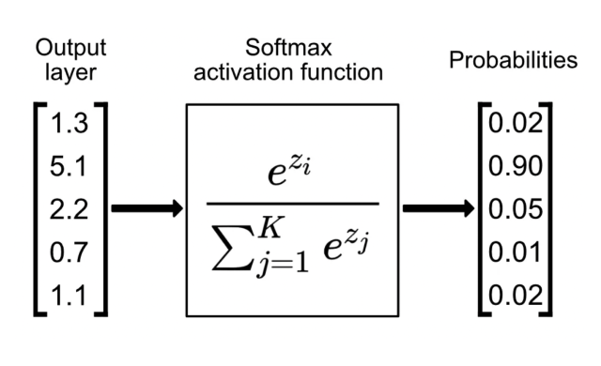

Triton
https://www.singlestore.com/blog/a-guide-to-softmax-activation-function/
https://openai.com/index/triton/
https://triton-lang.org/main/index.html
import triton
import triton.language as tl
@triton.jit
def softmax(Y, stride_ym, stride_yn, X, stride_xm, stride_xn, M, N, BLOCK_SIZE: tl.constexpr):
m = tl.program_id(0)
n = tl.arange(0, BLOCK_SIZE)
X = X + m * stride_xm + n * stride_xn
x = tl.load(X, mask=n < N, other=-float('inf'))
z = x - tl.max(x, axis=0)
num = tl.exp(z)
denom = tl.sum(num, axis=0)
y = num / denom
Y = Y + m * stride_ym + n * stride_yn
tl.store(Y, y, mask=n < N)
import torch
# Allocate input/output tensors
X = torch.normal(0, 1, size=(583, 931), device='cuda')
Y = torch.empty_like(X)
# SPMD launch grid
grid = (X.shape[0], )
# enqueue GPU kernel
softmax[grid](Y, Y.stride(0), Y.stride(1),
X, X.stride(0), X.stride(1),
X.shape[0] , X.shape[1], 1024)
Triton is a Python-based language and compiler for writing high-performance GPU kernels without writing CUDA (or other GPU code) directly
It serves DSL and compiler for custom GPU kernels
Goal: Make high-performance GPU kernel programming more accessible
LLVM and MLIR are under the hood
https://godbolt.org/z/fc37Edob6

Slide 25
Content
LLVM vs GCC
AOT vs JIT
Compilers integration into ML workflows
Python compilation process

Slide 26
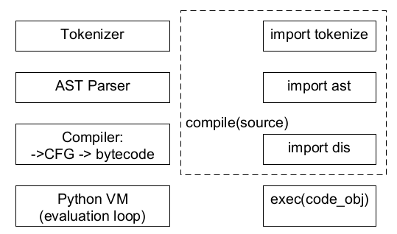
Python interpreter <-> built-in modules & functions
CPython exposes much of its internal pipeline through public APIs:
Inspect and transform source with tokenize and ast
Produce and inspect code objects with compile() and dis
Execute compiled code with exec()

Slide 27
Python AST Parser
$ python3
Python 3.14.3 (main, Feb 3 2026, 15:32:20) [Clang 17.0.0 (clang-1700.6.3.2)] on darwin
Type "help", "copyright", "credits" or "license" for more information.
>>> import ast
>>> a = ast.parse("def sum(a, b): return a + b")
>>> a
Module(body=[FunctionDef(name='sum', args=arguments(posonlyargs=[], args=[arg(...), arg(...)], vararg=None, kwonlyargs=[], kw_defaults=[], kwarg=None, defaults=[]), body=[Return(value=BinOp(...))], decorator_list=[], returns=None, type_comment=None, type_params=[])], type_ignores=[])
>>> ast.unparse(a)
'def sum(a, b):\n return a + b'
python3 -m ast --help
ast.parse("def sum(a, b): return a + b")
Classes and methods:
ast.NodeVisitor - base class to walk AST in read-only mode
ast.NodeTransformer - base class to walk AST to replace/remove nodes
ast.walk() - walk without Visitor pattern
ast.literal_eval() / eval() - evaluate AST
ast.unparse() – useful for decompiler or obfuscator

Slide 28
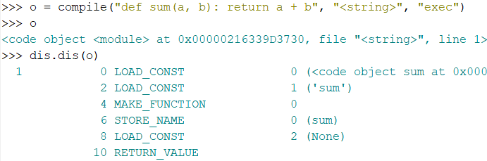
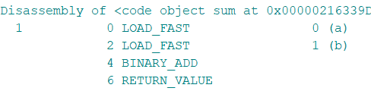
Python Virtual Machine
Python source code is first compiled into bytecode
Bytecode is a low-level, platform-independent instruction format
The Python Virtual Machine executes this bytecode
In CPython, the VM is an interpreter written mostly in C
Execution is stack-based (like JVM): bytecode instructions push and pop values from a virtual stack

Slide 29
Python bytecode (IR)
As any IR it has 3 forms:
  Byte-code itself: *.pyc file content or code_object.co_code
  In-memory representation: code_object = compile(…)
  String representation: import dis; dis.dis(code_object)

Slide 30
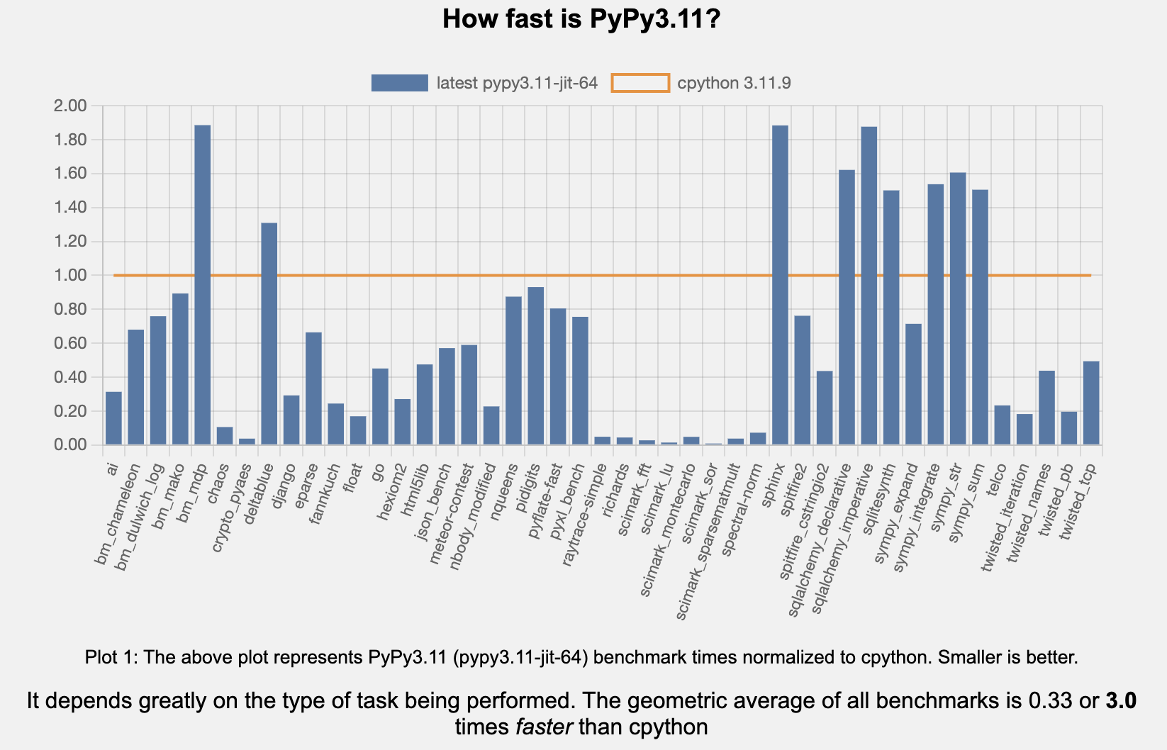
JIT compiler for Python
PyPy is a Python implemented in RPython as a JIT compiler
Provides good compatibility for pure Python, but C-extension-heavy workloads remain problematic
CPython 3.14 is stable (as of May 2026), while current PyPy targets only Python 3.11
3 times faster on average comparing with CPython 3.11*
https://speed.pypy.org/
* numbers are workload dependent, may vary in different scenarios
https://github.com/pypy/pypy

Slide 31
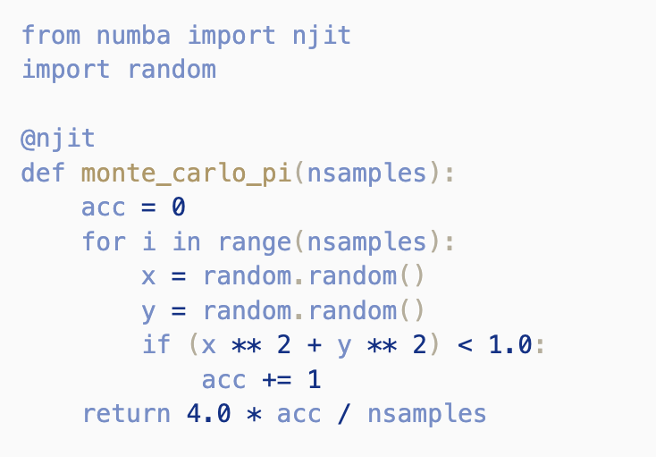
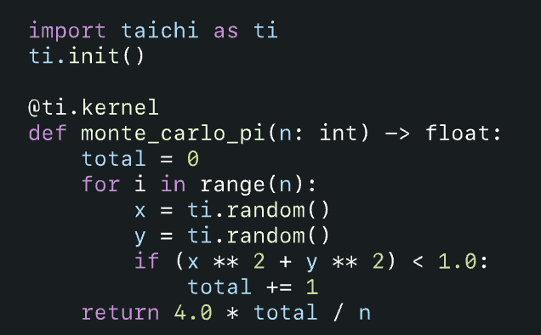
JIT compilers for Python functions
Numba
JIT-compiles Python functions to machine code via LLVM
Best for NumPy-heavy numerical code
Supports CPU and some GPU targets, especially CUDA
Minimal code changes: often just add @numba.jit
Taichi
Python-embedded DSL for high-performance kernels
Designed for parallel simulation, graphics, and numerical computing
Targets CPU/GPU backends
https://numba.pydata.org/
https://github.com/numba/numba
https://www.taichi-lang.org/
https://github.com/taichi-dev/taichi

Slide 32
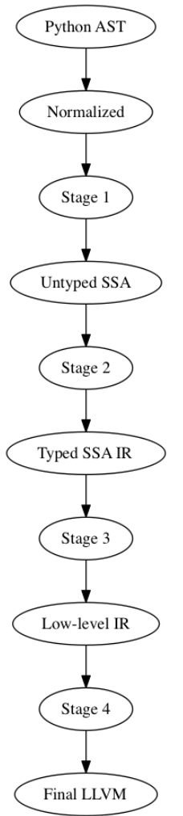
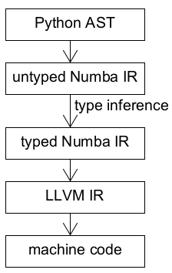
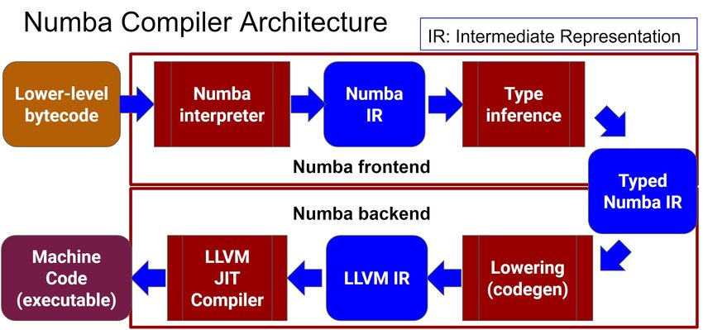
Typical compilation pipeline (Numba)
Saedi, Omid. "Towards Eco-Conscious Python: A Comparative Analysis of Performance, Energy Efficiency and Carbon Emissions Between CPython and Alternative Implementations." (2024).
https://numba.pydata.org/numba-doc/dev/developer/architecture.html

Slide 33


Type inference for Python
mypy + mypyC (transpiler to C)
pytype (type hints are not necessary; by Google)
pyright (type checker for VSCode; by Microsoft; written in TypeScript)
Python type hints are Turing-complete that means that full static checking/inference is undecidable
https://arxiv.org/pdf/2208.14755.pdf
mypy, pyright, pytype implement useful decidable approximations

Slide 34
Compilers evolution
Compilers are constantly evolving…
Understanding compilers means understanding how modern software is built, optimized and adapted to run on the hardware

Slide 35

Course feedback form
https://forms.gle/taqUuCfNCq4u5Xn9A
Backup: me@gooddoog.ru

Slide 36


Test
https://forms.gle/kQENCeeS6anmf6Lp8
Submission time: 10 minutes
Backup: me@gooddoog.ru

Slide 37
Extra materials
Triton Kernel Compilation Stages: https://pytorch.org/blog/triton-kernel-compilation-stages/
CPython’s internals: https://devguide.python.org/internals/

