Slide 1
Compilers 101
Debuggers

Slide 2
Previously…
Preprocessing
Lexical analysis
Frontend
Syntax analysis
Semantic analysis
IR Generation
IR Optimization
Middle-end
Code generation
Backend
Optimization

Slide 3
Why debugging?
Static analysis does not discover many kinds of errors (especially, logic errors)
Retrieve runtime information
Need some insight into running programs
Allow to change execution flow without recompilation

Slide 4
Debuggers in a nutshell
Ability to control execution
Resume after signal/trap
Ability to read/write memory
Registers and RAM
Mapping from binary code to source

Slide 5
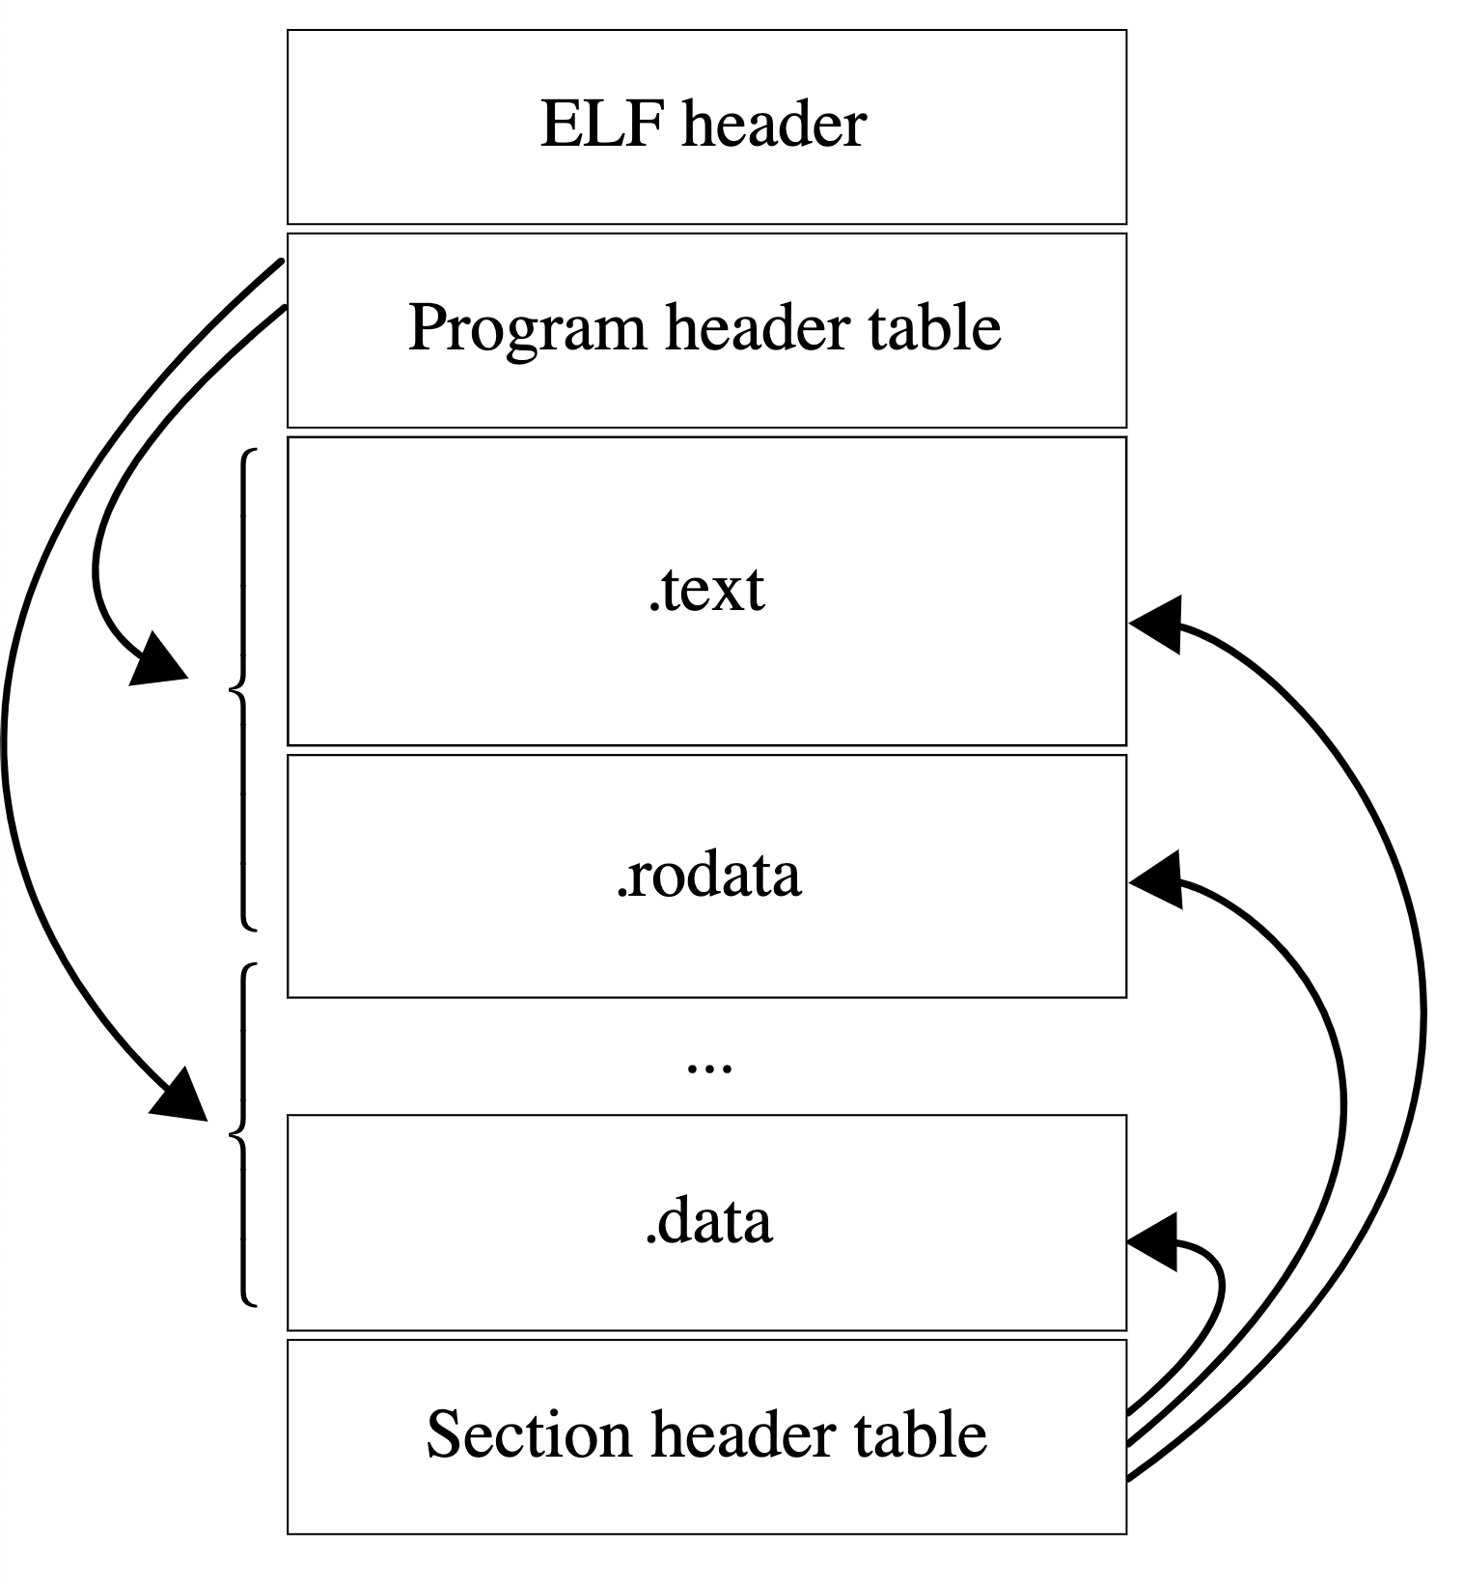
Executable and linkable format (ELF)
ELF is a common executable file format for Unix-like systems
File is divided in multiple sections
Sections can be read-only and executable
https://en.wikipedia.org/wiki/Executable_and_Linkable_Format

Slide 6
DWARF
DWARF is a widely used debugging information format
DWARF uses Debugging Information Entry (DIE) data structure
A DIE has a tag (DW_TAG_variable, DW_TAG_pointer_type, DW_TAG_subprogram)
And attributes (key-value pairs)
DIE attributes can reference other DIEs

Slide 7
Working with DWARF
Use -g flag to enable DWARF in the compiler
GDB and LLDB are the most used debuggers on Unix-like platfroms
libdwarf – C library for working with DWARF (http://www.prevanders.net/dwarf.html)
dwex – GUI for visualizing DWARF (https://github.com/sevaa/dwex)

Slide 8
PE and PDB
Portable Executable (PE) is an executable file format on Windows
Program database (PDB) is a debug info file format on Windows
PE is very much like ELF
Unlike DWARF, PDB is typically stored as an external file

Slide 9
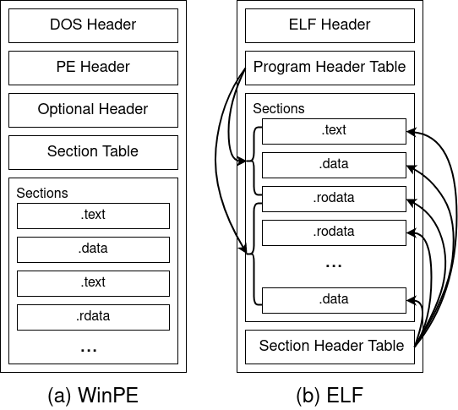
ELF and PE

Slide 10
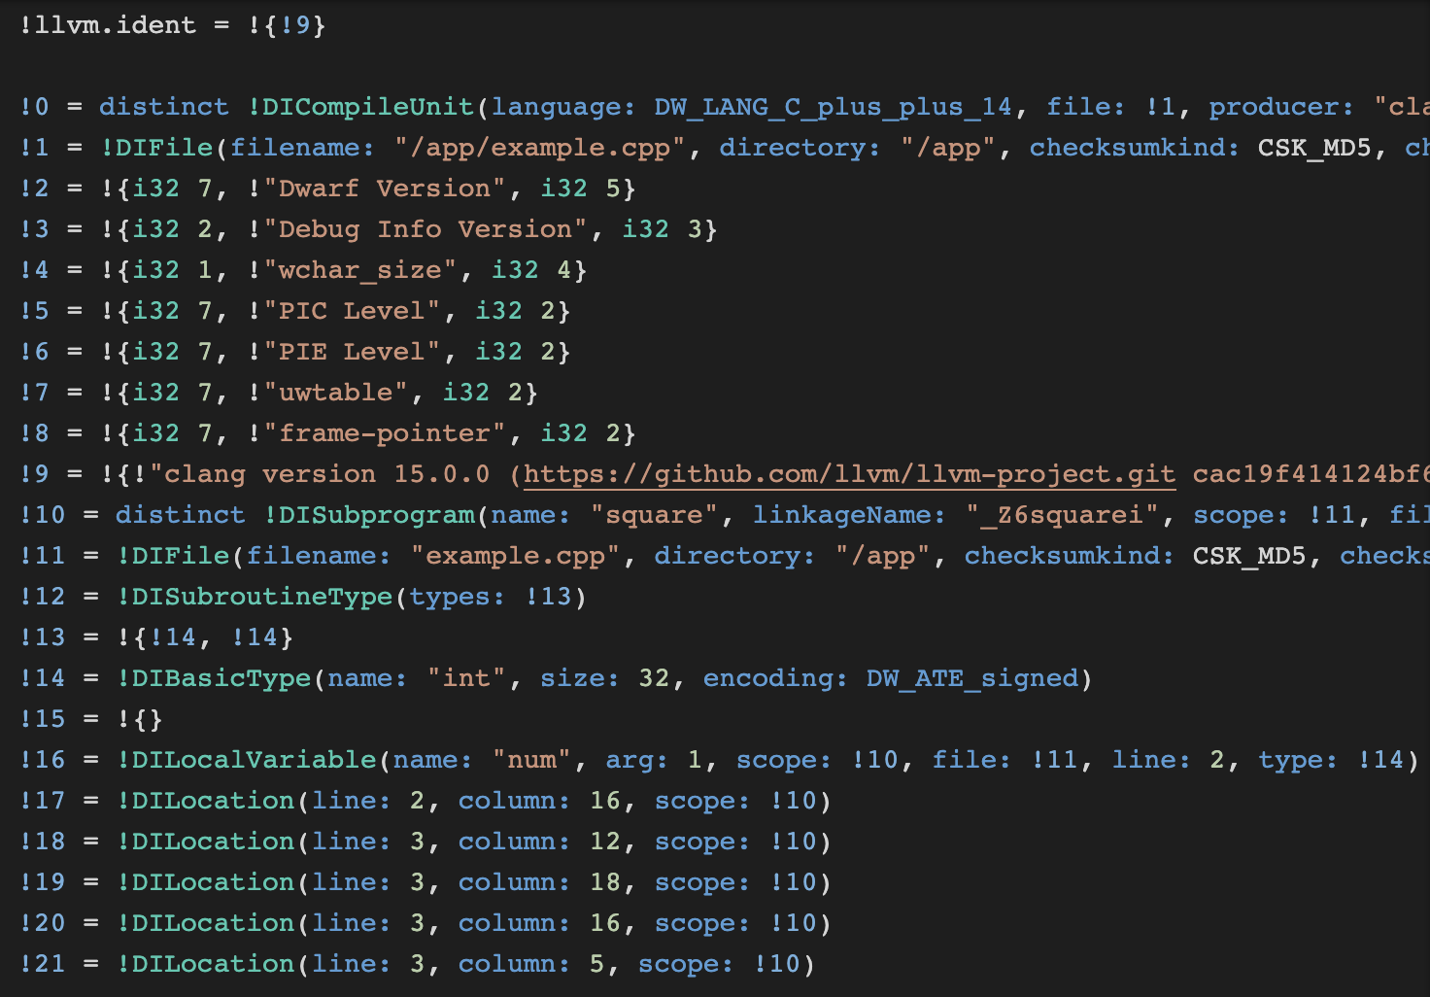
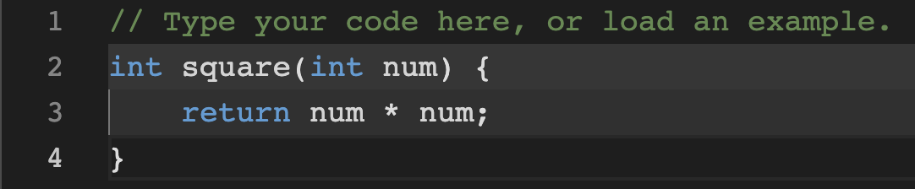

From LLVM IR to DWARF
LLVM IR:
Assembler:
https://godbolt.org/z/ecn15d566
https://godbolt.org/z/oW19bY35E

Slide 11
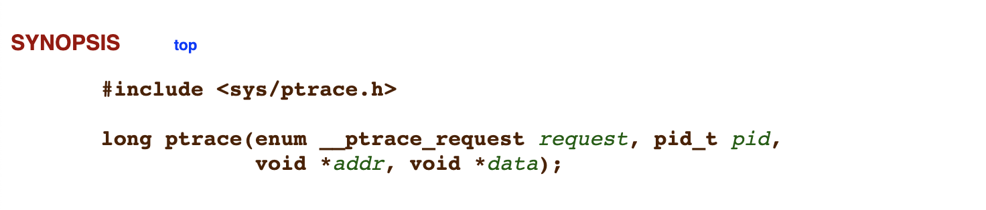
ptrace
Attach to process
Read/write registers
Read/write memory
Signal on traps
Trace syscalls (emulated capability)
https://man7.org/linux/man-pages/man2/ptrace.2.html

Slide 12
Debugger Engine
Debugger Engine provides an interface for examining and manipulating running processes
Debugger Engine can be used to both write debugger extensions (e.g., for WinDbg) and full-featured debuggers
Debugger Markup Language is similar to HTML, but for debug info
Full docs: https://docs.microsoft.com/en-us/windows-hardware/drivers/debugger/debugger-engine-and-extension-apis

Slide 13
Debugger features
Breakpoints
Step-by-step execution
Local variables overview
and many others…

Slide 14
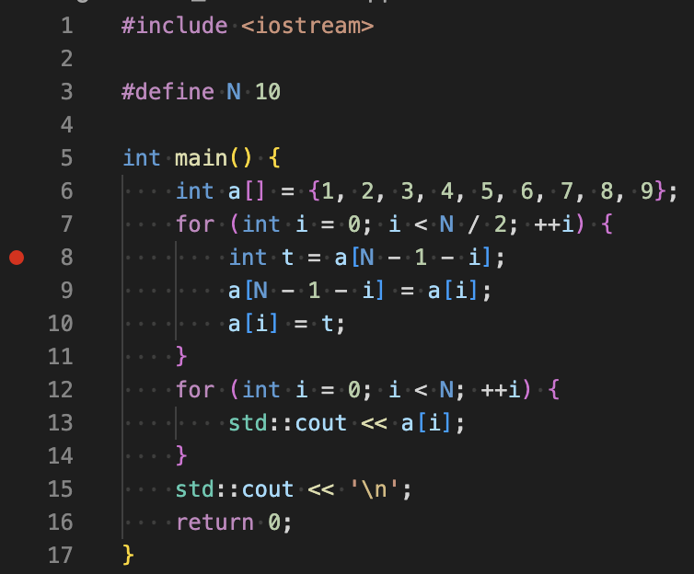
Breakpoints
Essential debugging tool
Two very different kind of breakpoints
Hardware – supported by CPU, limited number of BPs
Software – replace instruction at address with halt/trap/interrupt and then replace back with original instruction
GDB: break <file>:<line>
LLDB: breakpoint set -l <line>

Slide 15
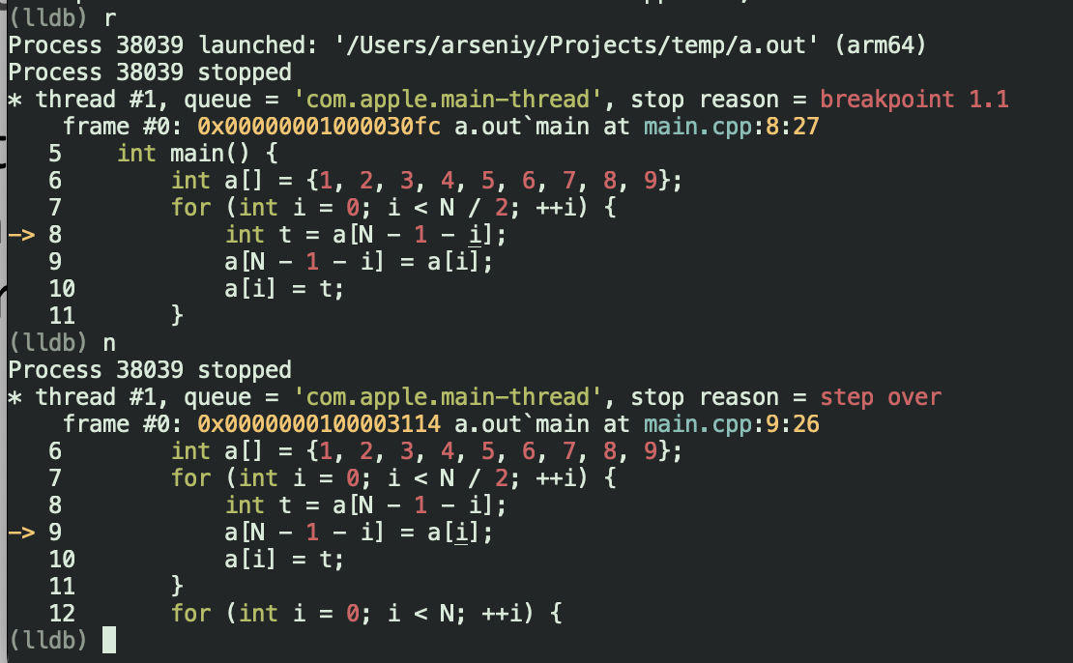
Step-by-step execution
Stepping commands let developers execute their program one line or instruction at a time. This helps in closely monitoring the changes in program state and variable values
GDB/LLDB:
step
next

Slide 16
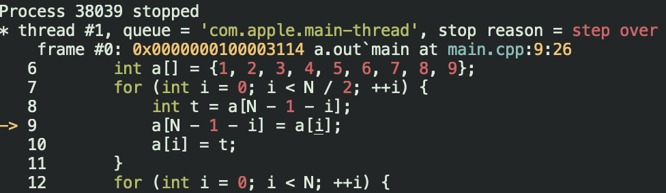
Inspect local variables and stack
See current values of the variables
GDB:
print <variable>
LLDB:
frame variable [variable]

Slide 17
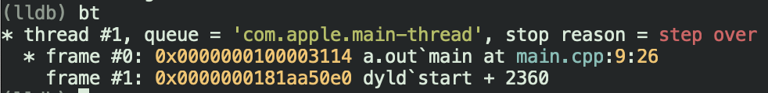
Stack trace
Stack tracing provides a look at the function call stack at any point in a program's execution. This is useful for understanding the sequence of function calls leading to the current point.
GDB/LLDB:
backtrace
bt

Slide 18
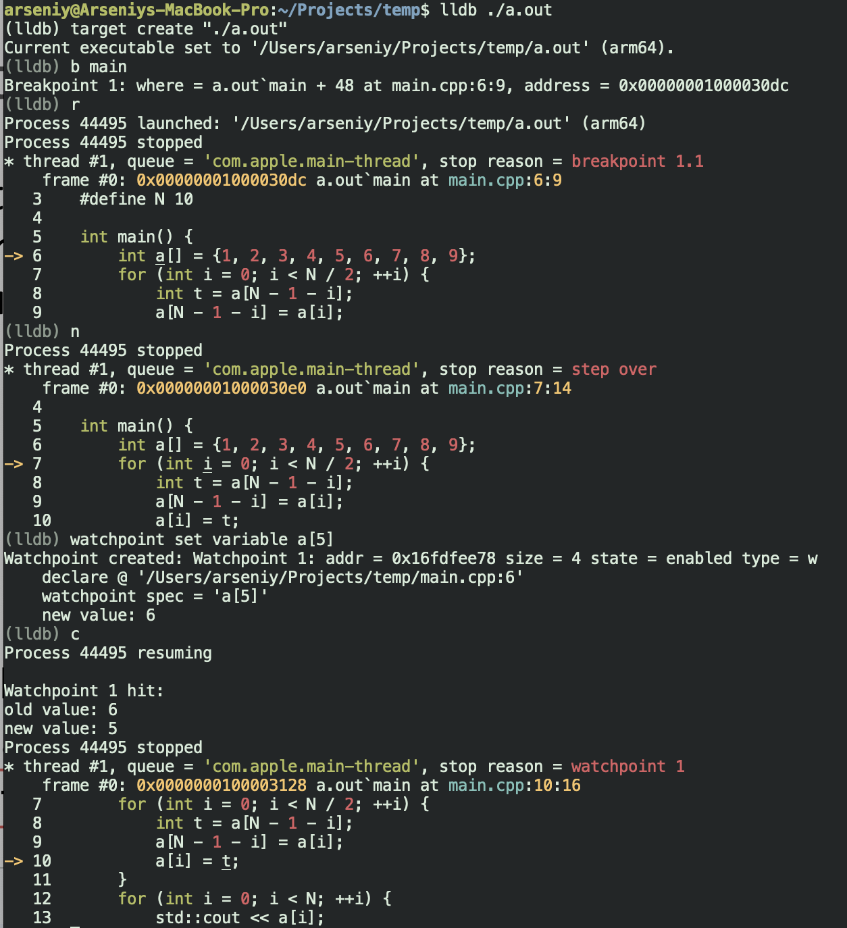
Watchpoints
Watchpoints are similar to breakpoints but are triggered by changes in the value of a variable rather than the execution of a specific line of code.
GDB:
watch <variable>
LLDB:
watchpoint set variable <variable>

Slide 19
Conditional breakpoints
These are breakpoints that are triggered only if a specified condition is true
Condition is checked every time when program reaches particular line of code
GDB:
break [location] if [condition]
LLDB:
breakpoint set --name [function] --condition '[condition]'

Slide 20
Modifying Program State
Debuggers often allow altering the state of the program, such as changing variable values or jumping to different points in the code.
GDB:
set var <variable>=<value>
LLDB:
expression <variable> = <value>

Slide 21
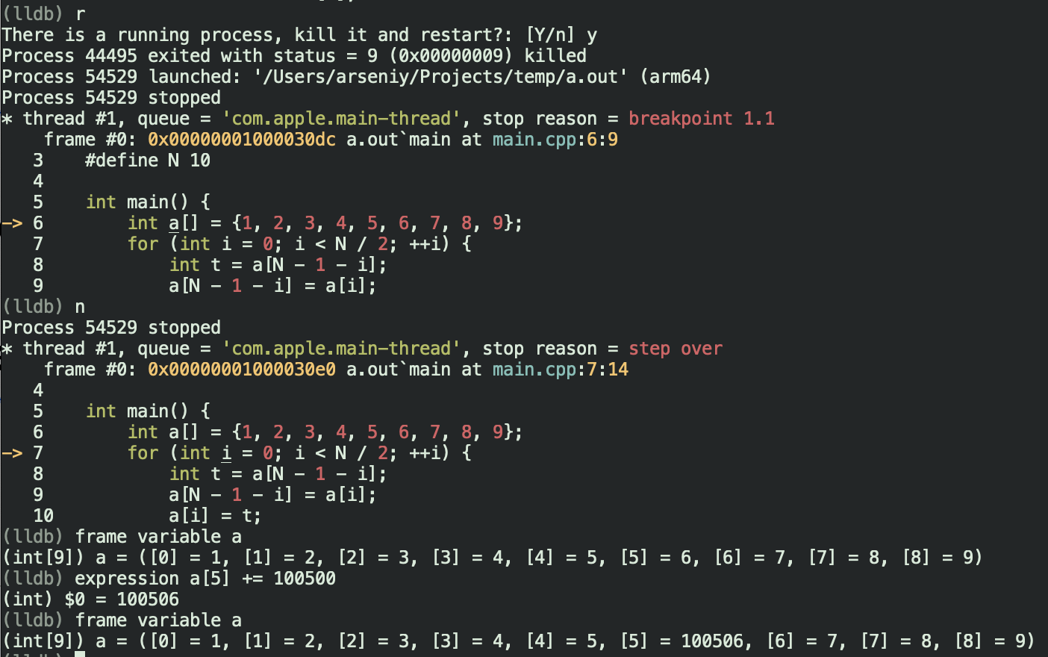
Modifying Program State

Slide 22
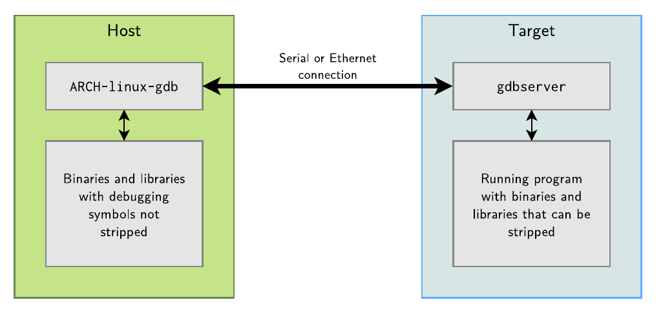
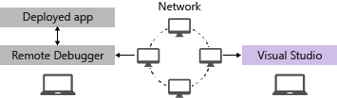
Remote debugging
This feature enables the debugging of a program running on a different machine than the debugger, which is useful for testing in different environments or on different hardware.
gdb/lldb network debugging
MSVC network debugging

Slide 23
LLDB network debugging architecture
Server
Linux
client
GDB remote protocol
macOS
CLI
Windows
…

Slide 24
Expression evaluation
Parsing programming languages is still a challenge for debuggers
Hard to keep up with all new features
For C++ LLDB uses a full Clang instance
Generate AST for given expression and try to generate a DWARF expression or JIT code

Slide 25
GDB remote protocol
Exchange textual messages in the format
Checksum is modulo 256 sum of all characters between $ and #
Most common packets
? – query reason for halt
b addr,mode – set breakpoint
c addr – continue at addr
g – read general registers
g XX... – write general registers
m addr,length - read memory
m addr,length:XX… - write memory
-> $packet-data#checksum
<- +
https://sourceware.org/gdb/onlinedocs/gdb/Remote-Protocol.html

Slide 26
Python interface
LLDB has flexible scripting facilities
Interfaces to control entire debugging session
Custom debugger commands
Pretty printers
Customize debugger to support your data structures

Slide 27
Time travel
Time travel debugging is the ability to step back one or more instructions
Basic principle: save state in particular points of program execution and restore it
Typical implementation ideas:
Virtual machine, that saves the whole processor state
Save state on perf counters change only
Use hardware assistance: Intel Processor Trace (PT), ARM CoreSight
Limitations:
Networking, GPUs, other peripherals
Multithreading

Slide 28
More useful materials on LLDB
LLDB tutorial: https://lldb.llvm.org/use/tutorial.html
GDB to LLDB commands mapping: https://lldb.llvm.org/use/map.html

Slide 29

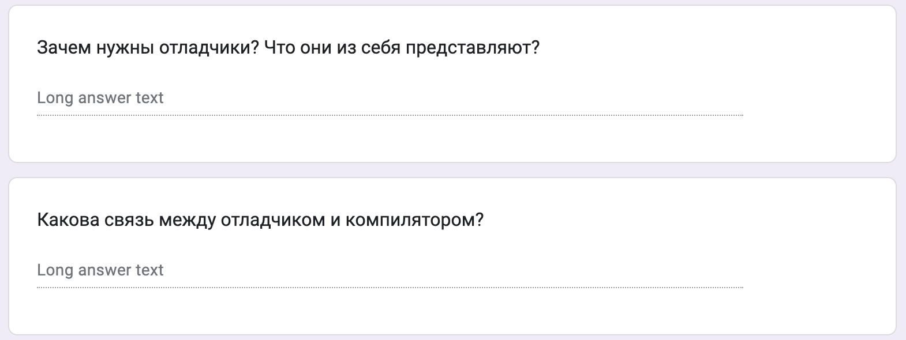
Test
https://forms.gle/VGhg53cKmkHoVtPw9
Submission time: 10 minutes
Backup: me@gooddoog.ru

Slide 30

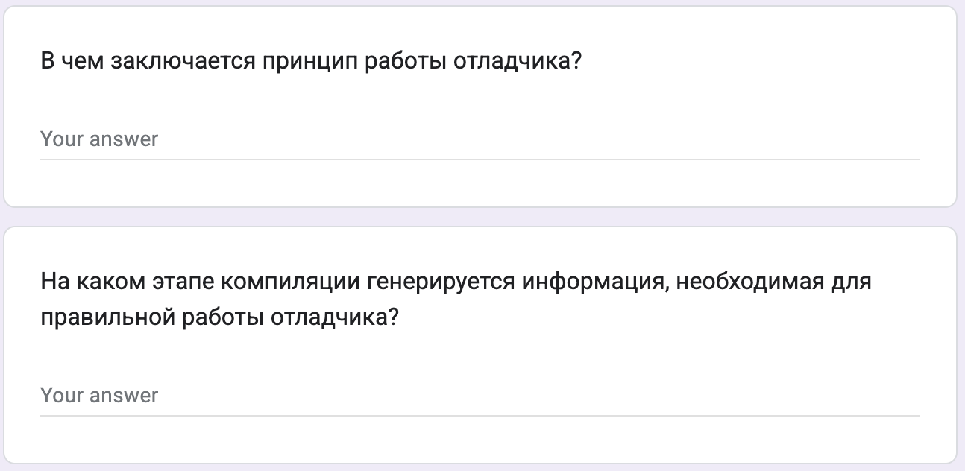
Test
https://forms.gle/ESvwo5dfw9drBFvk7
Submission time: 10 minutes
Backup: me@gooddoog.ru

Slide 31
Extra materials
Greg Law "Give me 15 minutes & I'll change your view of GDB” - https://www.youtube.com/watch?v=PorfLSr3DDI
LLVM Developers’ Meeting: R. Isemann “Better C++ debugging using Clang Modules in LLDB” - https://www.youtube.com/watch?v=vuNZLlHhy0k
2015 EuroLLVM Developers’ Meeting: “Why should I use LLDB?”- https://www.youtube.com/watch?v=JtpQZw9NpIU

