Slide 1
Compilers 101
Python internals and JIT compilers

Slide 2
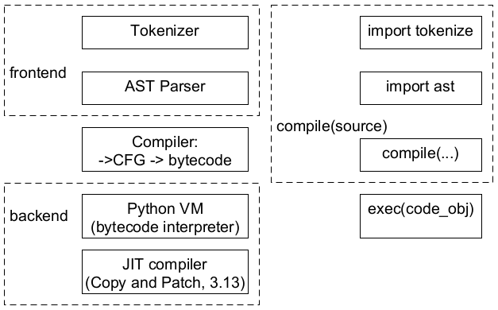
Python internals & their pure Python interfaces

Slide 3
Python AST Parser
Python 3.9 and before: LL(1) parser
Source code -> Concrete Syntax Tree (CST) -> AST
Python 3.9+: PEG grammar approach (PEP-617)
theory intro in 2004 by Bryan Ford
Gvido was inspired by TatSu PEG parser implementation
lib2to3 had LL(1) parser, that’s why it was removed in 3.10
PEG grammar is unambiguous => not commutative / ordered (get first)

Slide 4

Generate AST Parser
PEG-grammar: Grammar/python.gram -> parser.c
Generate parser in C
python -m pegen -v -o parser.c ./cpython/Grammar/python.gram
Generate parser in Python
pip install pegen
git clone https://github.com/we-like-parsers/pegen.git ./we-like-parsers_pegen/
python -m pegen -v -o parser.py ./we-like-parsers_pegen/data/python.gram
Grammar for C (~1.4k LoC) vs grammar for Python (~2.4k LoC)
One may not just separate libast.so from libpython.so.

Slide 5
If you need AST Parser in C++
Create own python.gram file with C++ Standard Library (std::string etc)
python -m pegen -v -o parser.cpp ./your_own/python.gram
Maybe use StringZilla for speed up (useful for many languages)
‘str’ codecs design is important (‘codecs’ are in pure Python now)
Make C++ compiler for Python using LLVM or MLIR

Slide 6
Python AST module (1/3)
python -m ast --help
ast.parse("def sum(a, b): return a + b")
ast.NodeVisitor – base class to walk AST in read-only mode (picompile)
ast.NodeTransformer – base class to walk AST to replace/remove nodes
ast.walk() – walk without Visitor pattern
ast.literal_eval() – light alternative to eval(), but still unsafe
ast.unparse() – useful for decompiler (uncompyle6, pycdc), auto formatter

Slide 7
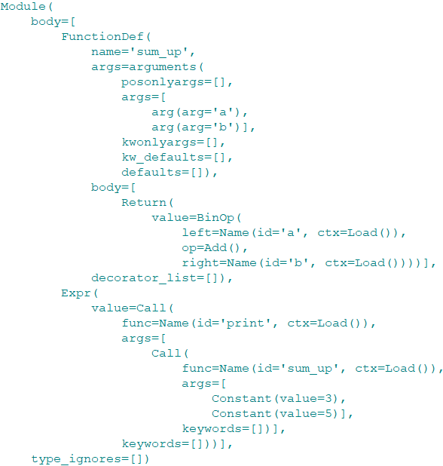


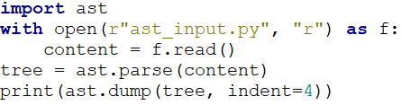
Python AST module (2/3)

Slide 8
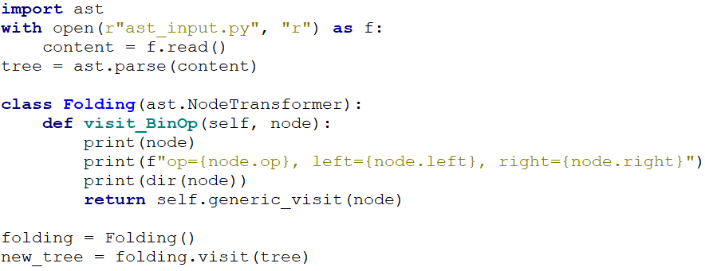
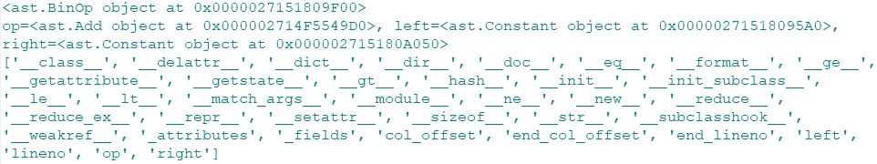
Python AST module (3/3)

Slide 9
At the bottom of Python AST docs…
See also
Green Tree Snakes, an external documentation resource, has good details on working with Python ASTs.
ASTTokens annotates Python ASTs with the positions of tokens and text in the source code that generated them. This is helpful for tools that make source code transformations.
leoAst.py unifies the token-based and parse-tree-based views of python programs by inserting two-way links between tokens and ast nodes.
LibCST parses code as a Concrete Syntax Tree that looks like an ast tree and keeps all formatting details. It’s useful for building automated refactoring (codemod) applications and linters.
Parso is a Python parser that supports error recovery and round-trip parsing for different Python versions (in multiple Python versions). Parso is also able to list multiple syntax errors in your python file.

Slide 10
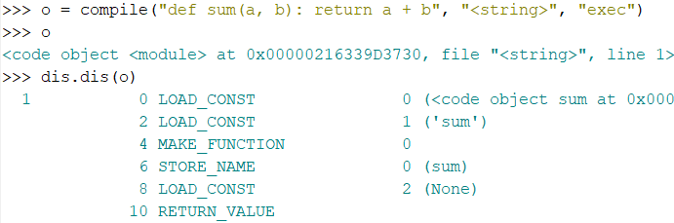
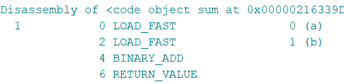
Python bytecode (IR)
As any IR it has 3 forms:
Byte-code itself: *.pyc file content or code_object.co_code
In-memory representation: code_object = compile(…) or PyCodeObject
String representation: import dis; dis.dis(code_object)

Slide 11
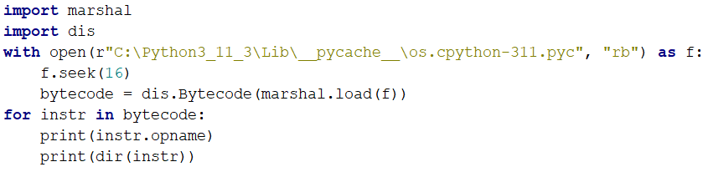
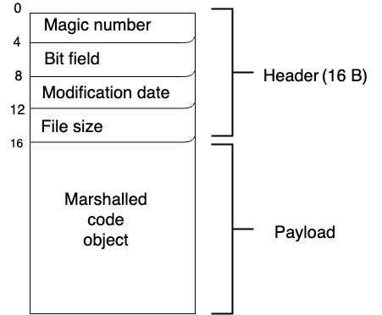
.pyc file format & decoding

Slide 12
Bytecode interpreter (Python VM)
Bytecode docs: https://devguide.python.org/internals/interpreter/ (3.11)
2 kinds of VM:
Stack-based VM (most popular, including Python VM)
More portable, easier implementation, more compact in memory (doesn’t need addresses)
Register-based VM (https://github.com/iritkatriel/cpython/tree/regmachine2)
Less portable, need more memory (need addresses), should be faster (need other compiler)
ceval.c, _PyEval_EvalFrameDefault(...) – can be replaced using _PyInterpreterState_SetEvalFrameFunc(...)
#include "generated_cases.c.h" (tier 1 / main interpreter)
#include "executor_cases.c.h" (tier 2 interpreter! new in 3.13, use micro-ops)

Slide 13
Bytecode specializations (Python 3.11, PEP-659)
Bytecode ops are too abstract initially
If “hot” code is detected (saturating counter), specialization is done:
Example: LOAD_GLOBAL -> LOAD_GLOBAL_BUILTIN / LOAD_GLOBAL_MODULE
Example: BINARY_ADD -> BINARY_ADD_INT / BINARY_ADD_FLT
If input is changed few times (counter too), de-optimization happens
back to LOAD_GLOBAL
back to BINARY_ADD

Slide 14
Source code of Compiler and Interpreter(s)
Python/ast.c, asdl.c, Parser/*.c (AST parser)
Python/ast_opt.c (constant folding + few other simple optimizations)
Python/compile.c (compile AST to CFG and then to bytecode)
#include <pycore_flowgraph.h>
#include <pycore_symtable.h> (symtable.c; import symtable)
Python/ceval.c (bytecode interpreter, or Python VM)
#include “generated_cases.c.h” (tier 1 / main interpreter): case <opcode>: { <some logic>; }
#include “executor_cases.c.h” (new in 3.13; tier 2 interpreter): case <micro-op>: { <some logic>; }
Python/jit.c (light JIT compiler: Copy and Patch approach)
#include “jit_stencils.h” (pieces of machine code generated by clang at build time)

Slide 15
Source code of built-in types and modules
Objects/
dictobject.c, listobject.c, unicodeobject.c, ...
Modules/
_json.c, socketmodule.c, timemodule.c, ...
Python/
sysmodule.c, _warnings.c, bltinmodule.c, ...
Lib/*.py

Slide 16
Python C API tiers and layers (1463 functions)
Limited C API (== Stable ABI): ~900 functions
Unstable C API see https://docs.python.org/3.13/c-api/stable.html
C API docs index (very useful)
Abstract Object Layer (connected with PyTypeObject: virtual method table)
Concrete Object Layer
How many lines of C needed to execute a + b in Python?
https://habr.com/ru/articles/780386/ (in Russian)
https://codeconfessions.substack.com/p/cpython-dynamic-dispatch-internals (orig)

Slide 17

Boxing and unboxing
PyObject* to static type
PyAPI_FUNC(long) PyLong_AsLong(PyObject *obj)
Statiс type to PyObject*
PyAPI_FUNC(PyObject *) PyLong_FromLong(long ival)

Slide 18
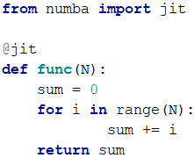

3rd-party JIT compilers for Python functions
@jit(cache=True, nopython=True) is recommended (cache=True saves ~1 sec.)

Slide 19
3rd-party JIT compilers for Python functions
Numba
pip install llvmlite; -> Numba IR -> LLVM IR
TBB support, Intel only GPU support, special replacements for Numpy functions
Taichi
GPU support; focus on graphics
more API
4 мушкетера: Python, Cython, Numba и Taichi (PyCon Weekend 2022)

Slide 20
3rd-party JIT compilers for Python
PyPy is a Python implemented in RPython as a JIT compiler
Trace based GC (mark-and-sweep with modifications)
ctypes are very slow with C extensions (need to rewrite code to CFFI)
~40% faster than CPython 3.11 in average (in pure Python)
Pyjion: JIT compiler running on .NET VM (project is closed)
Cinder: JIT compiler forked from CPython 3.9 (serves Nelzyagram*)
HIR (bytecode + expl. refcounting) -> LIR -> JIT compiler (own C++ implementation)
Full compatibility is not guaranteed and not checked (?)

Slide 21
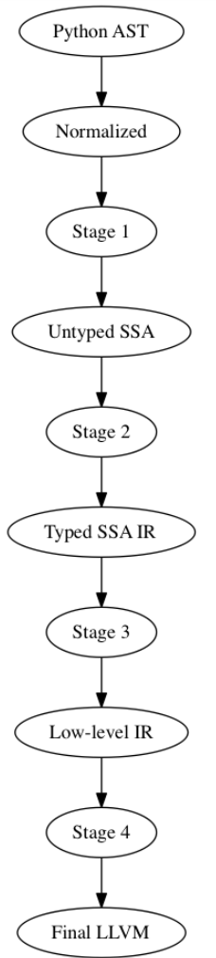
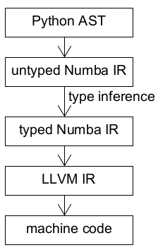
Typical compilation pipeline (Numba)
Env var NUMBA_DUMP_CFG=1
NUMBA_DUMP_IR=1
NUMBA_DUMP_ANNOTATION=1
NUMBA_DUMP_LLVM=1
NUMBA_DUMP_OPTIMIZED=1
NUMBA_DUMP_ASSEMBLY=1
search for “Numba Compiler Architecture”

Slide 22
Type inference for Python
mypy + mypyC (transpiler to C)
pytype (type hints are not necessary; by Google)
pyright (type checker for VSCode; by Microsoft; written in TypeScript)
JohnnyPeng18/HiTyper implements type dependency graph + some ML
Type inference is not decidable (algorithmically unresolvable) – 2022
https://arxiv.org/pdf/2208.14755.pdf

Slide 23
JIT compiler (Copy and Patch approach)
Brandt Bucher – A JIT Compiler for CPython (December, 2023)
The first idea publication at 2021
The first use for Lua (35% slower than LuaJIT) at 2023
Python JIT adds 2% - 9% performance improvement
LLVM (clang) is used at build time only. The distribution doesn’t have LLVM libs.
Python 3.13 may include it (configuration option: “-enable-experimental-jit”)
Machine code (as bytes) is copied from C header to memory (Copy)
Bytecode arguments are patched with data (Patch)

Slide 24
Global Interpreter Lock (GIL), no-GIL PEP-703
Threads in Python are not parallel! GIL cannot be disabled in pure Python.
GIL can be disabled in C code / C extension.
GILectomy (Larry Hastings, Python 3.6 fork) – failed
No-GIL (Sam Gross, MSFT, 2020-now, started as Python 3.9 fork)
Keynote talk at EuroPython 2022 (79x speed up for 80 cores)
PEP-703 accepted, Sam Gross approved as Python Core Developer in Feb 2024.
Biased RC (slowdown: 10% vs 60% w/ atomics), deferred RC (no RC for VM stack).
Immortal objects (None, True, ...): no RC for many constants, interned strings etc.
Thread-safe allocator “mimalloc” (born in 2019 at Microsoft)
Critical section C API

Slide 25
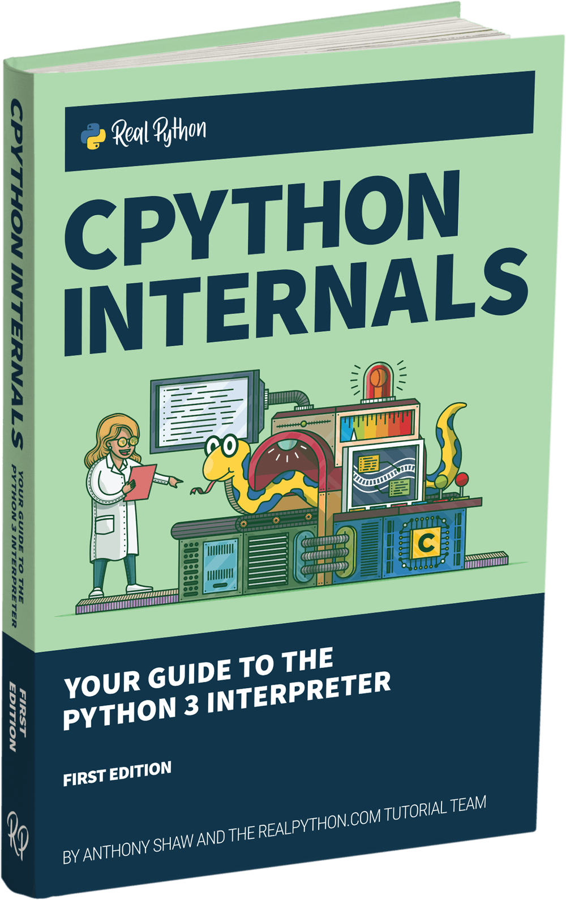
Recommended reading
Anthony Shaw (Microsoft) “CPython Internals”
(the 2nd edition covers versions till ~3.10)
Python Dev Guide: CPython’s Internals
https://devguide.python.org/internals/
(more compact)
About cell and free variables in closure
https://stackoverflow.com/a/23830790/3648361

Slide 26
Recommended watching & conferences/meetups
My Youtube playlist (Python, MLIR + LLVM, Mojo, Julia, Kotlin Native):
https://www.youtube.com/playlist?list=PLeZ4oq0ctHI2uO2SXcQj_DE3jHonxOJRk
Лучший курс по Python (by Nikita Sobolev, in progress…)
PyCon US: https://www.youtube.com/@PyConUS
EuroPython: https://www.youtube.com/@EuroPythonConference
PyCon Russia, Moscow Python, PiterPy, EkbPy, @Pytho_NN, Pytup, ...

Slide 27
Next time…
MLIR practice in 300 lines of code
Mojo🔥 & clangIR internals
Intro to exception handling
LLVM JIT engine (ORCv2) usage

Slide 28
No lab assignment
Where to ask questions
Telegram: @vasily_v_ryabov (questions)

Slide 29

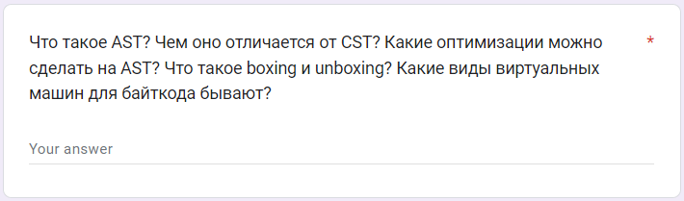
Test
https://forms.gle/eNpQzdsvN99S7byY6
Submission time: 10 minutes
Backup: vasily.v.ryabov@gmail.com

