Slide 1
Compilers 101
Optimizations – Part 1

Slide 2
Previously…
Preprocessing
Lexical analysis
Frontend
Syntax analysis
Semantic analysis
IR Generation
IR Optimization
Middle-end
Optimization
Backend
Code generation

Slide 3
Today
PHI nodes
LLVM Passes
Local optimizations

Slide 4
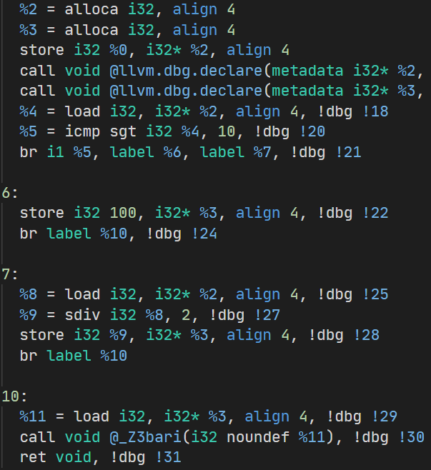
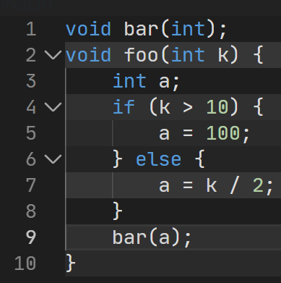

Memory SSA
https://godbolt.org/z/x6bf1fxxv

Slide 5
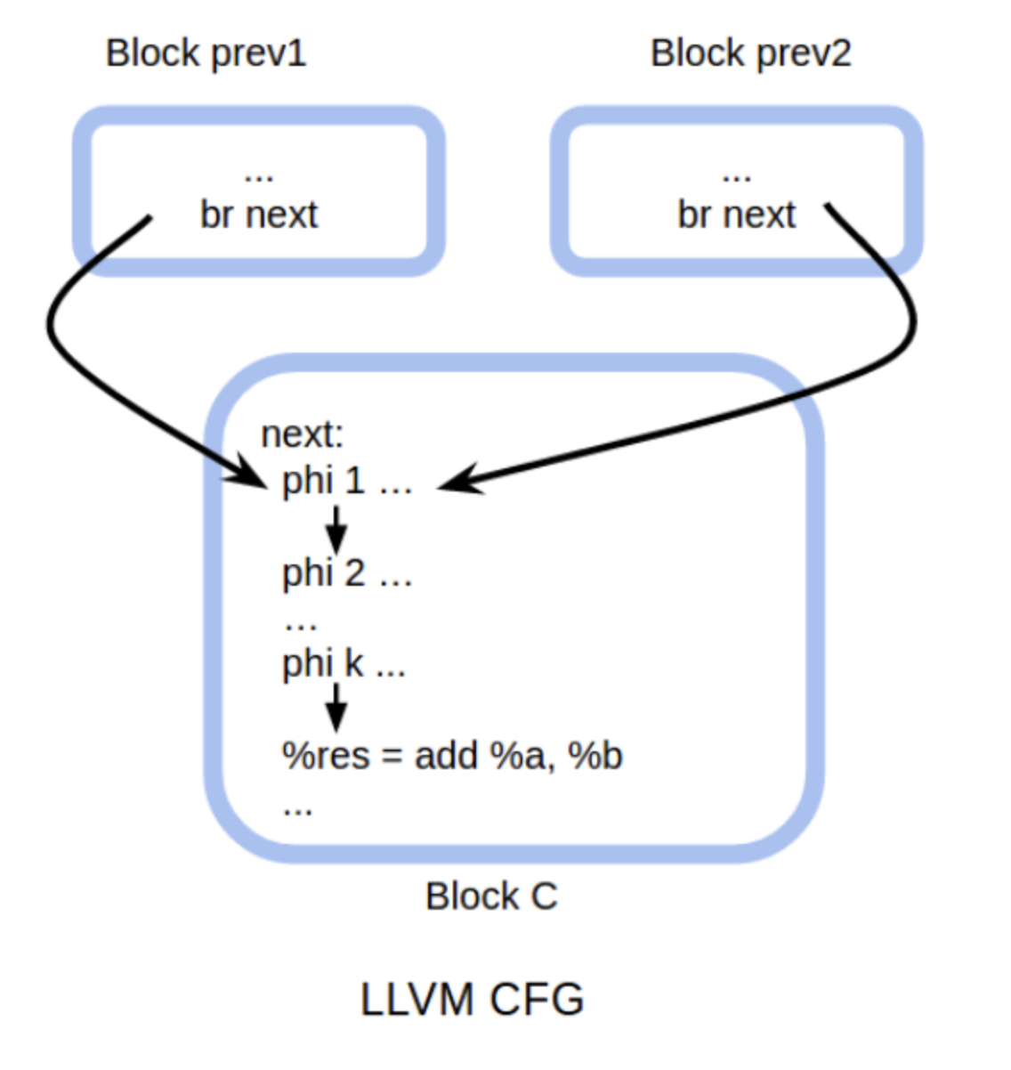
What are PHI nodes?
PHI node is a special kind of instruction in LLVM IR

Slide 6
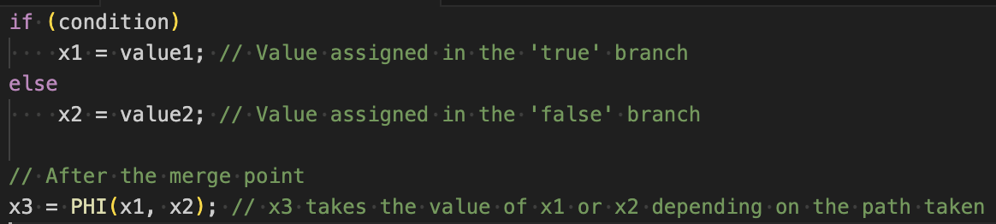
Why PHI nodes?
PHI nodes are essential for representing variable values that depend on the control flow in LLVM IR
They solve the problem of SSA (Static Single Assignment) form constraints, where each variable is assigned exactly once but used multiple times in different control flow paths.
PHI nodes effectively resolve the issue of variable assignments in loops and conditional branches, where the exact value of a variable can depend on the path taken through the program.

Slide 7
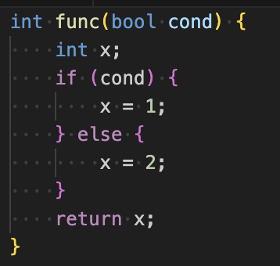
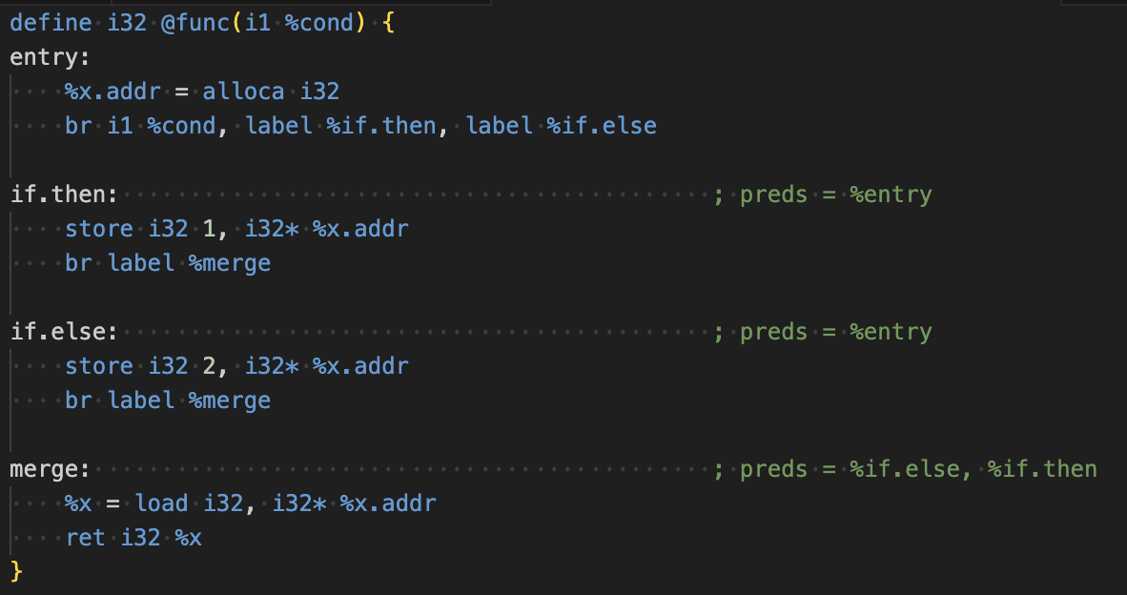
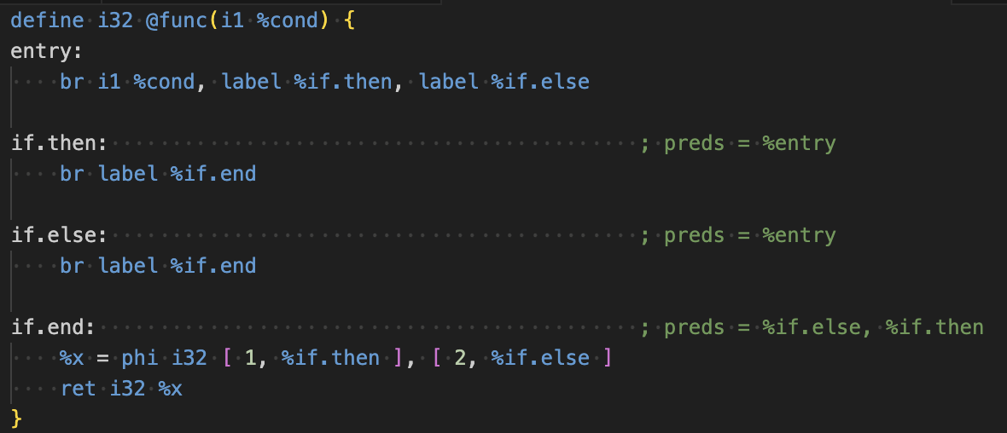
Example
Original C++ code
with condition
PHI nodes
Memory SSA

Slide 8
Working with LLVM IR
LLVM framework provides means to process LLVM IR, called Passes
We usually want to work with particular abstractions in IR: functions, loops, etc
LLVM provides that too
To run multiple passes on IR, you need a pass manager

Slide 9
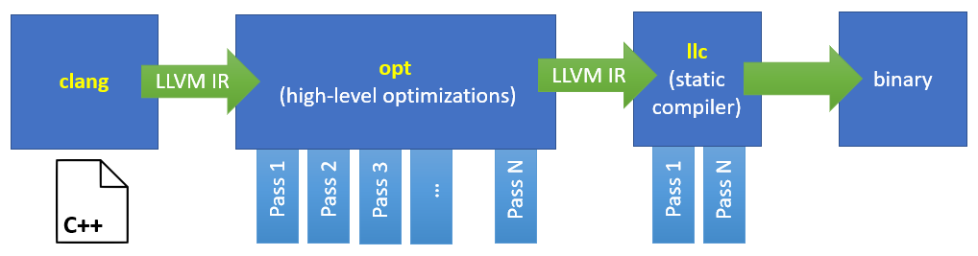
Pass
A pass in a compiler refers to a complete traversal of the source code or intermediate representation (IR) to perform specific processing tasks, such as lexical analysis, syntax analysis, optimization, or code generation.
https://egorbo.com/opt-for-llvm-guide.html

Slide 10
LLVM pass
Kinds of passes:
Analysis
Examples:
Loop Analysis (loop-analysis): This group of analysis passes provides detailed information about loops, including their nesting structure, induction variables, and trip counts.
Basic Alias Analysis (basicaa): This pass provides a very basic Alias Analysis implementation that can answer alias queries based on simple pointer analysis. It's a foundation for more complex analyses.
Transformation
Utility - for utility functions like printing the IR to a file for debugging purposes

Slide 11
Pass types
Passes are split by types:
ModulePass
operates on the whole compilation unit
use case: optimizations or analyses that need to consider multiple functions at once or need to deal with global variables
FunctionPass
operates on one function
optimizations or analyses that are local to a function, such as dead code elimination, constant propagation, or loop optimizations. These passes can run independently on each function, making them suitable for parallel execution.

Slide 12
Other types of passes
LoopPass
Specifically designed to operate on loops within a function. A LoopPass runs on each loop in a function, making it suitable for loop transformations and analysis.
Examples: loop unrolling, vectorization, or loop-invariant code motion.
CallGraphSCCPass
Operates on strongly connected components (SCCs) in the call graph. An SCC is a subset of functions that are mutually recursive. This pass allows optimizations that need to consider recursion and how functions interrelate more deeply than simple function-to-function calls.
In practice used in AMD passes
RegionPass
Targets a control-flow region within a function. A region can be a single basic block up to the entire function. Region passes allow for optimizations and analyses on these intermediate structures, which can be particularly useful for certain kinds of control flow and data flow optimizations.
Used in some control flow graph passes

Slide 13
Legacy vs new pass managers (PM)
Legacy PM has been deprecated
Note:
There are a lot of old information relative to old pass manager on the Internet
Consider reading carefully
Official docs are still based on the legacy PM in some places
Good entrypoint for reading the docs:
https://llvm.org/docs/NewPassManager.html

Slide 14
Analysis vs Transformation
Passes run on some piece of IR (module, function, etc)
Analysis passes produce results lazily
Passes need to request the result first
Results are cached
Transformation passes modify the IR

Slide 15
Writing a pass
struct HelloWorld : llvm::PassInfoMixin<HelloWorld> {
llvm::PreservedAnalyses run(llvm::Function &F,
llvm::FunctionAnalysisManager &FAM) {
llvm::dbgs() << F.getName() << “\n”;
return llvm::PreservedAnalyses::all();
}
}

Slide 16
Registering a pass
ModulePassManager MPM;
FunctionPassManager FPM;
FPM.addPass(HelloWorld());
MPM.addPass(createModuleToFunctionPassAdaptor(std::move(FPM)));

Slide 17
Why optimizing IR?
IR generation produces a lot of redundant code
Programmers are lazy

Slide 18
Challenges
Optimizer should not change observable behavior
Optimizations should not regress code performance
Optimized code must be of reasonable size
Almost all interesting optimizations are NP-hard

Slide 19
Optimization targets
Runtime – make programs run faster
Memory usage – make programs use less memory
Code size – produce smaller programs
Power consumption – select instructions that use less power at the cost of performance
…

Slide 20
-O<level> clang flags (1)
-O0, -O1, -O2, -O3
-O0: This level applies no optimizations; it aims for the fastest compilation time.
-O1: This level applies a minimal set of optimizations that reduce code size and execution time without significantly increasing the compilation time
-O2: Applies a broad set of optimizations that aim to improve code execution speed without incurring excessive compilation time. It does not perform optimizations that increase the size of the code significantly.
-O3: This level enables more aggressive optimizations than -O2, including optimizations that may significantly increase code size (e.g., loop unrolling). It aims for the highest execution speed, regardless of compilation time or code size.

Slide 21
-O<level> clang flags (2)
-Os
Optimizes for code size without significantly compromising execution speed.
Use case: Good for systems with limited memory or when distributing smaller binaries is desirable.
-Oz
Similar to -Os but more aggressive in reducing code size, possibly at a greater cost to execution speed.
Use case: Used for applications where the smallest possible code size is paramount, such as embedded systems with very limited memory resources.
-Ofast
All the optimizations from -O3 + optimizations that are not standard-compliant but are likely benefit performance. E.g., enables aggressive math optimizations.
Use Case: Suitable for applications where execution performance is top priority and where deviations from standard math behavior are acceptable.
-Og
Provides a good opt level while maintaining reasonable debug capabilities.

Slide 22
Semantics-preserving optimizations
An optimization is semantics-preserving if it does not alter the semantics of the original program
Examples
Dead code elimination
Loop invariant code motion
Non-examples
Replace bubble sort with quick sort

Slide 23
Function inlining
https://llvm.org/docs/Passes.html#always-inline-inliner-for-always-inline-functions
https://llvm.org/docs/Passes.html#inline-function-integration-inlining
Simply insert function body at call site
Not always profitable: there are heuristics to only inline small functions
Using ‘inline’ keyword in C/C++ only suggests compiler to inline function, not guarantees that
There is __attribute__((always_inline)) used for guaranteed inlining by the compiler
Usually more aggressive on GPUs and less aggressive on FPGAs
Note: there is an __attribute__((noinline)) that can be used to explicitly prevent function inlining, ensuring that the function call remains as a normal function call instead of being inlined by the compiler

Slide 24
Dead instruction elimination
https://llvm.org/docs/Passes.html#dce-dead-code-elimination
https://llvm.org/docs/Passes.html#globaldce-dead-global-elimination
https://llvm.org/docs/Passes.html#adce-aggressive-dead-code-elimination
Example:
%0 = add i32 %arg0, %arg1
%1 = sub i32 %arg0, %arg1
ret %1
; %0 is not used on RHS

Slide 25
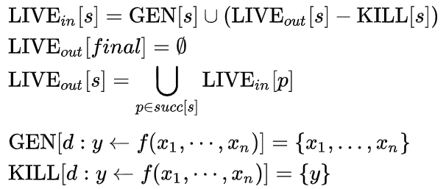
Liveness analysis
A variable is live at some point if it holds a value that may be needed in the future
Analysis is performed from the end of the function
Given block s:
https://en.wikipedia.org/wiki/Live_variable_analysis

Slide 26
Dead store elimination
https://llvm.org/docs/Passes.html#dse-dead-store-elimination
Removes stores to local variables, that are never read
LLVM variant only considers a single basic block
Example:
store i32 0, i32* %ptr <- going to be removed
store i32 42, i32* %ptr

Slide 27
Store to load forwarding
https://llvm.org/docs/Passes.html#mem2reg-promote-memory-to-register
Replace loads from memory with SSA values
Example:
store i32 42, i32* %ptr
%0 = load i32* %ptr
add i32 %0, 1
Replace with:
add i32 42, 1

Slide 28
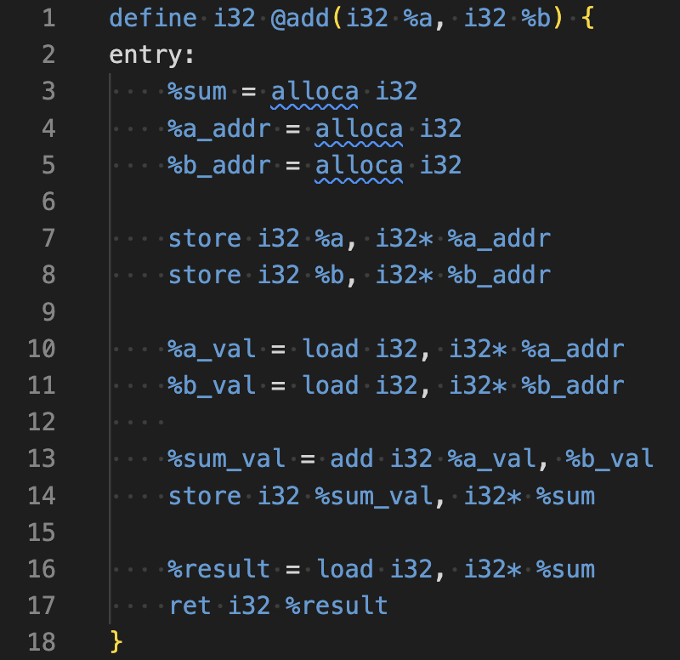
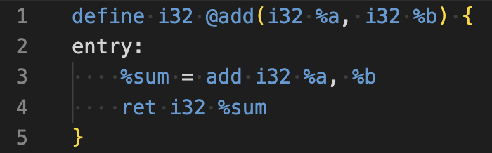
Spilling registers on stack
https://llvm.org/docs/Passes.html#reg2mem-demote-all-values-to-stack-slots
Inverse of mem2reg pass
Why?
For memory sanitizing
Converting SSA to Non-SSA for Legacy Compilers
Software Fault Injection & Fuzzing
Lowering for Stack-Based Architectures

Slide 29
Constant folding
https://llvm.org/docs/Passes.html#instcombine-combine-redundant-instructions
https://llvm.org/docs/Passes.html#aggressive-instcombine-combine-expression-patterns
Example:
%0 = add i32 42, 1
%1 = add i32 %arg0, %0
Equivalent to:
%0 = add i32 %arg0, 43

Slide 30
Arithmetic simplification
https://llvm.org/docs/Passes.html#instcombine-combine-redundant-instructions
https://llvm.org/docs/Passes.html#aggressive-instcombine-combine-expression-patterns
Example:
%0 = mul %arg0, 4
Equivalent to
%0 = shl %arg0, 2

Slide 31
Combine redundant instructions
https://llvm.org/docs/Passes.html#instcombine-combine-redundant-instructions
https://llvm.org/docs/Passes.html#aggressive-instcombine-combine-expression-patterns
Implementation is rules based in LLVM
A variation of arithmetic simplification
Often called peephole optimization
Example
%1 = add i32 %0, 1
%2 = add i32 %1, 1
Equivalent to
%1 = add i32 %0, 2

Slide 32
Common subexpression elimination (CSE)
Example: a = b + c + d; e = b + c + f; => t = b + c; a = t + d; e = t + f;
Principle
An expression a op b is available at a point p in a program if:
Every path from the initial node to p evaluates a * b before reaching p
There are no assignments (stores) to a or b after the evaluation but before p

Slide 33
Global value numbering
https://llvm.org/docs/Passes.html#gvn-global-value-numbering
GVN is a technique of determining equivalent computations in program
GVN works by assigning a numeric value to expressions
Two expressions have equal values if they are provably equal (thus algorithm requires SSA)

Slide 34
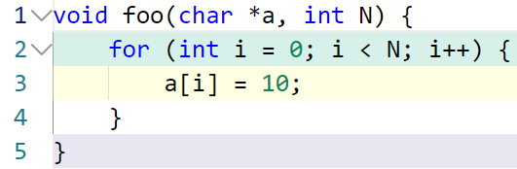
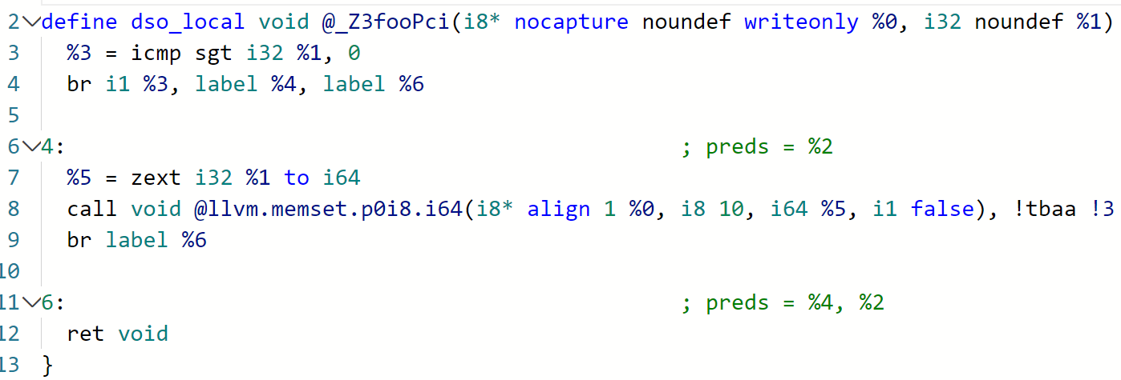
Memcpy optimizations
Eliminates memcpy calls and replaces sets of stores with memset
https://godbolt.org/z/odsKjnxra

Slide 35

Many more…
Available passes list:
https://llvm.org/docs/Passes.html

Slide 36
Important notes on passes
There is no silver bullet pass or pass pipeline
Different target architectures, programming domains have different demands
Different targets require different optimizations (what do we optimize?)
Pass execution order matters
Some passes have prerequisites
Some passes are useless after other passes have been applied
Reuse of already known implementations and concepts is important
But implementing something new may still be necessary

Slide 37
Running optimizations
Use opt tool
See full list of available passes names: https://llvm.org/docs/Passes.html (opt --print-pass-names)
Typical workflow:
Get LLVM IR:
clang -S -emit-llvm example.c -o example.ll
Apply optimizations
opt -S -mem2reg example.ll -o optimized.ll
opt -S -loop-unroll -instcombine -simplifycfg example.ll -o optimized.ll

Slide 38
Next time…
Loop optimizations

Slide 39

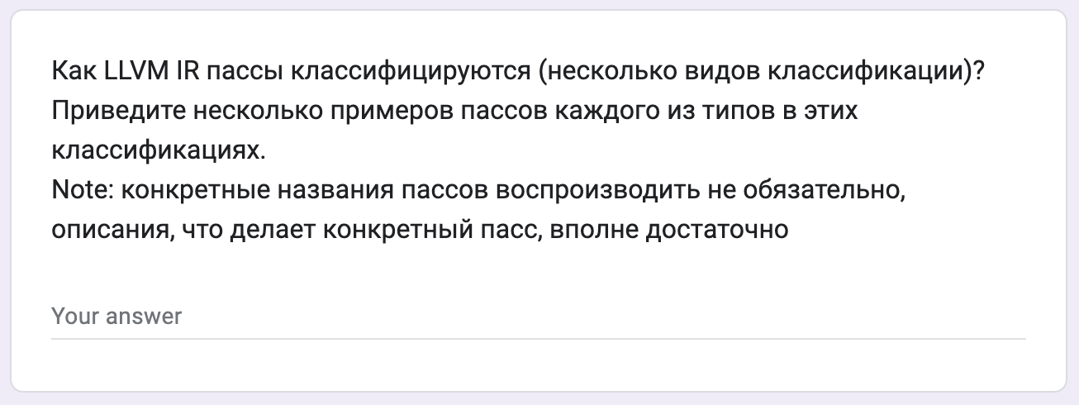
Test
https://forms.gle/EyGD924P98iMSJP26
Submission time: 10 minutes
Backup: me@gooddoog.ru

Slide 40

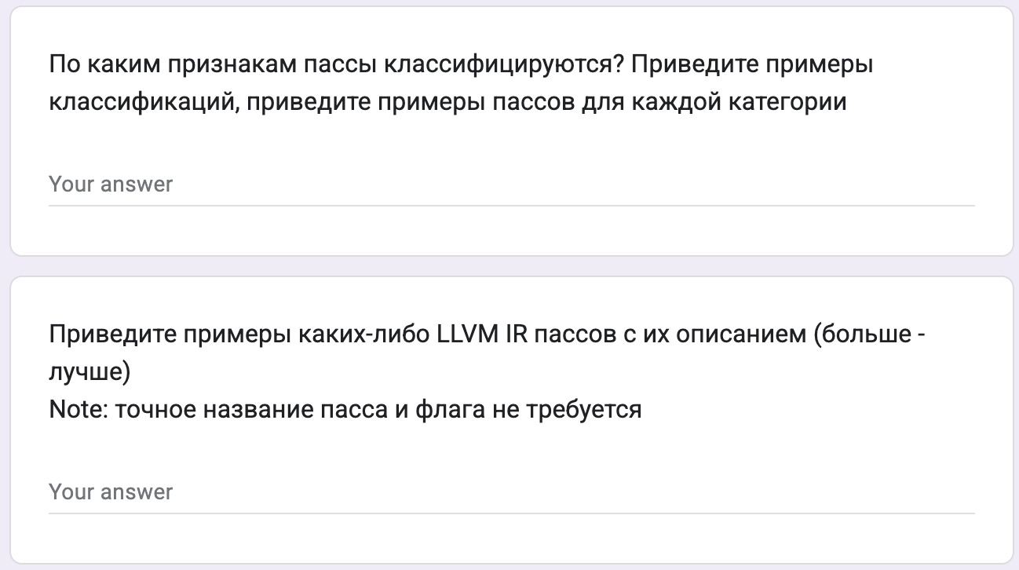
Test
https://forms.gle/VaqaruCTsACXQ6zf7
Submission time: 10 minutes
Backup: me@gooddoog.ru

Slide 41
Extra materials
LLVM IR language reference - https://llvm.org/docs/LangRef.html
Single-Static Assignment Form and PHI - https://mapping-high-level-constructs-to-llvm-ir.readthedocs.io/en/latest/control-structures/ssa-phi.html
LLVM Developers’ Meeting: A. Warzynski “Writing an LLVM Pass: 101” https://www.youtube.com/watch?v=ar7cJl2aBuU
List of LLVM Analyses and Transformations - https://llvm.org/docs/Passes.html

