Slide 1
Deep Residual Learning for Image Recognition
Kaiming He¹ ,Xiangyu Zhang¹,Shaoqing Ren¹,Jian Sun¹
¹Microsoft Research
IEEE Conference on Computer Vision and Pattern Recognition (CVPR), 2016
Speaker: En Li Adviser: Hung-Yin Tsai Date: 2025/7/16
Nano/Micro Engineering Analysis and Fabrication Lab

Slide 2
Outline
Nano/Micro Engineering Analysis and Fabrication Lab
Introduction
Methodology
Results
Conclusion
1

Slide 3
Introduction
Nano/Micro Engineering Analysis and Fabrication Lab
Deep convolution neural networks have led to breakthroughs in image recognition.
The levels of features can be enriched by number of stacked layers.
Vanishing
Exploding
Is learning better network as easy as stacking more layers?
2

Slide 4
Introduction
Nano/Micro Engineering Analysis and Fabrication Lab
Is learning better network as easy as stacking more layers?
Vanishing
Converging
Exploding
3

Slide 5
Introduction
Nano/Micro Engineering Analysis and Fabrication Lab
Vanishing
Exploding
Normalized initialization
Intermediate normalization layers
Converging
4
Notes:
如何解決

Slide 6
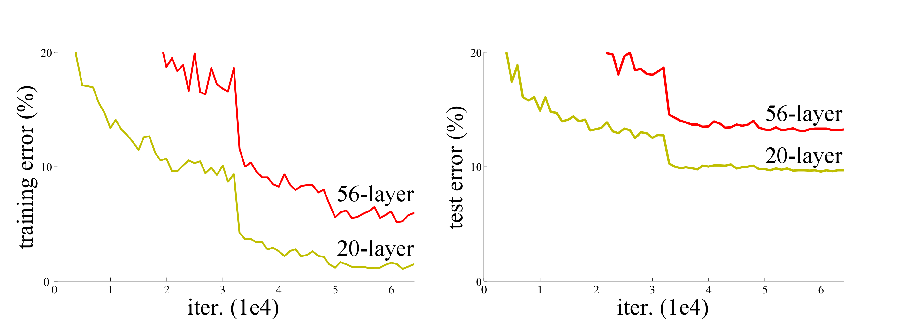
Introduction
Methodology
Nano/Micro Engineering Analysis and Fabrication Lab
Nano/Micro Engineering Analysis and Fabrication Lab
Converging
Degradation problem
Theoretically
SGD can not find the solution
Identity
mapping
Fig 1. Training error (left) and test error (right) on CIFAR-10 with 20-layer and 56-layer “plain” networks.
[1] K. He, X. Zhang, S. Ren, and J. Sun, “Deep residual learning for image recognition,” in Proceedings of the IEEE Conference on Computer Vision and Pattern Recognition (CVPR), Las Vegas, NV, USA, Jun. 2016, pp. 770–778.
5

Slide 7
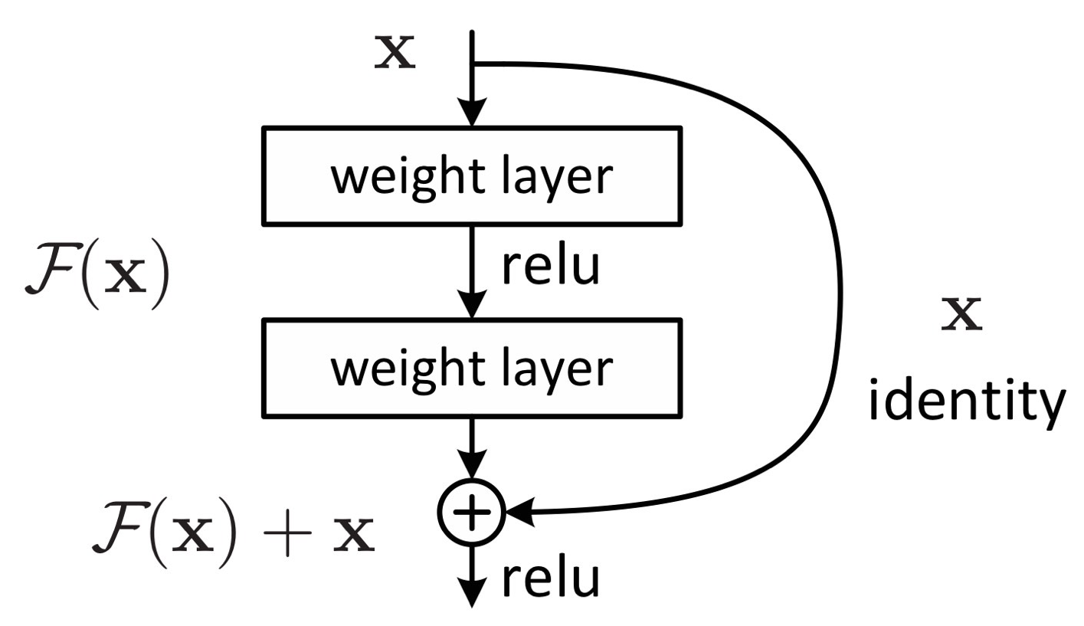





Introduction
Methodology
Nano/Micro Engineering Analysis and Fabrication Lab
Nano/Micro Engineering Analysis and Fabrication Lab
Deep residual learning framework
Shortcut Connection
$$x$$
$$H\left(x\right)−x$$
Residual Representations
$$F\left(x\right)$$
Fig 2. Residual learning: a building block.
$$F\left(x\right)+x$$
[1] K. He, X. Zhang, S. Ren, and J. Sun, “Deep residual learning for image recognition,” in Proceedings of the IEEE Conference on Computer Vision and Pattern Recognition (CVPR), Las Vegas, NV, USA, Jun. 2016, pp. 770–778.
6

Slide 8



Methodology
Nano/Micro Engineering Analysis and Fabrication Lab
Residual Network
Input $≠$ Output
Input $=$ Output
Extra zero entries padded for increasing dimensions
$1×1$ convolutions
Stride of 2
7
Notes:
再看下

Slide 9
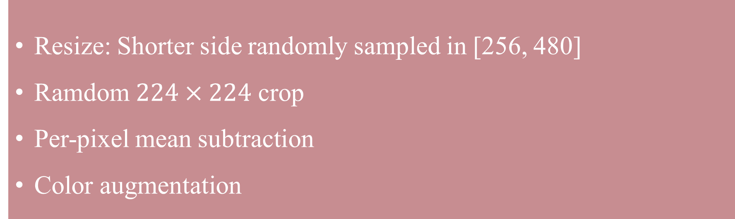
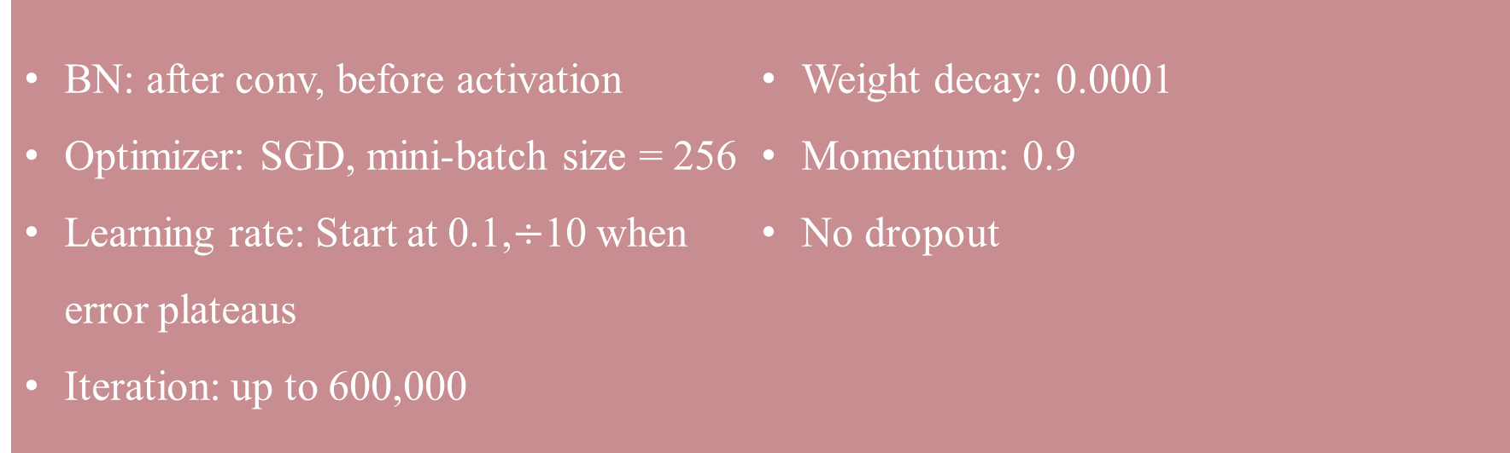
Methodology
Nano/Micro Engineering Analysis and Fabrication Lab
Implementation
Data Augmentation
Training Setting
Resize: Shorter side randomly sampled in [256, 480]
Ramdom $224×224$ crop
Per-pixel mean subtraction
Color augmentation
BN: after conv, before activation
Optimizer: SGD, mini-batch size = 256
Learning rate: Start at 0.1,$÷$10 when error plateaus
Iteration: up to 600,000
Weight decay: 0.0001
Momentum: 0.9
No dropout
8
Notes:
應該再GPT

Slide 10
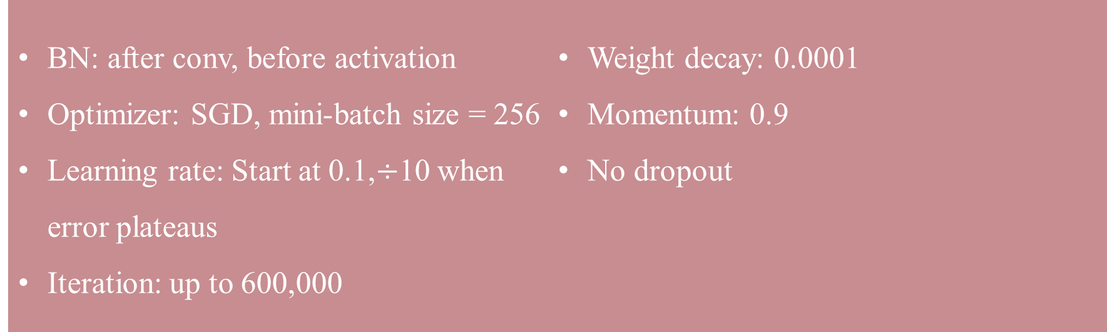
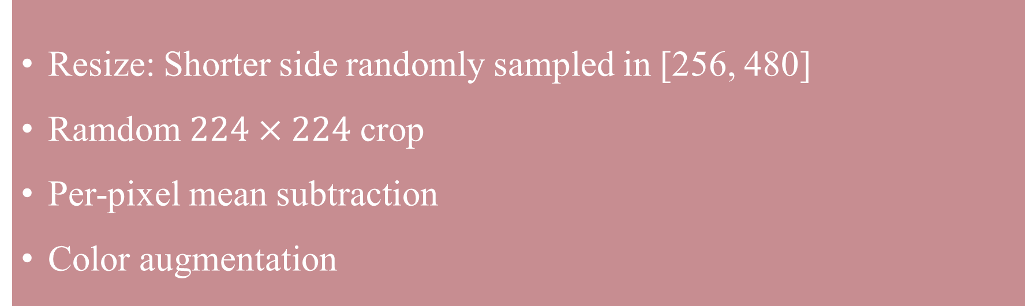
Methodology
Nano/Micro Engineering Analysis and Fabrication Lab
Implementation
Data Augmentation
Training Setting
Testing
Resize: Shorter side randomly sampled in [256, 480]
Ramdom $224×224$ crop
Per-pixel mean subtraction
Color augmentation
BN: after conv, before activation
Optimizer: SGD, mini-batch size = 256
Learning rate: Start at 0.1,$÷$10 when error plateaus
Iteration: up to 600,000
Weight decay: 0.0001
Momentum: 0.9
No dropout
10-crop testing for comparison
Fully-convolutional testing for best result
Average score at multiple scales: Shorter side in {224, 256, 384, 480, 640}
9
Notes:
應該再GPT

Slide 11
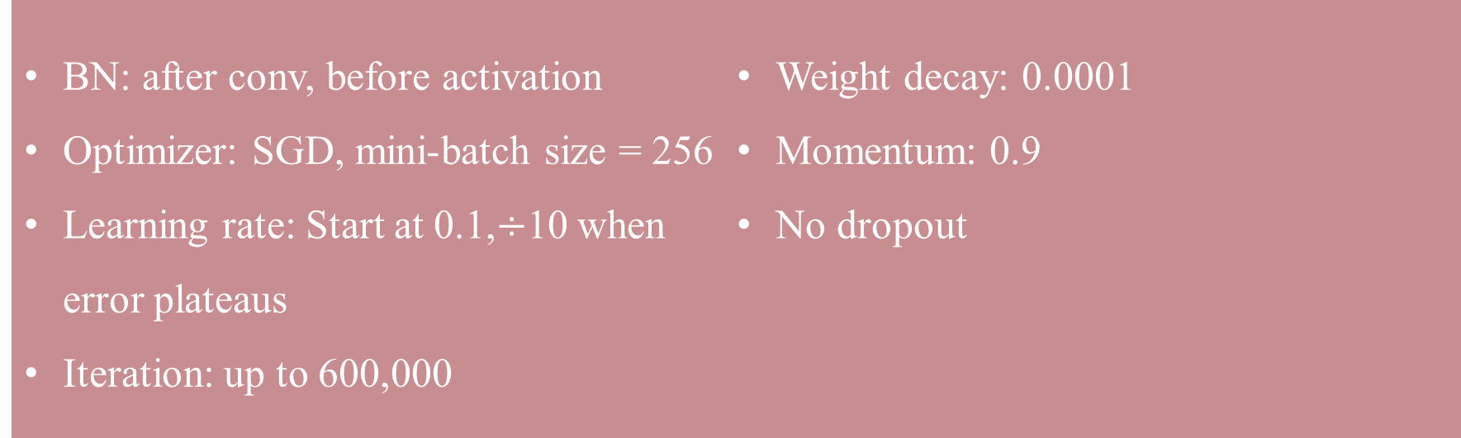
Methodology
Results
Nano/Micro Engineering Analysis and Fabrication Lab
Nano/Micro Engineering Analysis and Fabrication Lab
Implementation
Training Setting
Testing
BN: after conv, before activation
Optimizer: SGD, mini-batch size = 256
Learning rate: Start at 0.1,$÷$10 when error plateaus
Iteration: up to 600,000
Weight decay: 0.0001
Momentum: 0.9
No dropout
10-crop testing for comparison
Fully-convolutional testing for best result
Average score at multiple scales: Shorter side in {224, 256, 384, 480, 640}
10
Notes:
應該再GPT

Slide 12
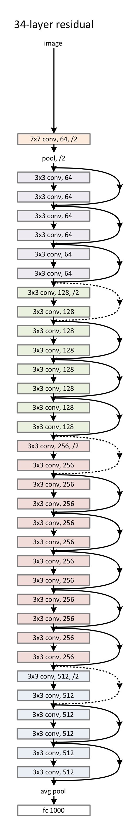
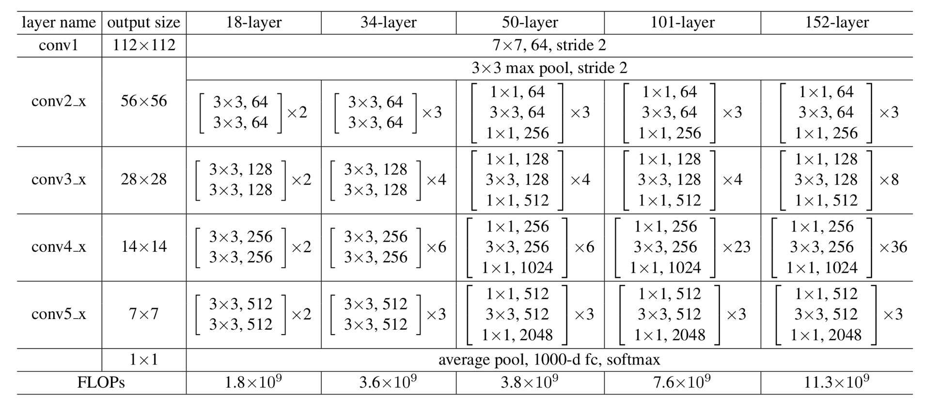
Methodology
Results
Nano/Micro Engineering Analysis and Fabrication Lab
Nano/Micro Engineering Analysis and Fabrication Lab
Table 1. Architectures for ImageNet
Fig 3. Residual network with 34 parameter layers
[1] K. He, X. Zhang, S. Ren, and J. Sun, “Deep residual learning for image recognition,” in Proceedings of the IEEE Conference on Computer Vision and Pattern Recognition (CVPR), Las Vegas, NV, USA, Jun. 2016, pp. 770–778.
11

Slide 13
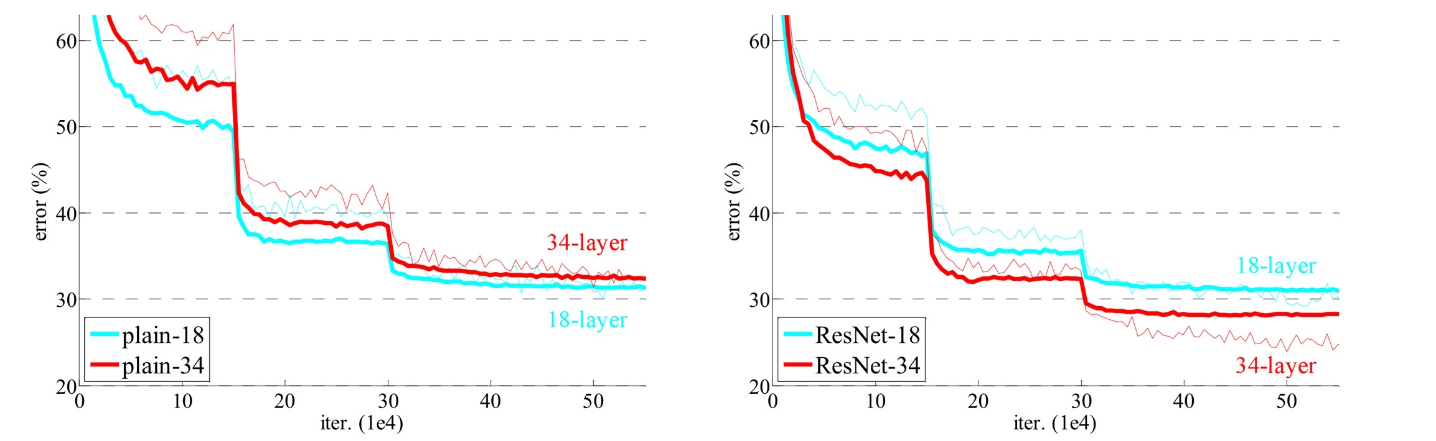

Results
Nano/Micro Engineering Analysis and Fabrication Lab
Learning rate: Start at 0.1, $÷$10 when error plateaus
Converging faster
Fig 4. Training on ImageNet. Left: plain networks of 18 and 34 layers. Right: ResNet of 18 and 34 layers.
[1] K. He, X. Zhang, S. Ren, and J. Sun, “Deep residual learning for image recognition,” in Proceedings of the IEEE Conference on Computer Vision and Pattern Recognition (CVPR), Las Vegas, NV, USA, Jun. 2016, pp. 770–778.
12

Slide 14
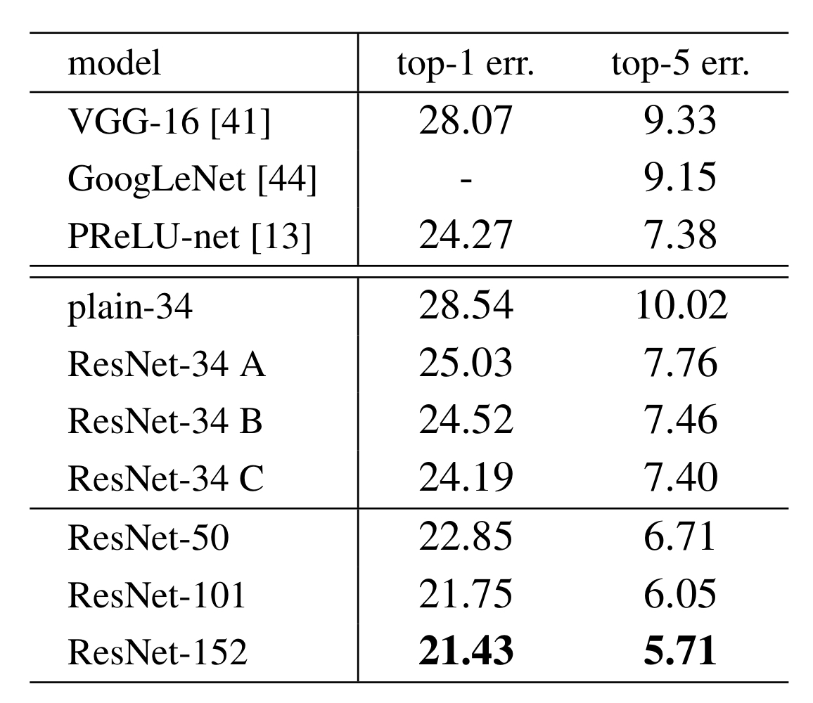

Results
Nano/Micro Engineering Analysis and Fabrication Lab
Table 2. Erro rates ($\%$, 10-crop testing) on ImageNet validation.
A. Zero Padding
B. Projection Shortcuts
C. All Shortcuts
[1] K. He, X. Zhang, S. Ren, and J. Sun, “Deep residual learning for image recognition,” in Proceedings of the IEEE Conference on Computer Vision and Pattern Recognition (CVPR), Las Vegas, NV, USA, Jun. 2016, pp. 770–778.
13

Slide 15
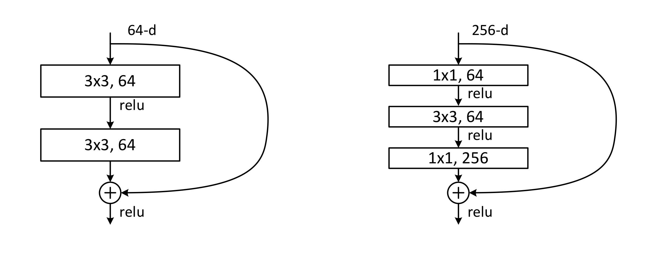


Results
Nano/Micro Engineering Analysis and Fabrication Lab
Bottleneck
$$×4$$
$$FLOPs×4^{2}$$
Fig 5. A deeper residual function $F$ for ImageNet. Left: a building block (on 56$×$56 feature maps) as in Fig. 2 for ResNet-34. Right: a “bottleneck” building block for ResNet-50/101/152.
[1] K. He, X. Zhang, S. Ren, and J. Sun, “Deep residual learning for image recognition,” in Proceedings of the IEEE Conference on Computer Vision and Pattern Recognition (CVPR), Las Vegas, NV, USA, Jun. 2016, pp. 770–778.
14

Slide 16
Results
Nano/Micro Engineering Analysis and Fabrication Lab
Table 1. Architectures for ImageNet
[1] K. He, X. Zhang, S. Ren, and J. Sun, “Deep residual learning for image recognition,” in Proceedings of the IEEE Conference on Computer Vision and Pattern Recognition (CVPR), Las Vegas, NV, USA, Jun. 2016, pp. 770–778.
15

Slide 17
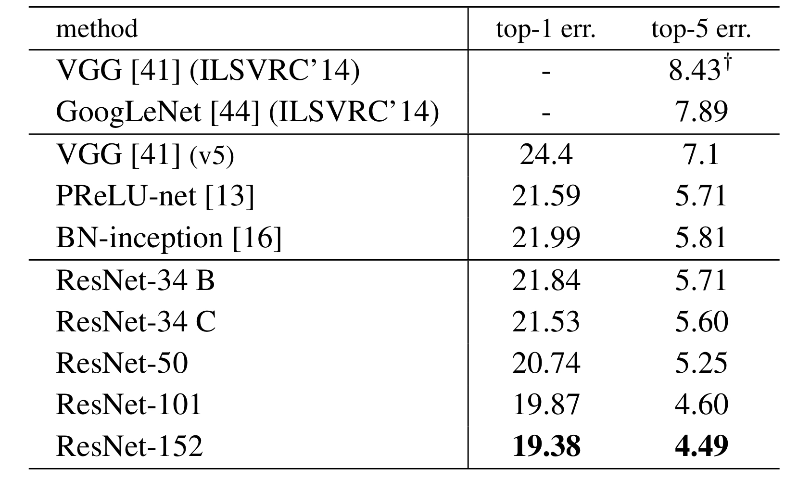
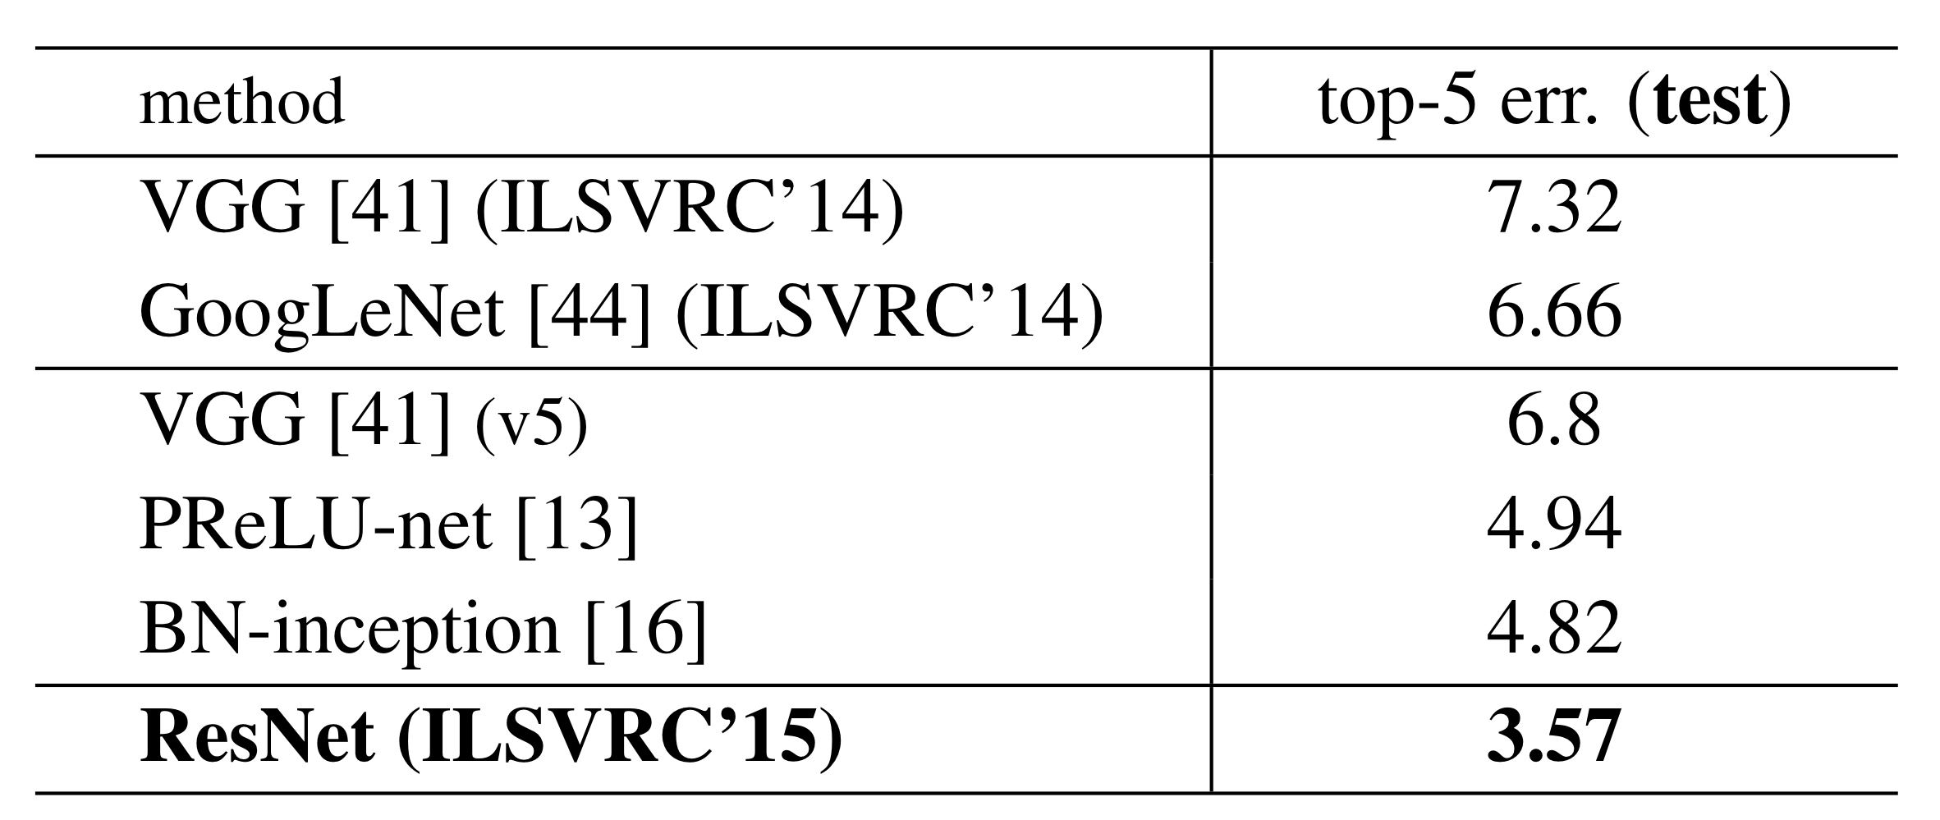
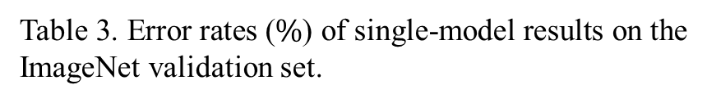
Results
Nano/Micro Engineering Analysis and Fabrication Lab
Table 3. Error rates ($\%$) of single-model results on the ImageNet validation set.
Table 4. Error rates ($\%$) of ensembles.
[1] K. He, X. Zhang, S. Ren, and J. Sun, “Deep residual learning for image recognition,” in Proceedings of the IEEE Conference on Computer Vision and Pattern Recognition (CVPR), Las Vegas, NV, USA, Jun. 2016, pp. 770–778.
16
Notes:
左右圖不一樣的原因

Slide 18
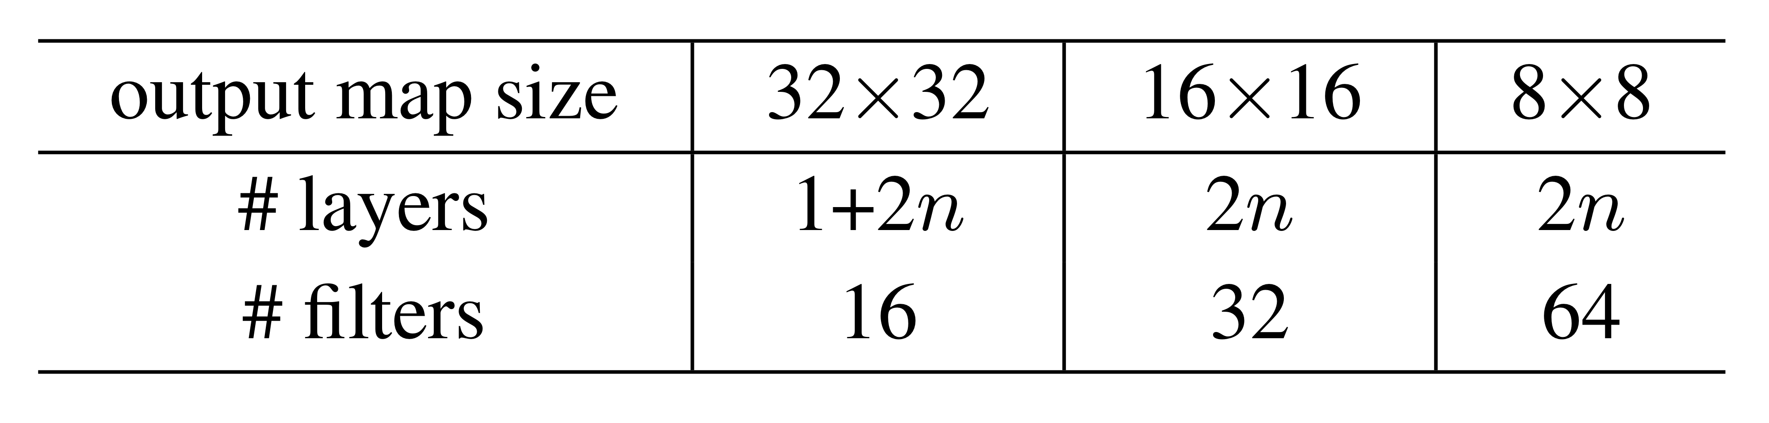
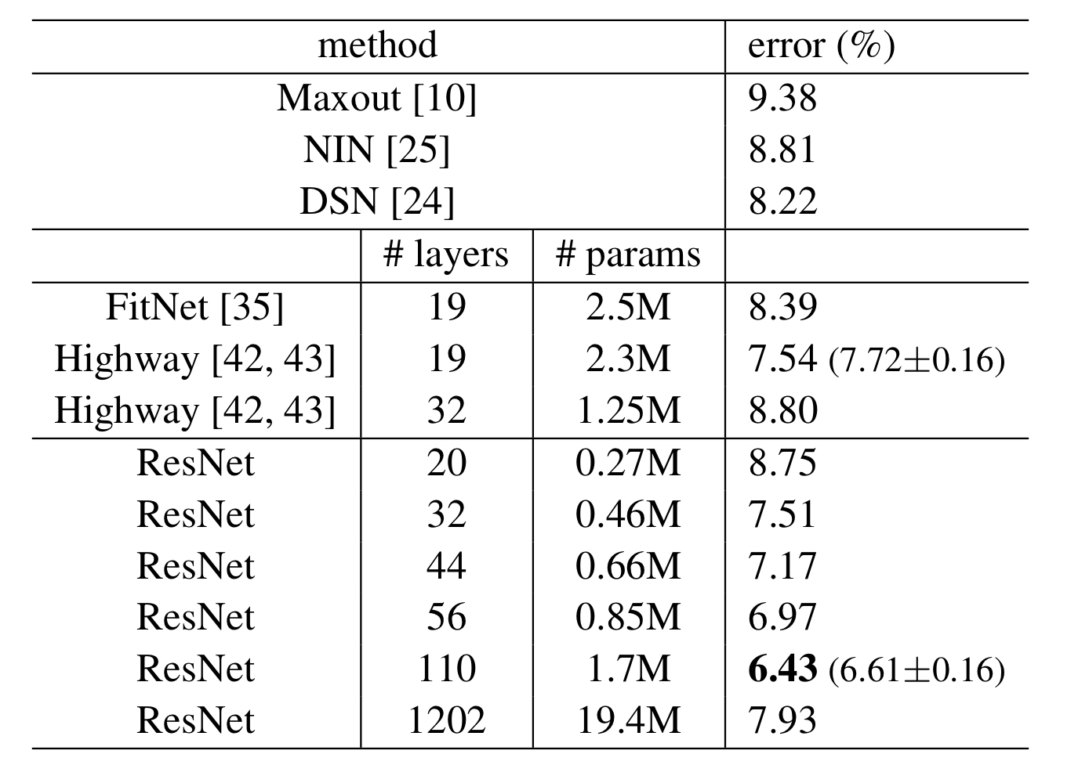
Results
Nano/Micro Engineering Analysis and Fabrication Lab
CIFAR-10
Table 5. ResNet architecture summery on CIFAR-10.
Table 6. Classification error on CIFAR-10 test set.
[1] K. He, X. Zhang, S. Ren, and J. Sun, “Deep residual learning for image recognition,” in Proceedings of the IEEE Conference on Computer Vision and Pattern Recognition (CVPR), Las Vegas, NV, USA, Jun. 2016, pp. 770–778.
17

Slide 19
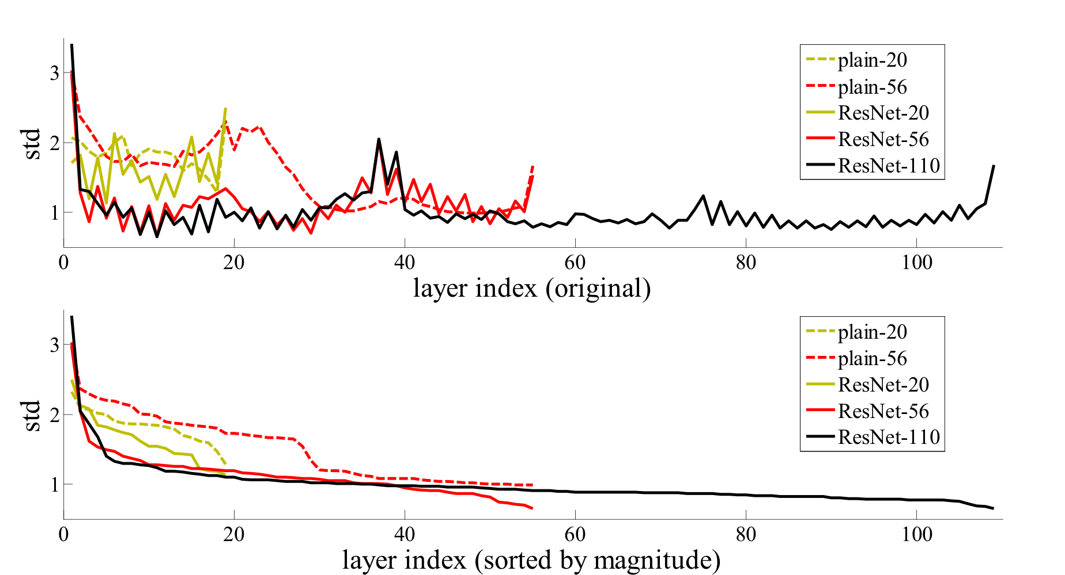
Results
Conclusion
Nano/Micro Engineering Analysis and Fabrication Lab
Nano/Micro Engineering Analysis and Fabrication Lab
CIFAR-10
Fig 6. Standard deviations (std) of layer responses on CIFAR-10.
[1] K. He, X. Zhang, S. Ren, and J. Sun, “Deep residual learning for image recognition,” in Proceedings of the IEEE Conference on Computer Vision and Pattern Recognition (CVPR), Las Vegas, NV, USA, Jun. 2016, pp. 770–778.
18
Notes:
再看或刪

Slide 20
Results
Conclusion
Nano/Micro Engineering Analysis and Fabrication Lab
Nano/Micro Engineering Analysis and Fabrication Lab
Residual Learning enables training of very deep neural networks (e.g., 152 layers)
ResNet solves the degradation problem with simple shortcut connections
Achieved state-of-the-art results on ImageNet (3.57% Top-5 error)
The architecture is simple, general, and widely applicable to other tasks
19
Notes:
問

Slide 21
Reference
[1] K. He, X. Zhang, S. Ren, and J. Sun, “Deep residual learning for image recognition,” in Proceedings of the IEEE Conference on Computer Vision and Pattern Recognition (CVPR), Las Vegas, NV, USA, Jun. 2016, pp. 770–778.
Nano/Micro Engineering Analysis and Fabrication Lab
20

Slide 22
Q&A
Nano/Micro Engineering Analysis and Fabrication Lab

