Slide 1
Bag of Tricks for Image Classiﬁcation with Convolutional Neural Networks
Nemish Murawat – 2016B2A30795P
Pooja Tulsyan - 2016B2A70721P
Akshika Goel - 2016B5A70672P

Slide 2
OBJECTIVE
Examine a collection of training procedure reﬁnements, such as changes in data augmentations, optimization methods and empirically evaluate their impact on the ﬁnal model accuracy through ablation study.
To show that, by combining these reﬁnements together, we are able to improve various CNN models signiﬁcantly.
To show the results on two different datasets Imagenette and Imagewoof.
To compare the results of two CNNs models: ResNet-50 and MobileNet.
Paper Link :https://arxiv.org/abs/1812.01187
Dataset Link :https://github.com/fastai/imagenette

Slide 3

NEED FOR SUCH “TRICKS”
Deep convolutional neural networks have become the dominating approach for image classiﬁcation. Various new architectures have been proposed and we have seen a steady trend of model accuracy improvement.
However, these advancements did not solely come from improved model architecture. Training procedure reﬁnements and optimization methods also played a major role.
A large number of such reﬁnements has been proposed in the past years, but has received relatively less attention. Most of them were only brieﬂy mentioned as implementation details while others can only be found in source code.

Slide 4

CONTRIBUTIONS OF THIS MODEL
These procedure and model architecture reﬁnements improve model accuracy but barely change computational complexity .
It also outperforms other newer and improved network architectures, such as SE-ResNeXt-50.
models trained with these tricks bring better transfer learning performance in other application domains such as object detection and semantic segmentation.

Slide 5
EXPERIMENTAL SETUP AND PRE-PROCESSING
We use the Imagenette dataset, which has 9469 images for training, 3925 images for validation and 10 classes and Imagewoof dataset, which has 9025 images for training, 3929 for validation and 10 classes .
We follow a widely used implementation of ResNet-50, Moblilenet_V2 as our baseline. The preprocessing pipelines between training and validation are different.
The weights of both convolutional and fully-connected layers are initialized with the Xavier algorithm. For batch normalization layers, γ vectors are initialized to 1 and β vectors to 0.
Nesterov Accelerated Gradient (NAG) descent is used for training.

Slide 6
PREPROCESSING PIPELINES(FOR TRAINING)
Randomly sample an image and decode it into 32-bit ﬂoating point raw pixel values in [0,255].
Randomly crop a rectangular region whose aspect ratio is randomly sampled in [3/4,4/3] and area randomly sampled in [8%,100%].
Resize the cropped region into a 224-by-224 square image. Flip horizontally with 0.5 probability .Scale hue, saturation, and brightness with coefﬁcients uniformly drawn from [0.6,1.4].
Add PCA noise with a coefﬁcient sampled from a normal distribution N(0,0.1).
Normalize RGB channels by subtracting mean of dataset and dividing by standard deviation of dataset, respectively

Slide 7
PREPROCESSING PIPELINES(FOR VALIDATION)
Resize each image’s shorter edge to 256 pixels while keeping its aspect ratio.
Crop out the 224-by-224 region in the center and normalize RGB channels similar to training.
Do not perform any random augmentations during validation.

Slide 8
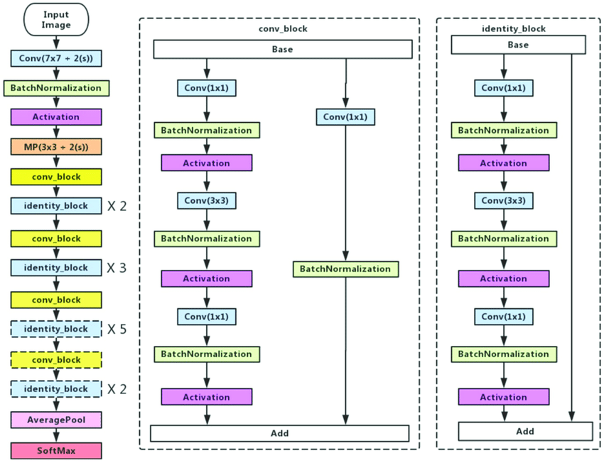
ARCHITECTURE OF RESNET-50

Slide 9
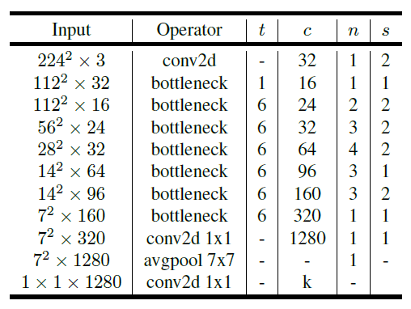
ARCHITECTURE OF MOBILENET_V2

Slide 10
TRICKS FOR EFFICIENT TRAINING
Mixup Data Augmentation
FP16 Training
Learning Rate Warmup
Zero Gamma For Batchnorm

Slide 11
Learning rate warmup
Increases the learning rate from 0 to the initial learning rate linearly. We used the ﬁrst m batches (5 data epochs) to warm up, and the initial learning rate is η , then at batch i , 1 ≤ i ≤ m , we set the learning rate to be iη/m.

Slide 12

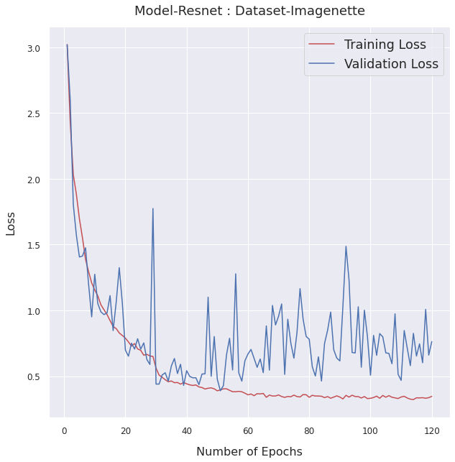
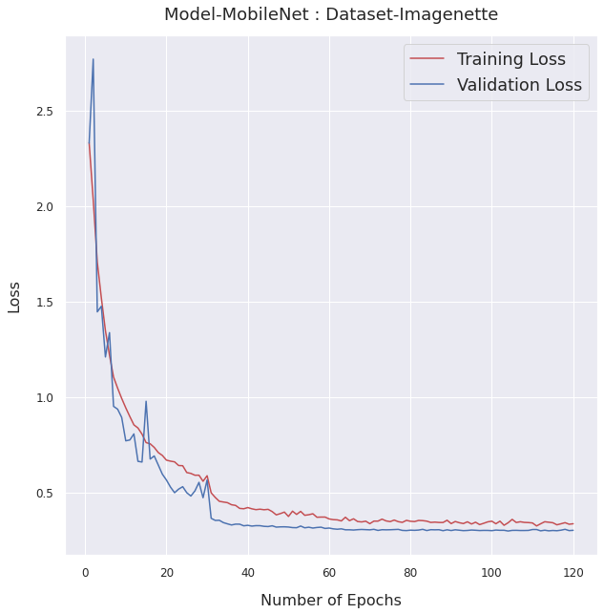
RESULTS(Loss function)

Slide 13
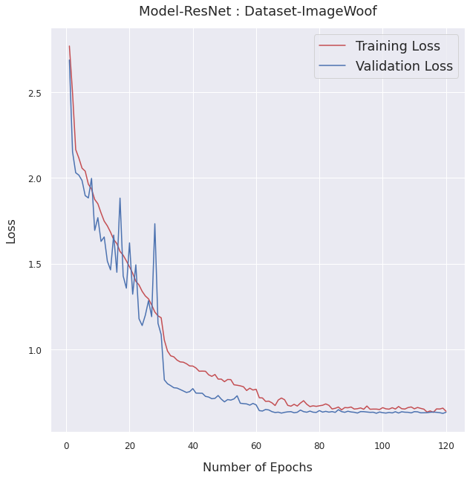
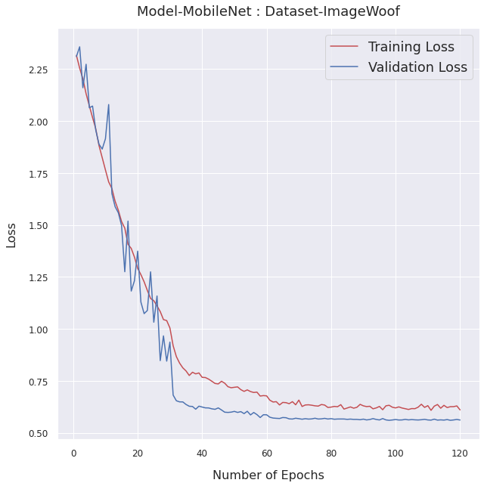

Slide 14
RESULTS(Accuracy)
 | Baseline | Learning Rate Warmup
MODEL | DATASET | Top-1 Accuracy | Top-3 Accuracy | Top-5 Accuracy | Top-1 Accuracy | Top-3 Accuracy | Top-5 Accuracy
Resnet | Imagenette | 87.18% | 96.68% | 99.00% | 88.48% | 97.17% | 99.05%
Resnet | Imagewoof | 68.28% | 89.99% | 96.30% | 79.84% | 94.42% | 97.88%
Mobilenet | Imagenette | 88.05% | 97.19% | 99.23% | 89.96% | 97.60% | 99.33%
Mobilenet | Imagewoof | 72.79% | 90.89% | 96.46% | 81.54% | 95.31% | 98.19%

Slide 15
Zero Gamma For Batchnorm
We initialize γ = 0 for all BN layers that sit at the end of a residual block. Therefore, all residual blocks just return their inputs, mimics network that has less number of layers and is easier to train at the initial stage.

Slide 16
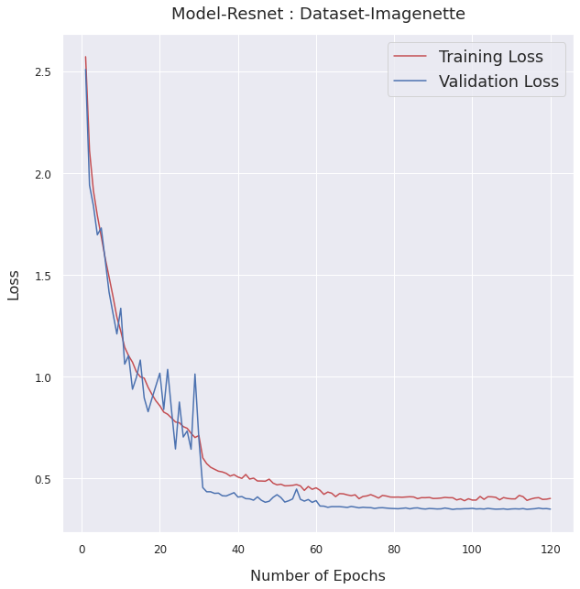
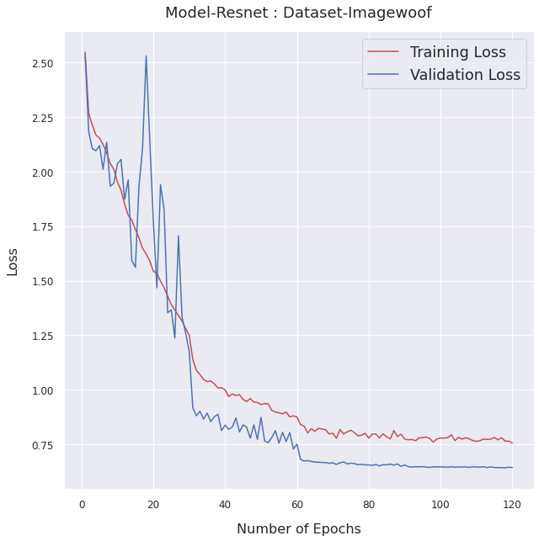
RESULTS(Loss function)

Slide 17
RESULTS(Accuracy)
 | Baseline | Zero Gamma For Batchnorm
MODEL | DATASET | Top-1 Accuracy | Top-3 Accuracy | Top-5 Accuracy | Top-1 Accuracy | Top-3 Accuracy | Top-5 Accuracy
Resnet | Imagenette | 87.18% | 96.68% | 99.00% | 88.33% | 97.07% | 99.13%
Resnet | Imagewoof | 68.28% | 89.99% | 96.30% | 78.36% | 94.34% | 97.88%

Slide 18
Mixup Data Augmentation
Randomly sample two examples (xi,yi) and (xj,yj). Then form a new example by a weighted linear interpolation of these two examples:
x = λxi + (1−λ)xj,
y = λyi + (1−λ)yj,
where λ ∈ [0,1] is a random number drawn from the Beta (α,α) distribution

Slide 19
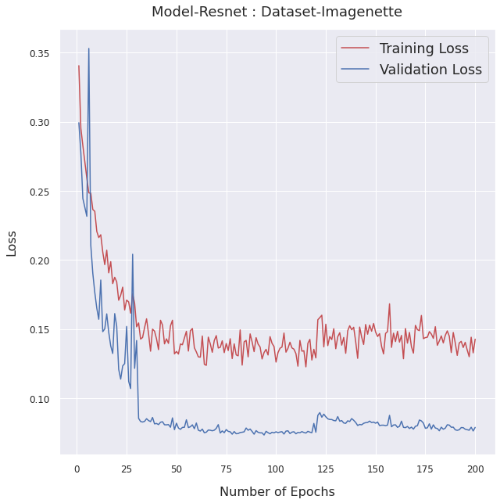
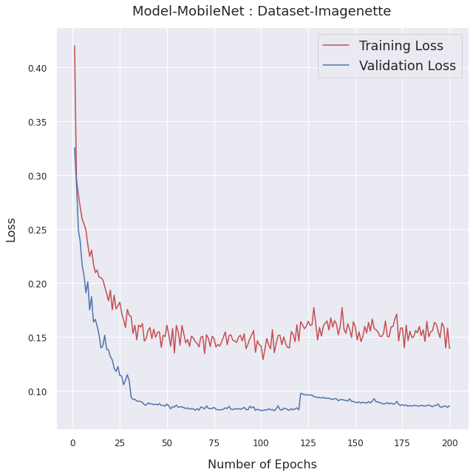
RESULTS(Loss function)

Slide 20
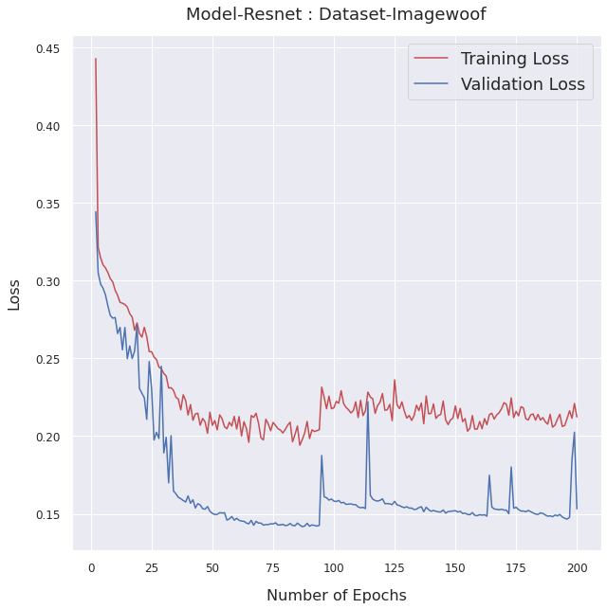


Slide 21
RESULTS(Accuracy)
 | Baseline | Mixup Data Augmentation
MODEL | DATASET | Top-1 Accuracy | Top-3 Accuracy | Top-5 Accuracy | Top-1 Accuracy | Top-3 Accuracy | Top-5 Accuracy
Resnet | Imagenette | 87.18% | 96.68% | 99.00% | 88.15% | 97.11% | 99.25%
Resnet | Imagewoof | 68.28% | 89.99% | 96.30% | 71.21% | 90.05% | 96.80%
Mobilenet | Imagenette | 88.05% | 97.19% | 99.23% | 88.56% | 97.89% | 99.44%
Mobilenet | Imagewoof | 72.79% | 90.89% | 96.46% | 73.10% | 90.94% | 96.59%

Slide 22
FP16 Training
Store all parameters and activations in FP16 and use FP16 to compute gradients.
At the same time, all parameters have an copy in FP32 for parameter updating. The overall training speed is accelerated by 2 to 3 times after switching from FP32 to FP16.This decreases the precision of the model but speeds up the process.

Slide 23
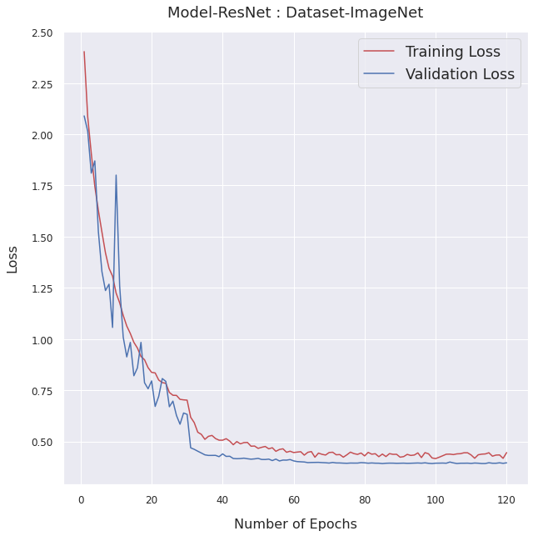
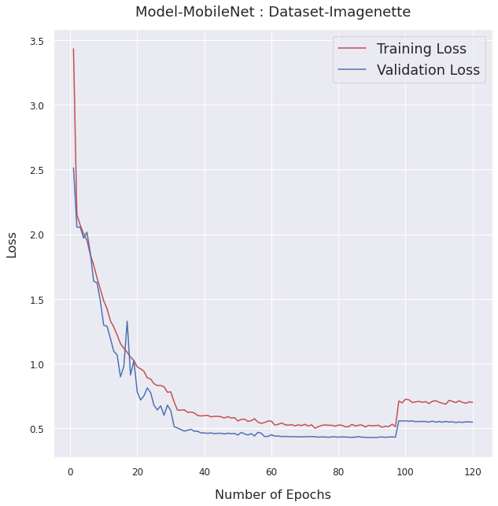
RESULTS(Loss function)

Slide 24
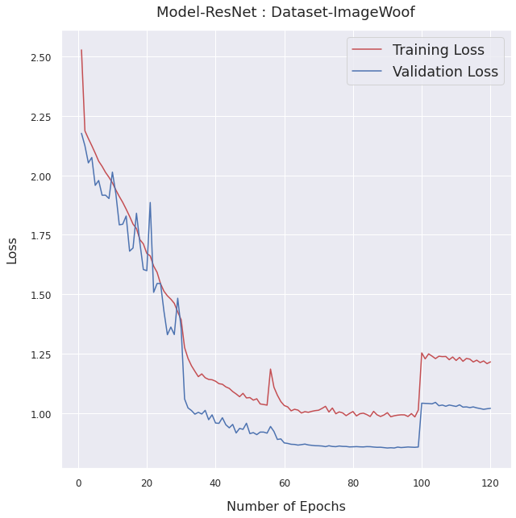
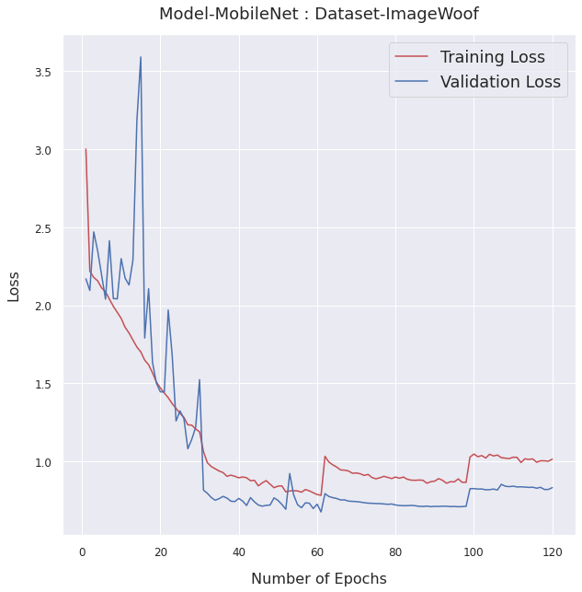

Slide 25
RESULTS(Accuracy)
 | Baseline | FP16
MODEL | DATASET | Top-1 Accuracy | Top-3 Accuracy | Top-5 Accuracy | Top-1 Accuracy | Top-3 Accuracy | Top-5 Accuracy
Resnet | Imagenette | 87.18% | 96.68% | 99.00% | 87.49% | 96.63% | 98.80%
Resnet | Imagewoof | 68.28% | 89.99% | 96.30% | 65.49% | 88.44% | 95.21%
Mobilenet | Imagenette | 88.05% | 97.19% | 99.23% | 81.61% | 94.98% | 98.29%
Mobilenet | Imagewoof | 72.79% | 90.89% | 96.46% | 71.90% | 92.26% | 97.22%
Note:Fp16 reduces the precision of the Output layer of each block, hence accuracy gets decreased with increase in time performance. When FP16 is implemented along other Data Augmentation techniques it increases accuracy achieved in less time as compared to Baseline model.

Slide 26

ADDITIONAL IMPLEMENTATION
We have performed and compared their results of FP16 training , Mixup and Learning rate warm-up on Mobile Net also.
An additional tweak i.e. No Bias Decay is also performed on Resnet and Mobilenet both.

Slide 27
No Bias Decay
The No Bias Decay heuristic applies the weight decay to the weights in convolution and fully connected layers. Other parameters, including the biases and γ and β in BN layers, are left unregularized. It’s equivalent to applying an L2 regularization to all parameters to drive their values towards 0. It’s recommended to only apply the regularization to weights to avoid overﬁtting.

Slide 28
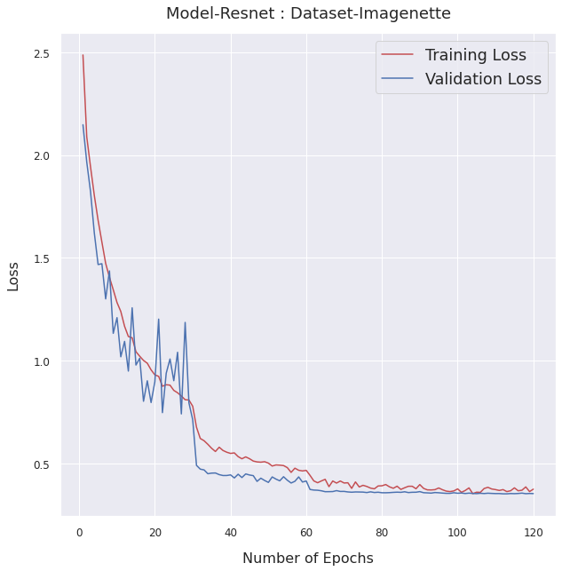
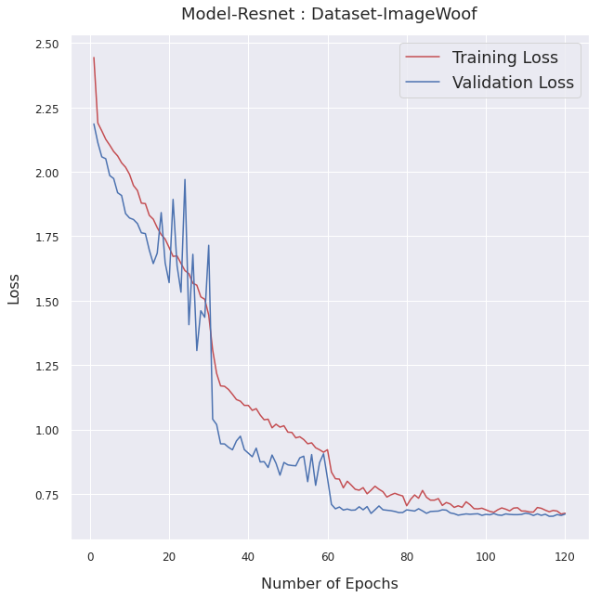
RESULTS(Loss function)

Slide 29
RESULTS(Accuracy)
 | Baseline | No Bias Decay
MODEL | DATASET | Top-1 Accuracy | Top-3 Accuracy | Top-5 Accuracy | Top-1 Accuracy | Top-3 Accuracy | Top-5 Accuracy
Resnet | Imagenette | 87.18% | 96.68% | 99.00% | 88.71% | 97.29% | 99.26%
Resnet | Imagewoof | 68.28% | 89.99% | 96.30% | 78.56% | 93.81% | 97.58%

Slide 30
Conclusions:
Data Augmentation techniques such as Mixup, Learning Rate warmup, Zero Gamma and Nobias Decay increased the accuracy of the model.
Data Augmentation techniques such as FP16 increases the time performance of model whereby affecting model accuracy minutely.
Data Augmentation techniques doesn’t include much complex computation and increases the accuracy of the model. Hence, a powerful tool if used appropriately.

Slide 31
THANK YOU

