Slide 1
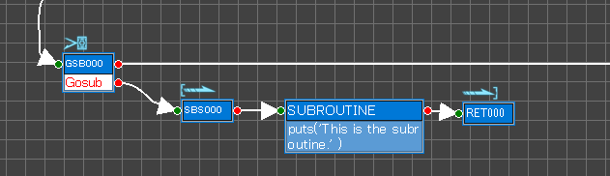
Call Subroutine
Subroutine Start
Subroutine End
(Return)

Slide 2
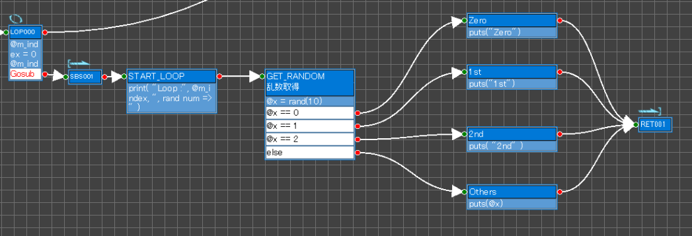
Loop
&
Call Subroutine
Subroutine Start
Subroutine End
(Return)

Slide 3
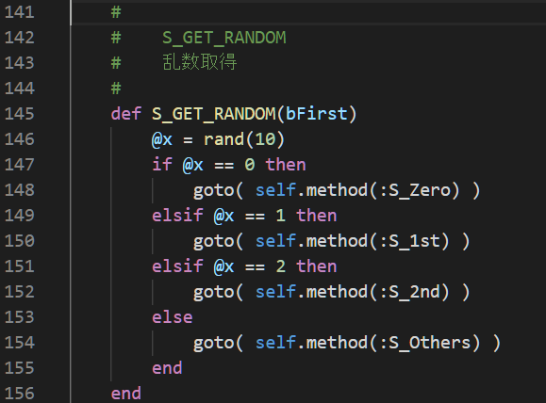

Slide 4
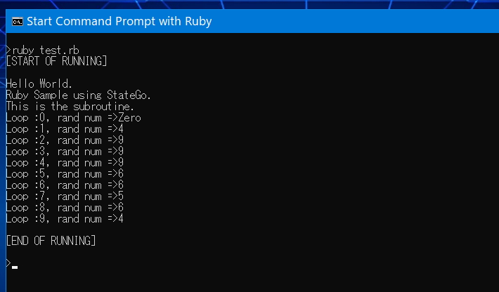
Call Subroutine
Loop 10 Times
and
Branch by random value

