Slide 1


Slide 2


Slide 3
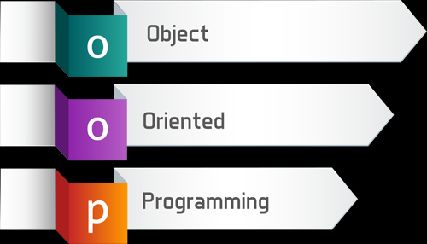

Slide 4


Slide 5
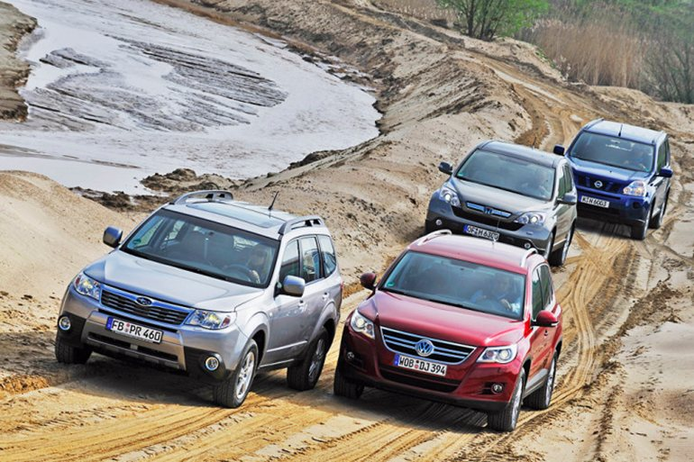

Slide 6
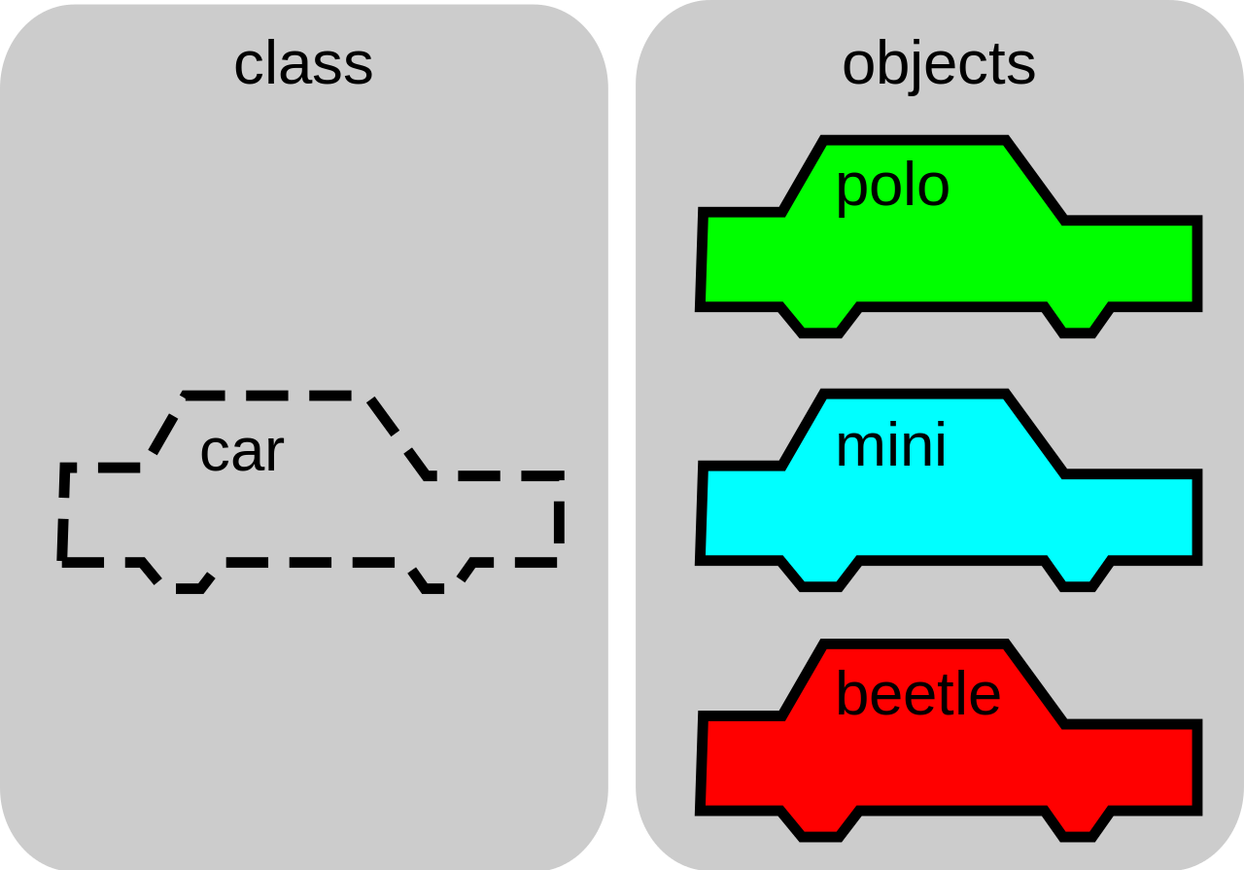

Slide 7
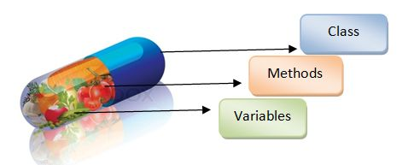

Slide 8
Example
Class Person
  Attributs:
    FirsrtName
    LastName
    Birthdate
  Methods
    Eat()
    Drink()
    Work()

Slide 9
Example
Class Car
    Attributs:
    Model
    BoardNo
    Color
  Methods:
    Drive()
    SpeedUp()
    Stop()

