Slide 1
Scup 2023 Management Track Assessment
NEFSC
Stenotomus chrysops
June 2023

Slide 2
Scup 2015 SAW 60
Most recent ‘Benchmark’ Assessment
Stock definition: Cape Hatteras to Maine
SAW-60 concluded that the scup stock was not overfished nor did it experience overfishing in 2014. The Review Panel stated that “…all of the ToRs were met and the assessment results can be used as a basis for management. “
The Panel concluded that the assessment represented a robust summary of scup population dynamics, but noted uncertainty
regarding the steepness of the estimated rise in biomass since 2000, the possible “cryptic” biomass, and in the accuracy of the Biological Reference Points.
)
Tagging
5
Poole (1962)
5
Murawski (1970)
5
Lux & Nichy (1981)
5
Monaghan (1992)
)
Morphometrics and Meristics
5
Wilk et al. (1980)
5
Fogarty et al. (1983)
)
Genetics
5
Jones and Quattro (1999): no subdivision at Cape
Hatteras

Slide 3
Recent Updates
Stock definition: Cape Hatteras to Maine
Model Update in 2017
Analysis: NFT ASAP SCAA, AGEPRO Projection
YPR/SSBR BRP models
Not Overfished and No Overfishing in 2016
SSC accepted projections for
OFLs/ABCs in 2018-2019
)
Tagging
5
Poole (1962)
5
Murawski (1970)
5
Lux & Nichy (1981)
5
Monaghan (1992)
)
Morphometrics and Meristics
Data Updates in 2016 and 2018
All Fishery Catch and Catch-at-age
All Surveys
SSC made no changes to OFLs/ABCs
5
Wilk et al. (1980)
5
Fogarty et al. (1983)
)
Genetics
5
Jones and Quattro (1999): no subdivision at Cape
Hatteras

Slide 4
Recent Updates
Stock definition: Cape Hatteras to Maine
Operational Assessment in 2019
Analysis: NFT ASAP SCAA, AGEPRO Projection
YPR/SSBR BRP models
Not Overfished and No Overfishing in 2018
Historically large 2015 year class recruiting
SSB about 2X BMSY target
F about 70% of FMSY threshold
Increasing but still ‘minor’ internal retrospective
(SSB -11%; F +26%) no adjustment
Consistency between recent assessments
SSC accepted projections for
OFLs/ABCs in 2020-2021
)
Tagging
5
Poole (1962)
5
Murawski (1970)
5
Lux & Nichy (1981)
5
Monaghan (1992)
)
Morphometrics and Meristics
5
Wilk et al. (1980)
5
Fogarty et al. (1983)
)
Genetics
5
Jones and Quattro (1999): no subdivision at Cape
Hatteras

Slide 5
Recent Updates
Stock definition: Cape Hatteras to Maine
Management Track Assessment in 2021
Analysis: NFT ASAP SCAA, AGEPRO Projection
YPR/SSBR BRP models
Not Overfished and No Overfishing in 2019
Historically large 2015 year class recruiting
SSB about 2X BMSY target
F about 70% of FMSY threshold
Increasing but still ‘minor’ internal retrospective
(SSB -14%; F +20%) no adjustment
Consistency between recent assessments
SSC accepted projections for
OFLs/ABCs in 2022-2023
)
Tagging
5
Poole (1962)
5
Murawski (1970)
5
Lux & Nichy (1981)
5
Monaghan (1992)
)
Morphometrics and Meristics
5
Wilk et al. (1980)
5
Fogarty et al. (1983)
)
Genetics
5
Jones and Quattro (1999): no subdivision at Cape
Hatteras

Slide 6
2023 Management Track Assessment Data and modeling overview
Stock definition: Cape Hatteras to Maine
Add 2020-2022 fishery and research survey data to the
2015 SAW 60 / 2017 / 2019 / 2021 assessment model
Update mean weight and maturity averages for BRPs and projections
Update BRPs
Evaluate stock status relative to updated BRPs
Conduct projections for 2024-2025 to determine OFLs
Level 2 Management Track review
CAMS 2020-2022 commercial fishery catch data
BIG Indices to ‘AS’
Minor model setting changes (input CVs, ESSs)
Backup – Examination of aggregate survey trends or PlanBsmooth using NEFSC fall survey trend to project trend of catch
)
Tagging
5
Poole (1962)
5
Murawski (1970)
5
Lux & Nichy (1981)
5
Monaghan (1992)
)
Morphometrics and Meristics
5
Wilk et al. (1980)
5
Fogarty et al. (1983)
)
Genetics
5
Jones and Quattro (1999): no subdivision at Cape
Hatteras

Slide 7
TOR 1: Fishery Catch
1. Estimate catch from all sources including landings and discards

Slide 8
Commercial Landings
Comm. Landings: mostly MA to NJ, out to edge of shelf
NEFSC Weighout/Dealer AA through 2019; CAMS 2020-2022
Mainly a mixed trawl fishery (>90% of landings);
Some hand gear and trap landings
Avg. ~18,000 mt (40 million lbs) for 1948-1966
Avg. ~ 6,400 mt (14 million lbs) for 1967-1996
Under quotas, avg. 4,500 mt (10 million lbs) for 1997-2017
2018: 6,064 mt (13 million lb), 56% of CQ (10,858 mt)
2019: 6,252 mt (14 million lb), 57% of CQ (10,879 mt)
2020: 6,177 mt (14 million lb), 61% of CQ (10,083 mt)
2021: 5,944 mt (13 million lb), 64% of CQ ( 9,299 mt)
2022: 5,507 mt (12 million lb), 60% of CQ ( 9,245 mt)

Slide 9
Commercial Discards
SBRM Estimator through 2019; CAMS Estimator 2020-2022;
100% mortality rate
During 1997-2017: 1,500 mt = about 35% of comm. land.
2018: 3,293 mt = 54% of comm. land.
2019: 2,779 mt = 45% of comm. land.
2020: 2,611 mt = 42% of comm. land.
2021: 1,895 mt = 32% of comm. land.
2022: 2,171 mt = 39% of comm. land.

Slide 10
Commercial Discards
 | SBRM | CAMS | C-S | %
2018 | 3293 | 3505 | +212 | +6%
2019 | 2779 | 2877 | +98 | +4%
2020 | 2865 | 2611 | -254 | -9%
2021 | 2440 | 1895 | -545 | -22%

Slide 11
Recreational Landings
Largest catches in NY, CT, MA, and RI state waters
P/R Boat lands ~70%, Shore 20%, P/C Boat 10%
Under limits, avg. 4,000 mt (9 million lb) for 1997-2017
2018: 5,887 mt (13 million lb); 176% of RHL (3,342 mt)
2019: 6,403 mt (14 million lb); 192% of RHL (3,342 mt)
2020: 5,863 mt (13 million lb); 198% of RHL (2,954 mt)
2021: 7,540 mt (17 million lb); 274% of RHL (2,752 mt)
2022: 7,875 mt (17 million lb); 286% of RHL (2,757 mt)

Slide 12
Recreational Discards
Largest catches in NY, CT, MA, and RI state waters
P/R Boat discards ~64%, Shore 31%, P/C Boat 5%
15% mortality rate
Under limits, avg. 500 mt (1 million lb) for 1997-2017
2018: 644 mt (1.4 million lb)
2019: 560 mt (1.2 million lb)
2020: 541 mt (1.2 million lb)
2021: 653 mt (1.4 million lb)
2022: 738 mt (1.6 million lb)

Slide 13
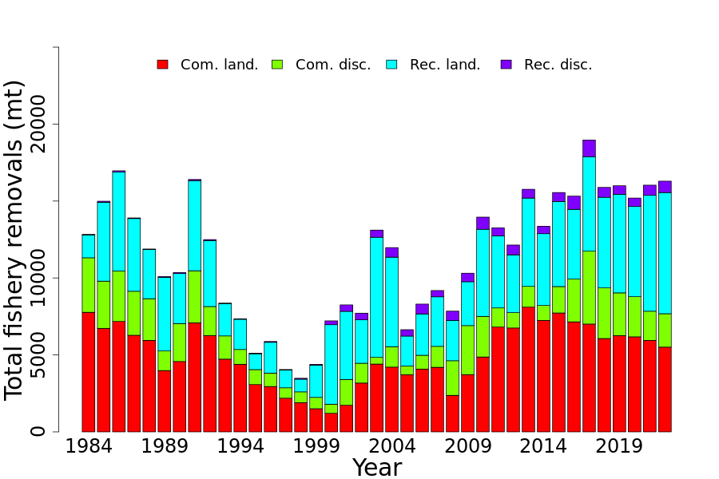

Slide 14
TOR 2: Indices of abundance
2. Evaluate indices used in the assessment (e.g., indices of relative or absolute abundance, recruitment, state surveys, age-length data, etc.)

Slide 15
Research Surveys
NEFSC Winter 1992-2007, Fall and Spring 1967-2022 (ALB IV)
MADMF Spring and Fall 1978-2022
RIDFW Spring and Fall 1981-2022
URIGSO Narragansett Bay, RI Sound 1959-2022
RI Industry Cooperative Trap 2005-2012
CTDEEP Spring and Fall 1984-2022
NYDEC Peconic Bay 1987-2022
NJDFW Coastal Apr-Oct 1988-2022
VIMS Juv. Trawl YOY 1955-2022
VIMS ChesMMAP 2002-2022
VIMS NEAMAP Fall and Spring 2007-2022

Slide 16
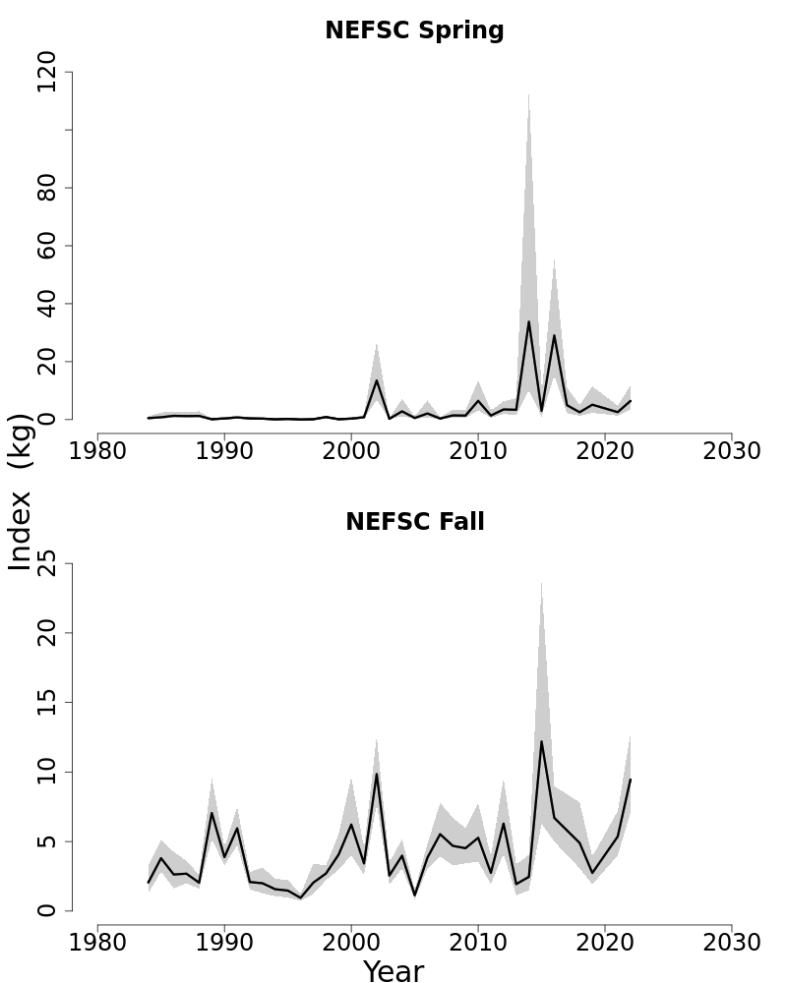

Slide 24
Scup (Stenotomus chrysops) Life History
Biological data from NEFSC survey and fishery samples
Maximum size & age fish in NEFSC SVs and fishery samples (scales):
SV: 1973 - 41 cm FL at age 14; 1976, 1978 - 38 cm at age 14;
2001 - 41 cm FL at age 9;
2014 - 45 cm at age 12;
2016 - 41 cm FL at age 14, 38 cm FL at age 16
2018 - 39 cm FL at age 16
2022 - 32 cm FL at age 17
Comm : 1970s - 45-46 cm FL at ages 8-10
2014 - 40 cm at age 14
2016 - 36, 38 cm at age 17
2017 - 36, 38 cm at age 17, 35 cm at age 18
2019 - 38 cm FL at age 17
Decreasing trend in mean weights at age since about 2000
~80% ---> ~30-40% mature at age 2, 100% ---> 80% at age 3; M = 0.20
Mechanisms unknown

Slide 27
TOR 3: Estimate F, R, and SSB
3. Estimate annual fishing mortality, recruitment and stock biomass (both total and spawning stock) as possible (depending on the assessment method) for the time series using the approved assessment method and estimate their uncertainty. Include retrospective analyses if possible (both historical and within-model) to allow a comparison with previous assessment results and projections, and to examine model fit.
a. Include bridge runs to sequentially document each change from the previously accepted model to the updated model proposed for this peer review.
b. Prepare a backup assessment approach that would serve as an alternative for providing scientific advice to management if the analytical assessment were to not pass review

Slide 28
2023 Management Track Assessment ASAP Model thru 2022
NEFSC NFT ASAP Statistical Catch at Age Model
M at ages 0-7+ (model ages 1-8+); constant M = 0.20
Weights at age for Catch and SSB; recent decreases
Maturity at age: 3 year moving window ~60-80% age 2, 100% age 3+
Recent decreases to ~30-40% age 2, ~80% age 3
Four fleets - Landings and Discards (Com L, Com D, Rec L, Rec D)
Several surveys with age comps and one stand-alone YOY index
Several aggregate indices of biomass
SV selex modeled with at-age estimation; constant over full time series
Fishery selex modeled with at-age estimation: 4 time blocks
1963, 1997, 2006, 2013; Land selex with S = 1 at true age 3 or 4;
discards at true age 1 or 2;

Slide 29
2023 Management Track Assessment ASAP Model Development
Revision to NEFSC survey Bigelow indices (minor)
Bridge runs using MTA 2021 model through 2019 – move on…
..to MTA 2023 model through 2022
Inflate input CVs of a few survey indices (MA fall, CT spring, NJ; to improve RMSE diagnostic (minor)
Re-center input catch and survey ESSs (minor)
Latter two revisions result in minor improvement to model diagnostics (i.e., clean-up)
Bridge/Sensitivity runs for CVs (NEWSET) and ESS (NEWSET_ESS)

Slide 30
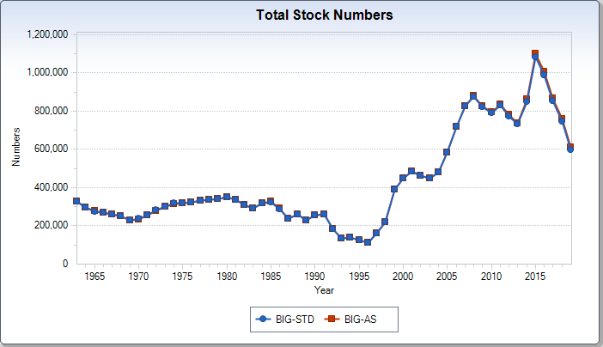
2023 Management Track Assessment
Revision to NEFSC survey Bigelow indices (minor)
Effect on MTA 2021 model through 2019

Slide 31
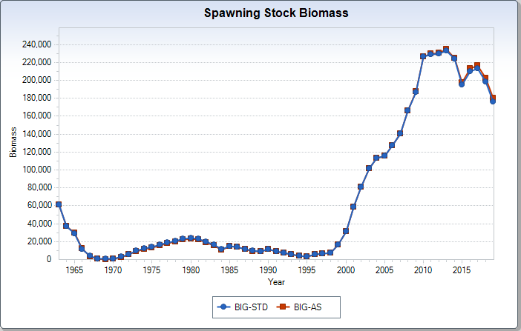
2023 Management Track Assessment
Revision to NEFSC survey Bigelow indices (minor)
Effect on MTA 2021 model through 2019

Slide 32
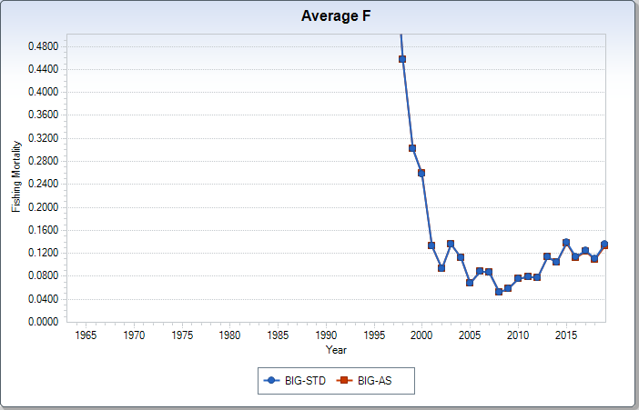
2023 Management Track Assessment
Revision to NEFSC survey Bigelow indices (minor)
Effect on MTA 2021 model through 2019

Slide 33
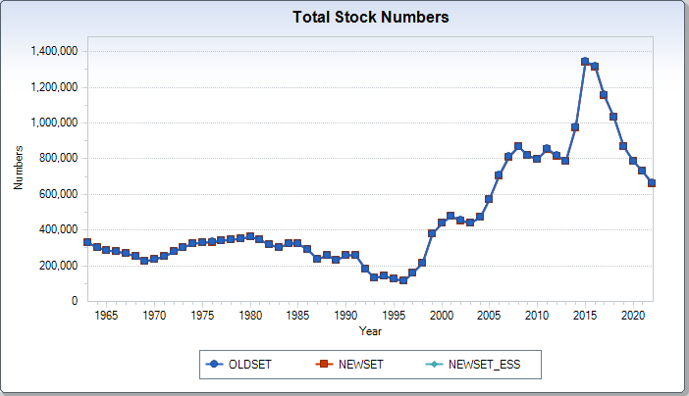
2023 Management Track Assessment
Inflate input CVs of a few survey indices (MA fall, CT spring, NJ; minor)
Re-center input catch and survey ESSs (minor)
Effect on MTA 2023 model through 2022

Slide 34
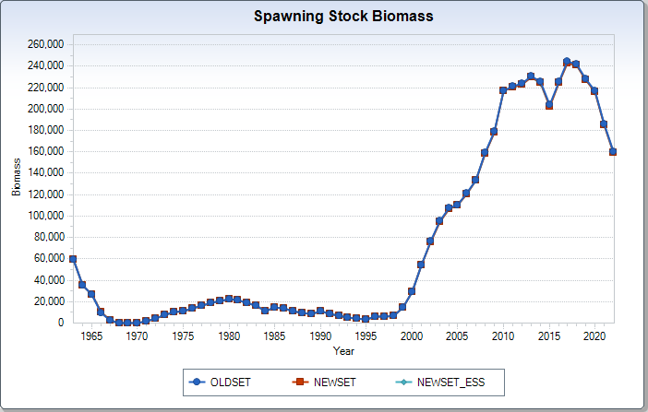
2023 Management Track Assessment
Inflate input CVs of a few survey indices (MA fall, CT spring, NJ; minor)
Re-center input catch and survey ESSs (minor)
Effect on MTA 2023 model through 2022

Slide 35
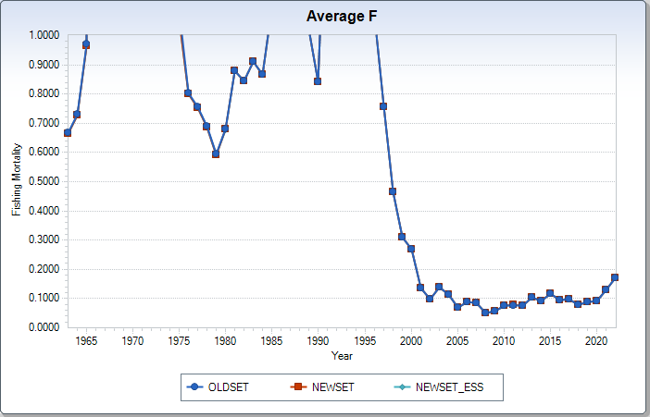
2023 Management Track Assessment
Inflate input CVs of a few survey indices (MA fall, CT spring, NJ; minor)
Re-center input catch and survey ESSs (minor)
Effect on MTA 2023 model through 2022

Slide 36
2023 Management Track Assessment Final ASAP Model
Model now has a ‘major’ retrospective pattern: ‘Good’ retro; SSB underestimated (-21%), F overestimated (+42%)
Adjusted SSB and F are both outside 90% Terminal Year ~90%CI
Terminal Year (2022) SSB and F adjusted for stock status and stock size for projections
Jitter: 66% at final Objective Function value, 20% ~ 4 points below, 14% ~ 4 points above – however, final maximum gradient value = 0.0011, so fairly robust given that diagnostic
MCMC: no convergence problems or unusual high correlations, relatively precise estimates (terminal year CVs=15-20%)
Internal Estimation of BRPs not sufficient: estimated steepness (h) = 1, used proxies instead (F40% = FMSY)
Final Model: MTA2023_NEWSET_ESS_V1

Slide 37
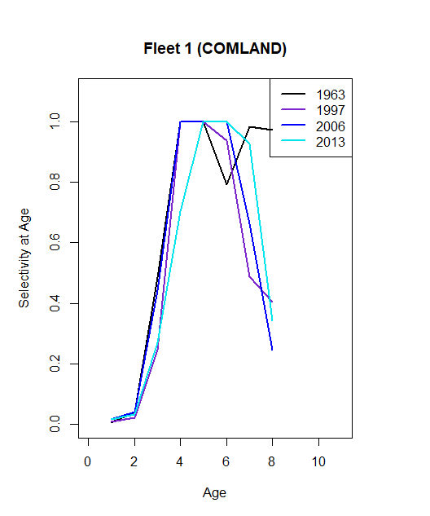

Slide 38
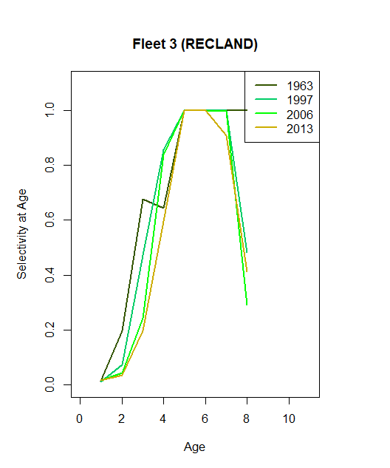

Slide 39
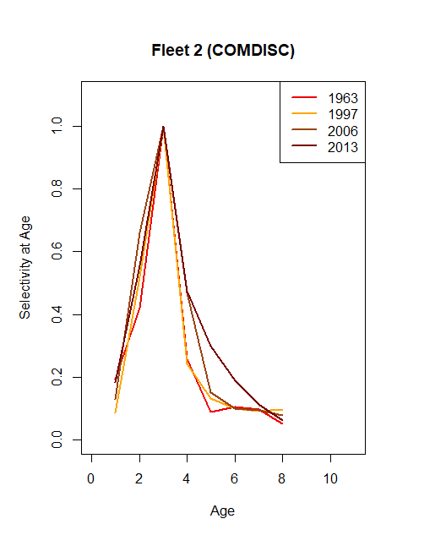

Slide 40
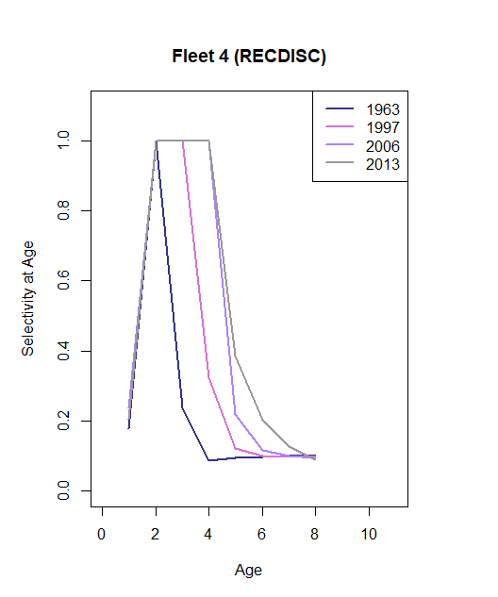

Slide 41
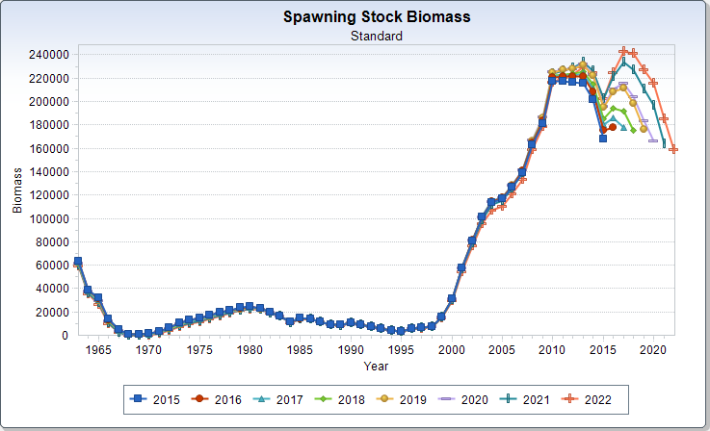
'Internal'
Retrospective
7-year 'peel'
Mohn's rho =
-27% to -1%, -21%
(underestimate SSB)

Slide 42
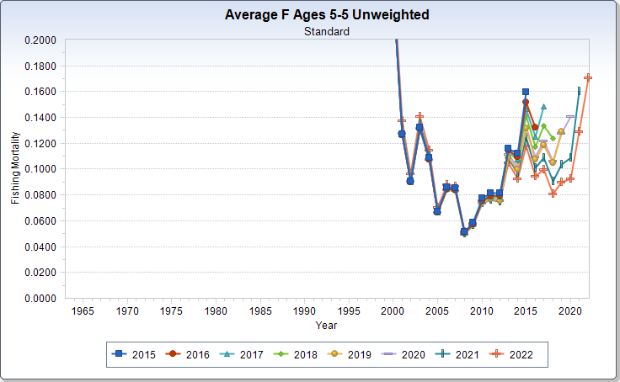
7-year 'peel'
Mohn's rho =
+54% to +6%, +42%
(overestimate F)

Slide 43
The model estimate of SSB in 2022 adjusted for internal retrospective error (-21.4%;
193,087) is outside the model estimate 90% confidence interval (131,720 – 192,050)
The model estimate of F in 2022 adjusted for internal retrospective error (+42.0%; 0.098) is outside the model estimate 90% confidence interval (0.140 – 0.208)
Therefore, adjustment of these terminal year estimates has been made for stock status determination and projections (SSB adjustment applied to all ages N)
SSB in 2022 adjusted from 159,050 mt to 193,087 mt
F in 2022 adjusted from 0.171 to 0.098

Slide 44
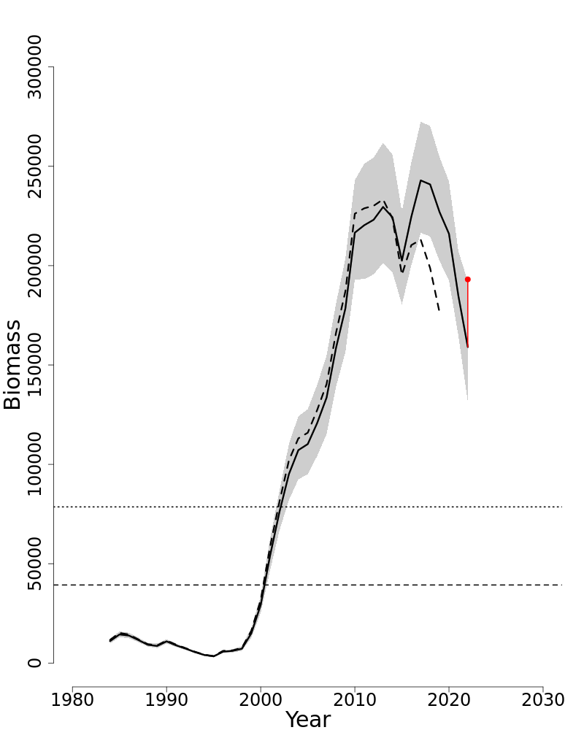

Slide 45
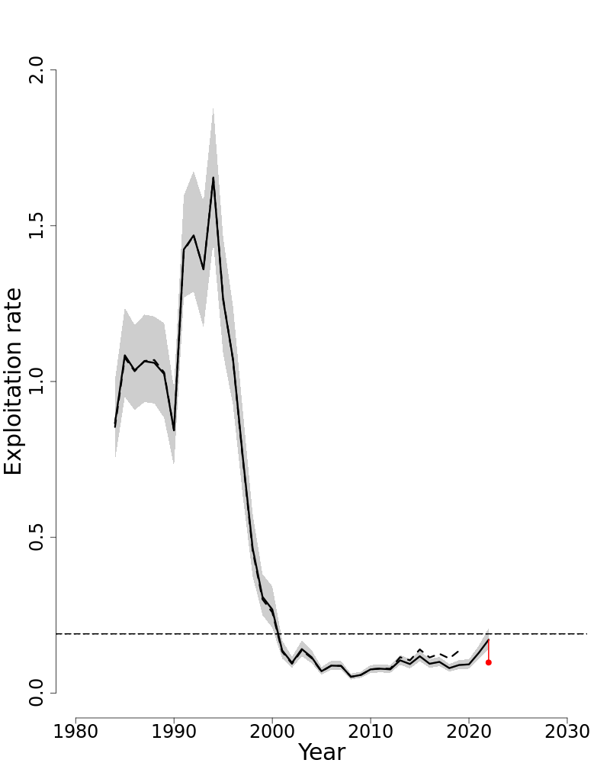

Slide 46
2023 Management Track Assessment ASAP Model Comparative results 2015 to 2023 models

Slide 47
Comparison across assessments
2008, 2015, 2017, 2019, 2021, 2023

Slide 48
Comparison across assessments
2008, 2015, 2017, 2019, 2021, 2023

Slide 49
Comparison across assessments
2008, 2015, 2017, 2019, 2021, 2023

Slide 50
Scup (Stenotomus chrysops) TOR 4: BRPs and Status
4. Re-estimate or update the BRP’s as defined by the management track level and recommend stock status. Also, provide qualitative descriptions of stock status based on simple indicators/metrics (e.g., age- and size-structure, temporal trends in population size or recruitment indices, etc.).

Slide 51
2021 Management Track Assessment: through 2019
BMSY = SSB40% = 90,019 mt
FMSY = F40% = 0.200
MSY = 12,671 mt
Not Overfished: SSB2019 = 176,404 mt, 1.96 x BMSY
Not Overfishing: F2019 = 0.136, 68% of FMSY
2023 Management Track Assessment: through 2022
BMSY = SSB40% = 78,593 mt
FMSY = F40% = 0.190
MSY = 11,959 mt
Not Overfished: ADJ SSB2022 = 193,087 mt, 2.46 x BMSY
Not Overfishing: ADJ F2022 = 0.098, 52% of FMSY

Slide 54
2023 Management Track Assessment TOR 4: Qualitative status
Expanded age structure in current catch and surveys relative to early 1990s
Most survey aggregate biomass indices near time series high through 2017, with a decrease since then
Survey indices suggest recruitment of several large year classes during 2000-2016, below average recruitment since 2017
Simple metrics indicate that mortality from all sources was lower than recruitment inputs to the stock since about 2000, which has resulted in SSB that is still well above the target
The high stock biomass has sustained relatively high catches during 2010-2022

Slide 55
Scup (Stenotomus chrysops) TOR 5: Projections
5. Conduct short-term stock projections when appropriate.

Slide 56
2023 Management Track Assessment OFL Projections 2024-2025
Projections for 2024-2025 OFLs at FMSY = 0.190
During 2018-2022, an average of 101% of the ABC was caught; assume 2023 ABC caught = 13,458 mt
Recruitment sampled from 1984-2022
Retrospective Adjustment using SSB factor as per SOP
OFL 2024 = 20,295 mt (CV = 18%)
OFL 2025 = 18,363 mt (CV = 18%)
Subsequent MAFMC SSC, MC, and Staff recommendations will determine OFLs/ABCs under the risk policy and any other options

Slide 57
2023 Management Track Assessment TOR 6: Respond to any review panel comments or SSC concerns from the most recent prior research or management track assessment.
2015 SAW 60
A standardized fishery dependent CPUE of scup targeted tows, from either NEFOP observer samples or the commercial study fleet, might be considered as an additional index of abundance to complement survey indices in future benchmark assessments: completed for 2015 SAW 60, CPUE indices not included model calibration
Explore additional sources of length/age data from fisheries and surveys in the early parts of the time series to provide additional context for model results: no success, likely alternative is to begin model in 1984 in next RTA
Explore experiments to estimate the catchability of scup in NEFSC and other research trawl surveys (side-by-side, camera, gear mensuration, acoustics, etc.): no progress
Refine and update the Manderson et al. availability analysis when/if a new ocean model is available (need additional support). Explore alternative niche model parameterizations including laboratory experiments on thermal preference and tolerance: no progress

Slide 58
2023 Management Track Assessment TOR 6: Respond to any review panel comments or SSC concerns from the most recent prior research or management track assessment.
2015 SAW 60
Explore the Study fleet data in general for information that could provide additional context and/or input for the assessment: completed for 2015 SAW 60, CPUE indices not included model calibration
A scientifically designed survey to sample larger and older scup would likely prove useful in improving knowledge of the relative abundance of these large fish: no progress

Slide 59
2023 Management Track Assessment TOR 6: Respond to any review panel comments or SSC concerns from the most recent prior research or management track assessment.
2019 OA
The recent recruitment of the largest year class in the assessment time series (the 2015 year class) has contributed to recent high commercial fishery discards. The exploration of management actions to reduce discarding in the event of future high recruitment events might include modification of the commercial fishery Gear Restricted Areas and modified commercial mesh sizes: considered annually as part of the specifications process
There is evidence of a decreasing trend in mean weights at age and maturity, perhaps indicative of density dependent effects. Potential effects on reference points and projected fishery yield should continue to be closely monitored: ongoing monitoring in assessment

Slide 60
2023 Management Track Assessment TOR 6: Respond to any review panel comments or SSC concerns from the most recent prior research or management track assessment.
2021 MT
The panel discussed the unusual direction of the retrospective pattern in the assessments (under estimating biomass and overestimating fishing mortality). There was concern that a retrospective adjustment would increase terminal year estimates of biomass and decreased estimate of fishing mortality when biomass is likely declining due to the decline in the large 2015 year class. The panel discussed potential causes for the retrospective pattern including the potential for overestimation of catch by Marine Recreational Information Program (MRIP): in this 2023 assessment, a retrospective adjustment has been made for stock status and projections, in line with recent ‘standard’ procedures
The panel discussed ideas on how the model inputs could be altered to reduce the retrospective pattern, noting that recommending a Level 2 review would allow for this flexibility. It was noted that shifting model influence weights between catch and survey did not result in much response. Splitting the selectivity series with the final series starting in 2013 did not change the retrospective pattern very much, but did reduce the error sufficiently that an adjustment was not needed: terminal selection block for 2013+ implemented in the 2021 model and retained in 2023 model

Slide 61
2023 Management Track Assessment TOR 6: Respond to any review panel comments or SSC concerns from the most recent prior research or management track assessment.
MAFMC SSC 2019-2022
Characterize the pattern of selectivity for older ages of Scup in both surveys and Fisheries: ongoing estimation in assessment
Explore the applicability of the pattern of fishery selectivity in the model to the most recent catch data to determine whether a new selectivity block in the model is warranted: updated in 2021 model – new 2013+ selectivity block added to model and retained in 2023 model
Mean weights-at-age have declined and age-at-maturity has increased slightly (the proportion mature at age 2 has decreased) in recent years. Continued monitoring of both is warranted: ongoing monitoring in assessment
It was conjectured that the increase in stock biomass since 2000 resulted from increased recruitments due to the imposition of gear restriction areas (GRAs), to minimize interactions between Scup and squid fisheries, and from increases in commercial mesh sizes. Long-term climate variation is a potential alternative explanation for increased recruitments from 2000 to 2015. Research to explore the validity of both hypotheses is warranted: no new research progress

Slide 62
2023 Management Track Assessment TOR 6: Respond to any review panel comments or SSC concerns from the most recent prior research or management track assessment.
MAFMC SSC 2019-2022
Improve estimates of discards and discard mortality for commercial and recreational fisheries: no specific progress, but no concerns expected if current levels of sampling are maintained; note 2022 commercial sampling at lowest (worst) intensity since 1994
Evaluate the degree of bias in the catch, particularly the commercial catch: no stock-specific progress, but GARFO CAMS estimates now included for 2020-2022 data
Conduct experiments to estimate catchability of Scup in NEFSC surveys: no progress
Explore the utility of incorporating ecological relationships, predation, and oceanic events that influence Scup population size on the continental shelf and its availability to resource surveys used in the stock assessment model: no new research progress
Explore additional source of age-length data from historical surveys to inform the early part of the time series, providing additional context for model results: no success, likely alternative is to begin model in 1984 in next RTA

Slide 63
2023 Management Track Assessment TOR 6: Respond to any review panel comments or SSC concerns from the most recent prior research or management track assessment.
MAFMC SSC 2019-2022
An MSE could evaluate the effectiveness of Scup management procedures: no progress
The Scup Statistical Catch at Age assessment model uses multiple selectivity blocks. The final selectivity block (2006-2018) is the longest in the model. The applicability of the most recent selectivity block to the current fishery condition is uncertain. If the fishery selectivity implied in this block changes, estimates of stock number, spawning stock biomass, and fishing mortality become less reliable: updated in 2021 model – new 2013+ selectivity block added to model and retained in 2023 model
Recruitment indices for Scup have been declining in recent years. The 2021 management track assessment should consider the implications on stock biomass projections should this trend continue: evaluated in the 2021 MTA assessment model and associated projections

Slide 64
2023 Management Track Assessment TOR 6: Respond to any review panel comments or SSC concerns from the most recent prior research or management track assessment.
MAFMC SSC 2019-2022
Most of the fishery-independent indices used in the model provide estimates of the abundance of Scup < age 3. One consequence is that much of the information on the dynamics of Scup of older ages arises largely from the fishery catch-at-age and from assumptions of the model, and are not conditioned on fishery-independent observations. As a result, the dynamics of these older fish remain uncertain. Knowledge of the dynamics of these older age classes will become more important as the age structure continues to expand: no new research progress, but assessment indicated the abundance of older fish in increasing in fishery and survey catches, and there is evidence of possible density dependent effects on growth and maturity
The projection on which the ABC was determined assumes that the quotas would be landed in 2019, 2020, and 2021; however, landings in recent years have been below the quotas and perhaps a more realistic assumption should be used in future projections: given the uncertainty of fishery dynamics and catch estimated for 2020, the 2021 MTA projections assumed the ABCs would be caught in 2020-2021; prelim 2020 catch is 94% of 2020 ABC. In current assessment, recent 5 year pattern (101% of ABC caught) indicates that assuming 2023 ABC will be caught is a valid assumption for projections
Uncertainty exists with respect to the estimate of natural mortality used in the assessment: no new research progress

Slide 65
2023 Management Track Assessment TOR 6: Respond to any review panel comments or SSC concerns from the most recent prior research or management track assessment.
MAFMC SSC 2019-2022
Uncertainty exists as to whether the MSY proxies (SSB40%, F40%) selected and their precisions are appropriate for this stock: no new research progress
Survey indices are particularly sensitive to Scup availability, which results in high inter-annual variability. Efforts were made to address this question in the Stock Assessment Workshop and Stock Assessment Review Committee (SAW/SARC) in 2015 that should be continued in the 2021 management track assessment: no new research progress
SSC is concerned over the reduction in port sampling which has the potential to exacerbate concerns about the dynamics of older fish: commercial landings sampling intensity in 2022 was the lowest (i.e., worst) since 1994

Slide 66
2023 Management Track Assessment TOR 3b: Backup – Aggregate Survey Trends (plot) and/or PlanBsmooth trend (cod/monkfish model)
PlanBsmooth:
NEFSC Fall survey only (spring not used in ASAP calibration)
Use entire 1984-2022 series in ALB units (incorporates calibration)
Use only 2009-2022 series in BIG units (no calibration)
Note: no surveys in 2017 or 2020 – program interpolates
ALBSV ‘Multiplier’ = 1.346; BIGSV ‘Multiplier’ = 1.460
So, use ~1.4 as ‘Multiplier’ for future OFL
Example: future 2024-2025 OFL/ABC might be 140% of current 2023 OFL/ABC
Relationship of OFL to ABC will depend on SSC application of risk-policy and assumption for OFL CV under Backup Plan

Slide 69
Extra Slides

Slide 70
2023 Management Track Assessment OFL Projections Effect of Retrospective Adjustment
Projection for 2024 OFL at FMSY = 0.190
During 2018-2022, an average of 101% of the ABC was caught; assume 2023 ABC caught = 13,458 mt
Recruitment sampled from 1984-2022
OFL SSB
NOADJ 2024 16,481 150,736
2025 15,057 132,305
ADJN 2024 20,664 175,527
2025 19,104 158,277
ADJSSB 2024 20,295 185,475
2025 18,363 162,716

Slide 71
Model comparisons/sensitivities:
Split NEFSC series into ALB and BIG
2) Force Flat Selex for Comm and Recr Landings

Slide 73
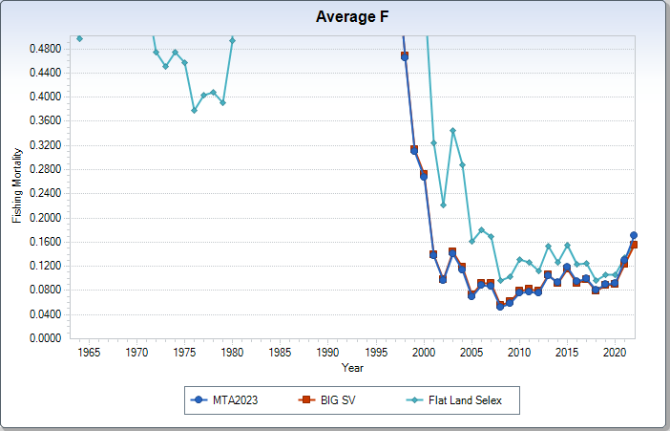
MTA2023 (dome) vs BIG SV vs Fixed Flat Selex

Slide 74
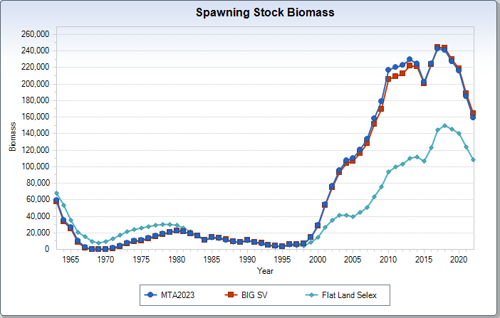
MTA2023 (dome) vs BIG SV vs Fixed Flat Selex

Slide 75
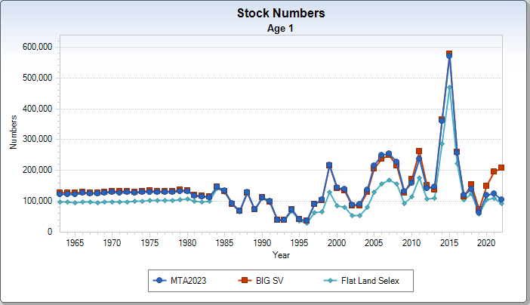
MTA2023 (dome) vs BIG SV vs Fixed Flat Selex

Slide 76
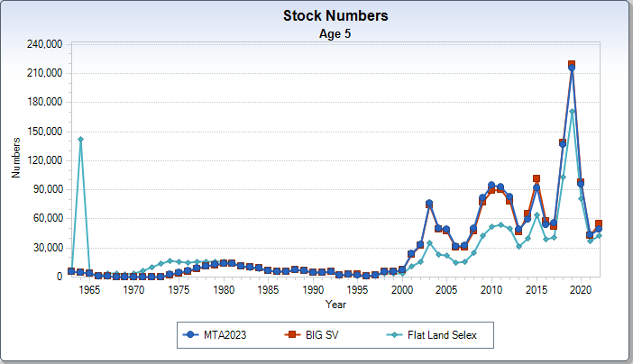
MTA2023 (dome) vs BIG SV vs Fixed Flat Selex

Slide 77
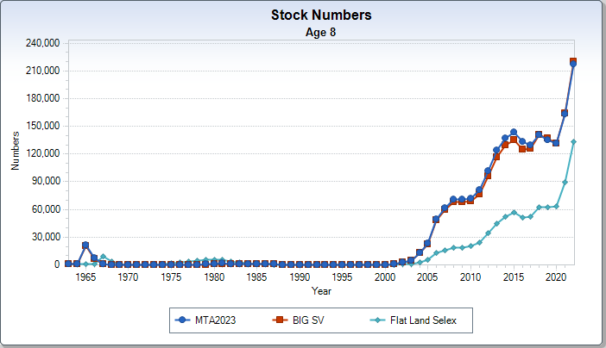
MTA2023 (dome) vs BIG SV vs Fixed Flat Selex

Slide 78
More Model comparisons/sensitivities…
Start model in 1984
2) compare to 2015 SAW 60 and MTA2023

Slide 79
2015 SAW 60 (1963+) vs MTA2023 (1963+) vs S1984 (1984+)

Slide 80
2015 SAW 60 (1963+) vs MTA2023 (1963+) vs S1984 (1984+)

Slide 81
2015 SAW 60 (1963+) vs MTA2023 (1963+) vs S1984 (1984+)

