Slide 1
VPOT and STRM Plots
Comparison of CFS and SFS UPP develop
CFS grib2 file used: pgbf2024090100.02.2024050100.grb2

Slide 2
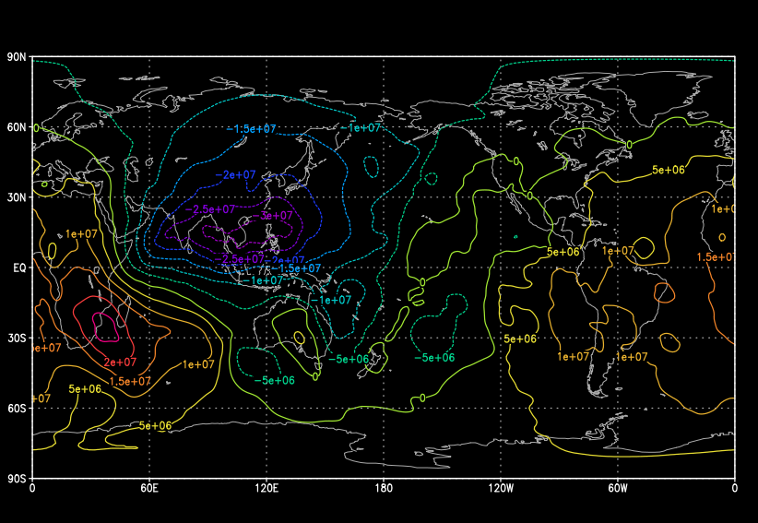
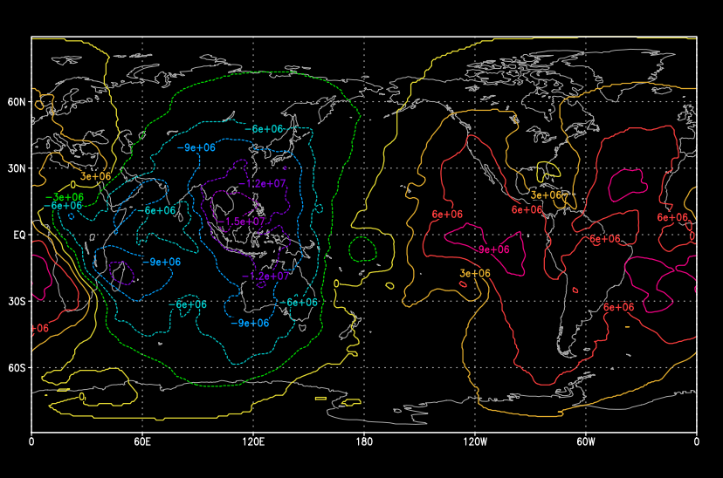
VPOT 200mb
CFS
SFS UPP develop

Slide 3
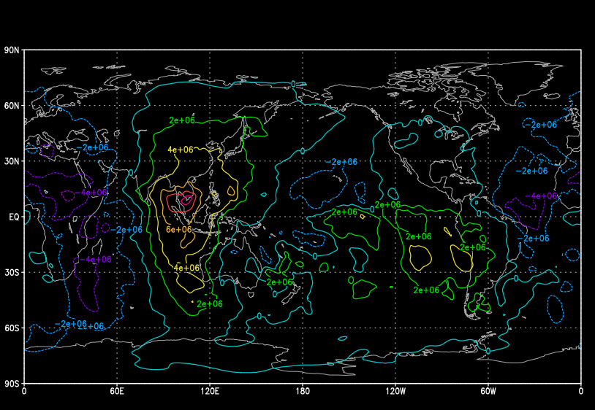
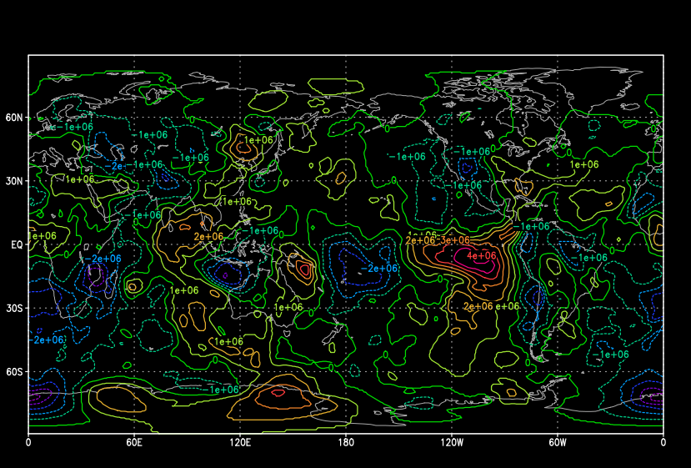
VPOT 500mb
CFS
SFS UPP develop

Slide 4
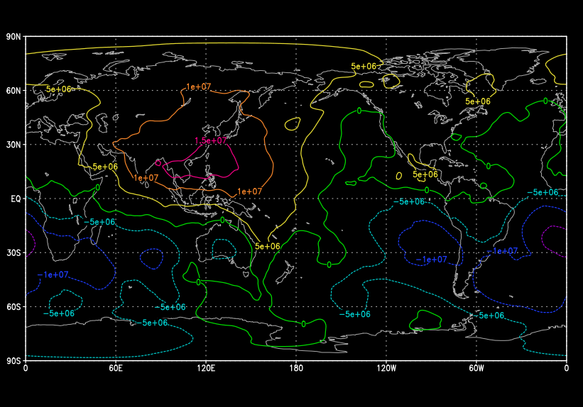
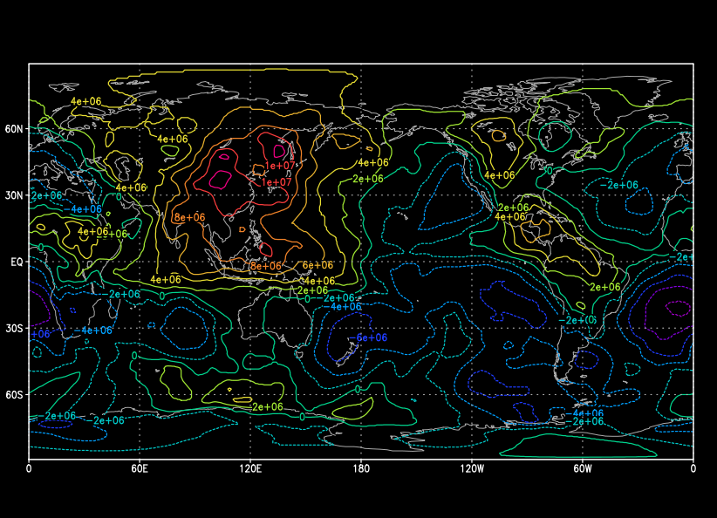
VPOT 1000mb
CFS
SFS UPP develop

Slide 5
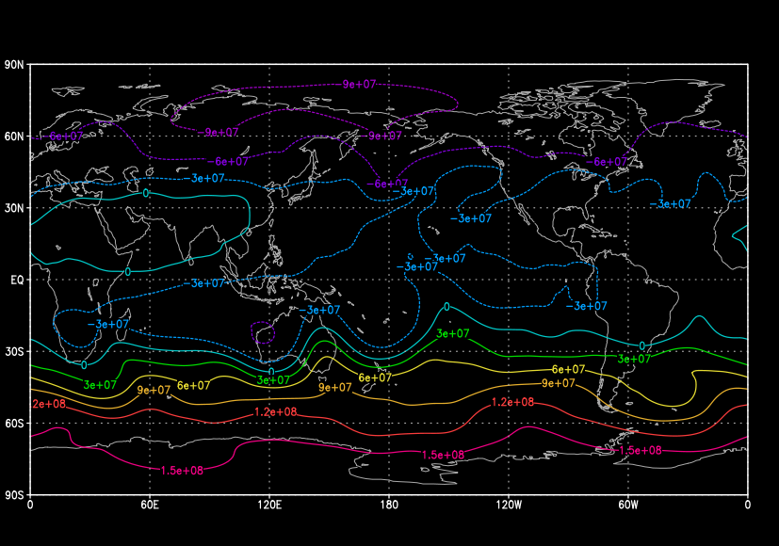
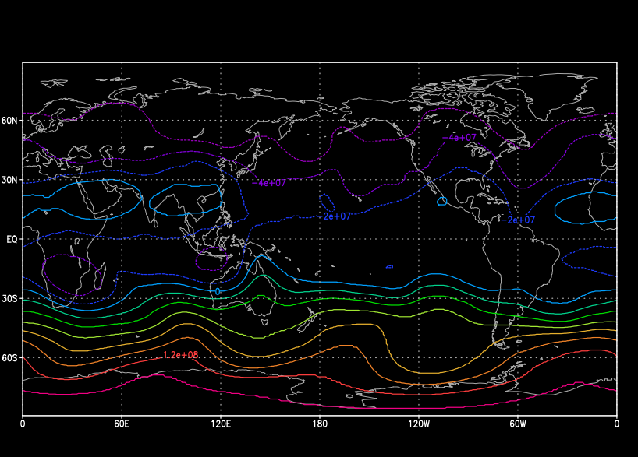
STRM 200mb
CFS
SFS UPP develop

Slide 6
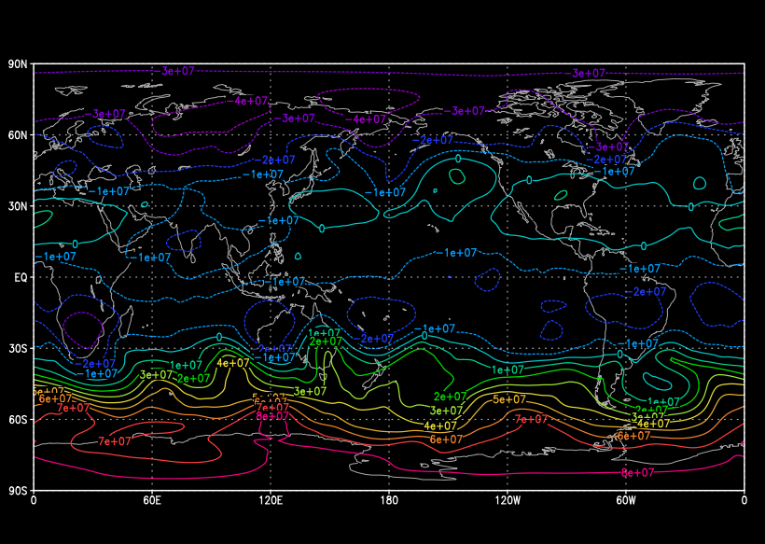
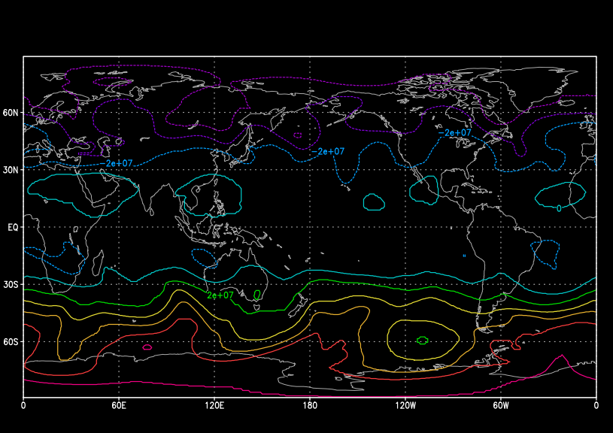
STRM 500mb
CFS
SFS UPP develop

Slide 7
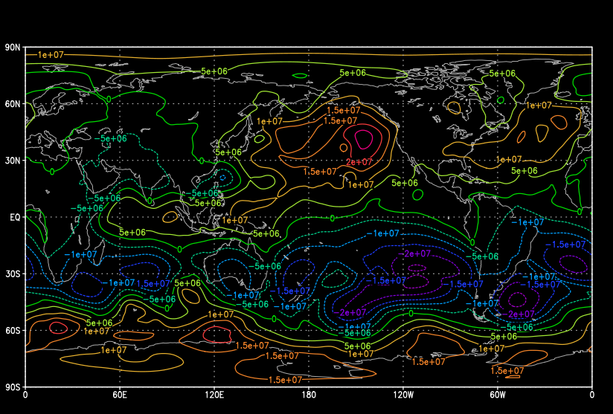
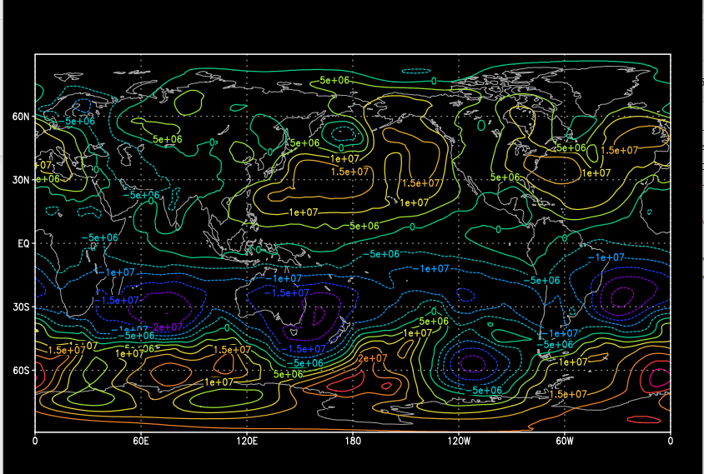
STRM 1000mb
CFS
SFS UPP develop

Slide 8
Appendix
Source code computations

Slide 9
1. Spectrally truncate wind vector fields on global cylindrical grid to compute velocity potential and stream function
Spectral truncation done in global domain IM,JM,LSM
U and V winds for each process are first collected in a separate vertical loop to get the full IM,JM domain
IDRT (grid identifier) is read in from post calculations, 4 for Gaussian grid in this case
Subroutine used is in NCEP library: sptrunv.f
Output U and V winds, CHI and PSI grids are output in full IM,JM,LSM domain
CFS program implementation is as shown in genpsiandchi.f
Computations in UPP/sorc/ncep_post.fd/MDL2P.f

Slide 10
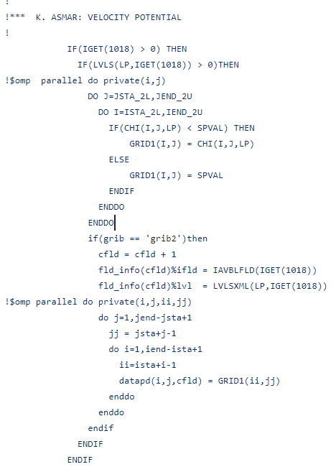
2. Store CHI and PSI grids for each process at the specified vertical level
CHI (VPOT) and PSI (STRM) grids are stored in the ISTA_2L:IEND_2U, JSTA_2L:JEND_2U for each process at the LP requested vertical levels
Store CHI grid (VPOT) for each process and vertical level in UPP/sorc/ncep_post.fd/MDL2P.f

