Slide 1
Velocity Potential (VPOT) and Streamfunction (STRM) Plots
Comparison of CFS operational output and GFSV16 input data processed with UPP

Slide 2
Input Datasets from WCOSS2
Datetime 2024-05-10
Forecast Hour 024 from the 00 cycle
CFS GRIB2 file used for plots
/lfs/h1/ops/prod/com/cfs/v2.3/cfs.20240510/00/6hrly_grib_01/pgbf2024051100.01.2024051000.grb2
GFSV16 input datasets to UPP to obtain GRIB2 results used in plots
/lfs/h1/ops/prod/com/gfs/v16.3/gfs.20240510/00/atmos
gfs.t00z.atmf024.nc
gfs.t00z.sfcf024.nc

Slide 3
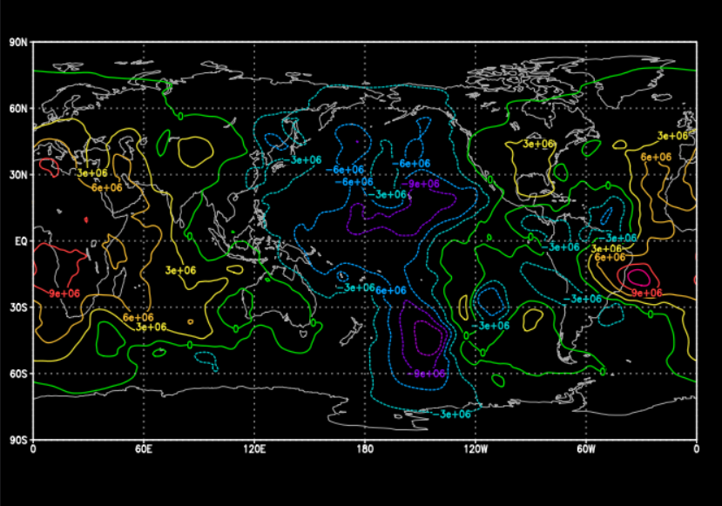
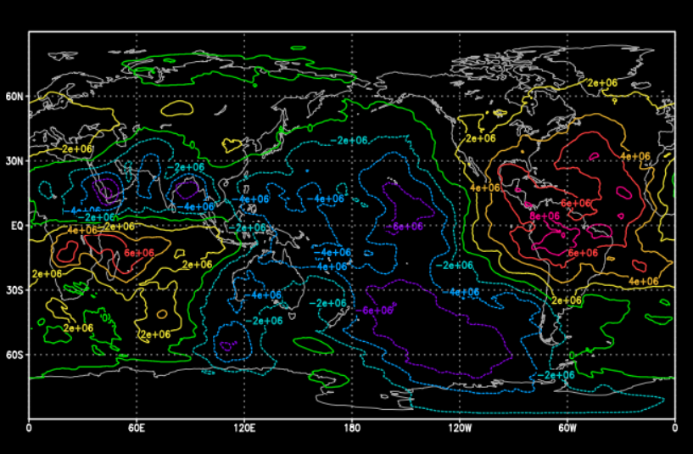
VPOT 200mb
CFS
GFSV16 input | SFS Control Files | UPP Processing

Slide 4
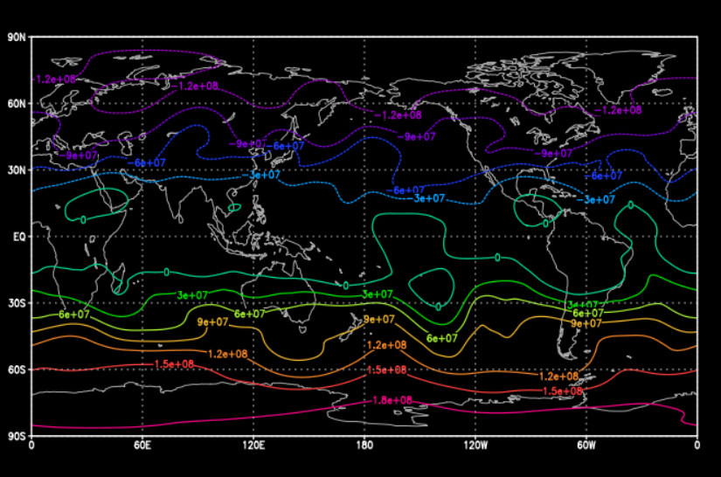
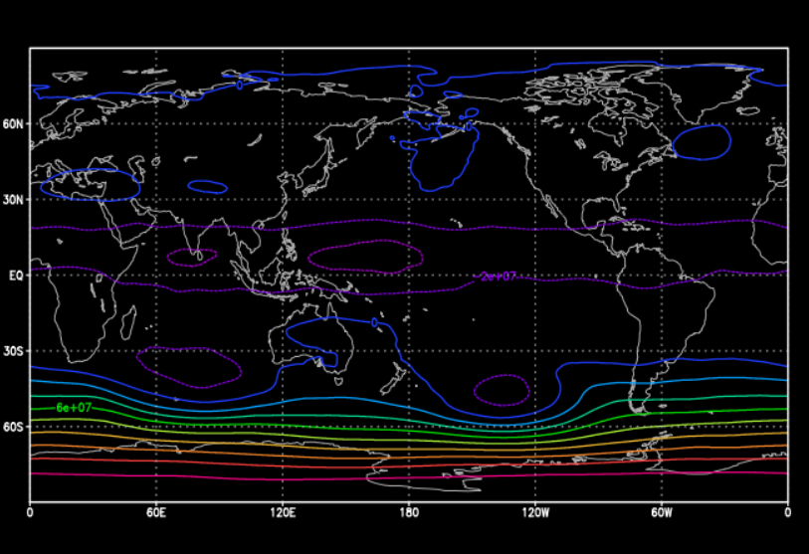
STRM 200mb
CFS
GFSV16 input | SFS Control Files | UPP Processing

Slide 5
Appendix
Source code UPP computations

Slide 6
1. Spectrally truncate wind vector fields on global cylindrical grid to compute velocity potential and stream function
Spectral truncation done in UPP global domain IM,JM,LSM
U and V winds for each process are first collected in a separate vertical loop to get the full IM,JM domain
IDRT (grid identifier) is read in from post calculations, 4 for Gaussian grid in this case
Subroutine used is in NCEP library: sptrunv.f
Output U and V winds, CHI and PSI grids are output in full IM,JM,LSM domain
CFS program implementation is as shown in genpsiandchi.f
Computations in UPP/sorc/ncep_post.fd/MDL2P.f

Slide 7
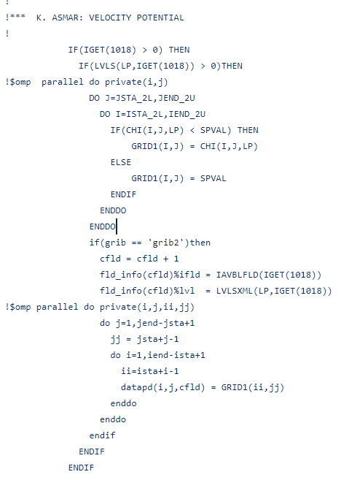
2. Store CHI and PSI grids for each process at the specified vertical level
CHI (VPOT) and PSI (STRM) grids are stored in the ISTA_2L:IEND_2U, JSTA_2L:JEND_2U for each process at the LP requested vertical levels
Store CHI grid (VPOT) for each process and vertical level in UPP/sorc/ncep_post.fd/MDL2P.f

