Slide 1
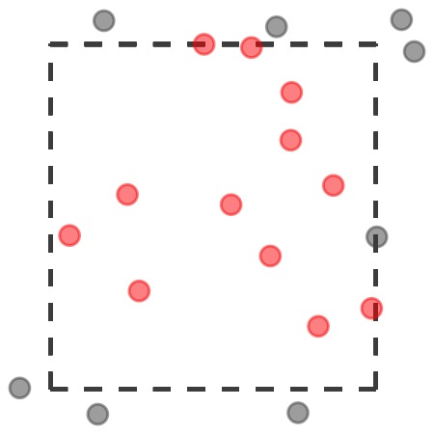

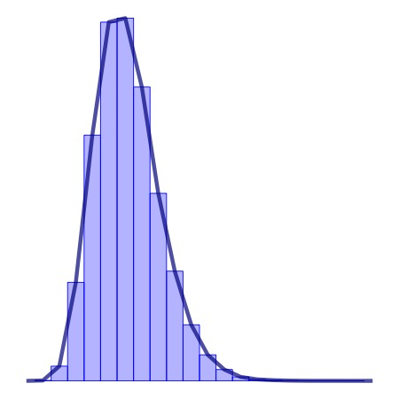
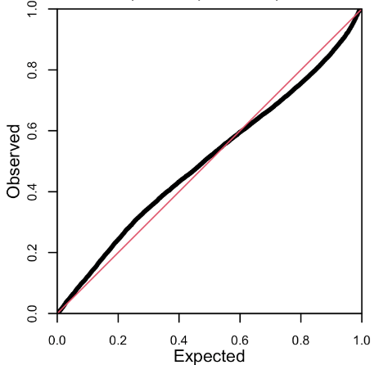
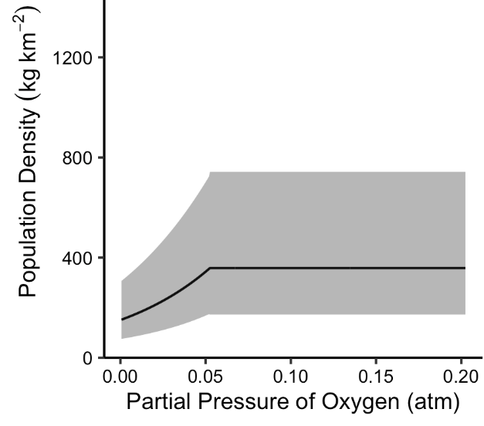
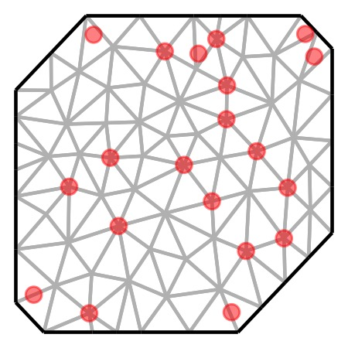
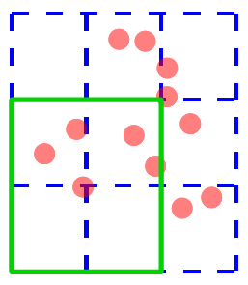
Data Pre-processing
Visualization
Filter spatial extent (?)
Standardize covariates (?)
Project coordinates
Distribution
Main effects
Spatial
Spatiotemporal
Model Structure
Distribution family
Main effects & their form
Spatiotemporal structure
Diagnostics
Model Fitting
Check convergence
Check residuals
Check parameters
Create mesh
Visualize mesh, data
Fit model
Check marginal effects
Prediction
Create prediction “grid”
Predict on these new data
Visualize random effects
Obtain index or COG

