Slide 1
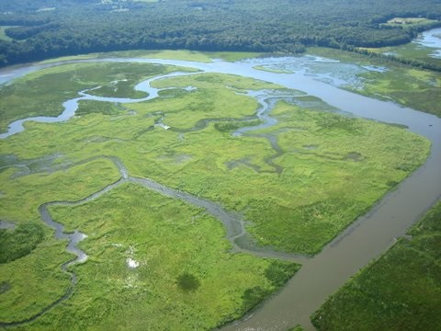
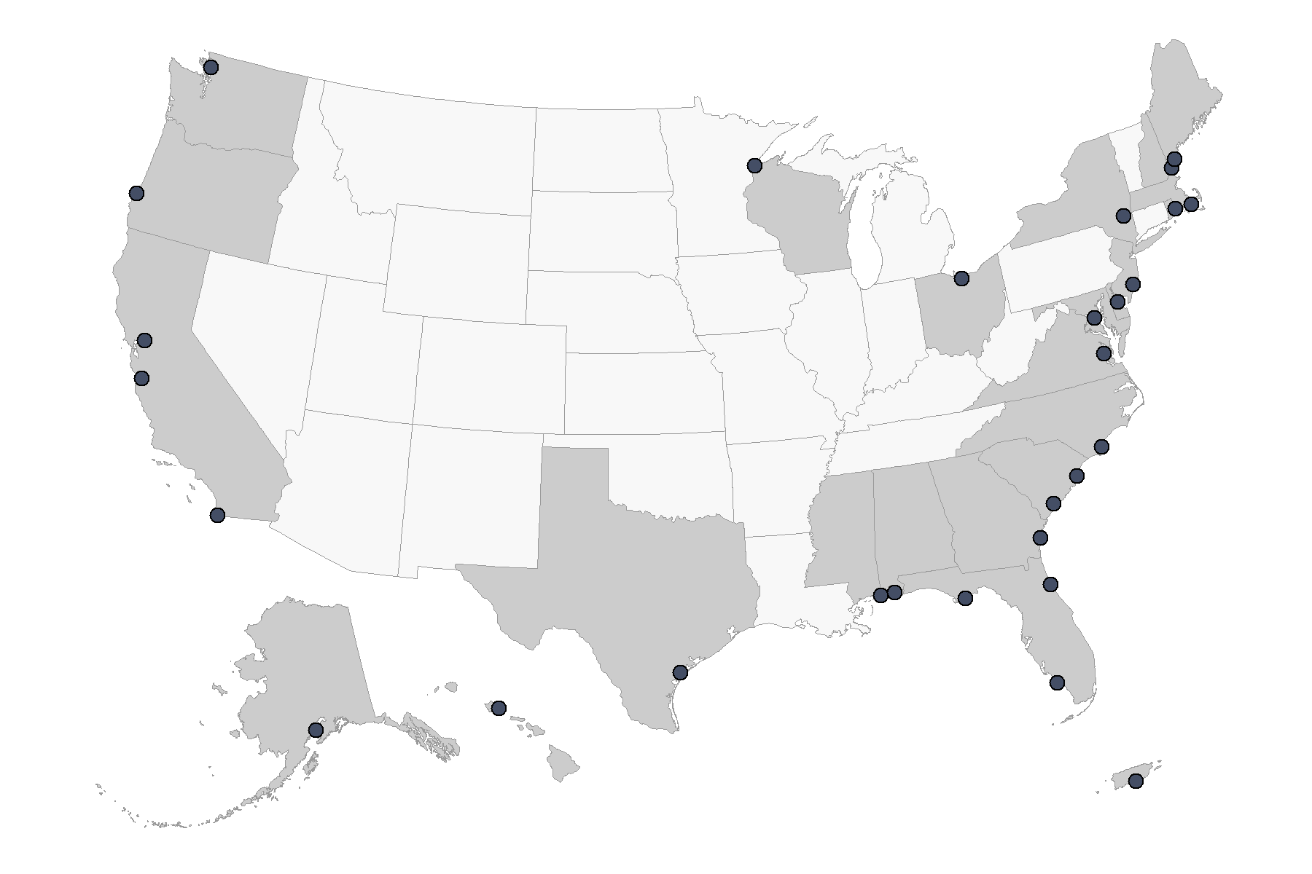
ESTUARY TRENDS: WEATHER & WATER QUALITY
National Estuarine Research Reserve System (NERRS)
The NERRS is a partnership program between NOAA and the coastal states to manage designated reserves. More than 1.3 million acres of estuarine land and water are protected. The health of every reserve is continuously monitored by the System Wide Monitoring Program (SWMP). Reserve-generated data and information are available to local citizens and decision makers. For more information go to:
https://coast.noaa.gov/nerrs/

Slide 2
Reserve
Ashepoo Combahee Edisto Basin
Apalachicola Bay
Chesapeake Bay - MD
Chesapeake Bay - VA
Delaware
Elkhorn Slough
Grand Bay
Great Bay
Guana Tolomato Matanzas
He'eia
Hudson River
Jacques Cousteau
Jobos Bay
Kachemak Bay
Lake Superior
Mission-Aransas
Narragansett Bay
North Inlet-Winyah Bay
North Carolina
Old Woman Creek
Padilla Bay
Rookery Bay
Sapelo Island
San Francisco Bay
South Slough
Tijuana River
Wells
Weeks Bay
Waquoit Bay
Ortho-phosphate | Ortho-phosphate | Ortho-phosphate | Ortho-phosphate
LOC 1 | LOC 2 | LOC 3 | LOC 4
x | i | i | i
h | h | h | h
i | h | — | i
— | h | h | h
— | — | — | —
— | — | — | —
i | i | — | —
— | h | h | h
— | h | h | h
x | x | x | x
— | — | h | h
i | — | — | —
— | — | i | i
— | — | — | i
x | x | x | x
— | — | i | —
h | h | — | h
— | — | — | —
— | — | — | —
— | — | — | —
i | i | i | —
i | — | — | i
i | i | i | —
— | h | — | —
i | i | i | —
— | — | i | i
h | — | h | h
i | i | i | i
— | i | — | —
Diss. Inorganic Nitrogen | Diss. Inorganic Nitrogen | Diss. Inorganic Nitrogen | Diss. Inorganic Nitrogen
LOC 1 | LOC 2 | LOC 3 | LOC 4
x | — | i | —
i | — | — | —
i | — | — | i
— | — | h | h
— | — | — | —
— | — | — | —
i | — | i | i
i | — | — | h
i | — | i | h
x | x | x | x
x | x | x | x
i | — | — | —
— | — | — | —
— | — | — | —
x | x | x | x
— | — | h | —
— | — | — | —
h | h | h | h
— | i | i | —
— | — | i | —
i | i | i | —
— | — | — | —
h | — | — | —
x | x | x | x
— | — | — | —
— | — | x | —
h | — | — | —
— | — | — | h
— | — | — | —
Chlorophyll-a | Chlorophyll-a | Chlorophyll-a | Chlorophyll-a
LOC 1 | LOC 2 | LOC 3 | LOC 4
x | i | i | i
— | — | i | i
— | — | h | —
— | — | i | i
h | — | — | —
— | — | — | —
h | — | h | h
— | — | — | —
i | i | i | i
x | x | x | x
— | — | — | —
h | — | — | —
— | h | — | —
— | — | — | —
x | x | x | x
— | — | — | —
— | — | — | —
— | — | h | —
h | h | h | h
— | — | — | h
— | — | — | —
— | — | — | —
— | — | — | i
i | — | — | —
— | — | — | —
— | h | i | i
— | i | — | —
— | — | h | —
— | h | — | —
Dissolved Oxygen | Dissolved Oxygen | Dissolved Oxygen | Dissolved Oxygen
LOC 1 | LOC 2 | LOC 3 | LOC 4
x | — | — | —
— | i | i | —
— | — | i | —
— | — | — | i
— | — | — | —
— | h | h | —
— | — | — | —
i | i | — | i
i | — | i | —
x | x | x | x
— | — | i | i
— | — | i | —
h | — | — | h
— | i | i | i
i | i | — | x
i | i | i | i
— | — | i | i
— | — | — | —
— | i | i | i
h | i | — | —
— | i | i | i
— | i | — | i
h | i | — | —
i | — | i | —
— | i | i | i
— | — | — | —
i | — | i | i
— | h | h | h
i | — | i | i
*Based on data collected from 2007-2016, LOC = Sample Location

Slide 3
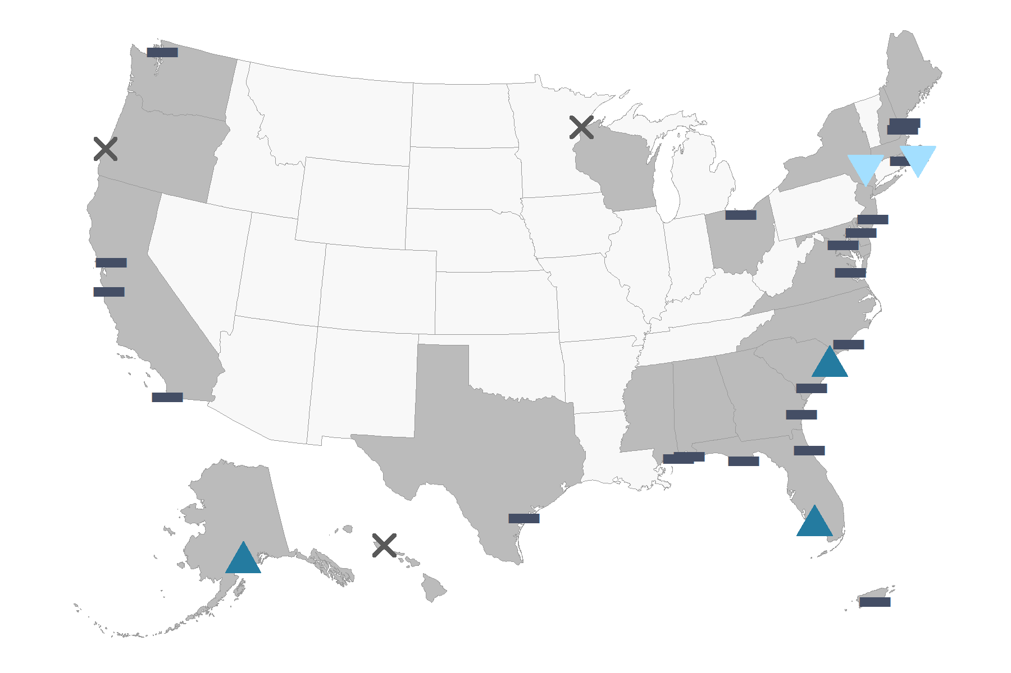
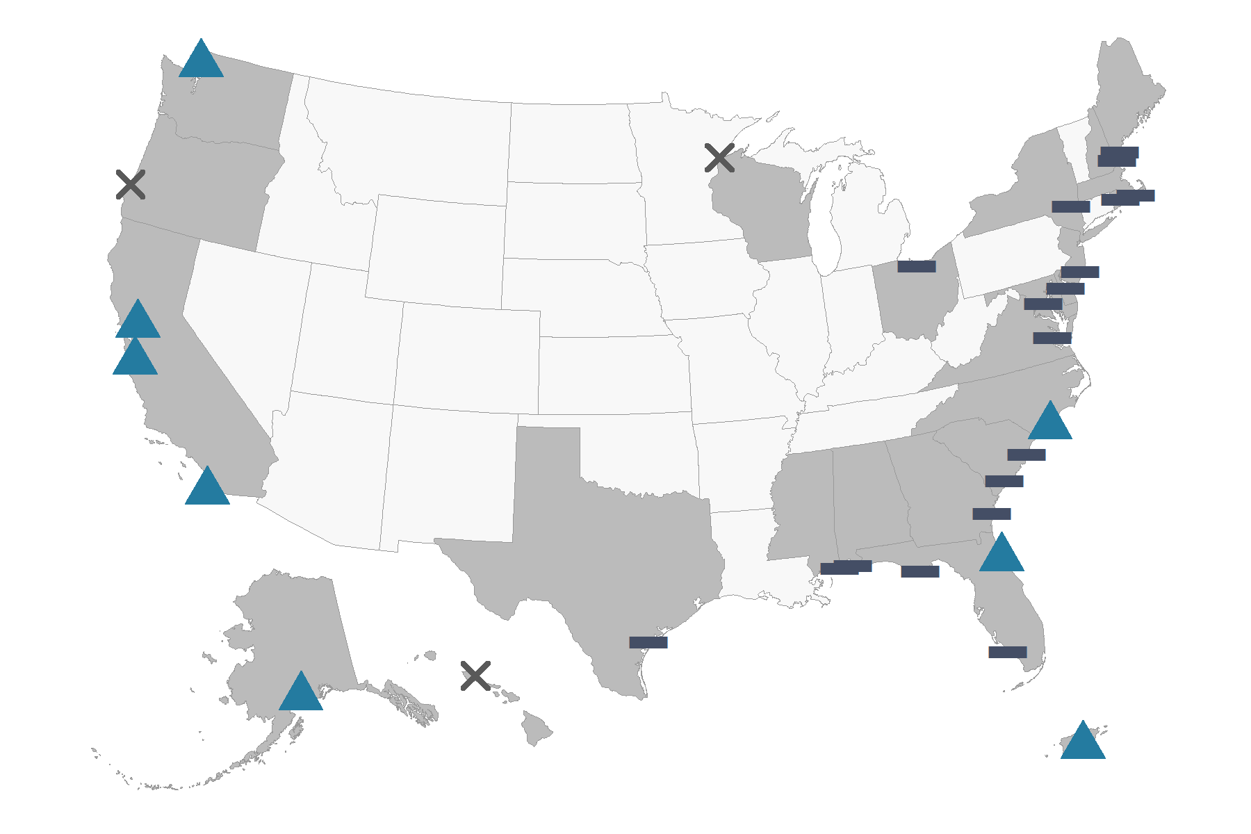
Trends in Precipitation
Precipitation is not changing at most reserves within the NERRS system. However, there are a few exceptions. A decreasing trend has been observed at two reserves in the northeast, and an increasing trend has been observed at two reserves in the southeast and at the reserve located in Alaska. A decreasing trend means it is getting dryer and an increasing trend means it is getting wetter.
*Based on data collected from 2007-2016
Trends in Air Temperature
Air temperature is increasing at four out of the five west coast reserves in the NERRS. system. An increasing trend has also been observed at two reserves in the southeast and at the reserves located in Puerto Rico and Alaska. Air temperature at the other reserve locations is not changing. An increasing trend means it is getting hotter and an decreasing trends means it is getting cooler.
*Based on data collected from 2007-2016

Slide 4
Contact NOAA
first.last@noaa.gov
(555) 555-1212

