Slide 1
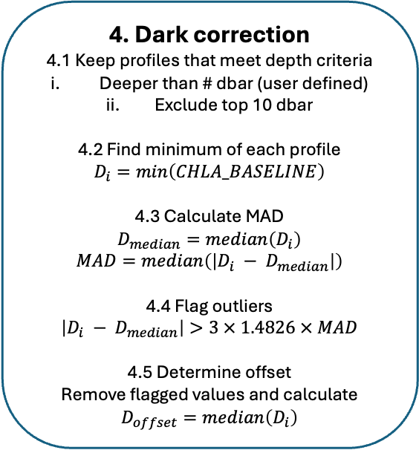
4. Dark correction
4.1 Keep profiles that meet depth criteria
Deeper than # dbar (user defined)
Exclude top 10 dbar
4.2 Find minimum of each profile
$$D_{i}=min\left(CHLA_BASELINE\right)$$
4.3 Calculate MAD
$$D_{median}=median\left(D_{i}\right)$$
$$MAD=median\left(\left|D_{i} − D_{median}\right|\right)$$
4.4 Flag outliers
$$\left|D_{i} − D_{median}\right|>3 × 1.4826 × MAD$$
4.5 Determine offset
Remove flagged values and calculate
$$D_{offset}=median\left(D_{i}\right)$$
1. Apply factory calibration
CHLA = (CHLA_FLUORESCENCE470_RAW – DARK) * SCALE
2. Initial global range QC
Flag values outside -0.2 and 100
(QC flag = 4)
3. Despike
CHLA_BASELINE, SPIKES = despike(CHLA)
KEY DIAGNOSTIC PLOTS
0.10
0.05
0
-0.05
-0.10
QC Flag = 1
QC Flag = 4 (High)
QC Flag = 4 (Low)
Profile number / Time
5.1 Apply offset
CHLA_FLUORESCENCE_ADJUSTED = CHLA – D_{offset}
5.2 Apply offset
CHLA_ADJUSTED = CHLA – D_{offset}
KEY DIAGNOSTIC PLOTS
Plot of Day vs Night CHLA_FLUORESCENCE_ADJUSTED
(Current one)
6. Apply NPQ correction
CHLA_ADJUSTED = NPQ correction(CHLA_ADJUSTED)
7. Final global range QC
Flag values outside 0 and 100
(QC flag = 4)

