Slide 1
How to include a temporal component in the analysis, improving on the ideas used in NOCFLUX2
20 Feb 2026

Slide 2
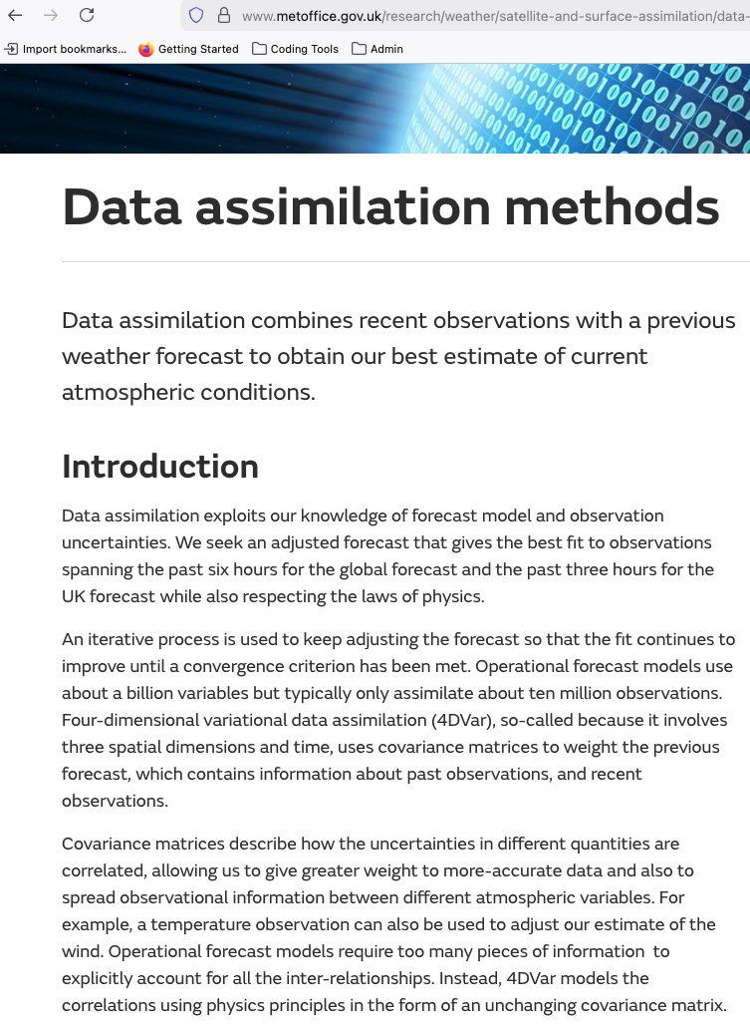
Outline
The goal is to include temporal constrains; this is in light we need to NOCFLUX3 at high temporal resolution, and observation coverage at daily timescale isn’t good even for modern period.
In NOCFLUX2, it uses this idea of a first-guess, literally taking the value from yesterday as a starter. I think we can improve on that using a data assimilation approach
Combining an autoregressive first guess and assimilate new observations
Use an improved autocorrelation approach than NOCFLUX2

Slide 3
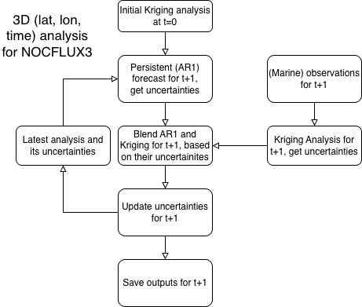
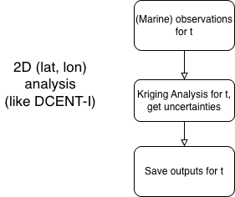
The problem with how we do the infilling
“2D-VAR” (x, y), each time is analysed separately
“3D-VAR” (x, y, t), temporally linked via persistent forecast

Slide 4

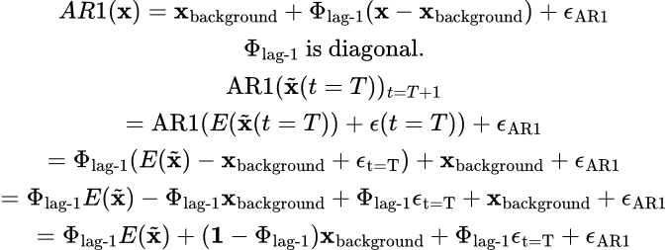
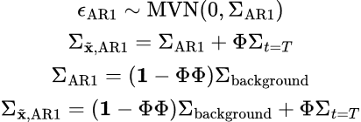
Persistence: AR1 from T to T+1 and its uncertainties
Let start of with an estimate for t = T that has uncertainty epsilon; epsilon is zero-meaned with big sigma variance
The AR1 model is defined by lag 1 correlation (defined in diagonal matrix 𝚽 that nudges the field toward background climatology) in an exponential decay manner
The AR1 model has its own epsilon / uncertainties
The uncertainty of AR1 can then be computed, it is a blend of uncertainty of the original estimate and the climatological variance
Persistent areas: Original uncertainty carried forward
Low persistence: Goes towards climatological variance
Notes:
First Guess:
E(\tilde{\textbf{x}}(t=T))+\epsilon(t=T) = \tilde{\textbf{x}}(t=T) \\
\epsilon(t=T) \sim \text{MVN}(0,\Sigma_{t=T})\\
AR1:
AR1(\textbf{x}) = \textbf{x}_\text{background} + \Phi_{\text{lag-1}}(\textbf{x} - \textbf{x}_\text{background}) + \epsilon_{\text{AR1}}
\\
\Phi_{\text{lag-1}} \text{ is diagonal.}\\
\text{AR1}(\tilde{\textbf{x}}(t=T))_{t=T+1} \\
= \text{AR1}(E(\tilde{\textbf{x}}(t=T))+\epsilon(t=T))+\epsilon_\text{AR1} \\
= \Phi_{\text{lag-1}} (E(\tilde{\textbf{x}})-\textbf{x}_\text{background}+\epsilon_\text{t=T})+\textbf{x}_\text{background}+\epsilon_\text{AR1} \\
= \Phi_{\text{lag-1}} E(\tilde{\textbf{x}})-\Phi_{\text{lag-1}} \textbf{x}_\text{background}+\Phi_{\text{lag-1}}\epsilon_\text{t=T}+\textbf{x}_\text{background}+\epsilon_\text{AR1}\\
=\Phi_{\text{lag-1}} E(\tilde{\textbf{x}})+(\textbf{1}-\Phi_{\text{lag-1}})\textbf{x}_\text{background}+\Phi_{\text{lag-1}}\epsilon_\text{t=T}+\epsilon_\text{AR1}
Uncertainties:
\epsilon_\text{AR1}\sim \text{MVN}(0,\Sigma_\text{AR1})\\
\Sigma_{\tilde{\textbf{x}},\text{AR1}} = \Sigma_\text{AR1}+\Phi\Sigma_{t=T} \\
\Sigma_\text{AR1} = (\textbf{1}-\Phi\Phi)\Sigma_\text{background}\\
\Sigma_{\tilde{\textbf{x}},\text{AR1}} = (\textbf{1}-\Phi\Phi)\Sigma_\text{background}+\Phi\Sigma_{t=T}

Slide 5
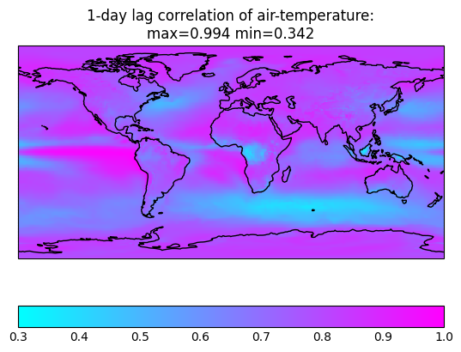
Lag-1 Day Air Temperature Correlation (computed from Archie’s daily files)
Very persistent areas (> 0.8):
Equatorial Pacific,
South Tropical Indian Ocean
Subtropical NE Pacific (Baja California)
Subtropical Atlantic (Cape Verde, Angola)
Variable areas (< 0.5):
Equatorial Atlantic
Off equatorial Pacific
Gulf Stream
Kuroshio
Southern Oceans
For anomalies to drop off by 1/e in 1 day,
lag-1-corr ~ 0.37
Nearly everywhere has lag-1-corr > 0.37
If lag-1-corr is 0.99, 1/e at around day 100
If 1/e at day 3, lag-1-corr ~ 0.72 (i.e. NOCFLUX2)

Slide 6
New revised analysis flow (3D-VAR in words)
Preliminaries:
Get an estimate to lag-1 autocorrelation and its uncertainty (takes me 1 minute or 2 to do on Archie’s files)
Start at t = 0, do Kriging estimate, ordinary or universal/mid-scale, get uncertainties
Compute an autoregressive estimate for t+1, get uncertainties
Do Kriging estimate for t+1, get uncertainties
Blend the Kriging estimate for t+1 and AR for t based on their uncertainties, get new combined uncertainty

Slide 7
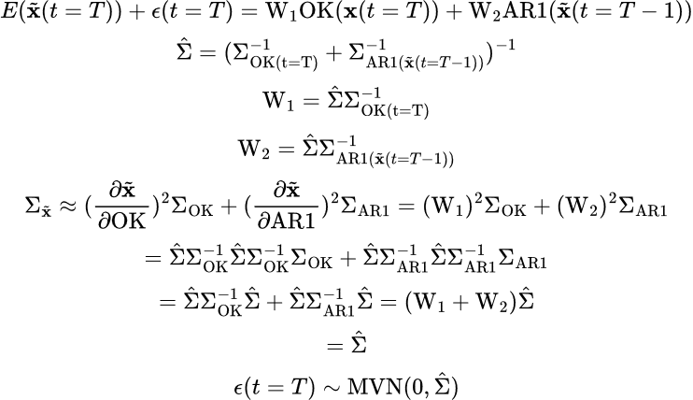
Blending AR1 and Kriging: inverse variance weighted average
𝚺s are (error) covariance matrices
At t=0, we start of with an initial Kriging-only estimate.
For t≥1, the estimates from AR1 from “yesterday” (t-1) blend with the new information observed “today”, the blending weights depends on the relative uncertainty of the new observations and the AR1 estimate
If uncertainty of AR1 (or Kriging) is large, it is downplayed by the inverse variance weighted average. Inverse variance weighting prejudices uncertain estimates. The weights favour the less uncertain estimate.
This is a basic Kalman Filter. W1 is called Kalman Gain – information gained by assimilating new (Kriged) observations.
Notes:
https://en.wikipedia.org/wiki/Inverse-variance_weighting
https://physics.stackexchange.com/questions/15197/how-do-you-find-the-uncertainty-of-a-weighted-average
https://stats.stackexchange.com/questions/62768/question-about-inverse-variance-weighting
===
E(\tilde{\textbf{x}}(t=T)) + \epsilon(t=T) = \text{W}_\text{1}\text{OK}(\textbf{x}(t=T)) + \text{W}_\text{2}\text{AR1}(\tilde{\textbf{x}}(t=T-1)) \\
\hat{\Sigma} = (\Sigma_\text{OK(t=T)}^{-1}+\Sigma_{\text{AR1}(\tilde{\textbf{x}}(t=T-1))}^{-1})^{-1}\\
\text{W}_\text{1} = \hat{\Sigma}\Sigma_\text{OK(t=T)}^{-1}\\
\text{W}_\text{2} = \hat{\Sigma}\Sigma_{\text{AR1}(\tilde{\textbf{x}}(t=T-1))}^{-1}\\
\Sigma_{\tilde{\textbf{x}}} \approx (\frac{\partial \tilde{\textbf{x}}}{\partial \text{OK}})^2 \Sigma_\text{OK} + (\frac{\partial \tilde{\textbf{x}}}{\partial \text{AR1}})^2 \Sigma_\text{AR1}
= (\text{W}_\text{1})^2 \Sigma_\text{OK} + (\text{W}_\text{2})^2 \Sigma_\text{AR1} \\
= \hat{\Sigma}\Sigma_\text{OK}^{-1} \hat{\Sigma}\Sigma_\text{OK}^{-1} \Sigma_\text{OK} + \hat{\Sigma}\Sigma_{\text{AR1}}^{-1}\hat{\Sigma}\Sigma_{\text{AR1}}^{-1} \Sigma_{\text{AR1}}
\\
= \hat{\Sigma}\Sigma_\text{OK}^{-1} \hat{\Sigma} + \hat{\Sigma}\Sigma_{\text{AR1}}^{-1}\hat{\Sigma} = (\text{W}_\text{1} + \text{W}_\text{2}) \hat{\Sigma}\\
= \hat{\Sigma} \\
\epsilon(t=T) \sim \text{MVN}(0, \hat{\Sigma})
====
E(\tilde{\textbf{x}}(t=T)) + \epsilon(t=T) = \text{W}_\text{1}\text{OK}(\textbf{x}(t=T)) + \text{W}_\text{2}\text{AR1}(\tilde{\textbf{x}}(t=T-1)) \\
\hat{\Sigma} = (\Sigma_\text{OK(t=T)}^{-1}+\Sigma_{\text{AR1}(\tilde{\textbf{x}}(t=T-1))}^{-1})^{-1}\\
\text{W}_\text{1} = \hat{\Sigma}\Sigma_\text{OK(t=T)}^{-1}\\
\text{W}_\text{2} = \hat{\Sigma}\Sigma_{\text{AR1}(\tilde{\textbf{x}}(t=T-1))}^{-1}\\
\Sigma_{\tilde{\textbf{x}}} \approx (\frac{\partial \tilde{\textbf{x}}}{\partial \text{OK}})^2 \Sigma_\text{OK} + (\frac{\partial \tilde{\textbf{x}}}{\partial \text{AR1}})^2 \Sigma_\text{AR1} + 2 \frac{\partial \tilde{\textbf{x}}}{\partial \text{OK}} \frac{\partial \tilde{\textbf{x}}}{\partial \text{AR1}} \text{Cov}_{\text{OK,AR1}}
\\
= (\text{W}_\text{1})^2 \Sigma_\text{OK} + (\text{W}_\text{2})^2 \Sigma_\text{AR1} + 2 \text{W}_\text{1} \text{W}_\text{2} \text{Cov}_{\text{OK,AR1}}\\
= \hat{\Sigma}\Sigma_\text{OK}^{-1} \hat{\Sigma}\Sigma_\text{OK}^{-1} \Sigma_\text{OK} + \hat{\Sigma}\Sigma_{\text{AR1}}^{-1}\hat{\Sigma}\Sigma_{\text{AR1}}^{-1} \Sigma_{\text{AR1}}
+ 2 \text{W}_\text{1} \text{W}_\text{2} \text{Cov}_{\text{OK,AR1}} \\
= \hat{\Sigma}\Sigma_\text{OK}^{-1} \hat{\Sigma} + \hat{\Sigma}\Sigma_{\text{AR1}}^{-1}\hat{\Sigma} + 2 \text{W}_\text{1} \text{W}_\text{2} \text{Cov}_{\text{OK,AR1}} \\
= (\text{W}_\text{1} + \text{W}_\text{2}) \hat{\Sigma} + 2 \text{W}_\text{1} \text{W}_\text{2} \text{Cov}_{\text{OK,AR1}} \\
= \hat{\Sigma} + 2 \text{W}_\text{1} \text{W}_\text{2} \text{Cov}_{\text{OK,AR1}} \\
\epsilon(t=T) \sim \text{MVN}(0, \hat{\Sigma} + 2 \text{W}_\text{1} \text{W}_\text{2} \text{Cov}_{\text{OK,AR1}})
\\
\text{Cov}_{\text{OK,AR1}} \approx \Phi_{\text{Lag-1}} \sqrt{\text{Diag}(\Sigma_\text{OK})} \sqrt{\text{Diag}(\Sigma_\text{AR1})}

Slide 8
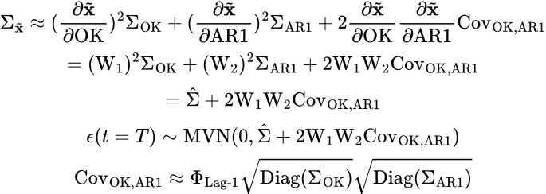
Blending AR1 and Kriging: Uncertainties propagation
If AR and OK are uncorrelated:
(follows from last slide)
If AR and OK are correlated, there is now an extra term in the output uncertainties
Assume the extra-term can be described by the same lag correlation, the extra term is always positive and is largest when w1 = ½ or w1 = w2; the AR-OK correlation always results in higher uncertainties
Uncertainties
if AR and OK
are uncorrelated
The extra term
Notes:
https://en.wikipedia.org/wiki/Inverse-variance_weighting
https://physics.stackexchange.com/questions/15197/how-do-you-find-the-uncertainty-of-a-weighted-average
https://stats.stackexchange.com/questions/62768/question-about-inverse-variance-weighting
===
E(\tilde{\textbf{x}}(t=T)) + \epsilon(t=T) = \text{W}_\text{1}\text{OK}(\textbf{x}(t=T)) + \text{W}_\text{2}\text{AR1}(\tilde{\textbf{x}}(t=T-1)) \\
\hat{\Sigma} = (\Sigma_\text{OK(t=T)}^{-1}+\Sigma_{\text{AR1}(\tilde{\textbf{x}}(t=T-1))}^{-1})^{-1}\\
\text{W}_\text{1} = \hat{\Sigma}\Sigma_\text{OK(t=T)}^{-1}\\
\text{W}_\text{2} = \hat{\Sigma}\Sigma_{\text{AR1}(\tilde{\textbf{x}}(t=T-1))}^{-1}\\
\Sigma_{\tilde{\textbf{x}}} \approx (\frac{\partial \tilde{\textbf{x}}}{\partial \text{OK}})^2 \Sigma_\text{OK} + (\frac{\partial \tilde{\textbf{x}}}{\partial \text{AR1}})^2 \Sigma_\text{AR1}
= (\text{W}_\text{1})^2 \Sigma_\text{OK} + (\text{W}_\text{2})^2 \Sigma_\text{AR1} \\
= \hat{\Sigma}\Sigma_\text{OK}^{-1} \hat{\Sigma}\Sigma_\text{OK}^{-1} \Sigma_\text{OK} + \hat{\Sigma}\Sigma_{\text{AR1}}^{-1}\hat{\Sigma}\Sigma_{\text{AR1}}^{-1} \Sigma_{\text{AR1}}
\\
= \hat{\Sigma}\Sigma_\text{OK}^{-1} \hat{\Sigma} + \hat{\Sigma}\Sigma_{\text{AR1}}^{-1}\hat{\Sigma} = (\text{W}_\text{1} + \text{W}_\text{2}) \hat{\Sigma}\\
= \hat{\Sigma} \\
\epsilon(t=T) \sim \text{MVN}(0, \hat{\Sigma})
====
E(\tilde{\textbf{x}}(t=T)) + \epsilon(t=T) = \text{W}_\text{1}\text{OK}(\textbf{x}(t=T)) + \text{W}_\text{2}\text{AR1}(\tilde{\textbf{x}}(t=T-1)) \\
\hat{\Sigma} = (\Sigma_\text{OK(t=T)}^{-1}+\Sigma_{\text{AR1}(\tilde{\textbf{x}}(t=T-1))}^{-1})^{-1}\\
\text{W}_\text{1} = \hat{\Sigma}\Sigma_\text{OK(t=T)}^{-1}\\
\text{W}_\text{2} = \hat{\Sigma}\Sigma_{\text{AR1}(\tilde{\textbf{x}}(t=T-1))}^{-1}\\
\Sigma_{\tilde{\textbf{x}}} \approx (\frac{\partial \tilde{\textbf{x}}}{\partial \text{OK}})^2 \Sigma_\text{OK} + (\frac{\partial \tilde{\textbf{x}}}{\partial \text{AR1}})^2 \Sigma_\text{AR1} + 2 \frac{\partial \tilde{\textbf{x}}}{\partial \text{OK}} \frac{\partial \tilde{\textbf{x}}}{\partial \text{AR1}} \text{Cov}_{\text{OK,AR1}}
\\
= (\text{W}_\text{1})^2 \Sigma_\text{OK} + (\text{W}_\text{2})^2 \Sigma_\text{AR1} + 2 \text{W}_\text{1} \text{W}_\text{2} \text{Cov}_{\text{OK,AR1}}\\
= \hat{\Sigma}\Sigma_\text{OK}^{-1} \hat{\Sigma}\Sigma_\text{OK}^{-1} \Sigma_\text{OK} + \hat{\Sigma}\Sigma_{\text{AR1}}^{-1}\hat{\Sigma}\Sigma_{\text{AR1}}^{-1} \Sigma_{\text{AR1}}
+ 2 \text{W}_\text{1} \text{W}_\text{2} \text{Cov}_{\text{OK,AR1}} \\
= \hat{\Sigma}\Sigma_\text{OK}^{-1} \hat{\Sigma} + \hat{\Sigma}\Sigma_{\text{AR1}}^{-1}\hat{\Sigma} + 2 \text{W}_\text{1} \text{W}_\text{2} \text{Cov}_{\text{OK,AR1}} \\
= (\text{W}_\text{1} + \text{W}_\text{2}) \hat{\Sigma} + 2 \text{W}_\text{1} \text{W}_\text{2} \text{Cov}_{\text{OK,AR1}} \\
= \hat{\Sigma} + 2 \text{W}_\text{1} \text{W}_\text{2} \text{Cov}_{\text{OK,AR1}} \\
\epsilon(t=T) \sim \text{MVN}(0, \hat{\Sigma} + 2 \text{W}_\text{1} \text{W}_\text{2} \text{Cov}_{\text{OK,AR1}})
\\
\text{Cov}_{\text{OK,AR1}} \approx \Phi_{\text{Lag-1}} \sqrt{\text{Diag}(\Sigma_\text{OK})} \sqrt{\text{Diag}(\Sigma_\text{AR1})}
https://en.wikipedia.org/wiki/Inverse-variance_weighting
https://physics.stackexchange.com/questions/15197/how-do-you-find-the-uncertainty-of-a-weighted-average
https://stats.stackexchange.com/questions/62768/question-about-inverse-variance-weighting
===
E(\tilde{\textbf{x}}(t=T)) + \epsilon(t=T) = \text{W}_\text{1}\text{OK}(\textbf{x}(t=T)) + \text{W}_\text{2}\text{AR1}(\tilde{\textbf{x}}(t=T-1)) \\
\hat{\Sigma} = (\Sigma_\text{OK(t=T)}^{-1}+\Sigma_{\text{AR1}(\tilde{\textbf{x}}(t=T-1))}^{-1})^{-1}\\
\text{W}_\text{1} = \hat{\Sigma}\Sigma_\text{OK(t=T)}^{-1}\\
\text{W}_\text{2} = \hat{\Sigma}\Sigma_{\text{AR1}(\tilde{\textbf{x}}(t=T-1))}^{-1}\\
\Sigma_{\tilde{\textbf{x}}} \approx (\frac{\partial \tilde{\textbf{x}}}{\partial \text{OK}})^2 \Sigma_\text{OK} + (\frac{\partial \tilde{\textbf{x}}}{\partial \text{AR1}})^2 \Sigma_\text{AR1}
= (\text{W}_\text{1})^2 \Sigma_\text{OK} + (\text{W}_\text{2})^2 \Sigma_\text{AR1} \\
= \hat{\Sigma}\Sigma_\text{OK}^{-1} \hat{\Sigma}\Sigma_\text{OK}^{-1} \Sigma_\text{OK} + \hat{\Sigma}\Sigma_{\text{AR1}}^{-1}\hat{\Sigma}\Sigma_{\text{AR1}}^{-1} \Sigma_{\text{AR1}}
\\
= \hat{\Sigma}\Sigma_\text{OK}^{-1} \hat{\Sigma} + \hat{\Sigma}\Sigma_{\text{AR1}}^{-1}\hat{\Sigma} = (\text{W}_\text{1} + \text{W}_\text{2}) \hat{\Sigma}\\
= \hat{\Sigma} \\
\epsilon(t=T) \sim \text{MVN}(0, \hat{\Sigma})
====
Correlated
E(\tilde{\textbf{x}}(t=T)) + \epsilon(t=T) = \text{W}_\text{1}\text{OK}(\textbf{x}(t=T)) + \text{W}_\text{2}\text{AR1}(\tilde{\textbf{x}}(t=T-1)) \\
\hat{\Sigma} = (\Sigma_\text{OK(t=T)}^{-1}+\Sigma_{\text{AR1}(\tilde{\textbf{x}}(t=T-1))}^{-1})^{-1}\\
\text{W}_\text{1} = \hat{\Sigma}\Sigma_\text{OK(t=T)}^{-1}\\
\text{W}_\text{2} = \hat{\Sigma}\Sigma_{\text{AR1}(\tilde{\textbf{x}}(t=T-1))}^{-1}\\
\Sigma_{\tilde{\textbf{x}}} \approx (\frac{\partial \tilde{\textbf{x}}}{\partial \text{OK}})^2 \Sigma_\text{OK} + (\frac{\partial \tilde{\textbf{x}}}{\partial \text{AR1}})^2 \Sigma_\text{AR1} + 2 \frac{\partial \tilde{\textbf{x}}}{\partial \text{OK}} \frac{\partial \tilde{\textbf{x}}}{\partial \text{AR1}} \text{Cov}_{\text{OK,AR1}}
\\
= (\text{W}_\text{1})^2 \Sigma_\text{OK} + (\text{W}_\text{2})^2 \Sigma_\text{AR1} + 2 \text{W}_\text{1} \text{W}_\text{2} \text{Cov}_{\text{OK,AR1}}\\
= \hat{\Sigma}\Sigma_\text{OK}^{-1} \hat{\Sigma}\Sigma_\text{OK}^{-1} \Sigma_\text{OK} + \hat{\Sigma}\Sigma_{\text{AR1}}^{-1}\hat{\Sigma}\Sigma_{\text{AR1}}^{-1} \Sigma_{\text{AR1}}
+ 2 \text{W}_\text{1} \text{W}_\text{2} \text{Cov}_{\text{OK,AR1}} \\
= \hat{\Sigma}\Sigma_\text{OK}^{-1} \hat{\Sigma} + \hat{\Sigma}\Sigma_{\text{AR1}}^{-1}\hat{\Sigma} + 2 \text{W}_\text{1} \text{W}_\text{2} \text{Cov}_{\text{OK,AR1}} \\
= (\text{W}_\text{1} + \text{W}_\text{2}) \hat{\Sigma} + 2 \text{W}_\text{1} \text{W}_\text{2} \text{Cov}_{\text{OK,AR1}} \\
= \hat{\Sigma} + 2 \text{W}_\text{1} \text{W}_\text{2} \text{Cov}_{\text{OK,AR1}} \\
\epsilon(t=T) \sim \text{MVN}(0, \hat{\Sigma} + 2 \text{W}_\text{1} \text{W}_\text{2} \text{Cov}_{\text{OK,AR1}})
\\
\text{Cov}_{\text{OK,AR1}} \approx \Phi_{\text{Lag-1}} \sqrt{\text{Diag}(\Sigma_\text{OK})} \sqrt{\text{Diag}(\Sigma_\text{AR1})}

Slide 9
Python notebooks
https://git.noc.ac.uk/stchan/autoregressive_and_universal_kriging/-/blob/91ed15b65287fb519f27569873d09983b9f44e9d/uk_ez_via_external_drift_example.ipynb
https://git.noc.ac.uk/stchan/autoregressive_and_universal_kriging/-/blob/91ed15b65287fb519f27569873d09983b9f44e9d/presistence.ipynb

Slide 10
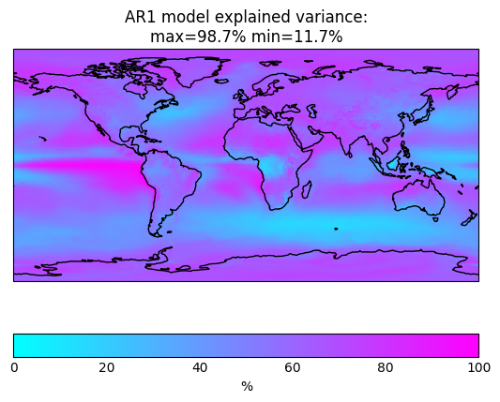
AR1 Explained Variance (computed from Archie’s daily files)

