Slide 1
Engineering Mechanics
By
Dr. Pradipta Basu Mandal
Dept. of Mechanical Engineering Techno India University

Slide 2
Truss Structures

Slide 3

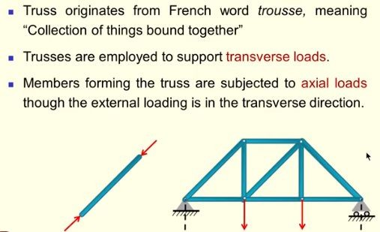
Truss System

Slide 4
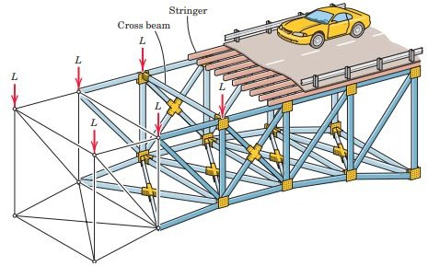
Bridge Truss

Slide 5
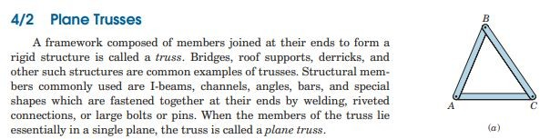

Slide 6
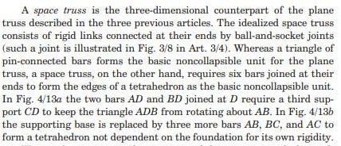
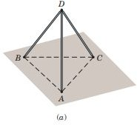

Slide 7
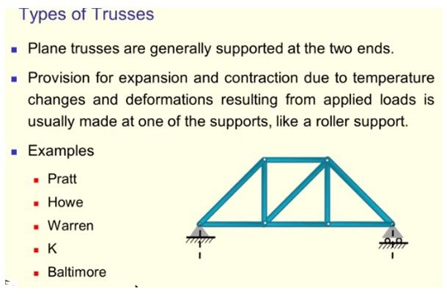

Slide 8
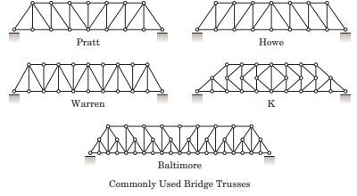

Slide 9
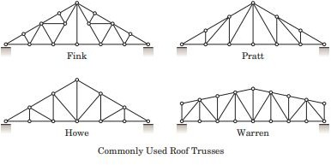

Slide 10
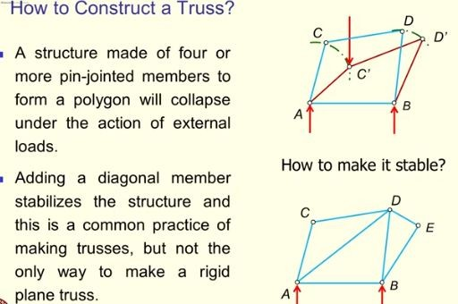

Slide 11
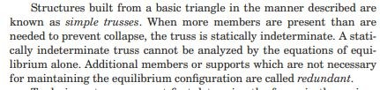

Slide 12
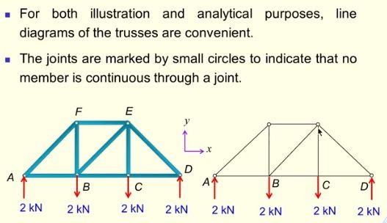
Representations of a truss

Slide 13
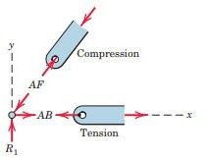
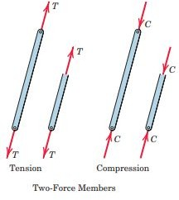
Forces on truss members
Convention followed- Sense of the force away from the joint is tension, and towards the joint compression.

Slide 14
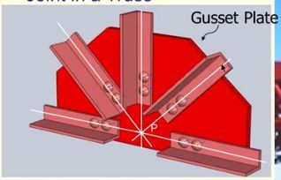
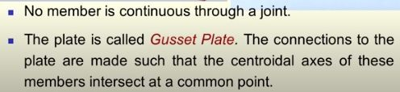
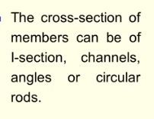

Slide 15
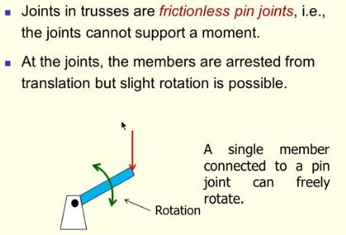

Slide 16
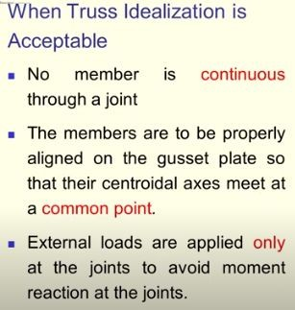
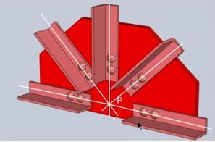

Slide 17
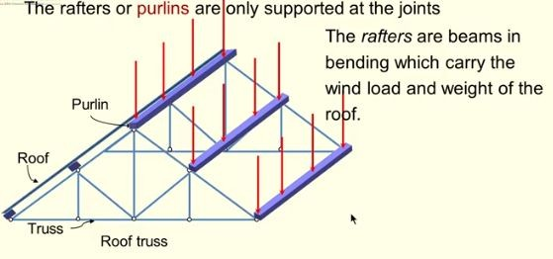

Slide 18
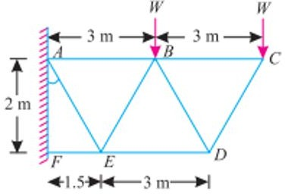
Truss connected to the wall or structure at one end and free at the other end.

Slide 19
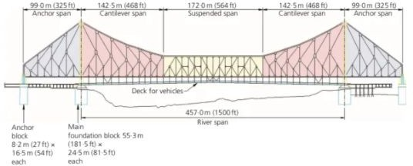

Slide 20
Howrah Bridge

Slide 21
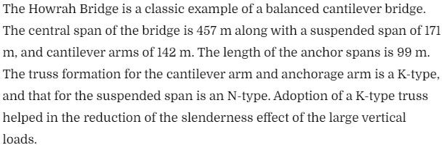

Slide 22
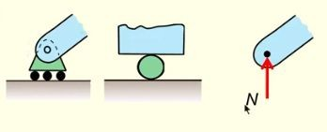
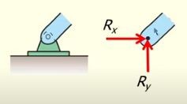
Supports

Slide 23
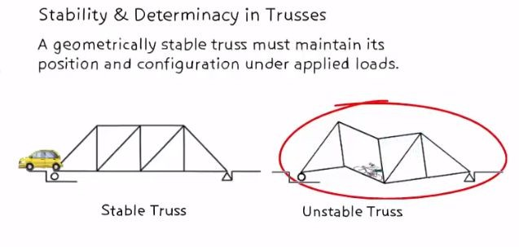

Slide 24
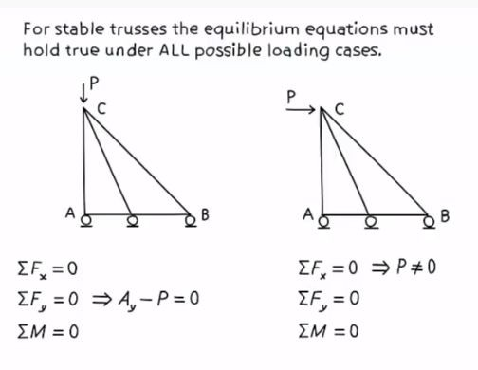

Under the action of a horizontal force, the truss translates as a whole as there are no horizontal restraints. However there is no deformation of its members.
Equilibrium equation is not satisfied
We call such a system as externally unstable.

Slide 25
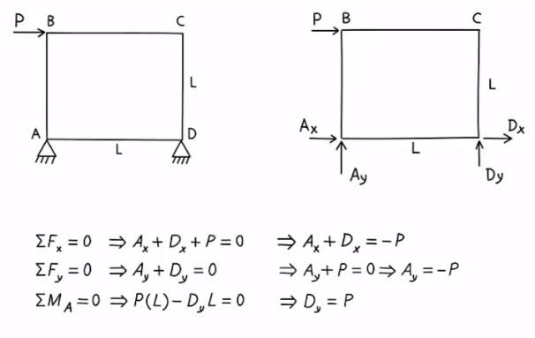
The truss is externally stable as the equilibrium equations are satisfied.
However its internal stability needs to be checked.

Slide 26
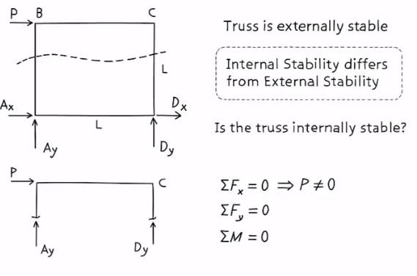
For the FBD the x component of force remains unbalanced.
Hence the equilibrium equation is not satisfied.
The truss system is internally unstable.

Slide 27
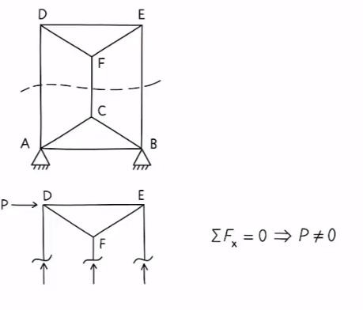
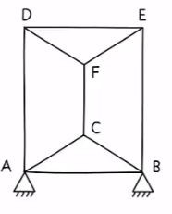
Truss is unstable

Slide 28
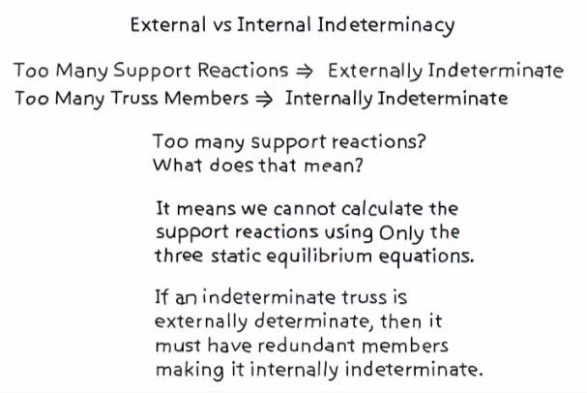

Slide 29
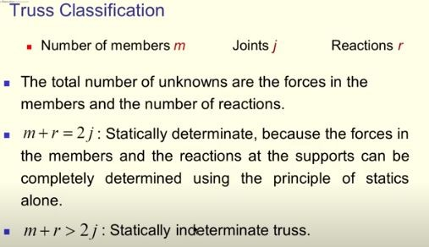
Internal Stability criteria for a planar truss
Perfect Truss

Slide 30

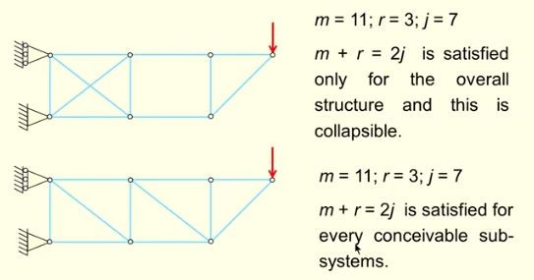
Reactions at joint 1 Rx
Reactions at joint 5 Rx, Ry
1
2
2
3
3 4 4
10
6
1
8
5
11
5
9
6
7
7
1

Slide 31
External Indeterminacy (EI)= r - 3
r is the number of support reactions and 3 is the number of equilibrium equations
Internal Indeterminacy (II) = m + r- 2j
Static Indeterminacy (EI + II) = m + r -2j + r -3 = m + 3 - 2j
Degree of Indeterminacy (DI) = Total Number of unknowns -
Total number of equations.
For Statically Determinate structure DI = 0.

Slide 32
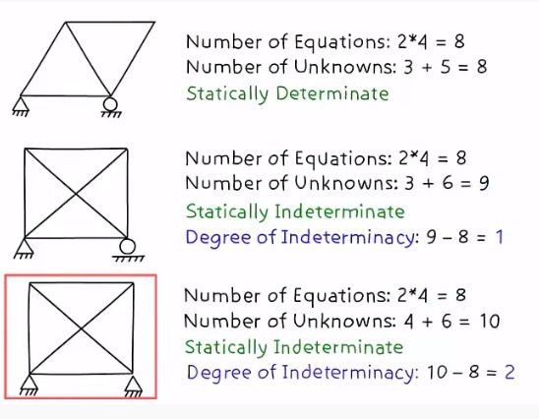
Examples

Slide 33
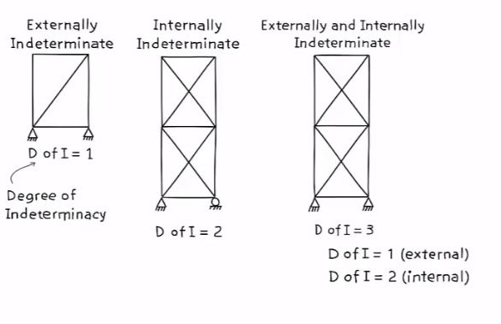

Slide 34
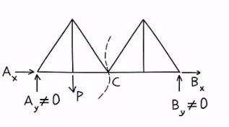
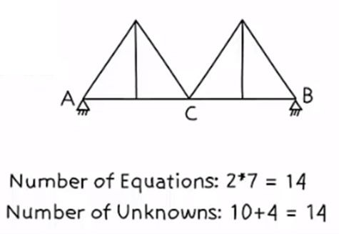
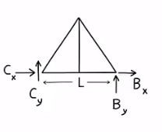

FBD
Truss is unstable

Slide 35
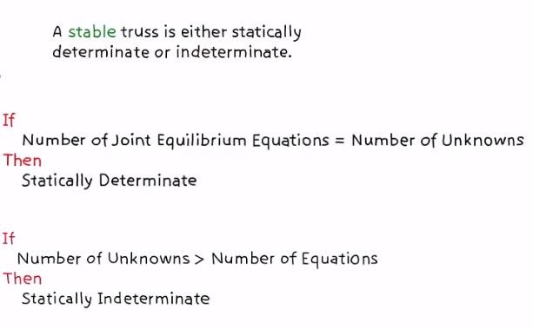

Slide 36
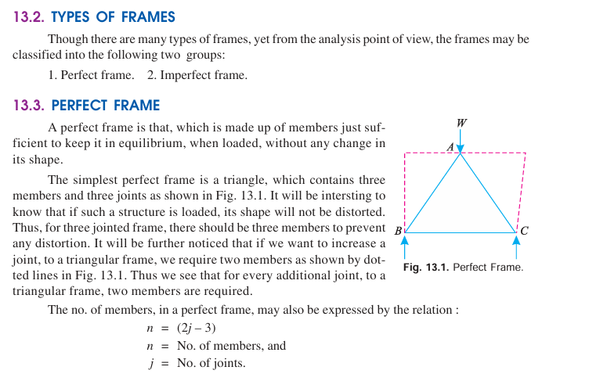

Slide 37
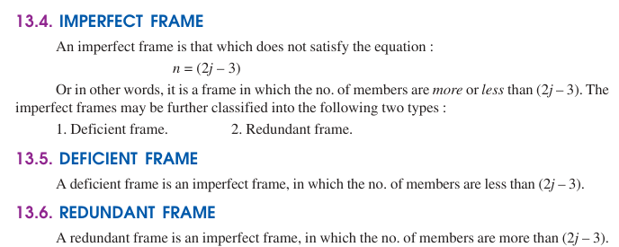

Slide 38
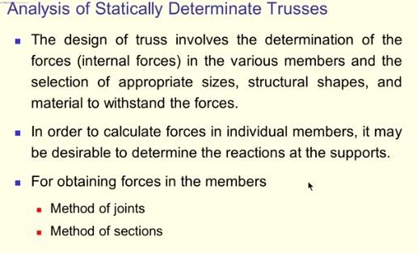

Slide 39
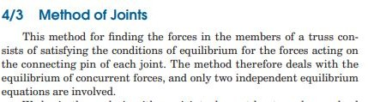

Slide 40
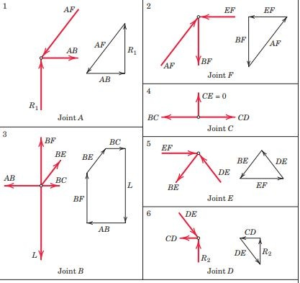
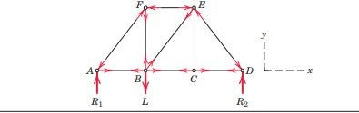
Examples

Slide 41
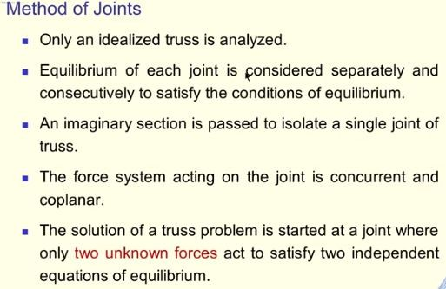

Slide 42
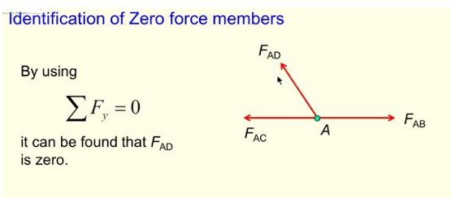
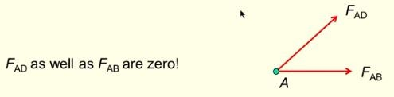

Slide 43
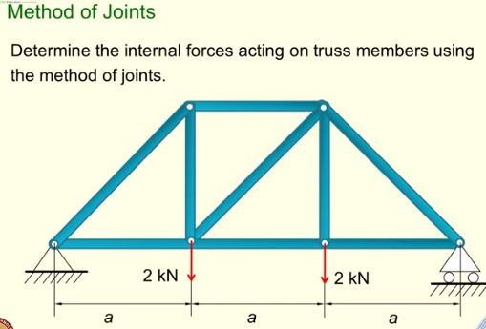
Illustrative example

Slide 44


F
E

Slide 45


Slide 46

F
E

Slide 47


Slide 48


Slide 49


Slide 50


Slide 51


Slide 52


Final Results

Slide 53

Example
A truss hinged at A, and supported on rollers inclined at 45° with the horizontal at D, is loaded as shown in Fig. 12.33
Find the reactions at A and D.

Slide 54





Solution

Slide 55



x

Slide 56

Illustrative example

Slide 57


Slide 58


Slide 59




Slide 60
Example
A truss hinged at A, and supported on rollers inclined at 45° with the horizontal at D, is loaded as shown in Fig. 12.33
Find the reactions at A and D.

Slide 61
Solution

Slide 62



Slide 63
j = 12
(Indeterminate system)
m = 21 r = 4
m + r = 25 > 2j = 24
Horizontal forces are neglected. Thus the system may be reduced to having one pin support and one roller. Then r = 3
In this case m + r = 24 = 2j
Taking moment about G we get Ay Ay*24 = 10*8 + 10*16 + 10* 20
Ay = 18.33 kN

Slide 64

Section 1 :
Σ MA = 0
0.707*F_CJ*12 – 10*4 - 10*8 = 0 F_CJ = 14.14 kN
Σ MJ = 0
0.894*F_CD*6 + 18.33*12 – 10*4 – 10*8 = 0 F_CD = -18.63 kN
F_CD = 18.63 kN -
Compression

Slide 65

Section 2 :
Σ MG = 0
12*F_DJ + 10*16 +10*20-18.33*24 – 14.14*0.707*12= 0
F_DJ = 16.67 kN

Slide 66

Example

Slide 67


Slide 68





10 kN
10 kN
FBD
10 kN
10 kN
G

Slide 69


Z Z

Slide 70



=18.02 kN

Slide 71


Slide 72



Slide 73


Slide 74



Slide 75


Slide 76


Zero Force Members

Slide 77



Slide 78


Slide 79



Slide 80


Slide 81


Slide 82


Slide 83

Solution. Contd.

Slide 84


Slide 85


Solution

Slide 86


Slide 87




Slide 88

Example
For the truss shown in the figure, the force in the member QR is

Slide 89

Example
For the plane truss shown in the figure, the number of zero force members for the given loading is

Slide 90
Solution

Slide 91


Example

Slide 92

Example
Find the reactions at B and C.

Slide 93

Problem

Slide 94


Problem
Hint. Take a vertical plane cutting the members BC, CF and FE.
Then take moments about points F, C and E.

Slide 95


Problem

